Slide 1




How opinions on movies compare
Between twitter and The Internet
E team
Notes:
자기소개랑 팀소

Slide 2


Contents
Topic
Movies
Process
Execution Result
Review (고찰)
Notes:
목차소

Slide 3

Topic
Seeing how opinions on movies differ
Between twitter and Internet reviews
By analyzing tweets

Slide 4




2. Movies
Frozen 2
Jumanji next level
It Chapter two
Rambo: last blood
Parasite
Notes:
우리는 총 5개~!~!~!~
하니씩 찝어주

Slide 5

3. Process
>> Made csv files through tweepy
>> Did a sentimental analysis
>> Converted numbers to rating
>> Made a graph
>> Compare and analyze
Notes:
On the files

Slide 6




Vocabulary for prediction
 | positive | negative | neutral
words | awesome, outstanding, fantastic, terrific, good, nice, great, gem, funny, wonderful , love, incredible, | bad , terrible , useless , hate, waste , awful, soulless , never , trash , shit , shitty , ass | movie, sound, actors, words, OMG, fucking, instead,lmao

Slide 7

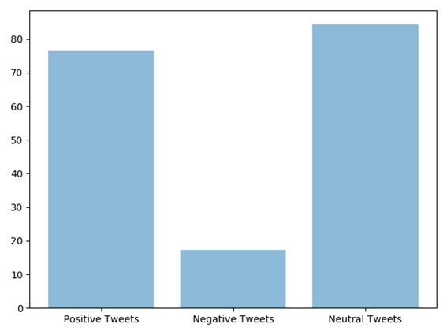
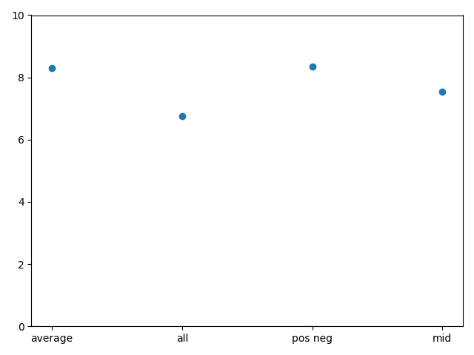
4. Execution Result
Frozen 2
8.3
7.55
6.76
8.34
Notes:
각 데이터가 무엇을 의미하는지 자세하게 모두 설명 어느정도 예측에 성공한 데이

Slide 8
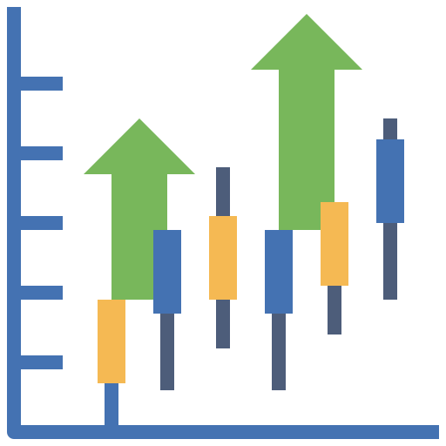
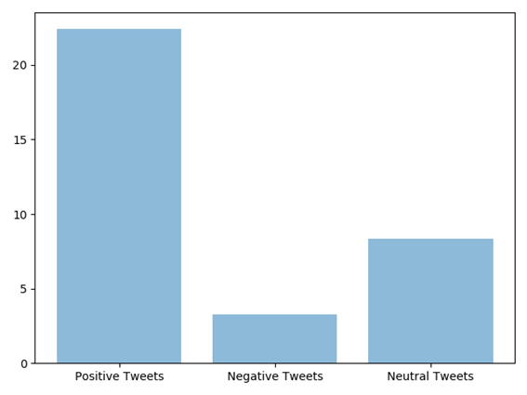
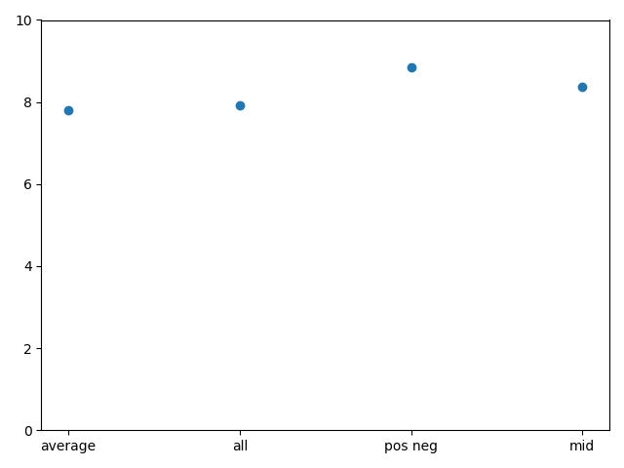
4. Execution Result
Jumanji : Next Level
8.85
8.38
7.8
7.91
Notes:
예측에 성공

Slide 9

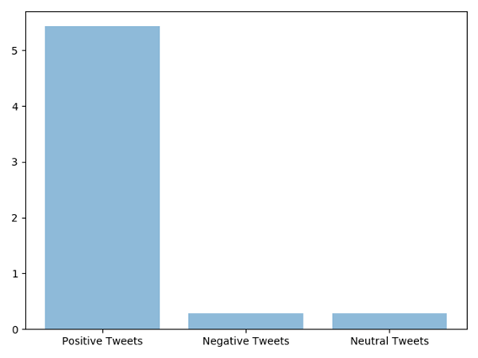
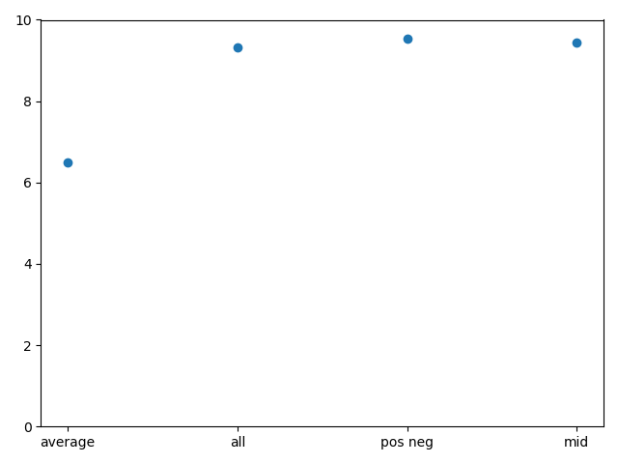
4. Execution Result
Rambo : Last Blood
9.32
9.54
9.43
6.5
Notes:
옛날 영화에 대해 평을 남기는 것은, 주로 긍정적인 의견을 올린다고 예상된다. 그래서 평점에 비해 압도적으로 높은 점수가 나타난것 같다.

Slide 10
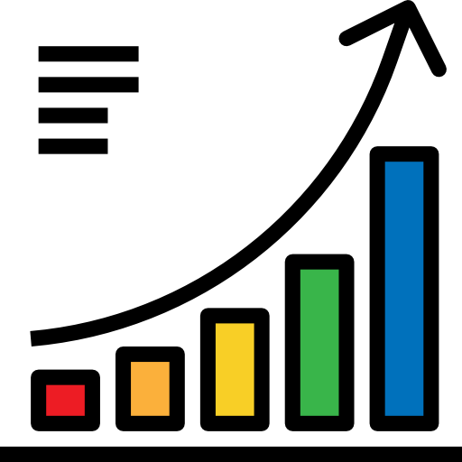
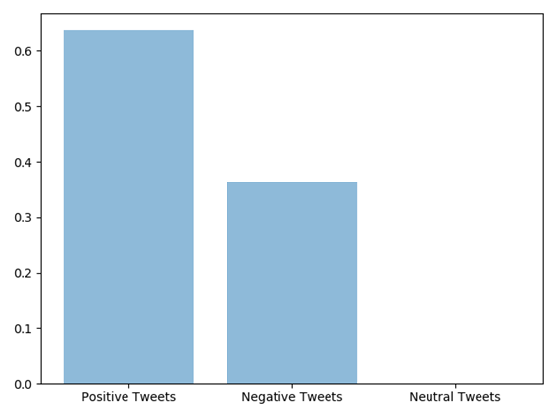
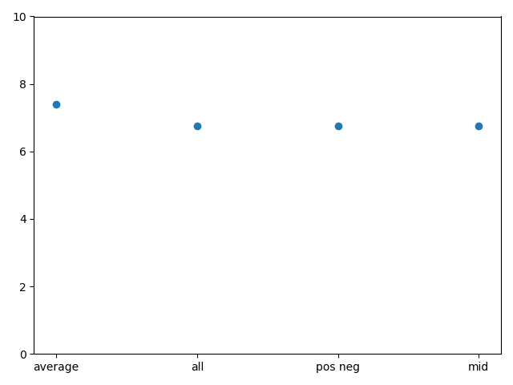
4. Execution Result
It : Chapter 2
7.4
6.76
6.76
6.76
Notes:
영화분위기 자체가 어둡고 무섭기에, 평점에 비해 글로 영화를 표현한 트위터에서는 비교적 낮은 점수가 나옴

Slide 11
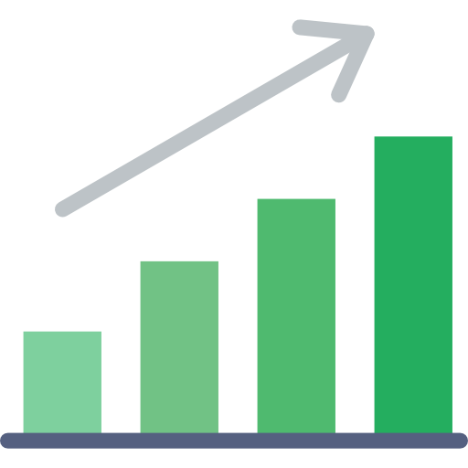
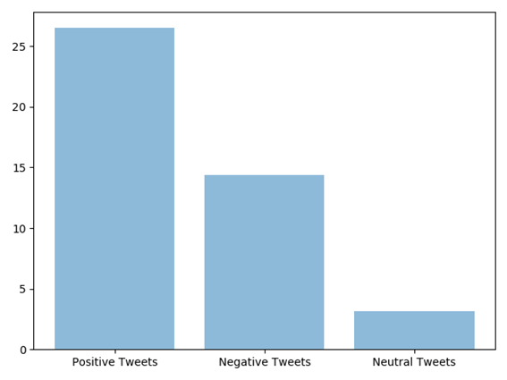
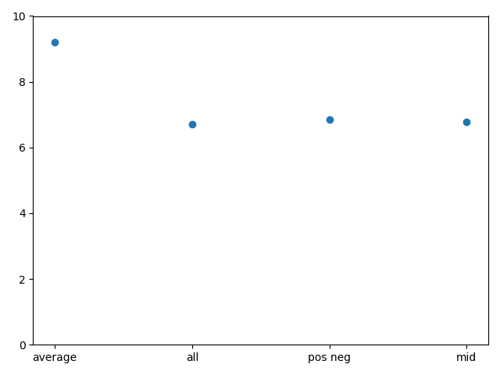
4. Execution Result
Parasite
9.2
6.71
6.84
6.77
Notes:
기생충또한 영화의 분위기가 소름끼치거나 부정적인 느낌을 주기에, 평점은 높더라도 트위터 문장에서는 부정적인 느낌이 나타나는 것 같다

Slide 12

5.Review
Our results = Actual reviews.
Darker the theme of the movie
More Prominent the negative expressions
A smaller sample data
Makes bigger population information.
Advertisement and Marketing
Notes:
We found that our results were very close to the actual reviews.
However, we also found that the darker the theme of the movie the more
Prominent the negative expressions were.
Through a small sample data we can predict a bigger population information.
Even with a relatively small sample size we think using this information in
Advertisement and marketing could be possible.

