Slide 1
1. Project Topic
Drone Delivery System
To guide the drone from initial point to final point (target)
- Must pass the intermediate waypoint(s)
- Must not crash into the ground
Avoid severe collision when landing
Optimization of the performance
Compare PID and RL results with criteria
Flight time
Stability
Efficiency in terms of fuel consumption

Slide 2
2. Problem-Solving Approach
Simulation
PID control
Reinforcement Learning

Slide 3
2. Problem-Solving Approach
Simulation (PID)
Create an object(drone) : DroneSimulator()
control input
Update the state of the drone PID control Repeat until
it reaches target

Slide 4
2. Problem-Solving Approach
Reinforcement Learning
Agent
Environment
State
Action
Reward
Policy (Algorithm)

Slide 5

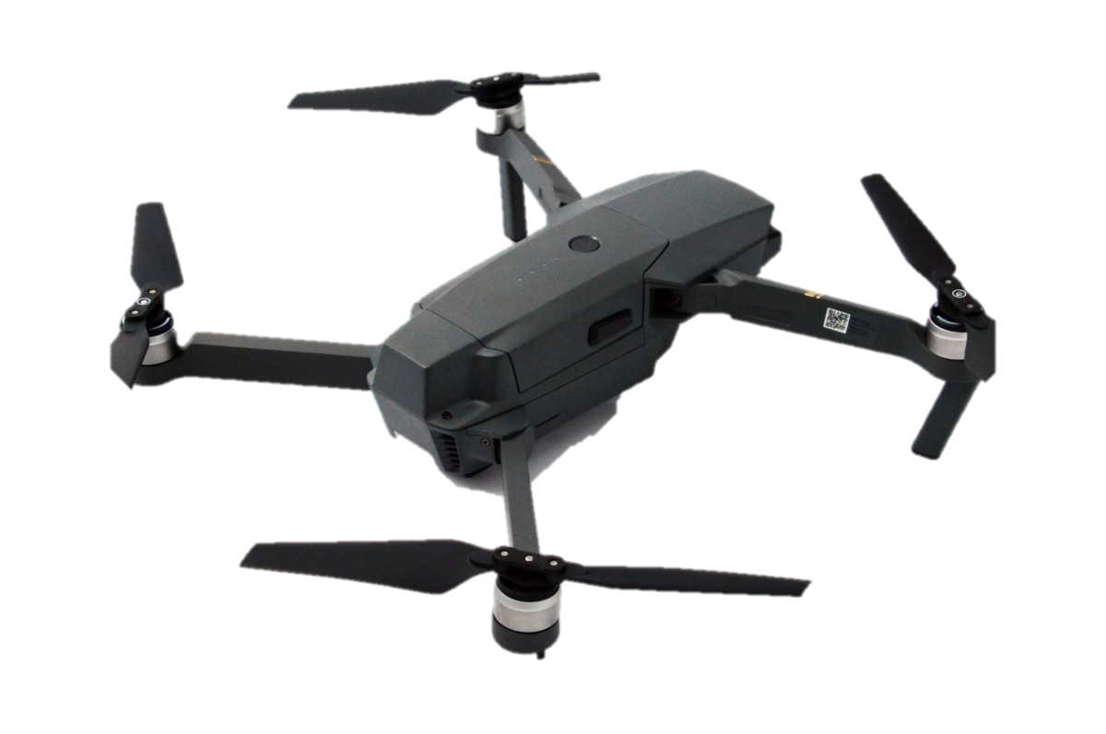
2. Problem-Solving Approach
Agent
SAC Agent
Action
Reward

Slide 6
2. Problem-Solving Approach
Environment
z
y
Starting point
x
Target point

Slide 7

2. Problem-Solving Approach
State
State
Position : [$x, y, z$]
Velocity : [$v_{x}, v_{y}, v_{z}$]
Acceleration : [$a_{x}, a_{y}, a_{z}$]
Angle(Euler) : [$α, β, γ$]
Angular Velocity : [$ω_{α}, ω_{β}, ω_γ$]

Slide 8

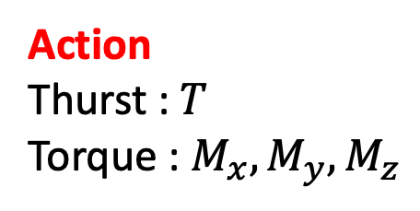
2. Problem-Solving Approach
Action
State
Position : [$x, y, z$]
Velocity : [$v_{x}, v_{y}, v_{z}$]
Acceleration : [$a_{x}, a_{y}, a_{z}$]
Angle(Euler) : [$α, β, γ$]
Angular Velocity : [$ω_{α}, ω_{β}, ω_γ$]
Action
Thurst : $T$
Torque : $M_{x}, M_{y}, M_{z}$

Slide 9
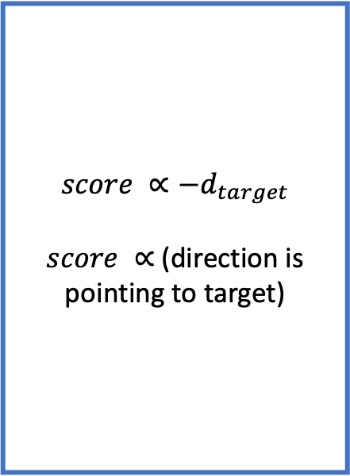
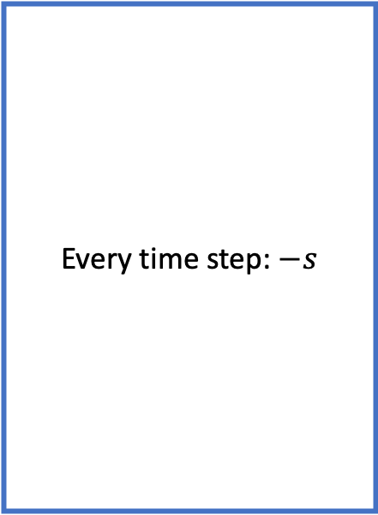
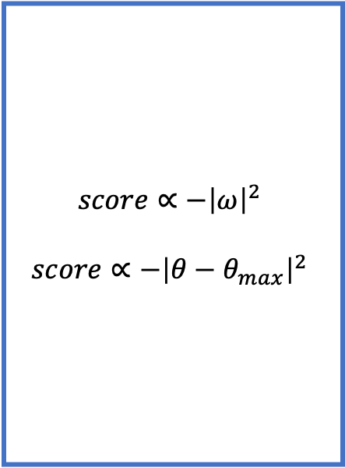
2. Problem-Solving Approach
Reward
Time
Distance
Stability
Every time step: $−s$
$$score ∝{−d}_{target}$$
$score ∝$(direction is pointing to target)
$$score∝−{\left|ω\right|}^{2}$$
$$score∝−{\left|θ−θ_{max}\right|}^{2}$$
How fast arrive to target
How close reach to target
How stable move

Slide 10
2. Problem-Solving Approach
Policy
Stochastic policy (possibility policy)
Value Function
Q-function

Slide 11
2. Problem-Solving Approach
SAC(Soft Actor-Critic)
Actor(NN) : Determine Action
Critic(NN) : Predict cumulative Reward
Maximize Entropy → Agent doing various actions → stable training

Slide 12
3. Tool Used
MATLAB ( & Additional Toolbox )
UAV Toolbox
Aerospace Toolbox
Reinforcement Learning Toolbox
Deep Learning Toolbox
6DOF equation
Compute the state of the drone
using the current state, control inputs(thrust & torque) and additional environmental factors

Slide 13
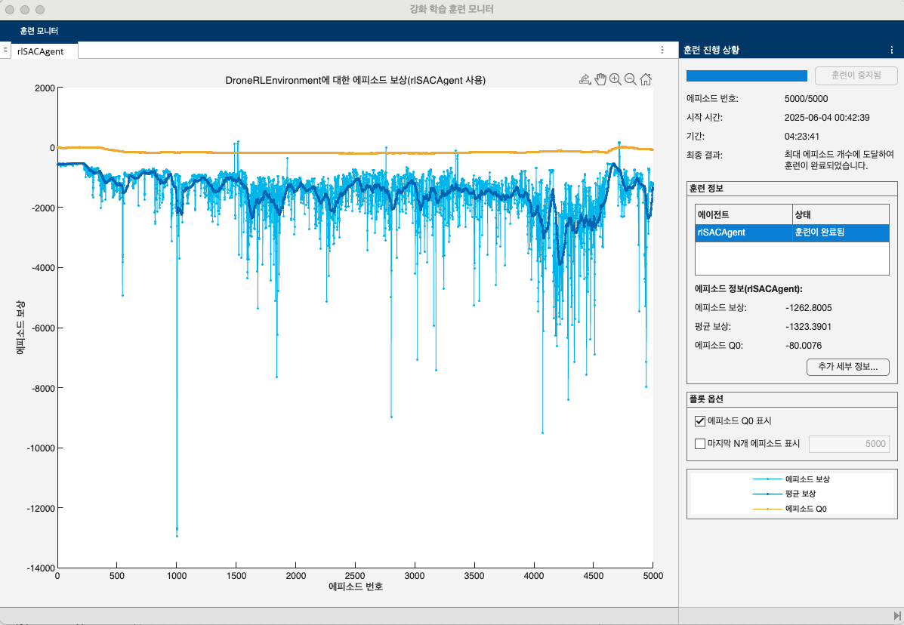
4. Final Results (RL)

Slide 14
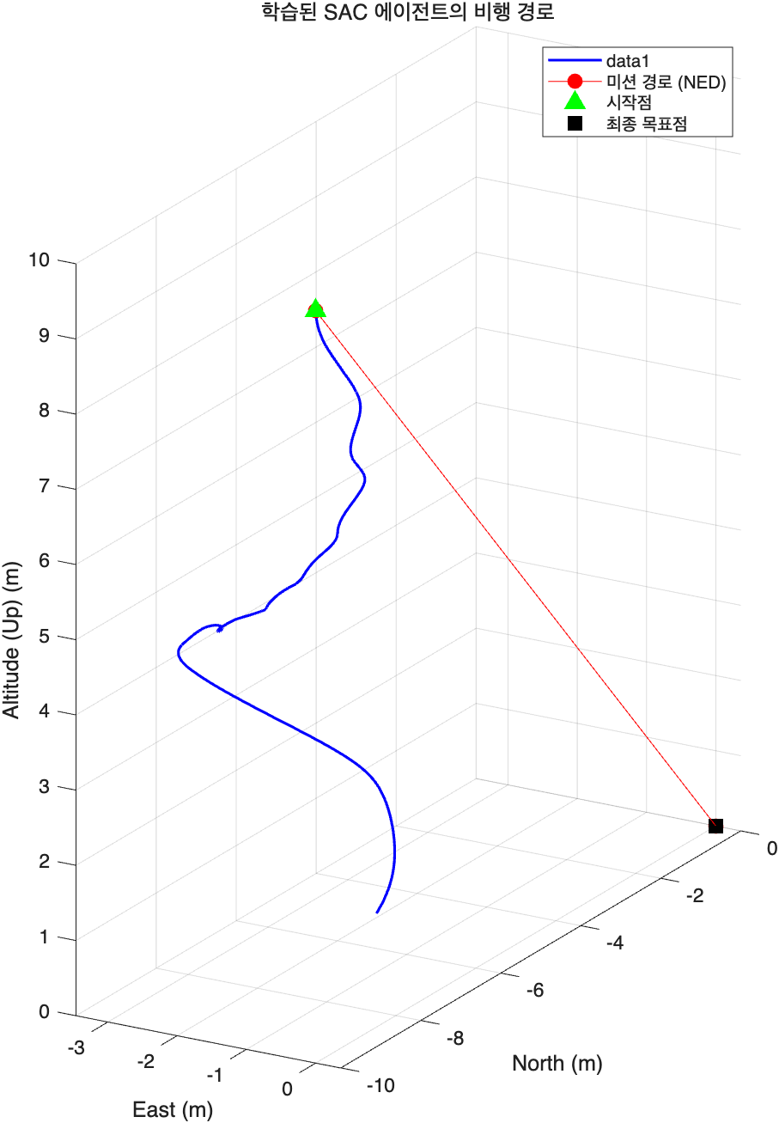
4. Final Result(RL)
Time : 5.4 sec
Impulse : 1.5 N*m

Slide 15
5. Discussion
Reinforcement Learning :
No arrive to Target point -> Change Reward parameters(☆)
Train not converge -> More Training

