Slide 1

PhD SEMINAR
Intelligent Digital Monitoring of Road Infrastructure
Vehicle video analytics for functional-condition assessment and evidence-based reporting
Astana | 2026
PhD dissertation research programme
Notes:
Cover image is a generated concept illustration and does not document a specific road segment. Presentation title and scope supplied by the author.

Slide 2
Urban monitoring problem
Astana already produces a distributed stream of road observations
01
Video + GPS
mobile observations
Dashcams in municipal and private vehicles repeatedly record roads and roadside assets.
Manual review cannot scale to the volume, geographic coverage, and seasonal variability of the video stream.
The missing layer is a reproducible method that links visual evidence to a mapped asset, condition label, confidence score, and inspection date.
02
Perception
objects and surfaces
03
Condition
functional state
04
Report
map and work order
Research premise
Repeated observations can convert opportunistic video into a longitudinal infrastructure inventory.
02
Notes:
Motivation based on the dissertation description provided by the author. No citywide video-volume estimate is asserted because no verified operational count was supplied.

Slide 3
Dissertation framing
Aim
Hypothesis
Develop an intelligent system that estimates the functional condition of road infrastructure from vehicle video and produces traceable reports.
Given mapped assets and repeated georeferenced observations, machine-learning models can infer functional condition with measurable uncertainty.
Object of research
Subject of research
Unit of evidence
Urban road infrastructure observed from moving vehicles.
Methods for detection, segmentation, condition classification, spatial association, and temporal aggregation.
Asset or road segment + coordinates + timestamp + state + confidence + image fragment.
03
Notes:
Research framing developed from the author's stated aim and hypothesis.

Slide 4
Research questions
RQ1
RQ2
Which representation fits each infrastructure class: bounding box, mask, keypoint, or road segment?
How much do spatial, geometric, and non-overlap priors improve recognition under occlusion?
RQ3
RQ4
How can local Astana data correct domain shift caused by snow, darkness, glare, and camera diversity?
How should repeated observations be fused into a reliable operational state and report?
04
Notes:
The research questions operationalize model design, domain adaptation, and evidence aggregation.

Slide 5
Published starting point: street-light monitoring in Astana
Our peer-reviewed study established the first validated component of the dissertation
Dataset
Environmental coverage
Validated result
4,260 annotated night-time dashcam frames
1280 × 720 pixels
Astana road scenes
Pole and lamp classes
1,494 clear frames
1,524 snowfall frames
1,242 rain frames
396 frames without poles or lamps
YOLO-CSE achieved the best reported recall and F1 among the evaluated models, supporting reliable detection under difficult night conditions.
Dissertation extension
Scale the evidence model from lighting to roads, markings, curbs, traffic control, and public-transport assets.
Aiymbay et al., Symmetry 17(8), 1294, 2025
05
Notes:
Source: Aiymbay, S.; Zhumadillayeva, A.; Matson, E.T.; Matkarimov, B.; Mukhametzhanova, B. Applying Computer Vision for the Detection and Analysis of the Condition and Operation of Street Lighting. Symmetry 2025, 17, 1294. https://doi.org/10.3390/sym17081294

Slide 6
Published dataset and training protocol
01
02
03
04
Acquisition
Annotation
Split
Training
Fujida Karma Duos cameras mounted on SUVs and sedans; night-time routes in Astana.
Two object classes: poles and lamps. Partial visibility and adverse weather retained.
75% training, 10% validation, 15% testing.
640 × 640 input; COCO2017 pretraining; 100 epochs; batch 32; NVIDIA A10.
Methodological lesson
Retaining snowfall, rain, empty frames, and vehicle-dependent viewpoints makes the benchmark closer to the intended municipal operating environment.
Aiymbay et al., 2025
06
Notes:
Experimental settings and dataset counts from https://doi.org/10.3390/sym17081294

Slide 7
YOLO-CSE architecture and structural priors
YOLO-CSE adds convolution and squeeze-and-excitation attention within the YOLOv5 C3 bottleneck.
01
02
03
04
Input
Backbone
C3 + SE
Detection heads
640 × 640 frame
multi-scale features
channel recalibration
pole and lamp boxes
Bilateral symmetry
Translational regularity
Radial emission
Pole and luminaire designs often contain mirrored structure.
Streetlights recur along road trajectories.
Light patterns provide a functional cue at night.
Aiymbay et al., 2025
07
Notes:
Architecture and symmetry discussion from https://doi.org/10.3390/sym17081294

Slide 8
Published benchmark results
Model
F1
mAP
YOLOv5n
0.743
0.772
YOLO-CSE
YOLOv5s
0.772
0.753
Recall 0.794
F1 score 0.808
mAP 0.798
YOLOv5m
0.777
0.740
YOLOv8n
0.711
0.749
YOLOv8s
0.757
0.764
YOLOv8m
0.788
0.791
Best recall and F1 in the reported comparison.
RT-DETR
0.748
0.788
Faster R-CNN
0.757
0.754
Interpretation
YOLO-CSE
0.808
0.798
The architecture improves missed-object control while retaining competitive precision.
Values reported in Aiymbay et al., 2025
08
Notes:
All values reproduced from the comparison table in https://doi.org/10.3390/sym17081294. Precision/recall values are discussed in the paper; this chart displays F1 and mAP.

Slide 9
Observed limitations and dissertation response
Small and distant luminaires
Higher-resolution tiling and temporal track aggregation
Partial occlusion by trees, buildings, and vehicles
Instance-level association plus structural priors
Bright windows and vehicle lights
Hard-negative mining and context-aware classification
Single-city, two-class scope
Multi-class Astana dataset and external benchmark pretraining
09
Notes:
Limitations synthesize failure modes and scope boundaries discussed in the author's published study. Proposed responses are dissertation hypotheses to be tested.

Slide 10
Infrastructure classes in the dissertation
Streetlights
Road surface
Road markings
pole, luminaire, operating state
drivable area, snow, ice, damage
visibility and wear
Curbs and road blocks
Traffic control
Public transport
curb, barrier, speed bump
traffic lights and signs
bus stops and accessibility
10
Notes:
Class scope supplied by the author. Labels will be refined through a formal annotation ontology before data collection.

Slide 11
Spatial and overlap priors
1
Streetlights
Upper image; partial poles and luminaires; overlaps with trees, vehicles, buildings, and window light. Vehicle and signal lights provide hard negatives.
2
Road + markings
Lower image; large, non-rectangular regions; vehicles and pedestrians occlude the surface. Gaps between vehicle masks may still belong to road.
3
Curbs / blocks / bumps
Lower image; few physical types; frequent vehicle occlusion and strong perspective distortion.
4
Traffic lights / signs
Intersection and roadside context; candidate non-overlap constraints must be validated rather than assumed universally.
5
Bus stops
Roadside structure with high appearance diversity; detection requires local examples and map context.
11
Notes:
Operational priors supplied by the author. The dissertation will encode them as testable constraints and report ablations, because real scenes can contain annotation and projection exceptions.

Slide 12
Multi-task perception design
01
02
03
04
Object detection
Semantic / instance segmentation
Binary or multilabel classification
Tracking and geospatial fusion
poles, luminaires, signs, signals, bus stops
road surface, markings, curbs, snow and ice regions
functional condition of each asset or road segment
deduplicate observations and associate them with mapped assets
Joint evidence record
geometry + class + condition + confidence + coordinates + timestamp + provenance
12
Notes:
Proposed dissertation architecture. Models and loss functions remain experimental choices and will be compared empirically.

Slide 13
Road segmentation will be implemented
Bounding boxes do not represent the geometry of road surfaces or markings
Drivable-area mask
Surface-condition mask
Marking mask
Separates visible road from sidewalks, medians, buildings, and background. Occluding vehicles remain separate instances.
Segments snow, ice, water, potholes, cracks, and repaired patches where pixel-level evidence is required.
Estimates line visibility and wear without forcing thin, elongated structures into unstable boxes.
Primary metrics
mIoU and class IoU for segmentation; boundary F1 for markings; calibration error for confidence.
13
Notes:
Road segmentation is a planned dissertation component. Metric definitions will follow the public benchmark protocols where applicable.

Slide 14
Binary functional-condition classifiers
Condition labels answer operational questions after localization or segmentation
Road segment
snow cleared / not cleared
ice present / absent
surface damaged / acceptable
Road markings
visible / not visible
worn / acceptable
occluded / observable
Street lighting
lamp on / off
pole intact / damaged
observable / uncertain
Other assets
curb intact / damaged
bus stop accessible / obstructed
sign present / missing
14
Notes:
Proposed binary and multilabel operational states. Final definitions require municipal acceptance criteria and an annotation manual. 'Snow cleared' is a local service-state label, not a generic weather label.

Slide 15
Public datasets for pretraining and benchmarking
Dataset
Verified scope
Role in this dissertation
BDD100K
100K driving videos; drivable area, lanes, detection, segmentation
Road and marking pretraining
Mapillary Vistas
25,000 high-resolution street images; 66 categories
Fine-grained street-object segmentation
ACDC
4,006 adverse-condition images with pixel labels; fog, night, rain, snow
Robustness under adverse visibility
RDD2022
47,420 images from six countries; 55,000+ damage instances
Crack and pothole detection
Public data supports representation learning. It does not replace local Astana condition labels or municipal acceptance criteria.
15
Notes:
Sources: BDD100K official repository and CVPR paper: https://github.com/bdd100k/bdd100k and https://openaccess.thecvf.com/content_CVPR_2020/html/Yu_BDD100K_A_Diverse_Driving_Dataset_for_Heterogeneous_Multitask_Learning_CVPR_2020_paper.html ; Mapillary Vistas ICCV paper: https://openaccess.thecvf.com/content_iccv_2017/html/Neuhold_The_Mapillary_Vistas_ICCV_2017_paper.html ; ACDC official dataset and ICCV paper: https://acdc.vision.ee.ethz.ch/ and https://openaccess.thecvf.com/content/ICCV2021/html/Sakaridis_ACDC_The_Adverse_Conditions_Dataset_With_Correspondences_for_Semantic_Driving_ICCV_2021_paper.html ; RDD2022: https://github.com/sekilab/RoadDamageDetector and https://arxiv.org/abs/2209.08538

Slide 16
Local Astana dataset is the core empirical contribution
1
Sampling frame
Road hierarchy, districts, intersections, bridges, bus corridors, and known assets.
2
Seasonal design
Dry, rain, snowfall, post-clearing, freeze-thaw, day, dusk, and night.
3
Annotation layers
Boxes, masks, binary states, observability flags, GPS, timestamp, route, and camera metadata.
4
Leakage control
Split by route, location, and time so adjacent video frames cannot inflate test performance.
5
Governance
Privacy filtering, retention rules, annotator agreement, and auditable label revisions.
16
Notes:
Proposed local data protocol. Exact route counts and sample sizes should be fixed after a pilot and power/coverage analysis, so this slide deliberately avoids invented targets.

Slide 17
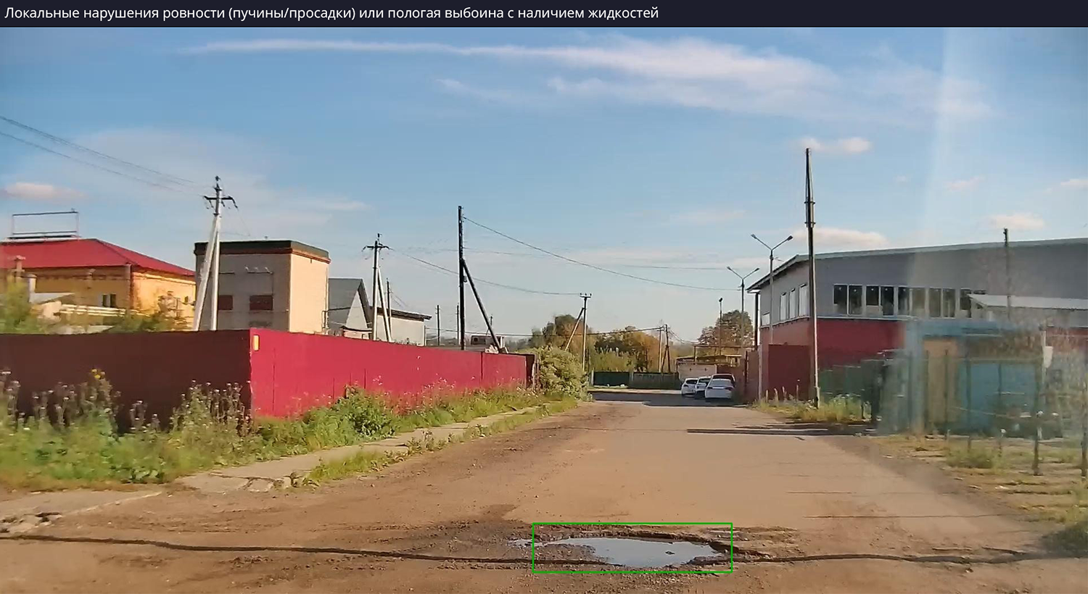
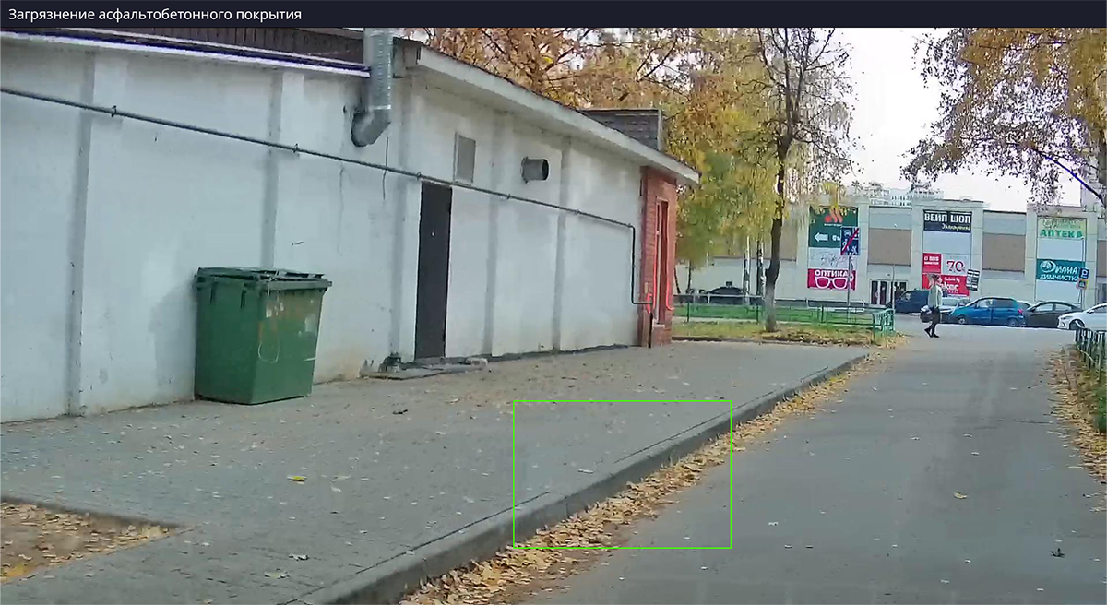
Industrial analogue: mobile road-condition analytics
Road-surface defect example
Asphalt contamination example
Interpretation
The vendor material demonstrates feasibility and reporting concepts. It does not provide an independent scientific benchmark for Astana.
Images: SoftLogic Kontrol ODX product page
17
Notes:
Images and product context: https://softlogic.ai/solution/kontrol_odx. Vendor-provided examples are shown as an industrial analogue, not as independent validation. Image URLs: https://softlogic.ai/media/file/solutions/image/detects/1/1.1(1).webp and https://softlogic.ai/media/file/solutions/image/detects/2/2.1.webp

Slide 18
Proposed end-to-end system
01
02
03
04
05
06
Capture
Quality control
Perception
State inference
Spatial fusion
Decision layer
video, GPS, time, camera
blur, darkness, privacy
detection and segmentation
binary / multilabel condition
asset and segment association
map, report, inspection queue
Temporal rule
A single frame creates an observation. Repeated independent observations create a condition estimate and trigger a report.
18
Notes:
Proposed system architecture. Thresholds for temporal fusion and report generation will be learned or selected on validation data and tested prospectively.

Slide 19
Experimental design and expected contribution
Perception accuracy
mAP, recall, F1; mIoU and boundary F1 for masks
Condition accuracy
balanced accuracy, macro F1, AUROC, calibration error
Robustness
season, weather, time, camera, distance, occlusion, and district strata
Generalization
public-data pretraining vs Astana-only vs combined domain adaptation
Operational validity
asset-level precision, false alerts per kilometre, time-to-confirm, report completeness
Expected contribution: an Astana-specific, uncertainty-aware method that converts repeated vehicle observations into auditable asset and road-segment histories.
19
Notes:
Proposed evaluation framework and expected contribution. Exact primary endpoints and acceptance thresholds will be preregistered after the pilot dataset establishes prevalence and uncertainty.

