Slide 1
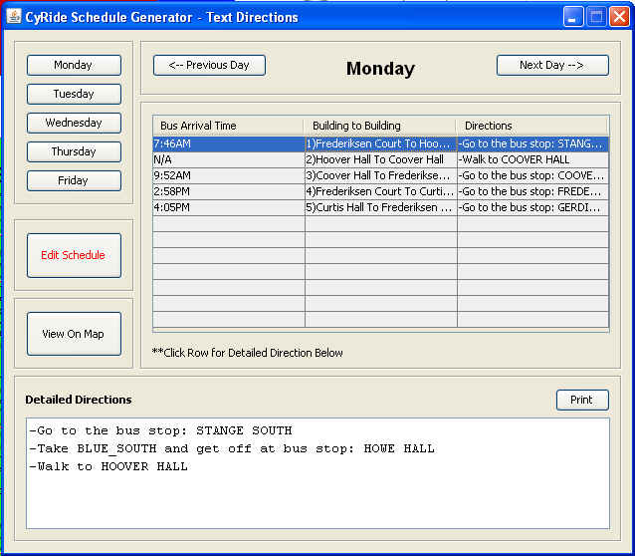
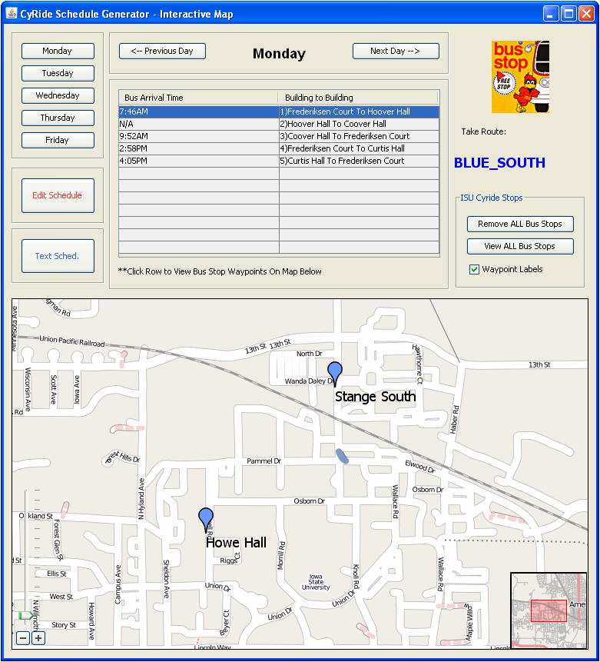
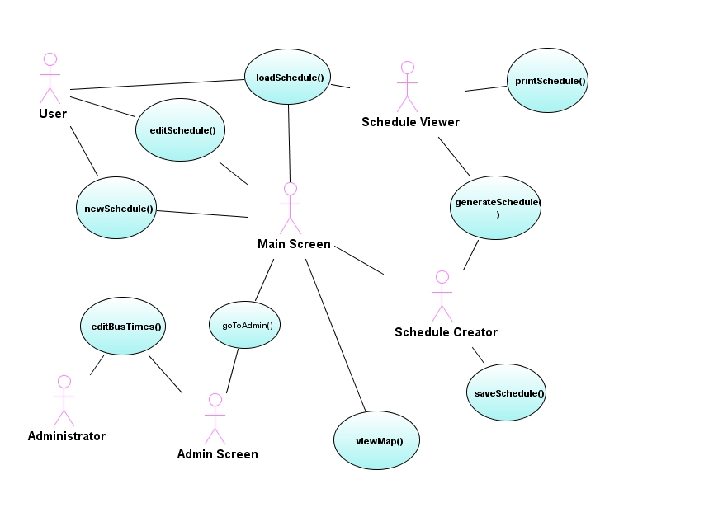
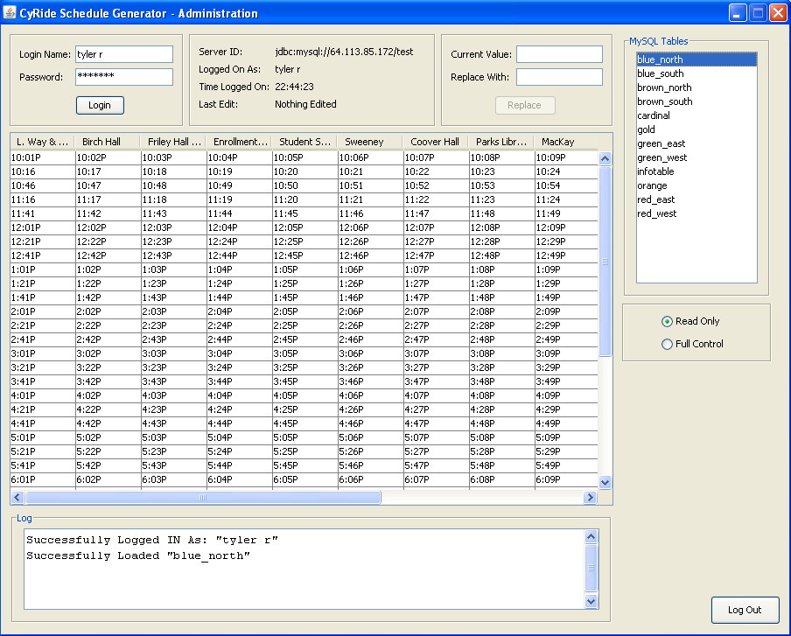
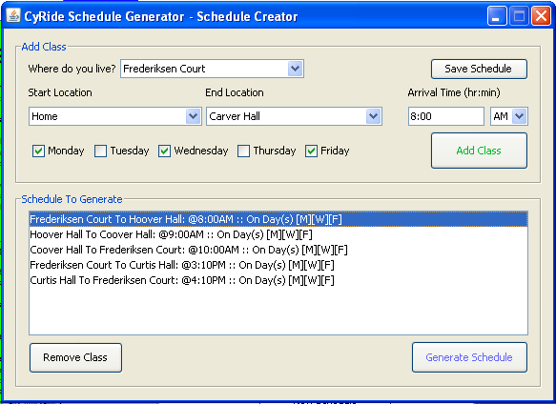
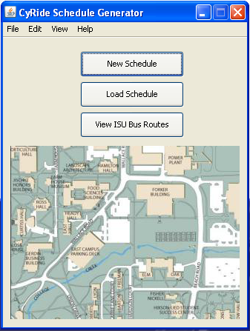
CyRide Bus Scheduler
ABC DEF
ABCD EFGH
EFFG JJKKLL
COM S 309 SPR 2012
Project Description:
Designed for Iowa State students to input their class schedule and the program will give them a bus schedule.
Text Directions
Visual Map Directions
Users:
Administrators
ISU Students
User Interfaces
Schedule Creator
User inputs their class schedule
Text Schedule Viewer
User views their generated schedule
Interactive Map
User can view where on the map the bus stops are located
Administration Data Editor
Allows for changes to the data used in calculating the routes
Module Interfaces:
GUI-Error Checking Interface
The GUI and Error Checking subsystem interact through an interface. The GUI sends data that the user has placed on the form. The error checker then checks the data and returns false if the data is incorrect.
private boolean checkInputs(String[ ] data)
This method checks for invalid inputs from the user.
private String[ ] getFile(File file)
This method returns an array of the data in the file or null if the file is not found.
private Boolean canCreateSchedule(String[ ] data)
This method returns whether the data is complete enough to generate a schedule.
Error Checking-Map/Generator Interface
The error checking-map/generator interface allows the map and generator to have correct data ported to them. The schedule generator will take the checked data from the user and create the proper list of directions for the user, sending them back to the GUI. The map will take the validated waypoints and create the new waypoint painter to overlay the map with.
private void mapError()
Checks the data for error and if an error is found, halts the process and returns control back to user with an error statement asking him or her to input their data again.
Generator-Database Interface
This interface connects the generator to the database with all the information about the bus routes. The database provides the information need to correctly from the path needed by the user.
private data callDatabase()
The method that makes the call to the database and then return the required data. It should put the data in a usable form such as a string or integer.
Generator-Map Viewer Interface
The generator-map viewer interface is a way for the schedule generator and the map viewer to pass information from one to another.
private void textViewer(Collection<pathData> data)
A method of class viewer that is called by the generator. Generator gives the method the collection of data that has all the paths that the user requires. It holds the route, times, and locations, that are stored as strings. The data is used by the viewer to create a viewable schedule. textViewer also calls viewChecker that checks to see if the collection is set up properly and does not have any null values.
private boolean viewChecker(Collection<pathData> data)
This method checks to see if the collection is set up properly and does not have any null values.
Map-GUI Interface
Transfers the data from the map to the GUI interface that is viewed by the user. Should display the correct routes for the user unless the user inputs incorrect data.
private void displayMap()
Should take the data from the map class and display a map with the routes the person should take to get to desired destinations.
private Waypoint getStart()
Returns a Waypoint containing the information of the starting position
private Waypoint getEnd()
Returns a Waypoint containing the information of the ending position
Design Decisions:
Database of bus times
Single threaded
Modulated the generator to simplify the process
Interactive Map
Team Info:
Team 08
Tyler Rykhoek – CPRE (Jr)
Jeff Thompson – CPRE (Jr)
Kyle Stephan – CPRE (Jr)
What went wrong:
Map doesn’t show route overlaid
Team member left
What went right:
Working complete project
Useful for students
Does not crash
Lessons Learned:
Start coding earlier
Learned GUI (java)

Slide 2
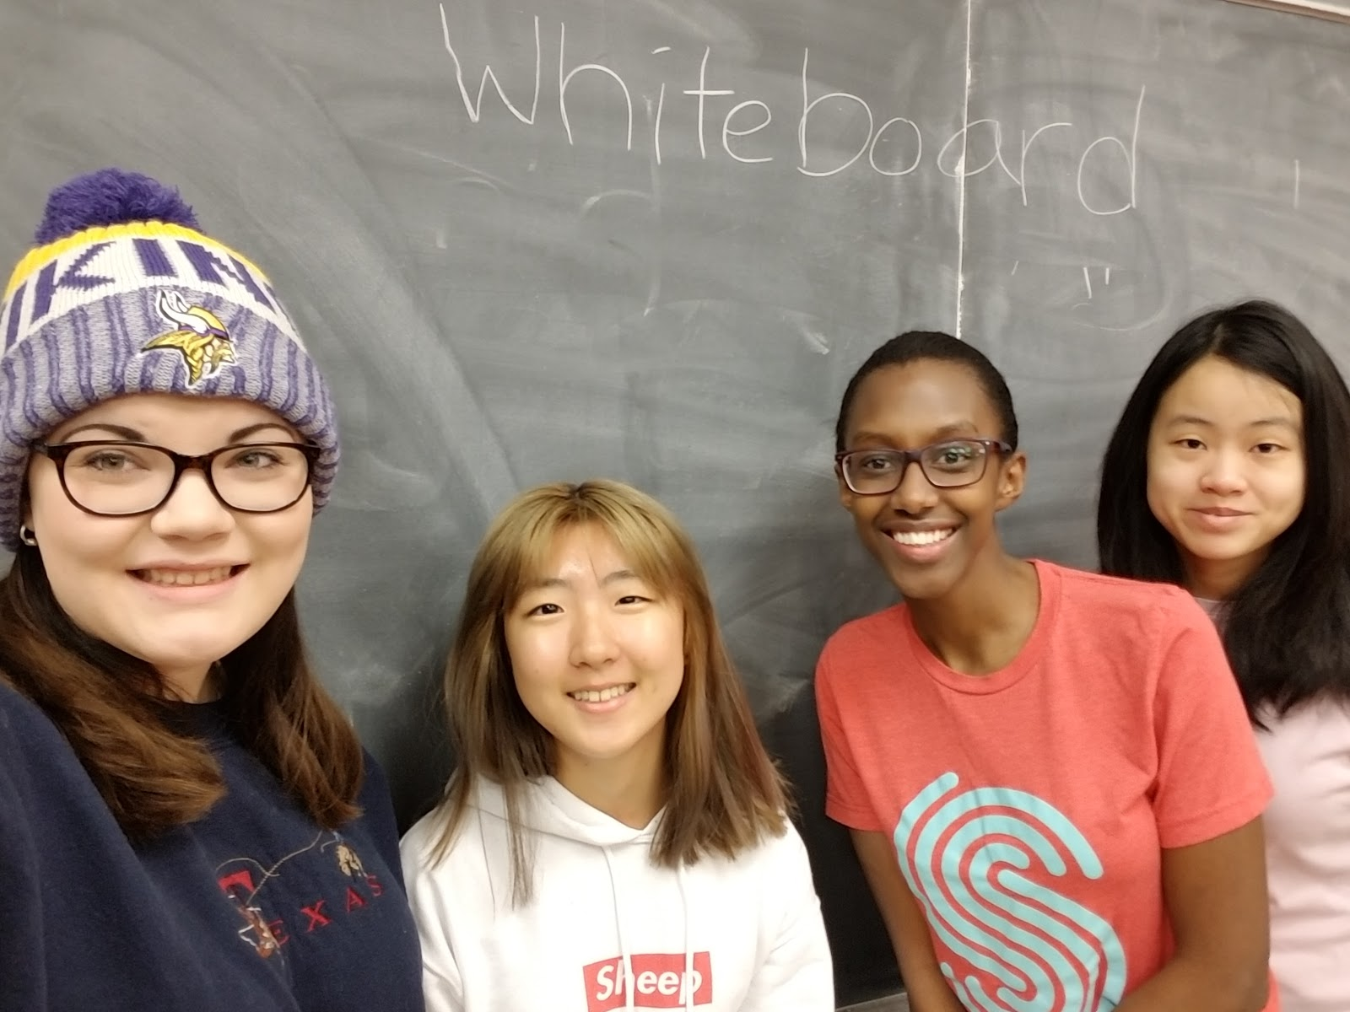
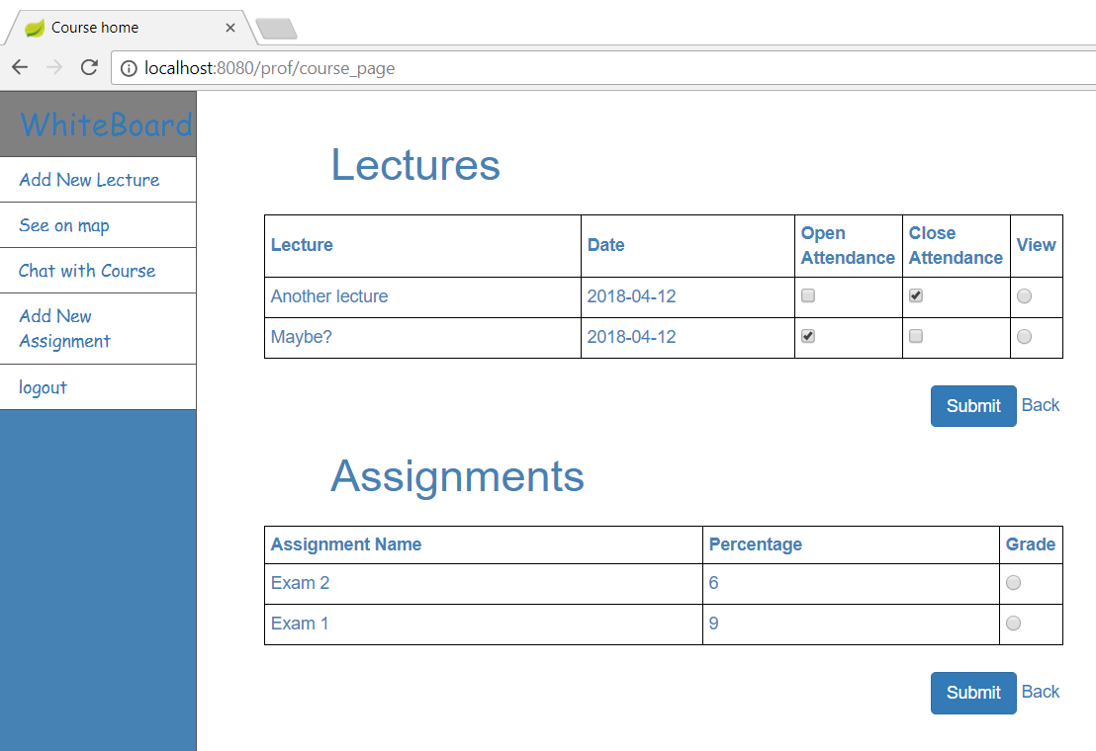
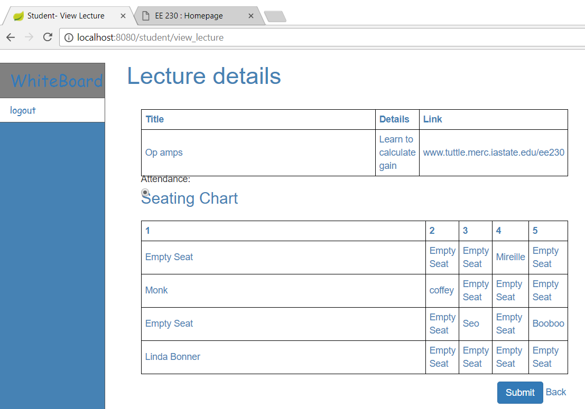
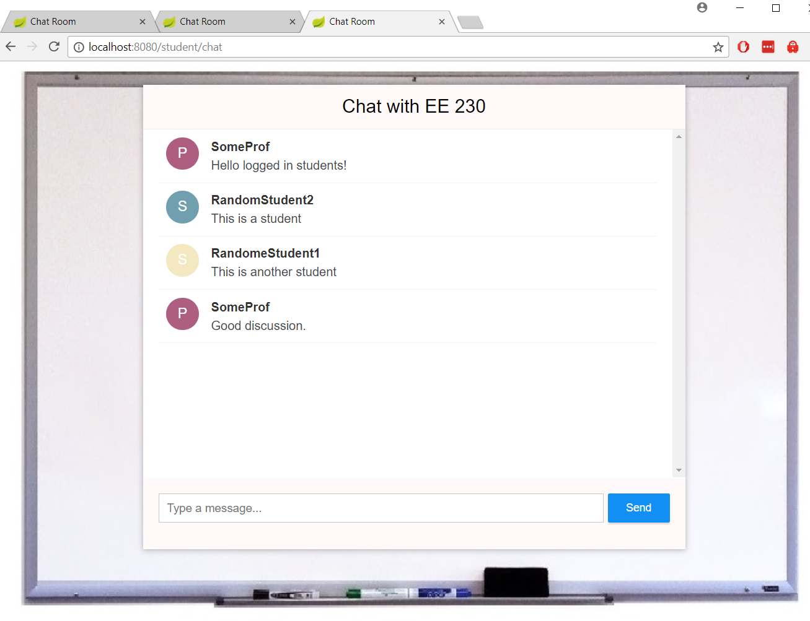
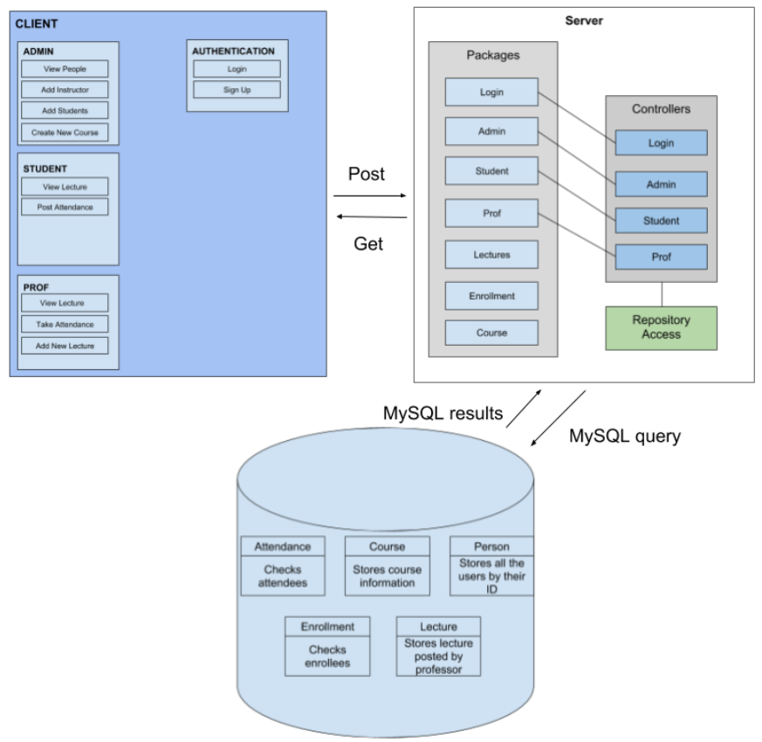
Whiteboard
Sarah Coffey (CprE)
Sydney-Shile Teh (CS)
Sung Yealim (SE)
Mwiza Mireille Iradukunda (SE)
Project Description
Whiteboard is a web application that helps professors, students, and administrators handle course management.
- Create courses and enroll professors and students
- View course location with Google Maps
- Create and view lectures
- Attendance, seating chart, and files
- Professor and student chatrooms by course
Screen sketches and snapshots
Actors and Use Cases
Administrators
- Create course
- Enroll students and professors
- View all users
Professors
- Create lectures by course
- Assign students to seats by lecture
- Open/close attendance by lecture
- Create assignments
- Assign grades
- View course location on Google Maps
- Chat with logged-in students within the course
Students
- View lectures by course
- Record attendance by lecture
- View course location on Google Maps
- Chat with professor and other logged-in students
within the course
Select Module Interfaces
Admin: Directs the logged-in administrator user to the
correct pages
by get and post maps
- Enroll User: Get mapping generates the list of courses and students and adds them to the model; Post mapping assigns the selected students to the chosen course with a call to the repo
- Create Course: Get mapping attaches the list of locations to chose from; Post mapping saves the user-entered course data to the repo
Chat: Functions that control how the messages route over Websocket
- sendMessage: Routes the message mapping to the correct course instance topic
Notification: Generates notifications for created lectures and attaches to student views
- Generation: Creates a notification when lecture created and sets an expiration on it
Block Diagram
Design Decisions
- Used html instead of jpa
- Spring MVC, Thymeleaf, and MySQL
- Separated functions and methods by user type
Development
- Learned A LOT about web application development
- Create more robust APIs between the DB/Controller/JS

