Slide 1
Building and Training a High-Dimensional Atomic Neural Network Potential (NNP) for Small Organic Molecules
Sung Jung
CSE Certificate Project; Spring 2022
Based on the ANI-1 NNP + some modifications

Slide 2


ANI1JL
“ANI-1 in JuLia”
Written like a standard Julia Package
Help of the Flux machine-learning library

Slide 3
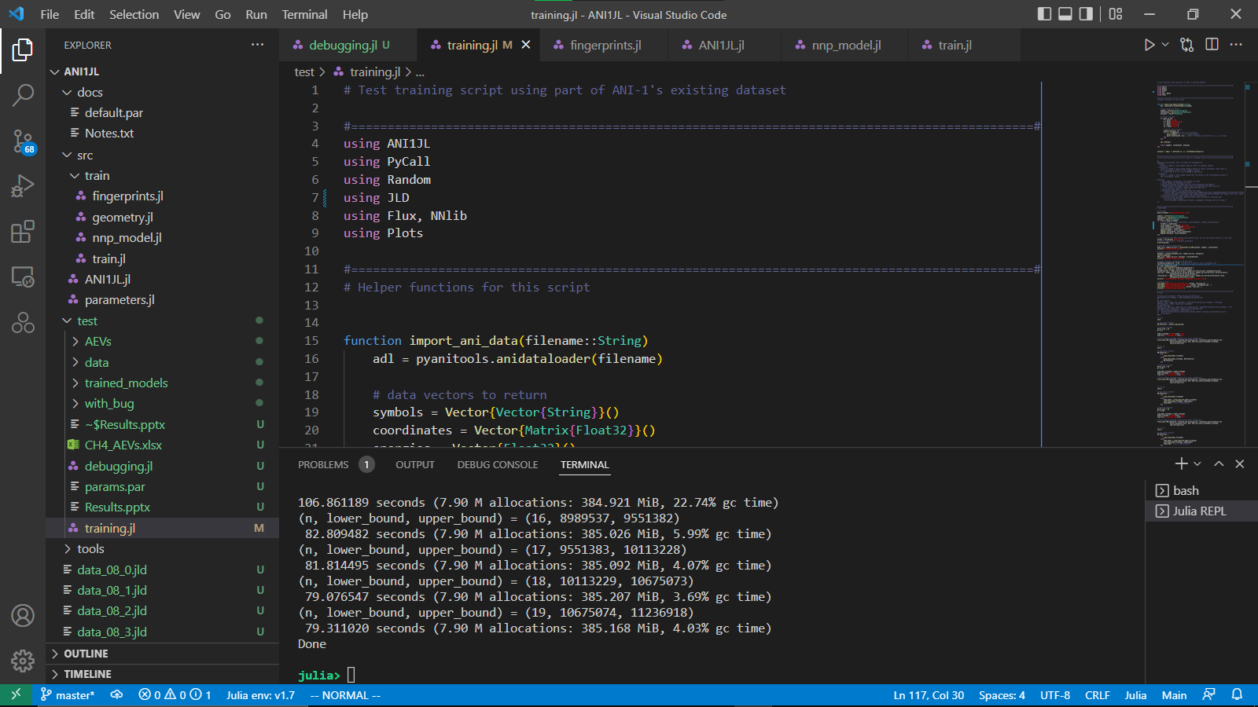

Slide 4
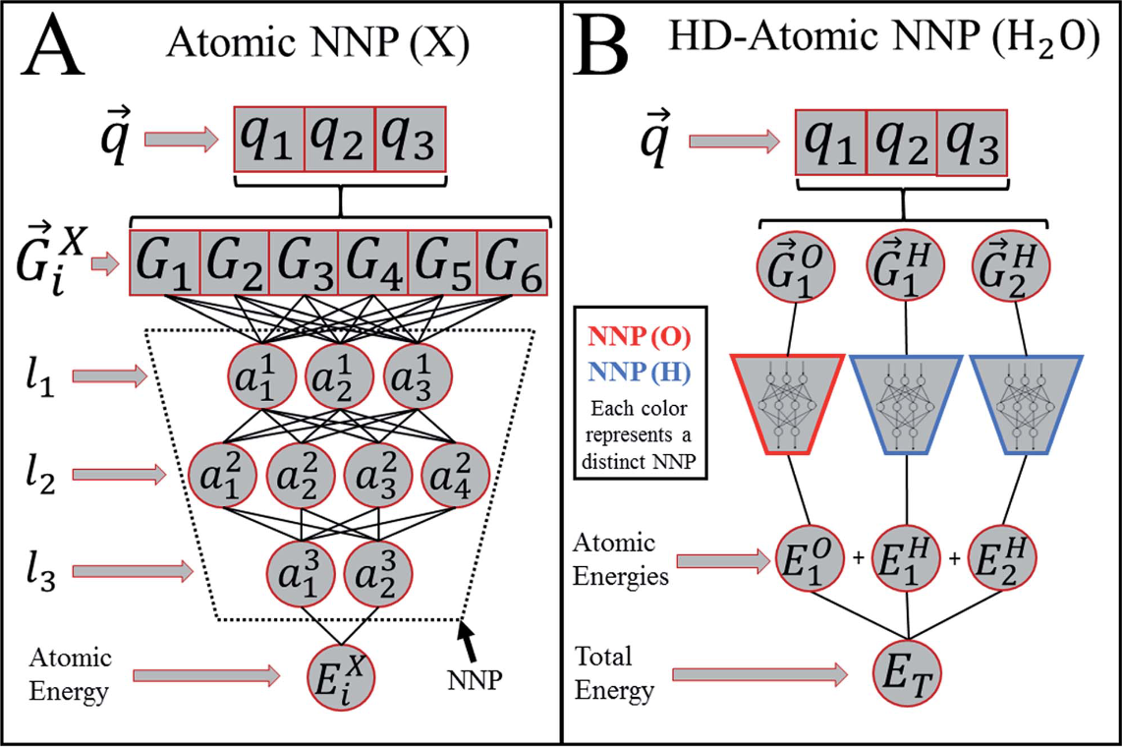
High-dimensional NNP
position
Atomic Environment Vector (AEV)
(aka “fingerprints”)
Hidden layers

Slide 5
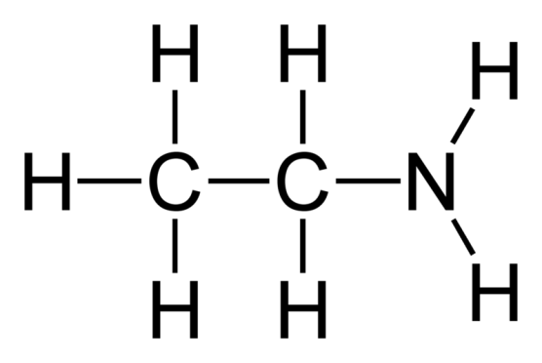

AEVs
H3
H5
H6
H1
N1
C1
C2
H2
H7
H4
$$G_{i}^{X}$$
X-C
X-O
X-N
X-H
N-X-H
O-X-O
O-X-H
H-X-H
Radial elements
Angular elements
For an NNP with N different element types, there are:
N radial elements
N(N+1)/2 radial elements

Slide 6
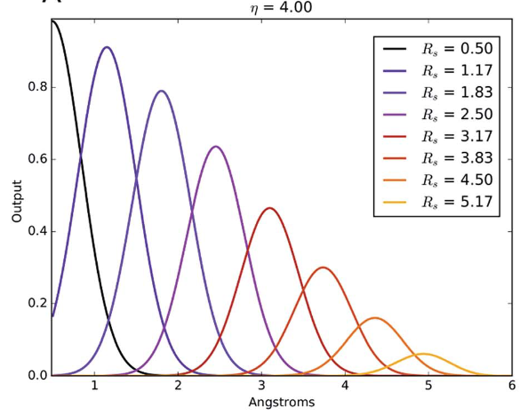


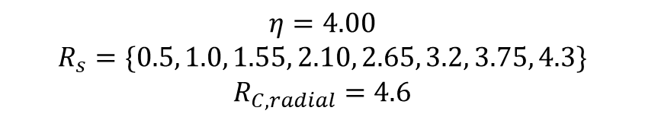
AEVs
H3
H5
H6
H1
N1
C1
C2
H2
H7
H4
$$G_{i}^{X}$$
X-C
X-O
X-N
X-H
N-X-H
O-X-O
O-X-H
H-X-H
Radial elements
Angular elements
CUTOFF FUNCTION
Each radial element is a vector of length 8
$$η=4.00$$
$$R_{s}=\{0.5, 1.0, 1.55, 2.10, 2.65, 3.2, 3.75, 4.3\}$$
$$R_{C, radial}=4.6$$
RADIAL ELEMENTS OF AEV

Slide 7
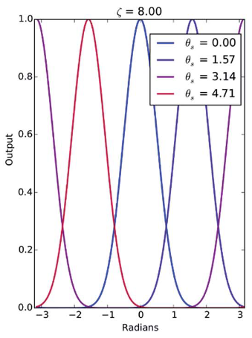
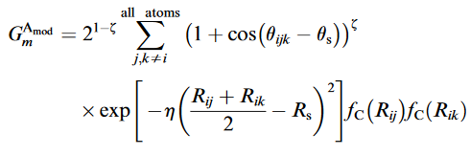
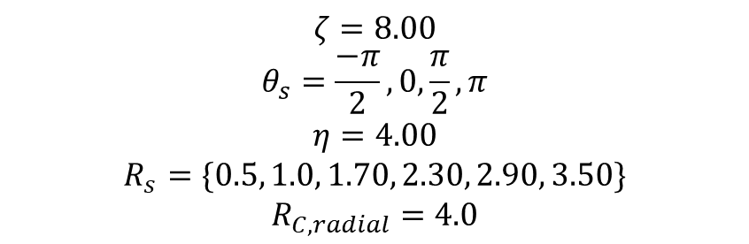
AEVs
H3
H5
H6
H1
N1
C1
C2
H2
H7
H4
$$G_{i}^{X}$$
X-C
X-O
X-N
X-H
N-X-H
O-X-O
O-X-H
H-X-H
Radial elements
Angular elements
CUTOFF FUNCTION
Each angular element is a vector of length 24
$$ζ=8.00$$
$$θ_{s}=\frac{−π}{2}, 0, \frac{π}{2}, π$$
$$η=4.00$$
$$R_{s}=\{0.5, 1.0, 1.70, 2.30, 2.90, 3.50\}$$
$$R_{C, radial}=4.0$$
ANGULAR ELEMENTS OF AEV

Slide 8
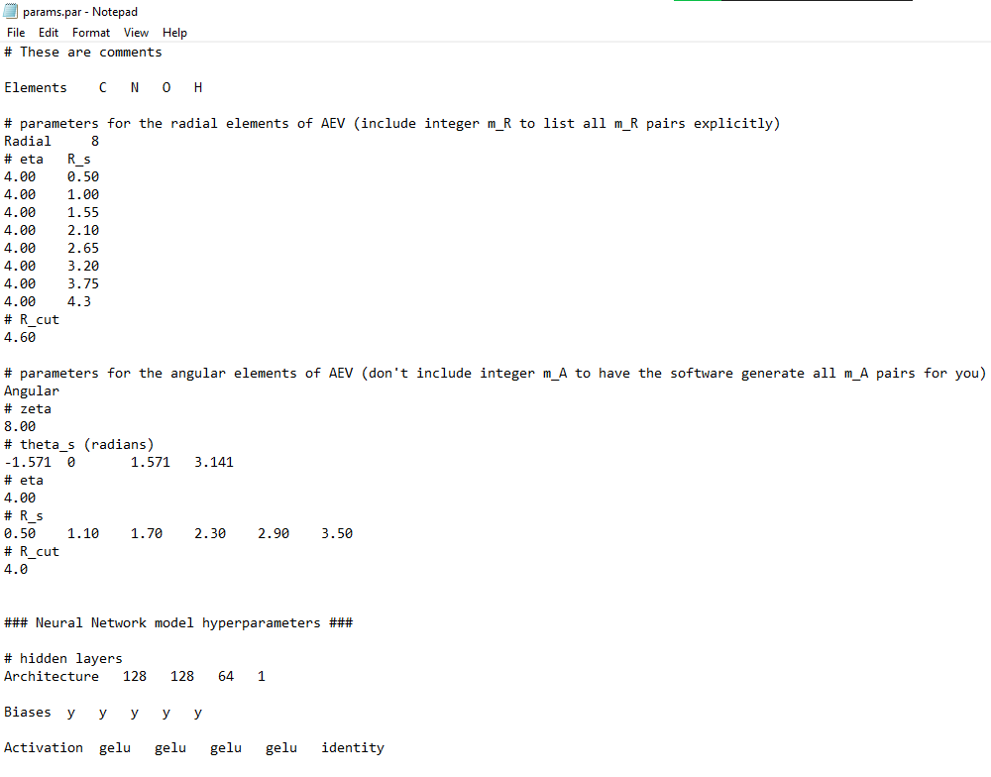
Model Parameters & Hyperparameters
Params datatype

Slide 9
Making AEVs & Training
AEVs_list, symbol_id_list = coordinates_to_AEVs(params, symbols, coordinates)
...
save_AEVs("AEVs/training_set_01-06.jld", params, training_set...)
NN_Potential = atomic_nnps(params) # alternatively, load from existing file
# Training settings
batch_size = 68
η = 0.1 # learning rate for optimizer
# Train network (package automatically saves checkpoints)
train_nnps!(NN_Potential; training_set=training_set, validation_set=validation_set,
batch_size=batch_size, η=η)

Slide 10
Dataset
Have been using the massive dataset made by the ANI-1 people

Slide 11
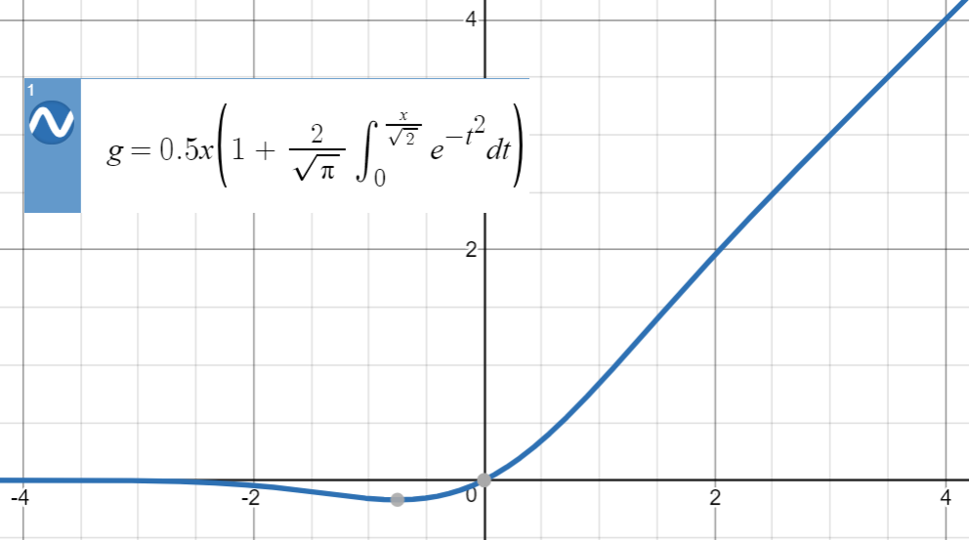
First training
Training data:
Organic molecules with 1 or 2 C/N/O
13 different molecules
61672 total data points
90%: training set
8%: validation set
2%: test set
GELU
GELU
Identity
272
64
1
1
Trained in minibatches of 68 on my laptop

Slide 12
First training
Optimizer: ADAM
learning rates:
0.1 -> 0.01 -> 0.001 -> 0.0001 -> 0.00001 -> 0.000001
Stopped when validation loss does not improve for 50 epochs
Biases allowed between all layers
Max norm regularization for weights
GELU
GELU
Identity
272
64
1
1
Trained in minibatches of 68 on my laptop

Slide 13
First training
Final validation RMSE = 0.033 kcal/mol

Slide 14
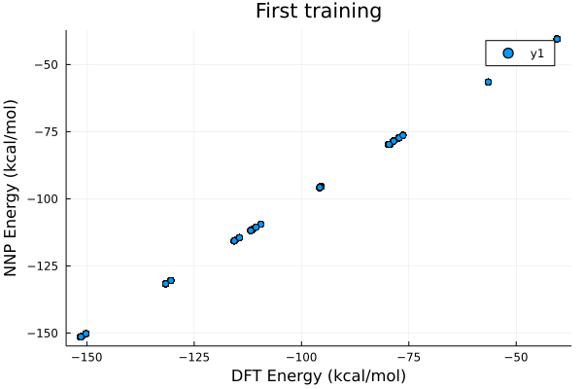
First training: results
Training RMSE = 0.033216402 kcal/mol
Validation RMSE = 0.03295033 kcal/mol
Test RMSE = 0.036458258 kcal/mol

Slide 15
Bigger training
Training data:
Organic molecules with 1-4 C/N/O
94 different molecules
~900,000 total data points
Parallelization (OpenMP style)
But not very efficient…
GELU
GELU
GELU
GELU
Identity
272
128
128
64
1
1

Slide 16
Bigger training
Trained in minibatches of 68 (first round) and 884 (2nd round) on Stampede2
Optimizer: ADAM
learning rates:
0.1 -> 0.001
Had to force quit due to time constraints (but validation was still improving)
Biases allowed between all layers
Max norm regularization for weights
GELU
GELU
GELU
GELU
Identity
272
128
128
64
1
1

Slide 17
Bigger training
Final validation RMSE = 0.0437 kcal/mol
Learning rate reduced

Slide 18
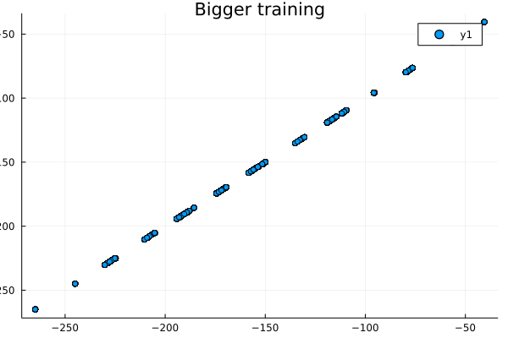

Bigger training results
Training RMSE = 0.042631466 kcal/mol
Validation RMSE = 0.042709608 kcal/mol
Test RMSE = 0.042404305 kcal/mol

Slide 19
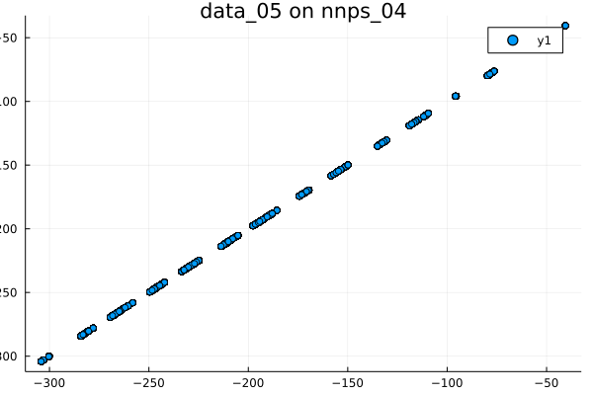
Bigger training: fitting larger molecules
Molecules with 5 C/N/O
267 different molecules
1,813,151 total data points
Fit to model trained on <=4 C/N/O
RMSE = 0.0471014158 kcal/mol

Slide 20
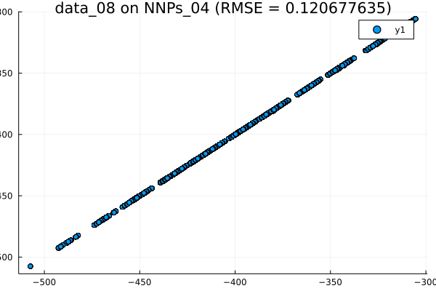
Bigger training: fitting larger molecules
Molecules with 8 C/N/O
47932 different molecules
11,236,918 total data points
Fit to model trained on <=4 C/N/O
RMSE = 0.121 kcal/mol

