Slide 1

- Mid-term Presentation -

Slide 2

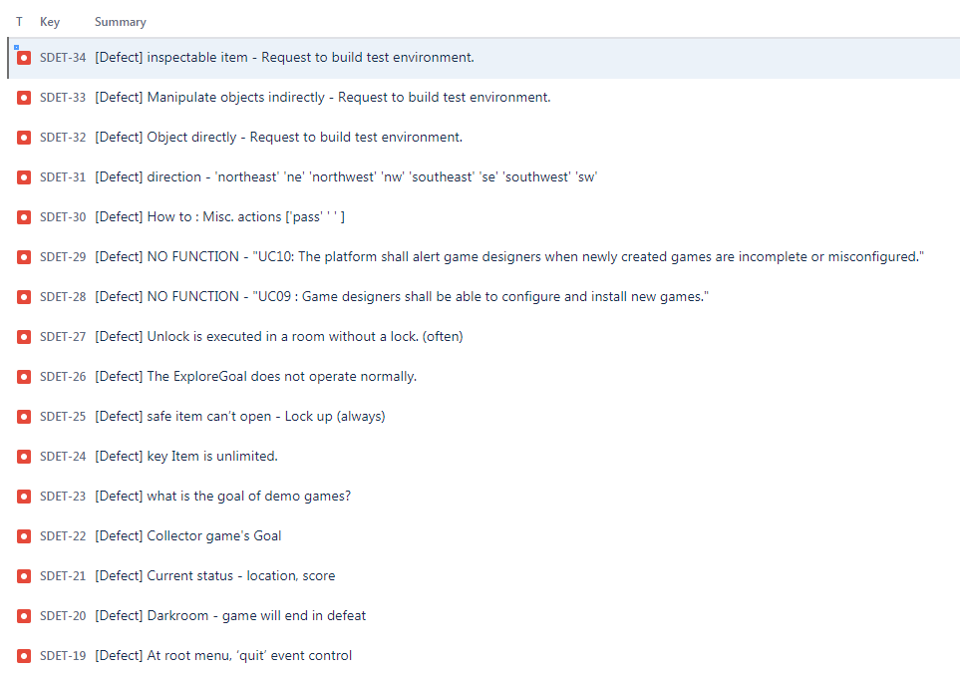
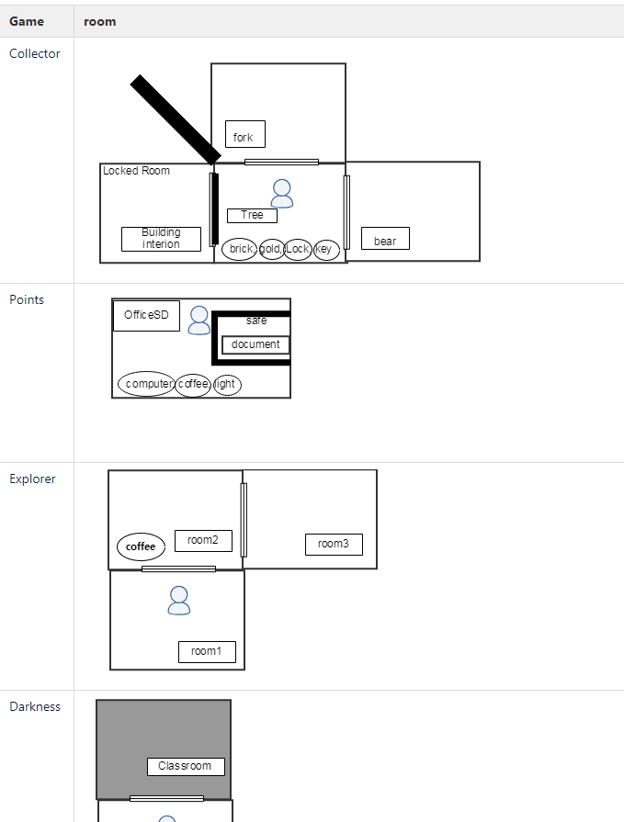
Appendix. Pre-Test outputs
Defect : 16
Game Map

