Slide 1
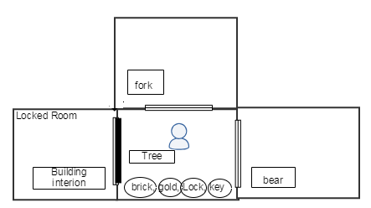
Player
Game Type
Collector
Hold Itmes
Game: Collect the following items: * a brick * a key * a peice of gold
Do you have brick, key and gold?
No
Yes
Game win

Slide 2
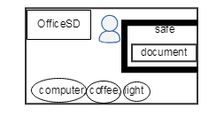
Player
Game Type
Points
Get Points
Game: The objective of this game is to earn points by doing certain things. You must earn801 to win
*801 Point : open safe + hold document + eat coffee
Point >= 801
No
Yes
Game win

Slide 3
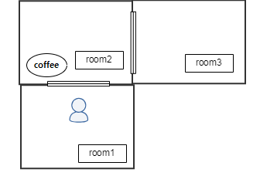
Player
Game Type
Explorer
Move room2
Game: Explore different connected rooms.
Visit room1, room2, room3
Move room3
Game win

Slide 4
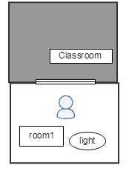
Player
Game Type
Darkness
Hold Light
Game: Explore a dark room
Move Classroom
Move Classroom
Move anyway
Game win
Game end

Slide 5
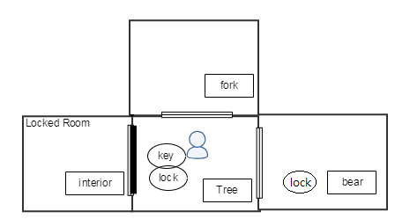
Player
Game Type
Lock Demo
Visit fork room
Game: The objective of this game is to unlock a room.
Visit fork, tree, bear, interior
Visit bear room
Open lock
Visit interior room
Game win

Slide 6
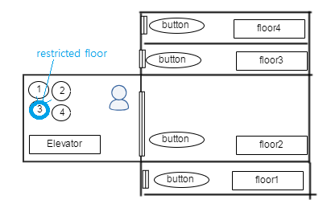
Player
Game Type
Elevator
Get Points
Game: The objective of this game is to demo an elevator
*10 Point : push button(2point) * 5
Point >= 10
No
Yes
Game win

Slide 7
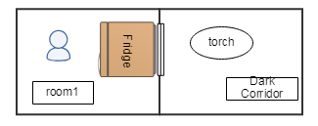
Player
Game Type
Obscured
Obscured room
Game: The objective of this game is to earn explore an obscured room.
Visit room1, DarkCorridor
Move east
Game win

Slide 8
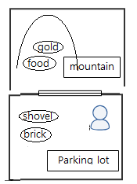
Player
Game Type
Excavatable
Hold shovel, brick
Game: Collect the following items * a brick * a food * a gold
Visit mountain
Found food, gold
Hold food, gold
Game win

Slide 9
Player
Game Type
Excavatable
Collector
Points
Explorer
Darkness
Lock demo
Elevator
Obscured
Hold shovel, brick
Hold Itmes
Get Points
Hold Light
Visit fork and bear room
Get Points
Visit mountain
Move room2
Obscured room
Do you have brick, key and gold?
Point >= 801
Open lock
Point >= 10
Move Classroom
Move Classroom
Found food, gold
Move room3
No
No
No
Move east
Move anyway
Visit interior room
Hold food, gold
Yes
Yes
Yes
Game win
Game win
Game win
Game win
Game end
Game win
Game win
Game win
Game win

