Slide 1
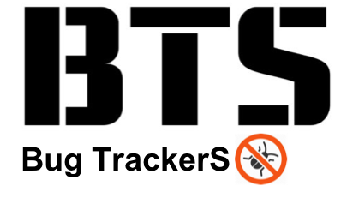
- Final Presentation -

Slide 2

Project Risk Management (to be edited)
황S
Project Risk
Technical Risk
- Unclear requirements make implementation and source modification difficult :
Modify and add requirements to clarify.
- skill level of java language among individual : assign job by individual skill level
Resource Risk
- Lack of human resource to implement new feature : separate developer and tester
- difficult to select appropriate project management tools : Using external JIRA tools that team members feel familiar.
Product Risk
Product Quality Risk
Many unintended errors occurred during the integration of new functions : Simultaneously execute integration test and system test.

Slide 3

Quality activity – Mutation Test (added)
황S
Goal : Satisfying Mutation coverage
Goal Coverage
80% line coverage 80% mutation coverage
Resource
Planned Effort : 5h (7/23, 1 member, 5 hours)
Estimated Effort : 10h (7/23, 2 members, each 5hours)
Actual : 11h (7/23 , 2 members, 6hours + 5hours )
Outputs (ref. appendix.5)
affected Unit Test Case : GameTest.java - 46 , ItemTest - 3, PlayerTest.java - 4
Mutation Test Result Report (PIT Summary)
Lessons Learned
Improvement of Mutation coverage was not directly related to improvement of Unit Test defect detection. → selectively handle the remaining test case bugs provided by the PIT.
explicit unit test case implementation of the parts to be checked and the degree of stub processing affected the mutation coverage.
The purpose of the mutation test is to check the fidelity of the test case.
test case verification of programs that contain a lot of logic to change the value
test case verification of safety-oriented programs (automotive, aviation-related programs, etc.).
we did mutation test before implement new feature
Notes:
예상 질문
유닛테스트 작성을 위해 디테일한 스펙을 정리 했는가?

Slide 4
Quality activity – Integration test (To be edited)
황S
Goal : Merge the new features into one repository and verify that they are working properly.
Completion criteria
Test case result : 100% pass
Resource
Planned Effort : 45h (7/18~20, 2hours a day, all members) -> 19h 30m
Actual Effort : 15h 40m
Outputs
Test case : 11 (ref. appendix.5 )
pass rate : : 100 %
Defect list : 1 (SDET-46) (appendix. 5)
Lessons Learned
In the tartan project, the modules are already integrated, should we do the integration test?
New feature integration test case 및 defect 기준으로 수정
New feature 내용 위주로 재구성
기존 내용은 effort. 관련된 데이터 위주로 재사용
Notes:
예상 질문

Slide 5


Appendix 4. Quality activity – Mutation Test
Before Coverage
After Coverage
Notes:
예상 질문
유닛테스트 작성을 위해 디테일한 스펙을 정리 했는가?

Slide 6
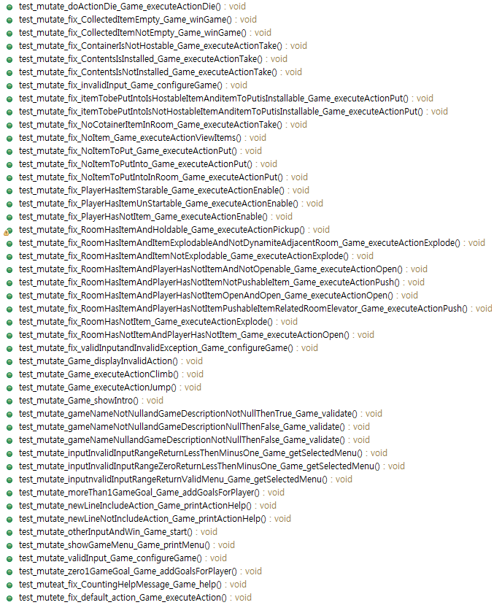


Appendix 4. Quality activity – Mutation Test
affected Unit Test Case List
GameTest
ItemTest
Player Test
Notes:
예상 질문
유닛테스트 작성을 위해 디테일한 스펙을 정리 했는가?

Slide 7
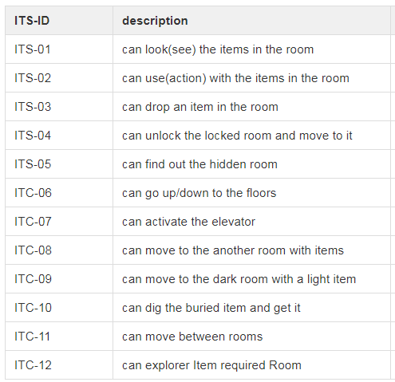
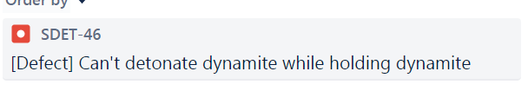
Appendix 5. Quality activity – Integration test
Test case
Defect list
Notes:
예상 질문

