Slide 1

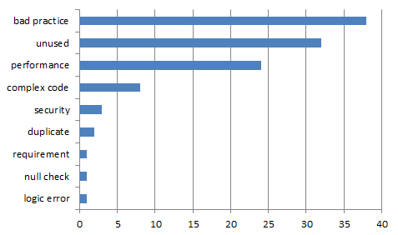
Quality activities - Static analysis
Goal
To detect defects with less effort than dynamic testing
To integrate static analysis tools to the CI environment
Resource
Planned Effort: (6/21 ~ 26) 50h (2h * 5days * 5 members)
Actual Effort : 36.5h
Outputs
Defect List
Lessons Learned
Static analysis result is used as a basic data of refactoring.
It helped to manage coding convention and complexity.

Slide 2

Quality activities - Refactoring & Re-Work
Goal
Improving Testability
Improving Code smells in SonarQube (by 1day debt)
Resource
Planned Effort(7/9 ~ 13) : 50h (2h * 5days * All members)
Actual Effort : 31h
Outputs
Refactoring status : Number of refactoring items (69) (ref. appendix.1)
SonarQube trend: (ref. appendix.2)
Lessons Learned
Refactoring is indispensable for Testability
Monitoring method for Field Status is needed to know changed status.
- Getter & setter methods are added
Method should return about that’s result of procedure.
Notes:
Monitoring method for Field Status is needed to know changed status.
- For this, We discussed for changing private fields to public fields
- Finally, we added getter & setter methods.

Slide 3

Quality activity – Unit Test
Goal
Verify the operation for function
Satisfying code coverage
Completion Criteria
Unit Test – Pass rate : 100%
Statement Coverage : 90% / Branch coverage : 80%
Resource
Planned Effort(7/16 ~ 20) : 50h (2h * 5 days * all members)
Actual : 64h
Outputs (ref. appendix.4)
Number of Unit Test : 332
Number of Defects
Coverage : statement coverage : 84%, branch coverage : 68%
Lessons Learned
To effectively write the Unit test, we need a detailed specification.
Less defect is found as it progresses to code coverage rather than verifying function operation
Notes:
Actual / estimated Effort : 64h/73h
Should simple code be included in the Unit test?
→ Our team's decision: don’t include

Slide 4
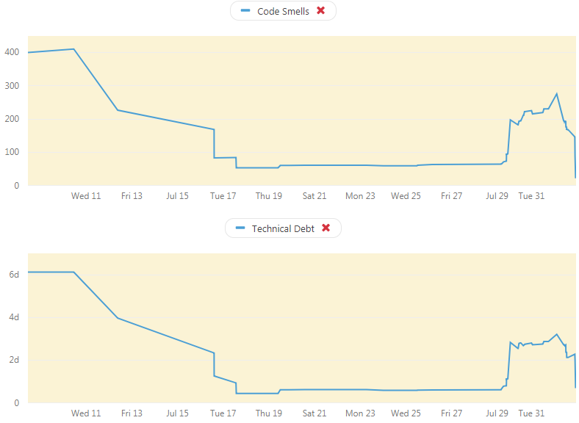
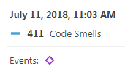
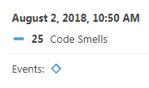
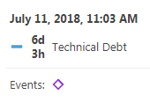
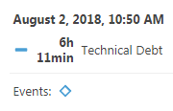
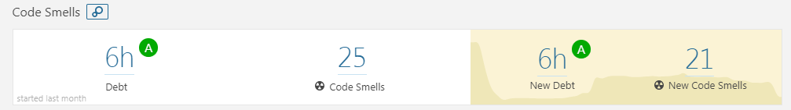
Appendix 2. Refactoring & Re-Work
SonarQube Trand

Slide 5
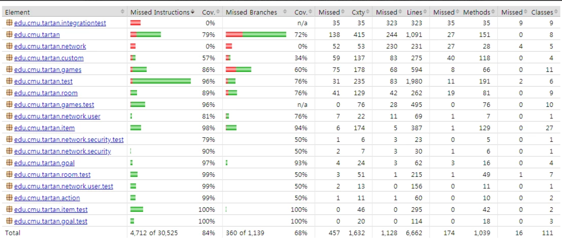
Appendix 4. Quality activity – Unit test
Coverage
Notes:
예상 질문
유닛테스트 작성을 위해 디테일한 스펙을 정리 했는가?

