Slide 1

- Mid-term Presentation -

Slide 2

Defect Categorization
Defect Detecting Method / Tool
Defect Severity
Defect Reporter

Slide 3
Code Review
Goal : Improving Testability
Sungho Chin
~~
~~~
Team Goal
Team Process.

Slide 4
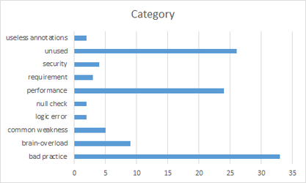
Code Review
Goal
Understanding system of Tartan Adventure.
checking correspondence between Spec. and Code
detecting Code defect
Working Hours
Period : 6/21 ~ 26
Actual / Planned : 36.5h / 50h (2h * 5days * 5 members)
Deliverables
number of Defects : 110
Lessons Learned
Vague requirements made code review hard.
Code review is one of good way to understanding System.

Slide 5
Refactoring & Re-Work
Goal
Improving Testability
Improving Code smells in SonarQube (by 1day debt)
Working Hours
Period : 7/9 ~ 13
Actual / Planned : ***/ 50h (2h * 5days * 5 members)
Deliverables
Refactoring Status :
SonarQube Trand :
Lessons Learned
Refactoring is indispensable for Testability
Monitoring method for Field Status is needed to know changed status.
- For this, We discussed for changing private fields to public fields
- Finally, we added getter & setter methods.
Method should return about that’s result of procedure.

Slide 6
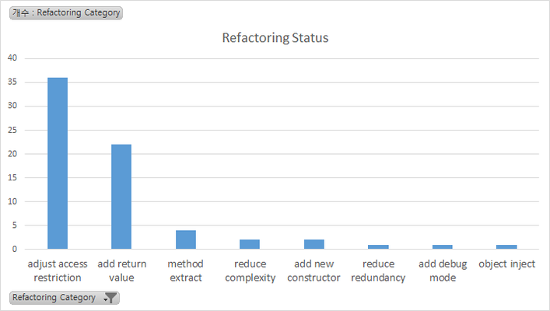
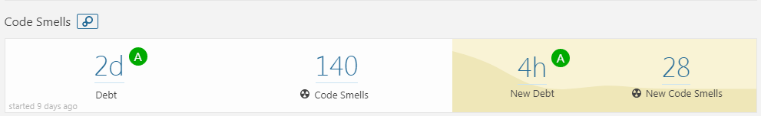
Refactoring & Re-Work
Refactoring Status
Category | num | Graph
adjust access restriction | 36
add return value | 22
method extract | 4
reduce complexity | 2
add new constructor | 2
reduce redundancy | 1
add debug mode | 1
object inject | 1

Slide 7
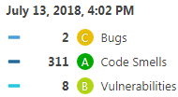
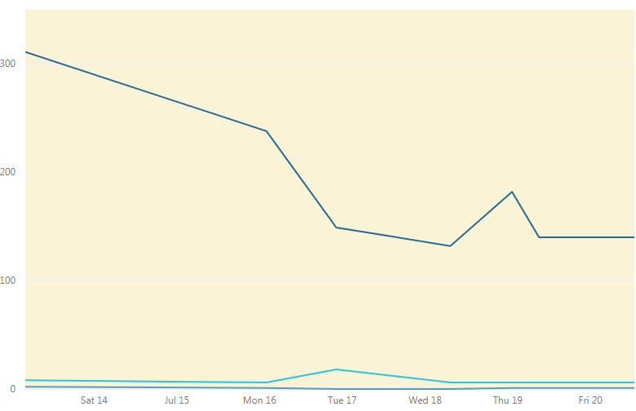
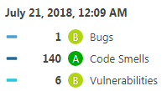
Refactoring & Re-Work
SonarQube Trand

