Slide 1

- Mid-term Presentation -

Slide 2

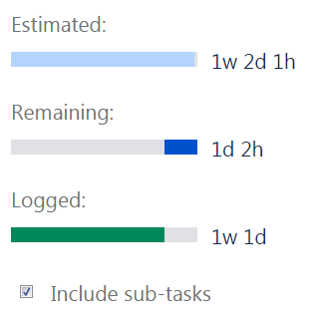
Quality activity – Unit test
Goal : Satisfying code coverage
Completion criteria
90% statement coverage
80% branch coverage
Participants : All members
Planned Effort : 45h (7/16~20, 3hours a day) -> 73h
Actual Effort : 64h
Outputs
Number of unit-test per class : 10 (241/24)
Jacoco test report
Defect list : 4 (SDET-47, SDET-48, SDET-51, SDET-54)
Review
Should simple code be included in the Unit test?
→ Our team's decision: don’t include
To effectively write the Unit test, we need a detailed specification.
1)
1) methods without conditional statements, getter/setter methods
Notes:
예상 질문
유닛테스트 작성을 위해 디테일한 스펙을 정리 했는가?

Slide 3
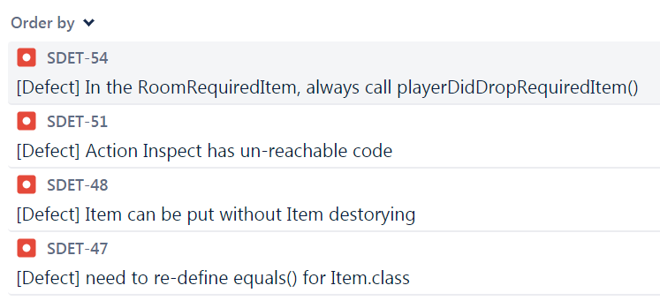
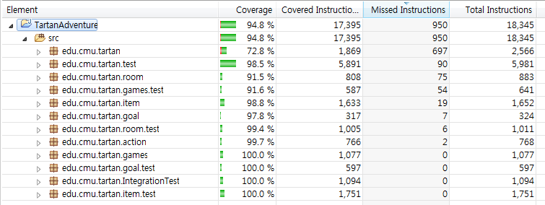
Quality activity – Unit test
Defect list : 4 (SDET-47, SDET-48, SDET-51, SDET-54)
Jacoco test report
Notes:
예상 질문
유닛테스트 작성을 위해 디테일한 스펙을 정리 했는가?

Slide 4
Quality activity – Integration test
Goal : Verify core sequence consistency (Risk based test)
Completion criteria
Test case result : 100% pass
Participants : All members
Planned Effort : 45h (7/18~20, 2hours a day) -> 19h 30m
Actual Effort : 15h 40m
Outputs
Test case :
Jacoco test report (pass rate) :
Defect list : 1 (SDET-46)
Review
Do small projects need integration testing?
In the tartan project, the modules are already integrated, should we do the integration test?
Notes:
예상 질문

Slide 5
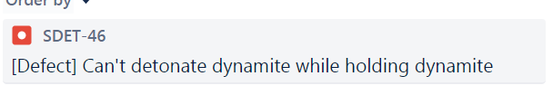
Quality activity – Integration test
Defect list : 1 (SDET-46)
Jacoco test report
Notes:
예상 질문

