Slide 1
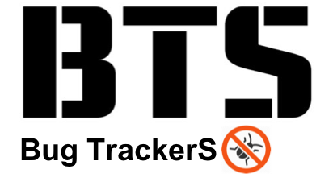
- Final Presentation -

Slide 2

Project Risk Management
Project Risk
Technical Risk
- Unclear requirements make implementation and source modification difficult :
Modify and add requirements to clarify.
- skill level of java language among individual : assign job by individual skill level
Resource Risk
- Lack of human resource to implement new feature : separate developer and tester
- difficult to select appropriate project management tools : Using external JIRA tools that team members feel familiar.
Product Risk
Product Quality Risk
Many unintended errors occurred during the integration of new functions : Simultaneously execute integration test and system test.

Slide 3

Quality activity – Mutation Test (added)
Goal : Satisfying Mutation coverage
Goal Coverage
80% line coverage 80% mutation coverage
Resource
Planned Effort : 5h
Estimated / Actual Effort : 10h / 11h
Outputs (ref. appendix.4)
affected Unit Test Case : GameTest.java - 46 , ItemTest - 3, PlayerTest.java - 4
Mutation Test Result Report (PIT Summary)
Mutation coverage : 55 -> 71.3 % (for Game, Player, Item classes)
Lessons Learned
Improvement of Mutation coverage was not directly related to improvement of Unit Test defect detection. → selectively handle the remaining test case bugs provided by the PIT.
explicit unit test case implementation of the parts to be checked and the degree of stub processing affected the mutation coverage.
The purpose of the mutation test is to check the fidelity of the test case.
test case verification of programs that contain a lot of logic to change the value
test case verification of safety-oriented programs (automotive, aviation-related programs, etc.).
we did mutation test before implement new feature
Notes:
예상 질문
유닛테스트 작성을 위해 디테일한 스펙을 정리 했는가?

Slide 4
Quality activity – Integration test
Goal : Merge the new features into one repository and verify that they are working properly. (Big-bang integration)
Completion criteria
Test case pass ratio : 100%
Resource
Planned Effort : 60h
Estimated / Actual Effort : 46.5h / 27.5h
Outputs(ref. appendix.5 )
Test case : 17 (pass rate 100 %)
Defect list : 7 (Critical : 162, 163, 166, 167 / Major : 154, 165, 196)
Lessons Learned
In the tartan project, the modules are already integrated, should we do the integration test? → it is judged that there are no difference between system test and this integration test
We could find many issues in the integration with other functions. → For our team, we used integration test more than unit test.
Notes:
예상 질문

Slide 5
Course Lesson & Learned
Hyoyeon Hwang
- It was a good time to experience the work of the test engineer while we were working on the project. As a test manager, I will try to apply what I learned in this course to my work.

Slide 6


Appendix 4. Quality activity – Mutation Test
Before Coverage
After Coverage
Notes:
예상 질문
유닛테스트 작성을 위해 디테일한 스펙을 정리 했는가?

Slide 7
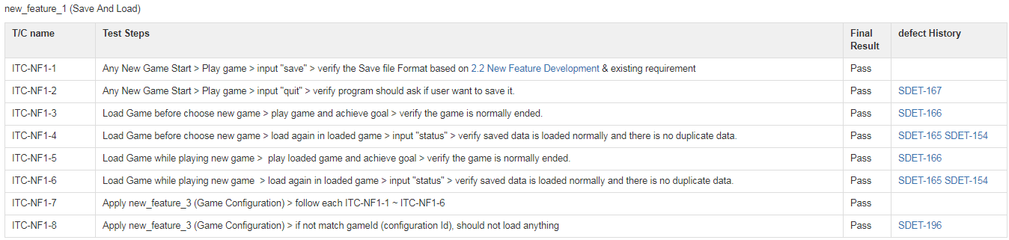
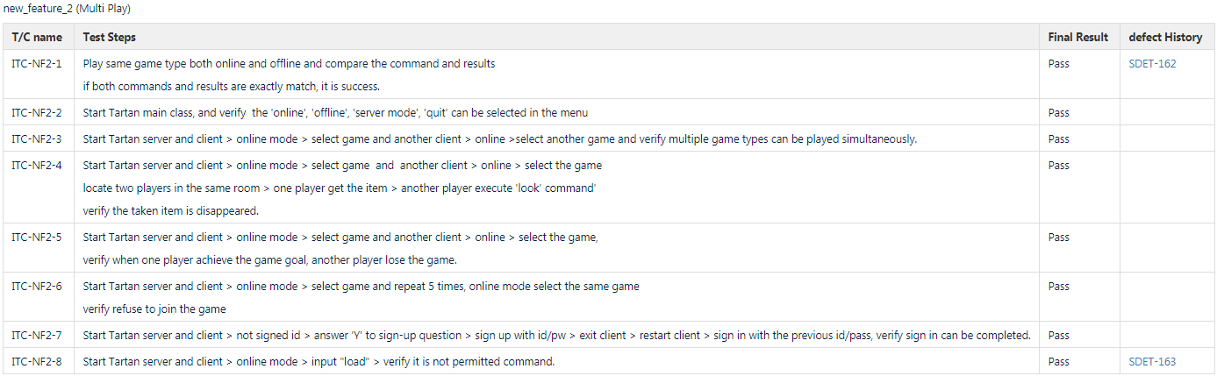
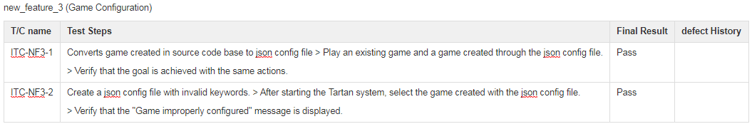
Appendix 5. Quality activity – Integration test
Test case
Notes:
예상 질문

