Slide 1

- Mid-term Presentation -

Slide 2


Who is BTS?
BTS is originally the most famous k-pop star these days. Recently, their song has been ranked 1st place in the Billboard.
So, we named it as we want to be a star in testing.
The group's 2018 album, LOVE YOURSELF 轉 'Tear', debuted at number one on the Billboard200 and number 10 on the BillboardHOT100 , marking the highest rank for an Asian artist in history
2017 and 2018 Billboard Music Awards BBMAs - Top Social Artist

Slide 3
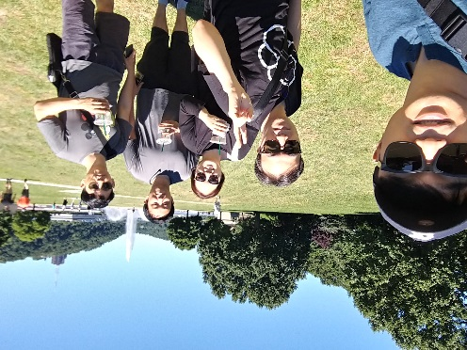
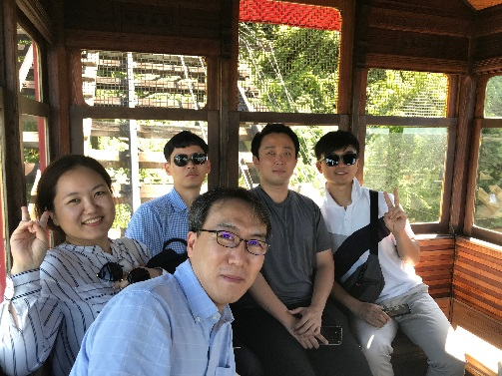
Team introductions
Team Goal :
“Studying and Understanding of SDET Culture and Techniques”, not dancing or singing!!
Team members (main role)
Sungho Chin (Team & Project Lead)
Jonggu Lee (Code Review Lead)
Sujung Lyu (Refactoring Lead)
Jinhyuk Yang (Static Analysis Lead)
Hyoyeon Hwang (Plan & Test Lead)
Team Process :
Every member should be involved in every quality management process.
5 hrs for project / day, 1 project meeting / day, 1 mentoring meeting / week

Slide 4
Project introductions
Project Goal
“Tracking bugs and defects until our customer(jeff) is satisfied.”
focus on testability
=> not focus on simple coverage ratio
Quality Goals
Testability : line coverage : 90%, branch coverage : 80%, mutation coverage : 90%
Functional correctness : unit test - pass 100%
Functional suitability for new features : 60%
Usability (optional) : improve game command and message visibility (can be play the game with the less use ‘help’ command)
Discussion of collected data : team Wiki, JIRA, Sonar, GIthub

Slide 5
Project Plan

Slide 6
Quality activities
Code review : Team (Technical) Review
Pre-Test (optional) : It is not a formal quality system step
Ad-Hoc (Experience-based test design technique)
Refactoring : Sonar, testability
Unit test : White Box testing (statement testing, branch testing)
Integration test : Scenario testing (gray box)
System test : Scenario testing, Ad-hoc testing, Combination testing, BVA
2nd phase : for new features
Develop/Unit test
Code review
Integration test
System test

Slide 7
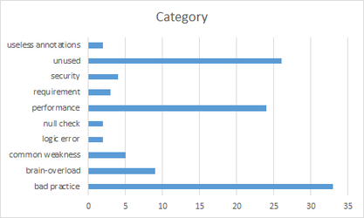
Quality activities - Code Review
Goal
Understanding system of Tartan Adventure.
checking correspondence between Spec. and Code
detecting Code defect
Resource
Planned Effort: (6/21 ~ 26) 50h (2h * 5days * 5 members)
Actual Effort : 36.5h)
Outputs
number of Defects : 110
Lessons Learned
Vague requirements made code review hard.
Code review is one of good way to understanding System.

Slide 8
Quality activities - Pre-Test (optional)
Goal
Quality ‘smell’ of the tartan system
Review of requirements (at system level)
Resource
Planned Effort: (7/16) 2 h (Sujung Lyu)
Actual Effort : 5 h
Outputs
TestCase : 26 (ref. appendix. 3)
Defect : 15 (ref. appendix. 4)
Map of Game 16(ref. appendix 5)
Lessons Learned
Understanding the tartan system
Ambiguous requirements and unexpected gaming behavior

Slide 9
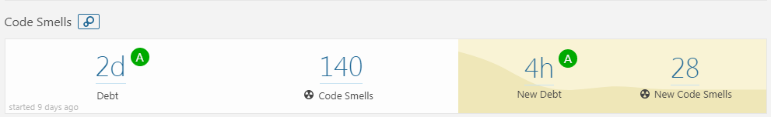
Quality activities - Refactoring & Re-Work
Goal
Improving Testability
Improving Code smells in SonarQube (by 1day debt)
Resource
Planned Effort: (7/9 ~ 13) 50h (2h * 5days * all members)
Actual Effort : 31h
Outputs
Refactoring status : number of refactoring items (69) (ref. appendix.1)
SonarQube trend: (ref. appendix.2)
Lessons Learned
Refactoring is indispensable for Testability
Monitoring method for Field Status is needed to know changed status.
- For this, We discussed for changing private fields to public fields
- Finally, we added getter & setter methods.
Method should return about that’s result of procedure.

Slide 10

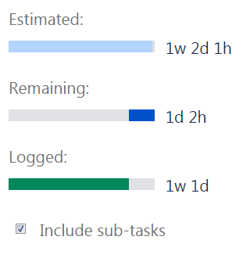
Quality activity – Unit test
Goal : Satisfying code coverage
Completion criteria
90% statement coverage
80% branch coverage
Resource
Planned Effort : 45h (7/16~20, 3 hours a day, all members))
Actual / estimated Effort : 64h/73h
Outputs (ref. appendix.4)
number of unit-test : 241
coverage : statement coverage : 88%, branch coverage : 85%
Defect list : 4 (SDET-47, SDET-48, SDET-51, SDET-54)
Lessons Learned
Should simple code be included in the Unit test?
→ Our team's decision: don’t include
To effectively write the Unit test, we need a detailed specification.
1)
1) methods without conditional statements, getter/setter methods
Notes:
예상 질문
유닛테스트 작성을 위해 디테일한 스펙을 정리 했는가?

Slide 11
Quality activity – Integration test
Goal : Verify core sequence consistency (Risk based test)
Completion criteria
Test case result : 100% pass
Resource
Planned Effort : 45h (7/18~20, 2hours a day, all members) -> 19h 30m
Actual Effort : 15h 40m
Outputs
Test case : 11 (ref. appendix.5 )
pass rate : : 100 %
Defect list : 1 (SDET-46) (appendix. 5)
Lessons Learned
In the tartan project, the modules are already integrated, should we do the integration test?
Notes:
예상 질문

Slide 12
Quality activity - System test
Goals
Verify requirements from the user's perspective.(2018LGSDETProject.pdf)
Especially, Use-Cases will be mainly verified.
Resource
Total Man Hours : 50 hours (5days / 5 hours per day / 2 members)
Periods : 7/19~25
Outputs
System Test Case
Test Result
Defect List (it is managed by JIRA System)
Argument Point
should we have to implement automation test system?

Slide 13
Next Plan
System Test (7/19 ~ 7/25)
two members will do it.
We will test not only the existing features but also the new features to be developed.
Mutation Test
one person will do the test
We will only test the Game class, because it is the core of the game operation.
Implement New Features. (7/23~27)
3 members
Integration Test for New Features. (7/26~27)
the number of tester is not determined yet. (New Feature Integration Testing was not decided whether it was a developer or a tester.)

Slide 14
Next Plan (cont.)
System Test2 (7/30 ~ 7/31)
This is the second system test to see if existing defects are resolved successfully and if new functionality is working.
Documentation (8/1 ~ 8/2)
Document output and prepare for final presentation.

Slide 15
Tools
CI : Github + Jenkins (http://40.74.87.221:8080)+ sonaQube
Source repository : github (https://github.com/sunghochin/TartanAdventure)
Quality Tool : SonarQube (http://40.74.87.211:9000/projects)
document configuration : wiki page (https://sdet-bts.atlassian.net/wiki/spaces/SDET/overview)
issue tracker : jira (https://sdet-bts.atlassian.net/secure/RapidBoard.jspa?projectKey=SDET&rapidView=1)
Coverage library : jacoco, pitest
Auto trigger build
Static analysis
build
Coverage integration
source commit
Measure coverage

Slide 16
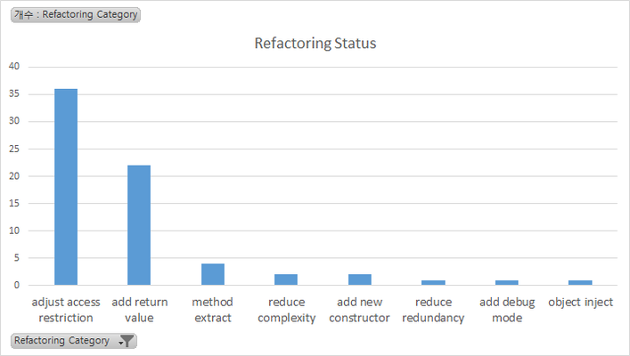
Appendix 1. Refactoring & Re-Work
Refactoring Status
Category | num | Graph
adjust access restriction | 36
add return value | 22
method extract | 4
reduce complexity | 2
add new constructor | 2
reduce redundancy | 1
add debug mode | 1
object inject | 1

Slide 17
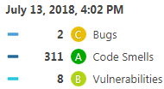
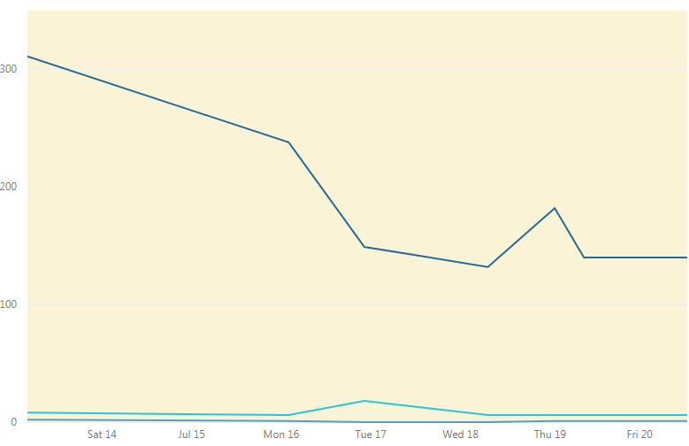
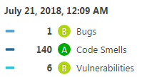
Appendix 2. Refactoring & Re-Work
SonarQube Trand

Slide 18
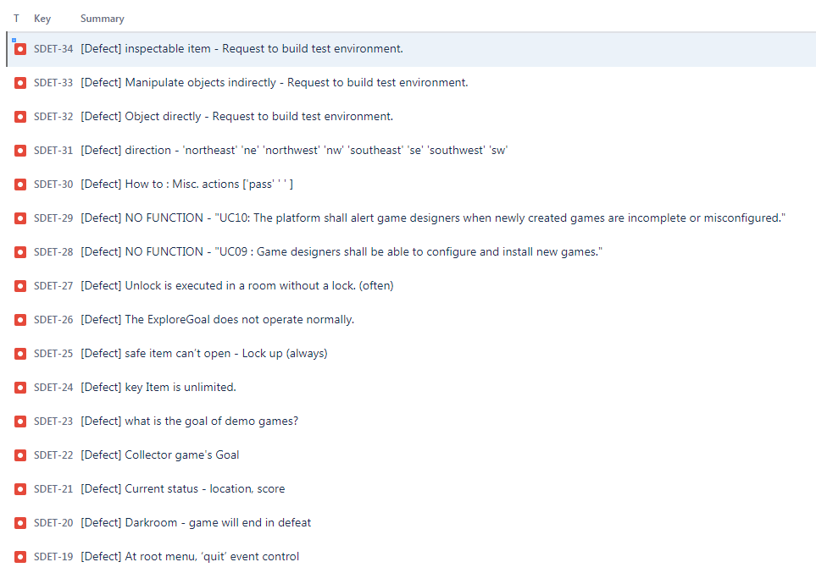
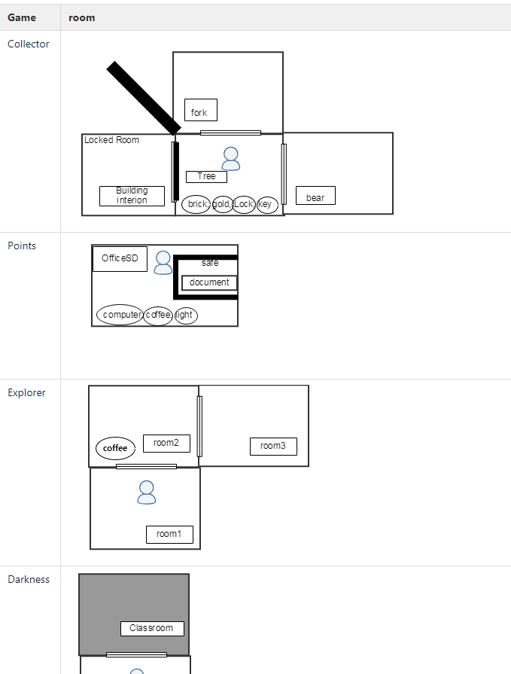
Appendix 3. Pre-Test outputs
Defect : 16
Game Map

Slide 19
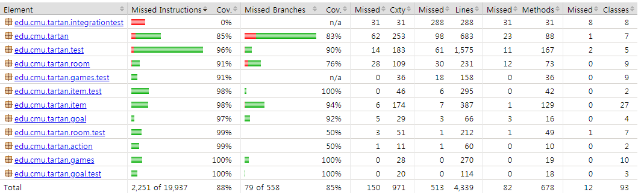
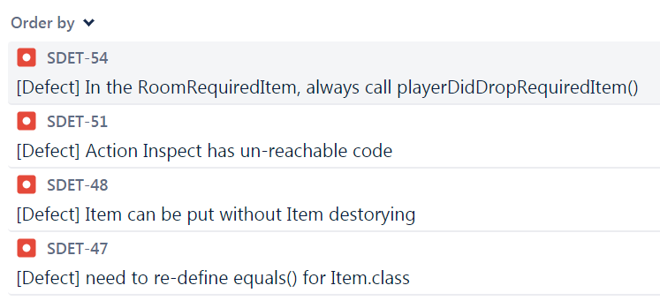
Appendix 4. Quality activity – Unit test
Coverage
Defect list
Notes:
예상 질문
유닛테스트 작성을 위해 디테일한 스펙을 정리 했는가?

Slide 20
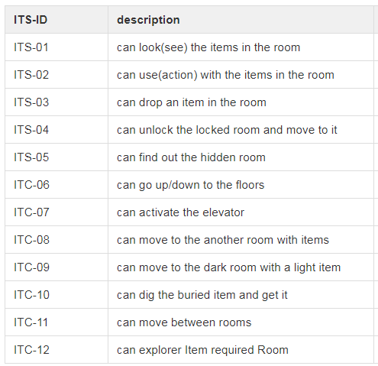
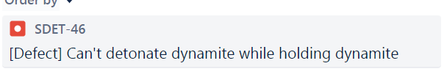
Appendix 5. Quality activity – Integration test
Test case
Defect list
Notes:
예상 질문

