Slide 1

Quality activity – Unit Test
Goal
Verify the operation for function
Satisfying code coverage
Completion Criteria
Unit Test – Pass rate : 100%
Statement Coverage : 90% / Branch coverage : 80%
Resource
Planned Effort(7/16 ~ 20) : 50h (2h * 5 days * all members)
Actual : 64h
Outputs (ref. appendix.4)
Number of Unit Test : 241
Coverage : tatement : 88%, branch : 85%
Defect List
Lessons Learned
To effectively write the Unit test, we need a detailed specification.
Less defect is found as it progresses to code coverage rather than verifying function operation
Notes:
Actual / estimated Effort : 64h/73h
Should simple code be included in the Unit test?
→ Our team's decision: don’t include

Slide 2

Quality activity – System test
Goals
Verify requirements from the user's perspective.
Especially, Use-Cases will be mainly validated.
Completion criteria
Test case pass rate : 100%
Resource
Planned Effort : 50 hours (5days / 5 hours per day / 2 members)
Actual Effort : 44.15h
Outputs
Test Cases : 492
Current Pass Rate : 94.7 %
Defect List
Lessons Learned
Ambiguous requirements and unexpected gaming behavior made code review hard.
Notes:
Scenario : 29, Action/Item : 434, Game Config. : 29
시나리오 : palyer와 designer의 시나리오 흐름도를 기반으로
시나리오의 시작에서 종료까지 path를 타도록 TC를 생성
Action/Item : 게임 진행시 필요한 세부 동작에 대한 test case. 모든 아이템(29개)의 action(14)을 실행하고, 추가로 item 없는 action에 대해서도 test하기 위한 tc 생성
Game Config. : designer의 시나리오과 관련 있음. 디자이너가 만든 게임의 valid 를 check 하는것에 대한 세부 TestCase를 분리한것.

Slide 3





Overall Course Lesson & Learned
I got the idea that quality activities could be
more enjoyable than development
- Sungho chin
I impressed about how Top level SW companies make
effort to ensure SW Quality. Applying valuable
techniques to my work is my homework. - Jonggoo Lee
I learned about various techniques and tools
It seems to be about to lead ‘well’ in collaboration.
- Sujung Lyu
It was nice to be able to study intensively.
I will try to apply various quality techniques
appropriately to actual projects. - Jinhyeok Yang
It was a good experience to work SDET during project.
I will try to apply what I learned in this course
to my work. - Hyoyeon Hwang

Slide 4
Q&A
Thank you for your attention!!

Slide 5
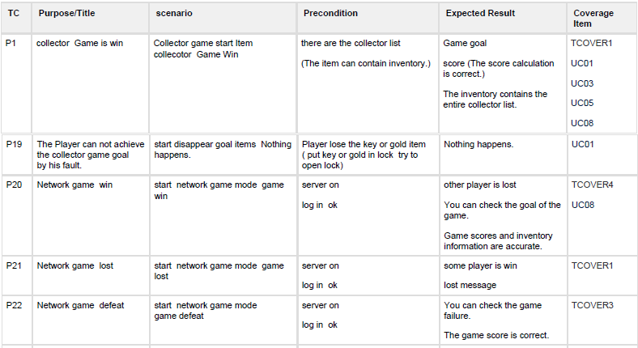
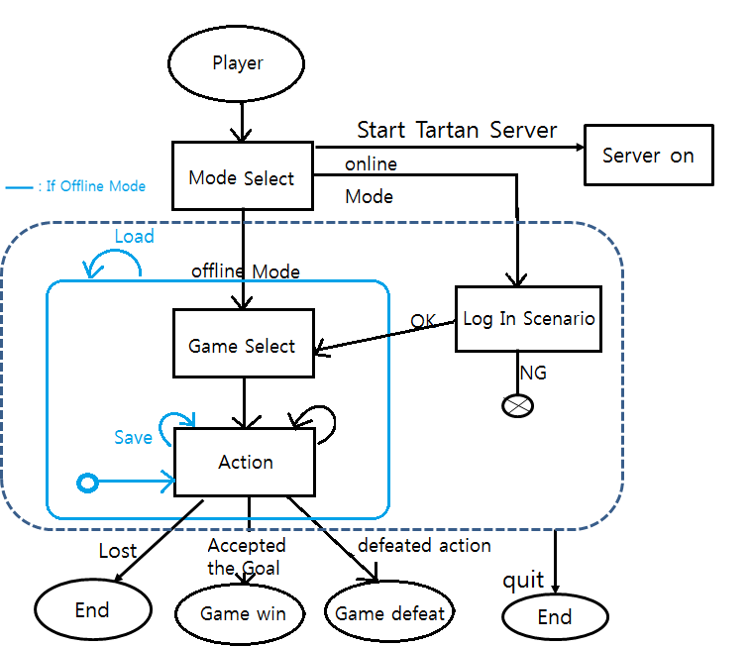
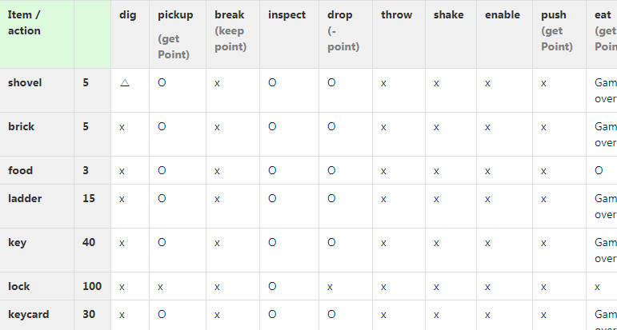
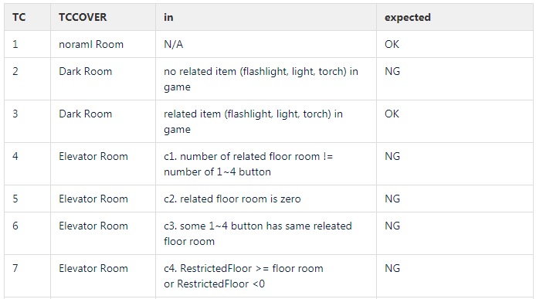
Appendix 7. Quality activity – System Test (1/3)
Scenario
Action & Item
Game Config.
Notes:
예상 질문

Slide 6
Appendix 7. Quality activity – System Test (2/3)
NG TC List
NG Defect
num | TC ID | Category | TestCase
1 | tc_breakpot | action-item | break pot
2 | tc_detonatedynamite | action-item | detonate dynamite
3 | tc_eatcoffee | action-item | eat coffee
4 | tc_eatfood | action-item | eat food
5 | tc_enter | action-item | enter
6 | tc_pass | action-item | pass
7 | tc_removedocumentinsafe | action-item | remove document in safe
8 | tc_removegoldinpot | action-item | remove gold in pot
9 | tc_cg3 | gameConfig - goal | Collect
10 | tc_cg5 | gameConfig - goal | explore
11 | tc_cg6 | gameConfig - goal | point
12 | tc_cr06 | gameConfig - room | Elevator Room : some 1~4 button has same releated floor room
13 | tc_cr11 | gameConfig - room | Excavatable Room : no shovel in game
14 | tc_cr12 | gameConfig - room | Lockable Room : No room related time (e.g key)
15 | tc_cr13 | gameConfig - room | Lockable Room : No lock in game
16 | tc_cr16 | gameConfig - room | Obscured Room : No (obscuring setted) itme in game
17 | tc_cr18 | gameConfig - room | Required Item Room: set room related item that is not holdable
18 | tc_cr21 | gameConfig - room | There is an unconnected room.
19 | tc_cr7 | gameConfig - room | Elevator Room: _elevatorInitialFloor>= floor room or _elevatorInitialFloor<0
20 | tc_p20 | Scenario - player | Network game → win
21 | tc_p22 | Scenario - player | Network game → defeat
22 | tc_p24 | Scenario - player | network game → log in NG
23 | tc_p25 | Scenario - player | offline mode → load game → game win
24 | tc_p4 | Scenario - player | Darkness Game is win
25 | tc_p5 | Scenario - player | Defeat the Darkness game
26 | tc_uc04 | UserCase | Players can query their current status (item inventory, location, score, etc.) at any time during a game.
Issue key | Summary | Priority
SDET-203 | [Defect] save/load : rooms visit information error. - at load time, current room is in room visited. | High
SDET-202 | [Defect] save/load : point cal error - elevator game 6point save -> continue game. 8 point -> load game score 14 | High
SDET-201 | [Defect] network game - "javax.crypto.IllegalBlockSizeException" error | Highest
SDET-199 | [Defect] network game - When do network games initialize? | High
SDET-197 | [Defect] network game : some one game lost -> gamer counter is not discount | Medium
SDET-194 | [Defect] requirement item room - There are no that item in the inventory. -> action error | High
SDET-193 | [Defect] game config. : There is an unconnected room. -> no error | Medium
SDET-192 | [Defect] game config. : requirement item room game -> there is not requireditem in game -> no error | Medium
SDET-191 | [Defect] [game config] excavatable room game have not shovel in game -> no error | Medium
SDET-190 | [Defect] game config. : look room game have not key, lock item in game - no error | Medium
SDET-189 | [Defect] game cofig : obscured room releated item is not in game -> no error | Medium
SDET-188 | [Defect] _elevatorRestrictedFloor 媛?諛?_elevatorInitialFloor 媛믪씠 ?ㅼ젣 痢?媛믨낵 ?ㅻ쫫 | Medium
SDET-187 | [Defect] [game config] elevator room -> no button item -> no error | Medium
SDET-186 | [Defect] collector game -> goal item is not in game -> no error | Medium
SDET-185 | [Defect] point game -> very large point over game all point -> no error | Medium
SDET-184 | [Defect] explore game -> goal room is not game -> no error | Medium
SDET-178 | [Defect] obscured room - obscuringItem : dynamite is not action | High
SDET-152 | [Defect] pass, "\ n" action in Additional action required item | Medium
SDET-151 | [Defect] [Discuss] 'status' action - room visited list : Indication of allowable duplication | Medium
SDET-122 | [Defect] installed item in safe -> remove action -> error status | High
SDET-121 | [Defect]'eat action' point action diffent | High
SDET-110 | [Defect] remove action error | High
SDET-108 | [Defect] break pot -> score error | High
SDET-100 | [Defect] Colletor Goal - status | Medium
SDET-90 | [Defect] Darkness Win/Defeat condition & Explore Goal | High
Notes:
예상 질문

Slide 7
Appendix 7. Quality activity – System Test (3/3)
Defect list : 66 (critical : 7 , major : 21, minor : 37)
Issue key | Summary | Priority
SDET-195 | [Defect] network game : safe item - error pin number -> game lock up | Highest
SDET-29 | [Defect] NO FUNCTION - "UC10: The platform shall alert game designers when newly created games are incomplete or misconfigured." | Highest
SDET-28 | [Defect] NO FUNCTION - "UC09 : Game designers shall be able to configure and install new games." | Highest
SDET-27 | [Defect] Unlock is executed in a room without a lock. (often) | Highest
SDET-26 | [Defect] The ExploreGoal does not operate normally. | Highest
SDET-25 | [Defect] safe item can?셳 open - Lock up (always) | Highest
SDET-200 | [defect] obscured game -> passage room in explored goal list is not game | Highest
SDET-203 | [Defect] save/load : rooms visit information error. - at load time, current room is in room visited. | High
SDET-202 | [Defect] save/load : point cal error - elevator game 6point save -> continue game. 8 point -> load game score 14 | High
SDET-199 | [Defect] network game - When do network games initialize? | High
SDET-194 | [Defect] requirement item room - There are no that item in the inventory. -> action error | High
SDET-182 | [Defect] log in - pw error -> unlimited retry | High
SDET-179 | [Defect] room releated - same direction multi room : no error | High
SDET-178 | [Defect] obscured room - obscuringItem : dynamite is not action | High
SDET-176 | [Defect] requireditem room - not to set the required item | High
SDET-161 | [Defect] collect game load -> play -> error about goal | High
SDET-142 | [Defect] Explorer game -> quit -> explored information is error (ofthen) | High
SDET-122 | [Defect] installed item in safe -> remove action -> error status | High
SDET-121 | [Defect]'eat action' point action diffent | High
SDET-112 | [Defect] Dig action error -> get duplicate items | High
SDET-111 | [Defect] Dig action - Error from the second action | High
SDET-110 | [Defect] remove action error | High
SDET-108 | [Defect] break pot -> score error | High
SDET-90 | [Defect] Darkness Win/Defeat condition & Explore Goal | High
SDET-87 | [Defect] need to add GameConfiguration : RoomExcavatable.java | High
SDET-53 | [Defect] need to change RoomExcavatable.java (dig items are not added in Room item) | High
SDET-52 | [Defect] need to change game.java if use item description | High
SDET-22 | [Defect] Collector game's Goal | High
Notes:
예상 질문

