Slide 1
Internship Learning
August 2nd, 2023
Tony Yim

Slide 2
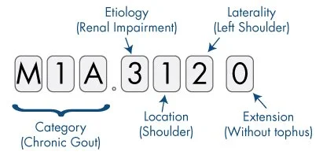
Unlocking the Potential of Healthcare Informatics through Disease Code Mapping
An example of ICD-10-CM (diagnosis code)
Bridging the Gap Between Disease Names and Standardized Codes
Tony Yim
Data Science Intern, MCP_Accelerate
Summer 2023
Image copyright Shutterstock / ver0nicka
©2020 Mayo Foundation for Medical Education and Research | slide-2

Slide 3

About Me
Data Science Intern in MCP Accelerate
Education:
University of Texas at Dallas
M.S. Business Analytics (Data Science Track) ‘23 Aug.
B.S. Finance ‘21
Related Projects:
Distributed Data Processing Project with Hadoop:
Topic: Effects of Weather on Flight Delays
Utilized Hadoop, HDFS, Spark, and Python to process data and conduct queries, identifying the key factors influencing flight delays.
Programming Projects:
Topic: Prediction of Housing Prices
Conducted data cleaning and performed exploratory data analysis on housing sales data using Python visualization techniques.
Technical Skill Experience:
Programming: Python, R, SQL, Pyspark
Software: Apache Hive, Tableau, Jupyter Notebook, MySQL, MongoDB

Slide 4
Problem Statement
Objective: Create comprehensive mapping system; streamline process of identifying accurate and standardized codes
Expected result:
An algorithm that can be deployed in MCP data to extract/find patients with any diagnosis code
Start-up companies lack corresponding codes for disease names, hindering the construction of comprehensive patient cohorts
Efficient mapping technique is needed to identify the appropriate codes

Slide 5
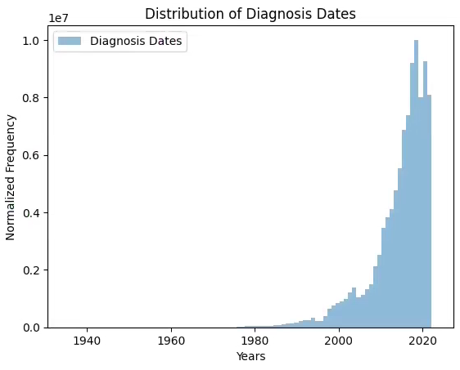
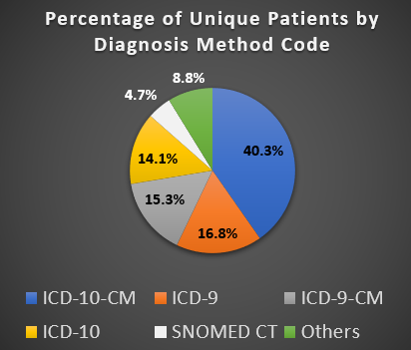
MCP Patient Data Analysis: Overview
2.3 million unique patients
Data spans approximately 87 years (1935 to 2023)

Slide 6
OMOP (Observational Medical Outcomes Partnership)
Standardized framework for conducting research
Standard analytical methods, tools, OMOP CDM, and Standardized Vocabularies.
OHDSI (Observational Health Data Sciences and Informatics)
Mapping UMLS CUI into the OHDSI Voc.*
Approach:
Identify matching vocabularies on both sides
Obtain CUI (UMLS) via OHDSI and reverse
* Challenge: OHDSI concept_code can overlap
How does OHDSI/OMOP create value?
OMOP CDM transforms data into a standardized format
Common Data Model (CDM)
Eliminates requirement for data extraction and enables standardized analytics

Slide 7
Overview of Reference Table
ICD-10 & ICD-10-CM to CUI
Source: ICD-10 from CMS.gov; ICD-10-CM from AHRQ
Original number: 72,836 ICD-10 codes & 74,549 ICD-10-CM codes
ICD-9 & ICD-9-CM to CUI
Source: ICD-9 & ICD-9-CM from CMS.gov
Original number: 13,521 ICD-9 codes & 14,567 ICD-9-CM codes
11,046 ICD-9 codes mapped to CUI (2475 unmapped; 18.3% unmapped)
13,171 ICD-9-CM codes mapped to CUI (1396 unmapped; 9.58% unmapped)
71,537 ICD-10 codes mapped to CUI (1299 unmapped; 1.78% unmapped)
73,610 ICD-10-CM codes mapped to CUI (939 unmapped 1.26% unmapped)
SNOMED CT
Source: UMLS
Original number: 508,540 SNOMED CT concepts
325,816 SNOMED CT concepts mapped to CUI (182,724 unmapped; 35.9% unmapped)

Slide 8
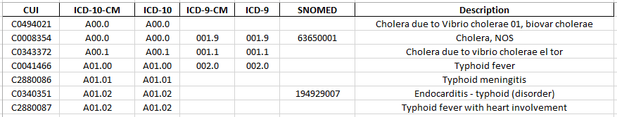
Overview of Conversion Process
ICD-10-CM
CUI
Reference table
ICD-10
ICD-9-CM
ICD-9
Utilize queries for data retrieval
SNOMED CT

Slide 9

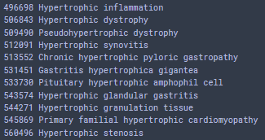
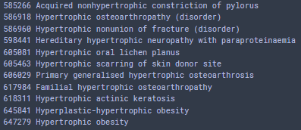
Example: Querying the Reference Table
Search based on the Description column:
Identify a keyword, e.g., ‘Hypertrophic’

Slide 10

Future Steps
Clinical Validation
Transfer to Discover
Mapping to OMOP Data Model
1
2
3
Double-check reference table with clinical expert
Further investigation of unmapped codes
For users to increase efficiency
Valuable and important step for MCP

