Slide 1


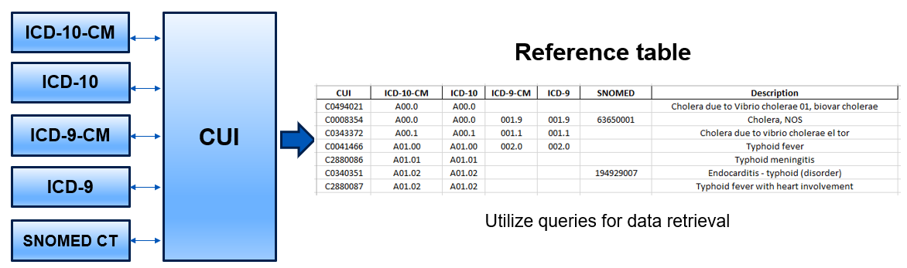
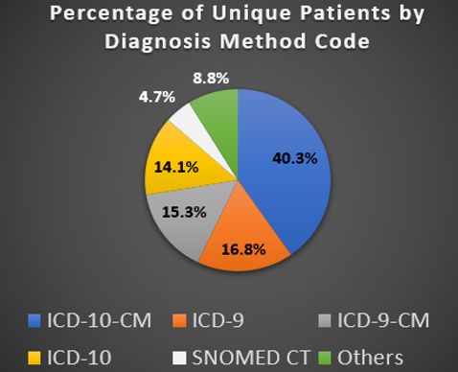

Data Science Internship
Mayo Clinic
Introduction
Mayo Clinic, the largest integrated, not-for-profit medical group, transforms healthcare with accessible, innovative, and compassionate care. They pioneer research for early diagnoses and cures, inspiring hope worldwide. Mayo Clinic Platform drives technology advancements. U.S. News & World Report ranks them No. 1 overall and in 14 specialties. They address health disparities, promote diversity, and ensure equitable access to care. Mayo Clinic's commitment to excellence and patient-centeredness shapes a healthier world.
Objectives
Develop a data mapping solution
Effective communication and teamwork
Enhance cohort creation for startup companies
Develop an algorithm using Python and SQL to enhance healthcare data platforms
Responsibility
As a Data Science intern, I was responsible for creating a comprehensive table mapping disease codes to bridge the gap between disease names and standardized codes
Create comprehensive mapping system; streamline the process of identifying accurate and standardized codes
Preparation of bi-weekly presentations to Mayo Clinic’s leadership
End-of-internship presentation to Mayo Clinic’s leadership
My Role
Learning
Acquired technical skills in data science tools like Python and gained proficiency in data visualization and analysis.
Developed a strong understanding of healthcare and medical data, including diagnosis codes and the mapping process between ICD codes and SNOMED CT concepts.
Conclusion
Working at Mayo Clinic was a fantastic opportunity. The summer internship provided me with invaluable experience, allowing me to acquire practical data science skills, including:
Python querying
Data analysis
Research on project
Creating reports and presentations
Working with large datasets
Excel based reporting
Working with mentor
Thanks to this experience, I am now equipped with a wealth of new skills and valuable insights that will undoubtedly shape my career path.
Contact
Name: Sungho Yim
Major: MS Business Analytics
Email: sunghoyim99@gmail.com
Cell No.: 480-369-5787
Conducted research on diagnosis codes and mapping processes to enhance data analysis
Utilized Python to perform mapping tasks, improving data integration and understanding
Presented research findings to Mayo Clinic's leadership, effectively communicating complex information.
Created a comprehensive reference table to streamline the relationship between different medical codes and concepts.
Collaborated closely with a mentor, gaining valuable guidance and insights during the internship.
Developed and delivered presentations on my work, contributing to knowledge sharing within the organization.
Overview of Diagnosis Code Conversion Process
From this reference table, search by description to obtain a list of all related diagnosis codes
The Mapping Process + Mayo Clinic Platform’s Patient Data Analysis
Overview of the Mapping Process
Obtain the disease codes (ICD-10-CM, ICD-10, ICD-9, ICD-9-CM, SNOMED) from various healthcare data sources.
These codes will serve as the basis for the subsequent mapping process.
Leverage the Unified Medical Language System (UMLS) to obtain Concept Unique Identifiers (CUIs) for the disease codes acquired in the data preparation step.
Analysis of Mayo Clinic Platform’s patient data

