Slide 1
Melbourne Housing Prices
Group 1: SAAB
Amrutha Bhat Benjamin Gartmann
Alex Sharifian
Sungho Yim

Slide 2
Purpose
Situation: increasing unaffordability of housing:
Significant challenge for many cities in the world.
Greater understanding of current housing market.
Examine top influential factors of housing prices.
Provide models for more accurate estimations.

Slide 3
Description of Data
# of variables: 21
# of observations: 13,580
Missing data: 4.64%
Categorical variables: CouncilArea, Regionname, YearBuilt

Slide 4


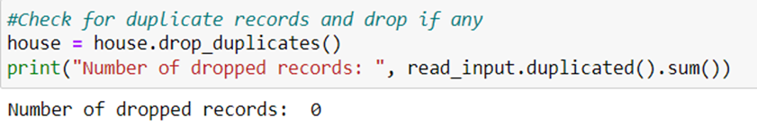
Data Cleansing
Missing values:
Duplicate records:

Slide 5
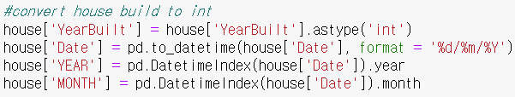
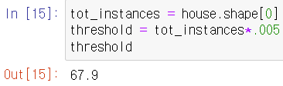
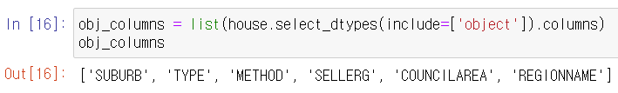
Data Preparation

Slide 6
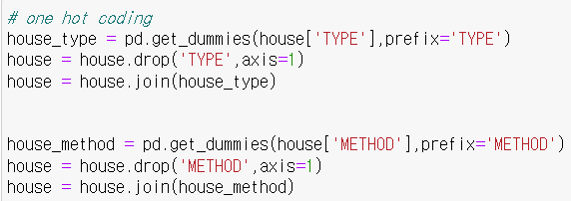
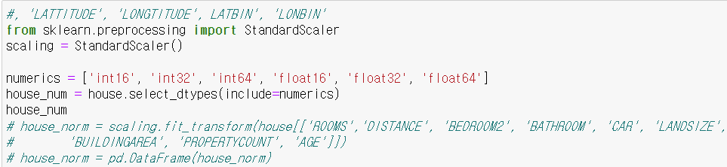
Data Preparation (continued)

Slide 7
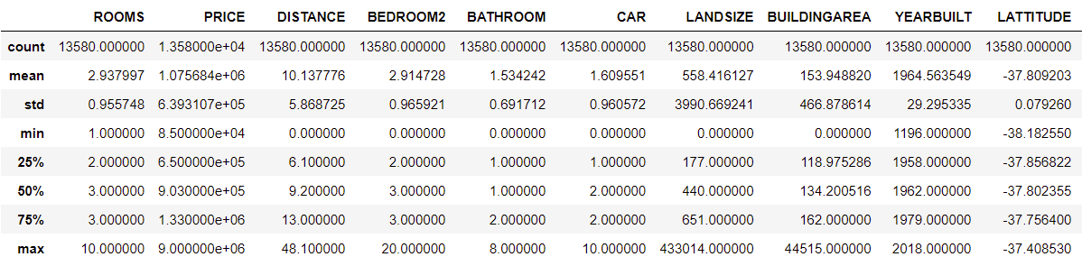
Visualization
Descriptive Summary Statistics for Numerical Variables:

Slide 8
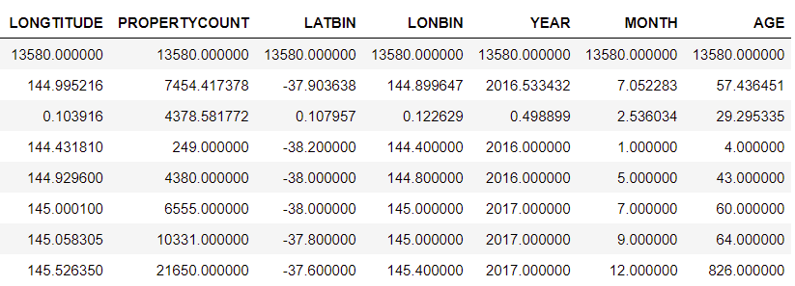

Visualization
Descriptive Summary Statistics for Numerical Variables:

Slide 9
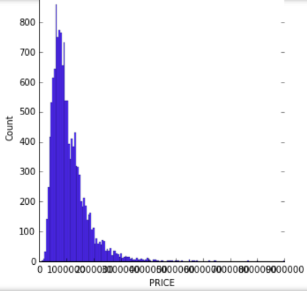
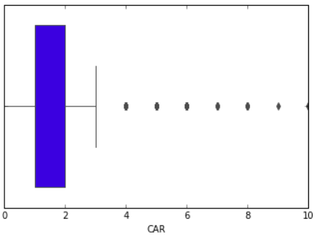
Visualization
Price: Car:

Slide 10
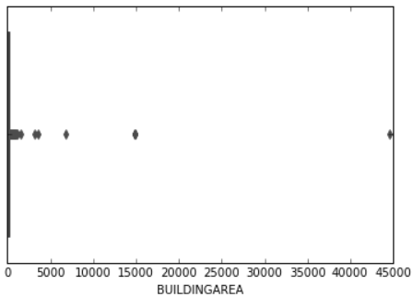
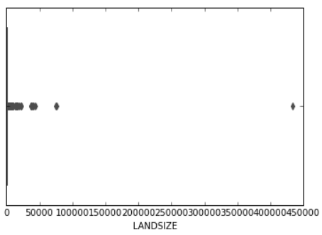
Visualization (continued)
Building Area: Land Size:

Slide 11
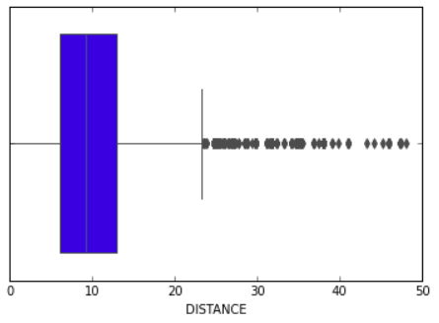
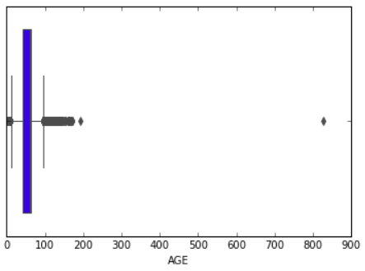
Visualization (continued)
Distance: Age:

Slide 12
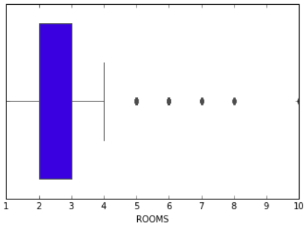
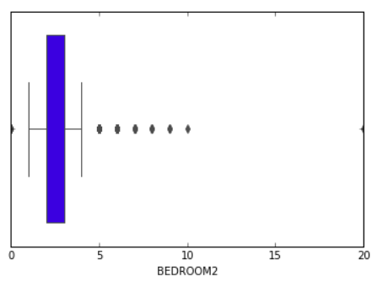
Visualization (continued)
Rooms: Age:

Slide 13

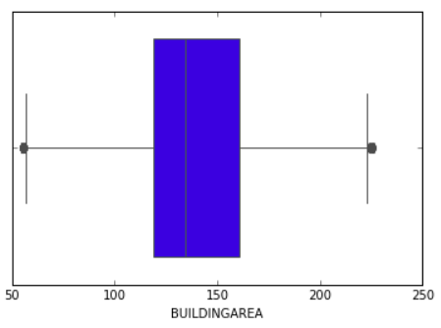
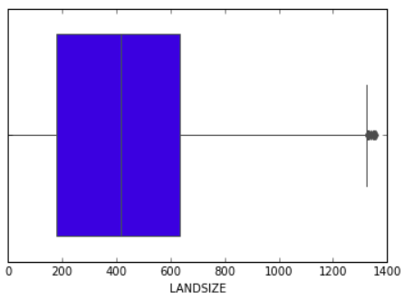
Visualization (continued)
Building Area: Land Size:

Slide 14
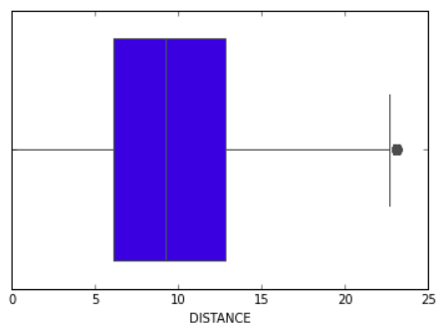
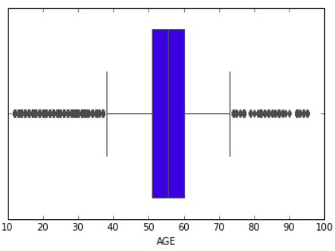
Visualization (continued)
Distance: Age:

Slide 15
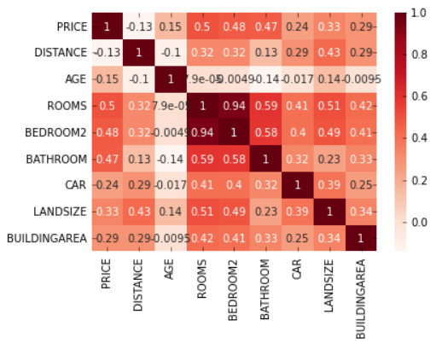
Visualization (continued)
Correlation matrix of ROOMS, BEDROOM2, BATHROOM, CAR, LANDSIZE and BUILDINGAREA:

Slide 16
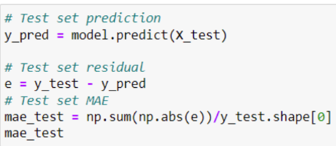
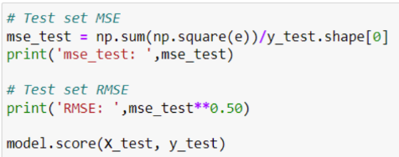
Regression Analysis: Linear Regression
Mean Average Error (MAE) of Test Set: 0.364
Mean Squared Error (MSE) of Test Set: 0.317
Root-Mean-Square Error (RMSE): 0.563
Model Score: 0.691

Slide 17
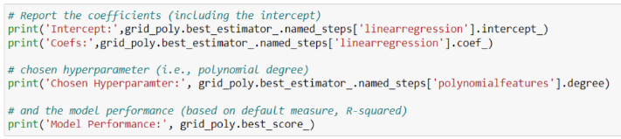

Regression Analysis: Polynomial Regression
Model Performance: 0.688
Chosen Hyperparameter: 1

Slide 18
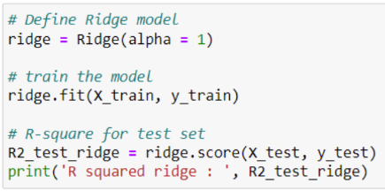
Regression Analysis: Ridge Regression
R squared: 0.691

Slide 19

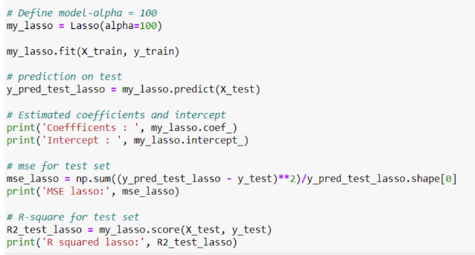
Regression Analysis: Lasso Regression
Intercept: [0.0285]
MSE lasso: 4190.12
R squared: 0.000763

Slide 20
Regression Analysis
The best model to choose for predictions is: Linear Regression
Because the model score for the linear regression model is higher than the other regression models.

Slide 21


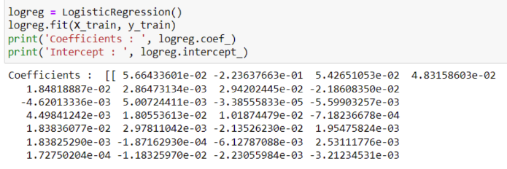

Classification Techniques: Logistic Regression Model
Intercept : [9.511 e-06]
0.768
0.744
0.641

Slide 22
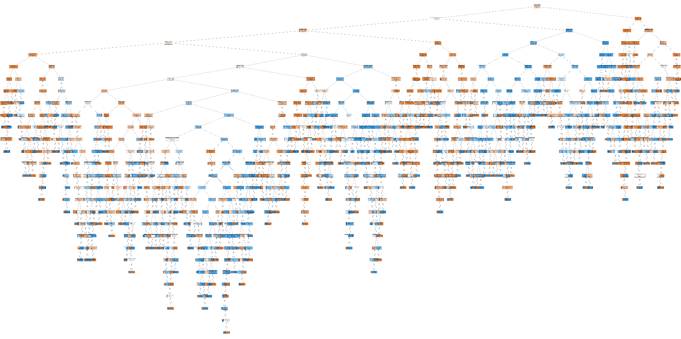
Classification Techniques: Decision Tree Model

Slide 23
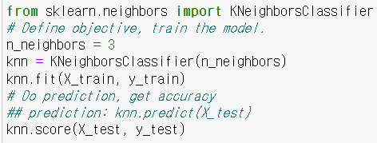
Classification Techniques: k-NN Model
Accuracy: 0.812
Final Model Performance: 0.81

Slide 24
Classification Techniques
The best model to choose for predictions is: Decision Tree
Because we have a balanced data set and decision tree has the highest accuracy score.

Slide 25
Conclusion
Takeaway: As our main motivation of inspecting the data set was to assign values to the differences between each house listing and the price for the listing,
(size, location, neighborhood, number of rooms/bathrooms)
We concluded that the Linear Regression was our most accurate model.
Suggestion to increase prediction accuracy: Collection of more data

