Slide 1
CARBON PASSPORT
A Simple Approach to Farm Emission Estimation
Theme: Rural Development & Agriculture
Presented by: Thoudam Maximus B.Sc.Computer Science

Slide 2
The Problem
Agriculture activities produce greenhouse-gas emissions,including methane and nitrous oxide.
Farmers need accessible ways to understand the emissions associated with their farming practices.
Emission calculations can be difficult to understand without a simple interface.
There is a need for tools to present estimated emissions in a clear and understandable format.

Slide 3
Proposed Solution
Carbon Passport is a web based estimation tool that:
Collects farm details and farming practices.
Estimates emissions from selected agricultural activities.
Converts emissions into tonnes of CO2 equivalent.
Displays the results in a simple Carbon Passport-style interface.
Provides a foundation for future farming-practice comparisons.

Slide 4
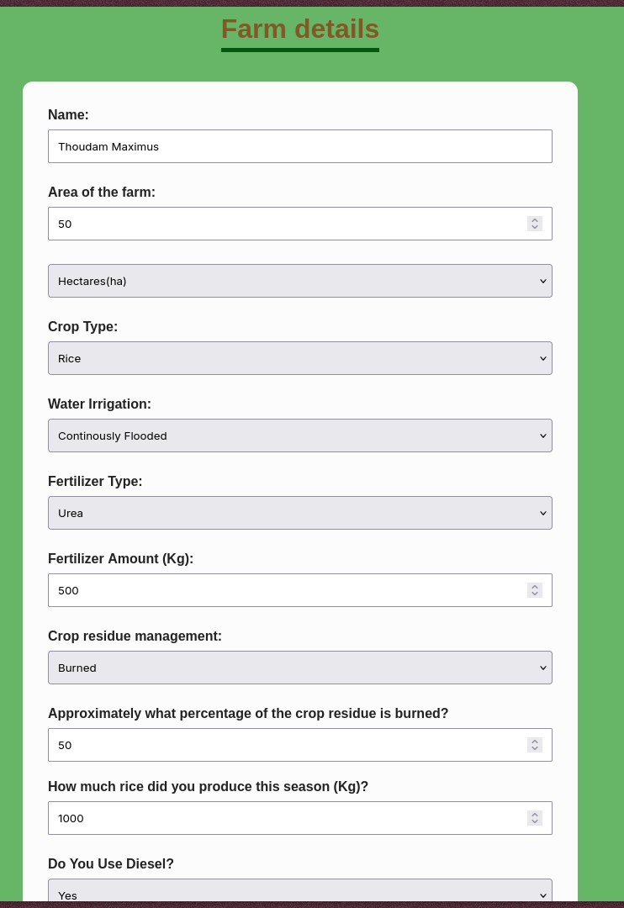
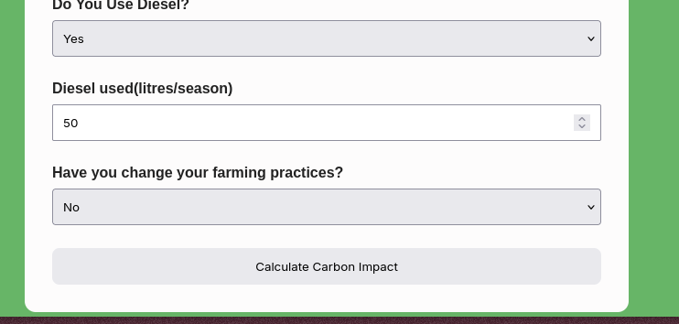

Slide 5
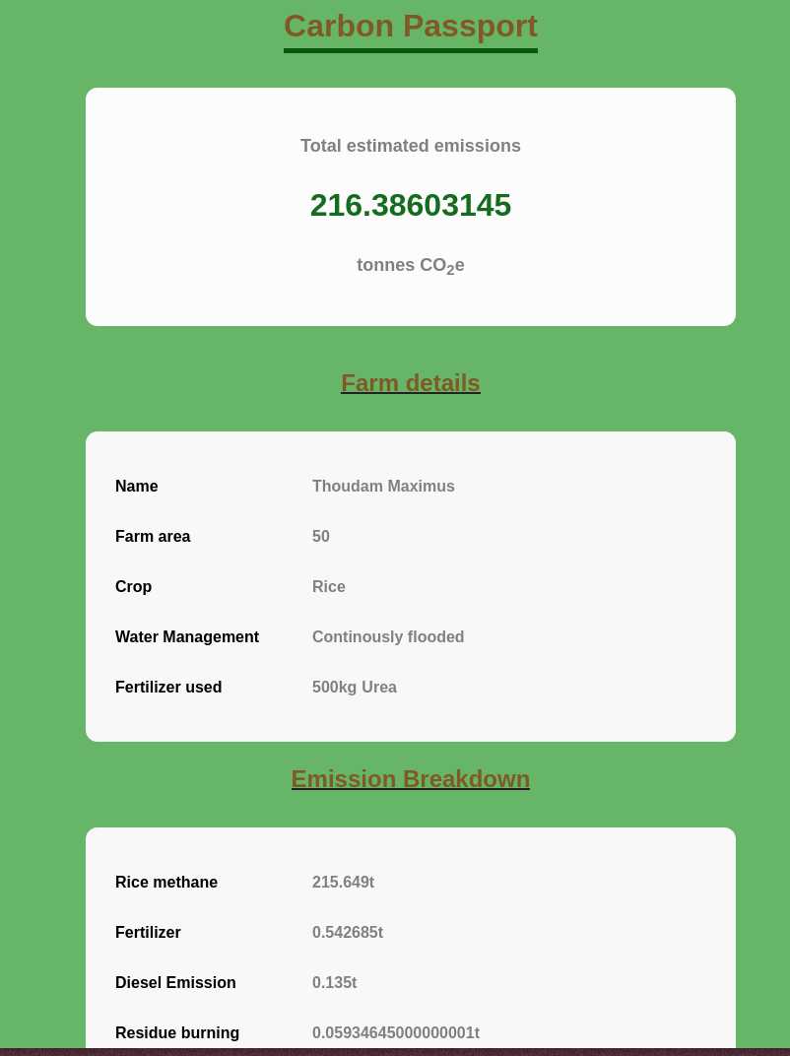
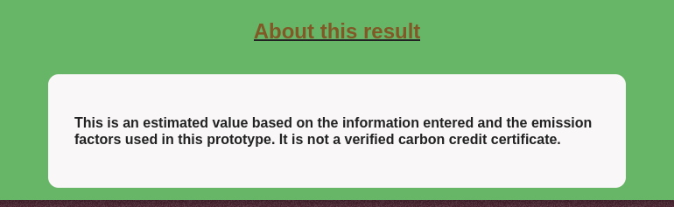

Slide 6
Methology & Calculation
              Methodology
  Farm Inputs → Emission Factors → CO₂e Estimation
1. Rice Methane (CH₄)
Rice methane emissions are estimated using water-management-specific emission factors.
2. Fertilizer Emissions (N₂O)
Nitrogen fertilizer inputs are used to estimate nitrous oxide emissions.
3. Diesel Emissions (CO₂)
Diesel consumption is multiplied by a simplified emission factor.
4. Crop-Residue Burning
Rice residue and burned percentage are used to estimate CH₄ and N₂O emissions.
5. CO₂ Equivalent
Different greenhouse gases are converted into a common unit using GWP100.

Slide 7
Rice Methane Emissions
Emission factors used in this prototype
Water management Factor
Continously flood 159.74 kg CH₄/ha
Intermittently flooded 66.20 kg CH₄/ha
Rain-fed 68.84 kg CH₄/ha
Formula
      CH₄ (kg)=Farm Area (ha)×Emission Factor
      Rice CO₂e (tonnes)=CH₄ (kg)×27​
                1000

Slide 8
Fertilizer Emission Calculation
Urea calculation:
Urea nitrogen content: 46%
Prototype N₂O-N emission factor: 0.58% (0.0058)
N₂O molecular conversion: 44/28
N₂O GWP100: 273
Formula
        1)N=Urea amount x 0.46 4)Fertilizer CO₂e=N2​O×273​
                1000
        2)N2​O-N=N×0.0058
        3)N2​O=N2​O-N×44
              28

Slide 9
Diesel & Crop-Residue Emissions
Diesel Emissions
Prototype emission factor: 2.7 kg CO₂/L
    Diesel CO₂e (tonnes)=Diesel Litres×2.7
            1000

Slide 10
Crop Residue Burning
Prototype constants
Parameter
Residue to rice ratio
Dry matter fraction
CH₄ emission factor
N₂O emission factor
CH₄ GWP100
N₂O GWP100
Gram-to-tonne conversion
Value
1.5
0.86
2.7 g/kg dry matter
0.07 g/kg dry matter
27
273
1,000,000

Slide 11
Calculation Concept (crop-residue burning)
Residue = RiceProduction x 1.5
Dry Matter = Residue x 0.86
Burned Matter = Dry Matter x Burned %
                100
CH₄ (g)=Burned Matter×2.7
N₂O (g)=Burned Matter×0.07

Slide 12
Global Warming Potential (GWP100)
Global Warming Potential (GWP100) compares the warming effect of greenhouse gases over a 100-year period relative to CO₂.
Gas GWP100
CO₂ 1
CH₄ (non-fossil) 27
N₂O 273
Conversion : CO₂e=Emissions×GWP100
Converting greenhouse gasses into CO₂ equivalent allows different gasses to be expressed in a common unit.

Slide 13
Application Workflow
Input Collection
The user enters farm details and farming practices.
Data Processing
JavaScript processes the submitted information.
Emission Estimation
Emission factors are applied to the relevant inputs.
CO₂e Conversion
Emissions from different gases are converted into CO₂ equivalent.
Result Display
The calculated values are displayed on the Carbon Passport results page.

Slide 14
Technology Stack
Technology Purpose
HTML5 Webpage structue and form
CSS3 Styling and layout
JavaScript Calculations and Interactivity
Sessionstorage Transfer of data between pages
VS Code Development environment
Live server Local testing and preview

Slide 15
Working MVP Demonstration
Demonstration Steps
1. Enter sample farm information.
2. Select farming practices.
3. Submit the form.
4. Calculate estimated emissions.
5. Display the Carbon Passport results.
6. View the emission breakdown.
MVP Outcome : A functional web-based prototype that estimates agricultural greenhouse-gas emissions using user-provided farm information.

Slide 16
Impact & Future Scope
Potential Impact
Make farm emission estimation more accessible.
Improve understanding of agricultural greenhouse-gas emissions.
Present technical information in a simple format.
Future Scope
Add Hindi and regional language support.
Improve region-specific emission factors.
Add documented baseline comparisons.
Estimate potential emission reductions from improved farming practices.
Explore carbon-credit methodologies and verification requirements

Slide 17
Limitation & Disclaimer
Limitations
The application provides preliminary emission estimates.
Some emission factors are simplified assumptions.
Results depend on the accuracy of user-provided data.
The application does not verify farm information.
The application does not issue certified carbon credits.
Further validation and research are required for real-world deployment.
Disclaimer
Carbon Passport is an estimation prototype. Its results should not be treated as verified carbon credits or guaranteed emission reductions.

Slide 18
References
1. India Second Biennial Update Report (BUR2)
Ministry of Environment, Forest and Climate Change, Government of India.
Used as the basis for rice methane emission factors.
2. IPCC Sixth Assessment Report (AR6)
Working Group I / Working Group III.
Used for GWP100 values.
3. India Agricultural Emission Methodology
Relevant national and international methodology sources for fertilizer and crop-residue emissions.
4. Prototype Assumptions
Simplified factors used for diesel and other calculation components are identified as assumptions where applicable.

Slide 19
THANK YOU
Carbon Passport
A Simple Approach to Farm Emission Estimation
Questions?
Presented by Thoudam Maximus

