Slide 1
RSAwithSHA256 Signing & Verifying
‘21-1 semester “Internet Security” Homework2
Sungmin Lee
Network Convergence and Security Laboratory
Sungmin@snu.ac.kr

Slide 2
Contents
Acronym & Terminology
HW Goals
HW Scenario
OpenSSL
Precondition
Demonstration
HW Notice & Guide
Q&A

Slide 3
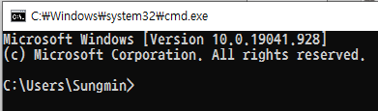
Acronym & Terminology
Keypair : a pair of public key and private key in asymmetry cryptography
CA : Certificate Authority
CSR : Certificate Signing Request
PKI : Public Key Infrastructure
CMD : Windows OS basic console program(Win + R, type ‘cmd’)
PKCS: Public-Key Cryptography Standard
SHA256 : cryptographic hash function in SHA-2 (Secure Hash Algorithm 2) family. 256 means output bit size (32 bytes)

Slide 4
HW Goals
Generate RSA Keypair, CSR and X.509 certificate
Handle CSR to make PKI chain of X.509 certificate
Implement RSAwithSHA256 signing & verifying signature APIs
Verify X.509 certificate chain

Slide 5
HW scenario (1/5)
1. Generates RSA keypair and self-signed X.509 cert
2. Distributes her X.509 cert to everyone
Carol
Bob
Trust
(a kind of CA)
Trust
Suspect
Alice
Bob
Bob
(Signer)
(Verifier)

Slide 6
HW scenario (2/5)
3. Generates RSA keypair and CSR 4. Requests Carol to make X.509 cert signed
Carol
Bob
Trust
(a kind of CA)
Trust
Suspect
Alice
Bob
Bob
(Signer)
(Verifier)

Slide 7
HW scenario (3/5)
5. Handles Alice’s signing request 6. Gives signed X.509 cert to Alice
Carol
Bob
Trust
(a kind of CA)
Trust
Suspect
Alice
Bob
Bob
(Signer)
(Verifier)

Slide 8
HW scenario (4/5)
7. Gives a message with its signature, her cert, to Bob
Carol
Bob
Trust
(a kind of CA)
Trust
Suspect
Alice
Bob
Bob
(Signer)
(Verifier)

Slide 9
HW scenario (5/5)
8. Reads the message 9. Verifies the message with its signature using Alice’s public key in her cert 10. Verifies Alice’s cert with Carol’s cert
Carol
Bob
Trust
(a kind of CA)
Trust
11. Trust by Carol
(If a trust anchor from Alice reaches to Carol)
Alice
Bob
Bob
(Signer)
(Verifier)

Slide 10
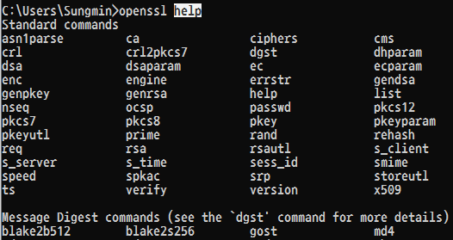
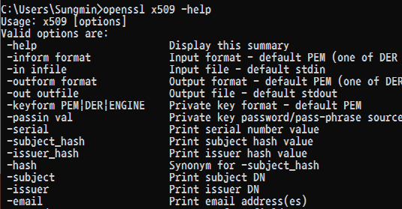
OpenSSL
Software library for cryptography and secure communication
Similar with Keytool in JDK which we used in HW1
Supports console commands
Useful commands : ‘help’ and ‘-help’

Slide 11
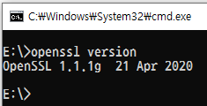
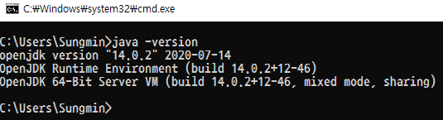
Preconditions
Install OpenSSL
Type ‘openssl version’ in CMD.
If version is not printed,
Visit https://slproweb.com/products/Win32OpenSSL.html to download and install (Light version is enough)
Add openssl install path to PATH environment variable
Close and open CMD again. Then type ‘openssl version’ again
Install OpenJDK (If you want to implement HW with Java language)
Type ‘java –version’ in CMD.
If version is not printed, Install OpenJDK and setup PATH environment
OpenJDK download & install guide https://openjdk.java.net/install/index.html
Close and open CMD again
Type ‘java -version’ again

Slide 12


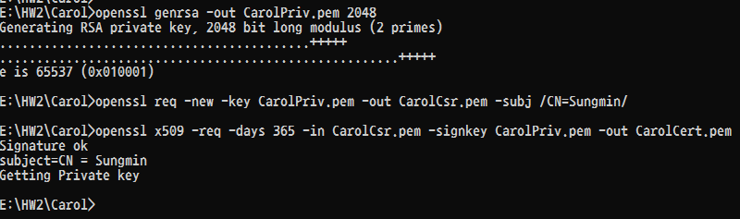

Demonstration (1/4)
0. Build codes (You can skip this if unnecessary. E.g., Python)
..\Alice> javac YOUR_CODE
..\Bob> javac YOUR_CODE
1. Carol generates RSA keypair and self-signed X.509 cert
..\Carol> openssl genrsa -out CarolPriv.pem 2048
..\Carol> openssl req -new -key CarolPriv.pem -out CarolCsr.pem -subj /CN=YOUR_NAME/
..\Carol> openssl x509 -req -days 365 -in CarolCsr.pem -signkey CarolPriv.pem -out CarolCert.pem
2. Carol distributes her X.509
..\Carol> copy CarolCert.pem ..\Bob\

Slide 13



Demonstration (2/4)
3. Alice generates RSA keypair and CSR
..\Alice> openssl genrsa -out AlicePriv.pem 2048
..\Alice> openssl req -new -key AlicePriv.pem -out AliceCsr.pem -subj /CN=Alice/
4. Alice requests Carol to make signed X.509
..\Alice> copy AliceCsr.pem ..\Carol\
5. Carol handles Alice’s signing request
..\Carol> openssl x509 -req -days 365 -CA CarolCert.pem -CAkey CarolPriv.pem -in AliceCsr.pem -out AliceCert.pem –CAcreateserial
6. Carol gives Carol signed X.509 to Alice
..Carol> copy AliceCert.pem ..\Alice\

Slide 14
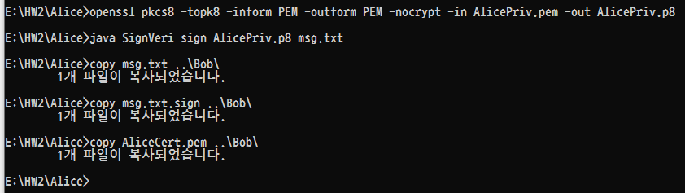
Demonstration (3/4)
7. Alice Gives a message with its signature and signed X.509 to Bob
..\Alice> openssl pkcs8 -topk8 -inform PEM -outform PEM -nocrypt -in AlicePriv.pem -out AlicePriv.p8
- The above can be skipped if PKCS8 is unnecessary
..\Alice> java SignVeri sign AlicePriv.p8 msg.txt
..\Alice> copy msg.txt ..\Bob\
..\Alice> copy msg.txt.sign ..\Bob\
..\Alice> copy AliceCert.pem ..\Bob\

Slide 15



Demonstration (4/4)
8. Bob reads the message
..\Bob> type msg.txt
9. Bob verifies the message with its signature
..\Bob> java SignVeri verify AliceCert.pem msg.txt msg.txt.sign
10. Bob verifies the Alice X.509 with Carol’s
..\Bob> openssl verify -CAfile CarolCert.pem AliceCert.pem

Slide 16
HW Notice & Guide (1/3)
Implement TODOs in the submission template if you prefer Java
If not, you can use ANY language you prefer to implement HW2 scenario
C, C++, Python, ...
You can use any library including 3rd party’s (e.g., BouncyCastle, PyOpenssl, ...)
If it is needed to build, your submission must include the library you used
Write README.txt for TA to test and score your submission
README must guide how to build and run your code as much detail as possible
If your submission requires specific version compiler(or interpreter) it must be mentioned
Scoring environment is Windows CMD only
Not on any other OS(e.g., Linux) and any IDE(e.g., Visual studio, Eclipse, PyCharm, ... )
Test yours in CMD before submission

Slide 17
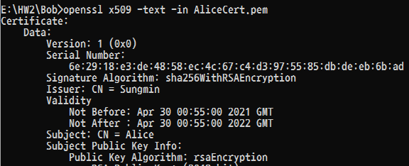
HW Notice & Guide (2/3)
Scores
Generating signed X.509 certificate: 10%
- Issuer CN should be YOUR_NAME in AliceCert.pem
- ..\Bob> openssl x509 -text -in AliceCert.pem
Signing Implementation: 30%
Signature verifying implementation: 30%
README.txt : 30%
Penalty
Any cheating and duplication → zero point
Hard coding(source code includes any key as it is) → zero point for the implementation

Slide 18
HW Notice & Guide (3/3)
Submission should be a single StudentNumber_Name.zip file
E.g., 2021-21212_Alice.zip
The .zip file should include the followings at least
Alice directory: source code, Alice private key, and Carol signed Alice’s X.509 certificate
Bob directory: source code, Carol’s X.509 certificate, any Alice file for Bob and its signature file
Carol directory: Self-signed Carol’s X.509, CSR from Alice, and Carol private key
Root: README.txt

Slide 19
Q&A
/ 19

