Slide 1

AI & AIX for Energy, Environment, and agriculture
1주차 2차시
Young-Min Yang

Slide 2

2027학년도 글로컬 교과 콘텐츠 개발 사업
1. 기본정보
과목명 | 미래기후변화대응 통합전력시스템 설계및 실습 | 교수명 | 양영민
주차명 | 1주차 | 차시명 | 1차시
2. 버전정보
Ver | 내용 | 작성자
1.0 | 초안 작성 | 교수명

Slide 3
오늘의 학습내용
1 | 강의 소개
2 | 기후변화와 전력시스템
3
오늘의 학습목표
1 | 이번학기에 배울 내용을 숙지한다
2 | 이번학기의 수업범위를 이해한다
3

Slide 4
01
머신러닝소개

Slide 5
Lecture Outline
What is Machine Learning? Types of Machine Learning
Data Q&A

Slide 6
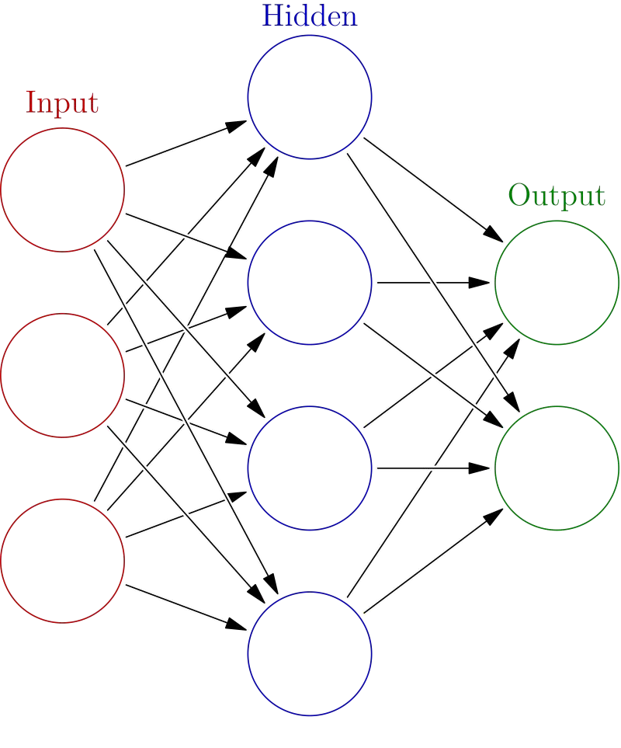
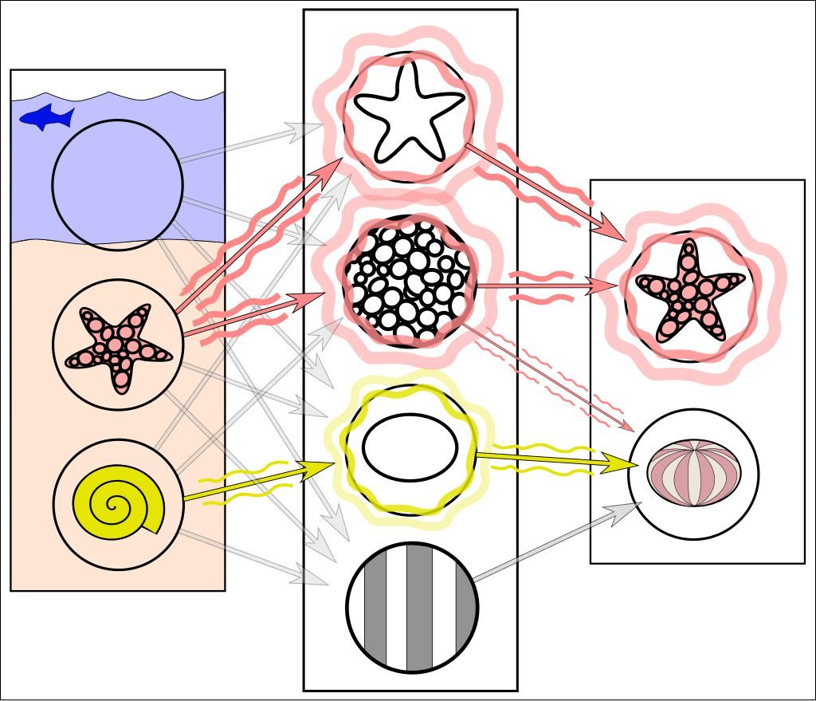
What is an ML Model?
The model consists of parameters and a structure that together transform inputs into outputs
The “learning” part means these parameters get adjusted through training to produce a “learned model” that can achieve a task

Slide 7
“Large” vs. “Small” Models
from sklearn.datasets import load_iris
from sklearn.ensemble import RandomForestClassifier
# Load data
X, y = load_iris(return_X_y=True)
# Create, train, and predict
model = RandomForestClassifier() model.fit(X, y)
predictions = model.predict(X[:5]) print(predictions)
Wide spectrum of models in terms of number of parameters
Small models can run in seconds on most laptops

Slide 8
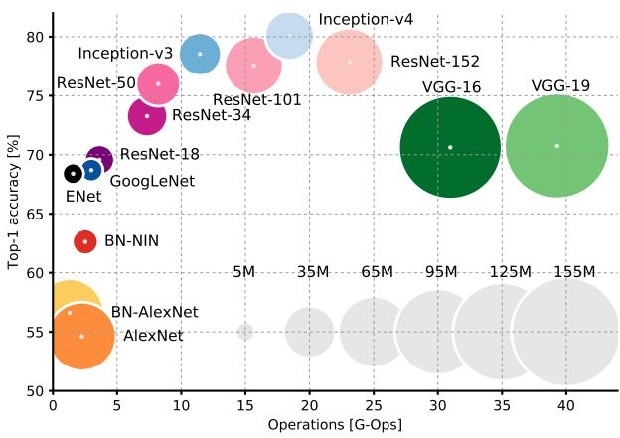
“Large” vs. “Small” Models
Larger models can require using a server (e.g., one powerful GPU running for half a day)
Very large models can require 10,000+ GPUs running for several months

Slide 9
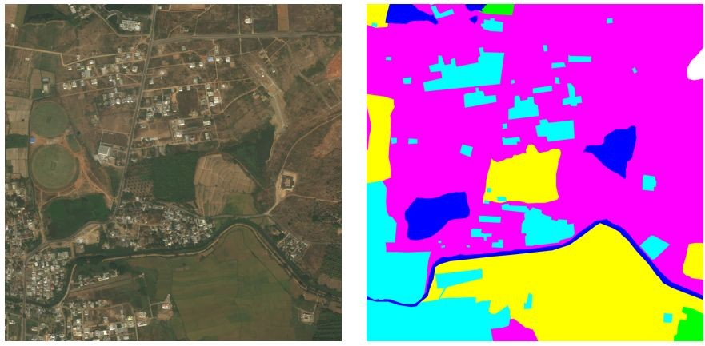
Task-Specific vs. General-Purpose Models
Task-specific model
Trained only for one task
Often trained with one data modality
Example: Segmenting by land use type in satellite imagery
+
+ …

Slide 10
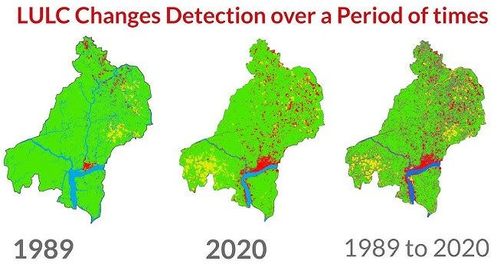
Task-Specific vs. General-Purpose Models
Task-specific model
Trained only for one task
Often trained with one data modality
Example: Segmenting by land use type in satellite imagery
General-purpose models
Aims to handle many different types of tasks across various domains
Trained on broad, diverse data
Example: Geospatial foundation models for segmenting by land use type, land use change detection, etc.
+
+ …

Slide 11
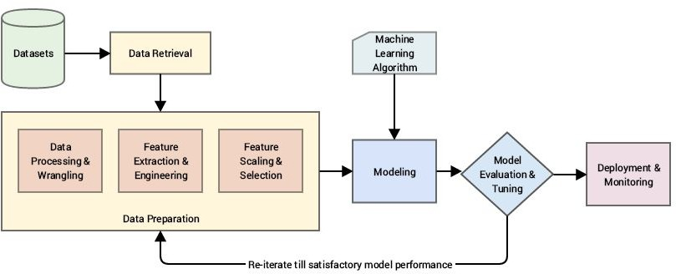
ML In Practice
Practical Machine Learning with Python. Bali, Sarkar, and Sharma.

Slide 12
Development → training → inference
Development
Setting up the data pipeline infrastructure
Deciding how to evaluate model performance
Testing different algorithms and hyperparameters
Choosing which model will be used for final training

Slide 13
Development → training → inference
Development
Setting up the data pipeline infrastructure
Deciding how to evaluate model performance
Testing different algorithms and hyperparameters
Choosing which model will be used for final training
Training
“Fitting” model parameters to improve performance on task
Choose training data to be representative of inference setting(s)
Can take minutes to months
Needs to be done again if data distribution evolves

Slide 14
Development → training → inference
Development
Setting up the data pipeline infrastructure
Deciding how to evaluate model performance
Testing different algorithms and hyperparameters
Choosing which model will be used for final training
Training
“Fitting” model parameters to improve performance on task
Choose training data to be representative of inference setting(s)
Can take minutes to months
Needs to be done again if data distribution evolves
Inference
Producing predictions for “unseen” data inputs
Uses the “frozen” model parameters from training
Assumes “unseen” inputs have similar distribution to training data
Typically runs much faster than training (milliseconds to seconds)

Slide 15
02
머신러닝 종류

Slide 16
Lecture Outline
What is Machine Learning?
Types of Machine Learning
Main paradigms
Data
Q&A
Climate-relevant ML subfields

Slide 17
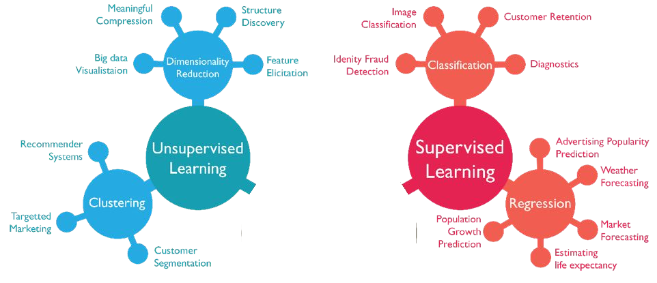

Learn from labeled dataset

Slide 18

Learn from unlabeled dataset
Generative AI
Learn from labeled dataset

Slide 19
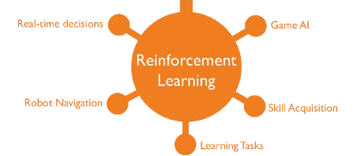
Learn from unlabeled dataset
Learn from labeled dataset
Generative AI
Optimize actions of agent in environment

Slide 20
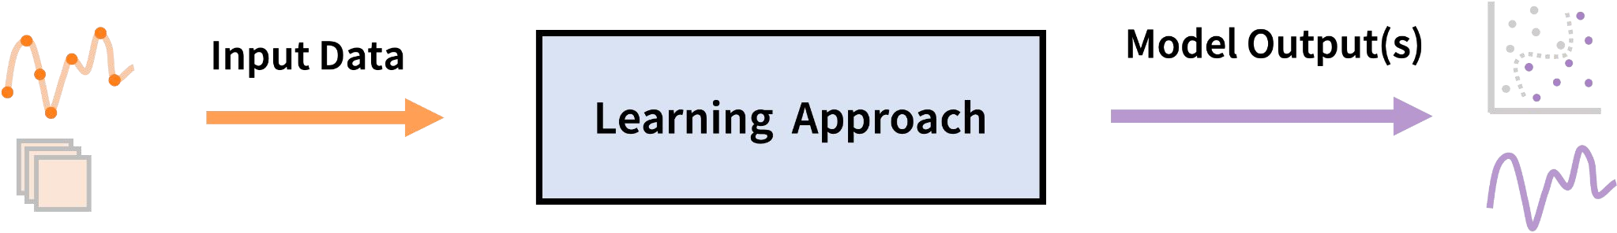
How to Choose a Learning Approach?
Input data:
Can comprise inputs, plus target outputs (commonly referred to as labels) when known
when we say a dataset is unlabeled, it means we do not have the target outputs a priori
Model output(s):
Can be categorical/numerical, discrete/continuous, single/multiple outputs
Learning approach:
Supervised Learning
Task-driven
Labeled data
Performance feedback

Slide 21
How to Choose a Learning Approach?
Input data:
Can comprise inputs, plus target outputs (commonly referred to as labels) when known
when we say a dataset is unlabeled, it means we do not have the target outputs a priori
Model output(s):
Can be categorical/numerical, discrete/continuous, single/multiple outputs
Learning approach:
Supervised Learning
Task-driven
Labeled data
Performance feedback
Unsupervised Learning
Data-driven
Unlabeled data
Reinforcement Learning
Reward-driven
Dynamically-collected state/action data
Performance feedback

Slide 22
Supervised Learning
Given a labeled dataset, i.e. inputs X^{(i)} with labels y^{(i)}:
{(X⁽¹⁾, y⁽¹⁾), (X⁽²⁾, y⁽²⁾), …, (X^{(n)}, y^{(n)})}
learn a function f to predict y given X, i.e. f(X) ≅ y.
X can have multiple elements, where each element represents some attribute (“feature”)
Regression: y is real-valued
Classification: y is categorical

Slide 23



Supervised Learning: Regression
Learn a function f to predict y given X, i.e. f(X) ≅ y.
Regression: y is real-valued
9
8
7
6
5
4
3
2
1
0
September Arctic Sea Ice Extent (1,000,000 sq km)
1970 1980
1990
2000
2010
2020
Year
Data from G. Witt. Journal of Statistics Education, Volume 21, Number 1 (2013)

Slide 24
















Supervised Learning: Classification
Learn a function f to predict y given X, i.e. f(X) ≅ y.
Classification: y is categorical
Well Site Age
Super-emitter well site
Not a super-emitter well site
A ML Approach to Methane Emissions Mitigation in the O&G Industry. Wang et al. 2020.
Oil and Gas Production

Slide 25
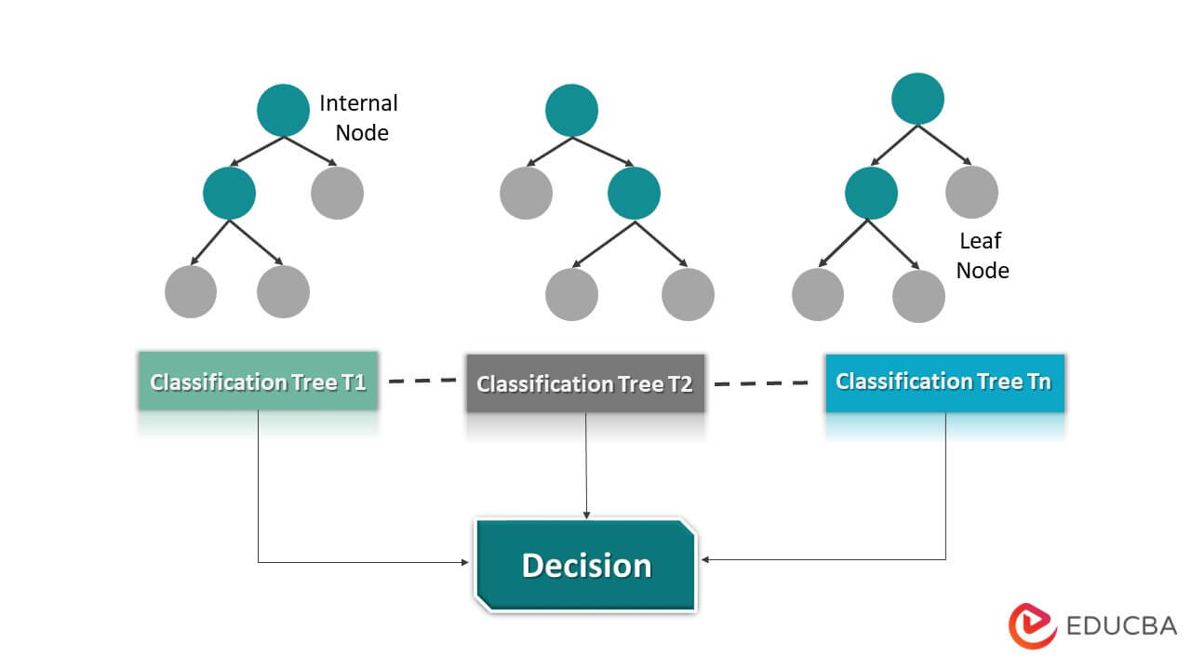
Supervised Learning: Common Models/Methods
Classification: Support vector machines, random forests, logistic regression, naive Bayes, neural networks
Image: https://www.educba.com/data-imputation/

Slide 26
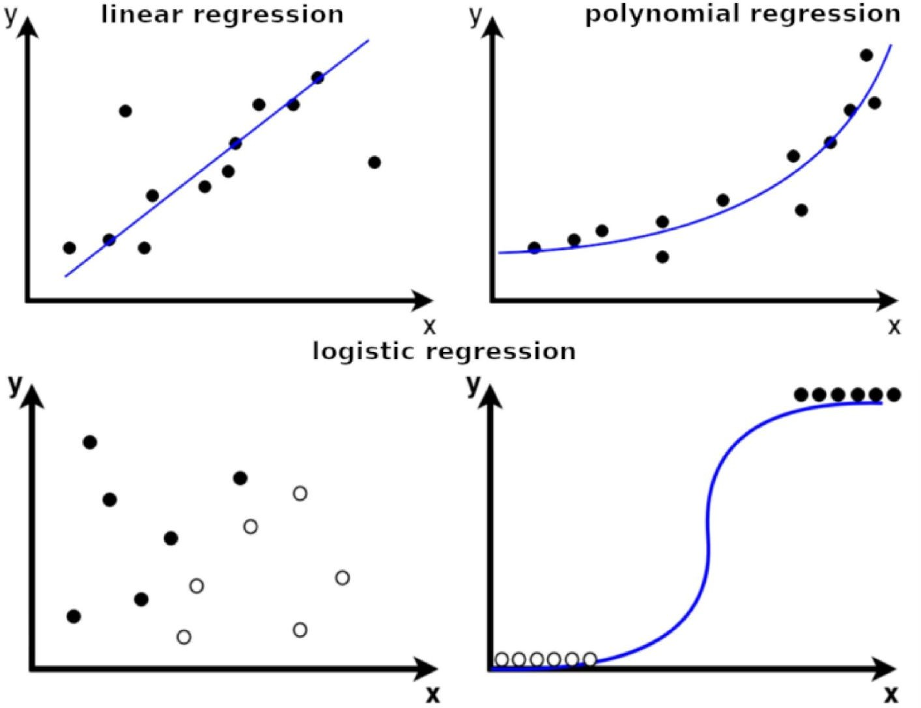
Supervised Learning: Common Models/Methods
Classification: Support vector machines, random forests, logistic regression, naive Bayes, neural networks
Regression: Linear regression, ridge regression, Gaussian processes, neural networks
Image: Analytics Vidhya

Slide 27
Supervised Learning
Criteria to choose an algorithm:
Type of input and output data
Data distribution, quality, and feature correlations
Desired performance and robustness guarantees
Example use case: Classifying a well site as a super-emitter or not based on its age and oil & gas production as features, with super-emitter labels existing for training

Slide 28























Unsupervised Learning
Given an unlabeled dataset, i.e. inputs X^{(i)} with no labels, learn hidden structure in the data.
Reliability Over-stressed
Unusual downtime
ZEV hydrogen fueling stations
Survey Data
Survey Data
Real-time Capacity Level
Real-time Capacity Level
Unsupervised Temporal Clustering to Monitor the Performance of Alternative Fueling Infrastructure. Ramea 2020.

Slide 29
Unsupervised Learning: Common Models/Methods
Learning Patterns in the Data: Principal Component Analysis (PCA), clustering, anomaly detection algorithms
Generative Modeling (generate synthetic data): Normalizing flows, variational autoencoders, generative adversarial networks
Some Transfer Learning Tasks: E.g., domain alignment

Slide 30
Unsupervised Learning
Criteria to choose an algorithm/model:
What is the primary goal?
  Clustering?
  Synthetic data generation?
  Domain adaptation?
Data distribution, quality, and feature correlations
Example use case: Synthetic generation of building energy load profiles

Slide 31
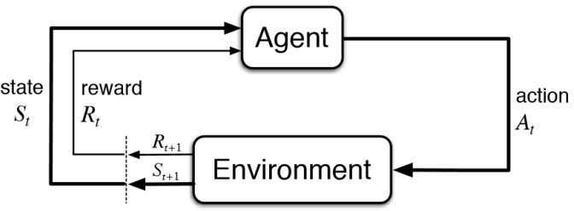
Reinforcement Learning
Goal: Find the best policy that maximizes the total expected reward over time
Examples:
RL is often used in settings where control is used
Game playing
Energy optimization in a building
Pan and zoom on satellite imagery
Figure from 5 Things You Need to Know about Reinforcement Learning

Slide 32
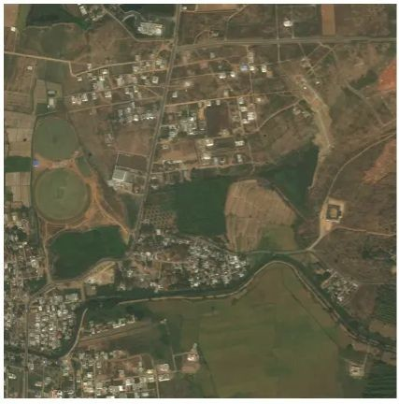
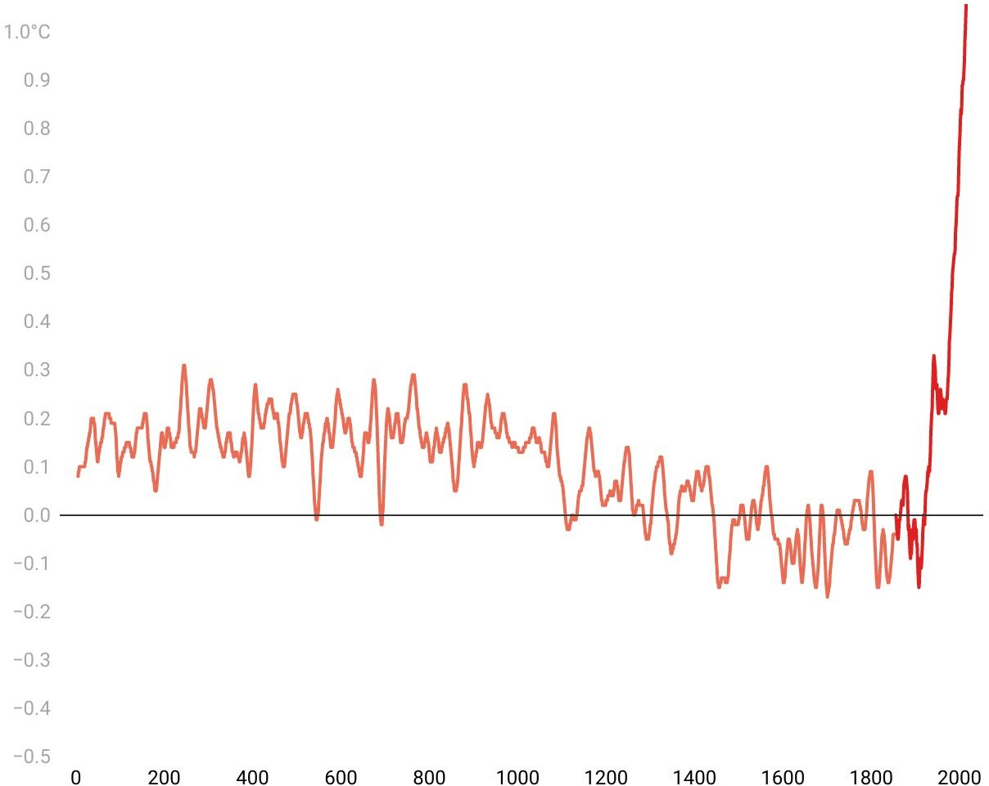
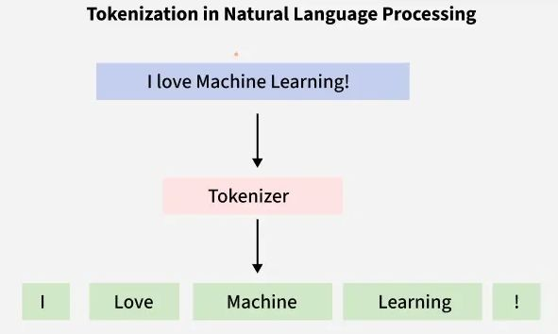
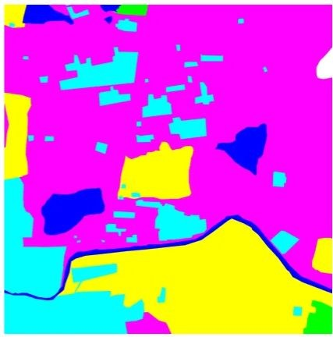
Some ML Approaches Associated with Data Modalities
Natural Language Computer vision Time series analysis Processing (NLP)
E.g., recurrent neural networks (RNNs), hidden Markov models (HMMs), large language models (LLMs)
Images: Geeksforgeeks, Medium, TIME

Slide 33

Summary -
출처

Slide 34
문제 1.
기후변화가 전력시스템에 미치는 영향으로 가장 적절한 설명은 무엇인가?
A. 기온 상승은 전력 수요와 무관하다
B. 극한기후는 발전 설비의 효율과 계통 안정성에 영향을 줄 수 있다
C. 기후변화는 오직 수력발전에만 영향을 미친다
D. 재생에너지 발전량은 기후변화와 관계없이 일정하다
문제 2.
다음 중 재생에너지 중심 전력시스템의 특징으로 가장 적절한 것은 무엇인가?
A. 발전 비용이 항상 화석연료보다 높다
B. 온실가스 배출은 줄지만 출력 변동성이 커질 수 있다
C. 에너지 저장장치가 필요 없다
D. 송배전 시스템의 중요성이 감소한다

Slide 35
.

Slide 36
Q&A

