Slide 1

AI & AIX for Energy, Environment, and agriculture
1주차 2차시
Young-Min Yang

Slide 2

2027학년도 글로컬 교과 콘텐츠 개발 사업
1. 기본정보
과목명 | 미래기후변화대응 통합전력시스템 설계및 실습 | 교수명 | 양영민
주차명 | 1주차 | 차시명 | 1차시
2. 버전정보
Ver | 내용 | 작성자
1.0 | 초안 작성 | 교수명

Slide 3
오늘의 학습내용
1 | 강의 소개
2 | 기후변화와 전력시스템
3
오늘의 학습목표
1 | 이번학기에 배울 내용을 숙지한다
2 | 이번학기의 수업범위를 이해한다
3

Slide 4
01
머신러닝소개

Slide 5
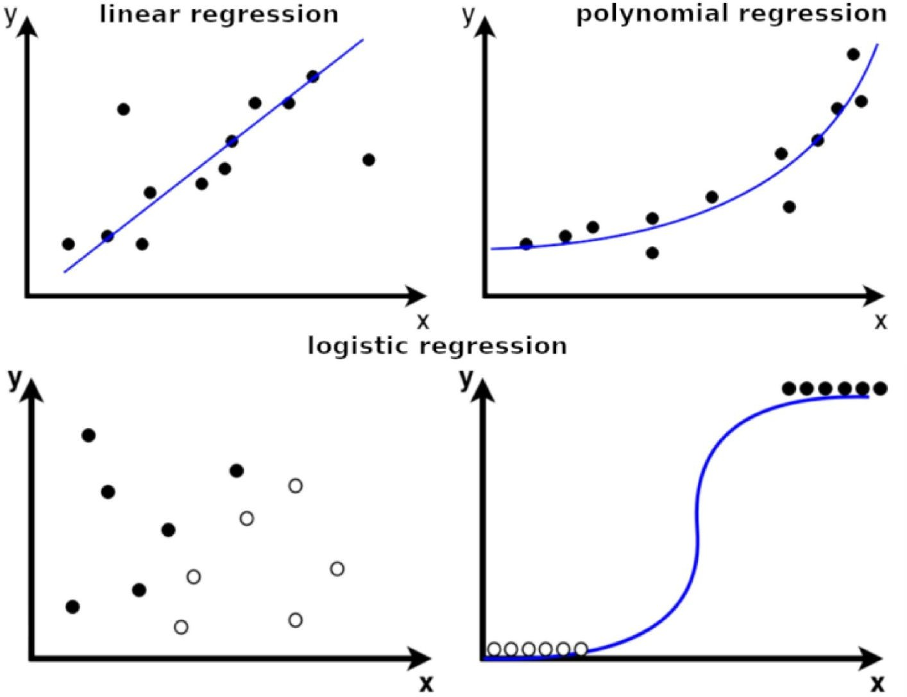
Remind : Supervised Learning
Classification: Support vector machines, random forests, logistic regression, naive Bayes, neural networks
Regression: Linear regression, ridge regression, Gaussian processes, neural networks
Image: Analytics Vidhya

Slide 6
Remind : Supervised Learning
Criteria to choose an algorithm:
Type of input and output data
Data distribution, quality, and feature correlations
Desired performance and robustness guarantees
Example use case: Classifying a well site as a super-emitter or not based on its age and oil & gas production as features, with super-emitter labels existing for training

Slide 7














Unsupervised Learning
Given an unlabeled dataset, i.e. inputs X^{(i)} with no labels, learn hidden structure in the data.
ZEV hydrogen fueling stations
Survey Data
Real-time Capacity Level
Unsupervised Temporal Clustering to Monitor the Performance of Alternative Fueling Infrastructure. Ramea 2020.

Slide 8











Unsupervised Learning
Given an unlabeled dataset, i.e. inputs X^{(i)} with no labels, learn hidden structure in the data.
Reliability Over-stressed
Unusual downtime
ZEV hydrogen fueling stations
Survey Data
Survey Data
Real-time Capacity Level
Real-time Capacity Level
Unsupervised Temporal Clustering to Monitor the Performance of Alternative Fueling Infrastructure. Ramea 2020.

Slide 9
Unsupervised Learning: Common Models/Methods
Learning Patterns in the Data: Principal Component Analysis (PCA), clustering, anomaly detection algorithms
Generative Modeling (generate synthetic data): Normalizing flows, variational autoencoders, generative adversarial networks
Some Transfer Learning Tasks: E.g., domain alignment

Slide 10
Unsupervised Learning
Criteria to choose an algorithm/model:
What is the primary goal?
  Clustering?
  Synthetic data generation?
  Domain adaptation?
Data distribution, quality, and feature correlations
Example use case: Synthetic generation of building energy load profiles

Slide 11
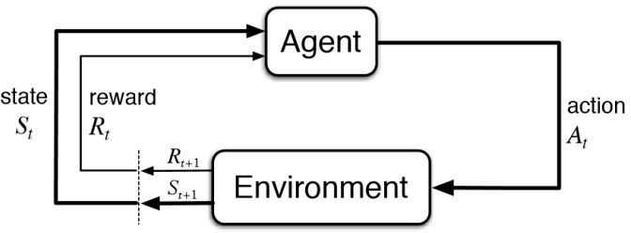
Reinforcement Learning
Goal: Find the best policy that maximizes the total expected reward over time
Examples:
RL is often used in settings where control is used
Game playing
Energy optimization in a building
Pan and zoom on satellite imagery
Figure from 5 Things You Need to Know about Reinforcement Learning

Slide 12
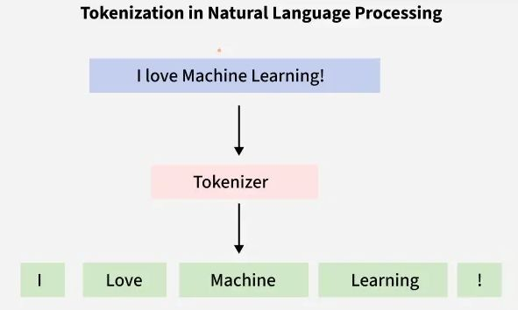
Some ML Approaches Associated with Data Modalities
Natural Language Computer vision Time series analysis Processing (NLP)
E.g., recurrent neural networks (RNNs), hidden Markov models (HMMs), large language models (LLMs)
Images: Geeksforgeeks, Medium, TIME

Slide 13
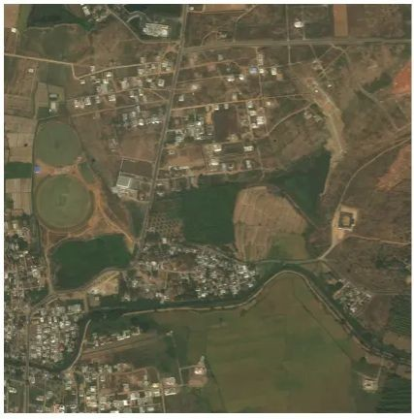
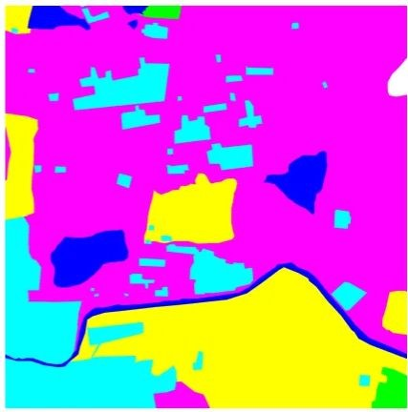
Some ML Approaches Associated with Data Modalities
Natural Language Computer vision Time series analysis Processing (NLP)
E.g., recurrent neural networks (RNNs), hidden Markov models (HMMs), large language models (LLMs)
Images: Geeksforgeeks, Medium, TIME

Slide 14
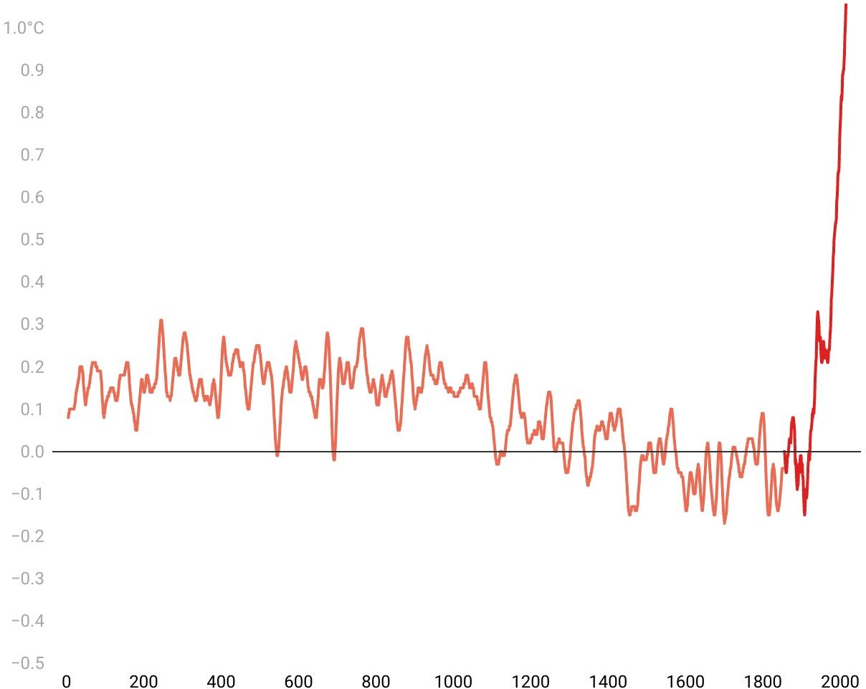
Some ML Approaches Associated with Data Modalities
Natural Language Computer vision Time series analysis Processing (NLP)
E.g., recurrent neural networks (RNNs), hidden Markov models (HMMs), large language models (LLMs)
Images: Geeksforgeeks, Medium, TIME

Slide 15
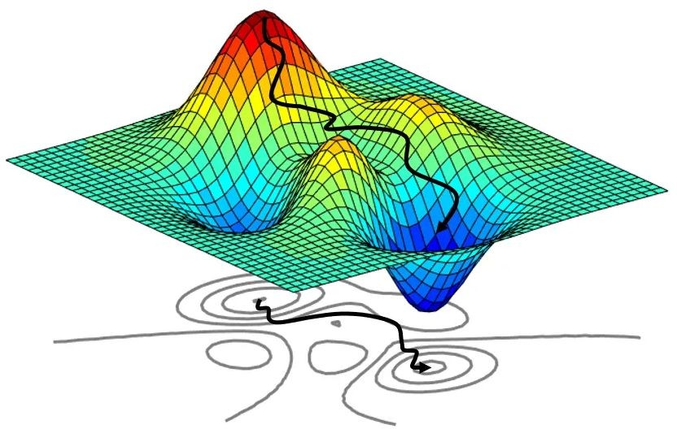
ML for Surrogate Modeling
Optimization models Physics models
Physics-informed models
Approximate expensive objective functions and constraints to accelerate search for optimal solutions
Images: Medium, Comsol, Reichstein et al 2019

Slide 16
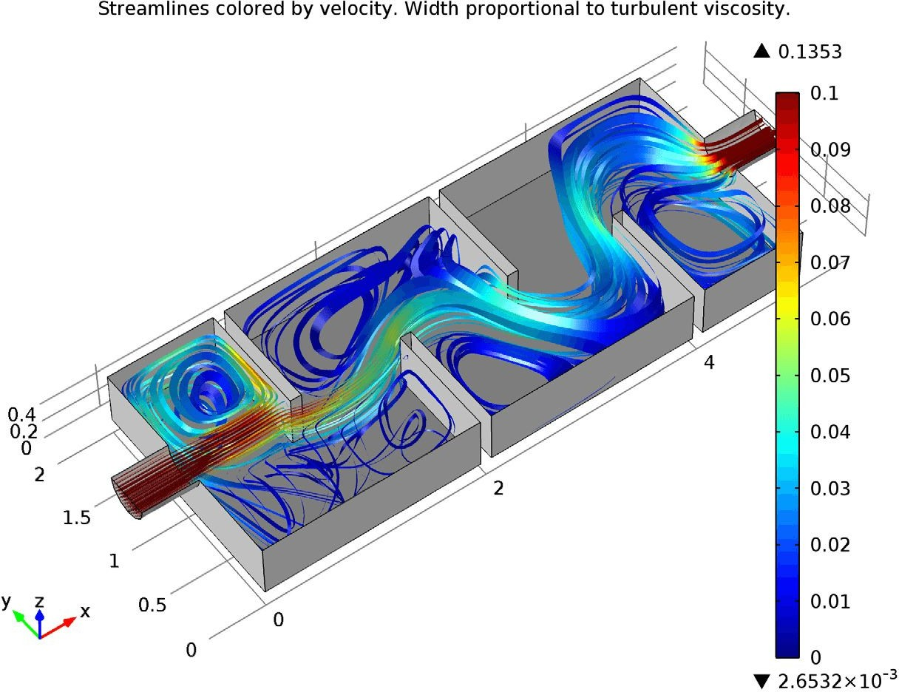
ML for Surrogate Modeling
Optimization models Physics models
Physics-informed models
Approximate expensive objective functions and constraints to accelerate search for optimal solutions
Emulate complex physics simulations (like fluid dynamics or structural mechanics)
Images: Medium, Comsol, Reichstein et al 2019

Slide 17
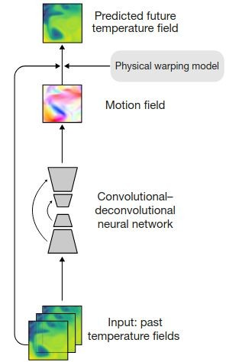
ML for Surrogate Modeling
Optimization models Physics models
Physics-informed models
Approximate expensive objective functions and constraints to accelerate search for optimal solutions
Emulate complex physics simulations (like fluid dynamics or structural mechanics)
Images: Medium, Comsol, Reichstein et al 2019

Slide 18
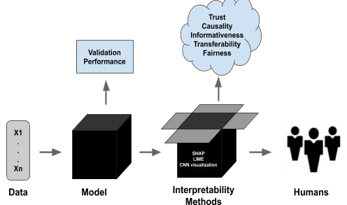

Interpretable & Explainable ML
Most of AI is not
causal!
Explainable AI provides reasons for its decisions after the fact, even if its internal workings are complex or opaque.
Interpretable AI has transparent internal logic that humans can directly understand by examining how the model itself works.
Causal ML
Identify and quantify cause-and-effect relationships (instead of correlations)
Enables prediction of intervention outcomes and counterfactual
Distance to city center
Commute distance
Built-up density
Image: ML CMU

Slide 19
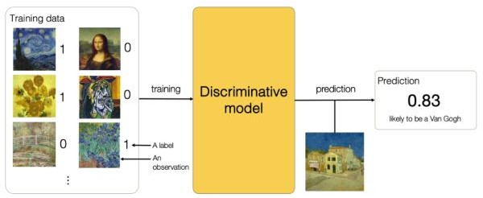
Generative vs. Discriminative ML
Discriminative AI models the conditional probability distribution, learning to map directly from inputs to outputs.
Images: Analytics yogi

Slide 20
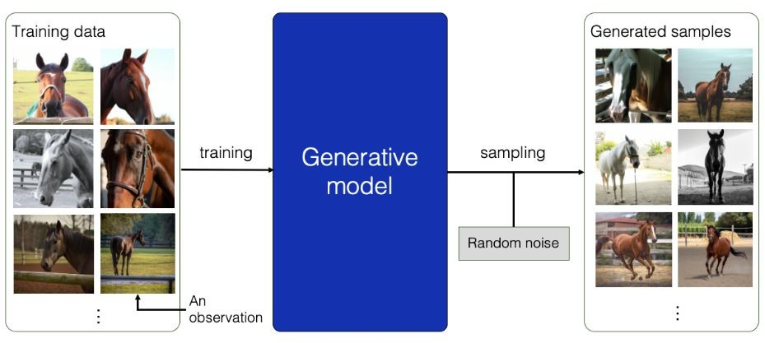
Generative vs. Discriminative ML
Discriminative AI models the conditional probability distribution, learning to map directly from inputs to outputs.
Generative AI (“GenAI”) explicitly models the joint probability distribution of the data, learning how features and labels occur together.
Images: Analytics yogi

Slide 21
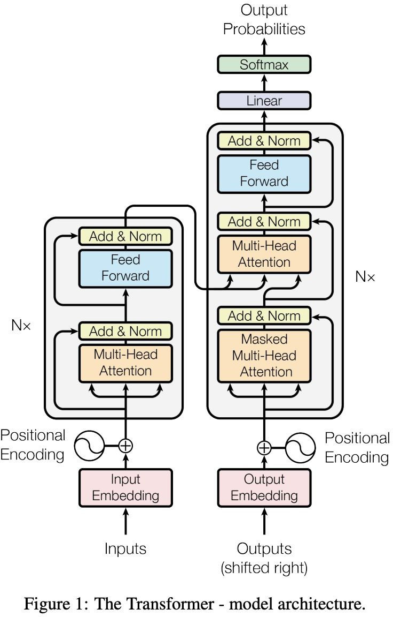

Example: Generative Pre-trained Transformer (GPT)
Core Idea: Predicts next token from previous ones (unsupervised)
Strengths: Analyzes patterns in diverse data at scale, often with impressive results
Limitations:
Requires massive data & compute
Inherits biases and inaccuracies from training data
Hallucinates without uncertainty estimates
Key Characteristics:
Interpolates patterns, doesn't truly “reason”
Pattern matching vs. direct fact retrieval
Figure source: Vaswani et al. (2017)

Slide 22
Lecture Outline
What is Machine Learning? Types of Machine Learning
Data
Data collection
Q&A
Data preparation for ML

Slide 23

The Importance of Data
Data is the core of machine learning
The quality of your model is dependent on the quality of your data
How much data is enough?
  Problem-dependent
  There are some okay heuristics, but almost always comes down to how things work empirically
Figure from What is Big Data? A Quick Introduction for Analytics and Data Engineering Beginners

Slide 24
Data Collection and Preparation
Define the task
Select data which aligns with that task
  Is the data labeled? If not, can you label the data?
Explore and clean the data
  Handle missing values (exclude data or impute)
  Investigate label quality
Split the data into training, validation, and test

Slide 25
Splitting the Dataset
Why do we need to split the dataset?
  To avoid overfitting and assess model performance on new data
Training: Learn model parameters
Validation: Select hyperparameters and compare models
Testing: Evaluate the best model to assess generalization performance on unseen data

Slide 26
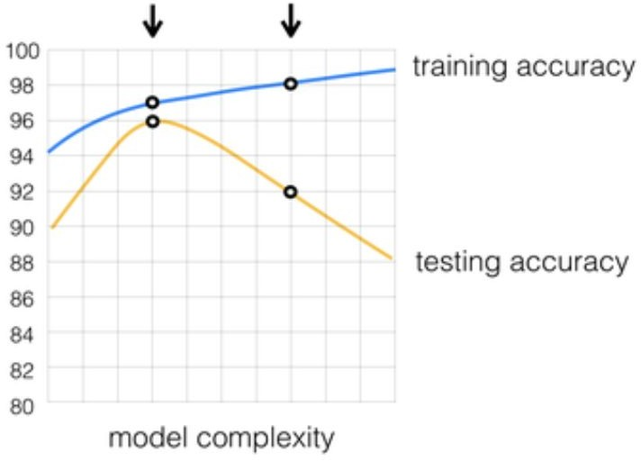
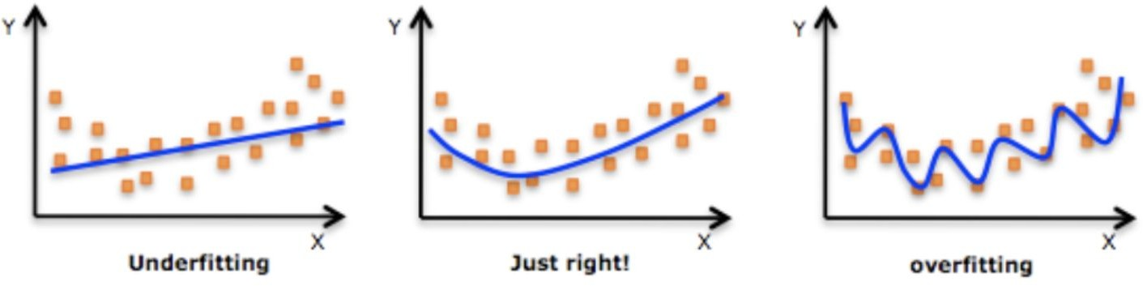
Overfitting vs. Generalization
Solution: k-fold Cross-Validation
Assess how well a predictive model will perform on “unseen” data by repeatedly splitting the dataset into k training and testing subsets.

Slide 27
Define the Task
Outline the requirements of the problem to be solved:
  Find the temporal, spatial constraints of the problem (making the ML solution valuable)
e.g., weather forecasting can be useful to optimize renewable energy production, but this can happen for optimizing existing infrastructure (short timescale), or for scoping the placement of new production sites (long timescale)
Establish the specifications your ML model has to comply with:
  What are the specifications for training? And for deployment?
Frame the ML task – some examples:
Classification Regression
Clustering
Image segmentation
Data augmentation
Anomaly Detection
On-line Optimization

Slide 28
Data Selection
Select data which aligns with the ML task
  By reviewing state-of-the-art applications
  By asking domain experts (identify researchers/practitioners working in this area)
  Carefully assessing the data requirements for the ML task
Note: You may need to review/relax some of the previous specifications based on the data that is actually available.
Is the dataset labeled? If not, can you label the data? Is it worth it to annotate to solve the problem, considering alternative approaches?

Slide 29
Explore and Clean the Data
Remove duplicate or irrelevant observations
Fix structural errors
Filter unwanted outliers
Handle missing data
Validate and quality-assure
From Data Cleaning: Definition, Benefits, And How-To - Tableau

Slide 30

Summary
Machine learning is useful for particular problems.
It is not a silver bullet.
There are many different types of machine learning.
Learning approaches: Supervised, unsupervised, reinforcement learning
Data modalities: NLP, computer vision, time series analysis
Requirements: e.g., interpretable and explainable, physics-informed
Other choices: Generative vs. discriminative, large vs. small, general-purpose vs. task-specific
Data is the core of machine learning!

Slide 31
문제 1.
기후변화가 전력시스템에 미치는 영향으로 가장 적절한 설명은 무엇인가?
A. 기온 상승은 전력 수요와 무관하다
B. 극한기후는 발전 설비의 효율과 계통 안정성에 영향을 줄 수 있다
C. 기후변화는 오직 수력발전에만 영향을 미친다
D. 재생에너지 발전량은 기후변화와 관계없이 일정하다
문제 2.
다음 중 재생에너지 중심 전력시스템의 특징으로 가장 적절한 것은 무엇인가?
A. 발전 비용이 항상 화석연료보다 높다
B. 온실가스 배출은 줄지만 출력 변동성이 커질 수 있다
C. 에너지 저장장치가 필요 없다
D. 송배전 시스템의 중요성이 감소한다

Slide 32
.

