Slide 1


ESS2222
Lecture 9 – Decision Trees and Random Forest
Hosein Shahnas
University of Toronto, Department of Earth Sciences,

Slide 2

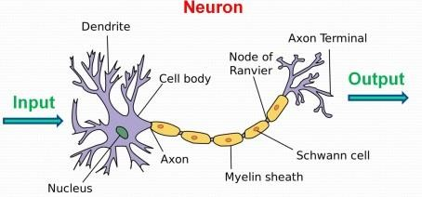
Outline
Decision Trees
Gini index
Decision Tree – Iris Classification Problem
Random Forest Algorithm
Bagging – Bootstrap Sampling
Random Forest – Image recognition
Feature Importance

Slide 3

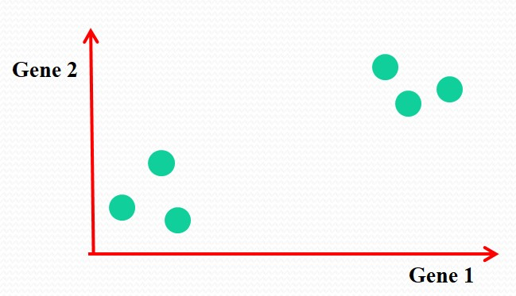
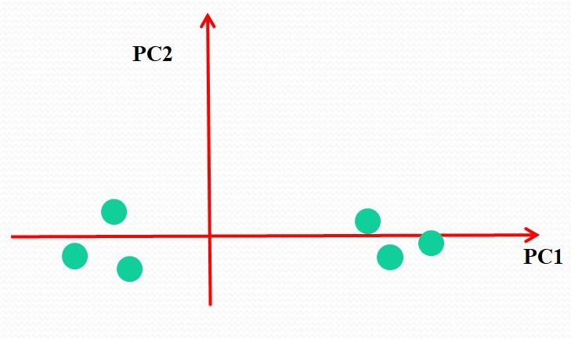
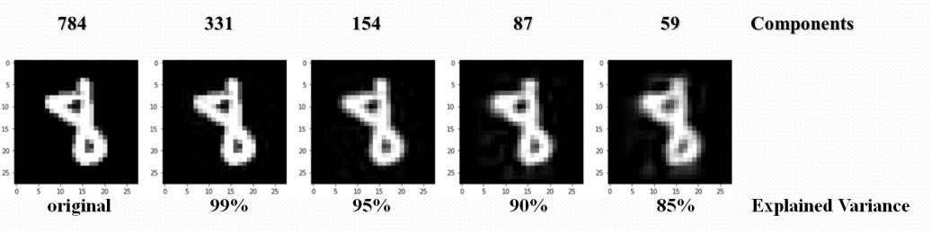

















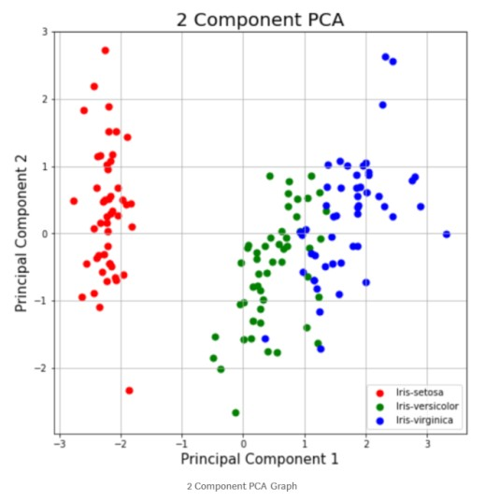
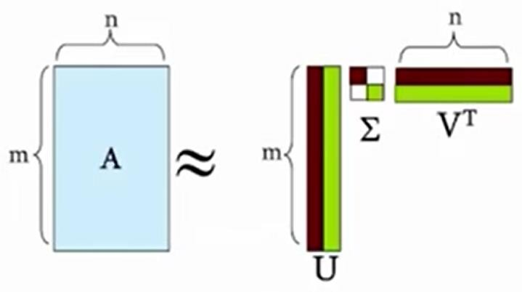
Review of Lecture 8
Accelerating the computational process by
ignoring less important features
Singular Value Decomposition (SVD)
^{A}[mn] ^{= U}[mr] ^{𝚺}[rr] ^{V}[nr]^{T}
Visualization

Slide 4

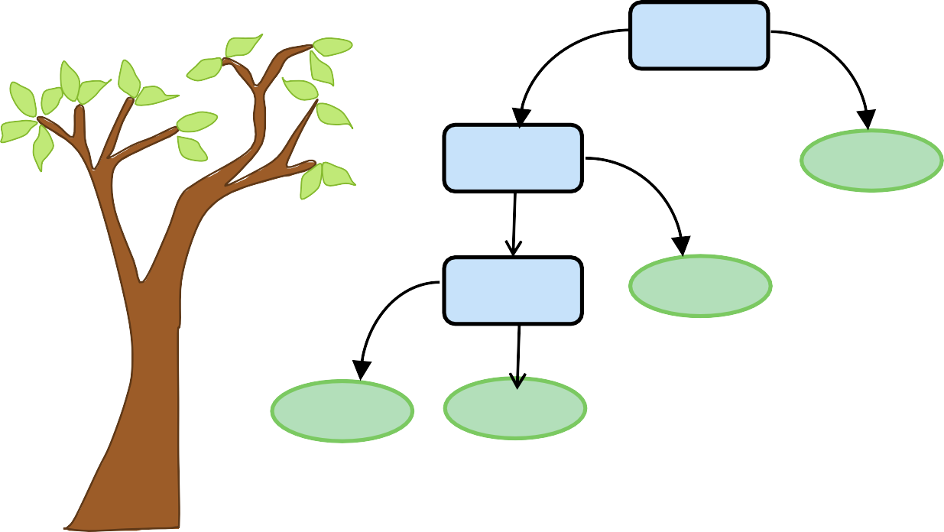
Classification and Regression Tree (CART)
Root node: The top most decision node
Decision Tree:
Decision nodes: Nodes that have two or
more braches
Leaf nodes: Nodes of the tree that have no
additional nodes coming off them
Should I accept the job?
yes
no
Salary > 50000
?
Commute > 1hr
?
no
yes
Decline offer
yes
Free coffee
?
no
Decline offer
Decline offer
 | Salary | Commute | Free coffee | Class
Job 1 | 50000 | 2 hr | Yes | 1
Job 2 | 45000 | 3 hr | No | 0
. . . | . . . | . . . | . . . | . . .
. . . | . . . | . . . | . . . | . . .
Job n | 53000 | 1 hr | No | 1
Accept offer
Tree-based methods are one of the commonly used supervised learning algorithms in
machine learning, both for regression and classification problems.

Slide 5

Decision Trees
Decision trees:
A decision tree is a simple but powerful supervised learning method that uses tree-like model of decisions and their possible consequences. They are used in both classification and regression problems.
Unlike the highly dimensional SVM, where it is impossible for a human brain to even imagine how the hyperplane built looks like, the decision trees provide very good visualization on the steps of decisions and the relative importance of the features.
class sklearn.tree.DecisionTreeRegressor class sklearn.tree.DecisionTreeClassifier
for classification for regression

Slide 6



Gini Index
Gini index: The gini index is a number describing the quality of the split of a node on a variable
(feature).
If a data set D contains samples from C classes, gini index is defined as:
gini(D) = 1 - ∑^{𝑪}
_{𝑷}𝟐
𝒄=𝟏 c
where P_{c} is the relative frequency of class c in D
If a data set D splits on S into two subsets D₁ and D₂, the gini index is defined as:
𝑫 𝑫
Entropy decreases
𝟏
𝟐
gini (D) = gini(
𝑫 ) +
gini(𝑫 )
𝟏 𝟐
S
where gini(𝑫_{𝟏}) < gini(D), gini(𝑫_{𝟐}) < gini(D)
𝑫 𝑫
Reduction in impurity:
∆ 𝒈𝒊𝒏𝒊 𝑺 = 𝒈𝒊𝒏𝒊 𝑫 − 𝒈𝒊𝒏𝒊𝑺 (𝑫)
D
Information Gain Entropy:
Information gain is a measure of decrease in entropy after
the data is split.
Information gain entropy is another criterion for choosing the features in splitting. Entropy is a measure of the degree of disorder or randomness in the system.
True
S
False
D₁
D₂
H(D) = 1- ∑^{𝑪} 𝑷_{𝒄} 𝒍𝒐𝒈(𝑷_{𝒄})
𝒄=𝟏

Slide 7

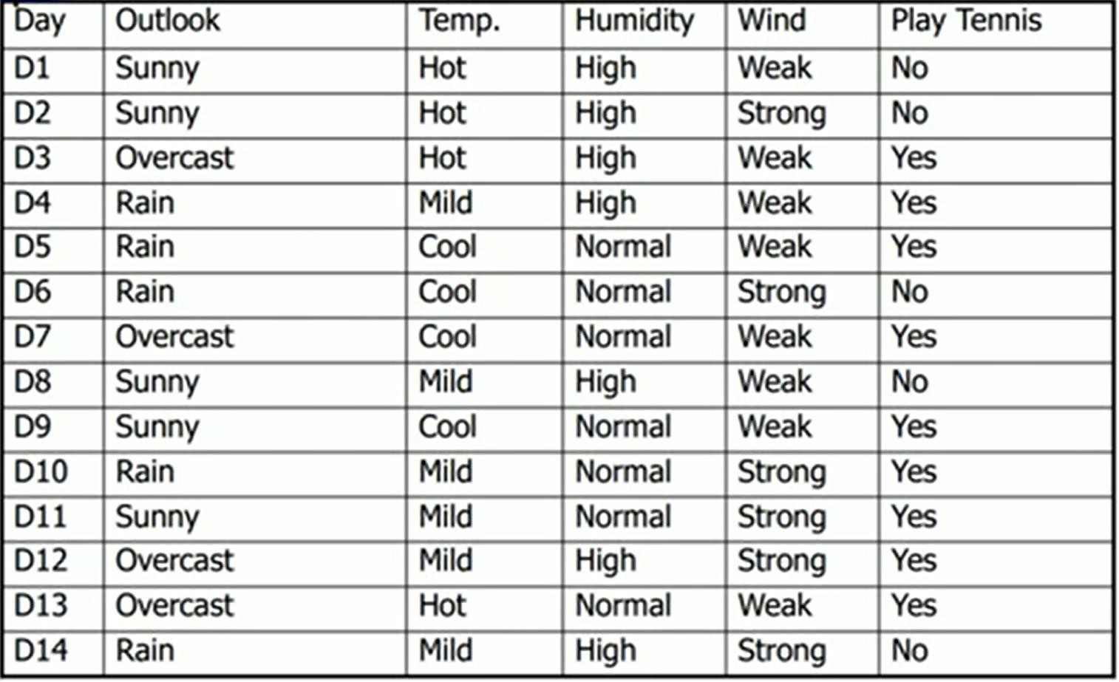
Gini Index
Example: Playing Tennis
Features
Class labels

Slide 8
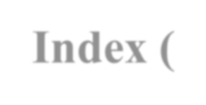

Gini Index (Gini Impurity)
P
Example: Playing Tennis
Wind: Strong?
True
S
False
D₁
D₂
Play Tennis: 3P, 3N
Play Tennis: 6P, 2N
𝟑
𝟔
𝟐
−
𝟐
−
𝟑
𝟔
𝟐
= 0.5
gini (Play Tennis | Wind =True) = 𝟏 −
gini (Play Tennis | Wind = False) = 𝟏 −
𝟔
𝟖
𝟐
𝟖
𝟐
= 0.375
gini (D) =
𝑫
𝟏
gini(
𝑫 ) +
𝑫
𝟐
gini(𝑫 )
S
𝑫
𝟏
𝑫
𝟐
𝟔
𝟖
= × 𝟎. 𝟓 + × 𝟎. 𝟑𝟕𝟓 = 0.4286
𝟏𝟒
𝟏𝟒

Slide 9
Gini Index (Gini Impurity)
P
Example: Playing Tennis
Humidity
High
S
Normal
D₁
D₂
Play Tennis: 3P, 4N
Play Tennis: 6P, 1N
𝟑
𝟕
𝟐
−
𝟐
𝟒
𝟕
−
𝟐
= 0.4898
gini (Play Tennis | Humidity = High) = 𝟏 −
𝟔
𝟕
𝟏
𝟕
𝟐
= 0.2449
gini (Play Tennis | Humidity = Normal) = 𝟏 −
gini (D) =
𝑫
𝟏
gini(
𝑫 ) +
𝑫
𝟐
gini(𝑫 )
S
𝑫 𝑫
𝟏 𝟐
𝟔 𝟖
= × 𝟎. 𝟒𝟖𝟗𝟖 + × 𝟎.2449 = 0.3674
𝟏𝟒
𝟏𝟒

Slide 10
Gini Index (Gini Impurity)
P
Example: Playing Tennis
Outlook
Sunny
Overcast
D₂
Rain
D₁
D₃
Play Tennis: 2P, 3N
Play Tennis: 4P, 0N
Play Tennis: 3P, 2N
𝟐
𝟓
𝟐
−
𝟐
𝟑
𝟓
−
𝟐
= 0.48
gini (Play Tennis | Outlook = Sunny) = 𝟏 −
𝟒
𝟒
𝟎
𝟐
= 0
gini (Play Tennis | Outlook = Overcast) = 𝟏 −
𝟒
𝟑
𝟓
𝟐
𝟑
𝟓
𝟐
= 0.48
gini (Play Tennis | Outlook = Rain) = 𝟏 −
−
gini (D) =
𝑫
𝟏
gini(𝑫 ) +
𝑫
𝟐
gini(𝑫 ) +
𝑫
𝟑
gini(𝑫 )
S
𝑫
𝟏
𝟐
𝟑
𝟒 𝟓
𝟏𝟒
𝑫 𝑫
𝟓
= × 𝟎. 𝟒𝟖 +
× 𝟎 + × 𝟎. 𝟒𝟖 = 0.3429
𝟏𝟒
𝟏𝟒
10

Slide 11
Gini Index (Gini Impurity)
P
Example: Playing Tennis
Temperature
Hot
Mild
D₂
Cool
D₁
D₃
Play Tennis: 2P, 2N
Play Tennis: 4P, 2N
Play Tennis: 3P, 1N
𝟐
𝟒
𝟒
𝟔
𝟐
𝟑
𝟒
𝟐
𝟔
𝟐
= 0.5
𝟐
= 0.4444
gini (Play Tennis | Temperature = Hot) = 𝟏 −
gini (Play Tennis | Temperature = Mild) = 𝟏 −
gini (Play Tennis | Temperature = Cool) = 𝟏 −
−
𝟐
−
𝟑
𝟒
𝟐
𝟏
𝟒
𝟐
= 0.375
−
gini (D) =
𝑫
𝟏
gini(𝑫 ) +
𝑫
𝟐
gini(𝑫 ) +
𝑫
𝟑
gini(𝑫 )
S
𝑫
𝟏
𝟐
𝟑
𝑫 𝑫
𝟒
𝟔
𝟒
= × 𝟎. 𝟓 + × 𝟎. 𝟒𝟒𝟒𝟒 + × 𝟎. 𝟑𝟕𝟓 = 0.4405
𝟏𝟒
𝟏𝟒
𝟏𝟒
11

Slide 12



Gini Index (Gini Impurity)
Example: Playing Tennis
gini_{S}(Windy) = 0.4286 gini_{S} (Humidity) = 0.3674 gini_{S} (Outlook) = 0.3429
gini_{S} (Temperature) = 0.4405
The splitting gain for Temperature feature is high, therefore we chose temperature as the feature for splitting.
gini(D) = 1 - ∑^{𝑪}
_{𝑷}𝟐
𝒄=𝟏 c
𝟓
𝟏𝟒
𝟐
𝟗
𝟏𝟒
𝟐
= 0.541
gini(D) = 𝟏 −
−

Slide 13

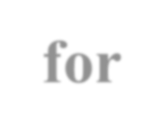
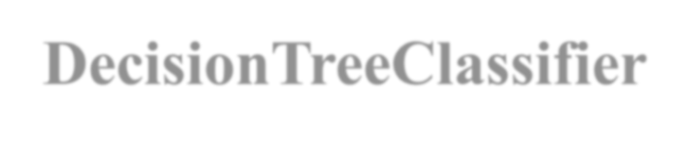

Parameters for
DecisionTreeClassifier
criterion : string, optional (default=”gini”)
The function to measure the quality of a split. Supported criteria are “gini” for the Gini impurity and “entropy” for the information gain.
splitter : string, optional (default=”best”)
The strategy used to choose the split at each node. Supported strategies are “best” to choose the best split and “random” to choose the best random split.
max_depth : int or None, optional (default=None)
The maximum depth of the tree. If None, then nodes are expanded until all leaves are pure or until all leaves contain less than min_samples_split samples.
min_samples_split : int, float, optional (default=2)
The minimum number of samples required to split an internal node.
min_samples_leaf : int, float, optional (default=1)
The minimum number of samples required to be at a leaf node.
max_features : int, float, string or None, optional (default=None)
The number of features to consider when looking for the best split.
max_leaf_nodes : int or None, optional (default=None)
Grow a tree with max_leaf_nodes in best-first fashion. Best nodes are defined as relative reduction in impurity. If None then
unlimited number of leaf nodes.
DecisionTreeRegressor
criterion : strstring, optional (default=”mse”)
The function to measure the quality of a split. Supported criteria are “mse” for the mean squared error, which is equal to variance reduction as feature selection criterion and minimizes the L2 loss

Slide 14
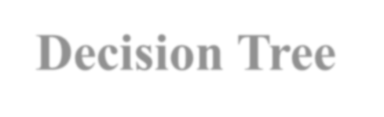
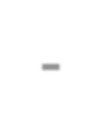

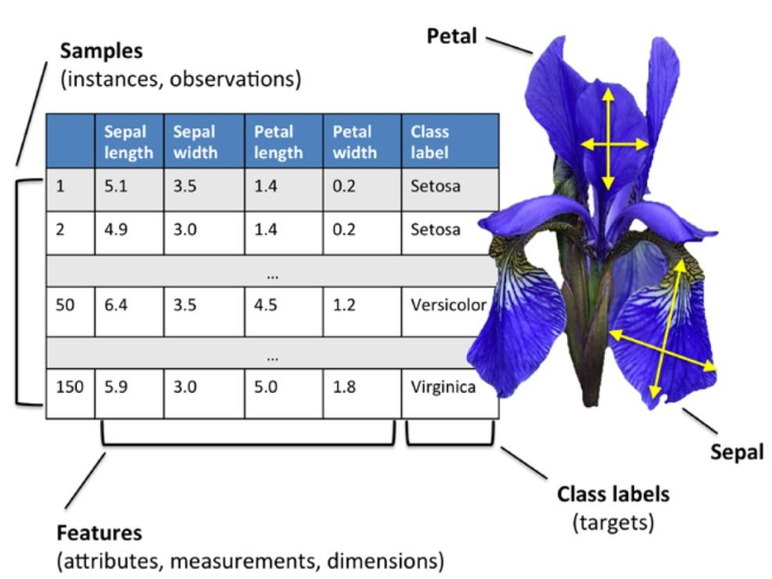
Decision Tree - Iris Classification Problem
Iris problem:
Three class problem with four features.
from sklearn.tree import DecisionTreeClassifier
from sklearn.model_selection import GridSearchCV
for grid search

Slide 15


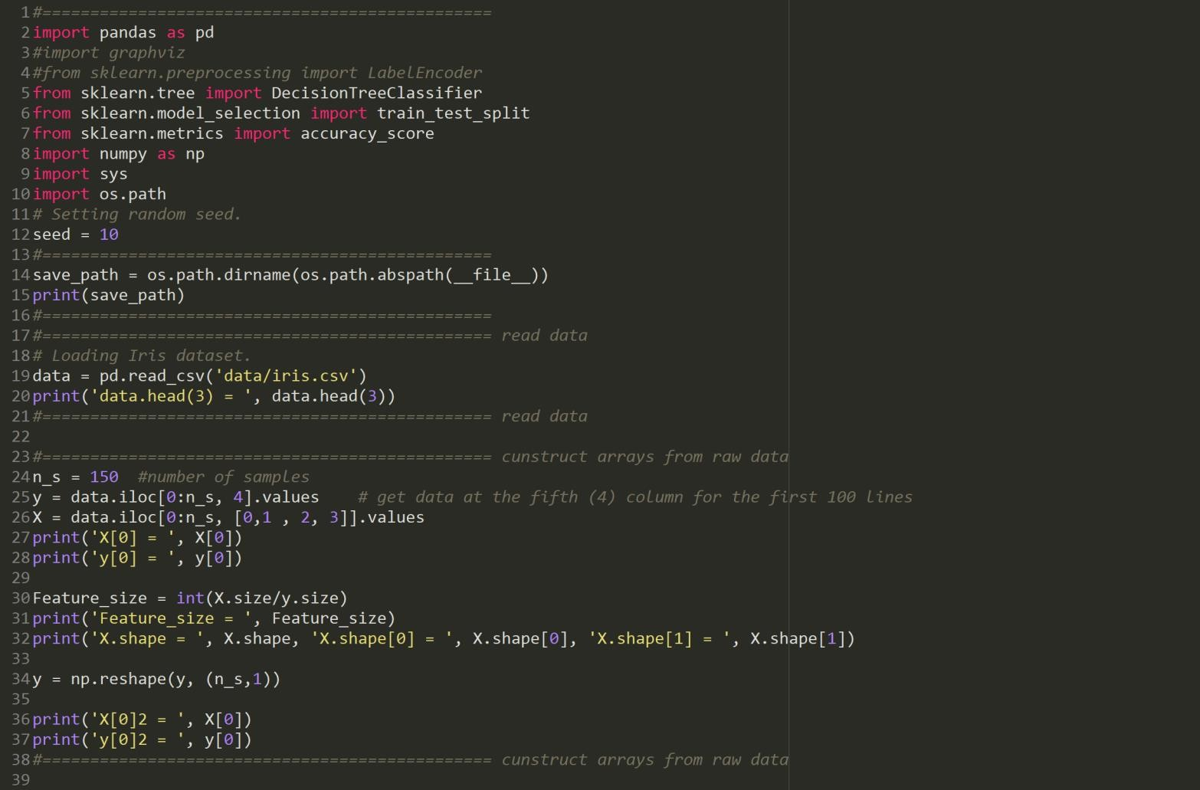
Decision Tree - Iris Problem

Slide 16
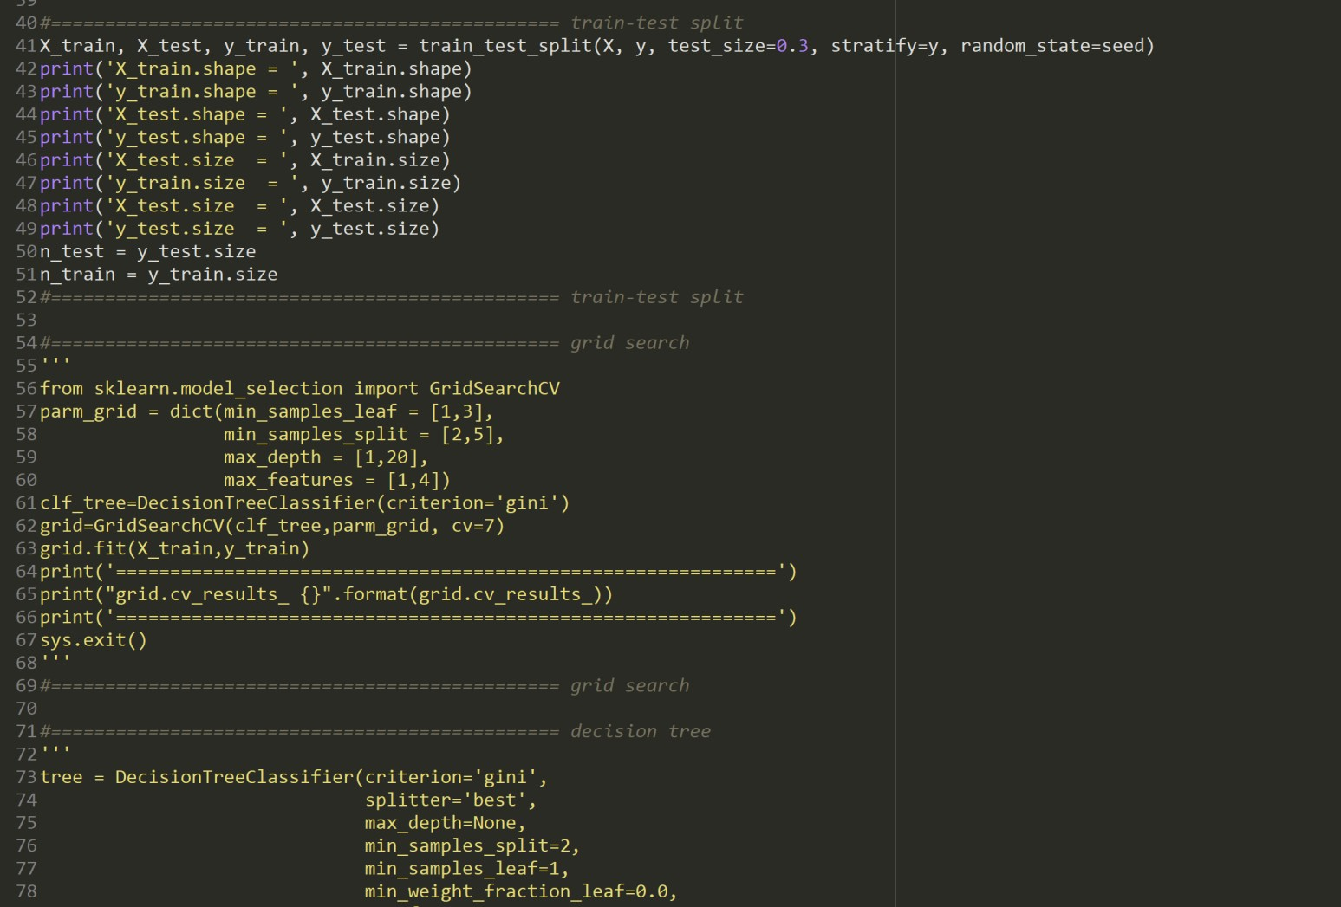
Decision Tree - Iris Problem

Slide 17
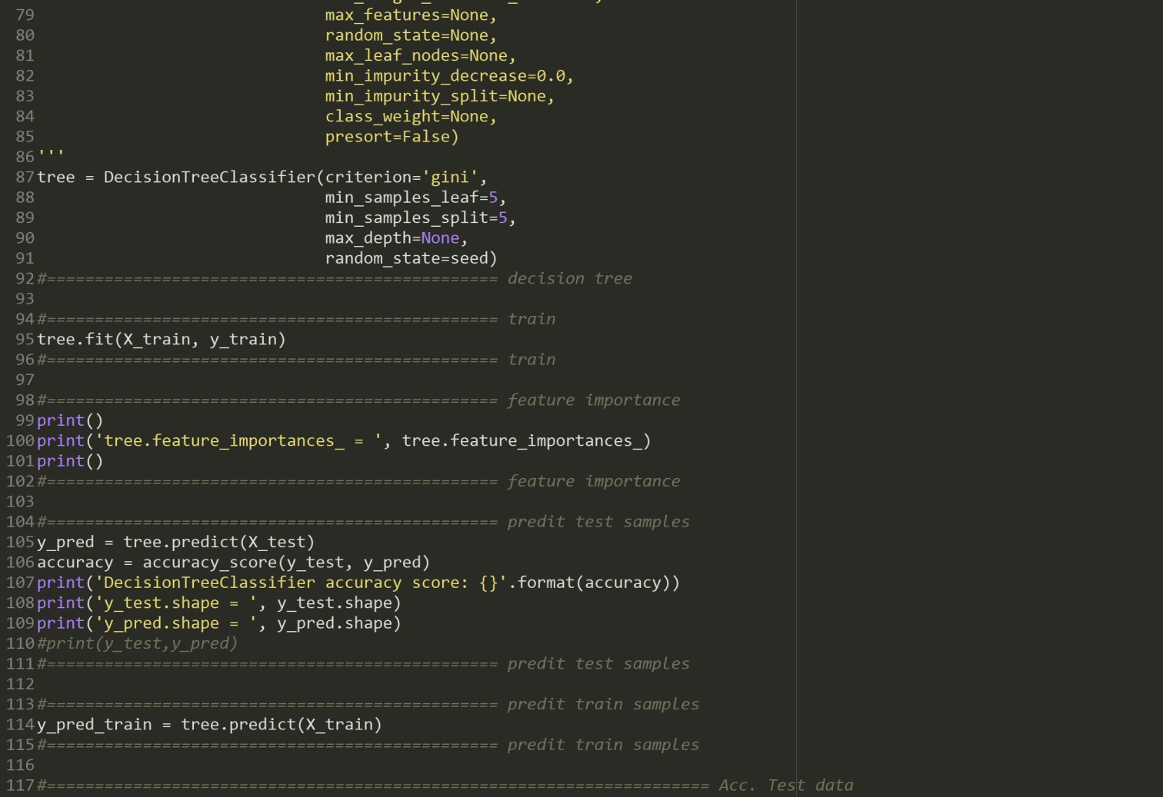
Decision Tree - Iris Problem

Slide 18
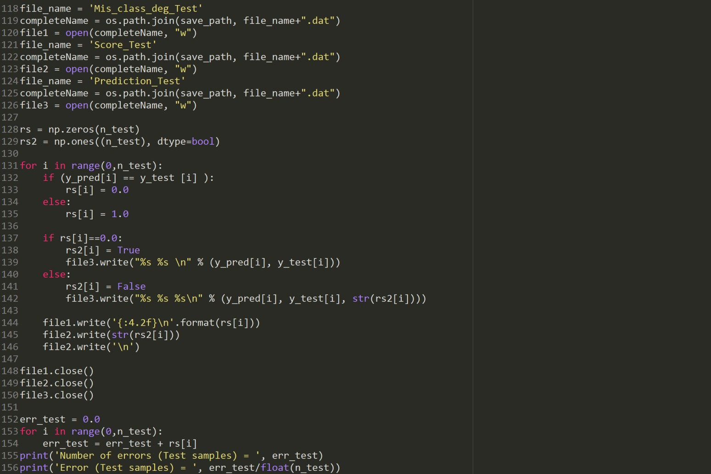
Decision Tree - Iris Problem

Slide 19
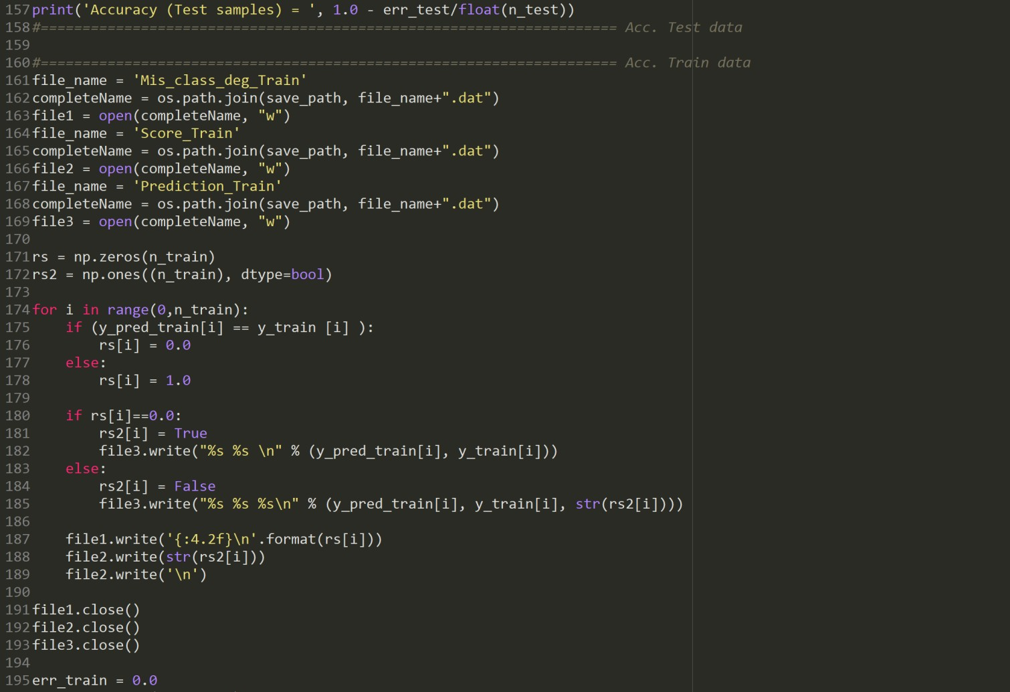
Decision Tree - Iris Problem

Slide 20
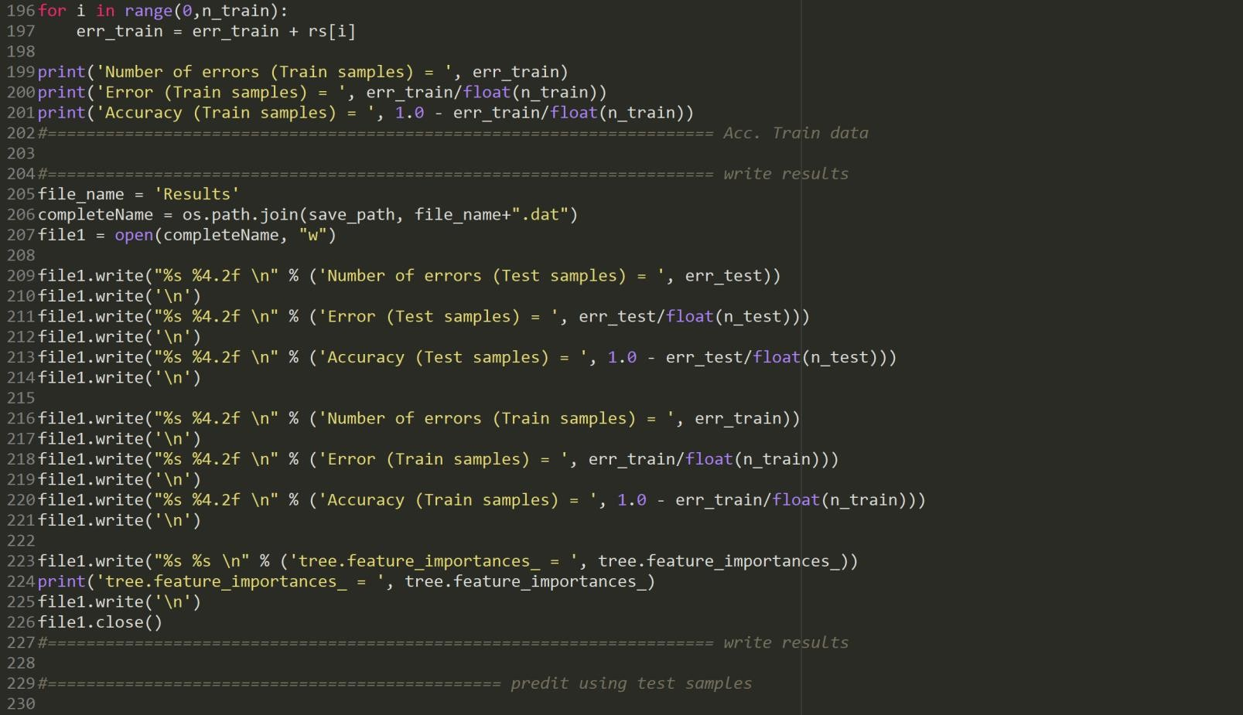
Decision Tree - Iris Problem

Slide 21
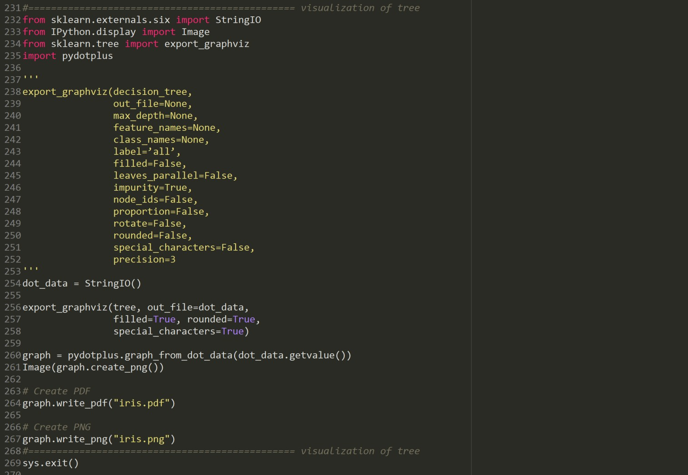
Decision Tree - Iris Problem

Slide 22
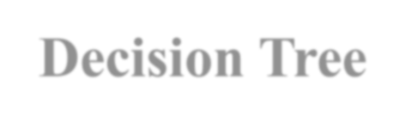
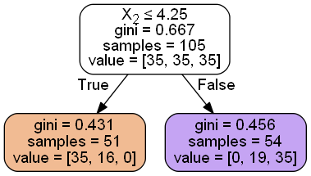
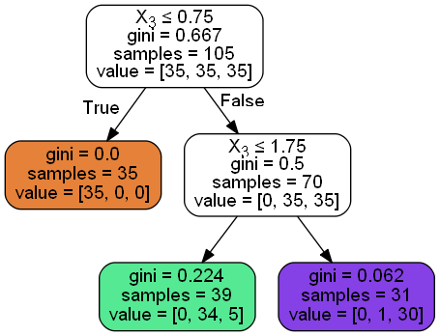
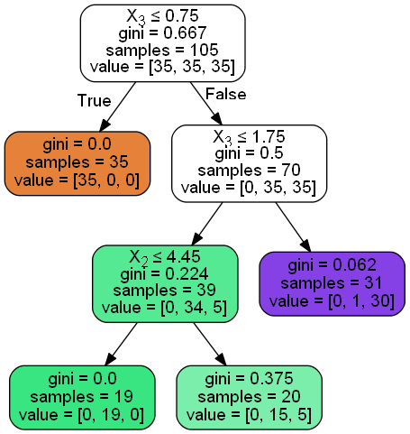
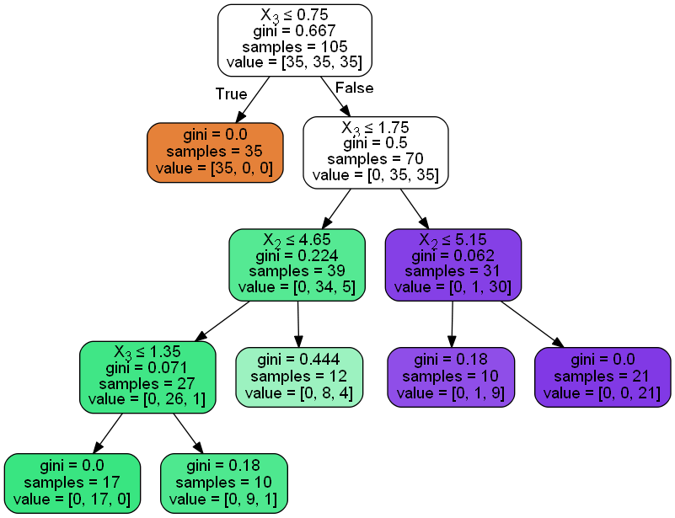
Decision Tree
Example 1: Iris problem
criterion='gini', splitter='best', min_samples_split=5, min_samples_leaf = ?, max_depth=20, max_features=None,
min_samples_leaf = 50
min_samples_leaf = 25
min_samples_leaf = 10
min_samples_leaf = 17

Slide 23
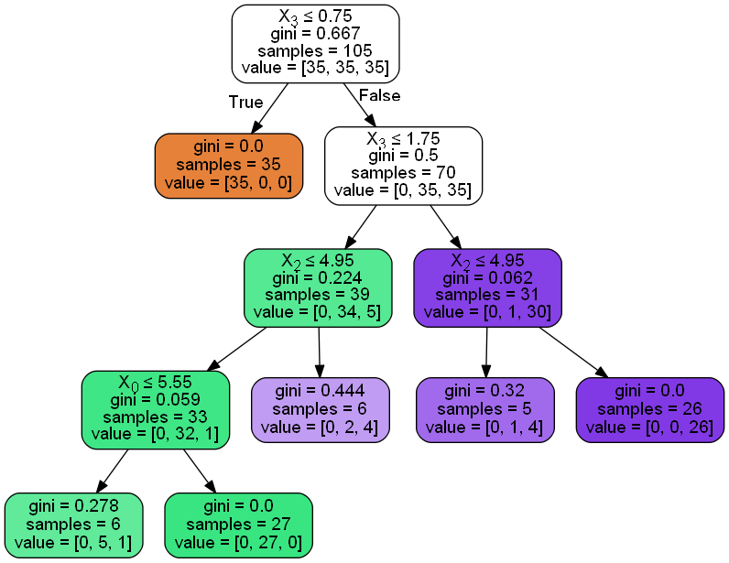
Decision Tree
Example 1: Iris problem
criterion='gini', splitter='best', min_samples_split=?, min_samples_leaf=5,, max_depth=20, max_features=None,
min_samples_split = 30
min_samples_split = 65
min_samples_split = 15

Slide 24
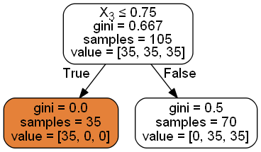
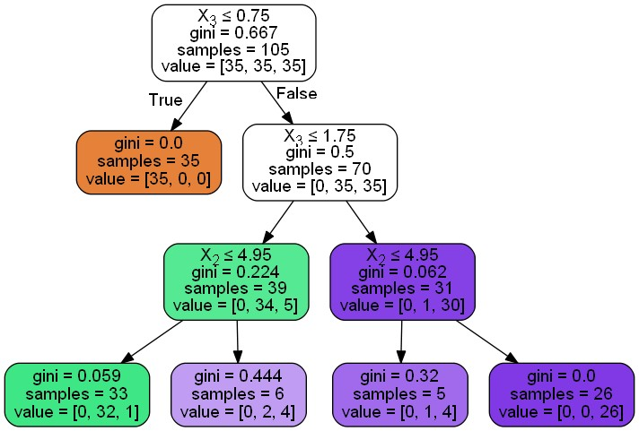
Decision Tree
Example 1: Iris problem
criterion='gini', splitter='best', min_samples_split=5, min_samples_leaf=5, max_depth = ?, max_features=None,
max_depth = 2
max_depth = 20
max_depth = 1
max_depth = 3

Slide 25
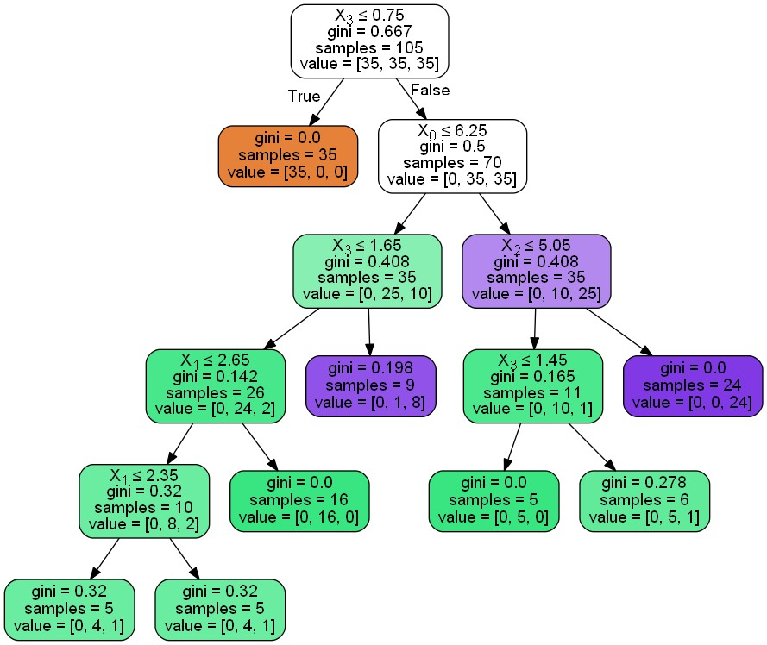
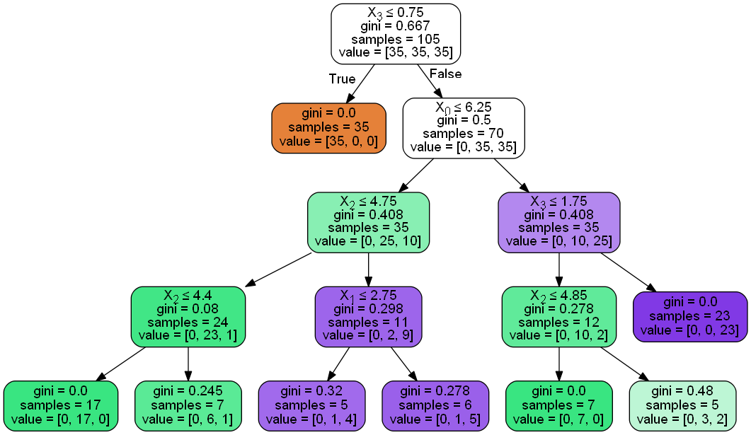
Decision Tree
Example 1: Iris problem
criterion='gini', splitter='best', min_samples_leaf=5, min_samples_split=5, max_depth=20, max_features = ?,
max_features = 2
max_features = 1
max_features = 4

Slide 26
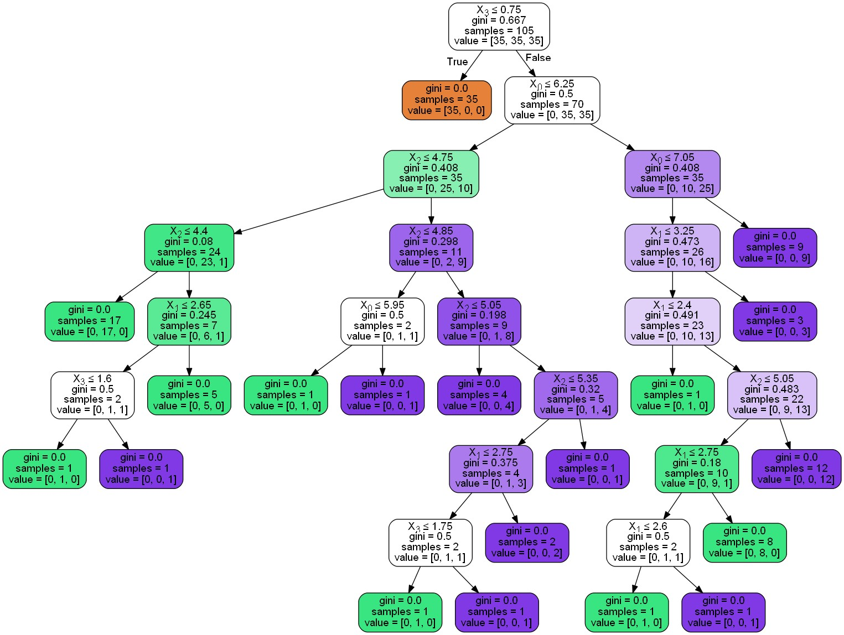
Decision Tree
Example 1: Iris problem
criterion='gini', splitter='best', min_samples_leaf=1, min_samples_split=2, max_depth=20, max_features=1,

Slide 27










Random Forest Algorithm
The random forest method is another way to elaborate nonlinear problems. Classification and Regression Trees (CART) were first introduced by Leo Breiman (2001) for classification or regression predictive modeling problems.
Trees: The trees are grown from different subsets of the training data by a bagging procedure (Breiman, 1996) which ensures the diversity of the trees and minimizes the similarities between them.
The bagging procedure is based on a bootstrap technique. In this method the mean value of a variable is calculated from the average of the mean values of the random subsets of that variable with replacement (i.e., the same value of the variable can be selected few times randomly in a subset). This reduces the correlation between the trees that may cause overfitting. The prediction for unseen data is then based on the average estimations from all regression or classification trees.
It has been shown that the generalization error for the forest converges as the number of the trees in the forest increases which prevents an overfitting problem. On the other hand, a reduction in the number of features in splitting reduces the correlation among trees and increases the model prediction accuracy (Breiman, 1996).

Slide 28

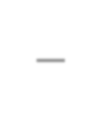

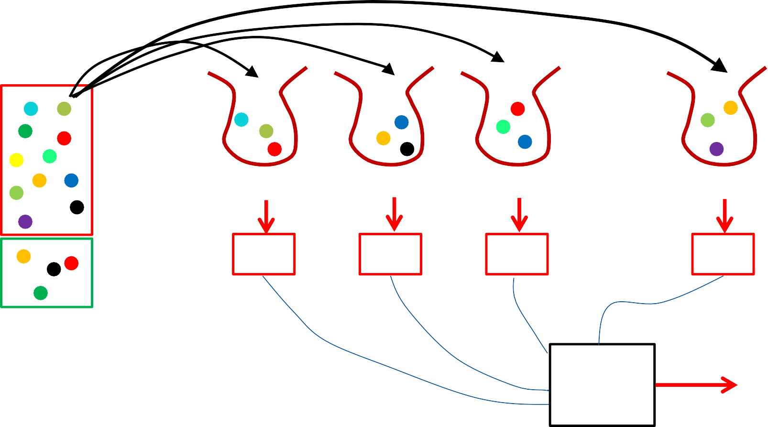
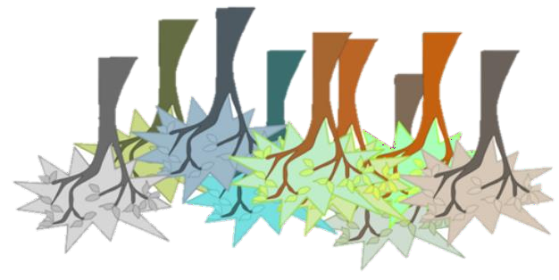
Bagging – Bootstrap Sampling
B₁
B₂
B₃
B_{m}
Train
Model1
Model 2
Model 3
Model m
Test
n: Number training samples
n’: Number of samples in a bag
Mean
y
n’<n (e.g., n’ = 60% n) m: Number of bags

Slide 29

Parameters
The random forest method has a number of tuning parameters (e.g., Raschka, 2015) which can be adjusted by a grid search or manually.
n_estimators : integer, optional (default=10)
The number of trees in the forest. Increasing this parameter to a certain level reduces the possibility of overfitting to the cost of computational time. However, a very large number of random trees may not result in a significant gain in the prediction accuracy and the score could even drop.
criterion : string, optional (default=”gini”)
The function to measure the quality of a split. Supported criteria are “gini” for the Gini
impurity and “entropy” for the information gain.
max_depth : integer or None, optional (default=None)
If None, then nodes are expanded until all leaves are pure or until all leaves contain less than min_samples_split samples. The depth of the tree is proportional to the number of splits of the nodes into the child nodes. Deeper trees are more complex and are more likely to overfit the training data.
.

Slide 30

Parameters
min_samples_split: int, float, optional (default=2)
The minimum number of samples required to split at each internal node of a tree (from one to all sample). However, splitting a larger number of samples at each node will cause underfitting and may abruptly cause a decrease in learning. This parameter may be declared as integer (the number of samples required to split at each node) or be set as the fraction of the samples in the range of 0<min_samples_split≤1 (floating).
min_samples_leaf : int, float, optional (default=1)
The minimum number of samples at a leaf node to avoid further splitting (integer or floating). Increasing this parameter may cause underfitting.
The parameters “max_depth” and “min_samples_leaf” control the level of regularization; that is, decreasing “max_depth” and increasing “min_samples_leaf” will result in a better regularization.
max_features : int, float, string or None, optional (default=”auto”)
The number of features to consider when looking for the best split.
The smaller values prevents overfitting, but too small values may introduce underfitting.
max_leaf_nodes: The maximum number of leaves in the tree.

Slide 31
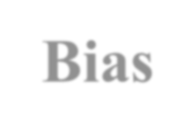



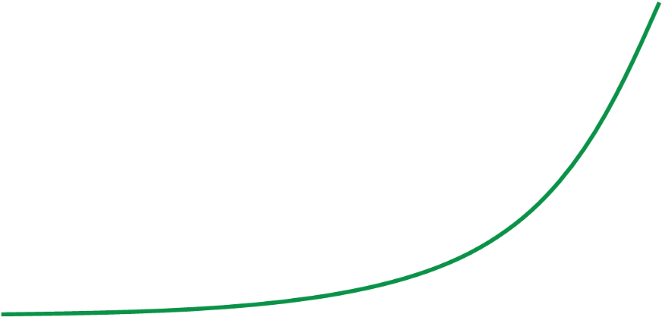

Bias-Variance Trade-off
Optimum Model complexity
Total Err
Variance
Bias²
Model Complexity
𝑬𝒓𝒓 𝒙
= 𝒈 𝒙 − 𝒇(𝒙) ^{𝟐} +
Bias
𝒈 𝒙 − 𝒈(𝒙) ^{𝟐} + 𝝈^{𝟐}
Variance Irreducible error

Slide 32




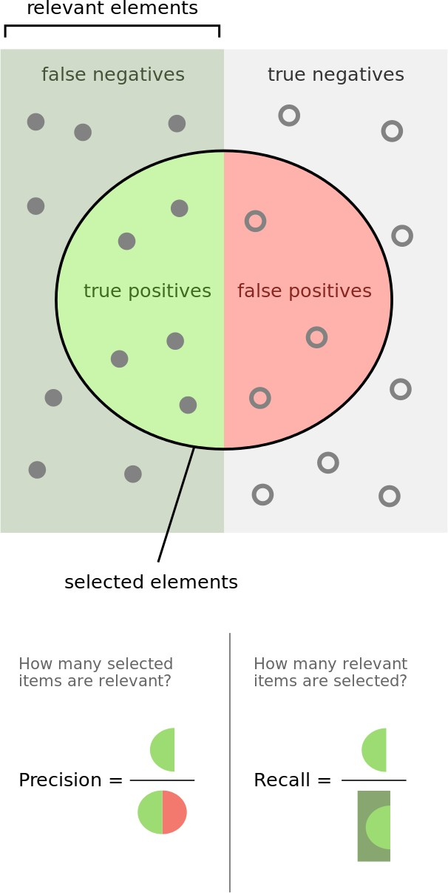
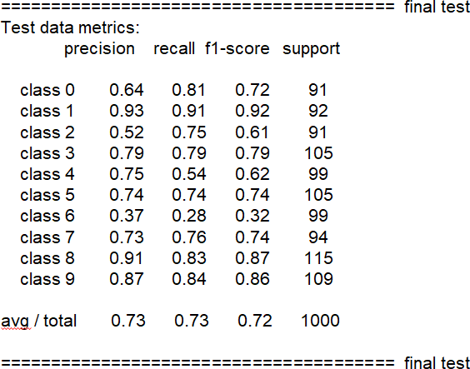
Random Forest Model
Image Recognition – Fashion Data
Fashion problem:
𝒑𝒓𝒆𝒄𝒊𝒔𝒊𝒐𝒏 = t_{p} / (t_{p} + f_{p})
𝒓𝒆𝒄𝒂𝒍𝒍 = t_{p} / (t_{p} + f_{n})
t_{p}: true positive f_{p} : false positive f_{n} : true positive
𝒇 = (𝟏 + 𝜷^{𝟐})
𝒑𝒓𝒆𝒄𝒊𝒔𝒊𝒐𝒏 × 𝒓𝒆𝒄𝒂𝒍𝒍
𝜷
𝜷^{𝟐} 𝒑𝒓𝒆𝒄𝒊𝒔𝒊𝒐𝒏 + 𝒓𝒆𝒄𝒂𝒍𝒍
𝒑𝒓𝒆𝒄𝒊𝒔𝒊𝒐𝒏 × 𝒓𝒆𝒄𝒂𝒍𝒍
^{𝒇𝟏 = 𝟐 ×} 𝒑𝒓𝒆𝒄𝒊𝒔𝒊𝒐𝒏 + 𝒓𝒆𝒄𝒂𝒍𝒍
The 𝒇_{𝜷} score can be interpreted as a weighted harmonic mean of the precision and recall, where an 𝒇_{𝜷} score reaches its best value at 1 and worst score at 0.
The support is the number of occurrences of each class in y_true.
Wiki

Slide 33
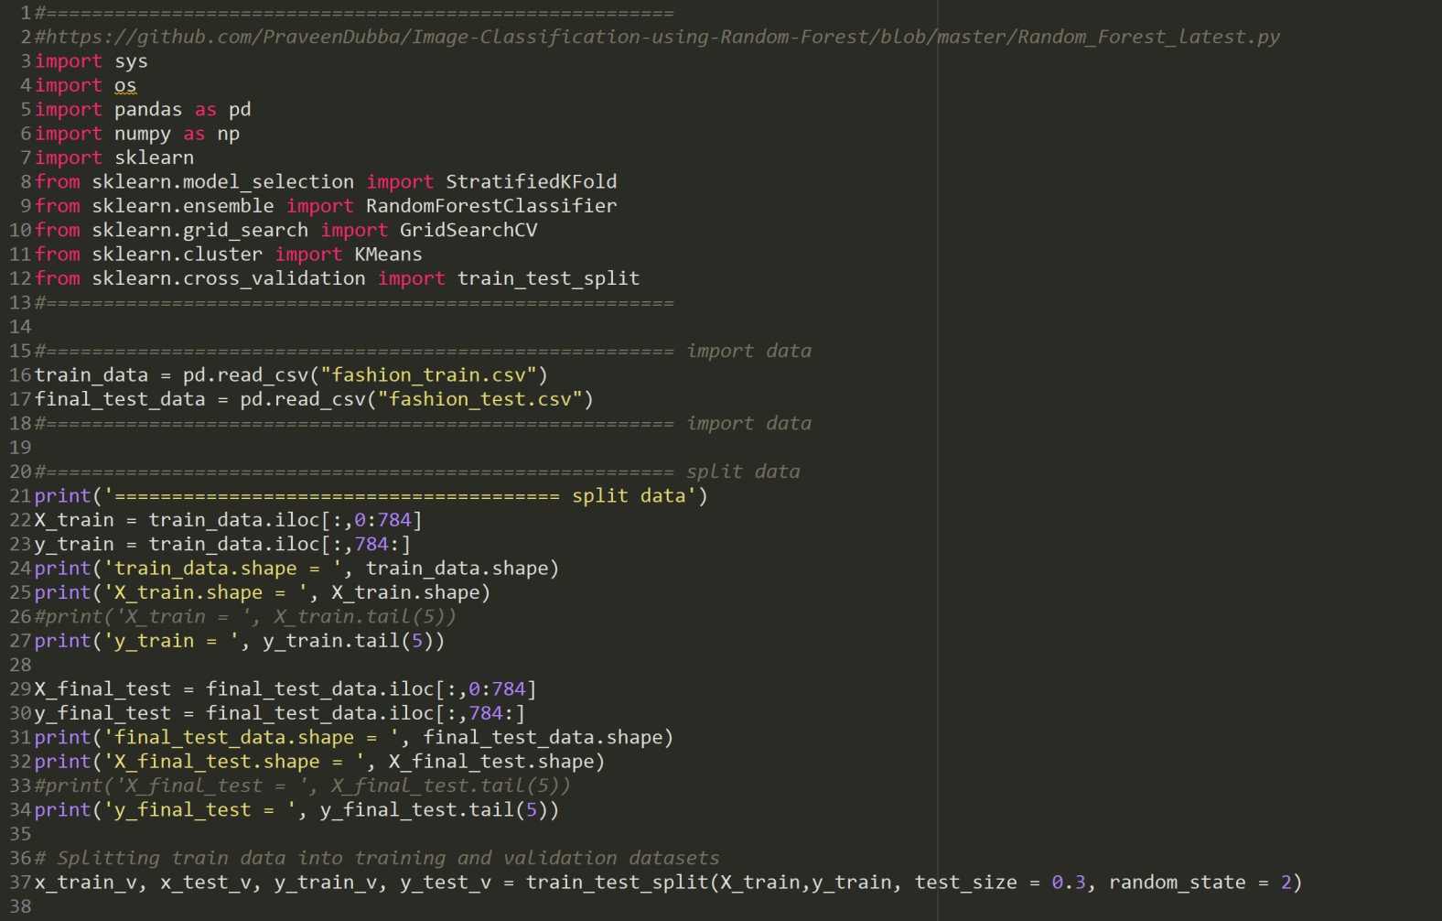
Random Forest Model
Image Recognition – Fashion Data

Slide 34
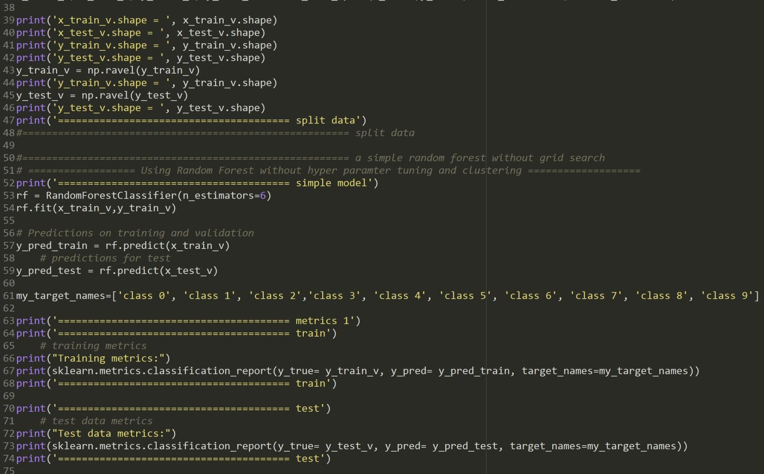
Random Forest Model
Image Recognition – Fashion Data

Slide 35
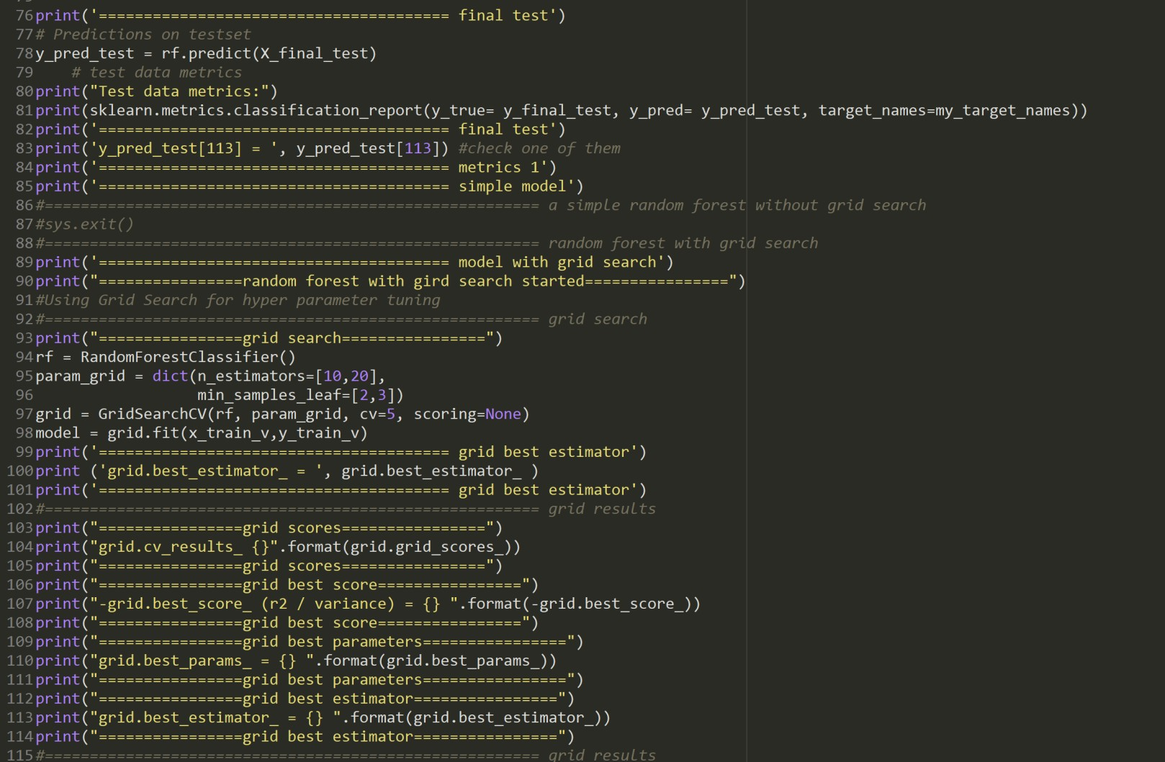
Random Forest Model
Image Recognition – Fashion Data

Slide 36
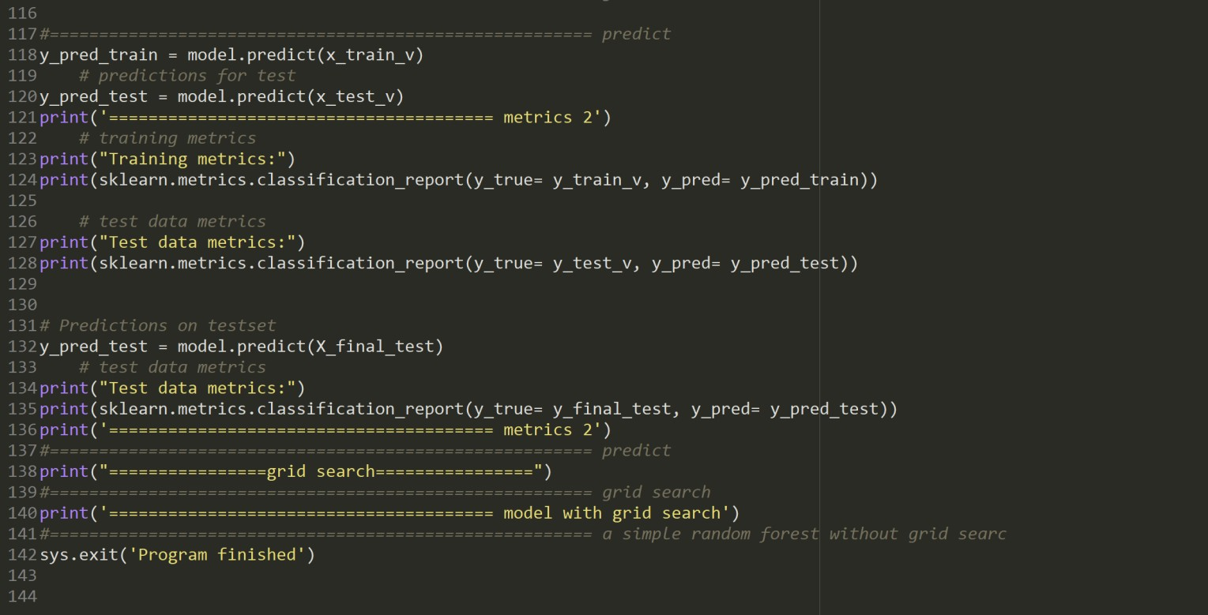
Random Forest Model
Image Recognition – Fashion Data

Slide 37

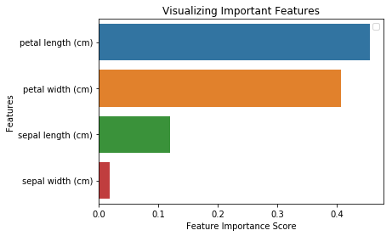
Feature Importance
tree.fit(X_train, y_train)
print('tree.feature_importances_ = ', tree.feature_importances_)
tree.feature_importances_ = [0.00425693 0. 0.06941788 0.92632519]
Or
clf.fit(X_train,y_train) import pandas as pd
feature_imp = pd.Series(clf.feature_importances_,index=iris.feature_names).sort_values(ascending=False)

Slide 38
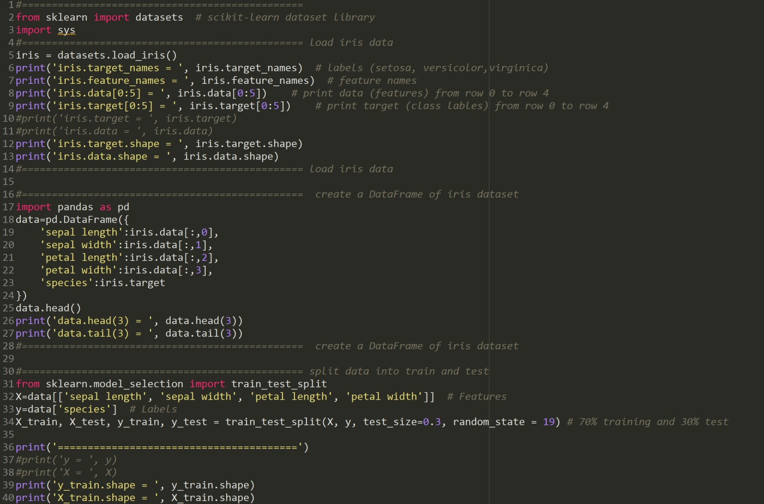
Feature Importance

Slide 39
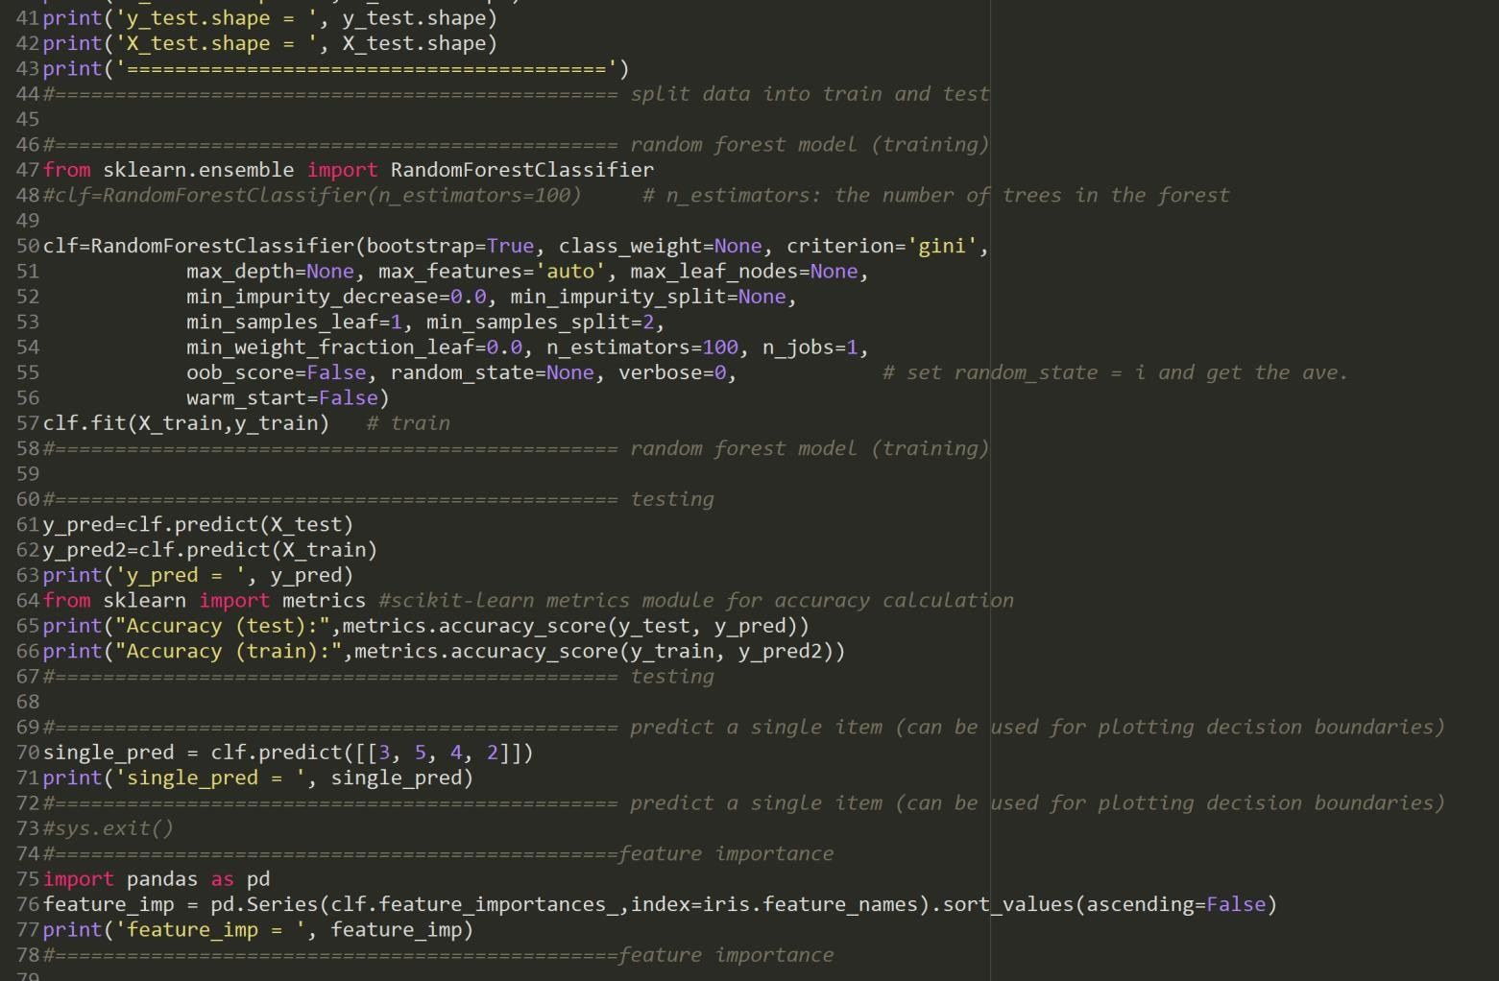
Feature Importance

Slide 40
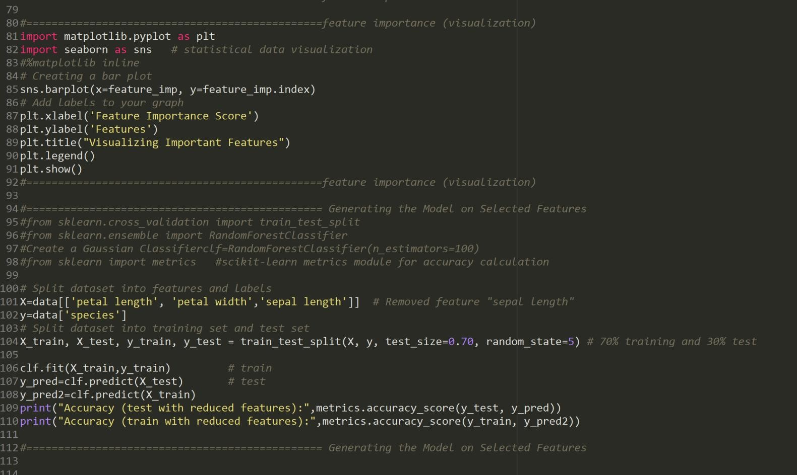
Feature Importance

