Slide 1
Conceptual Architecture
G17: Architecture
Addicted Aficionados
https://youtu.be/4FowPZlbfpQ

Slide 2
Group Members
Group Member | Role in Report
Sungmoon Choi | Implications for Developers / Presenter
Dayna Corman | Concurrency / Presenter
Michael Cox | Architecture Overview
Aydan Macgregor | Use-Case Sequence Diagrams / Leader
Samantha Mak | Control and Data Flow
Kylie Wong | Evolution of GNUstep & conclusions and lessons learned

Slide 3
1
Derivation Process
2
Architecture Overview and Components
3
Control and Data Flow
4
Concurrency and Use Case Diagrams
Notes:
(Dayna)

Slide 4
Derivation Process of GNUstep
Interaction and connection between components
1
Individual research, discussions
5
6
GNUstep strengths, challenges, adaptability
2
GNUstep vision, major components
3
GNUstep documentation, source code, and historical development
7
Architecture format
4
Community-driven resources: wiki pages, developer forums
8
Examples of architecture format
Notes:
(Dayna)

Slide 5
Architecture Overview: Layered Style & OO Components
Layered Style enables developers to focus on the application's functionality without worrying about the user's operating system or windowing system.
The lower layers can be adjusted to suit the user's OS, without affecting how the application's code interacts with the app-kit.
Notes:
(Dayna)

Slide 6
Components
Application: This is the program that the user creates that uses a GNUstep powered user interface.
Application Kit/app-kit: The app-kit is the collection of user interface elements, event-related classes, and classes designed to help with the development of tools, wrappers, and interfaces with web servers.
Libs-GUI: This is the part of the app-kit that handles all graphical user interface functionality, and contains classes and methods useful for all kinds of elements like buttons, select menus, and the like.
Notes:
(Dayna)

Slide 7
Components II
Libs-base: This is the part of the app-kit that handles all other functionalities that are useful to a developer, like interfacing with web servers, to utilities for tools.
Back end: The layer below the App-kit layer is the backend. This is where GNU-step starts to get very particular on the specific implementation of the operating system and windowing system that the end-user is using.

Slide 8
Component Interactions
Application
The application layer interacts mainly with the app-kit and shared library in GNUstep, allowing developers to program in a platform-independent way.
This ensures that developers don’t need to worry about system differences, thanks to the app-kit’s bindings.
App kit
The app-kit interacts with the shared library, the back-end, and the application.
It uses shared bindings to communicate with the back-end, allowing the back-end to be swapped for one that handles a different operating system, without affecting the app-kit or application.
Back end
The back-end interacts directly with the windowing and operating systems, requiring different versions for each system.
It works with the shared library for certain functions and is relied upon by the app-kit and, indirectly, the application. However, the application interacts minimally with the back-end.
Notes:
Could be combined with components if need be- (Dayna)

Slide 9
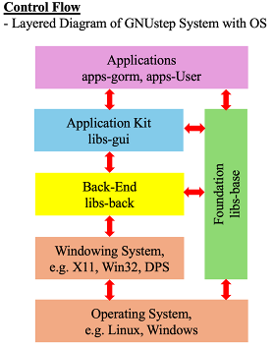
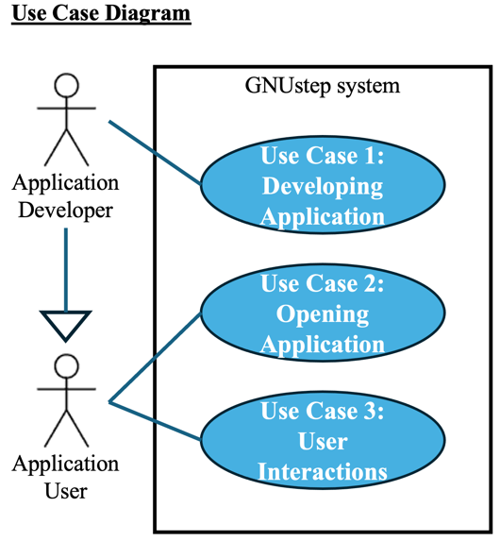
Control and Data Flow
Notes:
(Dayna)

Slide 10
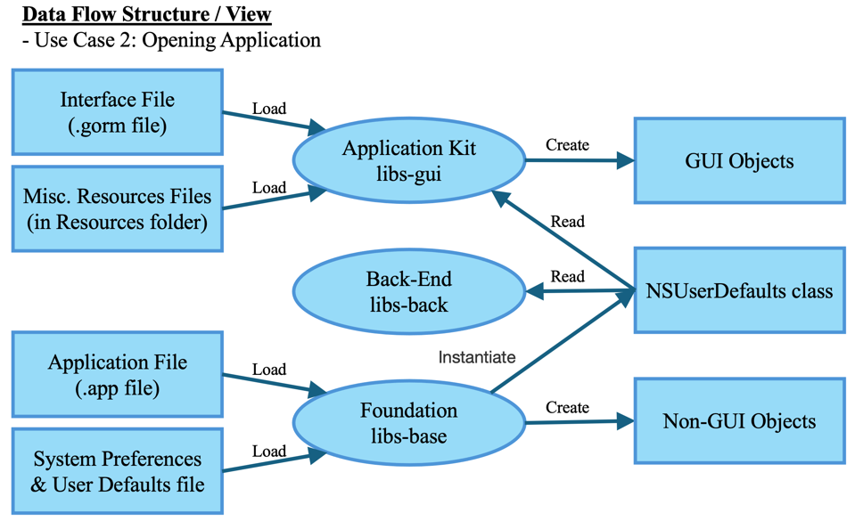
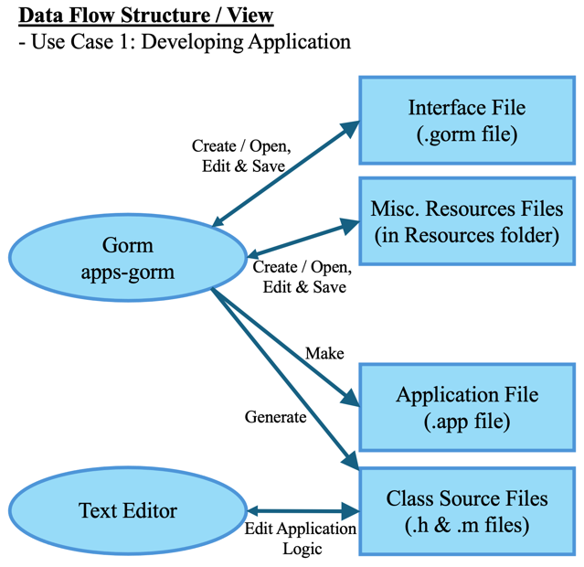
Control and Data Flow II
Notes:
(Dayna)

Slide 11
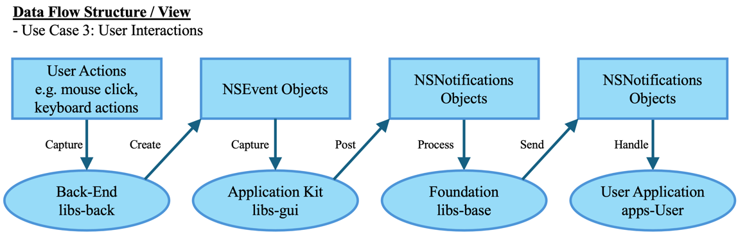
Control and Data flow III

Slide 12
Key Areas of Concurrency
GUI Processing
As a Framework for GUI application, users are able to interact with their application.
Low response time to ensure satisfactory user experience.
Offloading tasks to focus on user input or GUI updates.
Input Handling
Input from keyboard and mouse used to manipulate the GNUstep environment.
Executed on the main thread where events are dispatched and processed.
Offload tasks as background threads to prevent main thread blockage.
File Manipulation
Handles file synchronously and asynchronously using NSFileManager and NSFileHandle.
Uses NSThread to read and write to files asynchronously and NSData to read files synchronously.
Notes:
(Sungmoon)

Slide 13
Concurrency Control Mechanisms
Thread-Based Concurrency: Used to run multiple threads concurrently through NSThread Apple’s Grand Central Dispatch. Executing background tasks asynchronously.
Event-Based Concurrency: Used to handle user input and networking to ensure a low response time using NSRunLoop to prevent blocking the main thread. Maintaining responsiveness while performing operations.
Notes:
(Sungmoon)

Slide 14
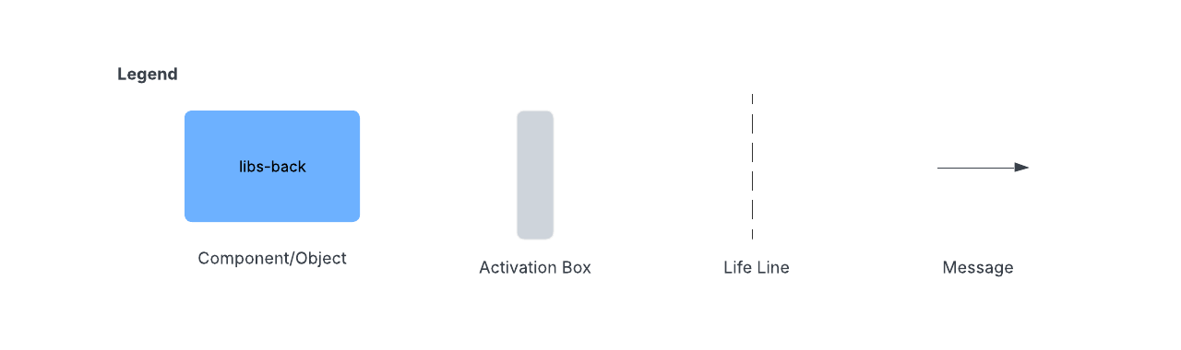
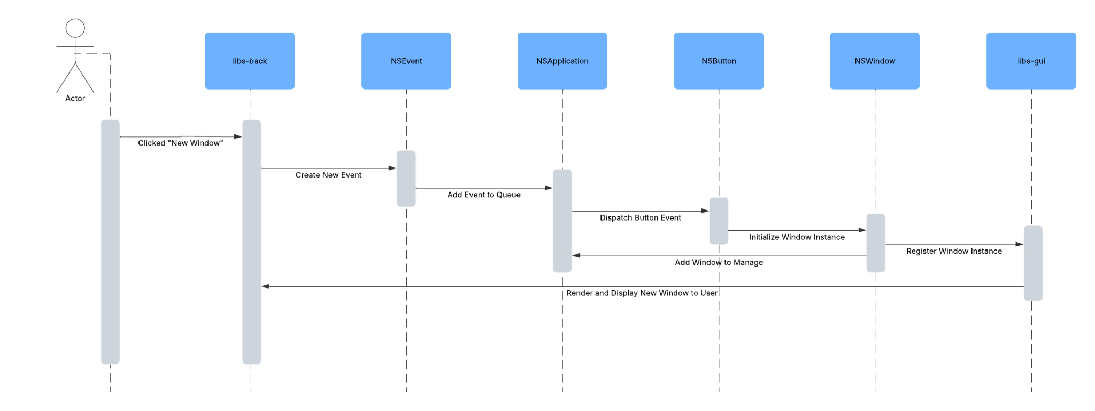
Use Case Sequence Diagrams
Use Case: The user creates a new window by selecting “New Window”
Notes:
(Sungmoon)

Slide 15
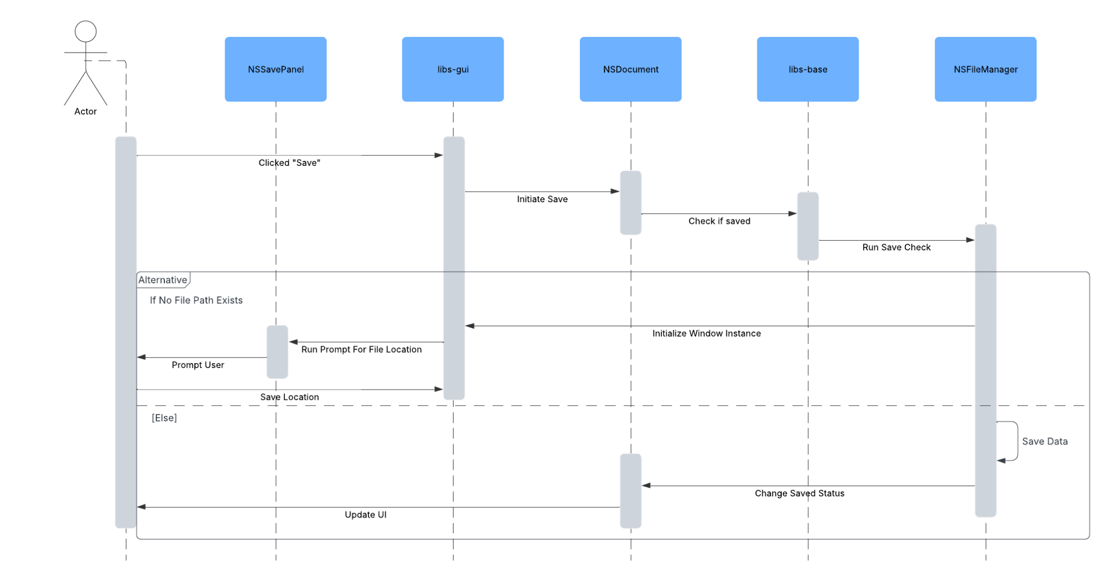
Use Case Sequence Diagrams II
Use Case: The user saves the application they are working on
Notes:
(Sungmoon)

Slide 16
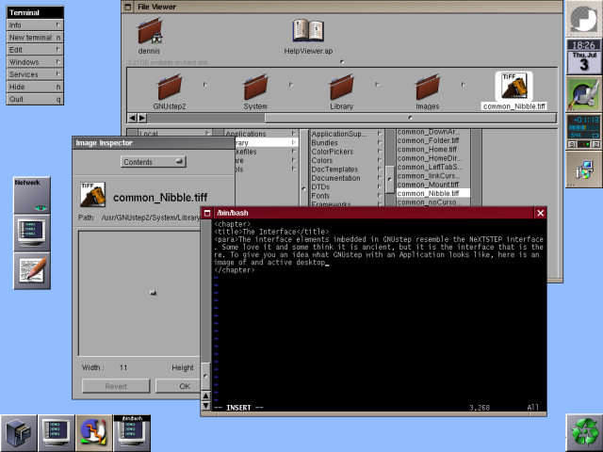
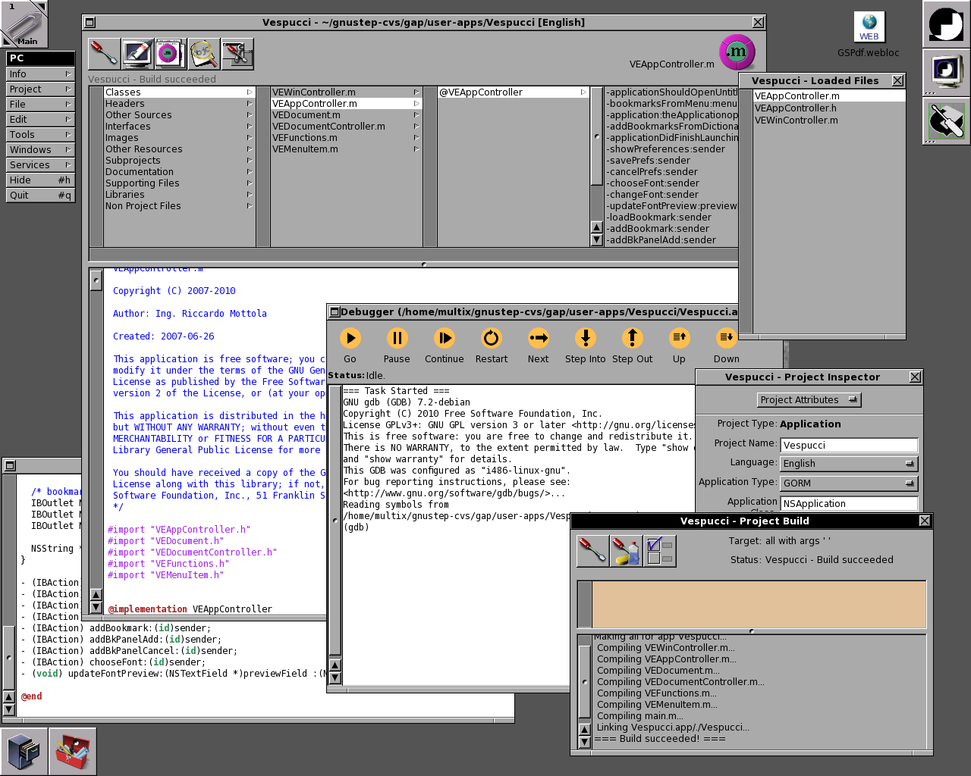
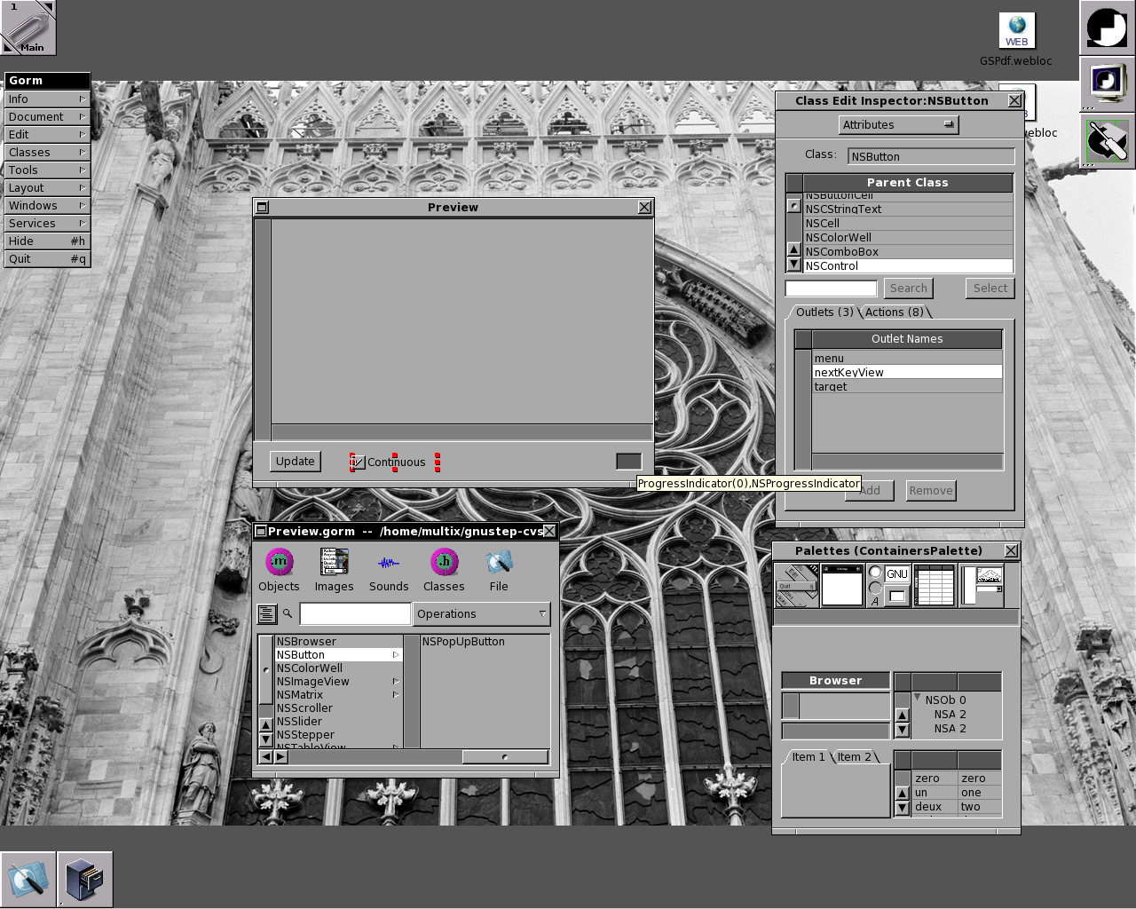
Implications for Developers
Figure 1: Example image of an active desktop in GNUstep, interface elements in GNUstep resembles the NeXTSTEP interface.
Figure 2: ProjectCenter is GNUstep’s IDE for development and management of applications.
Figure 3: Gorm allows developers to quickly create and edit graphical application interface.
Notes:
We might not even need this slide- (Sungmoon)

Slide 17
Modeling Alternatives and Potential Tradeoffs
Repository: offers centralized data management and streamlined communication, it lacks event-driven interactions.
Interpreter: offers dynamic script execution and flexibility, but not suited GNUstep’s more structured approach.
Ultimately, object-oriented and layered design styles are the most effective for maintaining cross-platform compatibility, independent development and modularity.
Notes:
Alternative architecture models - (see derivation process second par.) (Sungmoon)

Slide 18
Summary
Analyzed the conceptual architecture, focusing on its structure and key subsystems, data flow and concurrency.
GNUstep follows a layered architecture comprising five main object-oriented components.
Explored how different components interact to ensure seamless functionality.
Different concurrency types to handle user interaction and system events.
Examined structured control and data flow between layers.
Important Lessons:
Importance of flexibility in the system to adapt to changes
GNUstep has demonstrated the necessity of flexibility in a system to continuously adapt
Valuable insight into large-scale software architecture and development process
Experience analyzing and breaking down open-source software.
Notes:
(Sungmoon)

