Slide 1
Architecture Enhancement
G17: Architecture Addicted Aficionados
Link: https://youtu.be/OqvlP9FN_Ic
Notes:
*Don’t forget video link in this slide after presentation*

Slide 2
Group Member Roles
Group Members | Roles in Report
Sungmoon Choi | Mapping of Functional partitioning onto architecture’s structural decomposition(Presenter)
Dayna Corman | Comparison & Conclusion (Presenter)
Michael Cox | Testing Plan
Aydan Macgregor | Comparison & Conclusion (Leader)
Samantha Mak | Proposed enhancement
Kylie Wong | Non-Functional Requirements

Slide 3
1
Proposed Enhancement Overview
2
Impact of Proposed Architecture
3
Testing Plan
4
Architectural Approaches of Proposed Enhancement
Notes:
(Dayna)

Slide 4
Proposed Enhancement
We propose to enhance GNUstep with native three-dimensional graphics support with hardware accelerated rendering (3D-HAR).

Slide 5
Values and Benefits of 3D-HAR
Modernization – Updates and extends the GNUstep framework for modern graphical computing.
Platform Independence – Supports GNUstep developers in building cross-platform graphical systems.
Value-Added Software – Facilitates the development of advanced 3D graphics applications.
Hardware Abstraction – Shields developers from fast-changing hardware technologies.
Efficiency – Speeds up development cycles and enhances investment sustainability.
Functionality – Allows developers to concentrate on their application's core features.

Slide 6
Core Model Services
Virtual Rendering Services
Functional Partitioning of 3D-HAR
Transformer Services
Scene Services
Physical Rendering Services

Slide 7
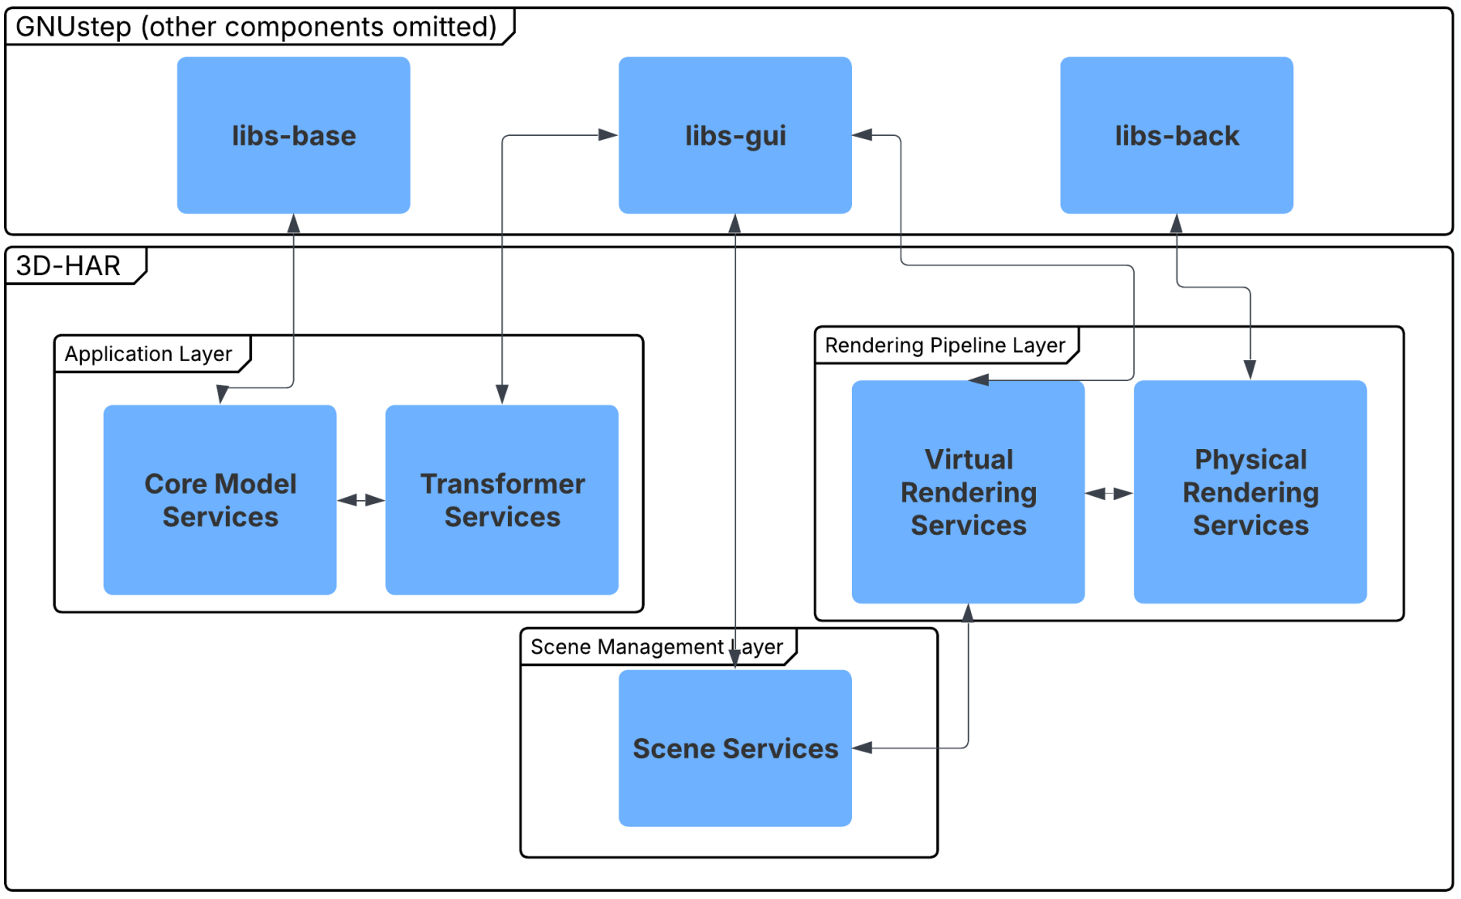
Mapping of Functional Requirements

Slide 8
GNUstep Component Changes for 3D-HAR
New 3D classes should derive from NSObject to ensure compatibility with GNUstep’s existing object-oriented framework
A new rendering engine must be integrated to support 3D visualization (OpenGL, Metal, Vulkan, etc.).
New UI elements in Gorm for designing and manipulating 3D objects.
Gorm must be updated to make 3D objects interactable with a mouse and keyboard.
Scene object hierarchy system to handle multiple 3D objects and lighting.

Slide 9
Component and Interface Changes I
Core Model Services
CMS
New classes to represent 3D object representation
Changed directory/file: libs-base/3DModel
Transformer Services
TS
Functions for scaling, rotating, and interaction
Changed directory/file: libs-gui/3DTransform
Management of objects and lighting in 3D space
Changed directory/file: libs-gui/3DScene
Scene Services
SS

Slide 10
Component and Interface Changes II
Virtual Rendering Services
VRS
Integration for 2D viewport
Changed directory/file: libs-gui/Rendering
Physical Rendering Services
PRS
Integration for GPU-bound rendering work
Changed directory/file: libs-back/3DRendering
G
UI implementation for 3D object manipulation
Changed directory/file: apps-gorm/3DObjects
Gorm

Slide 11
3D-HAR Risks
3D-HAR Risks
Security
Maintainability
Buffer Overflow
Memory Leaks
Codebase Expansion
Increased Technical Debt

Slide 12
Increased Complexity
Memory Management
Limitations of 3D-HAR
Hardware Dependency
Compatibility Issues

Slide 13
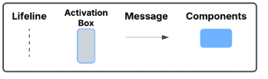
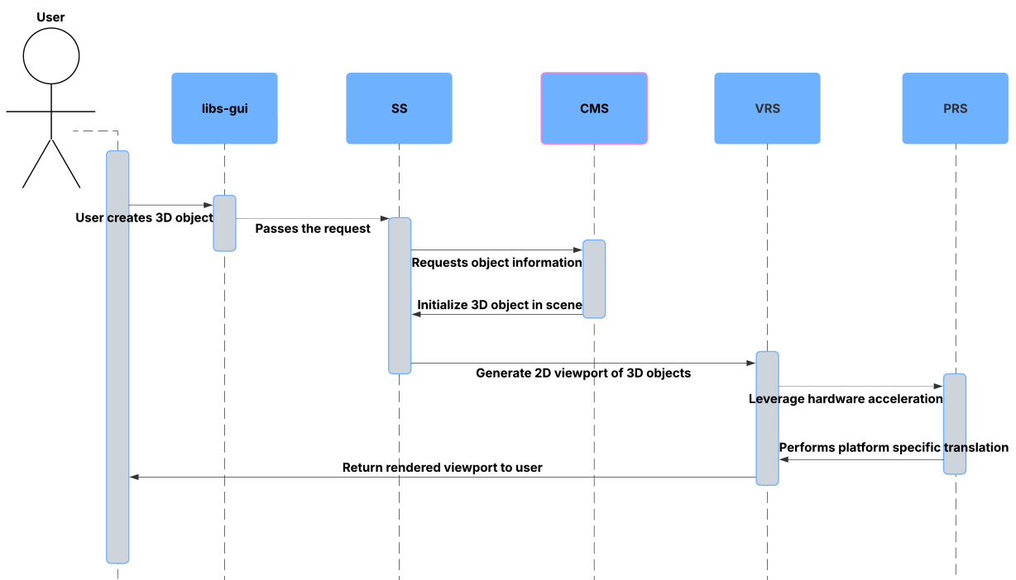
Sequence Diagram 1
Use Case 1:
User creates a 3D object

Slide 14
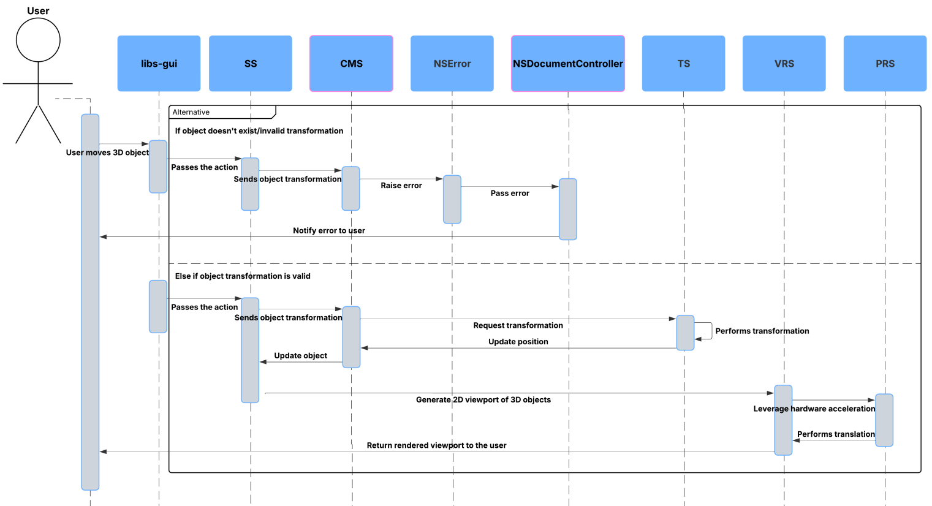
Sequence Diagram 2
Use Case 2:
Applying a transformation to a 3D object

Slide 15
Testing Plan for Each NFR I
Maintainability
Modifiability
Reusability
Usability
The idea of maintainability can be estimated with a “maintainability index”, which defines a formula that combines several other code metrics.
Maintainability indices, also describe ease of modification, so we can group these two NFRs into one test. We can also utilize tests for the next NFR to satisfy both this and the next NFR as well.
Reusability is another NFR that cannot be tested as is and must be analyzed through sub-criteria. In particular, we will focus on Modularity. Modularity can be assessed using unit testing and integration testing.
Usability is very difficult to quantify objectively, so the best way that we have to test it in a concrete way, is to do user testing. This is where you let many users test the software to ensure that they are easily able to perform intended tasks with as little issue as possible

Slide 16
Testing Plan for Each NFR II
Availability
Portability
Performance
The main way to test for availability is to just make sure that all tests pass before release, and record if and when a major issue is reported by users, and how fast the mean developer response is.
Portability can be tested, again with a kind of integration testing, where tests are run on different kinds of hardware/OS/windowing systems, such that proper functionality can be assured regardless of the environment the end-user is using.
The test for performance is easy to define concretely. Performance metrics can be defined, depending on some minimum hardware requirements

Slide 17
Architectural Approach 1:
Layered Style

Slide 18
Architectural Approach 1: NFR’s
Modifiability: The layered architectural style will reduce the need for interdependencies by organizing the functional partitions into layers. This implementation will allow for isolated modifications to be made to specific layers.
Maintainability: Each layer has a focused functionality of the system, for example, the UI or rendering. This can simplify debugging, allowing for each layer to be tested and debugged independently of the others. Layers can be updated and fixed independently, leading to faster maintenance.
Reusability: With clear and defined layers, components of the functionality can be reused independently. With layers designed to abstract platform-specific details, we can reuse the code across different platforms. As new platforms emerge, we can reuse code to integrate new platform-specific layers that can be added, swapped, or removed.

Slide 19
Architectural Approach 1: Stakeholders
GNUstep Project Community: A layered architecture provides the community with clearer transparency and decision-making.
Enhancement Contributors: Separating the concerns in our layered architecture makes it easier for the contributors to understand the project.
GNUstep Application Developers: Since layers are well defined, developers can focus on their specific application logic without the requirement of knowledge on the inner workings of lower level services.
GNUstep Application Users: With a layered architecture, changes made to the underlying system will not affect the UI, resulting in stable and predictable behaviour across applications.

Slide 20
Architectural Approach 1: Pros and Cons Table
Pros | Cons
Separates logical components for clear and independent layers | More layers mean more components to manage, this can complicate debugging
Enables independent development, testing and optimization | Some functionalities may need to be repeated across layers leading to code duplicates
Allows hardware and rendering service updates without disrupting other layers | Too many layers can make the system challenging to scale

Slide 21
Architectural Approach 2:
Event-Driven Style

Slide 22
Architectural Approach 2: NFR’s
Modifiability: Since our components interact through events instead of dependencies, modifying one component does not require a change to the other components. Additionally, event-driven object behaviours will be more flexible, allowing for adjustments without the modification of the core rendering pipeline.
Maintainability: If components interact through event triggers, then it becomes easier to track the flow of events instead of dealing with complicated dependencies. As time goes on and GNUstep expands, it will become easier to maintain an event-driven system since developers just need to update specific event handlers.
Reusability: Common 3D operations such as object transformation or input handling can be made with independent event listeners that can be reused across different GNUstep applications. Developers can reuse the event-driven components.

Slide 23
Architectural Approach 2: Stakeholders
GNUstep Project Community: Event-driven architecture provides a well-defined event flow, making the project easy to understand. There is also a faster adoption of new features for the community, allowing new enhancements incrementally by adding new events instead of refactoring the whole system.
Enhancement Contributors: Contributors can work on isolated event-driven modules without worrying about breaking other parts of the system. Since we don’t need to modify existing components, we can extend the functionality without any deep integration challenges from other components or functionalities.
GNUstep Application Developers: The applications are designed to only react when necessary, which reduces the amount of unnecessary computations.
GNUstep Application Users: Since event-driven architecture reduces the processing overload, applications will feel faster and more interactive, where users will benefit from real-time updates.

Slide 24
Architectural Approach 2: Pros and Cons Table
Pros | Cons
Increased performance through event-driven processing | Events must be processed sequentially or queued which may cause delays in rendering
Independent component development, testing, and debugging | Handling bugs in an event-driven system since errors can propagate unpredictably
Reactive components reduce processing requirements | Asynchronous event flows make it harder to track execution order

Slide 25
Best Realization of Architectural Approach
Layered Architecture | Event-Driven Architecture
Clear separation of logical components | Provides real-time updates and asynchronous processing
Improves project understanding for contributors and developers | Faster compute time benefits only a niche group of users
Clear separation of logical components. | Shares some benefits with layered architecture but lacks maintainability advantages
Conclusion:
Layered architecture offers better long-term scalability, maintainability, and optimization for 3D-HAR. It provides a more refined experience for stakeholders than an event-driven approach

Slide 26
GNUstep Concurrency Application for 3D-HAR
GUI Processing
As a Framework for GUI application, users are able to interact with their application.
Low response time to ensure satisfactory user experience.
Offloading tasks to focus on user input or GUI updates.
Input Handling
Input from keyboard and mouse used to manipulate the GNUstep environment.
Executed on the main thread where events are dispatched and processed.
Offload tasks as background threads to prevent main thread blockage.
File Manipulation
Handles file synchronously and asynchronously using NSFileManager and NSFileHandle.
Uses NSThread to read and write to files asynchronously and NSData to read files synchronously.
Notes:
(Sungmoon)

Slide 27
Team Issues and Report Limitations
Diverging Priorities: Some of our team members prioritize stability and maintainability while other prioritize performance and new features
Lack of Expertise: Our team has very limited experience on 3D graphics programming
Changing Development Roadmap: Future GNUstep updates could alter their API structure or architectural requirements making research outdated.
Hardware Dependency: The impact of 3D-HAR on GNUstep can vary based on GPU capabilities which makes discovered findings much harder to generalize.

Slide 28
Conclusion
Enhancement
Impacts and Risks
Architectural Decision
Team Learning
We proposed to enhance GNUstep with native three-dimensional graphics support with hardware accelerated rendering (3D-HAR).
The project will increase codebase complexity and introduce security vulnerabilities but will also provide performance and maintainability benefits.
A layered architecture was chosen for better maintainability, performance, and separation of components, benefiting all stakeholders.
The project provided valuable insights into architectural analysis, collaboration, and development, which our team will apply in our future careers.

