Slide 1
Concrete Architecture
G17: Architecture Addicted Aficionados
Video Link: https://youtu.be/VwYC3YgyaW0

Slide 2
Group Member Roles and Link
Group Member | Role in Report
Sungmoon Choi | Gorm Components and Component Interactions (Presenter)
Dayna Corman | Gorm Sequence Diagram and Notable Design Patterns (Presenter)
Michael Cox | Architecture top-level concrete with understand, dependency diagrams, components and component interactions
Aydan Macgregor | Introduction, Derivation Process, Use case sequence diagrams, conclusions and lessons learned (Leader)
Samantha Mak | High level architecture reflection, concrete implementation, discrepancies and rational
Kylie Wong | 2nd level subsystem reflection, Conceptual vs concrete, dependencies and key discrepancies
Notes:
After presentation add Video link in this slide

Slide 3
1
Derivation Process, Architecture Overview and Style
2
The Gorm Subsystem and Gorm Discrepancies
3
Concrete and Conceptual Dependencies
4
Key Discrepancies and Use Case Diagrams
Notes:
Overview

Slide 4

Derivation Process
1
Understand Tool
2
GNUstep documentation
A
Dependency Graphs
3
Community-driven Resources
B
Component Interactions
C
Newfound Interactions Between Components

Slide 5
Architecture
Components
apps-gorm
libs-corebase
libs-back
libs-gui
libs-base
2nd Level Subsystem:
Gorm

Slide 6
Architecture Overview
Gorm comprises different components to function including frameworks:
GormCore
InterfaceBuilder
GormObjCHeaderParser
Publish-
Subscribe
Object Oriented
Object-oriented: Components are structured like objects with their responsibilities where they interact through method calls.
Publish-subscribe: Components interactions are event-based and react according to the current state.

Slide 7
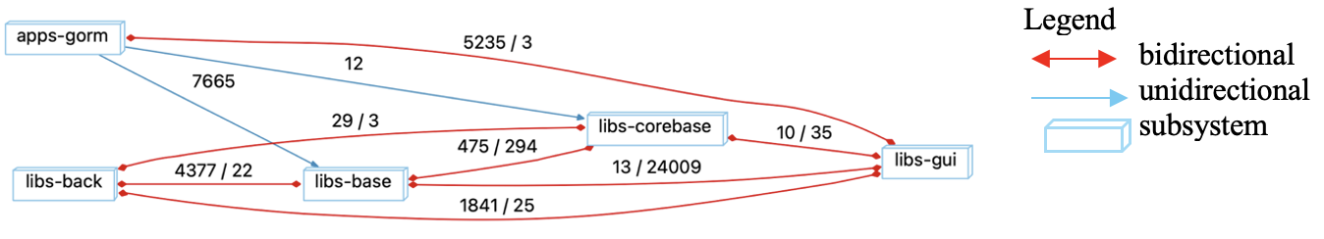
Gorm Full Dependency Diagram

Slide 8
Gorm
Components
Overview
GormCore
Applications
GormObjCHeaderParser
Plugins
InterfaceBuilder
Tools
Notes:
(You may take this slide out if necessary)

Slide 9
Gorm Components
GormCore:
The central component of Gorm, responsible for managing the application state and handling .gorm files (loading, saving and parsing files).
GormObjCHeaderParser:
Header file parser to read Objective-C.h files to extract class and method definitions used to understand the structure of custom classes and integrate them into Gorm’s UI design process.
Interfacebuilder:
The graphical user interface for designing and modifying .gorm files, allow users to drag and group UI components and property inspectors to modify attributes.

Slide 10
Gorm Components II
Applications:
Standalone applications that complement Gorm’s functionality.
Plugins:
Plugins are modular extensions that enhance their functionality by adding support to different UI formats, data models, and additional interface features. They allow Gorm to be flexible and extensible without modifying its core architecture.
Tools:
This component provides various utilities and tools that assist in the design and development process.

Slide 11
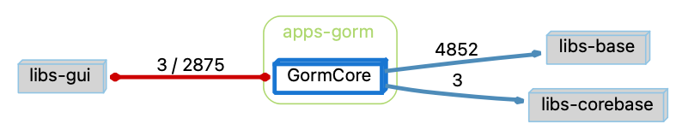
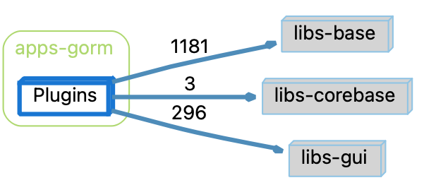
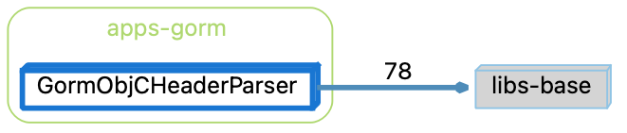
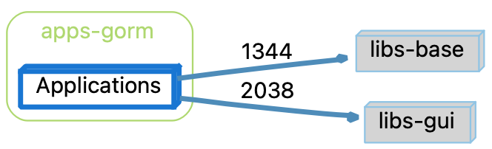
Component Dependency Graphs (in app-gorm using Understand)
GormCore
Plugin
GormObjCHeaderParser
Applications

Slide 12
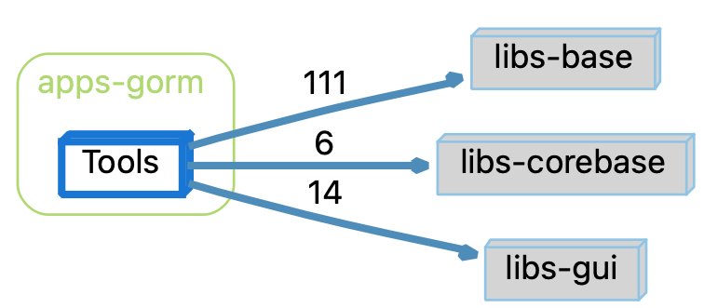
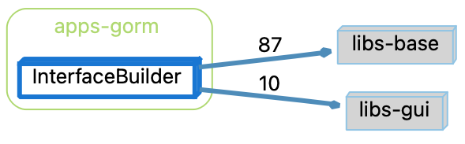
Component Dependency Graphs (in app-gorm using Understand)
Tools
InterfaceBuilder

Slide 13
Gorm Component Interactions
GormCore ↔ InterfaceBuilder:
GormCore provides the foundational functionality for the InterfaceBuilder to create and edit UI elements and InterfaceBuilder depends on GormCore for managing the document.
GormCore ↔ GormObjCHeaderParser:
GormObjCHeaderParser parses header files and provide method information to GormCore, such as in GormObjCHeaderParser.m, it parses an Objective-C header file and extracts class and method information which is then registered in GormClassManager.m in GormCore, being used for UI.

Slide 14
Gorm Component Interactions II
GormCore ↔ Plugins:
Plugins interact with GormCore to extend its functionality where in GormPluginPalette.m, it manages and loads the available UI elements into the palette where it is added to the document’s hierarchy in GormDocument.m.
GormCore ↔ Tools:
Tools interact with GormCore to manipulate the UI or generate code.

Slide 15
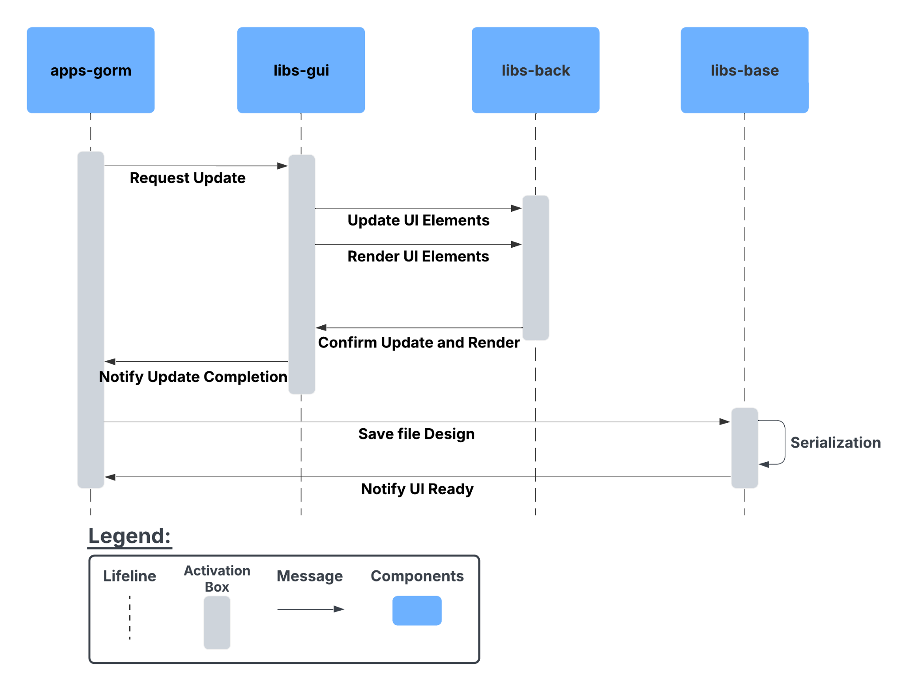
Gorm Sequence Diagram
Gorm sequence diagram of the user making a UI change and saving the file.

Slide 16
Gorm Architecture Design Patterns
Model View Controller:
Gorm acts as a view builder that shows the user the UI while we keep the model and controller separate as it works in Objective-C. By separating the different UI aspects, Gorm can promote flexibility, maintainability, and ease of testing in its subsystem.
Decoder Pattern:
Gorm files store the UI information in a serialized format that must be decoded at runtime to reconstruct the UI components and connections without hardcoding. This allows for UI state preservation, making saving and loading Gorm files easier.

Slide 17
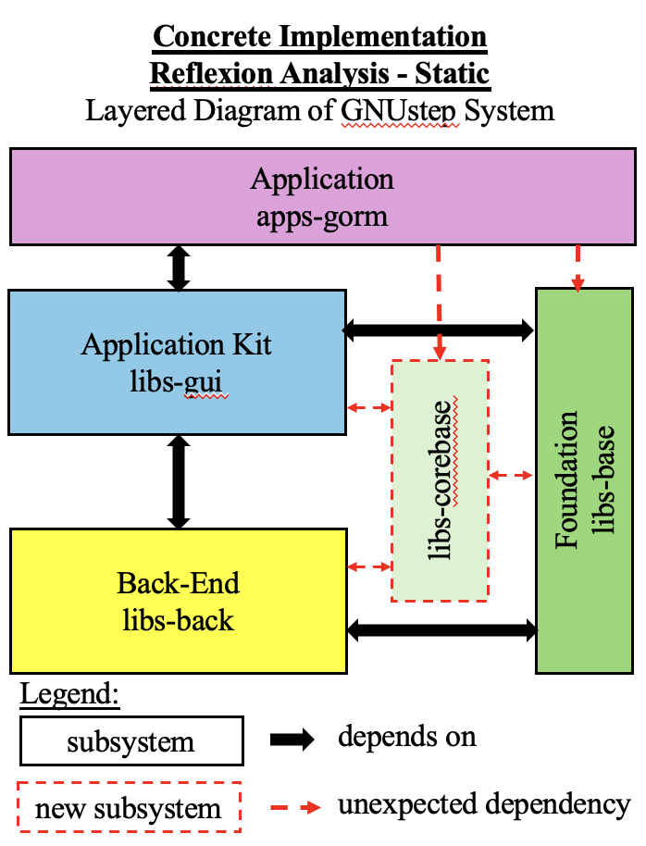
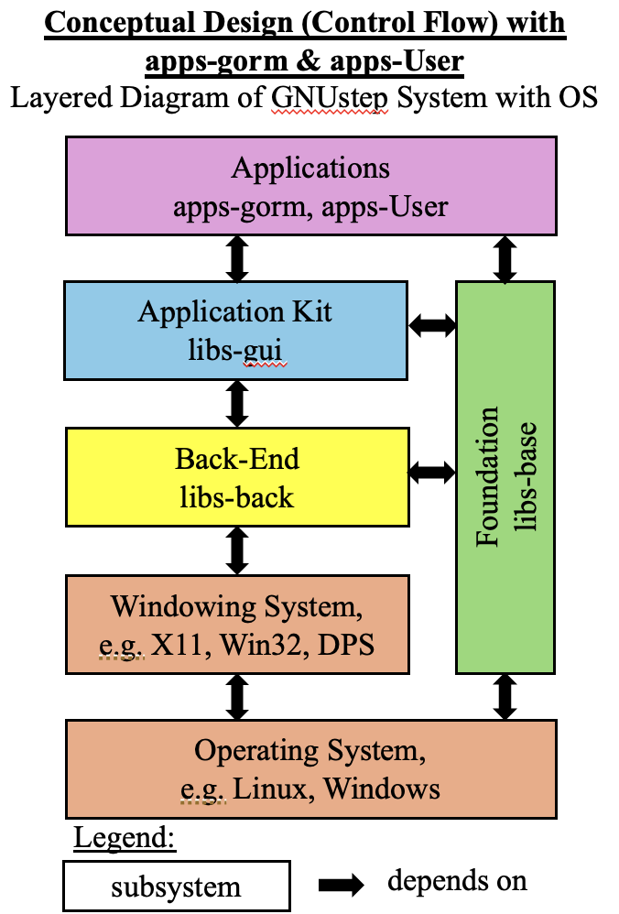
Concrete Implementation
Layered Diagram of Concrete Implementation (Reflexion Analysis - Static)
Recapped - Layered Diagram of Conceptual Design (Control Flow) in Assignment 1

Slide 18
Discrepancies and Rational
Discrepancy #2: Directions of flow between apps-gorm and libs-base
Discrepancy #1: presence of libs-corebase
Rationale: We have missed the relations, and entity, of libs-corebase.
Rationale: We used difference mechanisms in creating conceptual design vs. concrete implementation
little public documentation on libs-corebase, a library of general-purpose, non-graphical C objects.
functions seem to overlap significantly with libs-base, which is well-documented in its interactions with other libraries.
Limited knowledge in SciTools Understand runtime behaviours of program
At runtime, a user-defined object in a GNUstep application can register its interest in a notification with its selector method by names as string parameters to the notification center.

Slide 19
Conceptual vs. Concrete
Conceptual
Concrete
Modular, centralized system structure
Gormcore acts as central hub for UI management
Bidirectional Dependencies
Gorm ↔ libs-GUI (visual comp.)
Gorm ↔ libs-base (core logic)
Interacting Components
Interfacebuilder, plugins, tools, applications
Gorm only depends on libs-base
Bidirectional dependency between Gorm and libs-gui remains unchanged (visual comp.)
Gorm depends on libs-corebase for string encoding
Introduction of libs-corebase

Slide 20
Unexpected Dependencies
1. GormCore —(3)→ libs-corebase
There are two dependencies on libs-corebase in GormClassManager in using NSASCIIStringEncoding. This dependency was introduced by the lead developer of GNUstep Gregory Casamento on June 5, 2006.
2. Tools —(6)→ libs-corebase
Tools depend on libs-corebase for using NSUTF8StringEncoding, which is used in AppDelegate.m for processing tasks such as text encoding and conversion
3. Plugins —(3)→ libs-corebase
Plugins depend on libs-corebase for using NSUTF8StringEncoding and NSASCIIStringEncoding, specifically in Xib and GModel. This dependency was introduced by Gregory Casamento on October 22, 2023

Slide 21
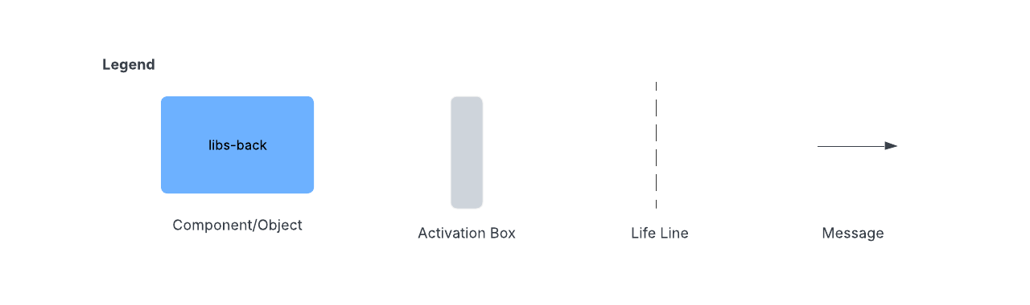
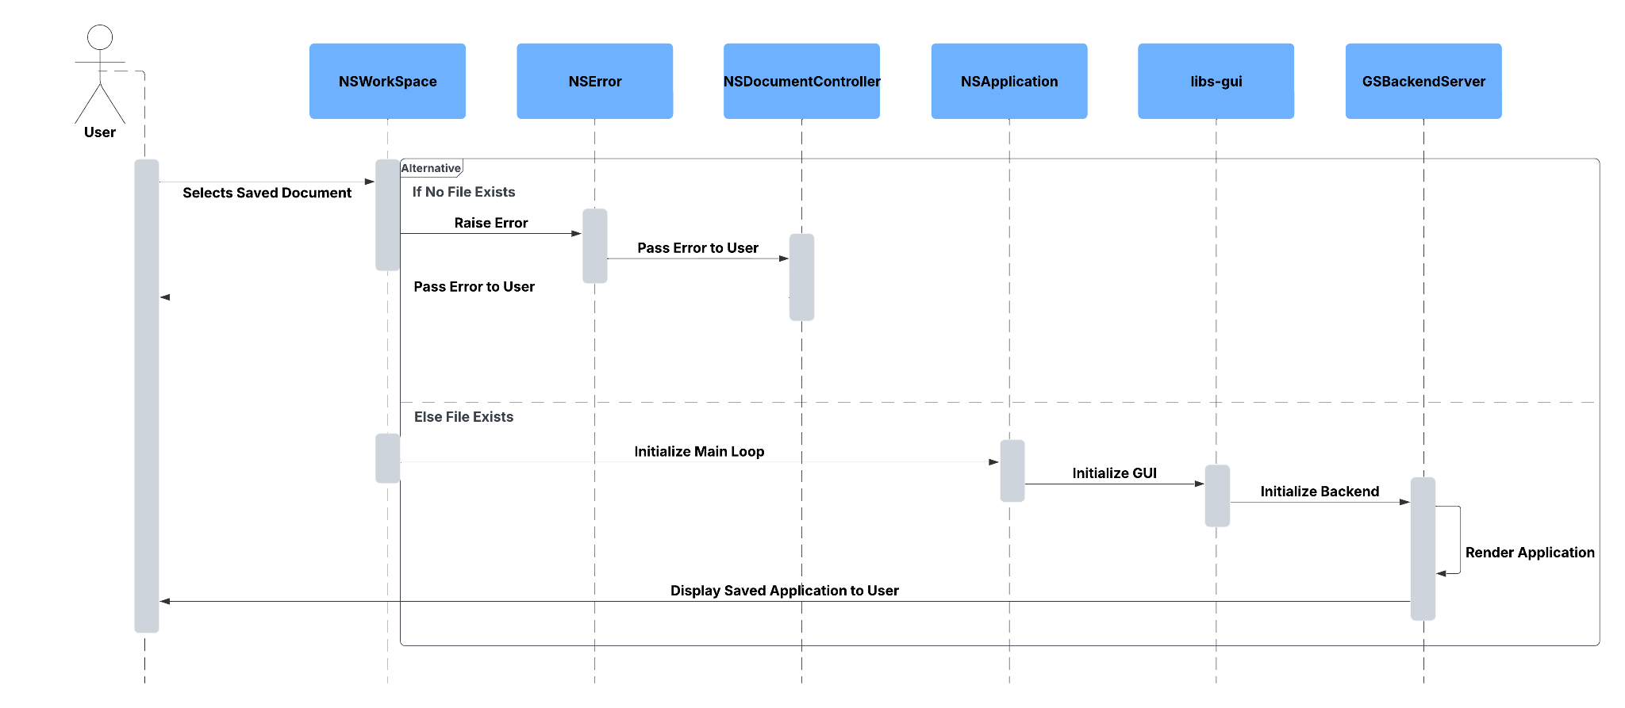
Use Case Sequence Diagrams
Use Case: The user selects a saved application to load

Slide 22
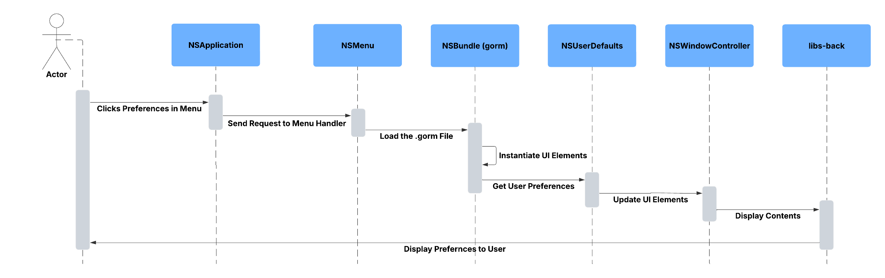
Use Case Sequence Diagram II
Use Case: The user loads preferences built with Gorm

Slide 23
Conclusion and Lessons Learned
Key Learnings and Appreciation
Gained deeper insight into the scale and complexity of GNUstep
Developed greater admiration for the efforts of the GNUstep development team
Comparison With previous Report
Comparison with conceptual architecture from the previous report
Found discrepancies in initial understanding and made fixes to better reflect component interactions
Confirmed layered style from previous assignment proposed does closely reflect the GNUstep architecture
Use of the Understand Tool
Helped to analyze interactions and dependencies in GNUstep and Gorm
Dependency graphs made understanding the concrete architecture easier than source code

