Slide 1

ORC File & Vectorization Improving Hive Data Storage and Query Performance
Owen O’Malley
owen@hortonworks.com
@owen_omalley
Jitendra Pandey
jitendra@hortonworks.com
Eric Hanson
ehans@microsoft.com
owen@hortonworks.com
June 2013

Slide 2
ORC – Optimized RC File

Slide 3
History
Originally Hive used MapReduce’s FileFormats
Text
SequenceFile
RCFile was developed to improve matters
Only read required columns (projection)
Each column is stored separately
Compresses columns separately
Avoid deserializing extra columns
Lazy deserialization

Slide 4
Remaining Challenges
Stores columns as type-free binary blobs
Can’t optimize representation by type
Can’t keep meaningful indexes
Complex types were not decomposed
Seeking into file requires byte by byte search
Need to find the sync marker
Compression done using stream-based codecs
Decompress column from start of group
Metadata is added at beginning of file
Lazy deserialization is very slow

Slide 5
Requirements
Two Primary Goals
Improve query speed
Improve storage efficiency
Support for the Hive type model
Complex types (struct, list, map, union)
New types (datetime, decimal)
A single file as output of each task.
Dramatically simplifies integration with Hive
Lowers pressure on the NameNode
Bound the amount of memory required

Slide 6
File Structure
Break file into sets of rows called a stripe.
Default stripe size is 256 MB
Large size enables efficient read of columns
Footer
Contains list of stripe locations
Self-describing types
Count, min, max, and sum for each column
Postscript
Contains compression parameters
Size of compressed footer

Slide 7
Stripe Structure
Data
Composed of multiple streams per column
Index
Required for skipping rows
Defaults to every 10,000 rows
Position in each stream
Min and max for each column
Footer
Directory of stream locations
Encoding of each column

Slide 8
File Layout

Slide 9
Compression
Light-Weight Compression
Type specific (int, string, timestamp, etc.)
Always enabled
Focus on being very inexpensive
Generic Compression
Support for none, Snappy, LZO, and Zlib
Entire file uses the same compression
Applied to each stream and footer
Applied after light-weight compression

Slide 10
Integer Column Serialization
Protobuf style variable length integers
Small integers have small representations
Run Length Encoding
Uses byte for run length
Runs can include very small fixed delta
Non-runs use only 1 extra byte / 128 values
Integer columns have two streams:
Present bit stream – is the value non-null?
Data stream – stream of integers

Slide 11
String Column Serialization
Use a dictionary to uniquify column values
Speeds up predicate filtering
Improves compression
Uses the same run length encoding
String columns have four streams:
Present bit stream – is the value non-null?
Dictionary data – the bytes for the strings
Dictionary length – the length of each entry
Row data – the row values

Slide 12
Hive Compound Types
Creates a tree of readers/writers
A different class of reader or writer for each type
Compound types use children for their values
create table Tbl (
col1 int,
col2 map<string,
struct<col5:string,
col6:double>>,
col7 timestamp)

Slide 13
Compound Type Serialization
Lists
Encode the number of items in each value
Uses the same run length encoding
Uses child writer for value
Maps
Encode the number of items in each value
Uses the same run length encoding
Uses the key and value child writers

Slide 14
Generic Compression
Codecs are used to compress blocks of bytes
Each compression block is prefixed by a 3 byte header
Was the codec used or not?
What is the compressed length?
To record a position in a compressed stream:
Offset of the start of compression header
Number of uncompressed bytes in block
Also the count from run length encoding

Slide 15
Column Projection
Hive puts the list of required column numbers for the current query in the configuration.
Only has ability to request top-level columns
ORC uses the stripe footer to find the requested columns’ data streams
Reads of adjacent streams are merged
Large stripe size means the HDFS reads are reasonable size

Slide 16
How Do You Use ORC
Added as a storage choice
create table Tbl (col int) stored as orc;
Do NOT change the Serde!
ORC in/output formats require OrcSerde
Control table properties
orc.compress default ZLIB
orc.compress.size default 256K
orc.stripe.size default 256MB
orc.row.index.stride default 10K

Slide 17
Managing Memory
The entire stripe needs to be buffered
ORC uses a memory manager
Scales down buffer sizes as number of writers increase
Configured using hive.exec.orc.memory.pool
Defaults to 50% of JVM heap size
It may improve performance to provide more memory to insert queries.
Scaling down stripe size cuts disk IO size
Use MapReduce’s High RAM jobs

Slide 18
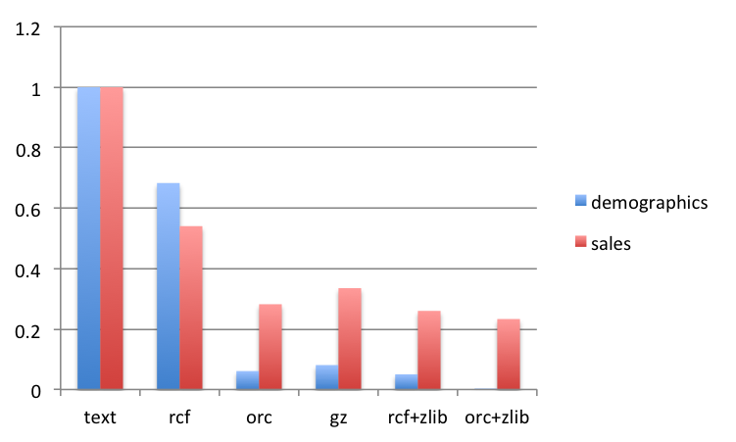
TPC-DS File Sizes

Slide 19
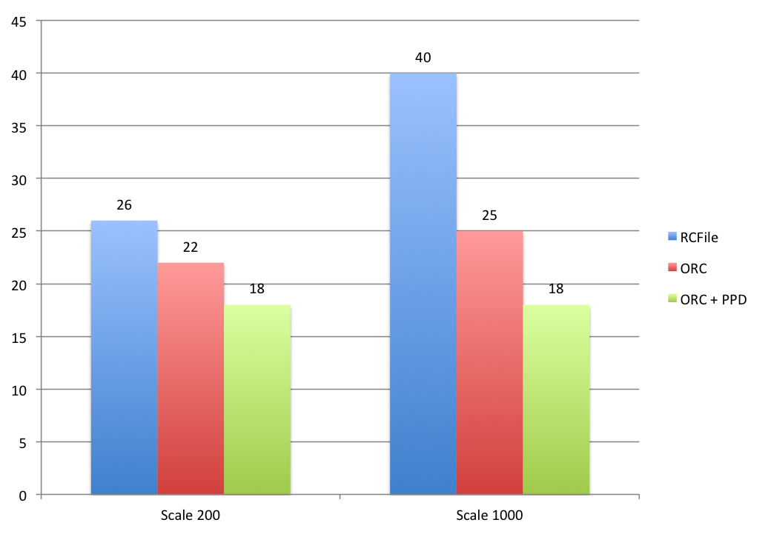
ORC Predicate Pushdown

Slide 20
Additional Details
Metadata is stored using Protocol Buffers
Allows addition and removal of fields
Reader supports seeking to a given row #
Metadata tool
hive –service orcfiledump file.orc
User metadata can be added at any time before the ORC writer is closed.
ORC files can be read or written from MapReduce or Pig using HCat.

Slide 21
Current work for Hive 0.12
Predicate pushdown row group skipping
Take subset of where clause and compare to min/max values in index to skip 10k rows
Make string columns sample the written data and pick their encoding appropriately
After 100k values, if dictionary has more than 80k entries use a direct encoding.
Add optional dictionary encoding of numbers.
Suppress present stream if no null values
Improve run length encoding

Slide 22
Future Work
Support count(*), min, max, and average from metadata
Improve integration with Pig
Extend index with optional bloom filter for string columns
Extend push down predicates with bloom filters
Allow MapReduce InputSplits to split stripes.
Writer may reorder rows to improve compression.
Must preserve requested sort order

Slide 23
Comparison
 | RC File | Trevni | Parquet | ORC
Hive Integration | Y | N | N | Y
Active Development | N | N | Y | Y
Hive Type Model | N | N | N | Y
Shred complex columns | N | Y | Y | Y
Splits found quickly | N | Y | Y | Y
Files per a bucket | 1 | many | 1 or many | 1
Versioned metadata | N | Y | Y | Y
Run length data encoding | N | N | Y | Y
Store strings in dictionary | N | N | Y | Y
Store min, max, sum, count | N | N | N | Y
Store internal indexes | N | N | N | Y
No overhead for non-null | N | N | N | Y ≥ 0.12
Predicate Pushdown | N | N | N | Y ≥ 0.12

Slide 24
Vectorization

Slide 25
Vectorization
Columnstore and vectorization together are a once-in-a-generation breakthrough
Being adopted by DW DBMSs
Joint Hortonworks-Microsoft Hive project
Row-at-a-time processing is CPU-hungry
Vectorize inner loop
Operate on 1024 row batch at once
Batch column is a vector of a primitive type

Slide 26
Why row-at-a-time execution is slow
Hive uses Object Inspectors to work on a row
Enables level of abstraction
Costs major performance
Exacerbated by using lazy serdes
Inner loop has many method, new(), and if-then-else calls
Lots of CPU instructions
Pipeline stalls ➔Poor instructions/cycle
Poor cache locality

Slide 27
How the code works (simplified)
class LongColumnAddLongScalarExpression {
int inputColumn;
int outputColumn;
long scalar;
void evaluate(VectorizedRowBatch batch) {
long [] inVector =
((LongColumnVector) batch.columns[inputColumn]).vector;
long [] outVector =
((LongColumnVector) batch.columns[outputColumn]).vector;
if (batch.selectedInUse) {
for (int j = 0; j < batch.size; j++) {
int i = batch.selected[j];
outVector[i] = inVector[i] + scalar;
}
} else {
for (int i = 0; i < batch.size; i++) {
outVector[i] = inVector[i] + scalar;
}
}
}
}
}
No method calls
Low instruction count
Cache locality to 1024 values
No pipeline stalls
SIMD in Java 8

Slide 28
Vectorization project
Prototype: 100M rows per core per second
Re-wrote large parts of engine
Using Hive ‘vectorization-branch’
Adapters to switch from vectorized to non-vectorized execution
single-table query code complete

Slide 29
Preliminary performance results
NOT a benchmark
218 million row fact table of real data, 25 columns
18GB raw data
6 core, 12 thread workstation, 1 disk, 16GB RAM
select a, b, count(*) from t where c >= const group by a, b -- 53 row result
warm start times | RC non-vectorized (default, not compressed) | ORC non-vectorized (default, compressed) | ORC vectorized (default, compressed)
Runtime (sec) | 261 | 58 | 43
Total CPU (sec) | 381 | 159 | 42

Slide 30
Thanks to contributors!
Microsoft Big Data:
Eric Hanson, Remus Rusanu, Sarvesh Sakalanaga, Tony Murphy, Ashit Gosalia
Hortonworks:
Jitendra Pandey, Owen O’Malley, Gopal V
Others:
Teddy Choi, Tim Chen
Jitendra/Eric are joint leads

