Slide 1
Module 1
Genes and Data

Slide 2
Outline
Introduction to module
Biological terminology, DNA, and RNA
Genes and DNA
RNA and proteins
From genes to proteins
Transcription process
Translation process
Data, variables, and Big datasets
Data types
First steps in working with Big datasets
Working with cBioPortal Part I
Working with cBioportal Part II

Slide 3
Learning Objectives
Describe DNA and RNA components, structure, and the processes of transcription and translation they are involved in.
Classify different types of variables by their ability to store and represent information in datasets.
Locate, analyze, and download Big Data datasets for medical and genetic studies by using online resources.

Slide 4
Introduction to Module
This module focuses on introducing the characteristics of data available in biomedical domains that are important for future Big Data analyses.
The structure and components of DNA and RNA are explained as well as the processes transforming DNA into RNA (translation) then RNA into proteins (transcription).
The data structures used to represent these biomedical data as well as clinical data are presented.
This knowledge is applied to performing cloud-based online data analyses of Big Data.
This module does not require prior knowledge in the application areas nor prior knowledge in data analysis.

Slide 5
Outline
Introduction to module
Biological terminology, DNA, and RNA
Genes and DNA
RNA and proteins
From genes to proteins
Transcription process
Translation process
Data, variables, and Big datasets
Data types
First steps in working with Big datasets
Working with cBioPortal Part I
Working with cBioportal Part II

Slide 6
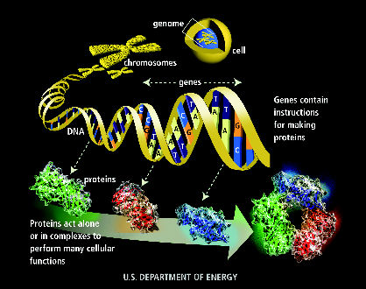
Human Genome Program, U.S. Department of Energy, Genomics and Its Impact on Medicine and Society: A 2001 Primer, 2001

Slide 7
Genes and DNA
Living organisms are made of cells, which is the smallest structural and functional unit of an organism.
Some organisms have several cells, like human beings, some have only one, like bacteria (viruses are not even considered as bacteria).
Cells generally have a nucleus, in particular in humans, and in the case when the nucleus or other organelles is separated from the rest of the cell by membranes, they are called eukaryotes. Otherwise they are called prokaryotes.
Cells are made up of different components or organelles such as a cytoplasm, nucleus mitochondria, etc.
Ultimately, cells and their components are made up of macromolecules, which are large aggregates of molecules.

Slide 8
Genes and DNA
Human body contains
37.2 trillion cells.
40 trillion bacteria, mostly in the digestive tract (some say 10 to 1). It is called the microbiome.
There exists many types of macromolecules
100,000 entries in databases of macromolecular structures.
DNA, RNA, and proteins are examples of macromolecule composing cells.
These macromolecules are created by living organisms.

Slide 9
Genes and DNA
DNA stands for DeoxyriboNucleic Acid.
DNA stores the genetic material in chromosomes in each cell nucleus (humans).
There is also some DNA in mitochondria (mitochondrial DNA).
DNA is transcribed into RNA out of the nucleus (transcription).
RNA stands for RiboNucleic Acid.
RNA is translated into proteins in a cytoplasm organelle called a ribosome (translation).
DNA → RNA → proteins.

Slide 10
Genes and DNA
DNA and RNA are composed of
Nucleotides (nucleic acid molecules) are composed of also a nitrogen base, a molecule of sugar, and a phosphate group.
There are two types of bases:
Pyrimidines
Cytosine (C) (DNA & RNA)
Thymine (T) (DNA)
Uracil (U) (RNA)
Purines
Adenine (A) (DNA & RNA)
Guanine (G) (DNA & RNA)
Nucleotides are linked through a 5-carbon sugar with phosphate (Ribose for RNA, Deoxyribose for DNA).

Slide 11
Genes and DNA
NH₂
O
O
H
H
C
H
H
C
CH₃
C
C
N
C
N
C
N
C
C
C
C
C
C
O
H
N
O
H
N
O
H
N
H
H
H
Thymine
Uracil
Cytosine
Note: double bonds on the base backbone have not been represented for simplification.
Pyrimidines

Slide 12
Genes and DNA
O
NH₂
C
H
C
N
N
C
N
C
N
H
C
H
C
C
C
C
C
N
N
NH₂
N
N
H
H
H
Guanine
Adenine
Note: double bonds on the base backbone have not been represented for simplification.
Purines

Slide 13
Genes and DNA
Adenine
5’
Phos phate
N
CH₂
2-deoxy ribose
C
C
DeoxyriboNucleic Acids: - Deoxyadenylic acid - Deoxycytidylic acid - Deoxyguanylic acid - Deoxythymidylic acid
3’
Deoxyadenylic acid

Slide 14
Genes and DNA
5’ end
5’
Phos phate
N
CH₂
2-deoxy ribose
C
C
Linkage of two nucleotides
3’ represents the 3rd Carbon atom on the sugar backbone
5’ represents the 5th Carbon atom
3rd carbon
3’
5’
Phos phate
N
CH₂
2-deoxy ribose
C
C
3’ end
3’

Slide 15
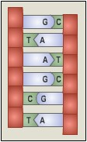
Genes and DNA
Succession of nucleotides composes a single strand in DNA.
Two strands of DNA pair themselves in the 3-D shape of a double helix, where bases are paired (bp = base pair).
A pairs with T.
G pairs with C.
Pairing of the bases (A<->T, G <-> C) provides chemical bonds responsible for the double helix shape.

Slide 16
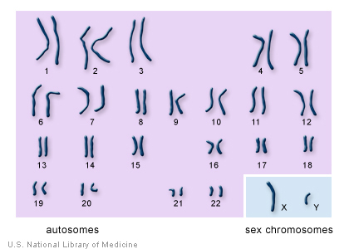
Genes and DNA
The 3D shape of the DNA takes the form of a chromosome.
A chromosome is a structure where the DNA is coiled around some proteins called histones.
Chromosomes reside in the nucleus of cells.
Humans have 46 chromosomes (23 pairs).
Chromosomes in 22 pairs look the same.
The 23rd pair is the gender chromosome – males have an X and a Y chromosome, females have two X chromosomes.
See karyotype to the right.

Slide 17
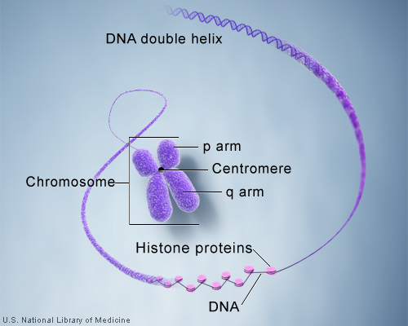
Genes and DNA

Slide 18
Genes and DNA
Genes
A gene is a part of the genome that can be transcribed.
A gene may encode a protein through an RNA sequence.
Genes are made of exons and introns.
Exons are regions coding for proteins and are separated by non coding regions or introns.
To simplify further details:
Genes are concentrated in certain regions of the genome rich in G and C.
Regions rich in A and T do not contain genes.
Between the two, CpG islands (repetition of C and G) separate coding regions from non coding ones.
Non coding regions can be parts of genes.

Slide 19
Genes and DNA
Genomes, diversity, size, structure
Profound diversity of living organisms genome.
DNA (cells), DNA or RNA (phage, virus).
Direction: from 5’ to 3’ of molecule (double stranded DNA) or both directions (single stranded).
Genome organized or not in chromosomes.
Human genome: 46 chromosomes, 3 billion bases, 20,000 – 25,000 genes.
Other species genome vary in size and number of genes.
Human genome has only twice as many genes than a primitive worm.
GenBank database.

Slide 20
Outline
Introduction to module
Biological terminology, DNA, and RNA
Genes and DNA
RNA and proteins
From genes to proteins
Transcription process
Translation process
Data, variables, and Big datasets
Data types
First steps in working with Big datasets
Working with cBioPortal Part I
Working with cBioportal Part II

Slide 21
RNA and Proteins
RNA stands for RiboNucleic Acid.
The difference between DNA and RNA is that RNA is composed of 5-carbon sugar molecules and of A / U / G / C nucleotides.
RNA is translated into proteins in a cytoplasm organelle called a ribosome (translation).
DNA → RNA → proteins.

Slide 22
RNA and Proteins
Adenine
5’
Phos phate
N
CH₂
Ribose
C
C
RiboNucleic Acids: - Adenylic acid - Cytidylic acid - Guanylic acid - Uridylic acid
3’
OH
Adenylic acid

Slide 23
RNA and Proteins
DNA
transcription
tRNA
mRNA
rRNA
Ribosome
translation
Protein

Slide 24
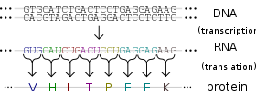
RNA and Proteins
Gene expressions are any molecular compound produced from genes (ex: RNA) Genes are expressed by being transcribed into RNA, and this transcript may then be translated into protein.

Slide 25
Human Genome Program, U.S. Department of Energy, Genomics and Its Impact on Medicine and Society: A 2001 Primer, 2001

Slide 26
RNA and Proteins
Proteome
The proteome is the set of proteins that can be expressed from a genome
Proteins are macromolecules composed of building blocks called aminoacids.
They require determination of:
Sequence of encoding genes
Location of the genes
Function of protein encoding genes
Different biochemical states (phosphorylation, glycosylation, co-enzymes…).

Slide 27
RNA and Proteins
Take away biological information
Molecules at the basis of life can be represented as digital symbol strings (DNA, RNA, …)
Digital symbols (monomers) constitute an alphabet
Unique representation
Importance of probabilistic models.

Slide 28
RNA and Proteins
Data quality
Garbage In Garbage Out (GIGO)
Natural noise
Difficulty of storing content (position in a sequence).
Database redundancy
Different representations: RNA, cDNA (corresponding complementary)
Different methods: single-pass sequence, multi-fold repetition of a sequence
Different fragments: pre-mRNA can lead to several levels of splicing in cDNA, alternative splicing
Difficulty to differentiate between true analogous sequences, and related ones.
Need to check the data.

Slide 29
Outline
Introduction to module
Biological terminology, DNA, and RNA
Genes and DNA
RNA and proteins
From genes to proteins
Transcription process
Translation process
Data, variables, and Big datasets
Data types
First steps in working with Big datasets
Working with cBioPortal Part I
Working with cBioportal Part II

Slide 30
Transcription
Genetic information can be
Genomic or concerning the DNA
Transcriptomic or concerning the transcriptome (RNA).
Gene expression is the process by which a product such as a protein or RNA (for example rRNA) is created from a gene.
Transcription is the process of producing the transcriptome from the genome.
DNA contains all the information necessary to create new macromolecules such as proteins and beyond new human beings.
The DNA is transcribed from 3’ to 5’ but the mRNA is synthesized from 5’ to 3’ (see next slides).

Slide 31
Transcription
DNA encodes the data representing the blueprint of a particular person.
The process by which a DNA is transcribed into corresponding RNA proceeds through a series of steps, much like a cooking recipe can be used to create a new dish.
The analogy with a computer program is even stronger, where the DNA represents the data, and the biological process of transcription represents a computer program.

Slide 32
Transcription
Transcription evolves through 4 steps:
Initiation – the DNA macromolecule opens and an enzyme (RNA polymerase) binds with the promoter of the template strand.
Elongation – RNA polymerase processes each nucleotide on the DNA template strand to produce an mRNA (messenger RNA).
Termination – the transcription stops either when meeting a “Rho” protein factor or a loop at the end of the DNA strand.
Processing – the newly created mRNA macromolecule is processed by removing the introns and slicing the exons together so that only regions coding for proteins are maintained.

Slide 33
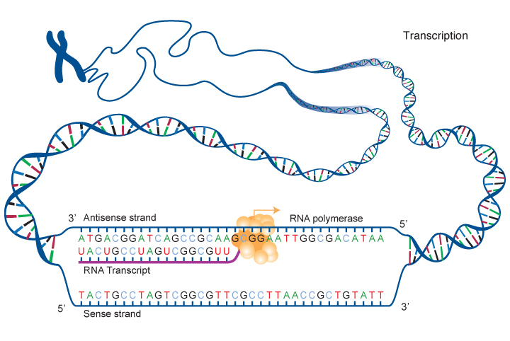
Transcription
The DNA (template strand) is transcribed from 3’ to 5’ but the mRNA is synthesized from 5’ to 3’.
(from National Human Genome Research Institute)

Slide 34
Transcription
During the transcription process, mRNA nucleotides are synthesized following a very strict process:
DNA A → mRNA U
DNA T → mRNA A
DNA G → mRNA C
DNA C → mRNA G.
It is like translating words between languages.

Slide 35
Transcription
Transcription example: Given the sequence (template strand): 3’-CTGAATCGAT-5’ The mRNA sequence transcribed from this DNA sequence is obtained by substituting the nucleotides following the rule: C→ G, G → C, A→ U, T → A: GACUUAGCUA
Also mRNA orientation during synthesis is 5’-3’ (from template strand); however this is 3’-5’ from the other DNA strand (sense strand) since the DNA in the first place is double stranded.

Slide 36
Outline
Introduction to module
Biological terminology, DNA, and RNA
Genes and DNA
RNA and proteins
From genes to proteins
Transcription process
Translation process
Data, variables, and Big datasets
Data types
First steps in working with Big datasets
Working with cBioPortal Part I
Working with cBioportal Part II

Slide 37
Translation
Translation is the process of producing a protein from a messenger RNA (mRNA).
Proteins are made of building blocks called aminoacids. Each aminoacid is coded by three nucleotides in the mRNA. The sequence of aminoacids composing a protein is synthesized by one by one and glued together as the translation progresses, in the order dictated by the mRNA strand.
This process takes place in ribosomes, organelles located in the cytoplasm where the mRNA has been led after the transcription.
A ribosome reads the mRNA strand in groups of three bases to assemble the protein.

Slide 38
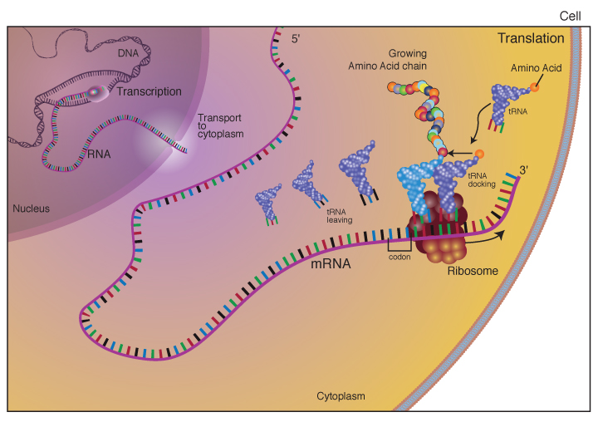
Translation
(from National Human Genome Research Institute)

Slide 39
Translation
There are 20 aminoacids in humans.
A certain combination of 3 bases, also called a codon, always leads to the same aminoacid.
There are 64 codons, out of which 61 code for aminoacids, plus 3 stop codons. Most aminoacids are therefore coded by several different codons.
The wheel on the following slide can be used to find which one. Start at the center with the first base, then move to the outside following the second then third base.
For example AUG leads to aminoacid Methionine (Met).

Slide 40
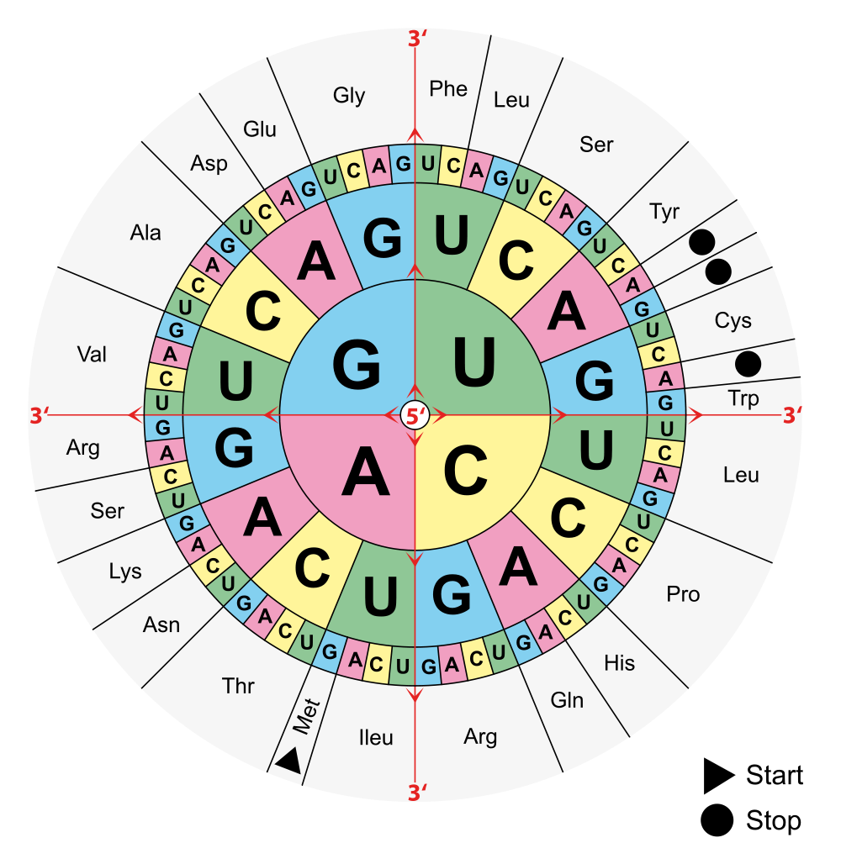
(from Wikimedia Commons)

Slide 41
Translation
What we see is that:
DNA, RNA, and proteins can be transformed into one another through coding or decoding.
Data representing DNA, RNA, or proteins can provide information about one another and can regulate one another.
In fact, these molecular compounds are part of larger systems called gene regulatory networks where molecular regulators can interact with each other and with other substances in the cell to affect the transcription of genes and/or the creation of gene expressions.
The regulators can be DNA, RNA, proteins, or other macromolecules.

Slide 42
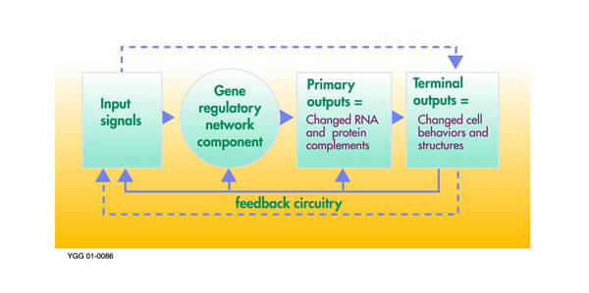
Translation
In turn the change in protein composition in the cell can greatly affect its structure and behavior.
(from Oak Ridge National Laboratory)

Slide 43
Translation
Big Data in biomedicine:
3.2 billions bases in human genome, at least one copy in each cell of the human body (3.3 GB).
100,000 macromolecules in database of macromolecular structures.
Sequence Read Archive (SRA) at NHI/NCBI stores over 3.6 petabases of raw sequence data (1 petabase, and 4 times more bytes) for 250,000 human individuals, 32,000 microbial genomes, and 5,000 animal and plant genomes.
Electronic medical records (EMRs) store over 500 petabytes on a world scale (1 petabyte = 10¹⁵ bytes = 1 million GB).
Predicted to grow very rapidly.

Slide 44
Outline
Introduction to module
Biological terminology, DNA, and RNA
Genes and DNA
RNA and proteins
From genes to proteins
Transcription process
Translation process
Data, variables, and Big datasets
Data types
First steps in working with Big datasets
Working with cBioPortal Part I
Working with cBioportal Part II

Slide 45
Data, Variables, and Big Datasets
Data are observations, facts, values of parameters:
Example: 37, 97, 5, etc.
Data may consist of numbers, words, images, …
Data: lowest level of abstraction (from which information and knowledge are derived).
Information is the communication of data in an understandable way. It is useful to whoever receives it.
Example: 37 ̊, 97 lbs, 5 ml, etc.
Computers can process data and turn it into information.

Slide 46
Data, Variables, and Big Datasets
Knowledge is derived from data and information through ‘formal or informal analysis’ – it is agreed to be true
Example: The earth is round Normal temperature is 37°C
Knowledge can be represented and organized in a knowledge base.
Data are stored in variables, which serve as containers.
Data → information → knowledge ( → action).

Slide 47
Data, Variables, and Big Datasets
Variables or data can be grouped into four categories:
Nominal
Ordinal
Numeric
Interval
Ratio

Slide 48
Data, Variables, and Big Datasets
Nominal data are used to describe data collected on variables for qualitative (what kind) differences between individuals.
Nominal data also called categorical, qualitative, or named data.
Numerical values are often assigned to categories of nominal variables.
Choice of numerical values is arbitrary as it is for labeling only.
Ex: ‘blue’ / ‘red’ / ‘green’ / ‘yellow’
Ex: ‘1’ / ‘2’ / ‘3’ / ‘4’

Slide 49
Data, Variables, and Big Datasets
Ordinal or ranked data are data expressing rankings from lowest to highest, according to a specified criterion.
Can be used to score severity of illness.
Ex: 0 = no disease or low risk of disease 1 = presence of disease
Can also include responses to questionnaires or interviews.
Ex: 0 = strongly disagree 4 = strongly agree

Slide 50
Data, Variables, and Big Datasets
Numeric data are numbers (quantitative data), with or without decimal point.
Ex: 3, 4.5, 10e-7
Numerical data can be:
Interval refers to numeric data such that equal distances between numbers corresponds to equal differences in measured trait or characteristic.
Ex: exam score.
Ratio Shares the property of equal differences with interval data but in addition the value 0 represents the total absence of measured trait or characteristic.
Ex: height, weight, length of survival.

Slide 51
Data, Variables, and Big Datasets

Slide 52
Data, Variables, and Big Datasets
Big Data refers to data defined by V’s
Volume (very large)
Variety (not only categorical or numerical values but also images, text, videos, social networks data etc.) – this is the case with biomedical data where we have a mix of data types, including different genetic data types as we will see in this course.
Velocity (changing or being generated very quickly).

Slide 53
Data, Variables, and Big Datasets
Genotype – set of genetic data about a person.
Phenotype – set of observable characteristics of a person resulting from the interaction of the genotype with the environment (Ex: height, weight, asthma, rash, etc.)

Slide 54
Outline
Introduction to module
Biological terminology, DNA, and RNA
Genes and DNA
RNA and proteins
From genes to proteins
Transcription process
Translation process
Data, variables, and Big datasets
Data types
First steps in working with Big datasets
Working with cBioPortal Part I
Working with cBioportal Part II

Slide 55
Working with cBioPortal
Watch the video.
Start here: http://ww.cbioportal.org

