Slide 1
Introduction to Ensemble Learning
Featuring Successes in the Netflix Prize Competition
Todd Holloway
Two Lecture Series for B551
November 20 & 27, 2007
Indiana University

Slide 2
Outline
Introduction
  Bias and variance problems
The Netflix Prize
  Success of ensemble methods in the Netflix Prize
Why Ensemble Methods Work
Algorithms
  AdaBoost
  BrownBoost
  Random forests

Slide 3



1-Slide Intro to Supervised Learning
We want to approximate a function,
Given examples,
Find a function h among a fixed subclass of functions for which the error E(h) is minimal,
Independent
of h
The distance
from of f
Variance of the
predictions

Slide 4
Bias and Variance
Bias Problem
  The hypothesis space made available by a particular classification method does not
  include sufficient hypotheses
Variance Problem
  The hypothesis space made available is too large for the training data, and the selected hypothesis may not be accurate on unseen data

Slide 5
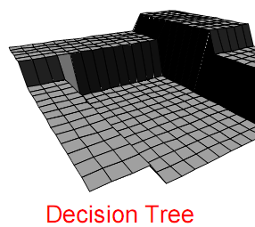
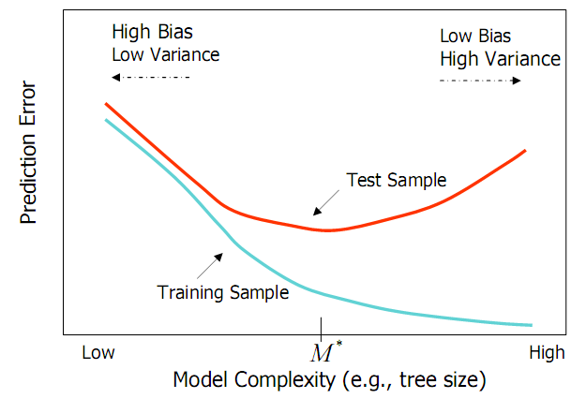
Bias and Variance
Decision Trees
Small trees have high bias.
Large trees have high variance. Why?
from Elder, John. From Trees to Forests and Rule Sets - A Unified Overview of Ensemble Methods. 2007.

Slide 6
Definition
Ensemble Classification
Aggregation of predictions of multiple classifiers with the goal of improving accuracy.

Slide 7
Teaser: How good are ensemble methods?
Let’s look at the Netflix Prize Competition…

Slide 8
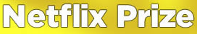
Began October 2006
Supervised learning task
  Training data is a set of users and ratings (1,2,3,4,5 stars) those users have given to movies.
  Construct a classifier that given a user and an unrated movie, correctly classifies that movie as either 1, 2, 3, 4, or 5 stars
$1 million prize for a 10% improvement over Netflix’s current movie recommender/classifier
(MSE = 0.9514)

Slide 9
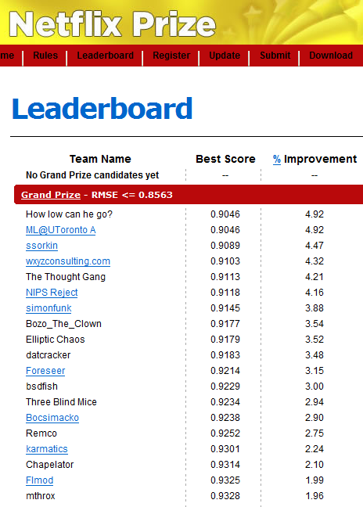
Just three weeks after it began, at least 40 teams had bested the Netflix classifier.
Top teams showed about 5% improvement.

Slide 10
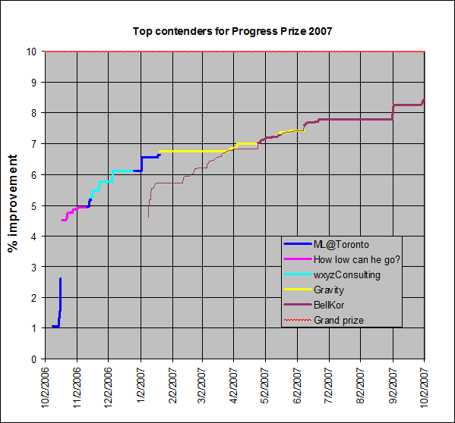
However, improvement slowed…
from http://www.research.att.com/~volinsky/netflix/

Slide 11
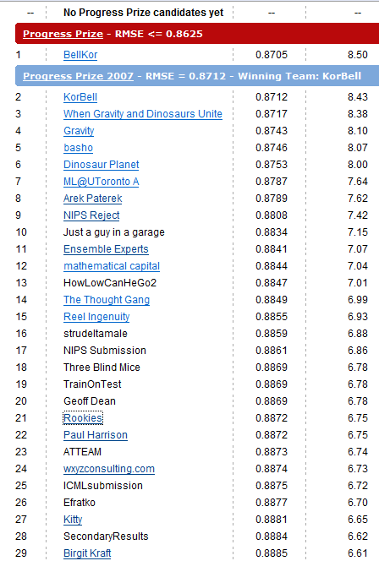
Today, the top team has posted
a 8.5% improvement.
Ensemble methods are the best performers…

Slide 12
Rookies
“Thanks to Paul Harrison's collaboration, a simple mix of our solutions improved our result from 6.31 to 6.75”

Slide 13
Arek Paterek
“My approach is to combine the results of many methods (also two-way interactions between them) using linear regression on the test set. The best method in my ensemble is regularized SVD with biases, post processed with kernel ridge regression”
http://rainbow.mimuw.edu.pl/~ap/ap_kdd.pdf

Slide 14
U of Toronto
“When the predictions of multiple RBM models and multiple SVD models are linearly combined, we achieve an error rate that is well over 6% better than the score of Netflix’s own system.”
http://www.cs.toronto.edu/~rsalakhu/papers/rbmcf.pdf

Slide 15
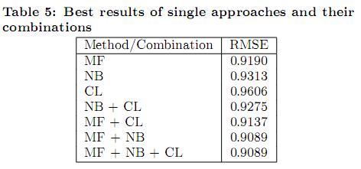
Gravity
home.mit.bme.hu/~gtakacs/download/gravity.pdf
Notes:
Matrix Factorization-SVD (MF), K-Nearest neighbor (NB), Clustering (CL).

Slide 16
When Gravity and
Dinosaurs Unite
“Our common team blends the result of team Gravity and team Dinosaur Planet.”
Might have guessed from the name…

Slide 17
BellKor / KorBell
And, yes, the top team which is from AT&T…
“Our final solution (RMSE=0.8712) consists of blending 107 individual results. “

Slide 18
Some Intuitions on Why Ensemble Methods Work…

Slide 19
Intuitions
Utility of combining diverse, independent opinions in human decision-making
  Protective Mechanism (e.g. stock portfolio diversity)
Violation of Ockham’s Razor
  Identifying the best model requires identifying the proper "model complexity"
See Domingos, P. Occam’s two razors: the sharp and the blunt. KDD. 1998.
Notes:
KDD 1998 Best paper award went to an argument against Ockham’s razor. Complexity is not related to overfiting. Mention use of Ockham’s razor in Naïve Bayes.

Slide 20
Intuitions
Majority vote
Suppose we have 5 completely independent classifiers…
  If accuracy is 70% for each
    10 (.7^3)(.3^2)+5(.7^4)(.3)+(.7^5)
    83.7% majority vote accuracy
  101 such classifiers
    99.9% majority vote accuracy

Slide 21
Strategies
Boosting
  Make examples currently misclassified more important (or less, in some cases)
Bagging
  Use different samples or attributes of the examples to generate diverse classifiers

Slide 22
Boosting
  Make examples currently misclassified more important (or less, if lots of noise). Then combine the hypotheses given…
Types
AdaBoost
BrownBoost

Slide 23


AdaBoost Algorithm
1. Initialize Weights
2. Construct a classifier. Compute the error.
3. Update the weights, and repeat step 2. …
4. Finally, sum hypotheses…
Notes:
Note: if weights can’t be used directly, they can be used to generate a weighted sample of the example. Point is that the construction of a classifier

Slide 24
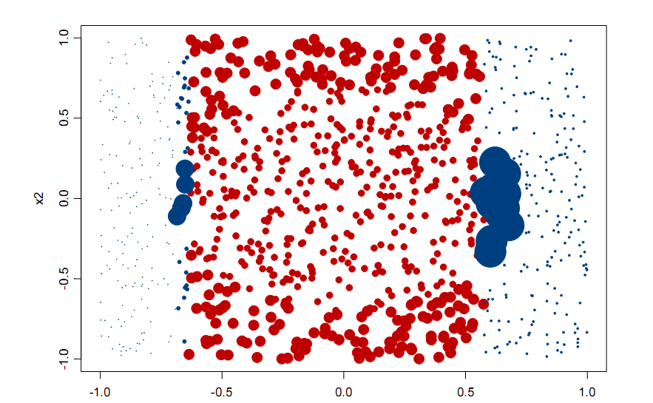
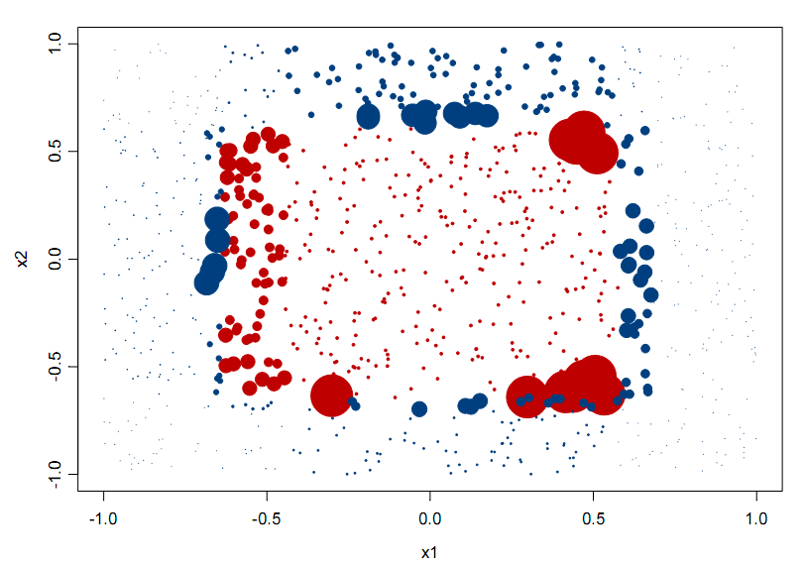
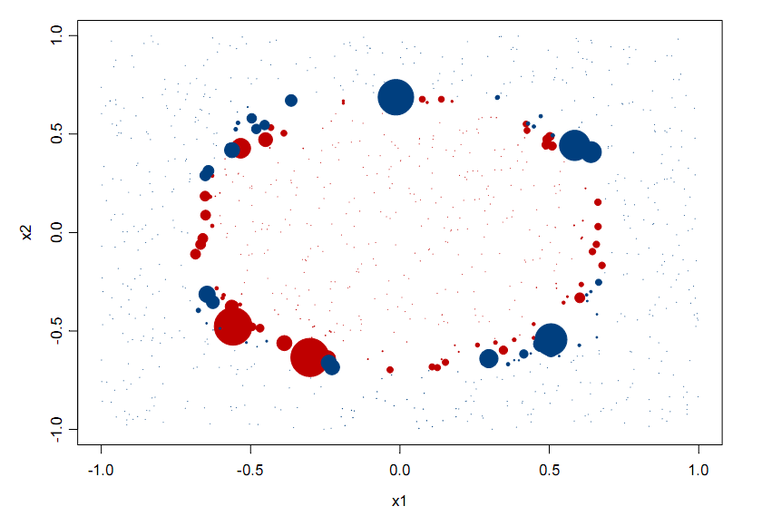
Classifications (colors) and
Weights (size) after 1 iteration
Of AdaBoost
20 iterations
3 iterations
from Elder, John. From Trees to Forests and Rule Sets - A Unified Overview of Ensemble Methods. 2007.
Notes:
Note after 1 iteration the step classes of a single decision tree.

Slide 25
AdaBoost
Advantages
  Very little code
  Reduces variance
Disadvantages
  Sensitive to noise and outliers. Why?

Slide 26
BrownBoost
Reduce the weight given to misclassified example
Good (only) for very noisy data.

Slide 27
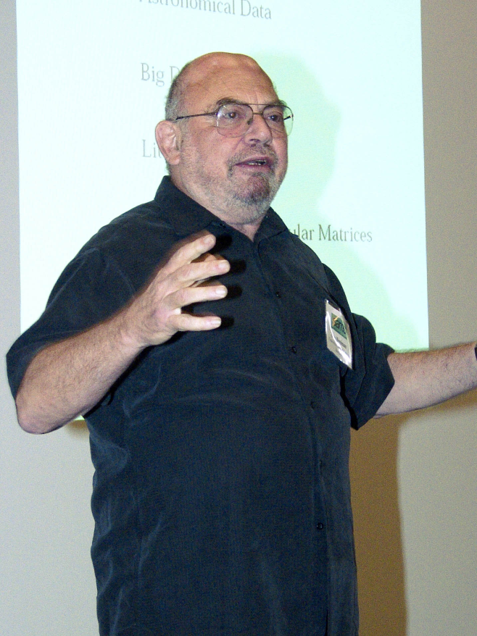
Bagging (Constructing for Diversity)
  Use random samples of the examples to construct the classifiers
  Use random attribute sets to construct the classifiers
    Random Decision Forests
Leo Breiman
Notes:
Originally rejected (journal of statistics). Can also create multiple NN using different random initial weights for diversity. Owns trademark on Random forests.

Slide 28
Random forests
At every level, choose a random subset of the attributes (not examples) and choose the best split among those attributes
Doesn’t overfit

Slide 29

Random forests
Let the number of training cases be M, and the number of variables in the classifier be N.
For each tree,
  Choose a training set by choosing N times with replacement from all N available training cases.
  For each node, randomly choose n variables on which to base the decision at that node.
Calculate the best split based on these.
Notes:
Grow trees deep to avoid bias.

Slide 30
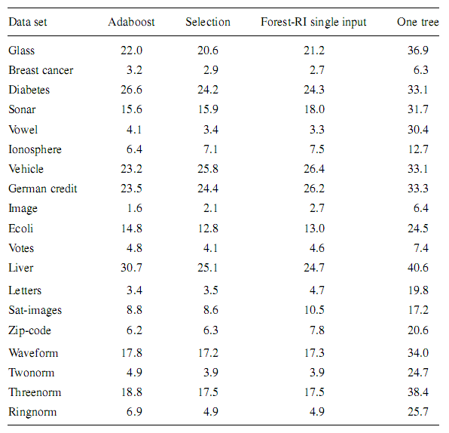
Breiman, Leo (2001). "Random Forests". Machine Learning 45 (1), 5-32

Slide 31
Questions / Comments?

Slide 32
Sources
David Mease. Statistical Aspects of Data Mining. Lecture. http://video.google.com/videoplay?docid=-4669216290304603251&q=stats+202+engEDU&total=13&start=0&num=10&so=0&type=search&plindex=8
Dietterich, T. G. Ensemble Learning. In The Handbook of Brain Theory and Neural Networks, Second edition, (M.A. Arbib, Ed.), Cambridge, MA: The MIT Press, 2002. http://www.cs.orst.edu/~tgd/publications/hbtnn-ensemble-learning.ps.gz
Elder, John and Seni Giovanni. From Trees to Forests and Rule Sets - A Unified Overview of Ensemble Methods. KDD 2007 http://Tutorial. videolectures.net/kdd07_elder_ftfr/
Netflix Prize. http://www.netflixprize.com/
Christopher M. Bishop. Neural Networks for Pattern Recognition. Oxford University Press. 1995.

