Slide 1
Substructure Similarity Search in Graph Databases
R95922022 陳芃安

Slide 2
Reference
Xifeng Yan, Philip S. Yu and Jiawei Han. Substructure Similarity Search in Graph Databases. SIGMOD 2005.
JW Raymond, P Willett. Maximum common subgraph isomorphism algorithms for the matching of chemical structures. Journal of Computer-Aided Molecular Design, 2002.

Slide 3
Motivation
Graph Database
  ChemIDplus
  KEGG
Searching topological structures in database
Similarity search of complex structures
  Exact matching is often too restrictive
  Manual refinements cannot be done by users effectively

Slide 4
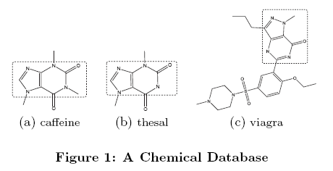

An example for similarity search

Slide 5
Similarity measurement
Structure-based similarity measurement
  Compare the topology of two graphs
  It is costly to compute but more accurate
Maximum Common Subgraph
  It is a NP-Complete Problem
For a query graph Q and a graph G in database
  Let P be the MCS of Q and G
  |E(P)| can be a similarity measurement
  Edge deletion number can also be a similarity measurement

Slide 6
Graph Similarity Filtering (Grafil)
A feature-based filtering algorithm
Query graph → a set of features
Edge deletions → the feature misses
Filter graphs by the maximum allowed feature misses
It doesn’t need to perform similarity computation between the query graph and each graph in the database

Slide 7
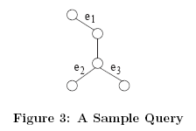
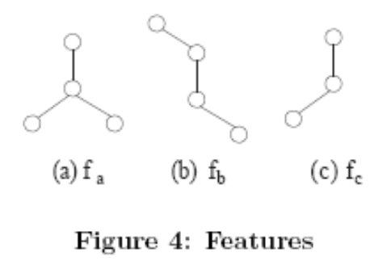
Structural Filtering
Transform the edge deletions to the misses of indexed features
May miss at most four occurrences of these features
 | Q | Q₁ | Q₂ | Q₃
f_{a} | 1 | 1 | 0 | 0
f_{b} | 2 | 0 | 1 | 1
f_{c} | 4 | 3 | 2 | 2

Slide 8
Feature-Graph Matrix
Feature-graph matrix
Create a feature-graph matrix for each graph in the database
This matrix is easy to maintain
G_{a} can be omitted because it only has 2 feature occurrences
 | G_{a} | G_{b} | G_{c} | G_{d}
f_{a} | 0 | 1 | 0 | 0
f_{b} | 0 | 0 | 1 | 0
f_{c} | 2 | 3 | 4 | 4
 | Q | Q₁ | Q₂ | Q₃
f_{a} | 1 | 1 | 0 | 0
f_{b} | 2 | 0 | 1 | 1
f_{c} | 4 | 3 | 2 | 2

Slide 9
Some observations of Feature-Graph Matrix
The feature-based filtering is not involved with any structure similarity checking
We only need to compute the upper bound of feature misses of the query graph

Slide 10
Framework
Index Construction
Feature miss estimation
Query processing
Query relaxation

Slide 11
Index construction
Select some features
build the feature-graph matrix for the database
 | G_{a} | G_{b} | G_{c} | G_{d}
f_{a} | 0 | 1 | 0 | 0
f_{b} | 0 | 0 | 1 | 0
f_{c} | 2 | 3 | 4 | 4
Index Construction
Feature miss estimation
Query processing
Query relaxation

Slide 12
Feature miss estimation (1)
Index Construction
Feature miss estimation
We build an edge-feature matrix for a query graph
Query processing
Query relaxation
 | f_{a} | f_{b(1)} | f_{b(2)} | f_{c(1)} | f_{c(2)} | f_{c(3)} | f_{c(4)}
e₁ | 0 | 1 | 1 | 1 | 0 | 0 | 0
e₂ | 1 | 1 | 0 | 0 | 1 | 0 | 1
e₃ | 1 | 0 | 1 | 0 | 0 | 1 | 1

Slide 13
Feature miss estimation (2)
Given a query graph Q and a set of features contained in Q, if the maximum edge deletion is k, what is the maximal number of features that can be missed?
The maximum number of columns that can be hit by k rows in the edge-feature matrix
Set k-cover problem
  It is a NP-Complete problem
 | f_{a} | f_{b(1)} | f_{b(2)} | f_{c(1)} | f_{c(2)} | f_{c(3)} | f_{c(4)}
e₁ | 0 | 1 | 1 | 1 | 0 | 0 | 0
e₂ | 1 | 1 | 0 | 0 | 1 | 0 | 1
e₃ | 1 | 0 | 1 | 0 | 0 | 1 | 1

Slide 14
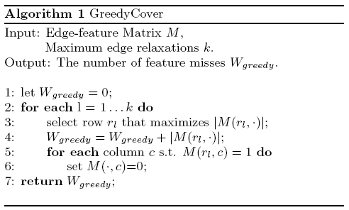

A greedy algorithm for the set k-cover problem
1.6-approximation algorithm

Slide 15
An example for greedy algorithm
k = 2
 | f_{a} | f_{b(1)} | f_{b(2)} | f_{c(1)} | f_{c(2)} | f_{c(3)} | f_{c(4)}
e₁ | 0 | 1 | 1 | 1 | 0 | 0 | 0
e₂ | 1 | 1 | 0 | 0 | 1 | 0 | 1
e₃ | 1 | 0 | 1 | 0 | 0 | 1 | 1
Ans=
4
+2

Slide 16
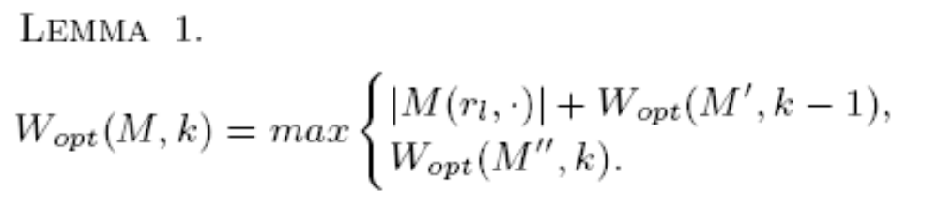
Improvement of the greedy algorithm
We can use brute force and branch and bound
Select a row based on greedy method
Optimal solution may/may not include this row
Recursion 太多層時就用 greedy method 直接求解

Slide 17
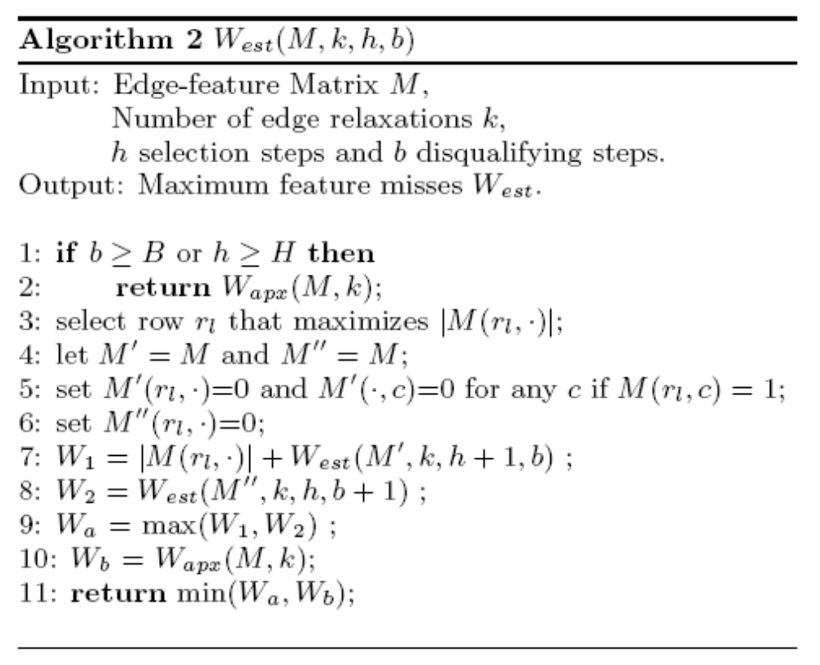

Algorithm2 for the set k-cover problem

Slide 18
Next Step
Index Construction
We just talked about how to do the feature miss estimation with a given feature set
Given many features, how to select a good feature set?
Should we use all features together in a single filter?
Feature miss estimation
Query processing
Query relaxation

Slide 19
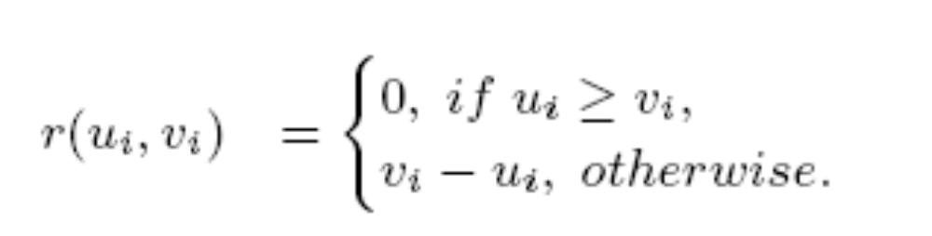
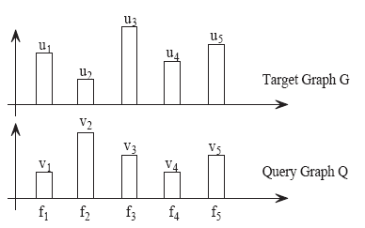
Filter graphs by the feature misses

Slide 20
Feature set selection
Should we use all features together in a single filter?
NO!
It will cause feature conjugation
  d_{max} is the value of feature miss estimation

Slide 21
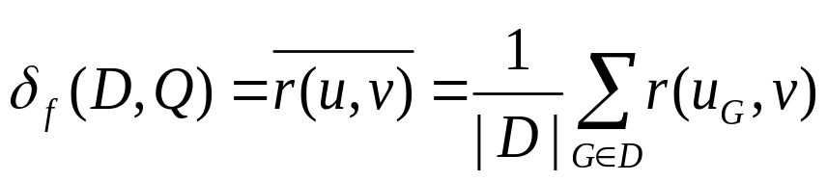
Selectivity
Given a graph database D, a query graph Q, and a feature f
The selectivity of f is

Slide 22
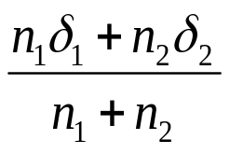
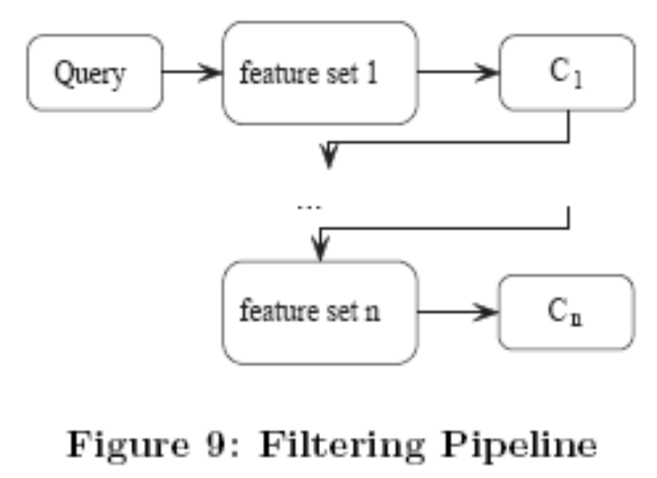
Hierarchical agglomerative clustering
Merge the two closet clusters into a single cluster
  By selectivity δ
The new selectivity of a cluster is

Slide 23
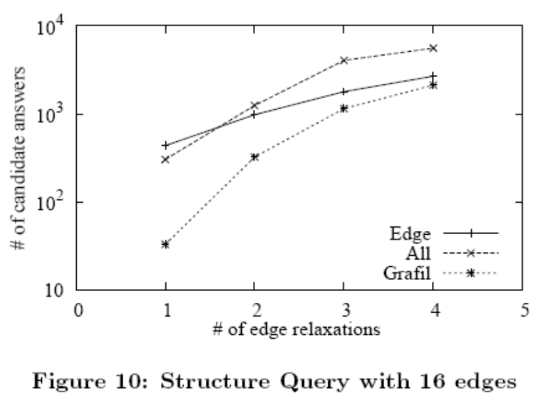
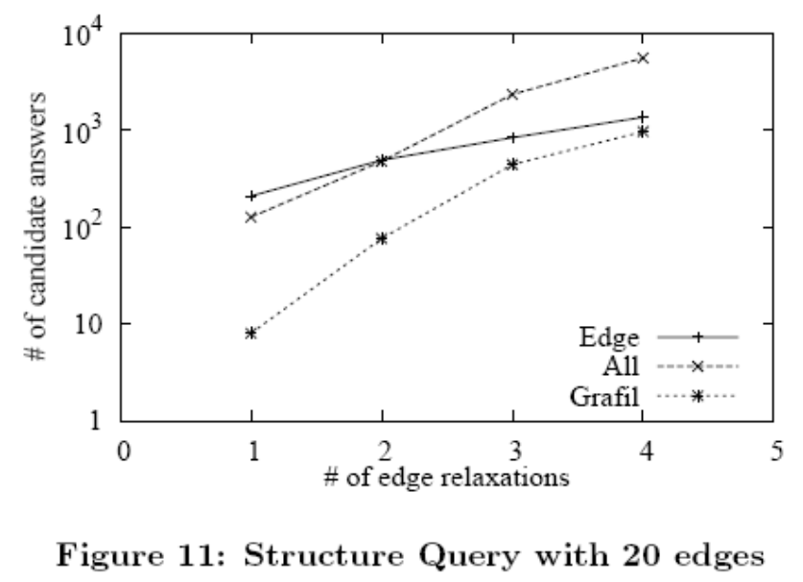
Result

Slide 24
More details
Where is the Feature Set?
  Path, motif, discriminative frequent structure
  X. Yan, P. Yu, and J. Han. Graph indexing: A frequent structure-based approach. SIGMOD’04, pages 335-346, 2004.
  M. Kuramochi and G. Karypis. Frequent subgraph discovery. ICDM’01, pages 313-320, 2001.
Maximum Common Subgraph?
  JW Raymond, P Willett. Maximum common subgraph isomorphism algorithms for the matching of chemical structures. Journal of Computer-Aided Molecular Design, 2002.

Slide 25
Thanks
Any Question?

