Slide 1



Dremel
Interactive Analysis of Web-Scale Datasets
Sergey Melnik, Andrey Gubarev, Jing Jing Long, Geoffrey Romer, Shiva Shivakumar, Matt Tolton, Theo Vassilakis
Presented by Maria Stylianou
marsty5@gmail.com
November 8th, 2012
KTH – Royal Institute of Technology
Notes:
- Hello everybody. I will present Dremel, a tool developed in Google,
- It is being used at Google since 2006
- But the paper was published in 2010

Slide 2
Outline
Motivation
Dremel – basic information
Dremel's Key Aspects
  Columnar Format
  Query Execution
Evaluation & Conclusions
Notes:
Let's briefly see the outline of the presentation.
I will start with the motivation of the authors do develop Dremel
Then I will explain what is Dremel and which are the key aspects that make Dremel to be novel
I will continue with with the evaluation, showing some of the experiments the authors contacted to support their idea.
And of course I will close my presentation with some observations and conclusions

Slide 3


Motivation
Data Big Data
Web-scale Datasets → more frequent
Large-scale Data Analysis → essential!
NOT
FAST
Speed Matters!
Notes:
Their motivation begun with the observation that data are becoming BIG
Web-scale Datasets are becoming more frequent
Performing Data analysis at scale is essential
As you may know Pig and Hive can perform ad-hoc queries into web-scale datasets
BUT they are NOT FAST
This is because they translate queries into MapReduce jobs, which makes the execution slower
The thing is... Speed Matters!
So, what the authors wanted to do is to develop a tool that would execute ad-hoc queries in large-scale datasets rapidly

Slide 4
Dremel to the rescue!
Interactive ad-hoc query system
Scalable Fault tolerant Fast
Analysis on in situ nested data
Access data
'in place'
Non
relational
Notes:
Dremel is an interactive ad-hoc query system
It is scalable, fault tolerant and Fast
It performs analysis on in situ nested data
In situ means: it accesses data 'in place'
Which means, it executes the computation in the place that the data are stored. In this case, BigTable of Google File System is used, so it does not take the data and take them into the tool, but the tool operates inside the dataset.
Nested data, non relational data
An Interoperation between the Dremel (query processor) and other data management tools

Slide 5
MapReduce or Dremel
or both
?
Notes:
There is a clear comparison between Dremel and MapReduce on the paper.
For now, I'll leave this blank and come back when it's time :)

Slide 6
Key Aspects of Dremel
Storage Format
  Columnar storage representation for nested data
Query Language & Execution
  SQL & Multi-level serving tree
Notes:
So! Let's start with the main characteristics of Dremel!
What makes Dremel so special is the use & combination of:
Columnar storage format of the data
Multi-level serving tree for query execution

Slide 7
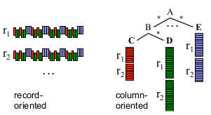
Storage Format
Columnar Storage Representation
Notes:
So far, data were stored as records.
Let's imagine we have a database with information for each EMDC student.
Each record (raw) consists of name, age, nationality and other data of the student
What's done so far, was to store all information for each student gathered in a record
Google, then, comes with this novel idea to store data in columns. That means, all names are stored together, all ages together, nationalities, etc.
So if Sarunas wants to see the ages of his students, he can just query the age and only the column age will be read.
That way, they improved retrieval efficiency
→ less data have to be read

Slide 8
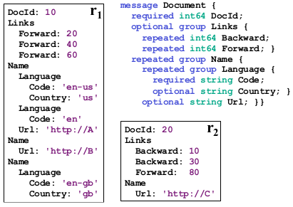
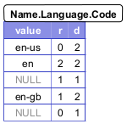
Data Model
Based on strongly-typed nested records
schema
Repetition
Level
Definition
Level
records

Slide 9
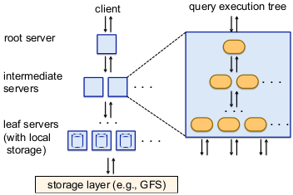
Query Language & Execution
SQL & Multi-level Serving Tree
Tablet
Contains
N rows from
the table
Notes:
Dremel uses an SQL-like language
And for executing queries, it uses multi-level serving trees
We have many servers, and one of them is the root server. The root server receives the query from the client and:
– determines all tablets of the table related to the query
– rewrites the query and sends it to the next level servers → How it rewrites it? In a way that each intermediate server will be assigned some of the tablets
– the intermediate servers do the same – rewrite the query they received – and send it to the next level.
– when queries reach the leaf servers, they scan the tablets & execute the queries in parallel – by accessing the common storage (Google File System) and send the result back to their parent
– each intermediate server receives more than one values and aggregates the results into one.
– this is done in all servers, till we reach the root server.
Each servers has an internal execution tree which includes evaluation of aggregation functions → for optimization purposes

Slide 10
Query Execution
Query Dispatcher
Schedules queries based on their priorities
Balances the load
Provides fault tolerance
  Handles stragglers
  Tablets are three-way replicated
Servers
running
slow
Notes:
Dremel is a multi-user system → several queries are executed at the same time.
Fault-tolerance and straggler detection also play positively in to execution time
3-way replication
When a leaf server can not access a tablet replica, it falls over to another replica.
Parameter specifies the minimum percentage of tablets that must be scanned before returning a result. → setting up this parameter low, it can speed up the execution significantly.
Dremel allows for "99.9%" type results, that reflect almost all, but not quite all, of the data.

Slide 11
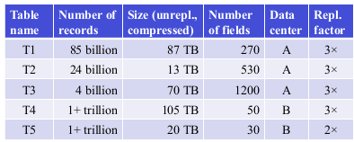
Experiments
Environment
Notes:
Now let's move on to the experiments they conducted. I only present the most important ones – according to me :)
The authors used 5 different tables in 2 different datasets, each one with different number of records, starting from 4 billion, up to more than 1 trillion.
The compressed data vary from 13TB to 105 TB
While
The number of fields begin with 30 and reaches 1200

Slide 12

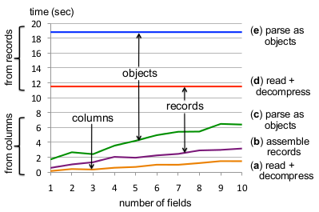
Experiments
Local Disk - Performance
Notes:
In the first experiment they

Slide 13

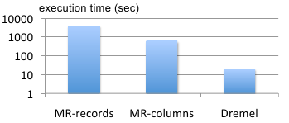
Experiments
MapReduce and Dremel
Counts the average number
of terms in a specific field
3000 workers
hours
minutes
seconds

Slide 14

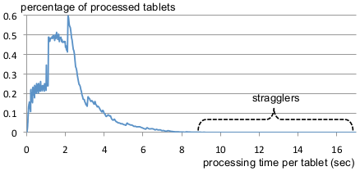
Experiments
Impact of Stragglers

Slide 15


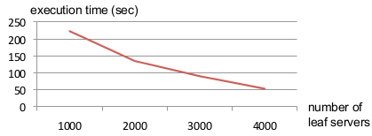
Experiments
Scalability
Selects top-20 adverts and
Their number of occurrences
In T4

Slide 16


What's happening today?
Google BigQuery
  Web Service [pay-per-query]
Open Dremel → Apache Drill
  Open Source Implementation
  of Google BigQuery
  Flexibility: broader range of query languages
Notes:
A team of Israeli engineers is building a clone they called OpenDremel, though one of these developers, David Gruzman, tells us that coding is only just beginning again after a long hiatus.
Google now offers a Dremel web service it calls BigQuery. You can use the platform via an online API, or application programming interface. Basically, you upload your data to Google, and it lets you run queries on its internal infrastructure.

Slide 17
MapReduce or Dremel
or both
MapReduce AND Dremel
?
MR Dremel
Data Processing Record Column
Oriented Oriented
In-situ Processing No Yes!
Size of Queries Large Small/Medium
Notes:
There is a clear comparison between Dremel and MapReduce on the paper.
Their intention is not to replace MapReduce
But to complement MapReduce

Slide 18
Conclusions
Multi-level
Execution
trees
Columnar
Data
Layout
Scalable & Efficient
MapReduce benefits
Near-linear scalability

Slide 19
Dremel
Interactive Analysis of Web-Scale Datasets
Sergey Melnik, Andrey Gubarev, Jing Jing Long, Geoffrey Romer, Shiva Shivakumar, Matt Tolton, Theo Vassilakis
Presented by Maria Stylianou
marsty5@gmail.com
November 8th, 2012
KTH – Royal Institute of Technology
Notes:
- Hello everybody. I will present Dremel, a tool developed in Google,
- It is being used at Google since 2006
- But the paper was published in 2010

Slide 20
References
S. Melnik et al. Dremel: Interactive Analysis of Web-Scale Datasets. PVLDB, 3(1):330–339, 2010
G. Czajkowski. Sorting 1PB with MapReduce. http://googleblog.blogspot.se/2008/11/sorting-1pb-with-mapreduce.html
Apache Drill, http://wiki.apache.org/incubator/DrillProposal
Google BigQuery, https://developers.google.com/bigquery/

