Slide 1
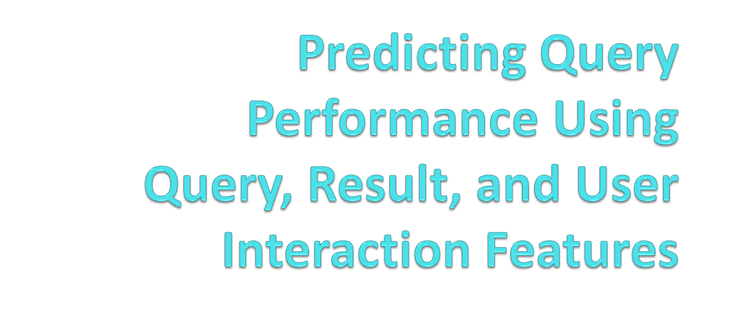
Qi Guo
Emory University
Ryen White, Susan Dumais, Jue Wang, Blake Anderson
Microsoft
Presented by Tetsuya Sakai, Microsoft Research

Slide 2
Motivation
Query evaluation is critical for search engines
  Understanding the quality of search results for individual queries (or in the aggregate)
Query evaluation often involves:
  Time-consuming and expensive human judgments
  User studies covering only a small fraction of queries
Automated methods can lead to rapid and cost-effective query performance prediction
Prior work used features of queries, results, the collection
  E.g., Query clarity (Cronen-Townsend et al., 2002); query difficulty prediction (Hauff et al., 2008)

Slide 3
Contribution
Our work differs from previous research:
  Investigates query, results, and interaction features
  Uses search engine logs (rather than standard IR test collections), since they reflect diversity of Web search tasks
Contributions:
  Investigate novel and rich set of interaction features in predicting query performance
  Determine which features and combinations of features are more important in predicting query quality
  Understand how accuracy varies with query frequency

Slide 4
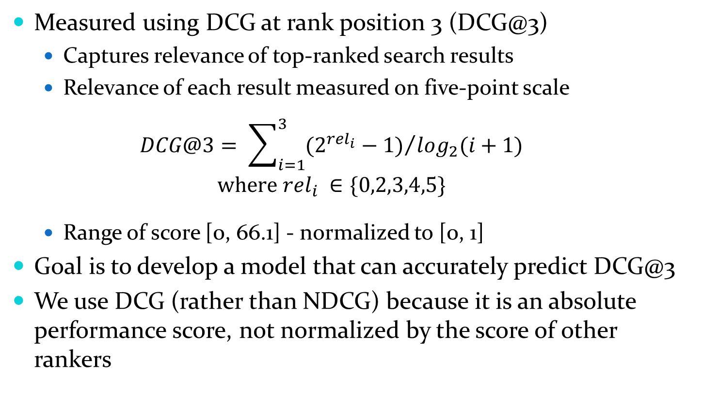
Predicting Query Performance

Slide 5
Features
Three classes:
  Query from Bing search logs
    E.g., QueryLength, HasURLFragment, HasSpellCorrection
  Results from Bing results pages
    E.g., AvgNumAds, AvgNumResults, MaxBM25F
    Text-matching baseline
  Interaction from Bing search logs and MSN toolbar logs
    E.g., AvgClickPos, AvgClickDwell, AbandonmentRate
    Include search engine switching and user satisfaction estimates
      Satisfaction estimates based on page dwell times
Logs collected during one week in July 2009

Slide 6
Experiment
2,834 queries from randomly sampling Bing query logs
  Mixture of common and rare queries
  60% training / 20% validation / 20% testing
  Explicit relevance judgments used to generate ground truth DCG values for training and testing
Query / Results / Interaction features generated for each query in the set

Slide 7
Experiment
Prediction model
  Regression: multiple additive regression trees (MART)
  Advantages of MART include model interpretability, facility for rapid training and testing, and robustness
Metrics used to evaluate performance
  Pearson’s correlation (R), mean absolute error (MAE)
  Compare predicted DCG@3 with ground truth (DCG@3 based on explicit human judgments)
Five-fold cross validation to improve result reliability

Slide 8
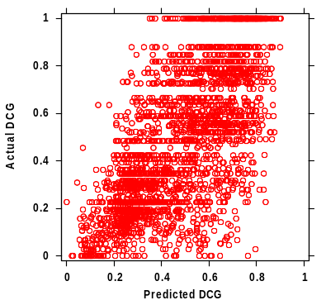
Findings: All Features
Effectively predicts DCG@3
  R=0.699, MAE =0.160
Correlation is sensible across
the full range of DCG values
Most predictive feature is an interaction feature
  Average rank of result click
Disagreements in prediction associated with novel result presentation
  E.g., Instant answers (likes maps and images) may influence
  user interaction features
Notes:
Average correlation between predicted and actual DCG scores across all queries and all runs is almost 0.7
Note that MAE is normalized to range from 0 to 1 inclusive
Most predictive feature of query performance is the average rank of a result click on the search engine result page
Cases where the predicted DCG score is radically different from the actual DCG score are associated with novel SERP features such as instant answers, inline answers, etc. that may interfere with interaction features

Slide 9
Findings: Feature Combinations
Feature Set | R | MAE
Query + Results + Interaction (full model) | 0.699 | 0.154
Results + Interaction | 0.698 | 0.160
Query + Interaction | 0.678 | 0.164
Interaction only | 0.667 * | 0.166 *
Query + Results | 0.556 ** | 0.193 **
Results only | 0.522 ** | 0.200 **
Query only | 0.323 ** | 0.228 **
Interaction features perform close to all features
  Strong predictive signal in interaction behavior
Results features perform reasonably well
Query features perform poorly
  Do not add much to Results or Interaction features
(Diff. from full model:
* = p < .05, ** = p < .01)

Slide 10
Findings: Query Frequency
Interaction features are important, but mostly available for frequent queries
  How well can we do on infrequent queries?
We looked at the correlation for different frequency bins
  Ranked queries by frequency
  Divided queries into equally-sized bins
  Computed correlation between predicted & actual DCG@3

Slide 11
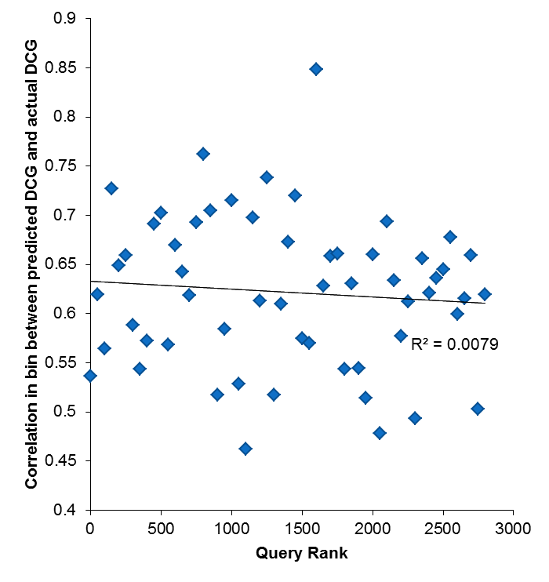
Findings: Query Frequency
Linear regression revealed very slight relationship between query frequency and prediction accuracy
(R² = .008)
This is good – we can accurately predict for
non-popular queries
High frequency
Low frequency

Slide 12
Summary
Automatically predicted search engine performance using query, results, and interaction features
Strong correlation (R ≈ 0.7) between predicted query performance and human relevance judgments using all feature classes
Users’ search interactions provide a strong signal of engine performance, performing well alone and adding substantially to Query and Results features

Slide 13
Implications and Future Work
Accurate prediction can help search engines:
  Know when to apply different processing / ranking / presentation methods
  Identify poorly-performing queries
  Sample queries of different quality
Further research is required to understand:
  Role of other features
  Effects related to the nature of the document collection
  Impact of engine settings on prediction effectiveness

