Slide 1
Architecture Studies 1 an architecturally mediocre presentation engine
Silicon Graphics
Akeley and Jermoluk
1988 (Paleozoic)
DN10000VS
Kirk and Voorhies
1990 (ancient)
Leo
Deering and Nelson
1993 (Brenden finishes 6th grade)
When you think of hardware, think of rectangles.
© 2002 Brenden Schubert

Slide 2
High-Performance Polygon Rendering
  every presentation should tell a story:
Once upon a time, there were two guys named Kurt Akeley and Tom Jermoluk.
Kurt was a genius. He went to quality schools such as the Stanford engine.
Tom was not so bright – he simply had an propensity for corporate elevation. He went to a second-tier school in Blacksburg, Va.
(these slides aren’t going on the web, are they?)

Slide 3
High-Performance Polygon Rendering
Kurt and Tom decided they wanted to render some polygons really fast…
And the rest, as they say, is history.

Slide 4
Anyway the System Overview
Transfer data to graphics subsystem
Transform vertex coordinates
Transform vertex normals
Light each vertex
Clip each vertex
Project each vertex
Map projected coordinates to screen
Fill screen-space polygon in framebuffer
Scan framebuffer engine at screen refresh rates
Be prepared to switch contexts
Do all this, like, really fast

Slide 5
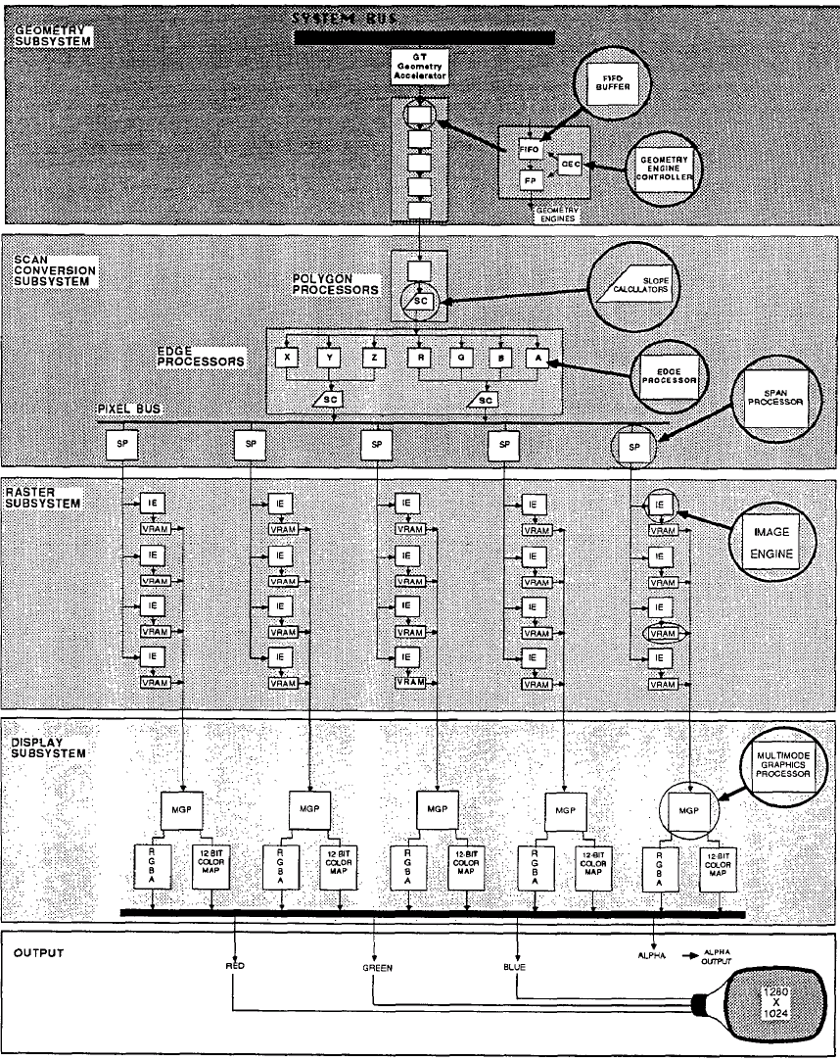

Slide 6
Data Transfer to Graphics Hardware
Data specified by function calls
  i.e. glVertex3f
400,000 vertexes per second = 10 MB/s
System bus engine capable of 64 MB/s
Use glVertex3fv to send larger blocks of data, improve bus efficiency

Slide 7
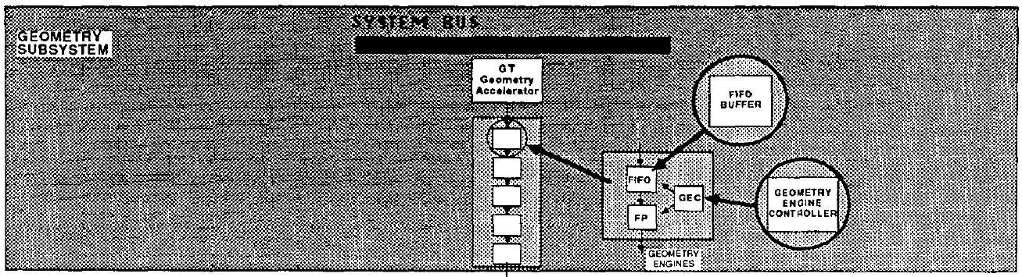
Geometry Subsystem
Comprised of 5 Geometry Engines
  Specialized 20 Mflops floating-point processors
The Geometry Engine
  FIFO input buffer (4 entries)
  Full pipelined concurrent microcode operation execution
Geometry Engine pipeline operates at 40-50 Mflops

Slide 8
Geometry Subsystem:
Geometry Engine Pipeline
Vertex and Normal transformation
Lighting calculations
Clip testing
Perspective division
Viewport transformation, color clamping, depthcue calculations

Slide 9
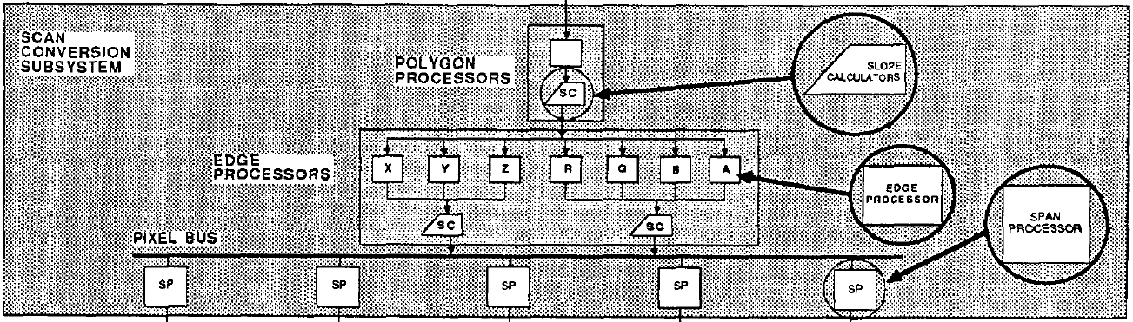
Scan Conversion Engine
Polygon Decomposer splits polygon into triangles and trapezoids with vertical edges
Edge Slope Calculators calculate slopes
Edge Interpolators find endpoints of each span to 1/8 pixel accuracy
Span Slope Calculators calculate color and depth slopes at span endpoints
Span Interpolators generate 40 Mpixels/s

Slide 10
Raster Subsystem
20 Image Engines TM
Receive pixels from Scan Conversion Engine
Perform Z-buffer operations, replace, high-speed clear
Write to the framebuffer in 5x4 tiles
Operation | Fill Rate
Replace | 80 Mpix/s
Z-buffer | 40 Mpix/s
Z-buffer/blend | 10 Mpix/s
High-speed clear | 160 Mpix/s

Slide 11
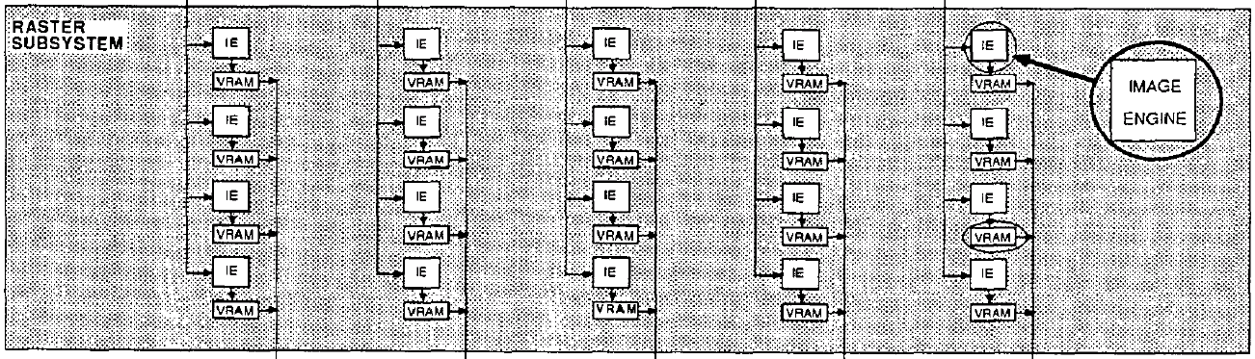
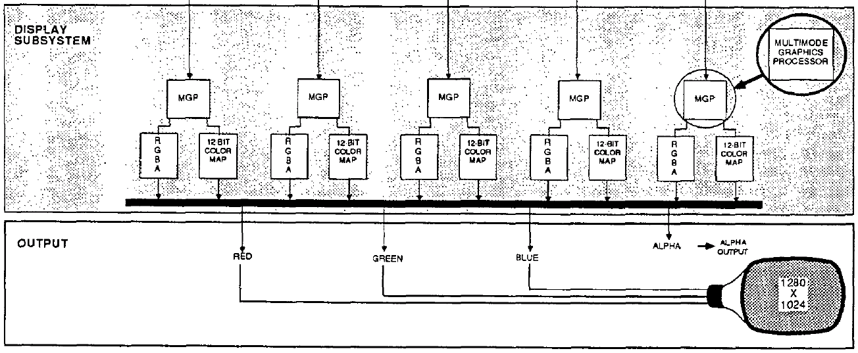

Slide 12
Display Subsystem
Reads pixel data from framebuffer
Interprets and routes color/alpha values to DA converters
Drives the display engine

Slide 13
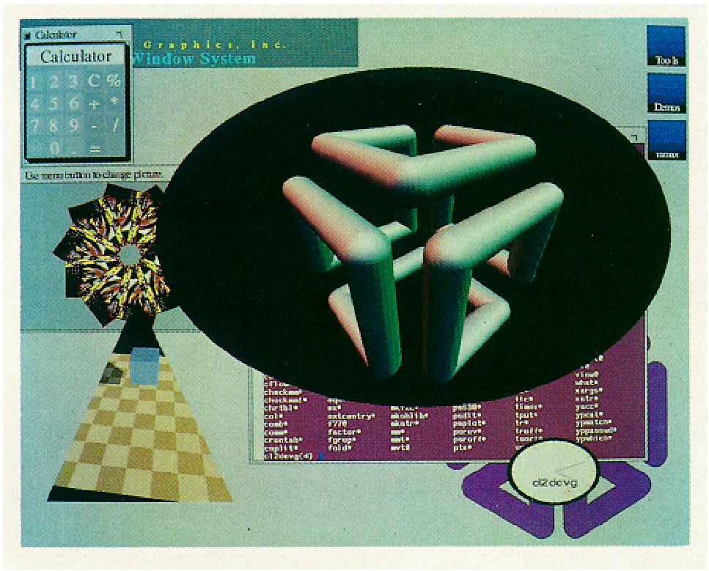
Special Features
Pan and Zoom
Window ID masking
Realtime Video
Alpha Blending
Antialiased Lines
Nolan used to have a desktop like this:

Slide 14
Performance
400,000 vertexes/s
Geometry limited around 140,000 tris/s
Fill limited around 40 Mpixels/s
210,000 antialiased lines/s
Screen clear in 8.3 ms
  @30hz 25% of frame time is clearing buffer engine
  The End.

Slide 15
The DN10000VS
“I’d like to use ‘profligate’ in a SIGGRAPH paper.”
“Let’s make one of the Key Words ‘quadratic’.”
“Maybe we can get away with software rendering if our cpu and memory are really fast”
“Maybe if for some reason this looks like it might not work, we should go found a specialized graphics-hardware company instead”

Slide 16
System Overview
Multiple CPUs used for transform and lighting calculations
  CPUs optimized at isa level for vertex transformation calculations
  Spin-locks used to control access to rendering data and rasterizing engine
Rasterizing Engine driven via main system bus
  Walks trapezoid scan lines, quadratically or linearly interpolating color, depth, and alpha

Slide 17
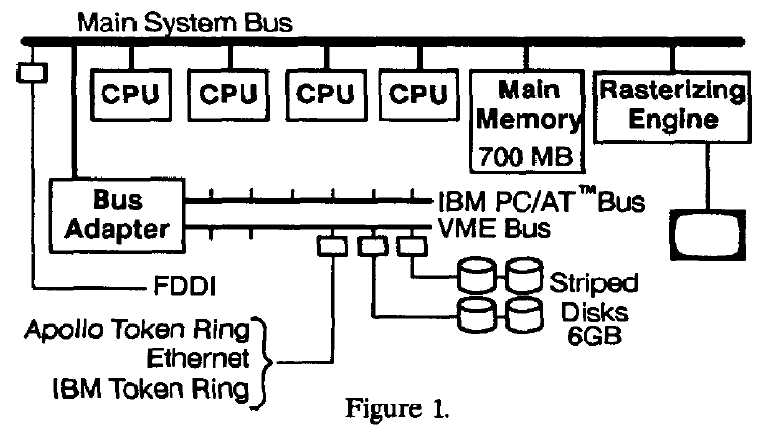

Slide 18
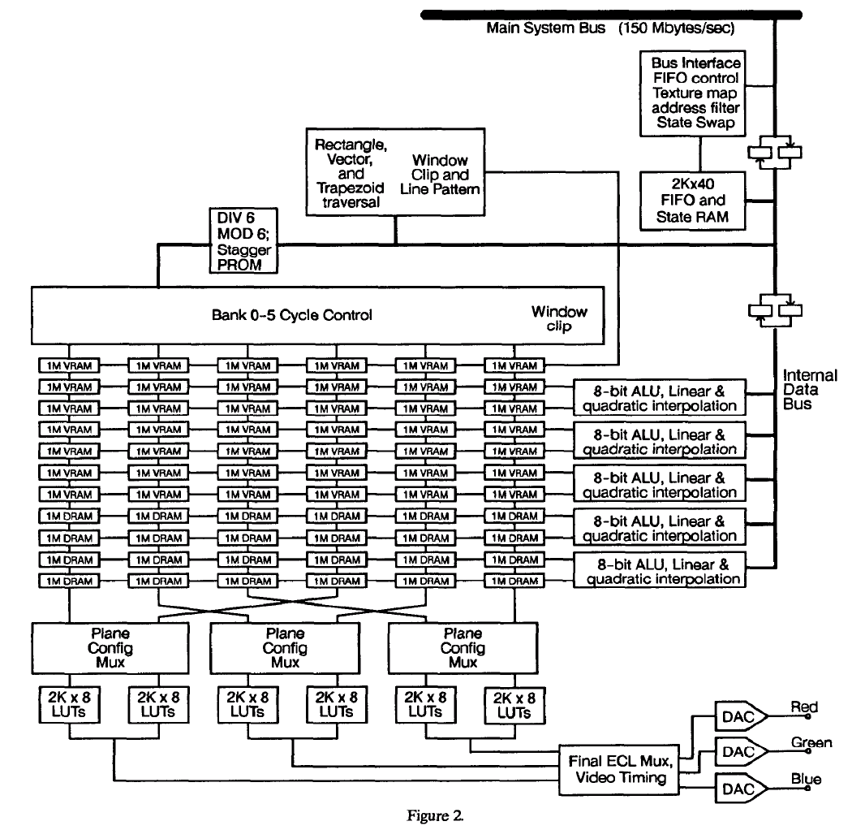

Slide 19
“Fast Phong” Shading
Gouraud Shading produces Mach bands (retina doesn’t like discontinuities in first derivative of intensity)
Quadratic interpolation + exponentiation texture map = ‘fast phong’ shading
  Fast Phong shading is Gary Bishop’s approximation of the phong shading model
  Requires lighting calculations at vertices and edge midpoints
No Mach bands, curved highlights

Slide 20
“Fast Phong” Shading
No Mach bands, curved highlights:
[I’d planned to put the pictures here but even at hi-res the color versions suck. Seriously. So much that it wasn’t even worth putting them here anyway. Sure, I could have gone and found some other pictures of Mach bands. But this took less effort.]

Slide 21
Texture Mapping
Texture must reside in framebuffer
Re-use color interpolators to interpolate texture coordinates
MIP-mapping used to prefilter textures
Quadratic interpolation used for perspective-correct texture interpolation

Slide 22
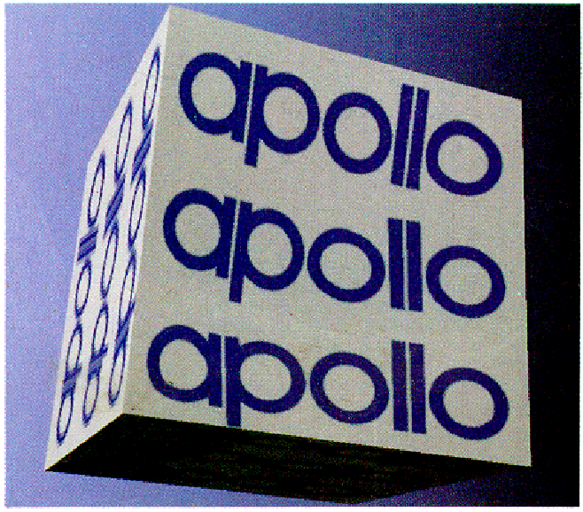

Texture Mapping
Quadratic interpolation used for perspective-correct texture interpolation:

Slide 23
Conclusions
Quadtratic Interpolation is probably the biggest contribution
  Not used by Akeley and Jermoluk
  Used for both shading and perspective-correct texturing

Slide 24
Conclusions
1990 must just have been the wrong time to be designing graphics hardware, because David Kirk is a smart guy
Let us count the follies:
  Do graphics calculation on the CPU to ride the CPU performance curve and get better application-graphics load-balancing
  Multiple processors process geometry at the primitive level, using spin-locks to interface to critical resources
  Simplify hardware to the point of no programmability (not even microcode)
  Memory is expensive – if possible, use main memory for the framebuffer

Slide 25
Conclusions
Graphics Hardware is not supposed to be ‘holistic’. It is meant to be fast. Yoga is meant to be ‘holistic’.
The End.

Slide 26
Leo
To digress for a moment: Do active vs. passive verbs in an abstract affect how exciting the paper sounds?
Paper | Passive Verbs in Abstract
Kirk & Voorhies | 2
Deering & Nelson | 3
Akeley & Jermoluk | 3.5

Slide 27
Leo System Overview
LeoCommand
  FIFO buffer for graphics commands
LeoFloat
  Floating-point intensive geometry calculations
LeoDraw
  Screen space rendering to VRAM
LeoCross
  Reads framebuffer, color lookups, double-buffering, video timing

Slide 28
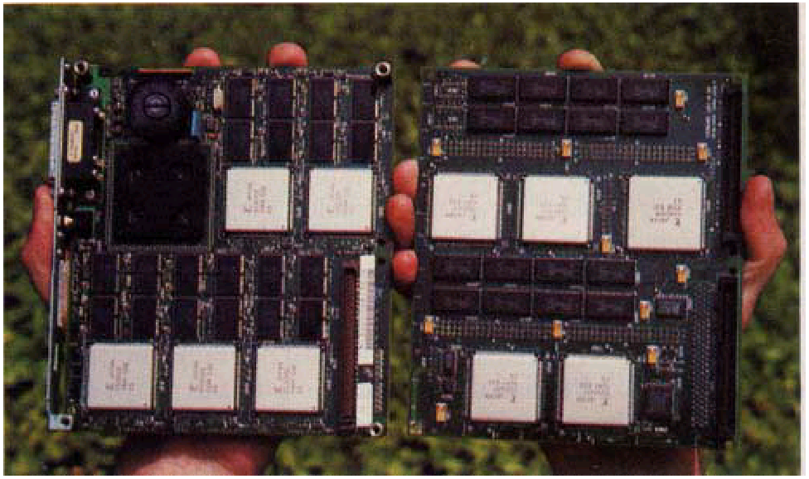

Slide 29
LeoCommand
Decomposes triangle strips into individual triangles
  D’oh!
Compresses color components, normals, and texture coordinates into 16 bits while shoveling them around the chip
  Sweet!

Slide 30
LeoFloat
Custom microcodable ASIC specialized for 32-bit floating-point graphics calculations
Double buffered asynchronous input and output packet hardware
288 internal registers (exactly the number needed to transform/clip/light a triangle)
Horizontally microprogrammable (avoids complex out-of-order execution tables)
“Kitchen sink” instruction

Slide 31
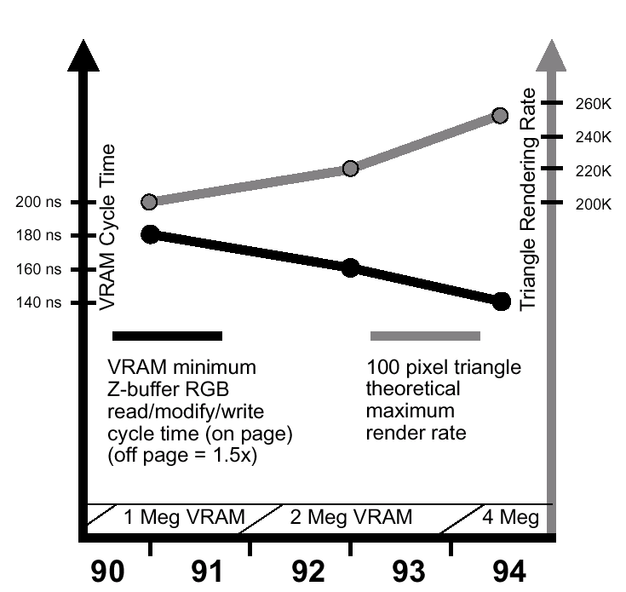
LeoDraw
Figure 5: somehow justifies decision to use 5-way interleaved memory (and thus 5 LeoDraw chips)
Broadcast triangle to all 5 rasterizers
  Each thinks it’s rasterizing the same triangle, but onto memory 1/5 as dense

Slide 32
LeoDraw
CAD features:
  Antialiased lines and dots
  Per-pixel depth cue
  ‘Picking’ support
Parallel 3D/2D contexts – multithreaded application can make simultaneous 2D and 3D graphics calls

Slide 33
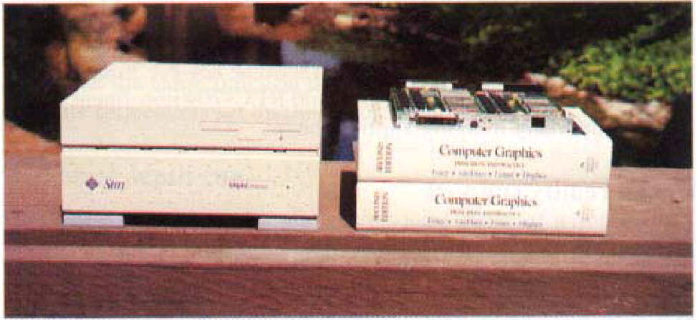
LeoCross
Video output
Supports virtual reality

Slide 34
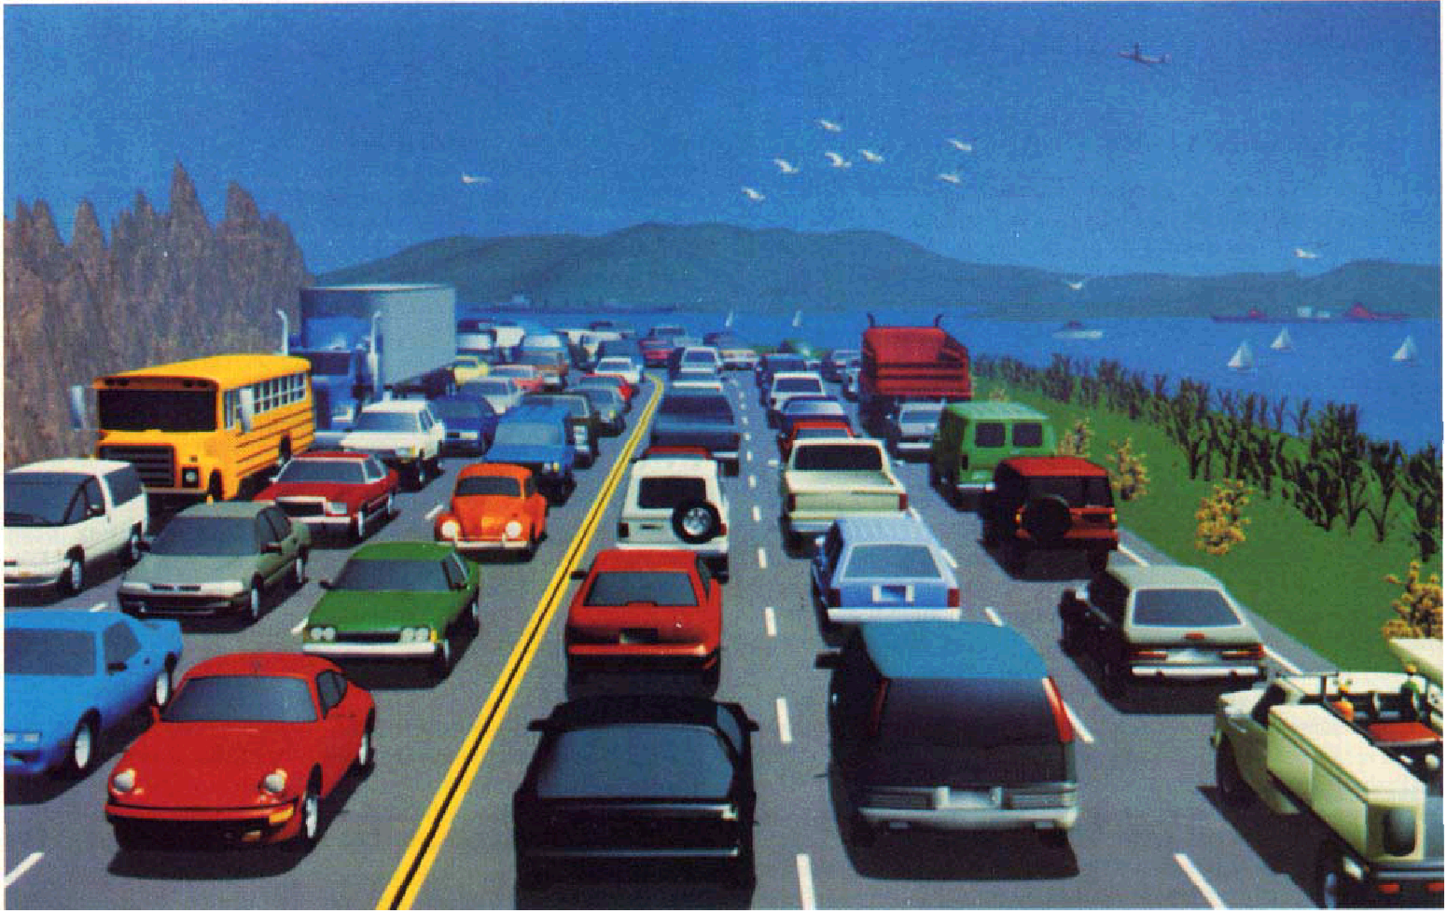
Results
210,000 100-pixel lit, Gouraud-shaded, z-buffered, depth-cued triangles/s
422,000 12 pixel long antialiased lines/s
730,000 antialiased points/s
10 Mpix/s drawpixels
The End.

