Slide 1
Image Compositing Hardware
(Another exciting presentation)
© 2002 Brenden Schubert
The Metabuffer: A Scalable Multiresolution Multidisplay 3-D Graphics System Using Commodity Rendering Engines
Lightning-2: A High-Performance Display Subsystem for PC Clusters
Scalable Interactive Volume Rendering Using Off-the-Shelf Components
Figure 1: The Title Slide

Slide 2
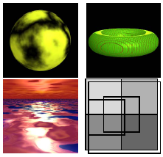
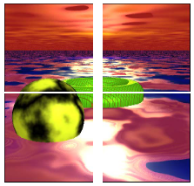
The Metabuffer
Sort-last parallel realtime rendering using COTS hardware
Independently scalable in renderers and displays
Any renderer viewport can map to any area of final composited image
Figure 2: The Metabuffer Overview Slide

Slide 3
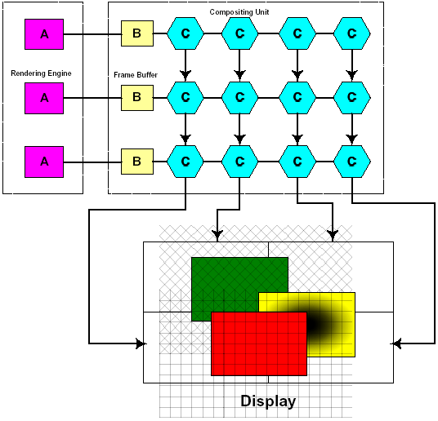
System Architecture
[A] = COTS renderer
[B] = onboard framebuffer
{C} = compositing unit
Not shown: compositing framebuffers used to drive displays
Figure 3: The Metabuffer System Architecture Slide

Slide 4
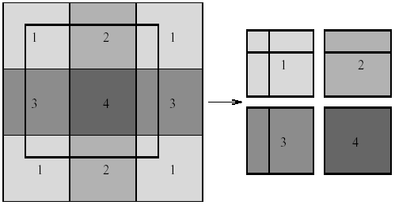
Data Flow
Viewport configuration kept track of on rendering nodes’ CPUs
-Routing/Compositing info encoded in image
Total data is proportional to input size
Figure 4: The Metabuffer Data Flow Slide

Slide 5
Bus Scheduling
IRSA round robin
  Idle recovery slot allocation
  Allows for best overall use of bus among “composers”
Composer vs. Compositor?
Figure 5: The Bus Scheduling Slide

Slide 6
Metabuffer Operation
Frame Transition
Waiting for PIPEREADY
Buffers are filled
Output framebuffers signal completion
Compositor relays finish signal
Master compositor signals start of frame
Compositors in pipe begin frame
Input framebuffer streams out data
Figure 6: The Metabuffer Operation Slide

Slide 7
Do we have interns at a major hardware manufacturer?
Nope. Guess we’ll just have to simulate/emulate this
Simulator
  Tries to accurately implement the architecture
  C++, multithreaded by object
Emulator
  Tries to produce the same output that the Metabuffer would as fast as possible
  128 node (PIII-800 GeForce2) Beowulf cluster
Figure 7: The Slide with the humorous title

Slide 8
Other Things
Software simulation uses raytracer to generate images and depthmap
Antialiasing can be done with supersampling and filtering at the output framebuffers
Foveated vision: multiple user view-tracking?
Stanford views pi meeting
High speed active network switch
Figure 8: The Other Things Slide

Slide 9

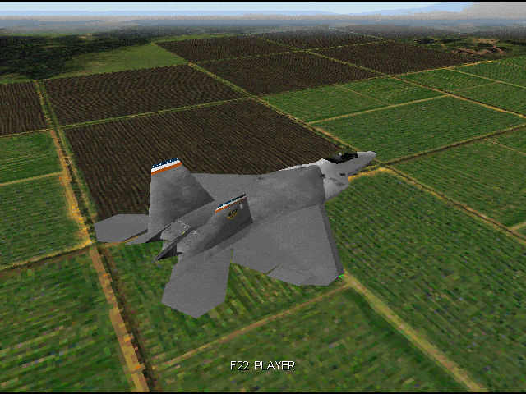

F-22 Lightning-2
by
Figure 9: The Joke Lightning-2 Overview Slide

Slide 10
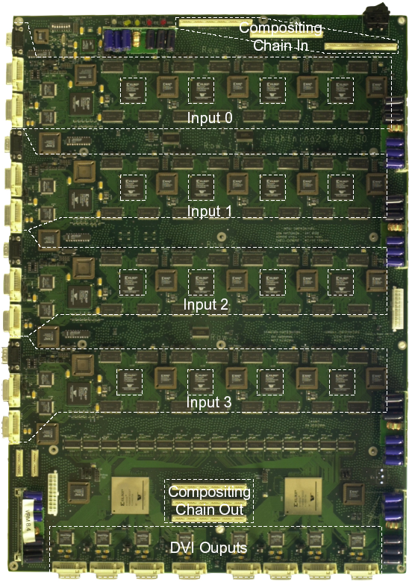
Lightning-2
Hardware compositing switch for clusters
DVI-to-DVI interface
Scales independently in inputs and outputs
Actually fabricated in hardware
Costs a lot
Figure 10: The Lightning-2 Overview Slide

Slide 11
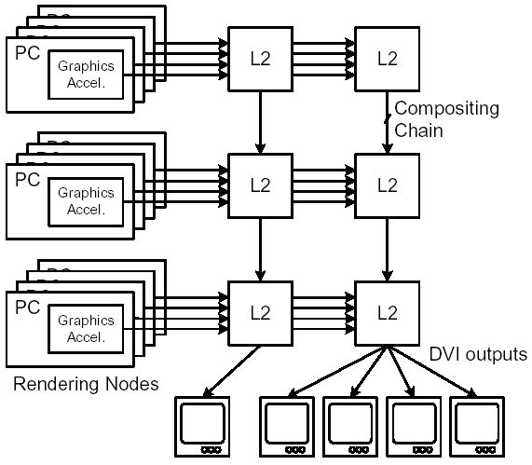
Lightning-2 Architecture
Connects to DVI-out from commodity graphics cards in cluster
DVI captured by first column of modules and propogated across rows
Compositing for each display output occurs down each column
Figure 11: The First Lightning-2 Architecture Slide

Slide 12
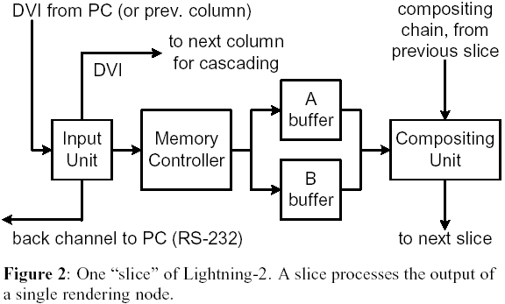
L-2 Module Architecture
DVI inputs
RS-232 back-channel
DVI Compositing in/out
Memory controller
Double-buffered framebuffer (SDRAM)
Figure 12: The Second Lightning-2 Architecture Slide

Slide 13
Pixel Reorganization
Input frames arrive in input-space raster order
Compositors operate in output-space raster order
Must map input order to output order
  Forward-Mapping:
  -Pixels reordered on write
-Pixels are stored in output-space raster order
  Reverse-Mapping:
  -Pixels reordered on read
  -Pixels are stored in input-space raster order
Figure 13: The Pixel Reorganization Slide

Slide 14
Input
Three ways to get data rendered by cluster video cards:
  Read pixels back into system memory
  Use scan-converters and capturer
  Use DVI interface
We’ll take #3
Thus need to transfer pixel mapping information via DVI
  Specified by encoding strip header in first two pixels of each scanline
Figure 14: The Input Slide

Slide 15
Frame/Depth Transfer
Buffer swap on horizontal blanking decreases latency
  All information encoded in scanline header – no frame-specific dependencies
Serial back-channel used to tell rendering nodes when previous frame has been received
Introduces additional frame of latency since rendering nodes could be up to 1 frame out of sync
Depth information must be read back to main memory and then copied to color buffer to send via DVI
  Introduces another frame of latency
Figure 15: The Frame Transfer Slide

Slide 16
Results
Frame Transfer Protocol
  Rendering node operates at 70Hz, Lightning-2 operates at 60Hz
  Allows 2.3ms for back-channel frame transfer signal
  Achieved >90% of the time (pesky os interference!)
Depth Compositing
  Depth copy has constant cost of appx. 17ms
  At >4 nodes this takes up more than half of the frame time and begins to drop speedup below ideal
Figure 16: The Lightning-2 Results Slide

Slide 17
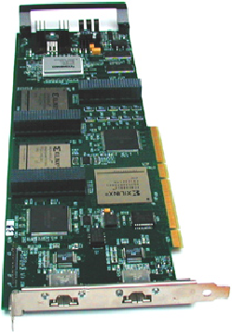
Sepia-2
Custom PCI-card for parallel interactive volume rendering on a cluster
Single-stage crossbar
Supports blending and non-commutative compositing operations
Figure 17: The Sepia-2 Title Slide

Slide 18
Sepia Architecture
Rendering accelerators (VolumePro 500 raycasters)
Display device (standard OpenGL renderer)
PCI Card - 1 for each rendering node and display device
  3 FPGAs
  2 ServerNet-2 gigabit network ports
  RAM buffers
High-speed network switches
Figure 18: The Sepia Architecture Slide

Slide 19
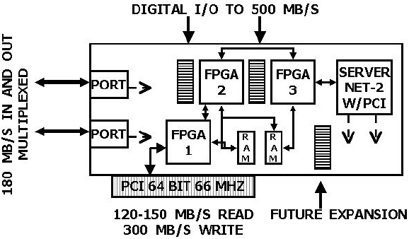
Sepia PCI Card
Figure 19: The Sepia PCI Card Slide

Slide 20
Comparison
Sepia-2 uses parallel blending operations
  Lightning-2 uses scan-line based pixel mapping
  MetaBuffer uses viewport transformations and depth compositing
Sepia-2 scales linearly (inputs + outputs) using Clos topology networking
  Lightning-2 and MetaBuffer scale ~quadratically (inputs x outputs) using mesh topology
Figure 20: The Sepia Comparison Slide

Slide 21
TeraVoxel Operation
VolumePro generates viewpoint-dependent base plane (sub-volume image)
  Writes it to main memory
BP is copied to larger-resolution SBP
Sepia-2 cards each read SBP from local main memories
  Transmit over network to display node
  Display node performs compositing operations
Display node textures result onto polygon to display using OpenGL
Figure 21: The TeraVoxel Operation Slide

Slide 22
Sepia Firmware
Need an associative blending operator to do raycasting in parallel
“F” is proven to be associative and equivalent to the basic subvoxel blending operation
Proof is elementary
Figure 22: The Sepia Firmware Slide

Slide 23
Clos Topology
Sepia-2 depends on full crossbar networking with linear scaling
Recursive Clos topology is proven to provide this
Read the 1953 Clos paper if you want to know more
Figure 23: The Clos Topology Slide

Slide 24
Sepia Results
Time spent in VolumePro calculation: 36-42ms
  Rest of calculation pipelined with no stage >36ms
  So optimal refresh rates are 24-28fps
Copying subimage to memory: 5ms
Transfer over network and blending calculation: 34ms
Maximum wait for vertical refresh to display new frame: 17ms
Worst-case combined latency: 102ms
Figure 24: The Sepia Results Slide

