Slide 1
Image Compositing - Software
Dale Beermann
Depth Complexity in Object-Parallel Graphics Architectures
Pixel Merging for Object-parallel Rendering: A Distributed Snooping Algorithm
Parallel Volume Rendering Using Binary-Swap Compositing
A Comparison of Parallel Compositing Techniques on Shared Memory Multiprocessors

Slide 2
Depth Complexity in Object-Parallel Graphics Architectures
Michael Cox, Pat Hanrahan - 1992
  An analysis of average depth complexity in a scene in order to find a place to look for a better algorithm for compositing of pixels after object-parallel rendering.
    Such an algorithm is presented in the next paper.
  Model is based on graphics primitive size distribution.
  Use RenderMan and a software implementation of SGI’s GL to generate traces of the pixels generated during the rendering process (I won’t go into this much).

Slide 3
Some Definitions
Vertical Parallelism
  also known as instruction-level parallelism and pipelining
Horizontal Parallelism
  also known as data parallelism, multiprocessing, and parallel processing.
  Two Types of Horizontal Parallelism:
    Image Parallelism
      also known as screen-space parallelism
      each processor is assigned a region of the screen and must render all primitives that would fall in that region - partial local frame buffers are created
    Object Parallelism
      also known as image composition
      primitives are assigned round-robin and a full frame buffer is created
      The Problem: Pixel Merge
        pixels rendered by all processors must be merged in the end

Slide 4
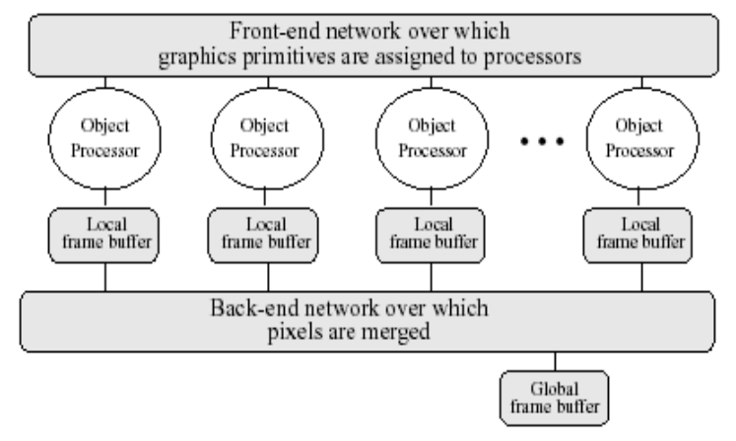
Object Parallelism
The object parallel architecture has three phases:
  object assignment to processors (round robin)
    done by the front-end network
  rendering (done locally on individual processors)
    performs local hidden surface removal with z-buffering
    produces a local frame buffer
  pixel merging
    done by the back-end network
    composite local frame buffers from all processors
    produces a global frame buffer with the final composited image

Slide 5
Some More Definitions
depth at (x,y)
  the number of primitives in a graphics scene to be rendered to this specific (x,y) position
depth complexity distribution or depth complexity
  in a graphics scene, this is the distribution of depth over the whole image (all (x,y) coordinates).
  will use subsets of the scene and refer to the depth complexity of these subsets as well
    ex. the 1/n primitives a processor may receive

Slide 6
Implications of Depth Complexity
Scenes with larger depth complexity require more back-end pixel traffic.
  Scenes require more processing for z-buffering when there is a large depth complexity because of increased comparisons.
  Removing depth complexity at the local frame buffer will reduce the bandwidth required by the back-end network.
    when done by local processors, it can be done in parallel
    depending on the back-end network, there is a limited amount of parallelism that can be achieved (other papers acknowledge these algorithms)

Slide 7
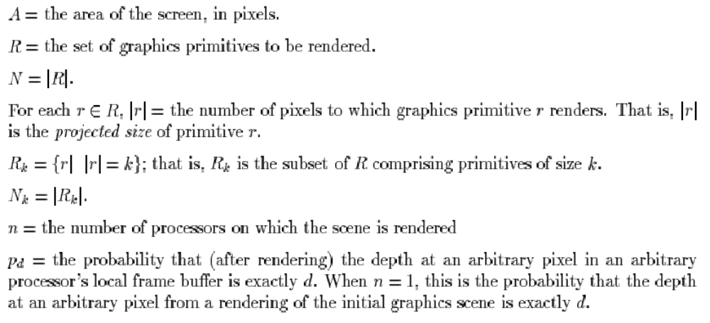
The Analytic Model (More Definitions)

Slide 8
The Analytic Model continued
Assumptions:
  screen coverage by primitives is uniformly and randomly distributed
  primitives are uniformly and randomly distributed to processors
A starting point (my attempt to explain the math):
  The Generating Function for probability distribution
    The probability that a primitive r with size k renders to (x,y) is k/(An)
      this is just the size of the primitive divided by the frame buffer area times the number of processors
    H_{k}(v) = (1 - (k/An)) + (k/An)v
    The coefficient of v_{o} is the probability that r does not render to (x,y)
      (1 - (k/An))
    The coefficient of v₁ is the probability that r does render to (x,y)
      (k/An)

Slide 9
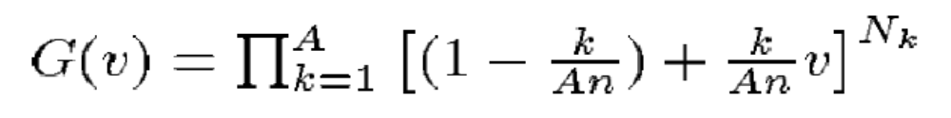
The Analytic Model continued (some more math)
  Generating functions can be multiplied to express convolution of the probability density functions (yeah I copied that from the paper).
    So the coefficient of v² in H_{k}(v)² is the probability the two primitives of size k render to (x,y)
    Moving along, H_{k}(v)^{Nk =} [(1 - (k/An)) + (k/An)v]^{Nk}
      N_{k} is the number of primitives with size k
      So the probability that d are rendered to (x,y) is represented by the coefficient of v^{d}
  Now we can find the generating function of the probability density of depth complexity by finding the product over all possible primitive sizes.

Slide 10
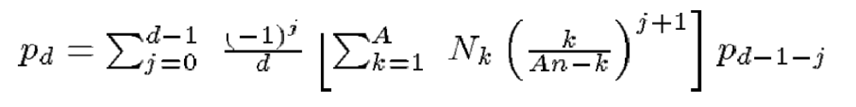
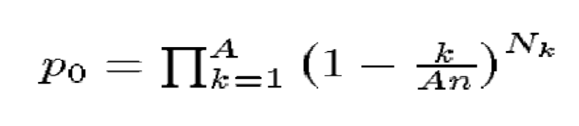
The Analytic Model continued (some more math)
  The probability p_{d} that an arbitrary pixel in an arbitrary processor’s local frame buffer has depth exactly d is the coefficient of v^{d} of G(v).
  Since they tell you to look in the appendix for this one, so will I.
    For all d, d > 0:
    and

Slide 11
The Analytic Model continued
  The point?
    With the graphics primitive size distribution for a given scene and the number of processors, they can predict the depth complexity probability density function.
    Then they can also predict the expected depth complexity and variance, and, what they are really aiming at, the expected number of active pixels per local frame buffer.
    I omit the rest of the math
  Some notes, p₀ is the probability that no primitive renders to some pixel
  Pr[arbitrary pixel (x,y) is active] is simply (1-p₀)

Slide 12
The Analytic Model continued
  Answers to some questions:
    A sparse frame buffer is one for which a small portion of the frame buffer has had primitives rendered to it.
      it is pointless to send all of the data across the wire when you only need to send a small portion of it
      active vs. inactive pixels denote which ones have had primitives rendered to them

Slide 13
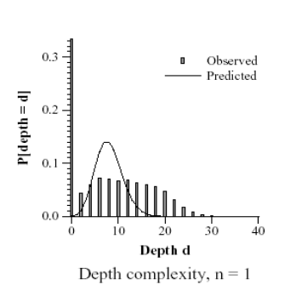
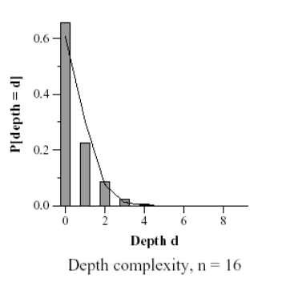
Some Depth Complexity Results
As the number of processors increase, the depth complexity goes down
  with 32 processors, for the Wash.ht scene, the depth complexity was never greater than 1
A problem: not all graphics primitives are uniformly distributed
  cube - for small numbers of processor, the model does not fit, but as the number of processors increases, the primitives are distributed better, getting rid of spatial coherence, and the model looks much nicer

Slide 14
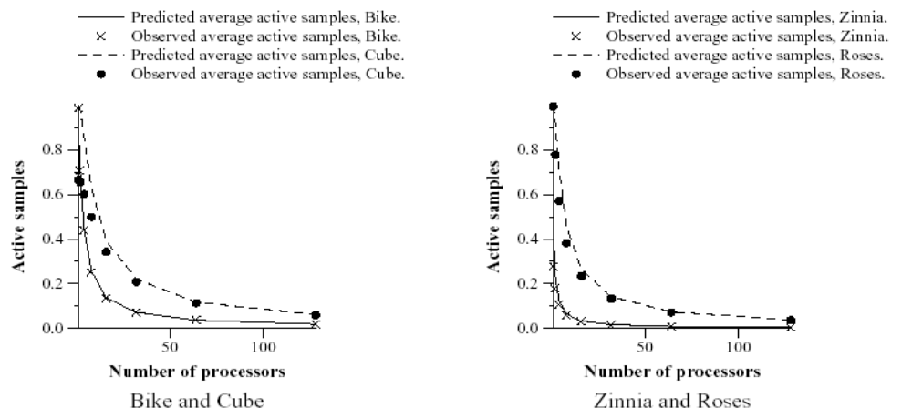
Some Depth Complexity Results
Screen coverage steeply declines when primitives are distributed across many processors.
  most of the frame buffers represent unused hardware.
    there is a potential here for reduced cost
    moving only those pixels rendered could help a lot
Average active sample prediction was very good.

Slide 15
Depth Complexity Conclusions
The fit of the model for uniprocessors can be good, but is much better for multiprocessors where primitives are distributed widely resulting in less spatial coherence among primitives for a processor.
Again, the model predicts the number of active samples for a scene pretty well.
Z-Buffering pixels locally has much less of an advantage when there are few processors as opposed to when there are many.
Basically, there has to be some way to take advantage of the sparse frame buffers in not transmitting so much pixel data.

Slide 16
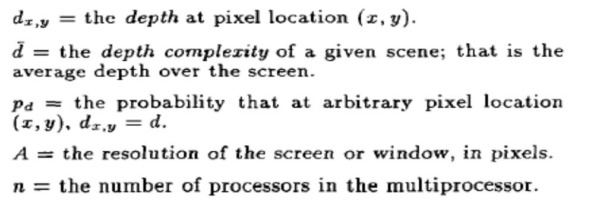
Pixel Merging for Object-Parallel Rendering: A Distributed Snooping Algorithm
Michael Cox, Pat Hanrahan - 1993
  Analyzes and compares a few different pixel merging algorithms and presents a new distributed snooping algorithm.
  A good part of the paper is based on the previous one.
    Describe different types of parallelism are described, as well as the pixel-merge problem
    Describe use of RenderMan and GL for tracing pixels
    Define the same bunch of terms

Slide 17
A Straightforward Pixel Merging Algorithm
Each node is assigned a subset of A (screen area) and is responsible for any pixels in that subset.
  either as the node renders them or after it is done rendering all pixels.
    could z-buffer pixels locally so it didn’t have to send so many off
    simulations show that few pixels will be deleted locally, so there really isn’t much of a benefit
After any node finishes rendering a pixel, those pixels are sent to the node responsible for them.
Each node then z-buffers the pixels it receives and the images from each node can be tiled.

Slide 18
A Straightforward Pixel Merging Algorithm cont.
Computing the network traffic is straight forward
  d_{a}A pixels must be sent, received and compared, this is the total network traffic
  this is simply the average depth of the pixels multiplied by the screen area

Slide 19
The PixelFlow Algorithm
Each processor has an associated full frame buffer it renders to.
After rendering, the first node sends its pixels to the second node, which performs z-buffering. The second node then sends its pixels to the third, etc.
  Parallelism is taken advantage of, so processors aren’t waiting while others are busy sending and z-buffering (once they’ve sent their pixels they are inactive though).
The final node will have the final image.

Slide 20
The PixelFlow Algorithm
The total number of pixels transferred will be nA, where n is the number of processors in the system.
  bandwidth required on each link is only A
In aggregate, O(nA) processing is required to read, compare, send and receive pixels

Slide 21
A Distributed Snooping Merge Algorithm
Each processor renders to a local frame buffer all the primitives it has received.
n processors share a global frame buffer to which pixels can be broadcast.
Processor 1 broadcasts all of its pixels to the global frame buffer while everyone else “listens” to the broadcast.
  keeps track of active vs. inactive pixels
For processors that have an active pixel for each (x,y) another processor broadcasts, they do a z-buffer check and discard the pixel if the need to.
The global frame buffer z-buffers the incoming pixels and ends up with the final image.

Slide 22
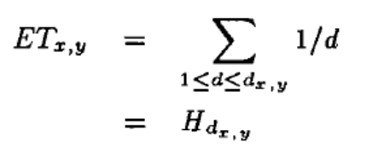
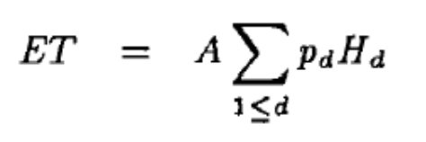
A Distributed Snooping Merge Algorithm cont.
Answers to some questions:
  Pixels that are broadcast include (screen-x, screen-y, eye-coordinate-z, red, green, blue, *parent-primitive)
Calculating expected network traffic:
  The first processor sends its pixels with probability 1, the next sends each pixels with probability 1/2, etc.
  so Expected Traffic at (x,y) is
  from the last paper, they use the distribution of depth, p_{d,} to find the expected traffic from all locations

Slide 23
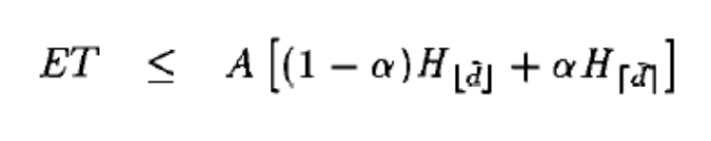
A Distributed Snooping Merge Algorithm cont.
They bound the equation for Estimated Traffic:
Basically, the idea is that you take the lower bound (floor) and use it for the probability that the pixel won’t be rendered (1-alpha). Similarly, you take the upper bound (ceiling) and use it for the probability that the pixel will be rendered.
Alpha is the (average depth complexity - the floor of the average depth complexity). I don’t know exactly what that means.
So, as the depth increases, the ET grows about at the same rate as log() of the average depth because the Harmonics grow so slowly.

Slide 24
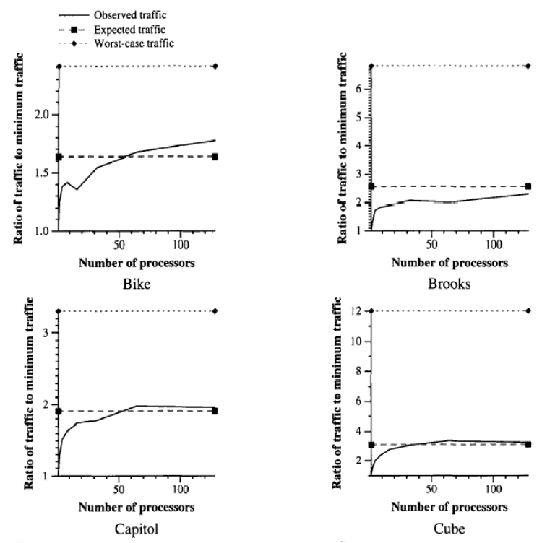
A Distributed Snooping Merge Algorithm Results
Expected traffic is close to Observed traffic for most scenes.
Minimum traffic is as observed on a uniprocessor, so the ratio is the comparison for multiprocessors to the uniprocessor result.
Ratio grows because z-buffering has been ignored. From before, it can be noted that it can be ignored for many processors, but is not an accurate assumption for few processors.

Slide 25
Algorithm Comparisons
d_{a} represents average depth
Uniprocessor z-buffering
d_{a}A pixels must be read and compared
log(d_{a})A pixels must be written
total cost is O(d_{a}A + log(d_{a})A)
Simple Algorithm
aggregate network traffic is d_{a}A pixels
O(d_{a}A) processor cycles required to route, send, receive, compare
PixelFlow Algorithm
total bandwidth required is nA pixels
O(d_{a}A) processor cycles required to route, send, receive, compare
Snooping Algorithm
requires network bandwidth log(d_{a})A in the expected case

Slide 26
A Distributed Snooping Merge Algorithm Conclusion
log(d_{a})A is better than d_{a}A.
There is still room for improvement. They mention that hardware modification for snooping support could be desirable.
The Zinnia scene exceeded expected traffic (not shown) because the largest primitive, the background, appeared first in the database, was thus given to the first processor, and thus every pixel had to be written to the global frame buffer and written over where necessary by other pixels.
The higher the depth complexity the better the reduction in traffic.

Slide 27
Parallel Volume Rendering Using Binary-Swap Image Compostion
Ma, Painter, Hansen, Krogh - 1994
  Present an algorithm where sub-volumes are raytraced independently to a local frame buffer, and resulting images are composited in parallel.
  Based on the fact that there are many available high perfomance workstations that could be used for rendering.
    no need for nodes to communicate while rendering data
      A Good Question: How does raytracing do lighting effects such as shadows when other primitives are located on other processors?
  Also go over image- and data-space subdivision.
    Data-space subdivision is usually applied to distributed computing while image-space subdivision generally involves a shared-memory multiprocessing environment

Slide 28
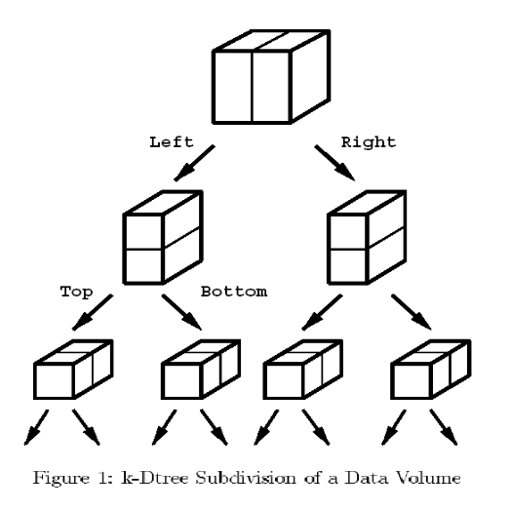
Divide and Conquer
Don’t mention how raytracing works in a distributed environment where nodes don’t have access to all primitives.
Use a kd-tree for data subdivision.
Data on the boundaries must be duplicated.

Slide 29
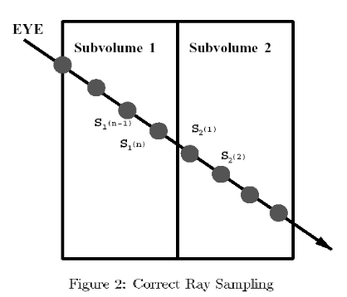
Parallel Rendering
Local rendering is done on each processor independently (again, that question…)
  only rays that fall within the subvolume are cast
  use an identical view position
Note that you must user consistent sampling locations so that “we can construct the original volume.”
  you could see volume boundaries
    get two primitives on boundaries

Slide 30

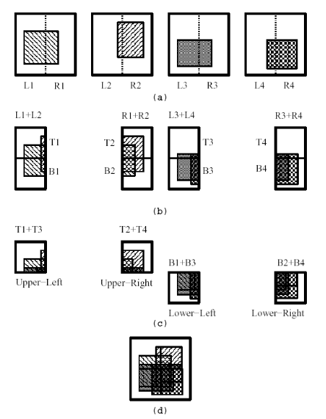
Image Composition
Need to composite images in back to front order
Porter and Duff - over
In the naïve process many processors become idle
  With Binary Swap every processor participates in every step of the compositing process
Each processor swaps its image with another, getting two coherent halves.
Division is then done along the opposite axis.
End up with 1/n of the image

Slide 31
Image Composition cont.
The final image is constructed by simply tiling the images from each processor
“Sparsity” can be exploited.
  don’t composite parts of the image that aren’t there
    processors keep a bounding box of their non-blank sub-image area
    is a bounding box the best way here?
      Could be very sparse but if two pixels far apart would create a big bounding box
      my suggestion - would it be possible to keep an ordered list of pixels and do a cross product on the two sets?
Number of processors had to be a power of two
  algorithm been expanded?

Slide 32
Communication Costs
Mathematical Massaging:
  after rendering each processor has approximately pn^{-2/3} pixels so the total number of pixels is pn^{1/3}
    don’t say where they come up with the exponent
  some number of pixels will be deleted in compositing
  massaging …. pixels transmitted is <= 2.43n^{1/3}p
    the way they come up with it doesn’t exactly make sense to me (anyone else?)

Slide 33
Comparison to Other algorithms
Direct Send
  assign a subset of the image pixels to each processor
  pixels transmitted is n^{1/3}p(1-1/n)
  may require n(n-1) messages to be transmitted
    every pixel a processor renders needs to be sent to another processor, and this happens for each processor - one processpor sends p(n-1) pixels, n processors, get pn(n-1)
Binary Swap
  each processor sends log(n) messages, so the total number of messages sent is nlog(n)
    can use nearest neighbor paths when they exist, when number of pixels transmitted is largest early in the compositing

Slide 34
Comparison to Other algorithms
Projection method
  rays propagate through a 3D grid decomposition of the volume data
  rays propagate back to front through the volumes from one processor holding a sub-volume to the processor holding the neighboring sub-volume
  transmits O(n^{1/3}p) pixels like the other two methods
  Must move through n^{1/3} processor nodes so the message latency grows by O(n^{1/3}) as opposed to (n-1) for direct send and log(n) for binary swap

Slide 35
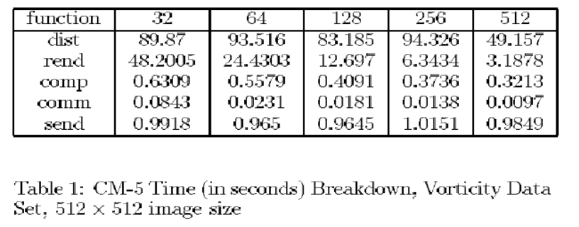
Implementation
Used the CM-5, a 1024 node supercomputer
  each node had 32MB of RAM and 64-bit wide vector units (unused).
Also experimented with a shared network of workstations.
Didn’t implement other algorithms, have no basis for comparison of timed results. Simulations do show that with more processors rendering time goes down while the percentage of time spent on distribution increases.

Slide 36
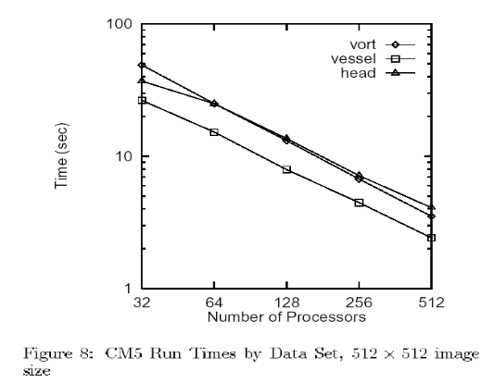
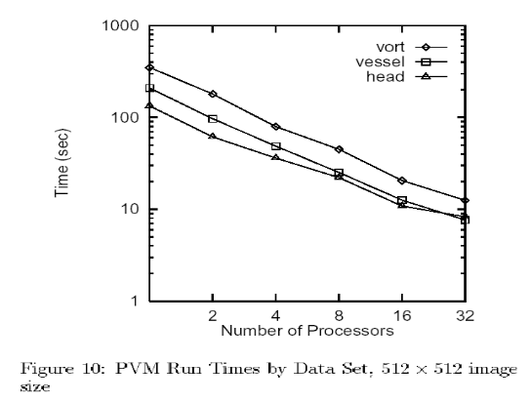
Conclusions
They say that binary swap can be faster.
It does keep the all the processors busy during compositing.
Networked workstations did not have linear speedup because they were on a shared network, data is somewhat inconsistent. A LAN doesn’t scale either, more nodes doesn’t mean more bandwidth.

Slide 37
Comparison of Parallel Compositing Techniques on Shared Memory Architecures
Reinhard and Hansen - 2000
  Mention the Parallel Pipeline
  Review Binary Swap
  Review Direct Send

Slide 38
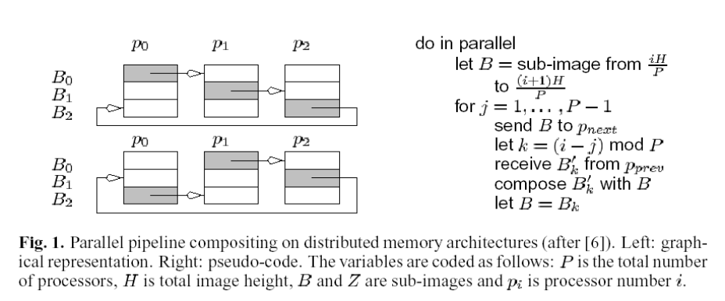
Parallel Pipeline
The basic idea is that the images and z-buffers to be composited are divided into P sub-images, one for each processor.
The sub-images flow around a “ring” of processors,
Each processor composites its sub-image k with the same sub-image that belongs to processor p_{k} There are P-1 steps

Slide 39
Parallel Pipeline
There are P-1 steps
  each processor composites N/P pixels during each iteration
  time complexity is O(N)
    N is number of pixels

Slide 40
Binary Swap
We already know how this works.
The algorithm iterates log₂(p) times and each time each processor composites N/(2^{i}) pixels
  N is number of pixels
  i is iteration number
  Total number of composites is N(1-1/p)

Slide 41
Binary Swap
Shared memory compositor (Direct Send)
  send all partial results for a given pixel to the processor that manages the pixel
  pixels are composited as they come in
  result is in a single block of memory, allowing direct display
  also O(N) for number of pixels
    P-1 steps, compositing N/P pixels at each step

Slide 42
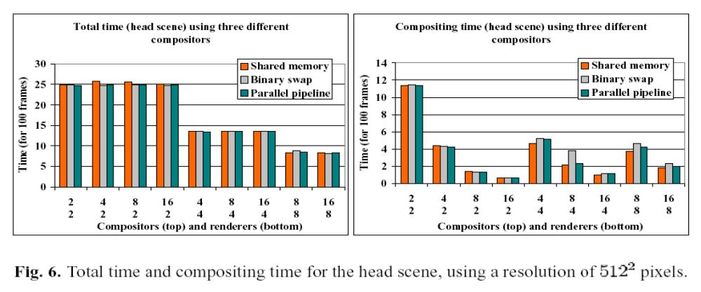
Results
Everything takes about the same time
  differences are due to overhead and cache efficiency

Slide 43
Conclusions
As long as the number of compositors and renderers is the same, there will be an optimum number of each
  adding one or the other will create a bottleneck
To reduce compositing time, must increase the number of compositors relative to the number of renderers.
  For a given number of renderers, doubling the compositors should have the compositing time
  We know every algorithm is linear, so this is no surprise

Slide 44


Conclusions
The big conclusion
  For a 1024² image, it takes 4 times the compositors it would for 512²
  good work boys
512²
512²
1024²
=
512²
512²

