Slide 1
Interfaces and Software Systems
Dale Beermann
Oct. 1 2002

Slide 2
Papers Presented
IRIS Performer: A High Performance Multiprocessing Toolkit for Real-Time 3D Graphics (SIGGRAPH ’94)
The Design of a Parallel Graphics Interface (SIGGRAPH ’98)
Curved PN Triangles (ACM ’01)

Slide 3
Typical Performance Limitations
Graphics System
  The graphics system cannot keep up with the commands it’s being issued
Data Generation
  Commands may not be issued as fast as the graphics system can process them
Graphics Interface
  The limited bandwidth between the graphics system and the host could be the limiting factor

Slide 4
Typical Performance Solutions
Packed Primitive Arrays
  May not solve the bandwidth problem
  Primitives still have to be decoded
  Can introduce an awkward programming model
Display Lists
  Easy - basically a compiled macro of commands
  Still could hold too much information
  If data is recomputed every frame, display lists are not useful
Compression
  Can compress the geometry or the texture data
  Increases encoding/decoding costs

Slide 5
Newer Performance Solutions
Parallel Interfaces
  IRIS Performer
    Use rigorous Database requirements and State Management to allow for multiprocessing
  A Parallel Graphics Interface
    Adds synchronization commands to an immediate-mode interface.
Geometry Compression
  Curved PN Triangles
    Provide an encoding for higher order primitives so less data needs to be transferred

Slide 6
Three Issues of a Parallel API
#1
State
  A stateless interface
    Requires that every command must include all information to execute
    Each command could hold redundant information
    State changes are expensive
  An interface with state
    Don’t need to re-specify data
    A command’s behavior is affected by previous commands

Slide 7
Three Issues of a Parallel API
#2
Immediate-mode vs. Retained-mode
  Immediate-mode
    Primitives can be sent off immediately
    Flexible programming style, easy to use
  Retained-mode
    A full scene representation is created and then sent to the graphics hardware
    Can improve performance, but can require lots of bandwidth
  Hybrid
    Many interfaces use both for better flexibility and performance benefits

Slide 8
Three Issues of a Parallel API
#3
Ordering Semantics
  Rules that constrain the order of commands to be executed need to be maintained
  Important for special behaviors
    Ground-plane shadows
    Transparency with alpha-compositing
  Sometimes it doesn’t matter
    Z-Buffering can solve ordering issues for opaque primitives

Slide 9
IRIS Performer
Rohlf and Helman, SIGGRAPH ‘94
A toolkit for the best possible performance for graphics workstations
  Uses Graphics Optimizations (e.g. LOD) and Multiprocessing
  Targeted at workstations using immediate mode graphics and small-scale shared memory

Slide 10
The Problem
IRIS Performer
Achieving Maximal Performance using Immediate Mode Rendering Libraries
  Often the Graphics Hardware is idle while the CPU crunches data
  It is hard to do multiprocessing and still maintain data synchronization
  It is hard to do multiprocessing without duplication of primitive data

Slide 11
The Solution
IRIS Performer
Simplification
  Scene Graph, LOD
    Allows for frustum culling and model selection
State Management
  pfState, pfDispList, pfGeoState
    Removes redundant state switching
Shared Memory and Data Synchronization
  pfBuffer, pfUpdatable
    Reduces the amount of memory required
Multiprocessing
  Combine everything and parallelize

Slide 12
The Libraries
IRIS Performer
libpr
  Efficient Rendering
  Provides high performance foundation
    Manages geometry and graphics state
    Also supports intersection and shared memory utilities
libpf
  Database Hierarchy and Automated Multiprocessing
    Uses a hierarchical scene graph to organize geometry
    Handles graph traversal configuration and control

Slide 13
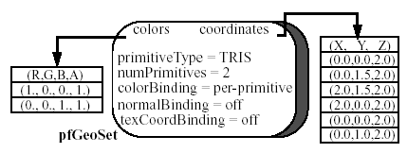
libpr
IRIS Performer
pfGeoSet – Efficient Geometry Primitive
  Maintains a set of homogeneous primitives
    Knowing structure lets Performer avoid if-tests like “should I send a color down the pipe with each vertex”?
  Construction is costly
    Should have more than just a few primitives
    pfuBuilder supplies convenient meshing and performance-oriented construction of pfGeoSets

Slide 14
libpr
IRIS Performer
pfState – Immediate Mode
  Generally used to set global state (e.g.. fog)
  Provides state management to avoid costly redundant mode changes
    Maintains all current and previous state in a state stack
  Partitions Graphics state into Modes and Attributes
    Modes - state changes like backface culling or flat shading
      Set by the application
    Attributes – state changes like texture and material parameters
      Applied by the application

Slide 15
libpr
IRIS Performer
pfDispList – Display List Mode
  Captures an entire frame’s worth of data
  Made up of references to libpr objects
    Does not contain individual vertex or primitive commands, these are in the libpr objects themselves

Slide 16
libpr
IRIS Performer
pfGeoState – Encapsulated Mode
  Used to specify the appearance of geometry (e.g. texture and material)
    Encapsulates all modes and attributes manages by libpr
    Globally inherits states when it doesn’t need to set them
      Only pushes what it needs changed (Lazy Push/Pop)
      Eliminates useless mode changes
    Guarantees Order Independence
      pfGeoStates do not inherit from one another

Slide 17
libpr
IRIS Performer
Multiprocessing Support
  Shared Memory
    References to memory allocations are counted to support operations like deleting
  pfMultiBuffer – Multibuffered Arrays
    Queues and multibuffered memory are supported to pass data between processes
      Manages multiple copies for multi-stage software pipelines
      Global Index keeps track of which process is working on which buffer

Slide 18
libpr
IRIS Performer
Database Intersection
  Allows picking and collision detection
  Ability to intersect line segments with polygons of a pfGeoSet
    Line segments are simple to test
    Don’t have to duplicate data, intersection just works on the current database

Slide 19
libpf
IRIS Performer
Adds Database Hierarchy and Automated Multiprocessing to libpr
  Manages a class hierarchy
  Allows for scene graph traversal
  Allows for Data Synchronization
  Performs automated multiprocessing on defined pipes

Slide 20
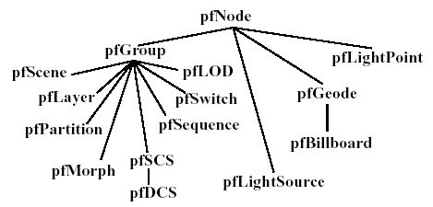
libpf
IRIS Performer
The Database – not just a scene graph
  Nodes are broken into three groups: abstract, internal, and leaf
    pfNode is the abstract class for all nodes
      Derived from pfUpdatable – maintains multiple copies for multiprocessing
    Internal node types are pfGroup, pfScene, pfSwitch, pfLOD, pfPartition, …
      Provide higher level functions
    Leaf node types are pfGeode, pfBillboard, pfLightPoint, pfLightSource

Slide 21
libpf
IRIS Performer
Node Hierarchy
  Provides state inheritance (top-down)
    Again, pfGeoState is not inherited, but pfState is
    Primary type of inherited state is 3D transformations
  Defines a hierarchy of bounding volumes
    Used to accelerate intersection and culling
Traversals
  ISECT – process intersection requests
  CULL – rejects objects outside viewing frustum, LOD
  DRAW – sends info to graphics subsystem
    Not exactly a traversal

Slide 22
libpf
IRIS Performer
Traversal Control
  Each type has a mask
    Allows traversal to exclude subgraphs
Traversal Callbacks
  pre- and post-traversal callbacks for each traversal type
    Allow application control of custom culling (e.g. arbitrary termination) and custom rendering (e.g. Video textures)
Efficiency
  Dependent on depth and balance of the scene graph
    pfPartition – creates a 2D grid of underlying data, line segment intersection determines pfGeoSets to draw

Slide 23
libpf
IRIS Performer
Performance Optimizations
  pfFlatten – Eliminating Transformations
    Small primitives consume time for transformations
    Applies static transform to static geometry
  pfLOD – Level of Detail
    Uses various parameters (eye-point distance, FOV, etc.) to select right model
  pfSequence – Animation
    Use precomputed animations (e.g. flames)
    Each child has a period of time to be displayed
  pfBillboard – Billboarded Geometry
    Rotates geometry to face the eye

Slide 24
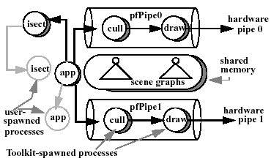
libpf
IRIS Performer
Multiprocessing
  pfPipe – provides access to multiple graphics subsystems
    Consists of CULL and DRAW stages
    The intersection pipeline is separate, has just ISECT
  pfMultiprocess – allows access to multiple CPUs
    Can combine or split rendering and intersection pipelines at stage boundaries

Slide 25
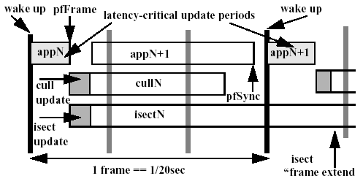
libpf
IRIS Performer
Process Synchronization
  Pipelined synchronization is enforced by Performer
    However, user created processes must be synchronized by the application

Slide 26
libpf
IRIS Performer
Frame Control
  pfFrame() tells the rendering and intersection pipelines to start on a new frame
    Pipelined process can frame extend
    If the APP process frame extends, frame rate drops even if pipelines can keep up – APP must keep up
  pfSync() suspends the calling process until the next frame boundary

Slide 27
libpf
IRIS Performer
Data Synchronization
  Multibuffering
    All libpf objects are pfUpdatables and contain a full scene graph
      Partitioned into pfBuffers
      Each pfBuffer is associated with one process
    Modifications made to pfUpdatables are kept in a update list
      APP is working on future frame
      Changes are applied downstream when other processes get to the current frame
    libpr primitives are not multibuffered
      Avoid this large memory penalty

Slide 28
libpf
IRIS Performer
Achieving Real-Time
  pfVClockSync()
    Called by pfSync()
    Tells the APP to wait until it should start on the next frame
  Fixed Frame Rate
    Need to maintain a fixed frame rate for visual coherence
    Stress-feedback filtering helps to reduce LOD artificially
    Always a frame late, can become oscillatory
  phase of the DRAW process
    Locked says that DRAW can only start on a frame boundary
      Frame-extending will halve frame rate
    Floating says DRAW can start as soon as possible

Slide 29
Conclusions
IRIS Performer
Database structure lends to many improvements
  culling, multibuffering, delayed updates
Maintaining Real-Time is difficult
  Many things can jeopardize frame rates
  Simplification makes this easier
Multiprocessing is only possible once the issues are taken care of

Slide 30
The Design of a Parallel Graphics Interface
Igehy, Stoll and Hanrahan, SIGGRAPH ’98
Adding synchronization commands to an immediate-mode interface.
  Application threads can issue explicitly ordered primitives in parallel
  Can synchronize contexts so every process uses the correct one.

Slide 31
Past Work: OpenGL and X
A Parallel API
Can use glFlush() and glFinish() in an attempt to preserve ordering
  Flush (Xflush, glFlush) is insufficient
    Only guarantees eventual execution
  Finish (XSync, glFinish) is too much
    Don’t necessarily need to wait for everything to finish
  Solution: glXWaitGL and glXWaitX
  But no mechanism for maintaining parallel issue of commands

Slide 32
The Parallel API Extensions
A Parallel API
Provides extensions for multithreaded use of OpenGL
  glpBarrier – provides synchronization for a set of streams in lock-step
  glp[P/V]Sema – provides point-to-point synchronization
  glpWaitContext – guarantees ordering between contexts

Slide 33
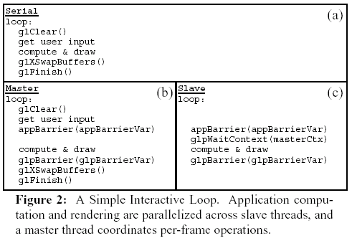
Simple Interactive Loop
A Parallel API

Slide 34
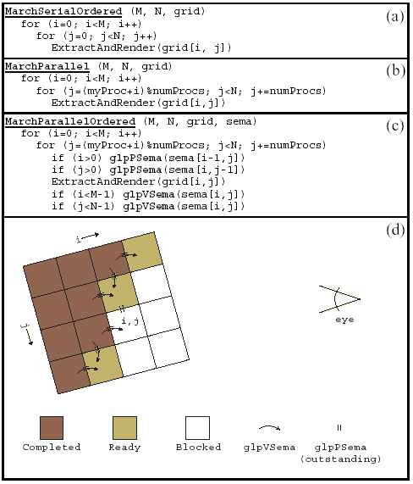
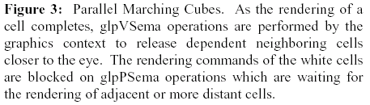
Marching Cubes
A Parallel API

Slide 35
Argus
A Parallel API
Shared Memory Multiprocessor graphics library
Implements a subset of OpenGL and the parallel API extensions
Sort-Middle tiled parallel graphics system

Slide 36
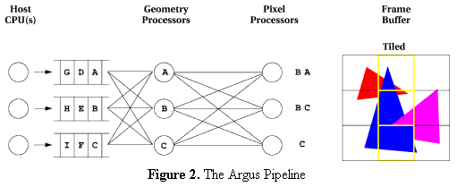
Argus
A Parallel API
Three types of threads
  Application Thread
    Runs application code and manages graphics context
  Geometry Thread
    Transforms and shades primitives
    Sends primitives to correct Rasterizer
  Rasterization Thread
    Draws transformed primitives into the framebuffer

Slide 37
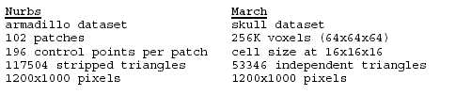
Performance of Argus
A Parallel API
Two tests, Nurbs and March
Nurbs
  Patch Tesselator, no ordering needed
  Synchronization done only on frame boundaries
March
  Parallel implementation of marching cubes
  Rendering done in back-to-front to allow transparency effects

Slide 38
Performance of Argus
A Parallel API
 | Nurbs | March
Uniprocessor | 1.65 Hz | 0.90 Hz
Serial API | 8.8 Hz | 6.3 Hz
Parallel API (4 contexts) | 32.3 Hz | 17.8 Hz
Parallel API (8 contexts)⁺* | 50.5 Hz | 40.9 Hz
⁺ Double the maximum rate at which a
single application can issue primitives
into Argus with no application
computation
* Assuming infinite fill rate

Slide 39
Conclusions
A Parallel API
By introducing synchronization commands Argus supports command-sequential consistency
The application can continue issuing graphics commands since synchronization is done between streams, not by the application
The API is scalable on a 24 processor system

Slide 40
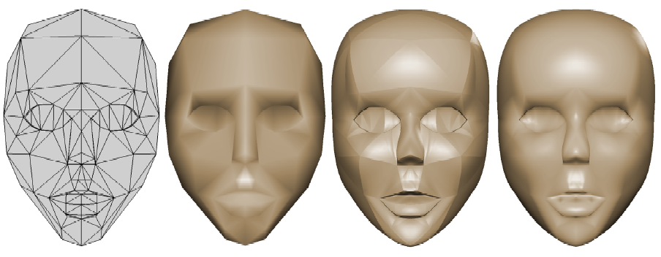
Curved PN Triangles
Vlachos, Peters, Boyd and Mitchell, ACM Symposium on Interactive 3D Graphics ’98
Replace flat triangles with curved patches and higher order normal variation
  Require minimal or no change to existing authoring tools and hardware designs
  Inexpensive means of improving visual quality
  Effectively sub-triangulates the original triangle into a programmable number of smaller, flat, triangles

Slide 41
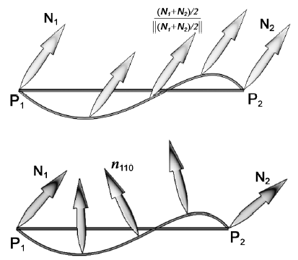
Geometry
Curved PN Triangles
A PN Triangle is defined as one cubic Bezier patch
  Matches point and normal information at the vertices
  Why cubic?
    Quadratics don’t have strict inflection
The normal is independently specified
  Separate linear or quadratic Bezier interpolant of the normals
  Why quadratic?
    Linear interpolation ignores inflection

Slide 42
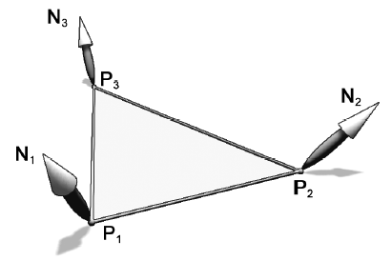
Geometry Coefficients
Curved PN Triangles
Start with P1, P2, P3 and N1, N2, N3 as the only information we know
b_{ijk} will represent the vertex coefficients for the new triangles
n_{ijk} will represent the normal coefficients for the new triangles
Calculating coefficients
  Step 0
    Spread out b_{ijk} evenly across the triangle
      b_{ijk} become (iP₁ + jP₂ + kP₃)

Slide 43
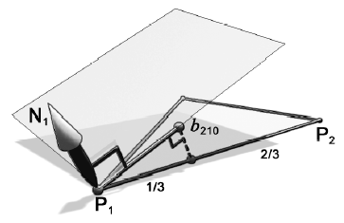
Geometry Coefficients
Curved PN Triangles
Calculating coefficients
  Step 1
    Leave the vertex coefficients in place
      b₃₀₀ = P₁; b₀₃₀ = P2; b₀₀₃ = P₃;
  Step 2
    For each corner, project the closest b_{ijk} to the tangent plane defined by the normal vector
      w_{ij} = (P_{j} – P_{i}) (dot) N_{i}
      b₂₁₀ = (2P₁ + P₂ – w₁₂N₁)/3;
      b₁₂₀ = (2P₂ + P₁ – w₂₁N₂)/3;
      …

Slide 44
Geometry Coefficients
Curved PN Triangles
Calculating coefficients
  Step 3
    Move the center from where we originally put it to the average of all six tangent points, and move it in the same direction ½ the distance already traveled
      E = (b₂₁₀ + b₁₂₀ + b₀₂₁ + b₀₁₂ + b₁₀₂ + b₂₀₁)/6;
      V = (P₁ + P₂ + P₃)/3;
      b₁₁₁ = E + (E – V)/2;

Slide 45
Normal Coefficients
Curved PN Triangles
Linear Normal Variation
  N(u,v) = N/magnitude(N), N = (1 – u – v)N₁ + uN₂ + vN₃;
  Approximates phong shading
    Shading stage will get triangles that look like N(u,v), N(u+h,v), N(u,v+h) for some step h
  Ignore inflections in geometry (picture from before)
Quadratic Normal Variation
  Mid-edge coefficient is used for inflection
    Average of the end normals is reflected across the plane perpendicular to the edge

Slide 46
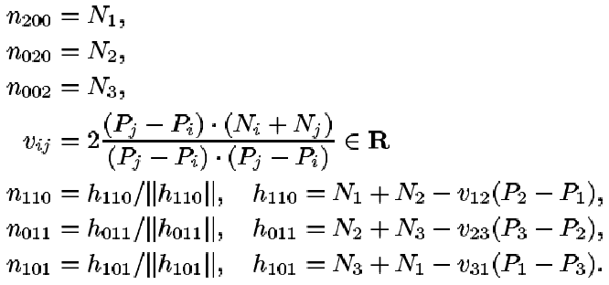
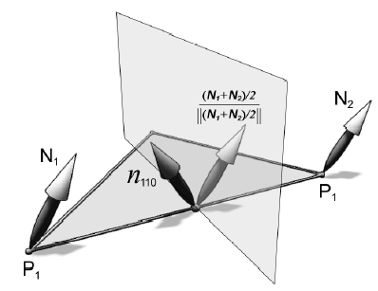
Normal Coefficients
Curved PN Triangles
The normals at the vertices will stay the same
The mid-edge coefficient is used for intermediate normals

Slide 47
Curved Sharp Edges
Curved PN Triangles
Connect two triangulations by identifying vertices on their boundary to form the crease
With entirely local information, cracks can not be avoided
  Have two normals per vertex on the boundary
Can add a seam of small triangles to create sharper edges

Slide 48
Hardware Performance
Curved PN Triangles
PN triangles are generated between the vertex-and-primitive-assembly stage and the vertex-shading stage
Fill rate is not a bottleneck because the screen area in pixels is unchanged
Vertex shading could be a problem
  State that performance is usually limited by bandwidth needed to feed vertices to the graphics processor
  If the graphics processor is sufficiently fast and the bus is busy, curved PN triangles render at the same speed as flat triangles

Slide 49
Hardware Performance
Curved PN Triangles
Form of geometry compression
  Reduces bus traffic
  Acts as a level of detail mechanism
    Higher LODs obtained on the fly
    Models for LOD 0-4 would require 70 times the amount of memory

Slide 50
Conclusion
Curved PN Triangles
Curved PN triangles provide a smoother silhouette and more organic shape
Can be viewed as a triangle multiplier
Sending a coarser triangulation can be seen as a form of geometry compression

