Slide 1

Maintaining Interactivity 2 - Subsampling
aka, the story of my life

Slide 2
Papers
Frameless Rendering: Double Buffering Considered Harmful [Bishop, et al., SIGGRAPH ‘94]
Interactive Rendering using the Render Cache [Walter, et al. EUROGRAPHICS ‘99]
Qsplat: A Multiresolution Point Rendering System for Large Meshes [Rusinkiewicz and Levoy, SIGGRAPH ’01]

Slide 3
Frameless Rendering: Double Buffering Considered Harmful
Bishop, Fuchs, McMillan, Scher Zagier
UNC Chapel Hill
SIGGRAPH ‘94

Slide 4
Frameless Rendering
Basic idea: improve interactivity by removing latency
All samples are rendered with the most up-to-date input
Allows smooth motion without needing to finish a whole frame every n milliseconds

Slide 5
Frameless Rendering
Samples updated in a randomized order
Crude image when scene is changing, higher quality renderings when the inputs are constant
Images appear blurry but have smooth and continuous motion

Slide 6
Frameless Rendering
[videos]

Slide 7
Interactive Rendering using the Render Cache
Walter, Drettakis, Parker
University of Utah
EUROGRAPHICS ‘99

Slide 8
Render Cache
Another method of speeding up slow renderers – or at least appearing to do so
As with frameless rendering, it decouples sample generation from sample display
Similarly well-suited to interactive raytracing

Slide 9
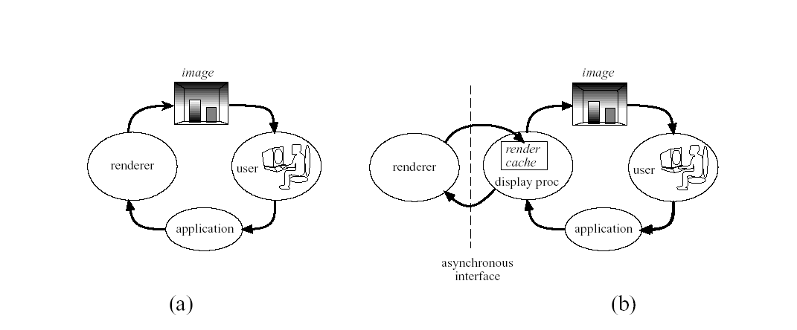
Render Cache

Slide 10
Render Cache
Uses point sample re-projection and interpolation to respond to updated user input
Prioritizes updates where samples are sparse
Uses depth culling to attempt to preserve occlusion even when undersampled

Slide 11
Render Cache
Basic idea: render to a point image, which is just an image that saves the z values at each pixel
When new input is received, the points making up the previous image are re-projected onto new camera plane

Slide 12
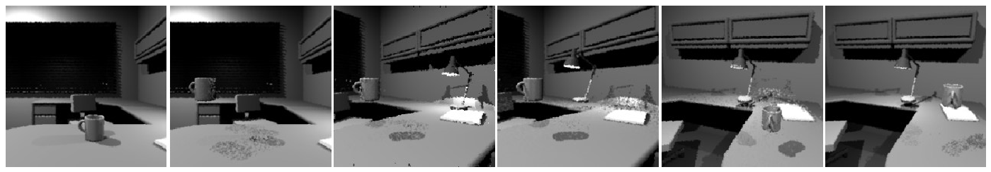
Render Cache
Example (can you see what’s going on here?)

Slide 13
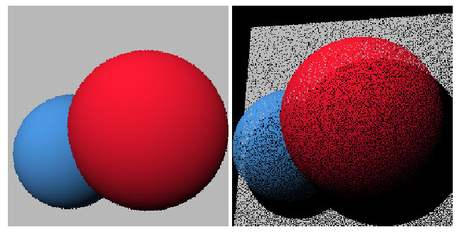
Render Cache
Example #2 (what about now?)
[Notice the disocclusion artifacts]

Slide 14
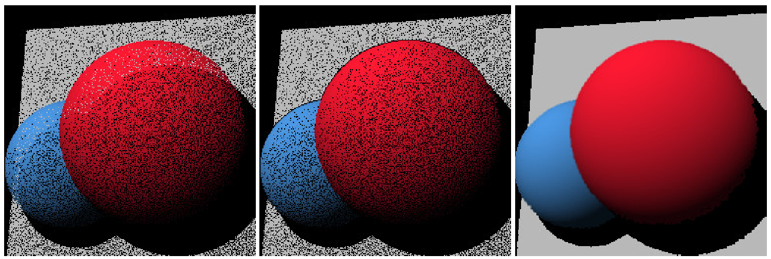
Render Cache
Example #3 – a better reconstruction

Slide 15
Render Cache
Uses a depth culling stage to remove samples whose depth are inconsistent with their 3x3 neighborhood (e.g., if its depth is more than 10% beyond the average)

Slide 16
Render Cache
Does a filtering pass, again on a 3x3 neighborhood
Performs a weighted average of neighboring samples [weights 4,2,1]

Slide 17
Render Cache
Must intelligently choose which samples to compute next
A grayscale priority image is constructed and then a diffusion dither is applied to it
Each pixels’s priority is based on the age of the points that map to it
The dither ensures spatial distribution and concentraion in high priority regions

Slide 18
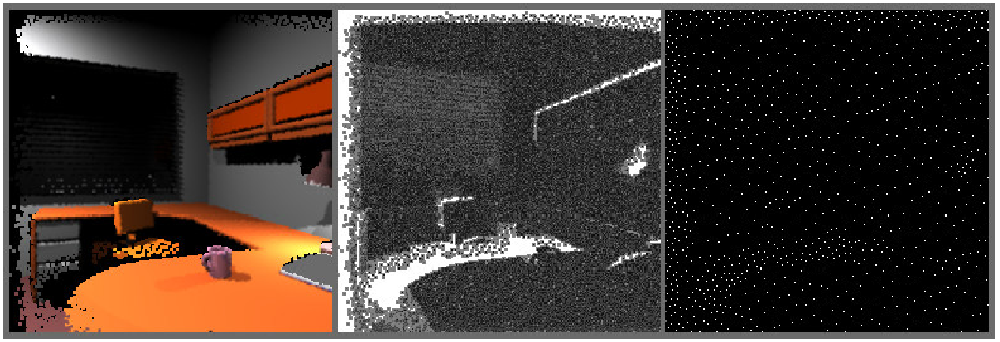
Render Cache

Slide 19
Render Cache
Application can supply hints as to which points are likely to need resampling soon
Eg: moving objects and their shadows, specular highlights

Slide 20
Render Cache
The cache is fixed-size and just slightly larger than the number of pixels to be displayed
When resampling, new points overwrite the old ones at the same location
Ensures stale data will eventually go away and keeps computational cost low

Slide 21
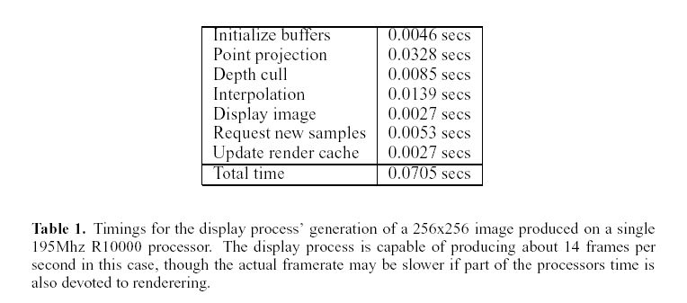
Render Cache

Slide 22
Render Cache
[video]

Slide 23
Qsplat: A Multiresolution Point Rendering System for Large Meshes

Slide 24
QSplat
Addresses the opposite problem – too many samples (e.g., 100M – 1B)
Organizes samples into a bounding sphere hierarchy that represents the data re-sampled at multiple resolutions

Slide 25
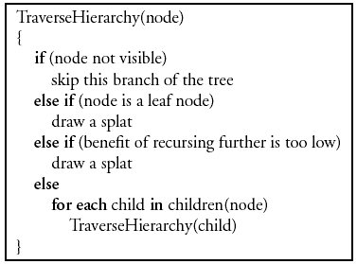
QSplat
Rendering Algorithm:

Slide 26
QSplat
Visibility culling: frustum and backface culling
If a leaf node is reached or recursion is not beneficial, the current sphere is splatted onto the screen
Recursion depth based on projected size of splat on screen

Slide 27
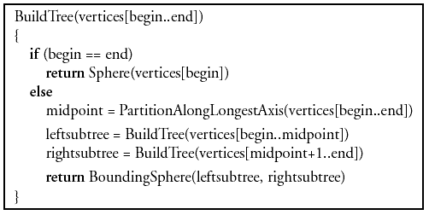
QSplat
Preprocessing Algorithm:

Slide 28
QSplat
Preprocessing begins with a triangle mesh
Triangles only used for computing sphere sizes and normals; connectivity is thrown away
Does recursive spatial subdivision
Nodes combined to give average branching factor of about 4
Overall process is very fast

Slide 29

QSplat
How to be miserly with bits:
Quantization, quantization, quantization

Slide 30
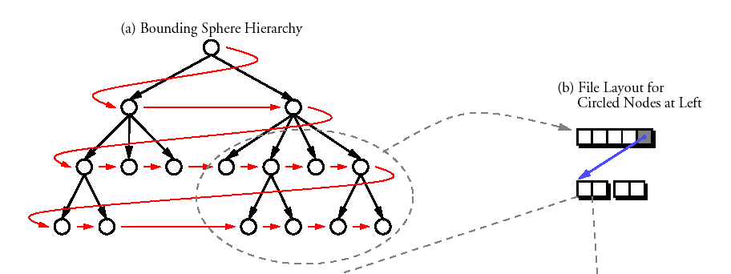
QSplat
Tree is arranged on disk and in memory in breadth-first order for fast loading and traversal

Slide 31
QSplat
Splat shape can be determined by user
…this is largely a time/quality tradeoff
Examples:
  OpenGL points (squares)
  Textured polygons
  Fuzzy alpha-blended spot
  Circles or ellipses

Slide 32
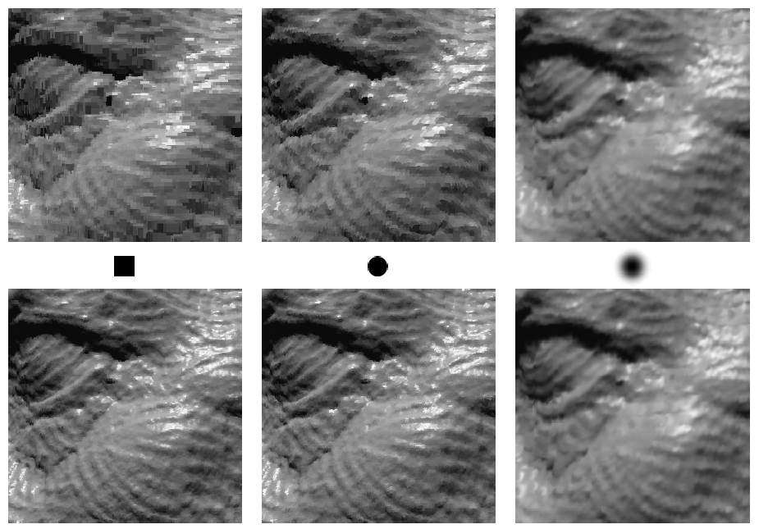
QSplat

Slide 33
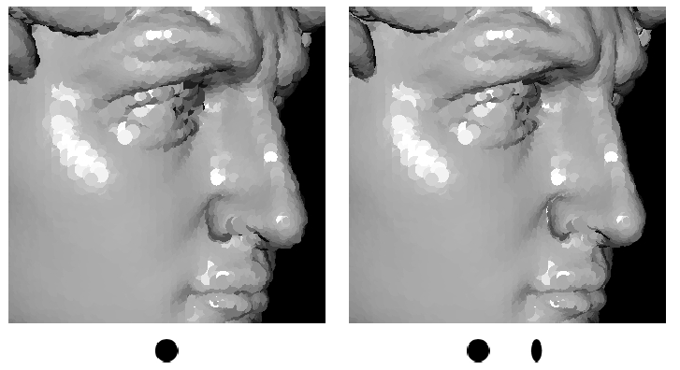
QSplat

Slide 34
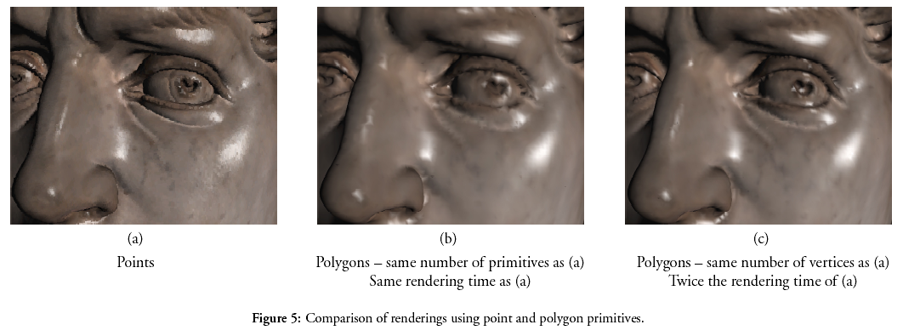
QSplat

Slide 35
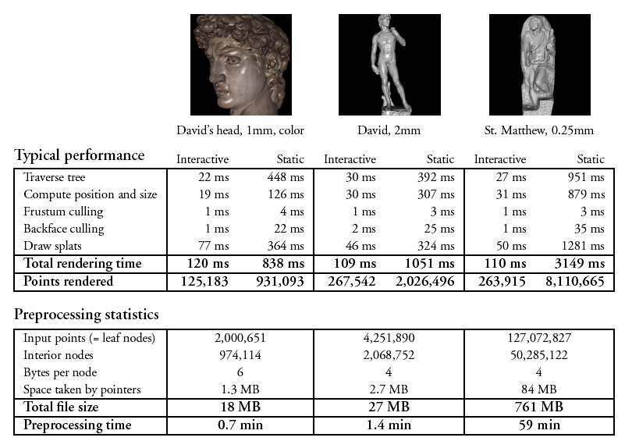
QSplat

Slide 36
QSplat
Future work:
  Even more space savings, e.g. with Huffman Coding (Oy Vey!!)
  When rendering speed is more important than size, incremental encoding could be removed
  Analysis of temporal coherence and caching behavior needed

Slide 37
QSplat
[demo]

