Slide 1
Partitioning Screen Space 2
Rui Wang

Slide 2
Architectural Implications of Hardware-Accelerated Bucket Rendering on the PC (97’)
Dynamic Load Balancing for Parallel Polygon Rendering (94’)
Models of the Impact of Overlap in Bucket Rendering (98’)

Slide 3
Architectural Implications of Hardware-Accelerated Bucket Rendering on the PC
Bucket Rendering
  Divide scene into screen-space tiles and render each tile independently
  Advantages
    Smaller memory requirement
    Parallel rendering
  Disadvantages
    Overlap of primitives over multiple buckets
    Overhead of sorting primitives into buckets

Slide 4
Bucket Rendering
RenderMan, PixelPlanes 5, PixelFlow, Apple systems, Talisman
Choosing tile size
  Smaller memory requirement, better load balancing, but more overlaps
  32x32 tile with dense SRAM
  128x128 tile with embedded DRAM

Slide 5
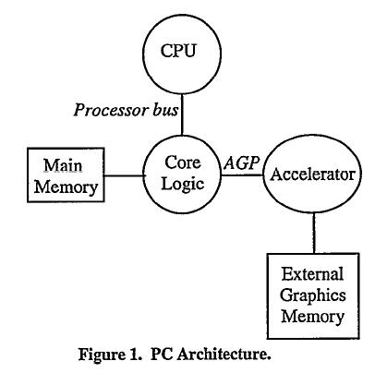
Architecture
Buckets

Slide 6
Bucket Sorting
Screen-aligned bounding box
Exact bucket sorting

Slide 7
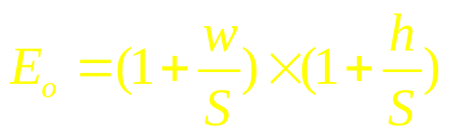
Analytical computation of overlap
Molnar 91’ , modified to consider r
Equation:
w
S

Slide 8
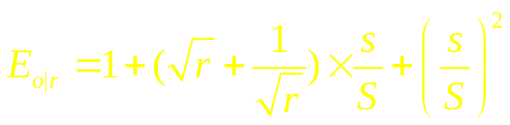
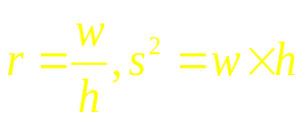
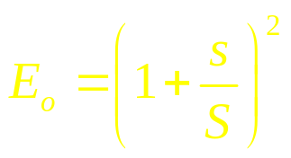
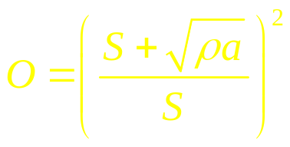
More Equations …
blah, blah, blah
minimized when r=1
or

Slide 9
Overhead incurred by overlap
  Main memory bandwidth
  AGP bandwidth
  Primitives set-up
Experiments
  Intel Scene Management
  Trace polygons rendered
  Bucket size 16, 32, 64, 128, 256

Slide 10
Results
Larger size tri doesn’t matter. Many primitives that are smaller than 1K pixel size have with large aspect ratio (Fig.2-9)
Expected E_{o} assuming r=1 closely fit observed overlap => Molnar equation is still a good prediction assuming r=1 (Tab.2)
Bounding box area scales with screen resolution

Slide 11
Discussion
Assume triangle set-up: 1M/s
Bandwidth of memory: 200~300MB/s
AGP bandwidth: 256MB/s
128x128 tile: resource consumption stay below 25%, 15%, 10% respectively for all resolutions (Tab.3)
32x32 tile: resource consumption prohibitively high above 1024x768 (Tab.4)

Slide 12
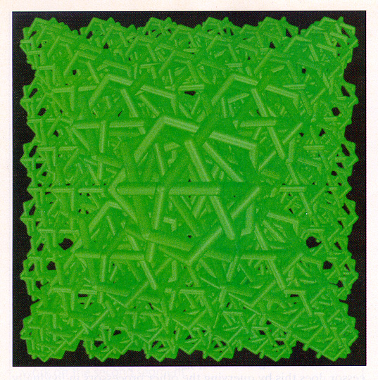
Dynamic Load Balancing for Parallel Polygon Rendering
A New graphics renderer incorporates
novel partitioning methods for efficient
Execution on a parallel computer. It
requires little overhead, executes
efficiently, and demands minimal
processor synchronization.

Slide 13
Image-space Parallel Algorithms
Horizontal, vertical strips, rectangular areas
Load balancing:
  Data nonadaptive: statically, dynamically
  Data adaptive: less suitable for a single image
Data nonadaptive
  Tile image space to RxP rectangular areas
  Tradeoff to choosing R (20 is good)
  This paper uses 2xP by applying a task adaptive work decomposition strategy

Slide 14
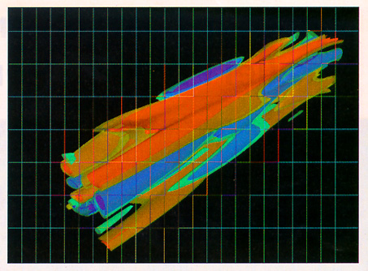

Slide 15
Algorithm Description
Preprocessing: 13%
  Data read-in, xforming, normal calc., back-face culling, clipping, perspective proj.
Rendering: 86%
  Hidden-face removal, shading, anti-aliasing, etc
Post processing: 1%
  Display frame buffer or store in file
Fig.2

Slide 16
Preprocessing
Number of objects > P
  Round-robin distribution
Number of objects < P
  Split into multiple sub objects
  Parallel xforming or clipping; Reader process assigns data to individual processors
Sort
Implementation on BBN TC2000 (96 processors), speedup 9.4

Slide 17
Rendering
Modified scan-line z-buffer algorithm with stochastic sampling (16 per pixel)
R=2: preprocessing overhead reduced
  The first P regions assigned to P processors
  Dynamically get from the additional P tasks
  partition: (steal tasks from other processors)
    Search for the processor with most work left P_{max}
    If there is sufficient work to do, proceed, otherwise return
    Set locks to prevent concurrent stealing
    Partition P_{max} work into two segments, take the lower one
    Unset locks and work on the new task

Slide 18
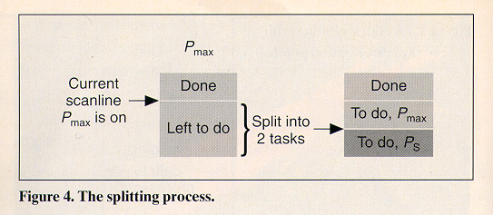
The splitting strategy maintains coherence at P_{max} side without interruption
With task adaptive approach, load balancing is good even for R=2
Effect of initial region aspect ratio on splitting:
  2:1 worst, 1:3 best

Slide 19
Some Issues
Find the remaining work on a processor
  Record and update the current remaining scan lines
  Fig.5
Avoid race conditions or deadlocks
  Test and lock: if not locked, store in p_max ; if locked, store in pot_p_max
After getting through a lock, the work might have been completed meanwhile
Post Processing …

Slide 20
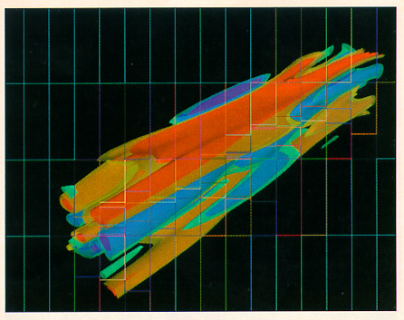

Slide 21
Data Distribution
Locally Cached (LC)
  Distributing data among memories
    Copy exactly the amount of data necessary for computation to local memory
    After preprocessing, each processor queries and retrieves data for rendering from other processors
  Data movement during partitioning
    Quick clip after data retrieved, instead of obtain exactly the lower region task => reduce the amount of data for further partitioning

Slide 22


Slide 23
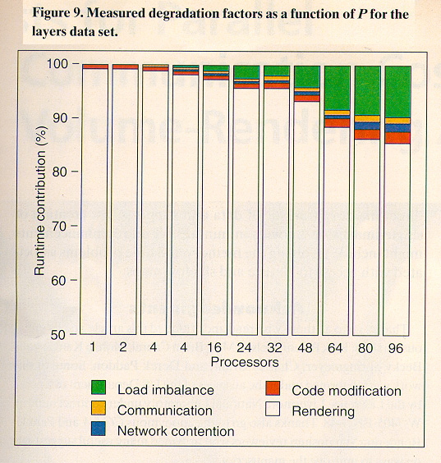
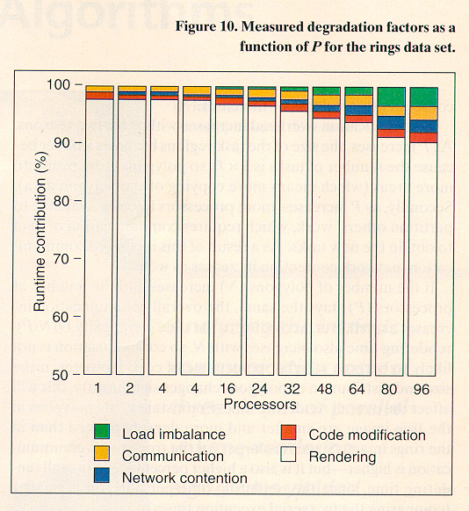
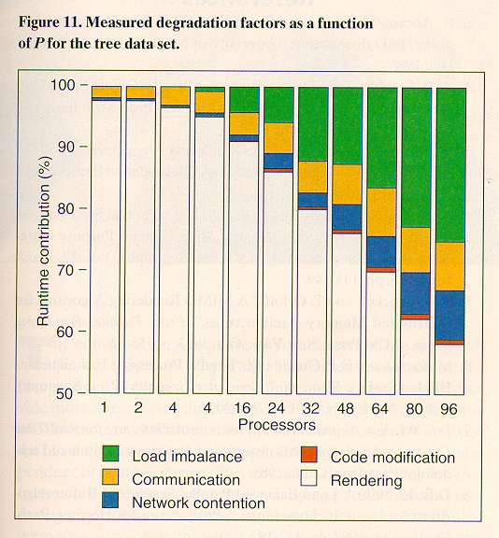
Load balancing overhead increases with P
Communication Overhead also increases with P

Slide 24
Models of the Impact of Overlap in Bucket Rendering
Bucket Rendering
  Subdivide frame buffer into coherent regions that are rendered independently
  Tile size is a design decision
  Advantages and disadvantages

Slide 25
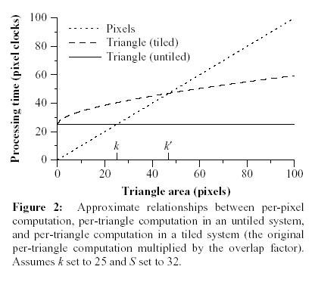
Analytical Models
Fig.1 defines key terms
Per-pixel cost=1
Per-triangle cost for non-tiled=k,
Tiled=kO
  knockout...

Slide 26
Modeling Overlap
Overlap factor:
Source of error:
  Assume unit aspect ratio, best for overlap
  Assume uniform tri area, worst for overlap
  Assume rho=3

Slide 27
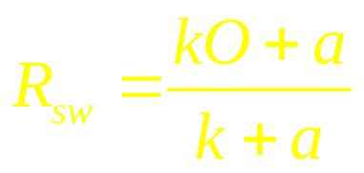
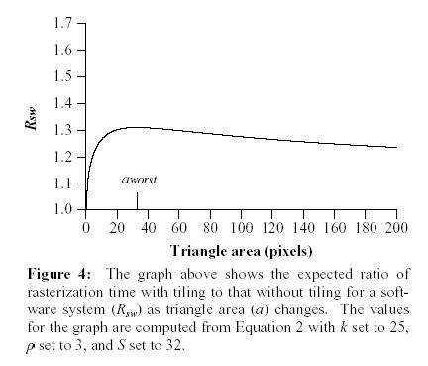
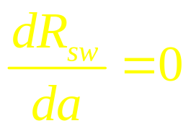
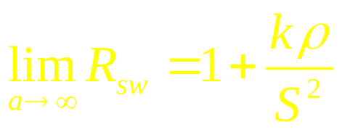
Software Model
Assume single processing unit for per-triangle and per-pixel work
k=25, S=32, rho=3
a_{worst}≈32.7

Slide 28
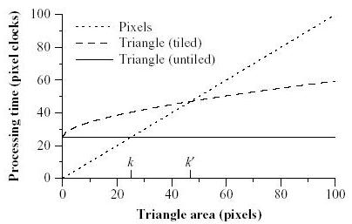

Hardware Model
Assume perfect pipelining (infinite buffer); processing time depends on the slowest unit
Processing time on real systems (Fig.3)
k=25
k’≈47

Slide 29
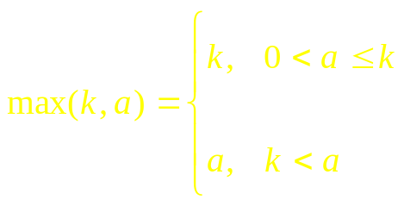
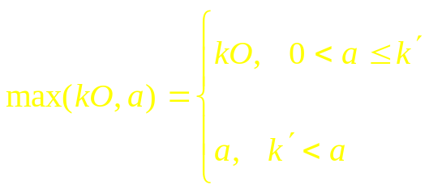
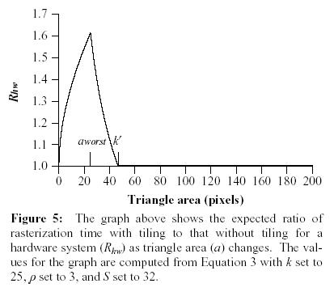
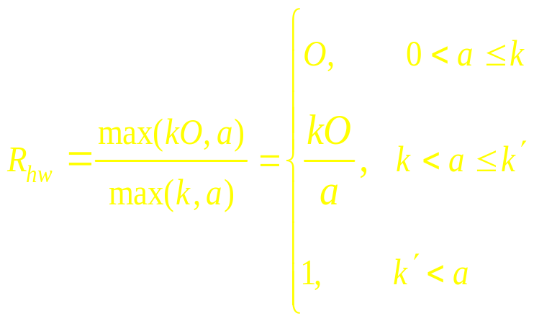
Hardware Model
Non-tiled: Tiled:
a_{worst}≈25

Slide 30
Observations of HW Model
Inefficiency of tiled rendering is limited
The worst case occurs at exactly the triangle area where processing the triangle requires as much time as processing its pixels (a_{worst}=k) => pipeline balanced

Slide 31
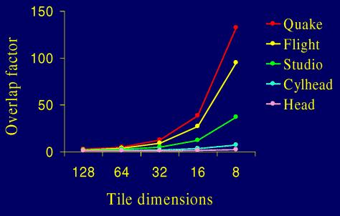
Experiments
How well the mathematical model works
Datasets
large triangles
avg. 2784.4
small triangles
avg. 8.4

Slide 32
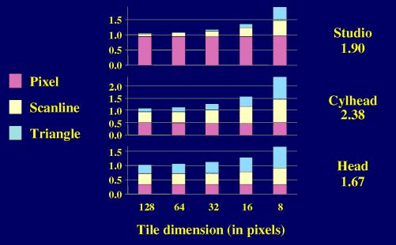
Experiments on SW Model
OpenGL Stream Codec (GLS)
Argus rendering system on top of SimOS (full machine simulator, measurement taken at pixel granularity)

Slide 33
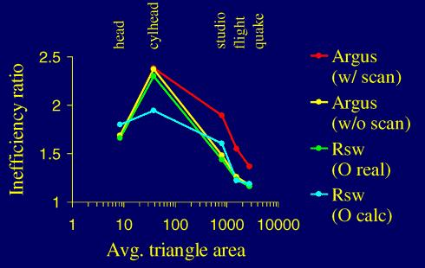
Experiments on SW Model
Decide k, O, a:
  k=9.3 (non-textured), k=3.6 (textured)
  O_{real} is measured, O_{calc} is predicted
  a=average tri area measured

Slide 34
Analysis on SW Model
Worst efficiency occurs at moderate size (conforms to the model)
Limitation:
  Error of overlap estimation using Molnar equ.
  Does not consider scan line processing time

Slide 35
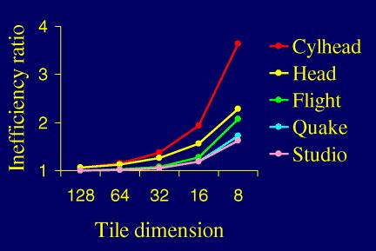
Experiments on HW Model
Single triangle buffer vs. Infinite

Slide 36
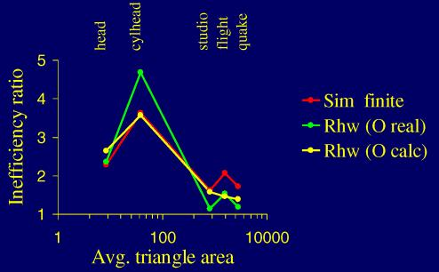
Experiments on HW Model
Decide k, O, a:
  k=25
  O_{real} is measured, O_{calc} is predicted
  a=average tri area measured

Slide 37
Analysis on HW Model
The model correctly predict inefficiency peaks at triangle area close to k=25
Interesting thing to understand (???)
  More buffer space is most effective when average tri area match k (pipeline balanced)
  For large avg. triangles, tiling moves effective tri area closer to k, thus infinite buffer takes effect
  For small avg. triangles, tiling moves effective tri area below k, thus infinite buffer has little effect
Overlap calc error still exists

Slide 38
Conclusion
The impact of overlap is highest when work is balanced between triangle processing and pixel processing
The impact of overlap in pipelined system is limited to a window of tri size around the design point of the system
Has limitations

