Slide 1
Foundations of Probabilistic Answers to Queries
Dan Suciu and Nilesh Dalvi
University of Washington

Slide 2
Databases Today are Deterministic
An item either is in the database or is not
A tuple either is in the query answer or is not
This applies to all variety of data models:
  Relational, E/R, NF2, hierarchical, XML, …

Slide 3
What is a Probabilistic Database ?
“An item belongs to the database” is a probabilistic event
“A tuple is an answer to the query” is a probabilistic event
Can be extended to all data models; we discuss only probabilistic relational data

Slide 4
Two Types of Probabilistic Data
Database is deterministic
Query answers are probabilistic
Database is probabilistic
Query answers are probabilistic

Slide 5
Long History
Probabilistic relational databases have been studied from the late 80’s until today:
Cavallo&Pitarelli:1987
Barbara,Garcia-Molina, Porter:1992
Lakshmanan,Leone,Ross&Subrahmanian:1997
Fuhr&Roellke:1997
Dalvi&S:2004
Widom:2005

Slide 6
So, Why Now ?
Application pull:
The need to manage imprecisions in data
Technology push:
Advances in query processing techniques
The tutorial is built on these two themes

Slide 7
Application Pull
Need to manage imprecisions in data
Many types: non-matching data values, imprecise queries, inconsistent data, misaligned schemas, etc, etc
The quest to manage imprecisions = major driving force in the database community
Ultimate cause for many research areas: data mining, semistructured data, schema matching, nearest neighbor

Slide 8
Theme 1:
A large class of imprecisions in data
can be modeled with probabilities

Slide 9
Technology Push
Processing probabilistic data is fundamentally more complex than other data models
Some previous approaches sidestepped complexity
There exists a rich collection of powerful, non-trivial techniques and results, some old, some very recent, that could lead to practical management techniques for probabilistic databases.

Slide 10
Theme 2:
Identify the source of complexity,
present snapshots of non-trivial results,
set an agenda for future research.

Slide 11
Some Notes on the Tutorial
There is a huge amount of related work:
probabilistic db, top-k answers, KR, probabilistic reasoning, random graphs, etc, etc.
We left out many references
All references used are available in separate document
Tutorial available at: http://www.cs.washington.edu/homes/suciu
Requires TexPoint to view
http://www.thp.uni-koeln.de/~ang/texpoint/index.html

Slide 12
Overview
Part I: Applications: Managing Imprecisions
Part II: A Probabilistic Data Semantics
Part III: Representation Formalisms
Part IV: Theoretical foundations
Part V: Algorithms, Implementation Techniques
Summary, Challenges, Conclusions
BREAK

Slide 13
Part I
Applications: Managing Imprecisions

Slide 14
Outline
Ranking query answers
Record linkage
Quality in data integration
Inconsistent data
Information disclosure

Slide 15
1. Ranking Query Answers
Database is deterministic
The query returns a ranked list of tuples
User interested in top-k answers.

Slide 16
The Empty Answers Problem
[Agrawal,Chaudhuri,Das,Gionis 2003]
Query is overspecified: no answers
Example: try to buy a house in Seattle…
SELECT *
FROM Houses
WHERE bedrooms = 4
AND style = ‘craftsman’
AND district = ‘View Ridge’
AND price < 400000
… good luck !
Today users give up and move to Baltimore

Slide 17
[Agrawal,Chaudhuri,Das,Gionis 2003]
Ranking:
Compute a similarity score between a tuple and the query
Q = SELECT *
FROM R
WHERE A₁=v₁ AND … AND A_{m}=v_{m}
Query is a vector:
Q = (v₁, …, v_{m})
Tuple is a vector:
T = (u₁, …, u_{m})
Rank tuples by their TF/IDF similarity to the query Q
Includes partial matches

Slide 18
Similarity Predicates in SQL
[Motro:1988,Dalvi&S:2004]
Beyond a single table:
“Find the good deals in a neighborhood !”
SELECT *
FROM Houses x
WHERE x.bedrooms ~ 4 AND x.style ~ ‘craftsman’ AND x.price ~ 600k
AND NOT EXISTS
(SELECT *
FROM Houses y
WHERE x.district = y.district AND x.ID != y.ID
AND y.bedrooms ~ 4 AND y.style ~ ‘craftsman’ AND y.price ~ 600k
Users specify similarity predicates with ~
System combines atomic similarities using probabilities

Slide 19
Types of Similarity Predicates
String edit distances:
  Levenstein distance, Q-gram distances
TF/IDF scores
Ontology distance / semantic similarity:
  Wordnet
Phonetic similarity:
  SOUNDEX
[Theobald&Weikum:2002,
Hung,Deng&Subrahmanian:2004]

Slide 20
Keyword Searches in Databases
[Hristidis&Papakonstantinou’2002,Bhalotia et al.2002]
Goal:
Users want to search via keywords
Do not know the schema
Techniques:
Matching objects may be scattered across physical tables due to normalization; need on the fly joins
Score of a tuple = number of joins, plus “prestige” based on indegree

Slide 21
[Hristidis,Papakonstantinou’2002]
Join sequences
(tuple trees):
Paper
Q = ‘Abiteboul’ and ‘Widom’
Author
Author
Person
Abiteboul
Person
Widom
In
Paper
Conference
Paper
Conference
Paper
Author
Author
Author
Abiteboul
Person
Editor
Widom
Person
Paper
Conference
Person
Author
Person
Widom
Person
Abiteboul

Slide 22
More Ranking: User Preferences
[Kiessling&Koster2002,Chomicki2002,Fagin&Wimmers1997]
Applications: personalized search engines, shopping agents, logical user profiles, “soft catalogs”
Two approaches:
Qualitative ) Pareto semantics (deterministic)
Quantitative ) alter the query ranking

Slide 23
Summary on Ranking Query Answers
Types of imprecision addressed:
Data is precise, query answers are imprecise:
User has limited understanding of the data
User has limited understanding of the schema
User has personal preferences
Probabilistic approach would…
Principled semantics for complex queries
Integrate well with other types of imprecision

Slide 24
2. Record Linkage
[Cohen: Tutorial]
Determine if two data records describe same object
Scenarios:
Join/merge two relations
Remove duplicates from a single relation
Validate incoming tuples against a reference

Slide 25
Fellegi-Sunter Model
[Cohen: Tutorial; Fellegi&Sunder:1969]
A probabilistic model/framework
Given two sets of records A, B:
Goal: partition A × B into:
Match
Uncertain
Non-match
A =
{a₁, a₂, a₃, a₄, a₅, a₆}
B =
{b₁, b₂, b₃, b₄, b₅}

Slide 26
Non-Fellegi Sunter Approaches
[Cohen: Tutorial]
Deterministic linkage
Normalize records, then test equality
  E.g. for addresses
  Very fast when it works
Hand-coded rules for an “acceptable match”
  E.g. “same SSN”;or “same last name AND same DOB”
  Difficult to tune

Slide 27
Application: Data Cleaning, ETL
Merge/purge for large databases, by sorting and clustering
Use of dimensional hierarchies in data warehouses and exploit co-occurrences
Novel similarity functions that are amenable to indexing
Declarative language to combine cleaning tasks
[Hernandez,Stolfo:1995]
[Ananthakrishna,Chaudhuri,Ganti:2002]
[Chaudhuri,Ganjam,Ganti,Motwani:2002]
[Galhardas et al.:2001]

Slide 28
Application: Data Integration
[Cohen:1998]
WHIRL
All attributes in in all tables are of type text
Datalog queries with two kinds of predicates:
  Relational predicates
  Similarity predicates X ~ Y
Matches two sets on the fly, but
not really a “record linkage” application.

Slide 29
WHIRL
[Cohen:1998]
datalog
Example 1:
Q₁(*) :- P(Company₁,Industry₁),
Q(Company₂,Website),
R(Industry₂, Analysis),
Company₁ ~ Company₂,
Industry₁ ~ Industry₂
Score of an answer tuple = product of similarities

Slide 30
WHIRL
[Cohen:1998]
Example 2 (with projection):
Q₂(Website) :- P(Company₁,Industry₁),
Q(Company₂,Website),
R(Industry₂, Analysis),
Company₁ ~ Company₂,
Industry₁ ~ Industry₂
Support(t) = set of tuples supporting the answer t
Depends
on query
plan !!
score(t) = 1 - ∏_{s 2 Support(t)} (1-score(s))

Slide 31
Summary on Record Linkage
Types of imprecision addressed:
Same entity represented in different ways
Misspellings, lack of canonical representation, etc.
A probability model would…
Allow system to use the match probabilities: cheaper, on-the-fly
But need to model complex probabilistic correlations: is one set a reference set ? how many duplicates are expected ?

Slide 32
3. Quality in Data Integration
[Florescu,Koller,Levy97;Chang,GarciaMolina00;Mendelzon,Mihaila01]
Use of probabilistic information to reason about soundness, completeness, and overlap of sources
Applications:
Order access to information sources
Compute confidence scores for the answers

Slide 33
[Mendelzon&Mihaila:2001
Global Historical Climatology Network
Integrates climatic data from:
  6000 temperature stations
  7500 precipitation stations
  2000 pressure stations
Starting with 1697 (!!)
Soundness of a data source:
what fraction of items are correct
Completeness data source:
what fractions of items it actually contains

Slide 34
[Mendelzon&Mihaila:2001
Global schema:
Temperature
Station
Local as view:
S₁:
V₁(s, lat, lon, c) ← Station(s, lat, lon c)
S₂:
V₂(s, y, m, v) ←
Temperature(s, y, m, v),
Station(s, lat, lon, “Canada”), y ≥ 1900
S₃:
V₃(s, y, m, v) ←
Temperature(s, y, m, v),
Station(s, lat, lon, “US”), y ≥ 1800
. . .
S₈₇₅₆:
. . .

Slide 35
[Florescu,Koller,Levy:1997;Mendelzon&Mihaila:2001]
Next, declare soundness and complete
S₂:
V₂(s, y, m, v) ←
Temperature(s, y, m, v),
Station(s, lat, lon, “Canada”), y ≥ 1900
Precision
Soundness(V₂) ≥ 0.7
Completneess(V₂) ≥ 0.4
Recall

Slide 36
[Florescu,Koller,Levy:1997
Goal 1: completeness ! order source accesses
S₅
S₇₄
S₂
S₃₁
. . .
[Mendelzon&Mihaila:2001]
Goal 2: soundness ! query confidence
Q(y, v) :-
Temperature(s, y, m, v), Station(s, lat, lon, “US”),
y ≥ 1950, y · 1955, lat ¸ 48, lat · 49
Answer:
Year | Value | Confidence
1952 | 55º F | 0.7
1954 | -22º F | 0.9
. . . | . . . | . . .

Slide 37
Summary:
Quality in Data Integration
Types of imprecision addressed
Overlapping, inconsistent, incomplete data sources
Data is probabilistic
Query answers are probabilistic
They use already a probabilistic model
Needed: complex probabilistic spaces. E.g. a tuple t in V₁ has 60% probability of also being in V₂
Query processing still in infancy

Slide 38
4. Inconsistent Data
[Bertosi&Chomicki:2003]
Goal:
consistent query answers
from inconsistent databases
Applications:
Integration of autonomous data sources
Un-enforced integrity constraints
Temporary inconsistencies

Slide 39
The Repair Semantics
[Bertosi&Chomicki:2003]
Consider
all “repairs”
Key
(?!?)
Name | Affiliation | State | Area
Miklau | UW | WA | Data security
Dalvi | UW | WA | Prob. Data
Balazinska | UW | WA | Data streams
Balazinska | MIT | MA | Data streams
Miklau | Umass | MA | Data security
Find people in State=WA ⇒ Dalvi
Find people in State=MA ⇒ ;
Hi precision, but low recall

Slide 40
Alternative Probabilistic Semantics
Name | Affiliation | State | Area | P
Miklau | UW | WA | Data security | 0.5
Dalvi | UW | WA | Prob. Data | 1
Balazinska | UW | WA | Data streams | 0.5
Balazinska | MIT | MA | Data streams | 0.5
Miklau | Umass | MA | Data security | 0.5
State=WA ⇒ Dalvi, Balazinska(0.5), Miklau(0.5)
State=MA ⇒ Balazinska(0.5), Miklau(0.5)
Lower precision, but better recall

Slide 41
Summary:
Inconsistent Data
Types of imprecision addressed:
Data from different sources is contradictory
Data is uncertain, hence, arguably, probabilistic
Query answers are probabilistic
A probabilistic would…
Give better recall !
Needs to support disjoint tuple events

Slide 42
5. Information Disclosure
Goal
Disclose some information (V) while protecting private or sensitive data S
Applications:
Privacy preserving data mining
Data exchange
K-anonymous data
V=anonymized transactions
V=standard view(s)
V=k-anonymous table
S = some atomic fact that is private

Slide 43
[Evfimievski,Gehrke,Srikant:03; Miklau&S:04;Miklau,Dalvi&S:05]
Pr(S)
= a priori probability of S
Pr(S | V)
= a posteriori probability of S

Slide 44
Information Disclosure
[Evfimievski,Gehrke,Srikant:03; Miklau&S:04;Miklau,Dalvi&S:05]
If ρ₁ < ρ₂, a ρ₁, ρ₂ privacy breach:
Perfect security:
Practical security:
Pr(S) ≤ ρ₁ and Pr(S | V) ≥ ρ₂
Pr(S) = Pr(S | V)
lim_{domain size → ∞} Pr(S | V) = 0
Database size
remains fixed

Slide 45
Summary:
Information Disclosure
Is this a type of imprecision in data ?
Yes: it’s the adversary’s uncertainty about the private data.
The only type of imprecision that is good
Techniques
Probabilistic methods: long history [Shannon’49]
Definitely need conditional probabilities

Slide 46
Summary:
Information Disclosure
Important fundamental duality:
Query answering: want Probability . 1
Information disclosure: want Probability & 0
They share the same fundamental concepts and techniques

Slide 47
Summary:
Information Disclosure
What is required from the probabilistic model
Don’t know the possible instances
Express the adversary’s knowledge:
  Cardinalities:
  Correlations between values:
Compute conditional probabilities
Size(Employee) ' 1000
area-code Ã city

Slide 48
6. Other Applications
Data lineage + accuracy: Trio
Sensor data
Personal information management
Using statistics to answer queries
[Widom:2005]
[Deshpande, Guestrin,Madden:2004]
Semex [Dong&Halevy:2005, Dong,Halevy,Madhavan:2005]
Heystack [Karger et al. 2003], Magnet [Sinha&Karger:2005]
[Dalvi&S;2005]

Slide 49
Summary on Part I: Applications
Common in these applications:
Data in database and/or in query answer is uncertain, ranked; sometimes probabilistic
Need for common probabilistic model:
Main benefit: uniform approach to imprecision
Other benefits:
  Handle complex queries (instead of single table TF/IDF)
  Cheaper solutions (on-the-fly record linkage)
  Better recall (constraint violations)

Slide 50
Part II
A Probabilistic Data Semantics

Slide 51
Outline
The possible worlds model
Query semantics

Slide 52
Possible Worlds Semantics
Attribute domains:
int, char(30), varchar(55), datetime
# values: 2³², 2¹²⁰, 2⁴⁴⁰, 2⁶⁴
Relational schema:
Employee(name:varchar(55), dob:datetime, salary:int)
# of tuples: 2⁴⁴⁰ £ 2⁶⁴ £ 2²³
# of instances: 2^{2440 £ 264 £ 223}
Database schema:
Employee(. . .), Projects( . . . ), Groups( . . .), WorksFor( . . .)
# of instances: N (= BIG but finite)

Slide 53
The Definition
The set of all possible database instances:
INST = {I₁, I₂, I₃, . . ., I_{N}}
will use Pr or I^{p}
interchangeably
Definition A probabilistic database I^{p}
is a probability distribution on INST
Pr : INST ! [0,1]
s.t. ∑_{i=1,N} Pr(I_{i}) = 1
Definition A possible world is I s.t. Pr(I) > 0

Slide 54
Example
I^{p} =
Customer | Address | Product
John | Seattle | Gizmo
John | Seattle | Camera
Sue | Denver | Gizmo
Customer | Address | Product
John | Boston | Gadget
Sue | Denver | Gizmo
Pr(I₂) = 1/12
Pr(I₁) = 1/3
Customer | Address | Product
John | Seattle | Gizmo
John | Seattle | Camera
Sue | Seattle | Camera
Customer | Address | Product
John | Boston | Gadget
Sue | Seattle | Camera
Pr(I₄) = 1/12
Pr(I₃) = 1/2
Possible worlds = {I₁, I₂, I₃, I₄}

Slide 55
Tuples as Events
One tuple t ) event t 2 I
Pr(t) = ∑_{I: t 2 I} Pr(I)
Two tuples t₁, t₂ ) event t₁ 2 I Æ t₂ 2 I
Pr(t₁ t₂) = ∑_{I: t1 2 I Æ t2 2 I} Pr(I)

Slide 56
Tuple Correlation
Disjoint
Pr(t₁ t₂) = 0
--
Negatively correlated
Pr(t₁ t₂) < Pr(t₁) Pr(t₂)
-
Independent
Pr(t₁ t₂) = Pr(t₁) Pr(t₂)
0
Positively correlated
Pr(t₁ t₂) > Pr(t₁) Pr(t₂)
+
Identical
Pr(t₁ t₂) = Pr(t₁) = Pr(t₂)
++

Slide 57
Example
I^{p} =
Customer | Address | Product
John | Seattle | Gizmo
John | Seattle | Camera
Sue | Denver | Gizmo
Customer | Address | Product
John | Boston | Gadget
Sue | Denver | Gizmo
++
--
-
Pr(I₂) = 1/12
Pr(I₁) = 1/3
Customer | Address | Product
John | Seattle | Gizmo
John | Seattle | Camera
Sue | Seattle | Camera
--
Customer | Address | Product
John | Boston | Gadget
Sue | Seattle | Camera
+
Pr(I₄) = 1/12
Pr(I₃) = 1/2

Slide 58
Query Semantics
Given a query Q and a probabilistic database I^{p},
what is the meaning of Q(I^{p}) ?

Slide 59
Query Semantics
Semantics 1: Possible Answers
A probability distributions on sets of tuples
8 A. Pr(Q = A) = ∑_{I 2 INST. Q(I) = A} Pr(I)
Semantics 2: Possible Tuples
A probability function on tuples
8 t. Pr(t 2 Q) = ∑_{I 2 INST. t2 Q(I)} Pr(I)

Slide 60
Example: Query Semantics
Purchase^{p}
Name | City | Product
John | Seattle | Gizmo
John | Seattle | Camera
Sue | Denver | Gizmo
Sue | Denver | Camera
SELECT DISTINCT x.product
FROM Purchase^{p} x, Purchase^{p} y
WHERE x.name = 'John'
and x.product = y.product
and y.name = 'Sue'
Pr(I₁) = 1/3
Name | City | Product
John | Boston | Gizmo
Sue | Denver | Gizmo
Sue | Seattle | Gadget
Possible answers semantics:
Pr(I₂) = 1/12
Answer set | Probability
Gizmo, Camera | 1/3 | Pr(I₁)
Gizmo | 1/12 | Pr(I₂)
Camera | 7/12 | P(I₃) + P(I₄)
Name | City | Product
John | Seattle | Gizmo
John | Seattle | Camera
Sue | Seattle | Camera
Pr(I₃) = 1/2
Possible tuples semantics:
Tuple | Probability
Camera | 11/12 | Pr(I₁)+P(I₃) + P(I₄)
Gizmo | 5/12 | Pr(I₁)+Pr(I₂)
Name | City | Product
John | Boston | Camera
Sue | Seattle | Camera
Pr(I₄) = 1/12

Slide 61
Special Case
Tuple independent probabilistic database
INST = P(TUP)
N = 2^{M}
TUP = {t₁, t₂, …, t_{M}}
= all tuples
pr : TUP ! [0,1]
No restrictions
Pr(I) = ∏_{t 2 I} pr(t) £ ∏_{t ∉ I} (1-pr(t))

Slide 62
Tuple Prob. ) Possible Worlds
Name | City | pr
John | Seattle | p₁ = 0.8
Sue | Boston | p₂ = 0.6
Fred | Boston | p₃ = 0.9
∑ = 1
E[ size(I^{p}) ] =
2.3 tuples
J =
I^{p} =
;
Name | City
John | Seattl
Name | City
Sue | Bosto
Name | City
Fred | Bosto
Name | City
John | Seattl
Sue | Bosto
Name | City
John | Seattl
Fred | Bosto
Name | City
Sue | Bosto
Fred | Bosto
Name | City
John | Seattl
Sue | Bosto
Fred | Bosto
I₁
I₂
I₃
I₄
I₅
I₆
I₇
I₈
(1-p₁)
(1-p₂)
(1-p₃)
p₁(1-p₂)(1-p₃)
(1-p₁)p₂(1-p₃)
(1-p₁)(1-p₂)p₃
p₁p₂(1-p₃)
p₁(1-p₂)p₃
(1-p₁)p₂p₃
p₁p₂p₃

Slide 63
Tuple Prob. ) Query Evaluation
Customer | Product | Date | pr
John | Gizmo | . . . | q₁
John | Gadget | . . . | q₂
John | Gadget | . . . | q₃
Sue | Camera | . . . | q₄
Sue | Gadget | . . . | q₅
Sue | Gadget | . . . | q₆
Fred | Gadget | . . . | q₇
Name | City | pr
John | Seattle | p₁
Sue | Boston | p₂
Fred | Boston | p₃
SELECT DISTINCT x.city
FROM Person x, Purchase y
WHERE x.Name = y.Customer
and y.Product = ‘Gadget’
Tuple | Probability
Seattle
Boston
p₁( )
1-(1-q₂)(1-q₃)
1- (1- )
£(1 - )
p₂( )
1-(1-q₅)(1-q₆)
p₃ q₇

Slide 64
Summary of Part II
Possible Worlds Semantics
Very powerful model: any tuple correlations
Needs separate representation formalism

Slide 65
Summary of Part II
Query semantics
Very powerful: every SQL query has semantics
Very intuitive: from standard semantics
Two variations, both appear in the literature

Slide 66
Summary of Part II
Possible answers semantics
Precise
Can be used to compose queries
Difficult user interface
Possible tuples semantics
Less precise, but simple; sufficient for most apps
Cannot be used to compose queries
Simple user interface

Slide 67
After the Break
Part III: Representation Formalisms
Part IV: Foundations
Part V: Algorithms, implementation techniques
Conclusions and Challenges

Slide 68
Part III
Representation Formalisms

Slide 69
Representation Formalisms
Problem
Need a good representation formalism
Will be interpreted as possible worlds
Several formalisms exists, but no winner
Main open problem in probabilistic db

Slide 70
Evaluation of Formalisms
What possible worlds can it represent ?
What probability distributions on worlds ?
Is it closed under query application ?

Slide 71
Outline
A complete formalism:
Intensional Databases
Incomplete formalisms:
Various expressibility/complexity tradeoffs

Slide 72
Intensional Database
[Fuhr&Roellke:1997]
Atomic event ids
e₁, e₂, e₃, …
Probabilities:
p₁, p₂, p₃, … 2 [0,1]
Event expressions: Æ, Ç, :
e₃ Æ (e₅ Ç : e₂)
Intensional probabilistic database J:
each tuple t has an event attribute t.E

Slide 73
Intensional DB ) Possible Worlds
Name | Address | E
John | Seattle | e₁ Æ (e₂ Ç e₃)
Sue | Denver | (e₁ Æ e₂ ) Ç (e₂ Æ e₃ )
J =
e₁e₂e₃=
000
001
010
011
100
101
110
111
I^{p}
;
John | Seattle
Sue | Denver
John | Seattle
Sue | Denver
(1-p₁)(1-p₂)(1-p₃)
+(1-p₁)(1-p₂)p₃
+(1-p₁)p₂(1-p₃)
+p₁(1-p₂)(1-p₃
p₁(1-p₂) p₃
(1-p₁)p₂ p₃
p₁p₂(1-p₃)
+p₁p₂p₃

Slide 74
Possible Worlds ) Intensional DB
Name | Address
John | Seattle
John | Boston
Sue | Seattle
E₁ = e₁
E₂ = :e₁ Æ e₂
E₃ = :e₁ Æ :e₂ Æ e₃
E₄ = :e₁ Æ :e₂ Æ :e₃ Æ e₄
Pr(e₁) = p₁
Pr(e₂) = p₂/(1-p₁)
Pr(e₃) = p₃/(1-p₁-p₂)
Pr(e₄) = p₄ /(1-p₁-p₂-p₃)
p₁
“Prefix code”
Name | Address
John | Seattle
Sue | Seattle
p₂
Name | Address | E
John | Seattle | E₁ Ç E₂
John | Boston | E₁ Ç E₄
Sue | Seattle | E₁ Ç E₂ Ç E₃
=I^{p}
J =
Name | Address
Sue | Seattle
p₃
Name | Address
John | Boston
p₄
Intesional DBs are complete

Slide 75
Closure Under Operators
[Fuhr&Roellke:1997]
v | E₁ Ç E₂ Ç . .
v | E₁ Æ:E₂
v | E
v₁ | v₂ | E₁ Æ E₂
Π
-
σ
£
v | E₁
v | E₂
… | …
v | E₁
v | E₂
v | E
v₁ | E₁
v₂ | E₂
One still needs to compute probability of event expression

Slide 76
Summary on Intensional Databases
Event expression for each tuple
Possible worlds: any subset
Probability distribution: any
Complete (in some sense) … but impractical
Important abstraction: consider restrictions
Related to c-tables
[Imilelinski&Lipski:1984]

Slide 77
Restricted Formalisms
Explicit tuples
Have a tuple template for every tuple that may appear in a possible world
Implicit tuples
Specify tuples indirectly, e.g. by indicating how many there are

Slide 78
Explicit Tuples
Independent tuples
Atomic, distinct.
May use TIDs.
tuple = event
Name | City | E | pr
John | Seattle | e₁ | 0.8
Sue | Boston | e₂ | 0.2
Fred | Boston | e₃ | 0.6
0
0
independent
E[ size(Customer) ] = 1.6 tuples

Slide 79
Application 1: Similarity Predicates
Cust | Product | Category
John | Gizmo | dishware
John | Gadget | instrument
John | Gadget | instrument
Sue | Camera | musicware
Sue | Gadget | microphone
Sue | Gadget | instrument
Fred | Gadget | microphone
Name | City | Profession
John | Seattle | statistician
Sue | Boston | musician
Fred | Boston | physicist
Step 1:
evaluate ~ predicates
SELECT DISTINCT x.city
FROM Person x, Purchase y
WHERE x.Name = y.Cust
and y.Product = ‘Gadget’
and x.profession ~ ‘scientist’
and y.category ~ ‘music’

Slide 80
Application 1: Similarity Predicates
Cust | Product | Category | pr
John | Gizmo | dishware | q₁=0.2
John | Gadget | instrument | q₂=0.6
John | Gadget | instrument | q₃=0.6
Sue | Camera | musicware | q₄=0.9
Sue | Gadget | microphone | q₅=0.7
Sue | Gadget | instrument | q₆=0.6
Fred | Gadget | microphone | q₇=0.7
Name | City | Profession | pr
John | Seattle | statistician | p₁=0.8
Sue | Boston | musician | p₂=0.2
Fred | Boston | physicist | p₃=0.9
Step 1:
evaluate ~ predicates
SELECT DISTINCT x.city
FROM Person^{p} x, Purchase^{p} y
WHERE x.Name = y.Cust
and y.Product = ‘Gadget’
and x.profession ~ ‘scientist’
and y.category ~ ‘music’
Tuple | Probability
Seattle | p₁(1-(1-q₂)(1-q₃))
Boston | 1-(1-p₂(1-(1-q₅)(1-q₆))) £(1-p₃q₇)
Step 2:
evaluate rest
of query

Slide 81
Explicit Tuples
Independent/disjoint tuples
Independent events: e₁, e₂, …, e_{i}, …
Split e_{i} into disjoint “shares” e_{i} = e_{i1}Ç e_{i2}Ç e_{i3}Ç…
e₃₄, e₃₇ ) disjoint events
e₃₇, e₅₇ ) independent events
--
0

Slide 82
Application 2: Inconsistent Data
Name | City | Product
John | Seattle | Gizmo
John | Seattle | Camera
John | Boston | Gadget
John | Huston | Gizmo
Sue | Denver | Gizmo
Sue | Seattle | Camera
SELECT DISTINCT Product
FROM Customer
WHERE City = ‘Seattle’
Step 1:
resolve violations
Name ! City (violated)

Slide 83
Application 2: Inconsistent Data
Name | City | Product | E | Pr
John | Seattle | Gizmo | e₁₁ | 1/3
John | Seattle | Camera | e₁₁ | 1/3
John | Boston | Gadget | e₁₂ | 1/3
John | Huston | Gizmo | e₁₃ | 1/3
Sue | Denver | Gizmo | e₂₁ | 1/2
Sue | Seattle | Camera | e₂₂ | 1/2
SELECT DISTINCT Product
FROM Customer^{p}
WHERE City = ‘Seattle’
++
--
0
Step 2:
evaluate query
Step 1:
resolve violations
Tuple | Probability
Gizmo | p₁₁ = 1/3
Camera | 1-(1-p₁₁)(1-p₂₂) = 2/3
E[ size(Customer) ] = 2 tuples

Slide 84
Inaccurate Attribute Values
[Barbara et al.92, Lakshmanan et al.97,Ross et al.05;Widom05]
Name | Dept | Bonus
John | Toy | Great | 0.4
 |  | Good | 0.5
 |  | Fair | 0.1
Fred | Sales | Good | 1.0
Name | Dept | Bonus | E | Pr
John | Toy | Great | e₁₁ | 0.4
John | Toy | Good | e₁₂ | 0.5
John | Toy | Fair | e₁₃ | 0.1
Fred | Sales | Good | e₂₁ | 1.0
Inaccurate attributes
Disjoint and/or independent
events

Slide 85
Summary on Explicit Tuples
Independent or disjoint/independent tuples
Possible worlds: subsets
Probability distribution: restricted
Closure: no
In KR:
Bayesian networks: disjoint tuples
Probabilistic relational models: correlated tuples
[Friedman,Getoor,Koller,Pfeffer:1999]

Slide 86
Implicit Tuples
[Mendelzon&Mihaila:2001,Widom:2005,Miklau&S04,Dalvi et al.05]
“There are other, unknown tuples out there”
Covers 10%
Name | City | Profession
John | Seattle | statistician
Sue | Boston | musician
Fred | Boston | Physicist
or
Completeness
=10%
30 other tuples

Slide 87
Implicit Tuples
[Miklau,Dalvi&S:2005,Dalvi&S:2005]
Statistics based:
Employee
Name | Depart | Phone
C tuples
(e.g. C = 30)
Semantics 1:
size(Employee)=C
Semantics 2:
E[size(Employee)]=C
We go with #2: the expected size is C

Slide 88
Implicit Possible Tuples
[Miklau,Dalvi&S:2005,Dalvi&S:2005]
Binomial distribution
Employee(name, dept, phone)
n₁ = | D_{name}|
n₂ = | D_{dept}|
n₃ = | D_{phone}|
8 t. Pr(t) = C / (n₁ n₂ n₃)
E[ Size(Employee) ] = C

Slide 89
Application 3:
Information Leakage
[Miklau,Dalvi&S:2005]
Pr(name,dept,phone) = C / (n₁ n₂ n₃)
S :- Employee(“Mary”, -, 5551234)
Pr(S) ≅ C/n₁n₃
V₁ :- Employee(“Mary”, “Sales”, -)
Pr(S | V₁) ≅ 1/ n₃
Pr(SV₁) ≅ C/n₁n₂n₃
Pr(V₁) ≅ C/n₁n₂
Practical secrecy
V₂ :- Employee(-, “Sales”, 5551234)
Pr(S | V₁V₂) ≅ 1
Pr(SV₁V₂) ≅ C/n₁n₂n₃
Pr(V₁ V₂) ≅ C/n₁n₂ n₃
Leakage

Slide 90
Summary on Implicit Tuples
Given by expected cardinality
Possible worlds: any
Probability distribution: binomial
May be used in conjunction with other formalisms
Entropy maximization
Conditional probabilities become important
[Domingos&Richardson:2004,Dalvi&S:2005]

Slide 91
Summary on Part III: Representation Formalism
Intensional databases:
  Complete (in some sense)
  Impractical, but…
  …important practical restrictions
Incomplete formalisms:
  Explicit tuples
  Implicit tuples
We have not discussed query processing yet

Slide 92
Part IV
Foundations

Slide 93
Outline
Probability of boolean expressions
Query probability
Random graphs

Slide 94
Probability of Boolean Expressions
Needed for query processing
E = X₁X₃ Ç X₁X₄ Ç X₂X₅ Ç X₂X₆
Randomly make each variable true with the following probabilities
Pr(X₁) = p₁, Pr(X₂) = p₂, . . . . . , Pr(X₆) = p₆
What is Pr(E) ???
Answer: re-group cleverly
E = X₁ (X₃ Ç X₄ ) Ç X₂ (X₅ Ç X₆)
Pr(E)=1 - (1-p₁(1-(1-p₃)(1-p₄)))
(1-p₂(1-(1-p₅)(1-p₆)))

Slide 95
Now let’s try this:
E = X₁X₂ Ç X₁X₃ Ç X₂X₃
X₁ | X₂ | X₃ | E | Pr
0 | 0 | 0 | 0
0 | 0 | 1 | 0
0 | 1 | 0 | 0
0 | 1 | 1 | 1 | (1-p₁)p₂p₃
1 | 0 | 0 | 0
1 | 0 | 1 | 1 | p₁(1-p₂)p₃
1 | 1 | 0 | 1 | p₁p₂(1-p₃)
1 | 1 | 1 | 1 | p₁p₂p₃
No clever grouping seems possible.
Brute force:
Pr(E)=(1-p₁)p₂p₃ +
p₁(1-p₂)p₃ +
p₁p₂(1-p₃) +
p₁p₂p₃
Seems inefficient in general…

Slide 96
Complexity of Boolean Expression Probability
[Valiant:1979]
Theorem [Valiant:1979]
For a boolean expression E, computing Pr(E) is #P-complete
NP = class of problems of the form “is there a witness ?” SAT
#P = class of problems of the form “how many witnesses ?” #SAT
The decision problem for 2CNF is in PTIME
The counting problem for 2CNF is #P-complete

Slide 97
Summary on
Boolean Expression Probability
#P-complete
It’s hard even in simple cases: 2DNF
Can do Monte Carlo simulation (later)

Slide 98
Query Complexity
Data complexity of a query Q:
Compute Q(I^{p}), for probabilistic database I^{p}
Simplest scenario only:
Possible tuples semantics for Q
Independent tuples for I^{p}

Slide 99
Extensional Query Evaluation
[Fuhr&Roellke:1997,Dalvi&S:2004]
or: p₁ + p₂ + …
Relational ops compute probabilities
v | p
v | 1-(1-p₁)(1-p₂)…
v₁ | v₂ | p₁ p₂
v | p₁(1-p₂)
Π
σ
£
-
v | p₁
v | p₂
v₁ | p₁
v₂ | p₂
v | p₁
v | p₂
v | p
Data complexity: PTIME

Slide 100
[Dalvi&S:2004]
SELECT DISTINCT x.City
FROM Person^{p} x, Purchase^{p} y
WHERE x.Name = y.Cust
and y.Product = ‘Gadget’
Wrong !
Jon | Sea | p₁(1-(1-q₁)(1-q₂)(1-q₃))
Sea | 1-(1-p₁q₁)(1- p₁q₂)(1- p₁q₃)
£
Correct
Π
Jon | Sea | p₁q₁
Jon | Sea | p₁q₂
Jon | Sea | p₁q₃
Jon | 1-(1-q₁)(1-q₂)(1-q₃)
£
Π
Jon | q₁
Jon | q₂
Jon | q₃
Jon | q₁
Jon | q₂
Jon | q₃
Jon | Sea | p₁
Jon | Sea | p₁
Depends on plan !!!

Slide 101
Query Complexity
[Dalvi&S:2004]
Sometimes @ correct extensional plan
Data complexity
is #P complete
Q_{bad} :- R(x), S(x,y), T(y)
Theorem The following are equivalent
Q has PTIME data complexity
Q admits an extensional plan (and one finds it in PTIME)
Q does not have Q_{bad} as a subquery

Slide 102
Summary on Query Complexity
Extensional query evaluation:
Very popular
  generalized to “strategies”
However, result depends on query plan !
General query complexity
#P complete (not surprising, given #SAT)
Already #P hard for very simple query (Q_{bad})
[Lakshmanan et al.1997]
Probabilistic database have high query complexity

Slide 103
Random Graphs
[Erdos&Reny:1959,Fagin:1976,Spencer:2001]
Relation:
G(x,y)
Domain:
D={1,2, …, n}
G^{p} = tuple-independent
pr(t₁) = … pr(t_{M}) = p
Graph G:
Random graph G^{p}
2
1
2
4
Edges hiding
here
1
3
4
n
3
n
Boolean query Q
What is lim_{n! 1} Q(G^{p})

Slide 104
Fagin’s 0/1 Law
[Fagin:1976]
Let the tuple probability be p = 1/2
Theorem [Fagin:1976,Glebskii et al.1969]
For every sentence Q in First Order Logic,
lim_{n! 1} Q(G^{p}) exists and is either 0 or 1
Examples
Holds almost surely: lim = 1 | Does not hold a.s. lim = 0
8 x.9 y.G(x,y) | 9 x.8y.G(x,y)
9 x.9 y.9 z. G(x,y)ÆG(y,z)ÆG(x,z) | 8 x.8y. G(x,y)

Slide 105
Erdos and Reny’s Random Graphs
[Erdos&Reny:1959]
Now let p = p(n) be a function of n
Theorem [Erdos&Ren]y:1959]
For any monotone Q, 9 a threshold function t(n) s.t.:
if p(n) ¿ t(n) then lim_{n! 1}Q(G^{p})=0
if p(n) À t(n) then lim_{n! 1}Q(G^{p})=1

Slide 106
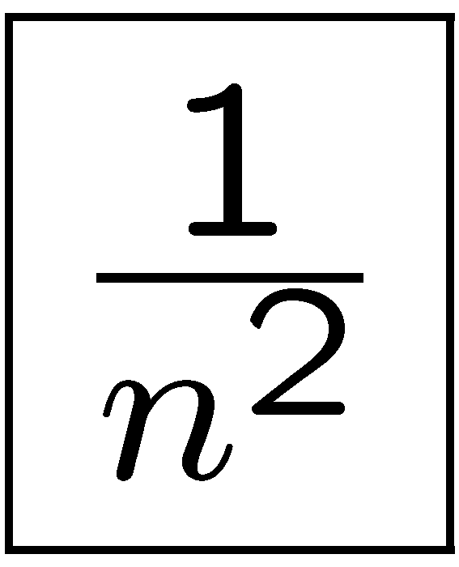
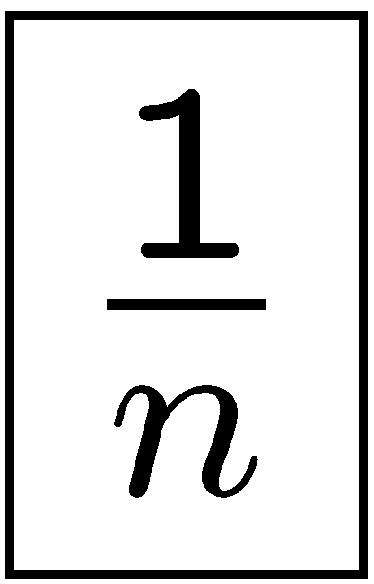
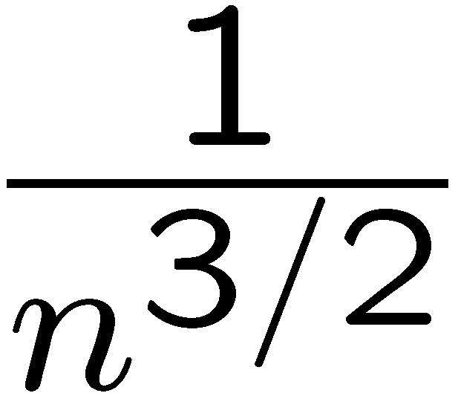
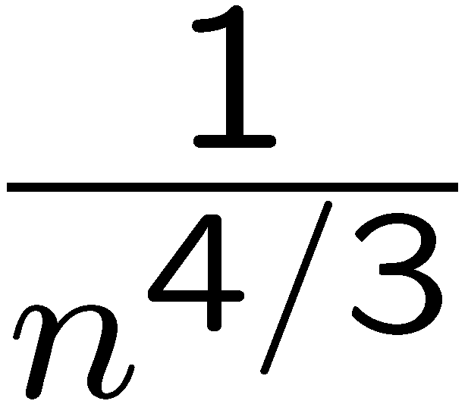
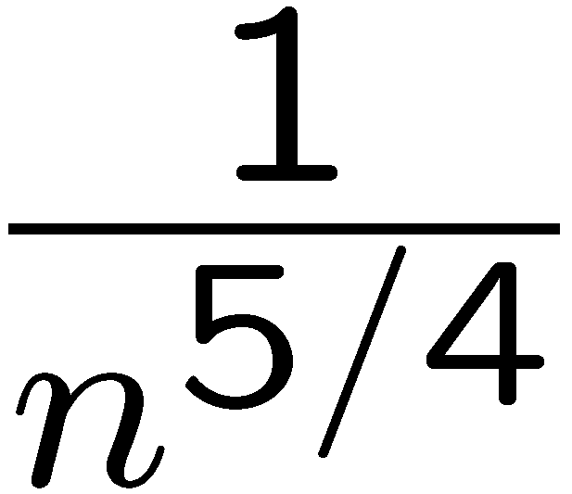
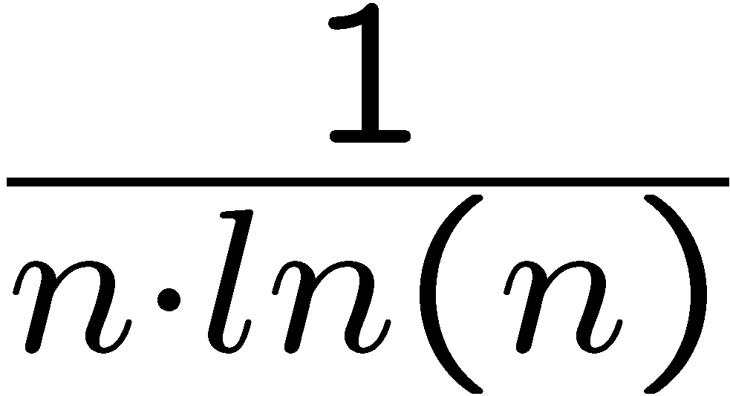
The Evoluation of Random Graphs
[Erdos&Reny:1959; Spencer:2001]
The tuple probability p(n) “grows” from 0 to 1.
How does the random graph evolve ?
0
…
1
Remark: C(n) = E[ Size(G) ] ' n²p(n)
The expected size C(n) “grows” from 0 to n².
How does the random graph evolve ?

Slide 107
The Void
[Spencer:2001]
p(n) ¿ 1/n²
C(n) ¿ 1
Contains almost surely | Does not contain almost surely
(nothing)
The graph is empty
0/1 Law holds

Slide 108
On the k’th Day
[Spencer:2001]
1/n^{1+1/(k-1)} ¿ p(n) ¿ 1/n^{1+1/k}
n^{1-1/(k-1)} ¿ C(n) ¿ n^{1-1/k}
Contains almost surely | Does not contain almost surely
trees with · k edges | trees > k edges cycles
The graph is disconnected
0/1 Law holds

Slide 109
On Day ω
[Spencer:2001]
1/n^{1+ε} ¿ p(n) ¿ 1/n, 8 ε > 0
n^{1-ε} ¿ C(n) ¿ n, 8 ε > 0
Contains almost surely | Does not contain almost surely
Any Tree | cycles
The graph is disconnected
0/1 Law holds

Slide 110
Past the Double Jump (1/n)
[Spencer:2001]
1/n ¿ p(n) ¿ ln(n)/n
n ¿ C(n) ¿ n ln(n)
Contains almost surely | Does not contain almost surely
Any Tree Any Cycle | Any subgraph with k nodes and ¸ k+1 edges
The graph is disconnected
0/1 Law holds

Slide 111
Past Connectivity
[Spencer:2001]
ln(n)/n ¿ p(n) ¿ 1/n^{1-ε}, 8 ε
n ln(n) ¿ C(n) ¿ n^{1+ε}, 8 ε
Contains almost surely | Does not contain almost surely
Every node has degree ¸ k, for every k ¸ 0 | Any subgraph with k nodes and ¸ k+1 edges
Strange logic
of random graphs !!
The graph is connected !
0/1 Law holds

Slide 112
Big Graphs
[Spencer:2001]
p(n) = 1/n^{α}, α 2 (0,1)
C(n) = n^{2-α}, α 2 (0,1)
α is irrational )
0/1 Law holds
0/1 Law does not hold
α is rational )
Fagin’s framework: α = 0
0/1 Law holds
p(n) = O(1)
C(n) = O(n²)

Slide 113
Summary on Random Graphs
Very rich field
  Over 700 references in [Bollobas:2001]
Fascinating theory
  Evening reading: the evolution of random graphs (e.g. from [Spencer:2001])

Slide 114
Summary on Random Graphs
Fagin’s 0/1 Law: impractical probabilistic model
More recent 0/1 laws for p = 1/n^{α} [Spencer&Shelah, Lynch]
In practice: need precise formulas for Pr(Q(I^{p}))
  Preliminary work [Dalvi,Miklau&S:04,Dalvi&S:05]

Slide 115
Part V
Algorithms,
Implementation Techniques

Slide 116
Query Processing on a Probabilistic Database
Top k answers
1. Simulation
Probabilistic
Query engine
SQL Query
2. Extensional joins
Probabilistic
database
3. Indexes

Slide 117
1. Monte Carlo Simulation
[Karp,Luby&Madras:1989]
Naïve:
E = X₁X₂ Ç X₁X₃ Ç X₂X₃
X₁X₂
X₁X₃
Cnt Ã 0
repeat N times
randomly choose X₁, X₂, X₃ 2 {0,1}
if E(X₁, X₂, X₃) = 1
then Cnt = Cnt+1
P = Cnt/N
return P /* ' Pr(E) */
X₂X₃
May be very big
0/1-estimator
theorem
Theorem. If N ¸ (1/ Pr(E)) £ (4ln(2/δ)/ε²) then:
Pr[ | P/Pr(E) - 1 | > ε ] < δ
Works for any E
Not in PTIME

Slide 118
Monte Carlo Simulation
[Karp,Luby&Madras:1989]
Improved:
E = C₁ Ç C₂ Ç . . . Ç C_{m}
Cnt Ã 0; S Ã Pr(C₁) + … + Pr(C_{m});
repeat N times
randomly choose i 2 {1,2,…, m}, with prob. Pr(C_{i}) / S
randomly choose X₁, …, X_{n} 2 {0,1} s.t. C_{i} = 1
if C₁=0 and C₂=0 and … and C_{i-1} = 0
then Cnt = Cnt+1
P = Cnt/N * 1/
return P /* ' Pr(E) */
Now it’s better
Theorem. If N ¸ (1/ m) £ (4ln(2/δ)/ε²) then:
Pr[ | P/Pr(E) - 1 | > ε ] < δ
Only for E in DNF
In PTIME
Notes:
Write E as \vee_{I=1,m} (\neg C_1 \wedge … \wedge \neg C_{i-1} \wedge C_i
Hence Pr(E) =

Slide 119
Summary on Monte Carlo
Some form of simulation is needed in probabilistic databases, to cope with the #P-hardness bottleneck
Naïve MC: works well when Prob is big
Improved MC: needed when Prob is small

Slide 120
2. The Threshold Algorithm
[Nepal&Ramakrishna:1999,Fagin,Lotem,Naor:2001; 2003]
Problem:
SELECT *
FROM R^{p}, S^{p}, T^{p}
WHERE R^{p}.A = S^{p}.B and S^{p}.C = T^{p}.D
Have subplans for R^{p}, S^{p}, T^{p} returning
tuples sorted by their probabilities x, y, z
Score combination:
f(x, y, z) = xyz
How do we compute the top-k matching records ?

Slide 121
[Fagin,Lotem,Naor:2001; 2003]
0 · ? · y₃
“No Random Access”
(NRA)
H007:
f(x₃,?, z₂)
H???:
f(?, ?, ?)
H5555:
f(x₂,y₁,z₃)
Total score:
H999:
f(?, y₃, ?)
H32:
f(x₁,?, ?)
R^{p}=
H32 | x₁
H5555 | x₂
H007 | x₃
? | ?
. . .
S^{p}=
H5555 | y₁
H44 | y₂
H999 | y₃
? | ?
. . .
T^{p}=
H44 | z₁
H007 | z₂
H5555 | z₃
? | ?
. . .
1 ¸ x₁ ¸ x₂ ¸ …
1 ¸ y₁ ¸ y₂ ¸ …
1 ¸ z₁ ¸ z₂ ¸ …

Slide 122
[Fagin,Lotem,Naor:2001; 2003]
Termination condition:
Threshold score
H???:
f(?, ?, ?)
k objects:
Guaranteed to be top-k
The algorithm is “instance optimal”
strongest form of optimality

Slide 123
Summary on the Threshold Algorithm
Simple, intuitive, powerful
There are several variations: see paper
Extensions:
  Use probabilistic methods to estimate the bounds more aggressively
  Distributed environment
[Theobald,Weikum&Schenkel:2004]
[Michel, Triantafillou&Weikum:2005]

Slide 124
Approximate String Joins
[Gravano et al.:2001]
Problem:
SELECT *
FROM R, S
WHERE R.A ~ S.B
Simplification for this tutorial:
A ~ B means “A, B have at least k q-grams in common”

Slide 125
[Gravano et al.:2001]
Definition of q-grams
String:
John_Smith
Set of 3-grams:
##J #Jo Joh ohn hn_ n_S _Sm Smi mit ith th# h##

Slide 126
[Gravano et al.:2001]
SELECT *
FROM R, S
WHERE R.A ~ S.B
Naïve solution,
using UDF
(user defined function)
SELECT *
FROM R, S
WHERE common_grams(R.A, S.B) ¸ k

Slide 127
[Gravano et al.:2001]
A q-gram index:
R
RAQ
Key | A | …
…
k743 | John_Smith | …
…
Key | G
…
k743 | ##J
k743 | #Jo
k743 | Joh
…

Slide 128
[Gravano et al.:2001]
SELECT *
FROM R, S
WHERE R.A ~ S.B
Solution using
the Q-gram Index
SELECT R.*, S.*
FROM R, RAQ, S, SBQ
WHERE R.Key = RAQ.Key and S.Key=SBQ.Key
and RAQ.G = RBQ.G
GROUP BY RAQ.Key, RBQ.Key
HAVING count(*) ¸ k

Slide 129
Summary on Part V:
Algorithms
A wide range of disparate techniques
Monte Carlo Simulations (also: MCMC)
Optimal aggregation algorithms (TA)
Efficient engineering techniques
Needed: unified framework for efficient query evaluation in probabilistic databases

Slide 130
Conclusions and
Challenges Ahead

Slide 131
Conclusions
Imprecisions in data:
A wide variety of types have specialized management solutions
Probabilistic databases promise uniform framework, but require full complexity

Slide 132
Conclusions
Probabilistic databases
Possible worlds semantics
  Simple
  Every query has well defined semantics
Need: expressive representation formalism
Need: efficient query processing techniques

Slide 133
Challenge 1:
Specification Frameworks
The Goal:
Design framework that is usable, expressive, efficient
The Challenge
Tradeoff between expressibility and tractability

Slide 134
Challenge 1:
Specification Frameworks
[Domingos&Richardson:04,Sarma,Benjelloun,Halevy,Widom:2005]
Features to have:
Support probabilistic statements:
  Simple: (Fred, Seattle, Gizmo) 2 Purchase has probability 60%
  Complex: “Fred and Sue live in the same city” has probability 80%
Support tuple corrleations
  “t₁ and t₂ are correlated positively 30%”
Statistics statements:
  There are about 2000 tuples in Purchase
  There are about 100 distinct Cities
  Every customer buys about 4 products

Slide 135
Challenge 2:
Query Evaluation
Complexity
Old: = f(query-language)
New: = f(query-language, specification-language)
Exact algorithm: #P-complete in simple cases
Challenge: characterize the complexity of approximation algorithms

Slide 136
Challenge 2:
Query Evaluation
Implementations:
Disparate techniques require unified framework
Simulation:
  Client side or server side ?
  How to schedule simulation steps ?
  How to push simulation steps in relational operators ?
  How to compute subplans extensionally, when possible ?
Top-k pruning:
  How can we “push thresholds” down the query plan ?

Slide 137
Challenge 3: Mapping Imprecisions to Probabilities
One needs to put a number between 0 and 1 to an uncertain piece of data
  This is highly nontrivial !
  But consider the alternative: ad-hoc management of imprecisions at all stages
What is a principled approach to do this ?
How do we evaluate such mappings ?

Slide 138
The End^{p}
Questions ?

