Slide 1
Data Warehouse
Lutfi Freij
Konstantin Rimarchuk
Vasken Chamlaian
John Sahakian
Suzan Ton

Slide 2

Inmon
Father of the data warehouse
Co-creator of the Corporate
Information Factory.
He has 35 years of
experience in database
technology management
and data warehouse design.

Slide 3
Inmon-Cont’d
Bill has written about a variety
of topics on the building, usage,
& maintenance of the data warehouse
& the Corporate Information Factory.
He has written more than 650
articles (Datamation, ComputerWorld,
and Byte Magazine).
Inmon has published 45 books.
  Many of books has been translated to Chinese, Dutch, French, German, Japanese, Korean, Portuguese, Russian, and Spanish.

Slide 4
Introduction
What is Data Warehouse?
A data warehouse is a collection of integrated databases designed to support a DSS.
According to Inmon’s (father of data warehousing) definition(Inmon,1992a,p.5):
  It is a collection of integrated, subject-oriented databases designed to support the DSS function, where each unit of data is non-volatile and relevant to some moment in time.

Slide 5
Introduction-Cont’d.
Where is it used?
It is used for evaluating future strategy.
It needs a successful technician:
  Flexible.
  Team player.
  Good balance of business and technical understanding.

Slide 6
Introduction-Cont’d.
The ultimate use of data warehouse is Mass Customization.
  For example, it increased Capital One’s customers from 1 million to approximately 9 millions in 8 years.
Just like a muscle: DW increases in strength with active use.
  With each new test and product, valuable information is added to the DW, allowing the analyst to learn from the success and failure of the past.
The key to survival:
  Is the ability to analyze, plan, and react to changing business conditions in a much more rapid fashion.

Slide 7
Data Warehouse
In order for data to be effective, DW must be:
  Consistent.
  Well integrated.
  Well defined.
  Time stamped.
DW environment:
  The data store, data mart & the metadata.

Slide 8
The Data Store
An operational data store (ODS) stores data for a specific application. It feeds the data warehouse a stream of desired raw data.
Is the most common component of DW environment.
Data store is generally subject oriented, volatile, current commonly focused on customers, products, orders, policies, claims, etc…

Slide 9
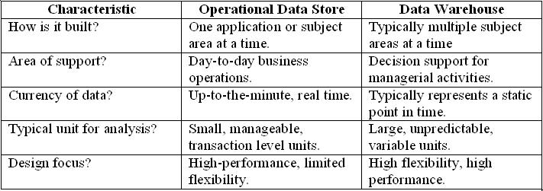
Data Store & Data Warehouse
Data store & Data warehouse, table 10-1 page 296

Slide 10
The data store-Cont’d.
Its day-to-day function is to store the data for a single specific set of operational application.
Its function is to feed the data warehouse data for the purpose of analysis.

Slide 11
The Data Mart
It is lower-cost, scaled down version of the DW.
Data Mart offer a targeted and less costly method of gaining the advantages associated with data warehousing and can be scaled up to a full DW environment over time.

Slide 12
The Meta Data
Last component of DW environments.
It is information that is kept about the warehouse rather than information kept within the warehouse.
Legacy systems generally don’t keep a record of characteristics of the data (such as what pieces of data exist and where they are located).
The metadata is simply data about data.

Slide 13
Conclusion
A Data Warehouse is a collection of integrated subject-oriented databases designed to support a DSS.
  Each unit of data is non-volatile and relevant to some moment in time.
An operational data store (ODS) stores data for a specific application. It feeds the data warehouse a stream of desired raw data.
A data mart is a lower-cost, scaled-down version of a data warehouse, usually designed to support a small group of users (rather than the entire firm).
The metadata is information that is kept about the warehouse.

Slide 14
Data Warehouse
Subject oriented
Data integrated
Time variant
Nonvolatile

Slide 15
Characteristics of Data Warehouse
Subject oriented. Data are organized based on how the users refer to them.
Integrated. All inconsistencies regarding naming convention and value representations are removed.
Nonvolatile. Data are stored in read-only format and do not change over time.
Time variant. Data are not current but normally time series.

Slide 16
Characteristics of Data Warehouse
Summarized Operational data are mapped into a decision-usable format
Large volume. Time series data sets are normally quite large.
Not normalized. DW data can be, and often are, redundant.
Metadata. Data about data are stored.
Data sources. Data come from internal and external unintegrated operational systems.

Slide 17
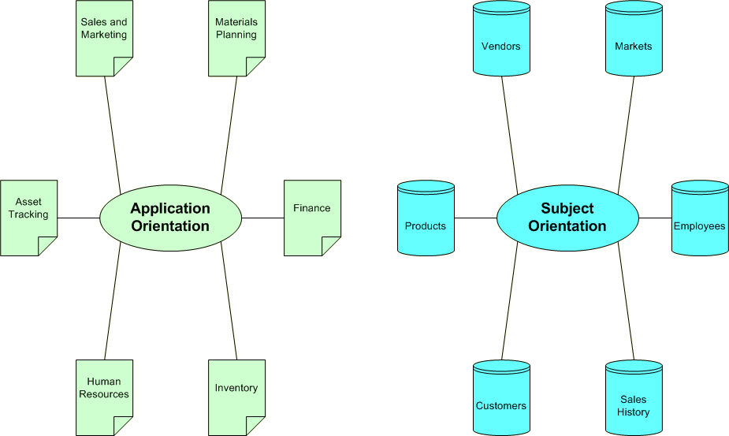
A Data Warehouse is Subject Oriented

Slide 18
Subject Orientation
Application Environment | Data warehouse Environment
Design activities must be equally focused on both process and database design | DW world is primarily void of process design and tends to focus exclusively on issues of data modeling and database design

Slide 19
Data Integrated
Integration –consistency naming conventions and measurement attributers, accuracy, and common aggregation.
Establishment of a common unit of measure for all synonymous data elements from dissimilar database.
The data must be stored in the DW in an integrated, globally acceptable manner

Slide 20
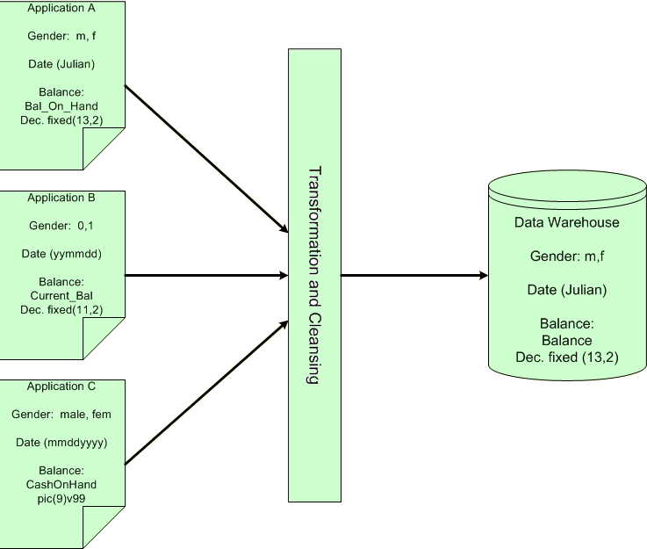
Data Integrated

Slide 21
Time Variant
In an operational application system, the expectation is that all data within the database are accurate as of the moment of access. In the DW data are simply assumed to be accurate as of some moment in time and not necessarily right now.
One of the places where DW data display time variance is in the structure of the record key. Every primary key contained within the DW must contain, either implicitly or explicitly an element of time( day, week, month, etc)

Slide 22
Time Variant
Every piece of data contained within the warehouse must be associated with a particular point in time if any useful analysis is to be conducted with it.
Another aspect of time variance in DW data is that, once recorded, data within the warehouse cannot be updated or changed.

Slide 23
Nonvolatility
Typical activities such as deletes, inserts, and changes that are performed in an operational application environment are completely nonexistent in a DW environment.
Only two data operations are ever performed in the DW: data loading and data access

Slide 24
Nonvolatility
Application | DW
The design issues must focus on data integrity and update anomalies. Complex processes must be coded to ensure that the data update processes allow for high integrity of the final product. | Such issues are no concern to in a DW environment because data update is never performed.
Data is placed in normalized form to ensure a minimal redundancy (totals that could be calculated would never be stored) | Designers find it useful to store many of such calculations or summarizations.
The technologies necessary to support issues of transaction and data recovery, roll back, and detection and remedy of deadlock are quite complex. | Relative simplicity in technology

Slide 25
Issues of Data Redundancy between DW and operational environments
The lack of relevancy of issues such as data normalization in the DW environment may suggest that existence of massive data redundancy within the data warehouse and between the operational and DW environments.
Inmon(1992) pointed out and proved that it is not true.

Slide 26
Issues of Data Redundancy between DW and operational environments
The data being loaded into the DW are filtered and “cleansed” as they pass from the operational database to the warehouse. Because of this cleansing numerous data that exists in the operational environment never pass to the data warehouse. Only the data necessary for processing by the DSS or EIS are ever actually loaded into the DW.
The time horizons for warehouse and operational data elements are unique. Data in the operational environment are fresh, whereas warehouse data are generally much older.(so there is minimal opportunity of the data to overlap between two environments )
The data loaded into the DW often undergo a radical transformation as they pass form operational to the DW environment. So data in DW are not the same.
Given this factors, Inmon suggests that data redundancy between the two environments is a rare occurrence with a typical redundancy factor of less than 1 %

Slide 27
The Data Warehouse Architecture
The architecture consists of various interconnected elements:
  Operational and external database layer – the source data for the DW
  Information access layer – the tools the end user access to extract and analyze the data
  Data access layer – the interface between the operational and information access layers
  Metadata layer – the data directory or repository of metadata information

Slide 28
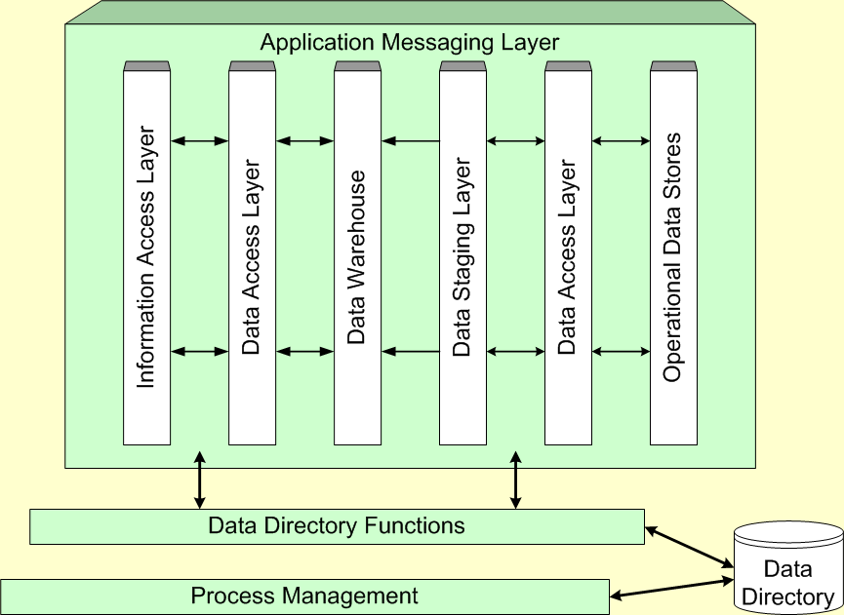
Components of the Data Warehouse Architecture

Slide 29
The Data Warehouse Architecture
Additional layers are:
  Process management layer – the scheduler or job controller
  Application messaging layer – the “middleware” that transports information around the firm
  Physical data warehouse layer – where the actual data used in the DSS are located
  Data staging layer – all of the processes necessary to select, edit, summarize and load warehouse data from the operational and external data bases

Slide 30
Data Warehousing Typology
The virtual data warehouse – the end users have direct access to the data stores, using tools enabled at the data access layer
The central data warehouse – a single physical database contains all of the data for a specific functional area
The distributed data warehouse – the components are distributed across several physical databases

Slide 31
The Metadata
The name suggests some high-level technological concept, but it really is fairly simple. Metadata is “data about data”.
With the emergence of the data warehouse as a decision support structure, the metadata are considered as much a resource as the business data they describe.
Metadata are abstractions -- they are high level data that provide concise descriptions of lower-level data.

Slide 32
The Metadata
For example, a line in a sales database may contain: 4056 KJ596 223.45
This is mostly meaningless until we consult the metadata that tells us it was store number 4056, product KJ596 and sales of $223.45
The metadata are essential ingredients in the transformation of raw data into knowledge. They are the “keys” that allow us to handle the raw data.

Slide 33
General Metadata Issues
General metadata issues associated with Data Warehouse use:
  What tables, attributes and keys does the DW contain?
  Where did each set of data come from?
  What transformations were applied with cleansing?
  How have the metadata changed over time?
  How often do the data get reloaded?
  Are there so many data elements that you need to be careful what you ask for?

Slide 34
Components of the Metadata
Transformation maps – records that show what transformations were applied
Extraction & relationship history – records that show what data was analyzed
Algorithms for summarization – methods available for aggregating and summarizing
Data ownership – records that show origin
Patterns of access – records that show what data are accessed and how often

Slide 35
Typical Mapping Metadata
Transformation mapping records include:
  Identification of original source
  Attribute conversions
  Physical characteristic conversions
  Encoding/reference table conversions
  Naming changes
  Key changes
  Values of default attributes
  Logic to choose from multiple sources
  Algorithmic changes

Slide 36
Implementing the Data Warehouse
Kozar list of “seven deadly sins” of data warehouse implementation:
  “If you build it, they will come” – the DW needs to be designed to meet people’s needs
  Omission of an architectural framework – you need to consider the number of users, volume of data, update cycle, etc.
  Underestimating the importance of documenting assumptions – the assumptions and potential conflicts must be included in the framework

Slide 37
“Seven Deadly Sins”, continued
  Failure to use the right tool – a DW project needs different tools than those used to develop an application
  Life cycle abuse – in a DW, the life cycle really never ends
  Ignorance about data conflicts – resolving these takes a lot more effort than most people realize
  Failure to learn from mistakes – since one DW project tends to beget another, learning from the early mistakes will yield higher quality later

Slide 38
Data Warehouse Technologies
No one currently offers an end-to-end DW solution. Organizations buy bits and pieces from a number of vendors and hopefully make them work together.
SAS, IBM, Software AG, Information Builders and Platinum offer solutions that are at least fairly comprehensive.
The market is very competitive. Table 10-6 in the text lists 90 firms that produce DW products.

Slide 39
The Future of Data Warehousing
As the DW becomes a standard part of an organization, there will be efforts to find new ways to use the data. This will likely bring with it several new challenges:
  Regulatory constraints may limit the ability to combine sources of disparate data.
  These disparate sources are likely to contain unstructured data, which is hard to store.
  The Internet makes it possible to access data from virtually “anywhere”. Of course, this just increases the disparity.

Slide 40
Objective
Interesting Facts
Data Can be Used To
Robust Infrastructure
Success of Data Warehouse Projects
Implementing Data Warehouse
Real Time Alerts & Integration
Identity Theft
What Can You Do?

Slide 41
Interesting Facts
Harrah’s Entertainment’s Data Warehouse holds 30 terabytes, or 30 trillion bytes of data, roughly three times the number of printed characters in the Library of Congress
Casinos, retailers, airlines, and banks are piling up data so vast, it would have been unthinkable years ago; result from the curse of cheap storage

Slide 42
Interesting Facts
Storage Shipments as of 2004: 22 exabytes or 22 million trillion bytes of hard disk space, double the amount in 2002.
Equivalent to 4x’s the space needed to store every word ever spoken by every human being who has ever lived.
Should double again in 2006

Slide 43
Data Can be Used To
Quantify the volume impact of vehicles across the marketing matrix
Account for decay and saturation factors in the determination of investment choices and returns
Execute “what-if” simulations of pricing or promotional scenarios before a proposed action is taken
Provide a continuous planning, measurement, analysis and optimization cycle supported by a software structure
Deliver robust data feeds into other systems supporting supply chain, sales, and financial reporting and endeavors

Slide 44
Robust Infrastructure
Data Identification and Acquisition
Data Cleansing, Mapping, and Transformation
Production System Loading and Ongoing Update
Notes:
To maintain a robust infrastructure, you should follow these guidelines.
Which data sources reflect the dynamics of the contemporary and historical market place.
Validity Checks,
Above loaded into the integrated data repository enabling a continuous cycle of near-time data availability

Slide 45
Success of Data Warehouse Projects
Over half of Data Warehouse projects are Doomed
  Fail due to lack of attention to Data Quality Issues
  More than half only have limited acceptance
  Consistency and Accuracy of Data
  Most businesses fail to use business intelligence (BI) strategically
  IT organizations build data warehouses with little to no business involvement

Slide 46

“A real-time enterprise without real-time business intelligence is a real fast, dumb organization.”
Stephen Brobst
Chief Technology Office
Teradata

Slide 47
Success of Data Warehouse Projects
Most challenging type of deployment for an enterprise
  Large scale and complex system configurations
  Sophisticated data modeling and analysis tools
  High visibility in broad range of important business functions within company
  Adoption of Linux-Based Platform

Slide 48
Implementing Data Warehouse
Challenges:
  Identifying new processes
  Assuring there were of real use
  Implementing and ensuring cultural shifts
  Managing content and New communities towards a common benefit
  Linear models
  Standards, Governance, Controls, Valuation
Notes:
These challenges are especially predominant in dot-com companies.
The key word of Implementing Data Warehouse is Convergence!
The inherent Linear relationship was either business has driven requirements for IT or IT has been an enabler of business. This was a practical need of separation.
Structural changes in business as a result of endemic information technology (information power on all desktops and many businesspersons acting as their own information centers, automated information is a basic lubricant of all business processes.)
Convergence means that info is no longer a separate commodity.
For the Final Note: Information, as any other business commodity, deserves the same treatment as any other core component of business

Slide 49
Teradata
Division of NCR in Dayton, Ohio
Competitor of IBM and Oracle
Multi-million Dollar Machines to run the world’s biggest data warehouses
  Wal-Mart
  Bank of America
  Verizon Wireless
Notes:
IBM and Oracle is designed more to handle online transaction processing

Slide 50
Teradata’s Success
Conventional IBM or Sun Microsystems overload for a couple hours to days on a few terabytes and/or data queries
IBM cannot return computation on certain complex requests
Equivalent to having data but not able to use it.

Slide 51
Real Time Alerts & Integration
Teradata 8.0 Version released in Oct 2004
  Improves real-time alerts and integration
Businesses can analyze operational info against historical info to identify events in near real-time using the new table design
Used by:
  Continental Airlines in the US: reroute passengers on delayed flights, reissuing tickets, reserving a room in a hotel booking system
  Southwest Airlines- savings between $1.2-$1.4 Million
Notes:
Southwest is a low-cost infrastructure

Slide 52
Identity Theft
Government Regulation of Personal Data is Needed (National Consumer Protection Standards)
ChoicePoint Folly
  Georgia-based data-collection company
  Founded in 1997 to analyze insurance claims information, but now provides data to customers including finance companies, law enforcement, and government
  Obtain personal information by perusing public records, or purchasing the information from other companies

Slide 53
Identity Theft
Duped by scammers who set 150 phony accounts to access personal data of as many as 145,000 people nationwide
Scammers set user accounts by faxing in phony business licenses, undetected for one year
750 people had their identities stolen
Theft would have gone unnoticed without California Identity theft law SB 1386

Slide 54
Identity Theft
MSN Event
Data Warehouse Information Gathering
Over the Phone Interviews
Trash Can Hunting
Gathered from Doctors, Internet Transactions, Telephone Operators (Overseas or Prisoners)

Slide 55
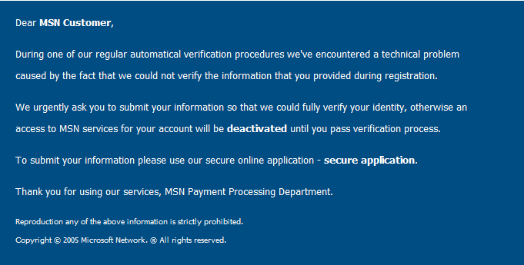
MSN Email

Slide 56
What Can You Do?
Carefully monitor your credit card bills and credit reports
Request a once a year free access credit report via the three big credit agencies.
  Equifax, Experian, TransUnion
Victims: contact Federal Trade Commission to report the theft and monitor credit reports.
  1-800-IDTHEFT

Slide 57
References
Decision Support Systems in the 21st Century 2nd Edition, by George M. Marakas, Prentice Hall, Upper Saddle River, NJ, 2003
http://seattletimes.nwsource.com/html/editorialsopinion/2002191098_credited27.html
Seattle times, plugging holes in data warehousing
Teradata warehouse improves real-time alerts and integration
Cliff Saran. Computer Weekly. Sutton: Oct 12, 2004. p. 22 (1 page)
ON THE MARK
Mark Hall. Computerworld. Framingham: Oct 18, 2004. Vol. 38, Iss. 42; p. 6 (1 page)
Optimization: It's All About the Data Brandweek: Ellen Pederson, Mark Anderson
THE NO-SACRIFICE, AFFORDABLE DATA WAREHOUSE APP Intelligent Enterprises, Michael Gonzalez

Slide 58
References
http://www.dmreview.com/article_sub.cfm?articleId=7071 Convergence- Beyond the Data Warehouse
http://www.computerworld.com/printthis/2001/0,4814,56969,00.html Micro-segmentation – Computerworld
Too Much Information Forbes article on data warehouse
http://reviews.cnet.com/4520-3513_7-5690533-1.html When identity thieves strike data warehouses
Over half of data warehouse projects doomed VNU Business Publications Limited, Robert Jaques 25 February 2005
http://www.linuxworld.com/magazine/?issueid=571 Linux World Article

Slide 59

Questions?

