Slide 1
Distributed Data-Parallel
Programming using Dryad
Andrew Birrell, Mihai Budiu,
Dennis Fetterly, Michael Isard, Yuan Yu
Microsoft Research Silicon Valley
UC Santa Cruz, 4th February 2008

Slide 2
Dryad goals
General-purpose execution environment for distributed, data-parallel applications
  Concentrates on throughput not latency
  Assumes private data center
Automatic management of scheduling, distribution, fault tolerance, etc.

Slide 3
Talk outline
Computational model
Dryad architecture
Some case studies
DryadLINQ overview
Summary

Slide 4
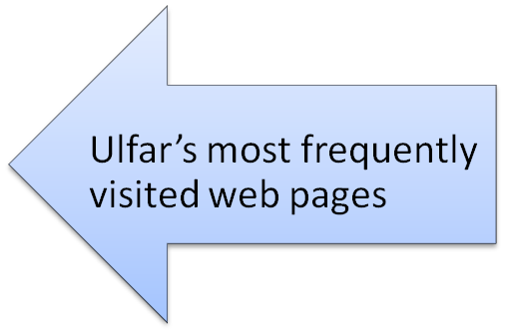
A typical data-intensive query
var logentries =
from line in logs
where !line.StartsWith("#")
select new LogEntry(line);
var user =
from access in logentries
where access.user.EndsWith(@"\ulfar")
select access;
var accesses =
from access in user
group access by access.page into pages
select new UserPageCount("ulfar", pages.Key, pages.Count());
var htmAccesses =
from access in accesses
where access.page.EndsWith(".htm")
orderby access.count descending
select access;

Slide 5
Steps in the query
var logentries =
from line in logs
where !line.StartsWith("#")
select new LogEntry(line);
var user =
from access in logentries
where access.user.EndsWith(@"\ulfar")
select access;
var accesses =
from access in user
group access by access.page into pages
select new UserPageCount("ulfar", pages.Key, pages.Count());
var htmAccesses =
from access in accesses
where access.page.EndsWith(".htm")
orderby access.count descending
select access;
Go through logs and keep only lines that are not comments. Parse each line into a LogEntry object.
Go through logentries and keep only entries that are accesses by ulfar.
Group ulfar’s accesses according to what page they correspond to. For each page, count the occurrences.
Sort the pages ulfar has accessed according to access frequency.

Slide 6
Serial execution
var logentries =
from line in logs
where !line.StartsWith("#")
select new LogEntry(line);
var user =
from access in logentries
where access.user.EndsWith(@"\ulfar")
select access;
var accesses =
from access in user
group access by access.page into pages
select new UserPageCount("ulfar", pages.Key, pages.Count());
var htmAccesses =
from access in accesses
where access.page.EndsWith(".htm")
orderby access.count descending
select access;
For each line in logs, do…
For each entry in logentries, do..
Sort entries in user by page. Then iterate over sorted list, counting the occurrences of each page as you go.
Re-sort entries in access by page frequency.

Slide 7
Parallel execution
var logentries =
from line in logs
where !line.StartsWith("#")
select new LogEntry(line);
var user =
from access in logentries
where access.user.EndsWith(@"\ulfar")
select access;
var accesses =
from access in user
group access by access.page into pages
select new UserPageCount("ulfar", pages.Key, pages.Count());
var htmAccesses =
from access in accesses
where access.page.EndsWith(".htm")
orderby access.count descending
select access;

Slide 8
How does Dryad fit in?
Many programs can be represented as a distributed execution graph
  The programmer may not have to know this
    “SQL-like” queries: LINQ
Dryad will run them for you

Slide 9
Who is the target developer?
“Raw” Dryad middleware
  Experienced C++ developer
  Can write good single-threaded code
  Wants generality, can tune performance
Higher-level front ends for broader audience

Slide 10
Talk outline
Computational model
Dryad architecture
Some case studies
DryadLINQ overview
Summary

Slide 11
Runtime
V
V
V
Services
  Name server
  Daemon
Job Manager
  Centralized coordinating process
  User application to construct graph
  Linked with Dryad libraries for scheduling vertices
Vertex executable
  Dryad libraries to communicate with JM
  User application sees channels in/out
  Arbitrary application code, can use local FS
Notes:
Let us move back to discussing the graph execution.
The Job Manager (JM) handles the scheduling of all the processes in the vertices of the graph.
It does this using a topological sort of the graph.
When nodes in the graph fail execution, parts of the subgraph may need to be re-executed, because the inputs that are needed may no longer be available. The vertices that had generated these inputs may have to be re-run. The JM will attempt to re-execute a minimal part of the graph to recompute the missing data.
On executing a vertex, the JM must choose a machine

Slide 12
Job = Directed Acyclic Graph
Outputs
Processing
vertices
Channels
(file, pipe,
shared
memory)
Inputs
Notes:
A dryad application is composed of a collection of processing vertices (processes).
The vertices communicate with each other through channels.
The vertices and channels should always compose into a directed acyclic graph.

Slide 13
What’s wrong with MapReduce?
Literally Map then Reduce and that’s it…
  Reducers write to replicated storage
Complex jobs pipeline multiple stages
  No fault tolerance between stages
    Map assumes its data is always available: simple!
Output of Reduce: 2 network copies, 3 disks
  In Dryad this collapses inside a single process
  Big jobs can be more efficient with Dryad

Slide 14
What’s wrong with Map+Reduce?
Join combines inputs of different types
“Split” produces outputs of different types
  Parse a document, output text and references
Can be done with Map+Reduce
  Ugly to program
  Hard to avoid performance penalty
  Some merge joins very expensive
    Need to materialize entire cross product to disk

Slide 15
How about Map+Reduce+Join+…?
“Uniform” stages aren’t really uniform

Slide 16
How about Map+Reduce+Join+…?
“Uniform” stages aren’t really uniform

Slide 17
Graph complexity composes
Non-trees common
E.g. data-dependent re-partitioning
  Combine this with merge trees etc.
Distribute to equal-sized ranges
Sample to estimate histogram
Randomly partitioned inputs

Slide 18
Scheduler state machine
Scheduling is independent of semantics
  Vertex can run anywhere once all its inputs are ready
    Constraints/hints place it near its inputs
  Fault tolerance
    If A fails, run it again
    If A’s inputs are gone, run upstream vertices again (recursively)
    If A is slow, run another copy elsewhere and use output from whichever finishes first

Slide 19
Dryad DAG architecture
Simplicity depends on generality
  Front ends only see graph data-structures
  Generic scheduler state machine
    Software engineering: clean abstraction
    Restricting set of operations would pollute scheduling logic with execution semantics
Optimizations all “above the fold”
  Dryad exports callbacks so applications can react to state machine transitions

Slide 20
Talk outline
Computational model
Dryad architecture
Some case studies
DryadLINQ overview
Summary

Slide 21
SkyServer DB Query
3-way join to find gravitational lens effect
Table U: (objId, color) 11.8GB
Table N: (objId, neighborId) 41.8GB
Find neighboring stars with similar colors:
  Join U+N to find
    T = U.color,N.neighborId where U.objId = N.objId
  Join U+T to find
    U.objId where U.objId = T.neighborID
    and U.color ≈ T.color

Slide 22
SkyServer DB query
H
Took SQL plan
Manually coded in Dryad
Manually partitioned data
[distinct]
[merge outputs]
(u.color,n.neighborobjid)
[re-partition by n.neighborobjid]
[order by n.neighborobjid]
Y
n
Y
select
u.color,n.neighborobjid
from u join n
where
u.objid = n.objid
U
U
select
u.objid
from u join <temp>
where
u.objid = <temp>.neighborobjid and
|u.color - <temp>.color| < d
S
4n
S
u: objid, color
n: objid, neighborobjid
[partition by objid]
M
4n
M
D
n
D
X
n
X
U
N
U
N

Slide 23
Optimization
H
Y
U
Y
n
Y
S
S
S
S
U
U
M
4n
S
S
M
M
4n
M
M
M
D
n
D
D
X
n
X
X
U
N
U
N
U
N

Slide 24
Optimization
H
Y
U
Y
n
Y
S
S
S
S
U
U
M
4n
S
S
M
M
4n
M
M
M
D
n
D
D
X
n
X
X
U
N
U
N
U
N

Slide 25
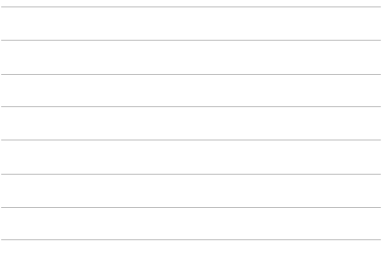
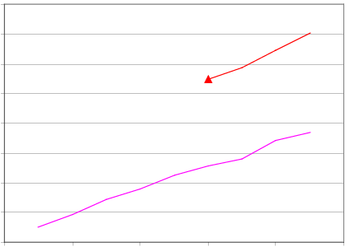
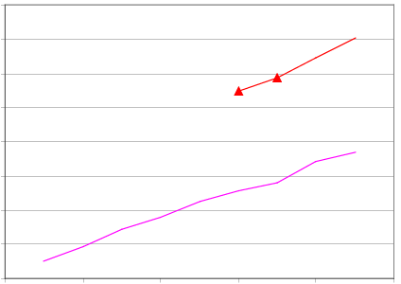
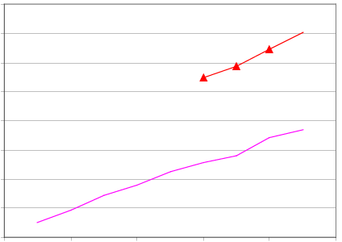
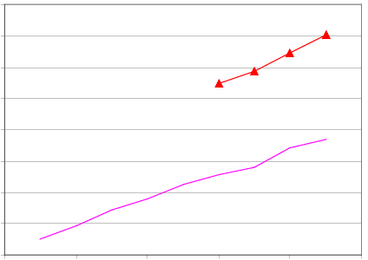
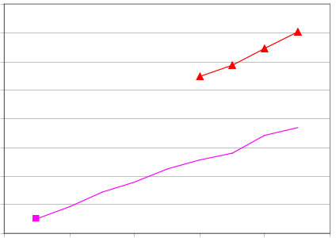
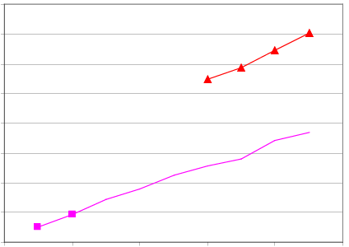
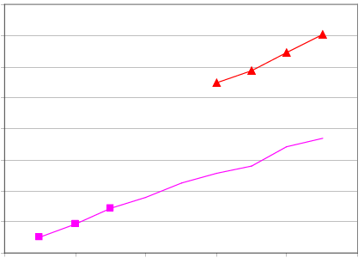
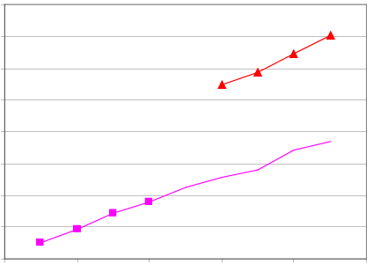
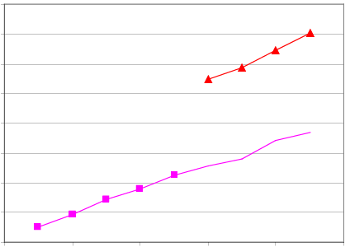
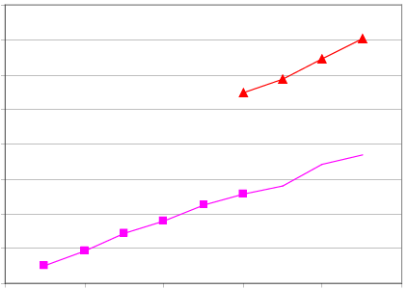
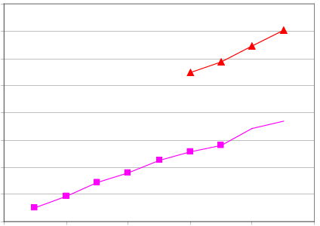
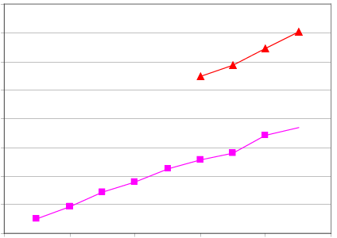
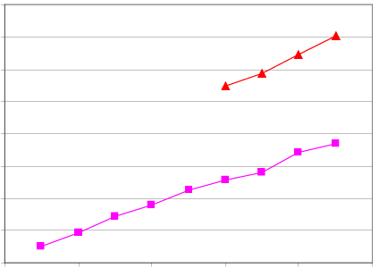
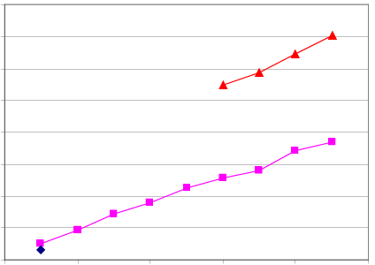



16.0
Dryad In-Memory
14.0
Dryad Two-pass
12.0
SQLServer 2005
10.0
Speed-up
8.0
6.0
4.0
2.0
0.0
0
2
4
6
8
10
Number of Computers

Slide 26
Query histogram computation
Input: log file (n partitions)
Extract queries from log partitions
Re-partition by hash of query (k buckets)
Compute histogram within each bucket

Slide 27
Naïve histogram topology
P parse lines
D hash distribute
S quicksort
C count occurrences
MS merge sort
Each
Q
is
:
k
C
C
Each
R
k
R
R
S
k
S
is
:
n
D
C
Q
Q
n
P
MS

Slide 28
Efficient histogram topology
P parse lines
D hash distribute
S quicksort
C count occurrences
MS merge sort
M non-deterministic merge
k
Each
Q'
is
:
Each
T
R
k
R
C
Each
is
:
R
T
S
is
:
D
P
C
C
Q'
n
M
MS
MS

Slide 29
MS►C
R
R
R
MS►C►D
T
M►P►S►C
Q’
P parse lines D hash distribute
S quicksort MS merge sort
C count occurrences M non-deterministic merge

Slide 30
MS►C
R
R
R
MS►C►D
T
M►P►S►C
Q’
Q’
Q’
Q’
P parse lines D hash distribute
S quicksort MS merge sort
C count occurrences M non-deterministic merge

Slide 31
MS►C
R
R
R
MS►C►D
T
T
M►P►S►C
Q’
Q’
Q’
Q’
P parse lines D hash distribute
S quicksort MS merge sort
C count occurrences M non-deterministic merge

Slide 32
MS►C
R
R
R
MS►C►D
T
T
M►P►S►C
Q’
Q’
Q’
Q’
P parse lines D hash distribute
S quicksort MS merge sort
C count occurrences M non-deterministic merge

Slide 33
MS►C
R
R
R
MS►C►D
T
T
M►P►S►C
Q’
Q’
Q’
Q’
P parse lines D hash distribute
S quicksort MS merge sort
C count occurrences M non-deterministic merge

Slide 34
MS►C
R
R
R
MS►C►D
T
T
M►P►S►C
Q’
Q’
Q’
Q’
P parse lines D hash distribute
S quicksort MS merge sort
C count occurrences M non-deterministic merge

Slide 35
Final histogram refinement
450
33.4 GB
1,800 computers
43,171 vertices
11,072 processes
11.5 minutes
R
450
R
118 GB
T
217
T
154 GB
Q'
10,405
Q'
99,713
10.2
TB

Slide 36
Optimizing Dryad applications
General-purpose refinement rules
Processes formed from subgraphs
  Re-arrange computations, change I/O type
Application code not modified
  System at liberty to make optimization choices
High-level front ends hide this from user
  SQL query planner, etc.

Slide 37
Talk outline
Computational model
Dryad architecture
Some case studies
DryadLINQ overview
Summary

Slide 38
DryadLINQ (Yuan Yu)
LINQ: Relational queries integrated in C#
More general than distributed SQL
  Inherits flexible C# type system and libraries
  Data-clustering, EM, inference, …
Uniform data-parallel programming model
  From SMP to clusters

Slide 39
LINQ
Collection<T> collection;
bool IsLegal(Key);
string Hash(Key);
var results = from c in collection
where IsLegal(c.key)
select new { Hash(c.key), c.value};

Slide 40

DryadLINQ = LINQ + Dryad
Collection<T> collection;
bool IsLegal(Key k);
string Hash(Key);
var results = from c in collection
where IsLegal(c.key)
select new { Hash(c.key), c.value};
Vertex
code
Query
plan
(Dryad job)
Data
collection
C#
C#
C#
C#
results

Slide 41
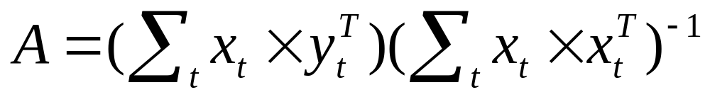
Linear Regression Code
PartitionedVector<DoubleMatrix> xx = x.PairwiseMap(
x,
(a, b) => DoubleMatrix.OuterProduct(a, b));
Scalar<DoubleMatrix> xxm = xx.Reduce(
(a, b) => DoubleMatrix.Add(a, b),
z);
PartitionedVector<DoubleMatrix> yx = y.PairwiseMap(
x,
(a, b) => DoubleMatrix.OuterProduct(a, b));
Scalar<DoubleMatrix> yxm = yx.Reduce(
(a, b) => DoubleMatrix.Add(a, b),
z);
Scalar<DoubleMatrix> xxinv = xxm.Apply(a => DoubleMatrix.Inverse(a));
Scalar<DoubleMatrix> result = xxinv.Apply(yxm,
(a, b) => DoubleMatrix.Multiply(a, b));

Slide 42
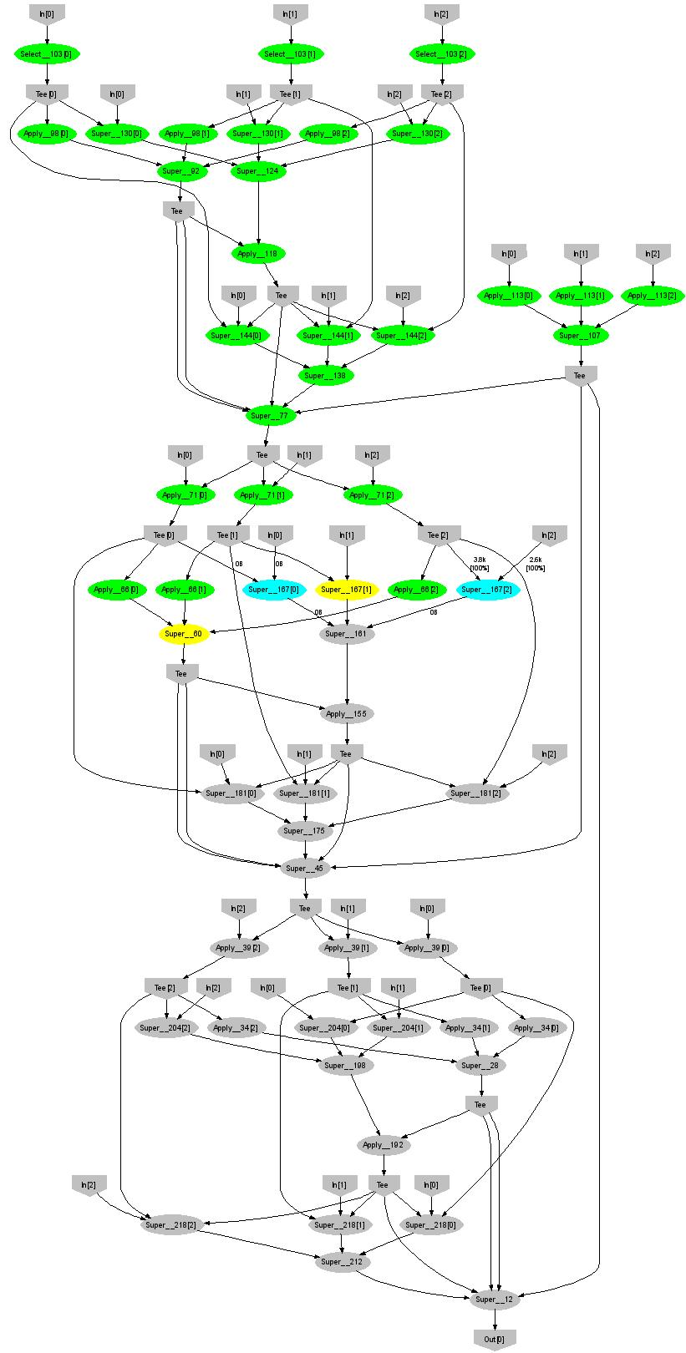
Expectation Maximization
190 lines
3 iterations shown

Slide 43
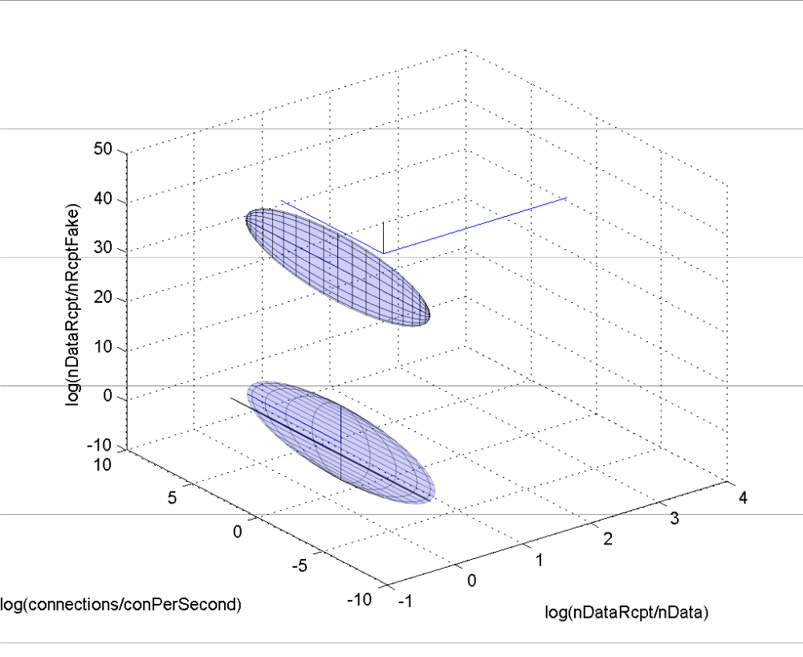
Understanding Botnet Traffic using EM
3 GB data
15 clusters
60 computers
50 iterations
9000 processes
50 minutes

Slide 44
Summary
General-purpose platform for scalable distributed data-processing of all sorts
Very flexible
  Optimizations can get more sophisticated
Designed to be used as middleware
  Slot different programming models on top
  LINQ is very powerful

