Slide 1

SQL Server 2014
InMemory OLTP
Greg Linwood
MyDBA
gregl@MyDBA.com

Slide 2




About Greg Linwood
Founder / Managing Director of MyDBA (2002)
Microsoft’s first Australian SQL Server MVP (2003)
Founder of the Australian SQL Server User Group (2004)
  www.SQLServer.org.au
Working with SQL Server since 1993

Slide 3

Agenda
Overview
Current server memory limits
Architecture
Five major changes
Physical storage
Durability
Constraints
Demos

Slide 4
Overview
Biggest OLTP engine redesign since SQL7 in 1998
Up to 100x performance improvement objective
Leverages big increases in server RAM
Optimistic Locking, Native Compilation, Hash Indexes
Tightly integrated into existing DBMS engine
Significant feature / language constraints in V1

Slide 5
Current Server memory limits
 | 768GB | 1.5TB | 2TB | 3TB | 4TB | 10TB
HP | DL380p G8 | DL560 G8 | DL580 G7 |  | DL980 G7 | ?
Dell | R720xd | R820 | R910 |  |  | ?
IBM | x3550 M4 | x3750 M4 | x3850 X5 | x3950 X5 |  | ?

Slide 6
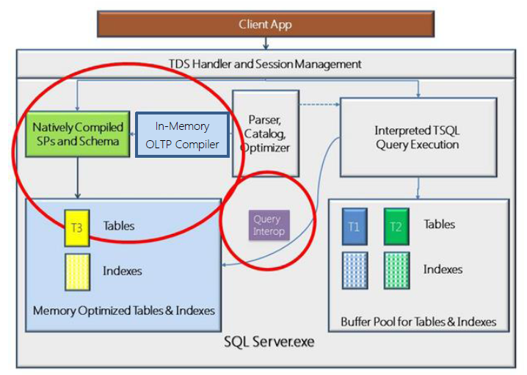
Architecture

Slide 7
Five Major Changes
Memory persistence
Lockless concurrency
Native Compilation
Hash indexes
Delayed Durability

Slide 8
Physical Storage
Tlogging as normal to comply with ACID
  Durability Options
Data Files
  Checkpoint File Pairs – based on Filestream
    Data Files
    Delta Files

Slide 9
Durability Options
Table durability options (inMemory tables only)
  DURABILITY = SCHEMA-ONLY
  DURABILITY = SCHEMA_AND_DATA
DELAYED DURABILITY
    DB Property – allow, deny, force
    Transaction option

Slide 10
Key Constraints
Table durability options (inMemory tables only)
  DURABILITY = SCHEMA-ONLY
  DURABILITY = SCHEMA_AND_DATA
DELAYED_DURABILITY
    DB Property – allow, deny, force
    Transaction option

Slide 11
Links
  SQL Server 2014 CT2 Site:
  http://www.microsoft.com/en-us/sqlserver/sql-server-2014.aspx?WT.mc_id=Blog_SSQL_TechEdNA_SQL2014
  Kalen Delaney's Whitepaper:
  http://sqlblog.com/blogs/kalen_delaney/archive/2013/10/20/sql-server-2014-in-memory-oltp-hekaton-whitepaper-for-ctp2.aspx
  MSDN - InMemory OLTP:
  http://msdn.microsoft.com/en-us/library/dn133186(v=sql.120).aspx
  SQL Server Blog - Memory Management
  http://blogs.technet.com/b/dataplatforminsider/archive/2013/11/14/sql-server-2014-in-memory-oltp-memory-management-for-memory-optimized-tables.aspx?WT.mc_id=Social_FBPAGE_OutgoingAnnouncements_Thu%20Nov%2014%2017:18:28%20GMT%202013_30623568_Microsoft%20SQL%20Server%20-%20sqlserver
  SQL Server Blog - Storage Allocation
  http://blogs.technet.com/b/dataplatforminsider/archive/2014/01/16/storage-allocation-and-management-for-memory-optimized-tables.aspx
  BWIN Video:
  http://www.youtube.com/watch?v=nO200qJ_i-Y
  SQLskills Melbourne Training:
  http://www.sqlskills.com/sql-server-training/melbourne-ie1-20140317/
  SQLskills Sydney Training:
  http://www.sqlskills.com/sql-server-training/sydney-ie1-20140310/
  Tony Rogerson Blog - Delayed Durability:
  http://dataidol.com/tonyrogerson/2014/01/08/throughput-improvement-through-delayed-durability-on-commit-tran-from-sql-server-2014/
  Tony Rogerson Blog - Hash Indexes:
  http://dataidol.com/tonyrogerson/2014/01/16/sql-server-hekaton-in-memory-tables-understanding-the-row-chains-of-hash-indexes/?utm_content=buffer7fc28&utm_medium=social&utm_source=twitter.com&utm_campaign=buffer
  Arshad Ali Blog - InMemory OLTP:
  http://www.mssqltips.com/sqlservertip/3108/sql-server-2014-in-memory-oltp-durability-natively-compiled-stored-procedures-and-transaction-isolation-level/?utm_source=dailynewsletter&utm_medium=email&utm_content=headline&utm_campaign=20140120

Slide 12
Thank you!
Questions?
gregl@MyDBA.com

