Slide 1
18-447
Computer Architecture
Recitation 3
Presenter: Kevin Chang
Prof. Onur Mutlu
Carnegie Mellon University
Spring 2015, 3/16/2015

Slide 2
Assignment and Exam Reminders
Lab 5: Due March 22 (Sunday)
  Data cache
HW 4: March 18 (Wednesday)
Midterm 1: March 20 (Friday)
  12:30 to 2:20pm
  Arrive early, sit with one seat in between you and the next person
  Closed book/notes, but you can bring a single 8.5 x 11 note sheet
  Look over the past midterms

Slide 3
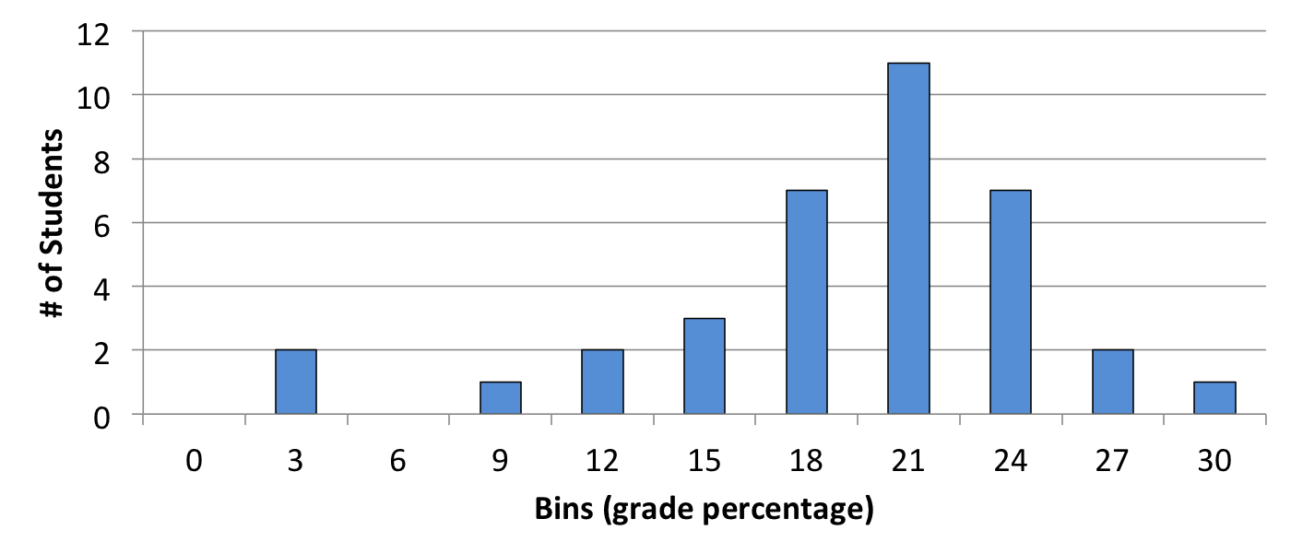
Mid-Semester Grade
Average: 18.6
Median: 19.1
STDDEV: 4.8

Slide 4
Review of Last Lecture
Virtual memory is a level of indirection that
  Provides the illusion of a large address space while having a small physical memory
    64-bit: ~16,000,000,000,000,000,000 (16 quintillion) bytes
  This illusion is provided separately for each program
Benefits of virtual memory
  Efficiency through demand paging: Cache the pages that are accessed in memory from disk
  Simplicity through automatic management by both SW and HW
  Safety: Address space separation and per-page protection
Notes:
** Too expensive to build 16qb bytes
Programmer does not need to know the physical size of memory nor manage it → A small physical memory can appear as a huge one to the programmer → Life is easier for the programmer
2. …
--------------
Benefits:
* efficiency. We only want to keep the working set the programs in the memory instead of bringing in every pages the program accesses. This is build on top of the idea caching where pages with high locality are kept in the memory.
* automatic: Programmer doesn’t need to deal with physical addresses or ensure data/programs are in the memory.
SW – OS
HW – MMU
Isolate the data from different programs in physical memory
Not every program is allowed to access every page in the memory

Slide 5
Basic Mechanisms
Virtual addresses are provided to a program
Address translation: Virtual addresses → physical addresses
Page table: The data structure that stores the translations
  Problem 1: Too large
    Solution: Hierarchical page tables
  Problem 2: Too slow
    Solution: Translation Lookaside Buffer (TLB)
Notes:
Second, there needs to be a mechanism to translate va to pa when the programs need to access data
Translations can be done through either SW/HW (most of today’s system relies on the HW MMU to perform this translation).
There’s a data structure called the page table where the mappings b/w the virtual addresses and the physical addresses are stored.
We also saw two problems with the page tables
Too large: There are too many mappings b/w the VA to PA
The solution we examined is to add another level of indirection by building hpt.
We then looked at how to mitigate this problem by introducing another level of indirection or hierarchy in the page tables.
Slow: page table walker (either SW or HW)
To mitigate this problem, today’s systems use a small cache structure called TLB to cache to recently translated virtual and physical address.
Cache the translation for the recently used VA in a small structure called TLB to avoid going to the page tables stored in the memory, which has long access latency.

Slide 6
Address Translation and Caching
Cache: Virtually addressed or physically addressed
  Virtual vs. physical cache
Problem 1: Homonym
  Same VA can map to different PAs
  Reason: VA is in different processes
Problem 2: Synonym
  Different VAs can map to the same PA
  Reason: Different virtual pages can share the same physical frame
  Due to: Shared libraries, copy-on-write, etc.
Notes:
When do we do the address translation? Before or after the L1 accesses
There are two major problems:
Homo
This may lead to cache accessing the wrong data
SYN
Same phy address can be present in multiple locations in the cache. Multiple copies.
This leas to inconsistent data. Imagine one process writes to a pa and the other location is out-of-date viewed by the other process.
Whether these two problems occur, depends on how you address the cache: virtually or physically.

Slide 7
Cache-VM Interaction
CPU
CPU
CPU
TLB
VA
cache
PA
cache
tlb
VA
PA
cache
tlb
VA
PA
lower
hier.
lower
hier.
lower
hier.
physical cache
virtual (L1) cache
virtual-physical cache
Notes:
There are three choices to address the cache

Slide 8
Cache-VM Interaction
CPU
CPU
CPU
TLB
VA
cache
PA
cache
tlb
VA
VA
PA
cache
tlb
PA
lower
hier.
lower
hier.
lower
hier.
physical cache
virtual (L1) cache
virtual-physical cache
No homonym
and synonym
High latency to
fast L1
Homonym and
synonym
Low latency
to fast L1
No Homonym and
synonym (?)
Low latency
to fast L1
Notes:
1.
2.
3. Use the physical address to check cache hits. Not on the critical path.

Slide 9
Virtually-Indexed Physically-Tagged Cache
If C≤(page_size × associativity), the cache index bits come only from page offset (same in VA and PA)
If both L1 cache and TLB are on chip
  Index both arrays concurrently using VA bits
  Check cache tag (physical) against TLB output at the end
  Physical tag eliminates the homonym problem
Virtual address
VPN
Page Offset
Index
BiB
TLB
physical
cache
PPN
=
tag
data
TLB hit?
cache hit?
Notes:
The key observation here is that the virtual address is not completely virtual. The lower bits, PPO, that are used to access the bytes in physical frame are actually physical address.

Slide 10
Virtually-Indexed Physically-Tagged Cache
How about synonym?
  No problem in this setup due to index bits from the PPO
When does synonym become a problem?
  C>(page_size × associativity), the cache index bits include V
Virtual address
VPN
Page Offset
Index
BiB
TLB
physical
cache
PPN
=
tag
data
TLB hit?
cache hit?
Notes:
Physical address from the page offset. Even if two VP map to the same PA, they will share the same index.

Slide 11
Virtually-Indexed Physically-Tagged Cache
How about synonym?
  No problem in this setup due to index bits from the PPO
When does synonym become a problem?
  C>(page_size × associativity), the cache index bits include V
Virtual address
VPN
Page Offset
Index
BiB
TLB
physical
cache
PPN
=
tag
data
TLB hit?
cache hit?
Notes:
This will become a problem as different virtual addresses will likely result in different indices.

Slide 12
Some Solutions to the Synonym Problem
Limit cache size to (page size times associativity)
  Get index from the page offset
On a write to a block, search all possible indices that can contain the same physical block, and update/invalidate
  Used in Alpha 21264, MIPS R10K
Restrict page placement in OS
  Make sure index(VA) = index(PA)
  Called page coloring
  Used in many SPARC processors
Notes:
2. Provide a simple form of coherence. You only have a limited number of locations.
3. These bits never change when we under go translation

Slide 13
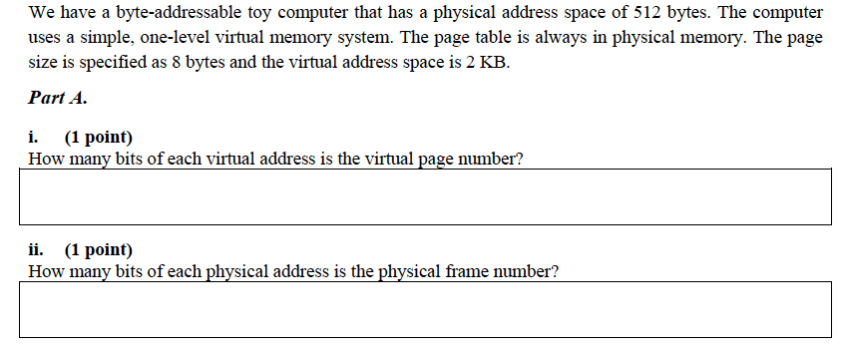
An Exercise (I)

Slide 14
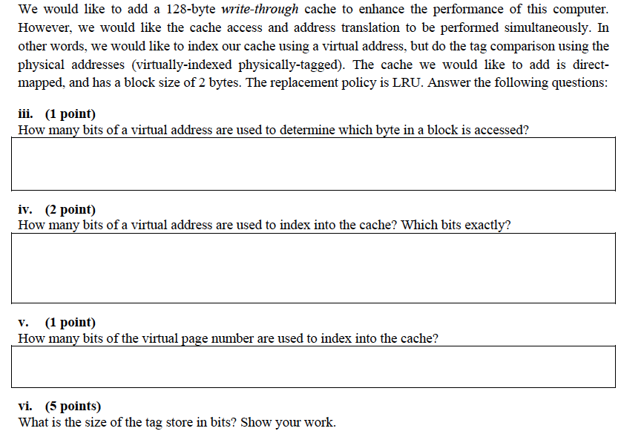
An Exercise (II)

Slide 15
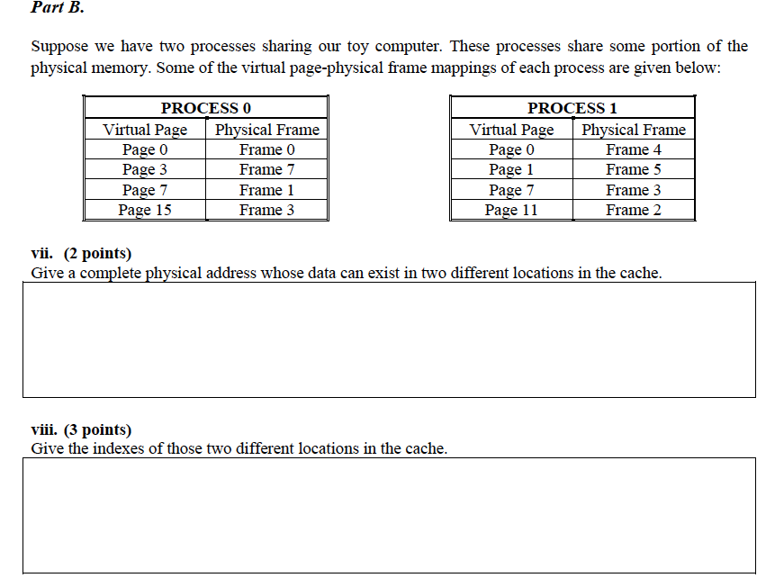

Slide 16
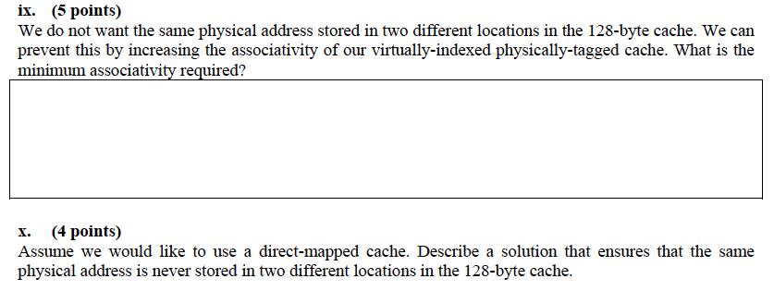
An Exercise (Concluded)

Slide 17
Solutions to the Exercise
http://www.ece.cmu.edu/~ece740/f11/lib/exe/fetch.php?media=wiki:midterm:midterm_s09_solution.pdf
And, more exercises are in past exams and in your homework…

Slide 18
Questions on Lab5?

