Slide 1
18-447
Computer Architecture
Lecture 10: Branch Prediction II
Prof. Onur Mutlu
Rachata Ausavarungnirun
Carnegie Mellon University
Spring 2015, 2/6/2015

Slide 2
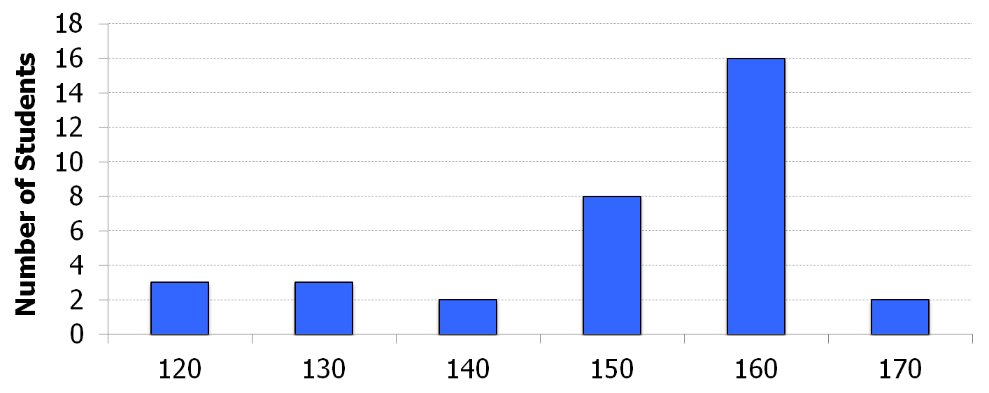
HW 1 Grades
Mean: 130.8
Median: 149.5
Stddev: 45

Slide 3
Agenda for Today & Next Few Lectures
Single-cycle Microarchitectures
Multi-cycle and Microprogrammed Microarchitectures
Pipelining
Issues in Pipelining: Control & Data Dependence Handling, State Maintenance and Recovery, …
Out-of-Order Execution
Issues in OoO Execution: Load-Store Handling, …

Slide 4
Reminder: Readings for Next Few Lectures (I)
P&H Chapter 4.9-4.11
Smith and Sohi, “The Microarchitecture of Superscalar Processors,” Proceedings of the IEEE, 1995
  More advanced pipelining
  Interrupt and exception handling
  Out-of-order and superscalar execution concepts
McFarling, “Combining Branch Predictors,” DEC WRL Technical Report, 1993. HW3 summary paper
Kessler, “The Alpha 21264 Microprocessor,” IEEE Micro 1999.

Slide 5
Reminder: Readings for Next Few Lectures (II)
Smith and Plezskun, “Implementing Precise Interrupts in Pipelined Processors,” IEEE Trans on Computers 1988 (earlier version in ISCA 1985). HW3 summary paper

Slide 6
Recap of Last Lecture
Predicated Execution Primer
Delayed Branching
  With and without squashing
Branch Prediction
  Reducing misprediction penalty (branch resolution latency)
  Branch target buffer (BTB)
Static Branch Prediction
Dynamic Branch Prediction
How Big Is the Branch Problem?

Slide 7
Recitation Session on Monday
Please bring questions related to:
  Lab 3
  HW 2 (due Wednesday)
  Lectures 1-10
  Reading assignments

Slide 8
Review: More Sophisticated Direction Prediction
Compile time (static)
  Always not taken
  Always taken
  BTFN (Backward taken, forward not taken)
  Profile based (likely direction)
  Program analysis based (likely direction)
Run time (dynamic)
  Last time prediction (single-bit)
  Two-bit counter based prediction
  Two-level prediction (global vs. local)
  Hybrid

Slide 9
Review: Importance of The Branch Problem
Assume N = 20 (20 pipe stages), W = 5 (5 wide fetch)
  Assume: 1 out of 5 instructions is a branch
  Assume: Each 5 instruction-block ends with a branch
How long does it take to fetch 500 instructions?
  100% accuracy
    100 cycles (all instructions fetched on the correct path)
    No wasted work
  99% accuracy
    100 (correct path) + 20 (wrong path) = 120 cycles
    20% extra instructions fetched
  98% accuracy
    100 (correct path) + 20 * 2 (wrong path) = 140 cycles
    40% extra instructions fetched
  95% accuracy
    100 (correct path) + 20 * 5 (wrong path) = 200 cycles
    100% extra instructions fetched

Slide 10
Review: Can We Do Better?
Last-time and 2BC predictors exploit “last-time” predictability
Realization 1: A branch’s outcome can be correlated with other branches’ outcomes
  Global branch correlation
Realization 2: A branch’s outcome can be correlated with past outcomes of the same branch (other than the outcome of the branch “last-time” it was executed)
  Local branch correlation

Slide 11
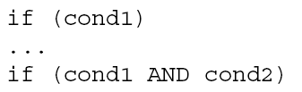
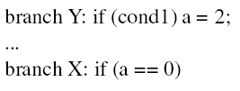
Global Branch Correlation (I)
Recently executed branch outcomes in the execution path is correlated with the outcome of the next branch
If first branch not taken, second also not taken
If first branch taken, second definitely not taken

Slide 12
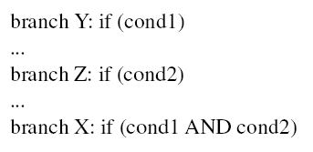
Global Branch Correlation (II)
If Y and Z both taken, then X also taken
If Y or Z not taken, then X also not taken

Slide 13
Global Branch Correlation (III)
Eqntott, SPEC 1992
  if (aa==2) ;; B1
  aa=0;
  if (bb==2) ;; B2
  bb=0;
  if (aa!=bb) { ;; B3
  ….
  }
  If B1 is not taken (i.e., aa==0@B3) and B2 is not taken (i.e. bb=0@B3) then B3 is certainly taken

Slide 14
Capturing Global Branch Correlation
Idea: Associate branch outcomes with “global T/NT history” of all branches
Make a prediction based on the outcome of the branch the last time the same global branch history was encountered
Implementation:
  Keep track of the “global T/NT history” of all branches in a register → Global History Register (GHR)
  Use GHR to index into a table that recorded the outcome that was seen for each GHR value in the recent past → Pattern History Table (table of 2-bit counters)
Global history/branch predictor
Uses two levels of history (GHR + history at that GHR)

Slide 15




Two Level Global Branch Prediction
First level: Global branch history register (N bits)
  The direction of last N branches
Second level: Table of saturating counters for each history entry
  The direction the branch took the last time the same history was seen
Pattern History Table (PHT)
00 …. 00
1 1 ….. 1 0
00 …. 01
GHR
(global history register)
2
3
previous
branch’s
direction
00 …. 10
index
0
1
11 …. 11
Yeh and Patt, “Two-Level Adaptive Training Branch Prediction,” MICRO 1991.

Slide 16
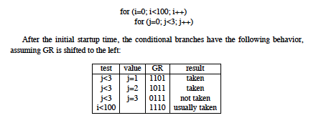
How Does the Global Predictor Work?
McFarling, “Combining Branch Predictors,” DEC WRL TR 1993.
This branch tests i
Last 4 branches test j
History: TTTN
Predict taken for i
Next history: TTNT
(shift in last outcome)
Notes:
Start with j=3, last iteration that is not taken…

Slide 17
Intel Pentium Pro Branch Predictor
4-bit global history register
Multiple pattern history tables (of 2 bit counters)
  Which pattern history table to use is determined by lower order bits of the branch address

Slide 18
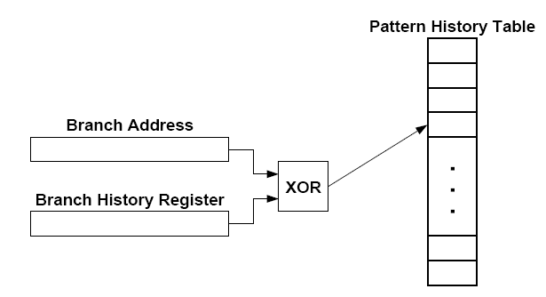
Improving Global Predictor Accuracy
Idea: Add more context information to the global predictor to take into account which branch is being predicted
  Gshare predictor: GHR hashed with the Branch PC
  + More context information
  + Better utilization of PHT
  -- Increases access latency
McFarling, “Combining Branch Predictors,” DEC WRL Tech Report, 1993.

Slide 19
Review: One-Level Branch Predictor
Direction predictor (2-bit counters)
taken?
PC + inst size
Next Fetch
Address
Program
Counter
hit?
Address of the
current instruction
target address
Cache of Target Addresses (BTB: Branch Target Buffer)

Slide 20
Two-Level Global History Branch Predictor
Which direction earlier
branches went
Direction predictor (2-bit counters)
taken?
Global branch
history
PC + inst size
Next Fetch
Address
Program
Counter
hit?
Address of the
current instruction
target address
Cache of Target Addresses (BTB: Branch Target Buffer)

Slide 21
Two-Level Gshare Branch Predictor
Which direction earlier
branches went
Direction predictor (2-bit counters)
taken?
Global branch
history
PC + inst size
Next Fetch
Address
XOR
Program
Counter
hit?
Address of the
current instruction
target address
Cache of Target Addresses (BTB: Branch Target Buffer)

Slide 22
Can We Do Better?
Last-time and 2BC predictors exploit only “last-time” predictability for a given branch
Realization 1: A branch’s outcome can be correlated with other branches’ outcomes
  Global branch correlation
Realization 2: A branch’s outcome can be correlated with past outcomes of the same branch (in addition to the outcome of the branch “last-time” it was executed)
  Local branch correlation

Slide 23
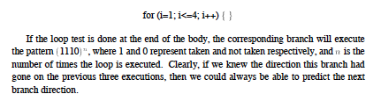
Local Branch Correlation
McFarling, “Combining Branch Predictors,” DEC WRL TR 1993.

Slide 24
Capturing Local Branch Correlation
Idea: Have a per-branch history register
  Associate the predicted outcome of a branch with “T/NT history” of the same branch
Make a prediction based on the outcome of the branch the last time the same local branch history was encountered
Called the local history/branch predictor
Uses two levels of history (Per-branch history register + history at that history register value)

Slide 25
Two Level Local Branch Prediction
First level: A set of local history registers (N bits each)
  Select the history register based on the PC of the branch
Second level: Table of saturating counters for each history entry
  The direction the branch took the last time the same history was seen
Pattern History Table (PHT)
00 …. 00
1 1 ….. 1 0
00 …. 01
2
3
00 …. 10
index
0
1
Local history registers
11 …. 11
Yeh and Patt, “Two-Level Adaptive Training Branch Prediction,” MICRO 1991.

Slide 26
Two-Level Local History Branch Predictor
Which directions earlier instances of *this branch* went
Direction predictor (2-bit counters)
taken?
PC + inst size
Next Fetch
Address
Program
Counter
hit?
Address of the
current instruction
target address
Cache of Target Addresses (BTB: Branch Target Buffer)

Slide 27
Hybrid Branch Predictors
Idea: Use more than one type of predictor (i.e., multiple algorithms) and select the “best” prediction
  E.g., hybrid of 2-bit counters and global predictor
Advantages:
+ Better accuracy: different predictors are better for different branches
+ Reduced warmup time (faster-warmup predictor used until the slower-warmup predictor warms up)
Disadvantages:
-- Need “meta-predictor” or “selector”
-- Longer access latency
  McFarling, “Combining Branch Predictors,” DEC WRL Tech Report, 1993.

Slide 28
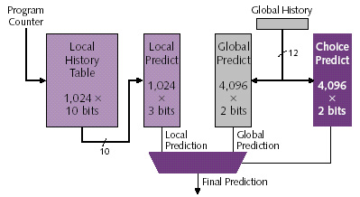
Alpha 21264 Tournament Predictor
Minimum branch penalty: 7 cycles
Typical branch penalty: 11+ cycles
48K bits of target addresses stored in I-cache
Predictor tables are reset on a context switch
Kessler, “The Alpha 21264 Microprocessor,” IEEE Micro 1999.

Slide 29
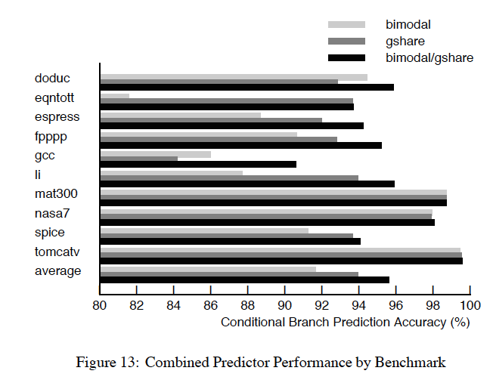
Branch Prediction Accuracy (Example)
Bimodal: table of 2bc indexed by branch address

Slide 30
Biased Branches
Observation: Many branches are biased in one direction (e.g., 99% taken)
Problem: These branches pollute the branch prediction structures → make the prediction of other branches difficult by causing “interference” in branch prediction tables and history registers
Solution: Detect such biased branches, and predict them with a simpler predictor (e.g., last time, static, …)
Chang et al., “Branch classification: a new mechanism for improving branch predictor performance,” MICRO 1994.

Slide 31
Some Other Branch Predictor Types
Loop branch detector and predictor
  Works well for loops with small number of iterations, where iteration count is predictable
Perceptron branch predictor
  Learns the direction correlations between individual branches
  Assigns weights to correlations
  Jimenez and Lin, “Dynamic Branch Prediction with Perceptrons,” HPCA 2001.
Geometric history length predictor
Your predictor?

Slide 32
How to Handle Control Dependences
Critical to keep the pipeline full with correct sequence of dynamic instructions.
Potential solutions if the instruction is a control-flow instruction:
Stall the pipeline until we know the next fetch address
Guess the next fetch address (branch prediction)
Employ delayed branching (branch delay slot)
Do something else (fine-grained multithreading)
Eliminate control-flow instructions (predicated execution)
Fetch from both possible paths (if you know the addresses of both possible paths) (multipath execution)

Slide 33
Review: Predicate Combining (not Predicated Execution)
Complex predicates are converted into multiple branches
  if ((a == b) && (c < d) && (a > 5000)) { … }
    3 conditional branches
Problem: This increases the number of control dependencies
Idea: Combine predicate operations to feed a single branch instruction
  Predicates stored and operated on using condition registers
  A single branch checks the value of the combined predicate
+ Fewer branches in code → fewer mipredictions/stalls
-- Possibly unnecessary work
-- If the first predicate is false, no need to compute other predicates
Condition registers exist in IBM RS6000 and the POWER architecture

Slide 34
Predication (Predicated Execution)
Idea: Compiler converts control dependence into data dependence → branch is eliminated
  Each instruction has a predicate bit set based on the predicate computation
  Only instructions with TRUE predicates are committed (others turned into NOPs)
(normal branch code)
(predicated code)
A
T
N
A
if (cond) {
b = 0;
}
else {
b = 1;
}
C
B
B
C
D
D
A
p1 = (cond)
branch p1, TARGET
A
p1 = (cond)
(!p1) mov b, 1
(p1) mov b, 0
B
B
mov b, 1
jmp JOIN
C
C
TARGET:
mov b, 0
D
D
add x, b, 1
add x, b, 1

Slide 35
Conditional Move Operations
Very limited form of predicated execution
CMOV R1 ← R2
  R1 = (ConditionCode == true) ? R2 : R1
  Employed in most modern ISAs (x86, Alpha)

Slide 36
Review: CMOV Operation
Suppose we had a Conditional Move instruction…
  CMOV condition, R1 ← R2
  R1 = (condition == true) ? R2 : R1
  Employed in most modern ISAs (x86, Alpha)
Code example with branches vs. CMOVs
  if (a == 5) {b = 4;} else {b = 3;}
  CMPEQ condition, a, 5;
  CMOV condition, b ← 4;
  CMOV !condition, b ← 3;

Slide 37
Predicated Execution (II)
Predicated execution can be high performance and energy-efficient
Predicated Execution
A
Fetch Decode Rename Schedule RegisterRead Execute
C
B
F
E
E
F
D
F
D
E
C
F
B
A
A
F
E
C
D
B
F
F
D
E
B
C
A
E
A
B
E
C
D
D
B
C
A
D
A
B
C
C
B
A
B
A
E
A
A
F
F
D
E
C
D
E
B
C
D
A
B
A
C
D
A
B
B
A
C
C
B
nop
Branch Prediction
D
Fetch Decode Rename Schedule RegisterRead Execute
F
E
D
B
A
E
Pipeline flush!!
F

Slide 38
Predicated Execution (III)
Advantages:
  + Eliminates mispredictions for hard-to-predict branches
  + No need for branch prediction for some branches
  + Good if misprediction cost > useless work due to predication
  + Enables code optimizations hindered by the control dependency
  + Can move instructions more freely within predicated code
Disadvantages:
  -- Causes useless work for branches that are easy to predict
  -- Reduces performance if misprediction cost < useless work
  -- Adaptivity: Static predication is not adaptive to run-time branch behavior. Branch behavior changes based on input set, program phase, control-flow path.
  -- Additional hardware and ISA support
  -- Cannot eliminate all hard to predict branches
  -- Loop branches

Slide 39
Predicated Execution in Intel Itanium
Each instruction can be separately predicated
64 one-bit predicate registers
each instruction carries a 6-bit predicate field
An instruction is effectively a NOP if its predicate is false
cmp
p1 p2 ←cmp
br
p2
else1
else1
p1
then1
join1
else2
p1
then2
br
p2
else2
then1
join2
then2
join1
join2

Slide 40
Conditional Execution in the ARM ISA
Almost all ARM instructions can include an optional condition code.
An instruction with a condition code is executed only if the condition code flags in the CPSR meet the specified condition.

Slide 41
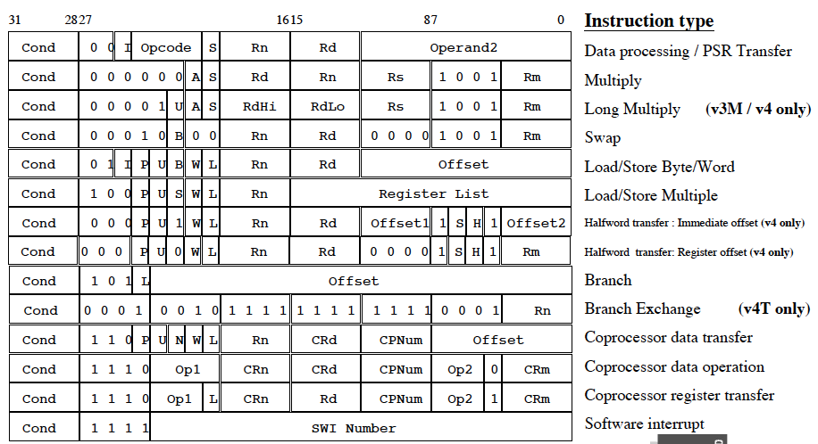
Conditional Execution in ARM ISA

Slide 42
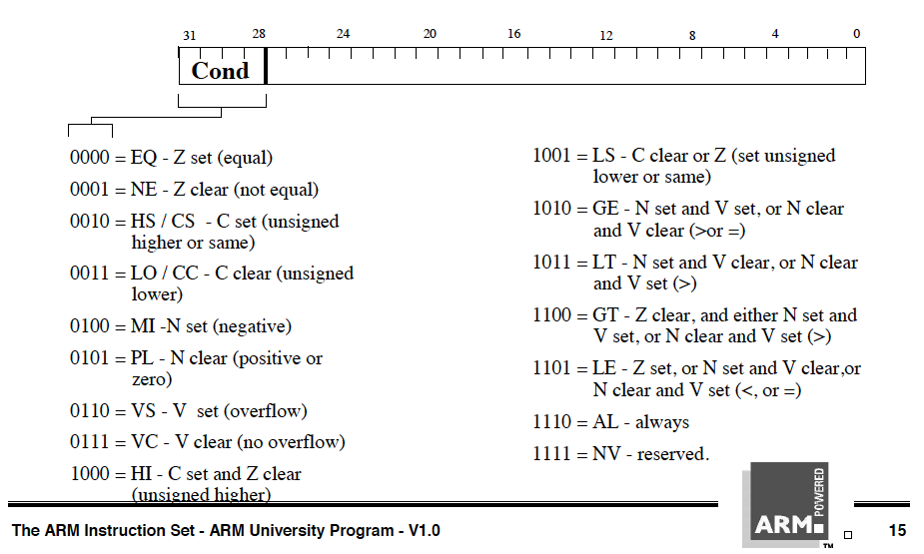
Conditional Execution in ARM ISA

Slide 43
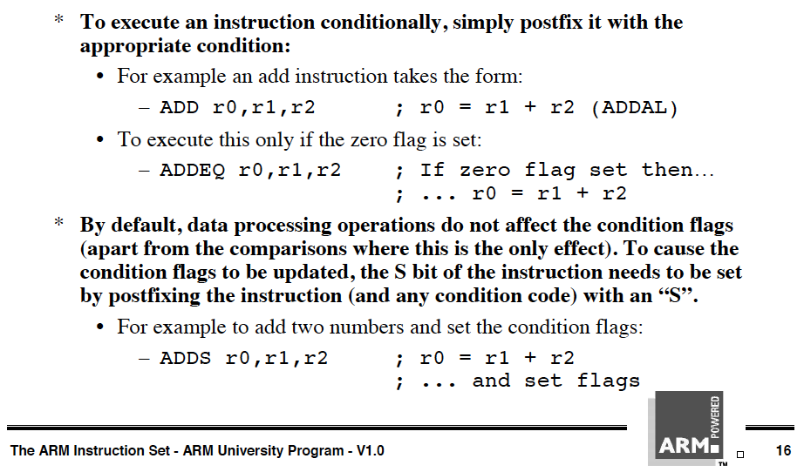
Conditional Execution in ARM ISA

Slide 44
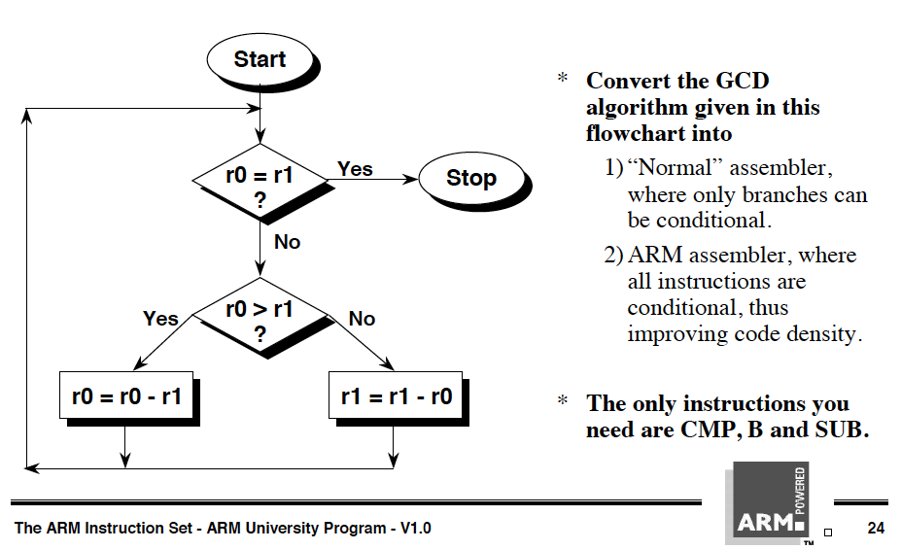
Conditional Execution in ARM ISA

Slide 45
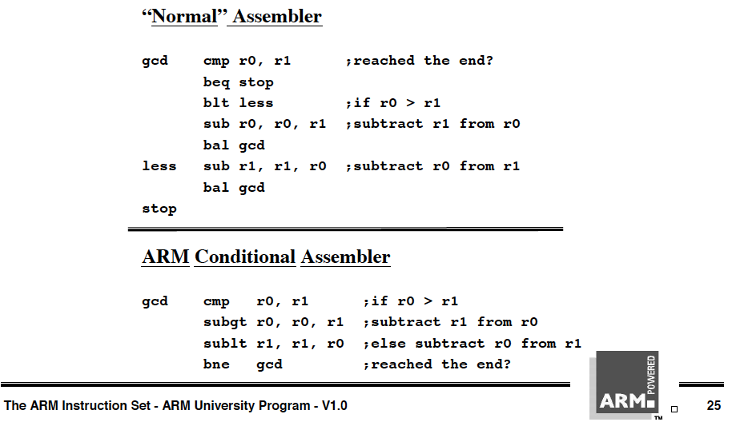
Conditional Execution in ARM ISA

Slide 46
Idealism
Wouldn’t it be nice
  If the branch is eliminated (predicated) only when it would actually be mispredicted
  If the branch were predicted when it would actually be correctly predicted
Wouldn’t it be nice
  If predication did not require ISA support

Slide 47
Improving Predicated Execution
Three major limitations of predication
  1. Adaptivity: non-adaptive to branch behavior
  2. Complex CFG: inapplicable to loops/complex control flow graphs
  3. ISA: Requires large ISA changes
Wish Branches [Kim+, MICRO 2005]
  Solve 1 and partially 2 (for loops)
Dynamic Predicated Execution
  Diverge-Merge Processor [Kim+, MICRO 2006]
    Solves 1, 2 (partially), 3
A

Slide 48
Wish Branches
The compiler generates code (with wish branches) that can be executed either as predicated code or non-predicated code (normal branch code)
The hardware decides to execute predicated code or normal branch code at run-time based on the confidence of branch prediction
Easy to predict: normal branch code
Hard to predict: predicated code
Kim et al., “Wish Branches: Enabling Adaptive and Aggressive Predicated Execution,” MICRO 2006, IEEE Micro Top Picks, Jan/Feb 2006.

Slide 49
Wish Jump/Join
High Confidence
Low Confidence
A
wish jump
A
A
nop
T
N
B
Taken
wish join
B
Not-Taken
C
B
C
C
D
D
D
A
A
p1=(cond)
wish.jump p1 TARGET
A
p1 = (cond)
branch p1, TARGET
p1 = (cond)
(!p1) mov b,1
(p1) mov b,0
B
nop
(!p1) mov b,1
wish.join !p1 JOIN
B
B
(1) mov b,1
wish.join (1) JOIN
mov b, 1
jmp JOIN
C
C
TARGET:
(p1) mov b,0
C
TARGET:
(1) mov b,0
TARGET:
mov b,0
JOIN:
D
normal branch code
predicated code
wish jump/join code

Slide 50
Wish Branches vs. Predicated Execution
Advantages compared to predicated execution
  Reduces the overhead of predication
  Increases the benefits of predicated code by allowing the compiler to generate more aggressively-predicated code
  Makes predicated code less dependent on machine configuration (e.g. branch predictor)
Disadvantages compared to predicated execution
  Extra branch instructions use machine resources
  Extra branch instructions increase the contention for branch predictor table entries
  Constrains the compiler’s scope for code optimizations

Slide 51
How to Handle Control Dependences
Critical to keep the pipeline full with correct sequence of dynamic instructions.
Potential solutions if the instruction is a control-flow instruction:
Stall the pipeline until we know the next fetch address
Guess the next fetch address (branch prediction)
Employ delayed branching (branch delay slot)
Do something else (fine-grained multithreading)
Eliminate control-flow instructions (predicated execution)
Fetch from both possible paths (if you know the addresses of both possible paths) (multipath execution)

Slide 52
Multi-Path Execution
Idea: Execute both paths after a conditional branch
  For all branches: Riseman and Foster, “The inhibition of potential parallelism by conditional jumps,” IEEE Transactions on Computers, 1972.
  For a hard-to-predict branch: Use dynamic confidence estimation
Advantages:
  + Improves performance if misprediction cost > useless work
  + No ISA change needed
Disadvantages:
  -- What happens when the machine encounters another hard-to-predict branch? Execute both paths again?
  -- Paths followed quickly become exponential
  -- Each followed path requires its own context (registers, PC, GHR)
  -- Wasted work (and reduced performance) if paths merge

Slide 53

Dual-Path Execution versus Predication
Dual-path
Predicated Execution
A
Hard to predict
path 1
path 2
path 1
path 2
C
B
C
B
C
B
D
D
D
CFM
CFM
D
E
E
E
E
F
F
F
F

Slide 54
Remember: Branch Types
Type | Direction at fetch time | Number of possible next fetch addresses? | When is next fetch address resolved?
Conditional | Unknown | 2 | Execution (register dependent)
Unconditional | Always taken | 1 | Decode (PC + offset)
Call | Always taken | 1 | Decode (PC + offset)
Return | Always taken | Many | Execution (register dependent)
Indirect | Always taken | Many | Execution (register dependent)
How can we predict an indirect branch with many target addresses?

Slide 55
Call and Return Prediction
Call X
…
  Call X
  …
    Call X
    …
    Return
  Return
Return
Direct calls are easy to predict
  Always taken, single target
  Call marked in BTB, target predicted by BTB
Returns are indirect branches
  A function can be called from many points in code
  A return instruction can have many target addresses
    Next instruction after each call point for the same function
  Observation: Usually a return matches a call
  Idea: Use a stack to predict return addresses (Return Address Stack)
    A fetched call: pushes the return (next instruction) address on the stack
    A fetched return: pops the stack and uses the address as its predicted target
    Accurate most of the time: 8-entry stack → > 95% accuracy

Slide 56
Indirect Branch Prediction (I)
Register-indirect branches have multiple targets
Used to implement
  Switch-case statements
  Virtual function calls
  Jump tables (of function pointers)
  Interface calls
A
A
R1 = MEM[R2]
branch R1
N
br.cond TARGET
T
?
TARG
A+1
α
β
δ
ρ
Conditional (Direct) Branch
Indirect Jump

Slide 57
Indirect Branch Prediction (II)
No direction prediction needed
Idea 1: Predict the last resolved target as the next fetch address
  + Simple: Use the BTB to store the target address
  -- Inaccurate: 50% accuracy (empirical). Many indirect branches switch between different targets
Idea 2: Use history based target prediction
  E.g., Index the BTB with GHR XORed with Indirect Branch PC
  Chang et al., “Target Prediction for Indirect Jumps,” ISCA 1997.
  + More accurate
  -- An indirect branch maps to (too) many entries in BTB
  -- Conflict misses with other branches (direct or indirect)
  -- Inefficient use of space if branch has few target addresses

Slide 58
More Ideas on Indirect Branches?
Virtual Program Counter prediction
  Idea: Use conditional branch prediction structures iteratively to make an indirect branch prediction
  i.e., devirtualize the indirect branch in hardware
Curious?
  Kim et al., “VPC Prediction: Reducing the Cost of Indirect Branches via Hardware-Based Dynamic Devirtualization,” ISCA 2007.

Slide 59
Issues in Branch Prediction (I)
Need to identify a branch before it is fetched
How do we do this?
  BTB hit → indicates that the fetched instruction is a branch
  BTB entry contains the “type” of the branch
  Pre-decoded “branch type” information stored in the instruction cache identifies type of branch
What if no BTB?
  Bubble in the pipeline until target address is computed
  E.g., IBM POWER4

Slide 60
Issues in Branch Prediction (II)
Latency: Prediction is latency critical
  Need to generate next fetch address for the next cycle
  Bigger, more complex predictors are more accurate but slower
PC + inst size
BTB target
Next Fetch
Address
Return Address Stack target
Indirect Branch Predictor target
Resolved target from Backend
???

Slide 61
Complications in Superscalar Processors
Superscalar processors
  attempt to execute more than 1 instruction-per-cycle
  must fetch multiple instructions per cycle
What if there is a branch in the middle of fetched instructions?
Consider a 2-way superscalar fetch scenario
  (case 1) Both insts are not taken control flow inst
    nPC = PC + 8
  (case 2) One of the insts is a taken control flow inst
    nPC = predicted target addr
    *NOTE* both instructions could be control-flow; prediction based on the first one predicted taken
    If the 1st instruction is the predicted taken branch
    → nullify 2nd instruction fetched

Slide 62
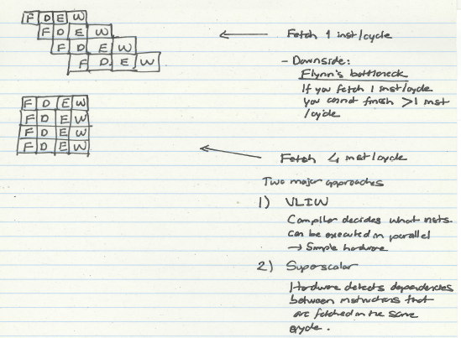
Multiple Instruction Fetch: Concepts

Slide 63
Review of Last Few Lectures
Control dependence handling in pipelined machines
  Delayed branching
  Fine-grained multithreading
  Branch prediction
    Compile time (static)
      Always NT, Always T, Backward T Forward NT, Profile based
    Run time (dynamic)
      Last time predictor
      Hysteresis: 2BC predictor
      Global branch correlation → Two-level global predictor
      Local branch correlation → Two-level local predictor
      Hybrid branch predictors
  Predicated execution
  Multipath execution
  Return address stack & Indirect branch prediction

