Slide 1
18-447
Computer Architecture
Lecture 11: Precise Exceptions,
State Maintenance, State Recovery
Prof. Onur Mutlu
Carnegie Mellon University
Spring 2015, 2/11/2015

Slide 2
Agenda for Today & Next Few Lectures
Single-cycle Microarchitectures
Multi-cycle and Microprogrammed Microarchitectures
Pipelining
Issues in Pipelining: Control & Data Dependence Handling, State Maintenance and Recovery, …
Out-of-Order Execution
Issues in OoO Execution: Load-Store Handling, …

Slide 3
Reminder: Announcements
Homework 2 due today (Feb 11)
Lab 3 online & due next Friday (Feb 20)
  Pipelined MIPS
  Competition for high performance
    You can optimize both cycle time and CPI
    Document and clearly describe what you do during check-off

Slide 4
Reminder: Readings for Next Few Lectures (I)
P&H Chapter 4.9-4.11
Smith and Sohi, “The Microarchitecture of Superscalar Processors,” Proceedings of the IEEE, 1995
  More advanced pipelining
  Interrupt and exception handling
  Out-of-order and superscalar execution concepts
McFarling, “Combining Branch Predictors,” DEC WRL Technical Report, 1993. HW3 summary paper
Kessler, “The Alpha 21264 Microprocessor,” IEEE Micro 1999.

Slide 5
Reminder: Readings for Next Few Lectures (II)
Smith and Plezskun, “Implementing Precise Interrupts in Pipelined Processors,” IEEE Trans on Computers 1988 (earlier version in ISCA 1985). HW3 summary paper

Slide 6
Readings Specifically for Today
Smith and Plezskun, “Implementing Precise Interrupts in Pipelined Processors,” IEEE Trans on Computers 1988 (earlier version in ISCA 1985). HW3 summary paper
Smith and Sohi, “The Microarchitecture of Superscalar Processors,” Proceedings of the IEEE, 1995
  More advanced pipelining
  Interrupt and exception handling
  Out-of-order and superscalar execution concepts

Slide 7
Review: How to Handle Control Dependences
Critical to keep the pipeline full with correct sequence of dynamic instructions.
Potential solutions if the instruction is a control-flow instruction:
Stall the pipeline until we know the next fetch address
Guess the next fetch address (branch prediction)
Employ delayed branching (branch delay slot)
Do something else (fine-grained multithreading)
Eliminate control-flow instructions (predicated execution)
Fetch from both possible paths (if you know the addresses of both possible paths) (multipath execution)

Slide 8
Review of Last Few Lectures
Control dependence handling in pipelined machines
  Delayed branching
  Fine-grained multithreading
  Branch prediction
    Compile time (static)
      Always NT, Always T, Backward T Forward NT, Profile based
    Run time (dynamic)
      Last time predictor
      Hysteresis: 2BC predictor
      Global branch correlation → Two-level global predictor
      Local branch correlation → Two-level local predictor
      Hybrid branch predictors
  Predicated execution
  Multipath execution
  Return address stack & Indirect branch prediction

Slide 9
Pipelining and Precise Exceptions: Preserving Sequential Semantics

Slide 10
Multi-Cycle Execution
Not all instructions take the same amount of time for “execution”
Idea: Have multiple different functional units that take different number of cycles
  Can be pipelined or not pipelined
  Can let independent instructions start execution on a different functional unit before a previous long-latency instruction finishes execution

Slide 11
Issues in Pipelining: Multi-Cycle Execute
Instructions can take different number of cycles in EXECUTE stage
  Integer ADD versus FP MULtiply
  What is wrong with this picture?
    Sequential semantics of the ISA NOT preserved!
    What if FMUL incurs an exception?
FMUL R4 ← R1, R2
ADD R3 ← R1, R2
F
D
E
E
E
E
E
E
E
E
W
F
D
E
W
F
D
E
W
F
D
E
W
FMUL R2 ← R5, R6
ADD R7 ← R5, R6
F
D
E
E
E
E
E
E
E
E
W
F
D
E
W
F
D
E
W

Slide 12
Exceptions vs. Interrupts
Cause
  Exceptions: internal to the running thread
  Interrupts: external to the running thread
When to Handle
  Exceptions: when detected (and known to be non-speculative)
  Interrupts: when convenient
    Except for very high priority ones
      Power failure
      Machine check (error)
Priority: process (exception), depends (interrupt)
Handling Context: process (exception), system (interrupt)

Slide 13
Precise Exceptions/Interrupts
The architectural state should be consistent when the exception/interrupt is ready to be handled
1. All previous instructions should be completely retired.
2. No later instruction should be retired.
Retire = commit = finish execution and update arch. state

Slide 14
Why Do We Want Precise Exceptions?
Semantics of the von Neumann model ISA specifies it
  Remember von Neumann vs. Dataflow
Aids software debugging
Enables (easy) recovery from exceptions, e.g. page faults
Enables (easily) restartable processes
Enables traps into software (e.g., software implemented opcodes)

Slide 15
Ensuring Precise Exceptions in Pipelining
Idea: Make each operation take the same amount of time
Downside
  Worst-case instruction latency determines all instructions’ latency
  What about memory operations?
  Each functional unit takes worst-case number of cycles?
FMUL R3 ← R1, R2
ADD R4 ← R1, R2
F
D
E
E
E
E
E
E
E
E
W
F
D
E
E
E
E
E
E
E
E
W
F
D
E
E
E
E
E
E
E
E
W
F
D
E
E
E
E
E
E
E
E
W
F
D
E
E
E
E
E
E
E
E
W
F
D
E
E
E
E
E
E
E
E
W
F
D
E
E
E
E
E
E
E
E
W

Slide 16
Solutions
Reorder buffer
History buffer
Future register file
Checkpointing
Readings
  Smith and Plezskun, “Implementing Precise Interrupts in Pipelined Processors,” IEEE Trans on Computers 1988 and ISCA 1985.
  Hwu and Patt, “Checkpoint Repair for Out-of-order Execution Machines,” ISCA 1987.

Slide 17
Solution I: Reorder Buffer (ROB)
Idea: Complete instructions out-of-order, but reorder them before making results visible to architectural state
When instruction is decoded it reserves an entry in the ROB
When instruction completes, it writes result into ROB entry
When instruction oldest in ROB and it has completed without exceptions, its result moved to reg. file or memory
Func Unit
Instruction
Cache
Register
File
Reorder
Buffer
Func Unit
Func Unit

Slide 18
What’s in a ROB Entry?
Need valid bits to keep track of readiness of the result(s)
V
DestRegID
DestRegVal
StoreAddr
StoreData
PC
Valid bits for reg/data + control bits
Exc?

Slide 19
Reorder Buffer: Independent Operations
Results first written to ROB, then to register file at commit time
What if a later operation needs a value in the reorder buffer?
  Read reorder buffer in parallel with the register file. How?
F
D
E
E
E
E
E
E
E
E
R
W
F
D
E
R
W
F
D
E
R
W
F
D
E
R
W
F
D
E
E
E
E
E
E
E
E
R
W
F
D
E
R
W
F
D
E
R
W

Slide 20

Reorder Buffer: How to Access?
A register value can be in the register file, reorder buffer, (or bypass/forwarding paths)
Instruction
Cache
Register
File
Func Unit
Func Unit
Content
Addressable
Memory
(searched with
register ID)
Reorder
Buffer
Func Unit
bypass path

Slide 21
Simplifying Reorder Buffer Access
Idea: Use indirection
Access register file first
  If register not valid, register file stores the ID of the reorder buffer entry that contains (or will contain) the value of the register
  Mapping of the register to a ROB entry: Register file maps the register to a reorder buffer entry if there is an in-flight instruction writing to the register
Access reorder buffer next
Now, reorder buffer does not need to be content addressable

Slide 22
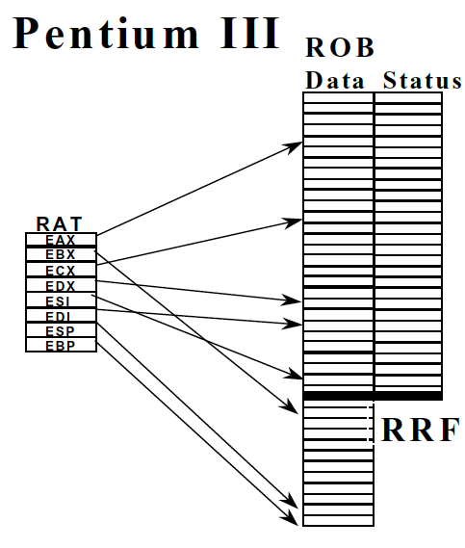
Reorder Buffer in Intel Pentium III
Boggs et al., “The Microarchitecture of the Pentium 4 Processor,” Intel Technology Journal, 2001.

Slide 23
Important: Register Renaming with a Reorder Buffer
Output and anti dependencies are not true dependencies
  WHY? The same register refers to values that have nothing to do with each other
  They exist due to lack of register ID’s (i.e. names) in the ISA
The register ID is renamed to the reorder buffer entry that will hold the register’s value
  Register ID → ROB entry ID
  Architectural register ID → Physical register ID
  After renaming, ROB entry ID used to refer to the register
This eliminates anti- and output- dependencies
  Gives the illusion that there are a large number of registers

Slide 24
Renaming Example
Assume
  Register file has pointers to reorder buffer if the register is not valid
  Reorder buffer works as described before
Where is the latest definition of R3 for each instruction below in sequential order?
  LD R0(0) → R3
  LD R3, R1 → R10
  MUL R1, R2 → R3
  MUL R3, R4 → R11
  ADD R5, R6 → R3
  ADD R7, R8 → R12

Slide 25
Reorder Buffer Storage Cost
Idea: Reduce reorder buffer entry storage by specializing for instruction types
Do all instructions need all fields?
Can you reuse some fields between instructions?
Can you implement separate buffers per instruction type?
  LD, ST, BR, ALU
V
DestRegID
DestRegVal
StoreAddr
StoreData
PC/IP
Control/valid bits
Exc?

Slide 26
In-Order Pipeline with Reorder Buffer
Decode (D): Access regfile/ROB, allocate entry in ROB, check if instruction can execute, if so dispatch instruction
Execute (E): Instructions can complete out-of-order
Completion (R): Write result to reorder buffer
Retirement/Commit (W): Check for exceptions; if none, write result to architectural register file or memory; else, flush pipeline and start from exception handler
In-order dispatch/execution, out-of-order completion, in-order retirement
E
Integer add
Integer mul
E
E
E
E
R
W
F
D
FP mul
E
E
E
E
E
E
E
E
R
. . .
E
E
E
E
E
E
E
E
Load/store

Slide 27
Reorder Buffer Tradeoffs
Advantages
  Conceptually simple for supporting precise exceptions
  Can eliminate false dependencies
Disadvantages
  Reorder buffer needs to be accessed to get the results that are yet to be written to the register file
    CAM or indirection → increased latency and complexity
Other solutions aim to eliminate the disadvantages
  History buffer
  Future file
  Checkpointing

Slide 28
Solution II: History Buffer (HB)
Idea: Update the register file when instruction completes, but UNDO UPDATES when an exception occurs
When instruction is decoded, it reserves an HB entry
When the instruction completes, it stores the old value of its destination in the HB
When instruction is oldest and no exceptions/interrupts, the HB entry discarded
When instruction is oldest and an exception needs to be handled, old values in the HB are written back into the architectural state from tail to head

Slide 29
History Buffer
Advantage:
  Register file contains up-to-date values for incoming instructions → History buffer access not on critical path
Disadvantage:
  Need to read the old value of the destination register
  Need to unwind the history buffer upon an exception → increased exception/interrupt handling latency
Func Unit
Instruction
Cache
Register
File
History
Buffer
Func Unit
Func Unit
Used only on exceptions

Slide 30
Comparison of Two Approaches
Reorder buffer
  Pessimistic register file update
  Update only with non-speculative values (in program order)
  Leads to complexity/delay in accessing the new values
History buffer
  Optimistic register file update
  Update immediately, but log the old value for recovery
  Leads to complexity/delay in logging old values
Can we get the best of both worlds?
  Principle: Heterogeneity
  Idea: Have both types of register files

Slide 31
Solution III: Future File (FF) + ROB
Idea: Keep two register files (speculative and architectural)
  Arch reg file: Updated in program order for precise exceptions
    Use a reorder buffer to ensure in-order updates
  Future reg file: Updated as soon as an instruction completes (if the instruction is the youngest one to write to a register)
Future file is used for fast access to latest register values (speculative state)
  Frontend register file
Architectural file is used for state recovery on exceptions (architectural state)
  Backend register file

Slide 32
Future File
Advantage
  No need to read the new values from the ROB (no CAM or indirection) or the old value of destination register
Disadvantage
  Multiple register files
  Need to copy arch. reg. file to future file on an exception
Func Unit
Instruction
Cache
Future
File
Arch.
File
Func Unit
ROB
Data and Tag
V
Func Unit
Used only on exceptions

Slide 33
In-Order Pipeline with Future File and Reorder Buffer
Decode (D): Access future file, allocate entry in ROB, check if instruction can execute, if so dispatch instruction
Execute (E): Instructions can complete out-of-order
Completion (R): Write result to reorder buffer and future file
Retirement/Commit (W): Check for exceptions; if none, write result to architectural register file or memory; else, flush pipeline, copy architectural file to future file, and start from exception handler
In-order dispatch/execution, out-of-order completion, in-order retirement
E
Integer add
Integer mul
E
E
E
E
R
W
F
D
FP mul
E
E
E
E
E
E
E
E
. . .
E
E
E
E
E
E
E
E
Load/store

Slide 34
Can We Reduce the Overhead of Two Register Files?
Idea: Use indirection, i.e., pointers to data in frontend and retirement
  Have a single storage that stores register data values
  Keep two register maps (speculative and architectural); also called register alias tables (RATs)
Future map used for fast access to latest register values (speculative state)
  Frontend register map
Architectural map is used for state recovery on exceptions (architectural state)
  Backend register map
  Convert fontend

Slide 35
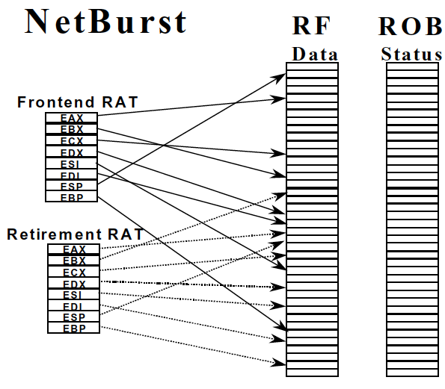
Future Map in Intel Pentium 4
Boggs et al., “The Microarchitecture of the Pentium 4 Processor,” Intel Technology Journal, 2001.
Many modern
processors
are similar:
MIPS R10K
Alpha 21264

Slide 36
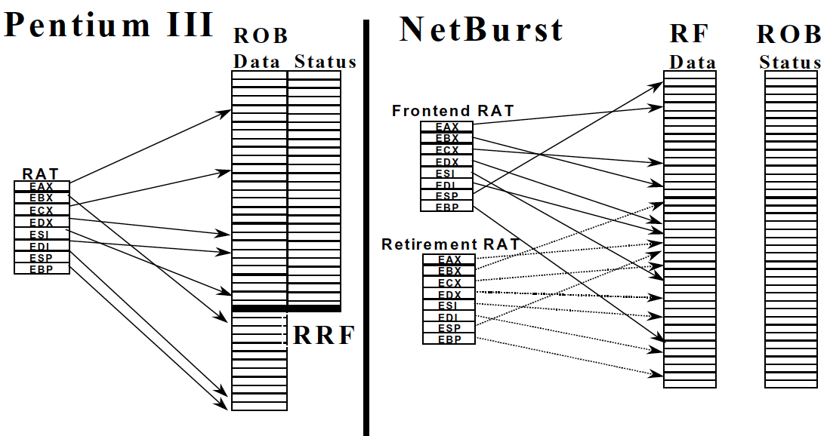
Reorder Buffer vs. Future Map Comparison

Slide 37
Before We Get to Checkpointing …
Let’s cover what happens on exceptions
And branch mispredictions

Slide 38
Checking for and Handling Exceptions in Pipelining
When the oldest instruction ready-to-be-retired is detected to have caused an exception, the control logic
  Recovers architectural state (register file, IP, and memory)
  Flushes all younger instructions in the pipeline
  Saves IP and registers (as specified by the ISA)
  Redirects the fetch engine to the exception handling routine
    Vectored exceptions

Slide 39
Pipelining Issues: Branch Mispredictions
A branch misprediction resembles an “exception”
  Except it is not visible to software (i.e., it is microarchitectural)
What about branch misprediction recovery?
  Similar to exception handling except can be initiated before the branch is the oldest instruction (not architectural)
  All three state recovery methods can be used
Difference between exceptions and branch mispredictions?
  Branch mispredictions are much more common
  → need fast state recovery to minimize performance impact of mispredictions

Slide 40
How Fast Is State Recovery?
Latency of state recovery affects
  Exception service latency
  Interrupt service latency
  Latency to supply the correct data to instructions fetched after a branch misprediction
Which ones above need to be fast?
How do the three state maintenance methods fare in terms of recovery latency?
  Reorder buffer
  History buffer
  Future file

Slide 41
Branch State Recovery Actions and Latency
Reorder Buffer
  Flush instructions in pipeline younger than the branch
  Finish all instructions in the reorder buffer
History buffer
  Flush instructions in pipeline younger than the branch
  Undo all instructions after the branch by rewinding from the tail of the history buffer until the branch & restoring old values one by one into the register file
Future file
  Wait until branch is the oldest instruction in the machine
  Copy arch. reg. file to future file
  Flush entire pipeline

Slide 42
Can We Do Better?
Goal: Restore the frontend state (future file) such that the correct next instruction after the branch can execute right away after the branch misprediction is resolved
Idea: Checkpoint the frontend register state/map at the time a branch is decoded and keep the checkpointed state updated with results of instructions older than the branch
  Upon branch misprediction, restore the checkpoint associated with the branch
  Hwu and Patt, “Checkpoint Repair for Out-of-order Execution Machines,” ISCA 1987.

Slide 43
Checkpointing
When a branch is decoded
  Make a copy of the future file/map and associate it with the branch
When an instruction produces a register value
  All future file/map checkpoints that are younger than the instruction are updated with the value
When a branch misprediction is detected
  Restore the checkpointed future file/map for the mispredicted branch when the branch misprediction is resolved
  Flush instructions in pipeline younger than the branch
  Deallocate checkpoints younger than the branch

Slide 44
Checkpointing
Advantages
  Correct frontend register state available right after checkpoint restoration → Low state recovery latency
  …
Disadvantages
  Storage overhead
  Complexity in managing checkpoints
  …

Slide 45
Many Modern Processors Use Checkpointing
MIPS R10000
Alpha 21264
Pentium 4
Yeager, “The MIPS R10000 Superscalar Microprocessor,” IEEE Micro, April 1996
Kessler, “The Alpha 21264 Microprocessor,” IEEE Micro, March-April 1999.
Boggs et al., “The Microarchitecture of the Pentium 4 Processor,” Intel Technology Journal, 2001.

Slide 46
Summary: Maintaining Precise State
Reorder buffer
History buffer
Future register file
Checkpointing
Readings
  Smith and Plezskun, “Implementing Precise Interrupts in Pipelined Processors,” IEEE Trans on Computers 1988 and ISCA 1985.
  Hwu and Patt, “Checkpoint Repair for Out-of-order Execution Machines,” ISCA 1987.

Slide 47
Registers versus Memory
So far, we considered mainly registers as part of state
What about memory?
What are the fundamental differences between registers and memory?
  Register dependences known statically – memory dependences determined dynamically
  Register state is small – memory state is large
  Register state is not visible to other threads/processors – memory state is shared between threads/processors (in a shared memory multiprocessor)

Slide 48
We did not cover the following slides in lecture. These are for your preparation for the next lecture.

Slide 49
Maintaining Speculative Memory State: Stores
Handling out-of-order completion of memory operations
  UNDOing a memory write more difficult than UNDOing a register write. Why?
  One idea: Keep store address/data in reorder buffer
    How does a load instruction find its data?
  Store/write buffer: Similar to reorder buffer, but used only for store instructions
    Program-order list of un-committed store operations
    When store is decoded: Allocate a store buffer entry
    When store address and data become available: Record in store buffer entry
    When the store is the oldest instruction in the pipeline: Update the memory address (i.e. cache) with store data
We will get back to this!

