Slide 1
18-447
Computer Architecture
Lecture 13: Out-of-Order Execution and Data Flow
Prof. Onur Mutlu
Carnegie Mellon University
Spring 2015, 2/16/2015

Slide 2
Agenda for Today & Next Few Lectures
Single-cycle Microarchitectures
Multi-cycle and Microprogrammed Microarchitectures
Pipelining
Issues in Pipelining: Control & Data Dependence Handling, State Maintenance and Recovery, …
Out-of-Order Execution
Issues in OoO Execution: Load-Store Handling, …
Alternative Approaches to Instruction Level Parallelism

Slide 3
Reminder: Announcements
Lab 3 due this Friday (Feb 20)
  Pipelined MIPS
  Competition for high performance
    You can optimize both cycle time and CPI
    Document and clearly describe what you do during check-off
Homework 3 due Feb 25
  A lot of questions that enable you to learn the concepts via hands-on exercise
  Remember this is all for your benefit (to learn and prepare for exams)
    HWs have very little contribution to overall grade
    Solutions to almost all questions are online anyway

Slide 4
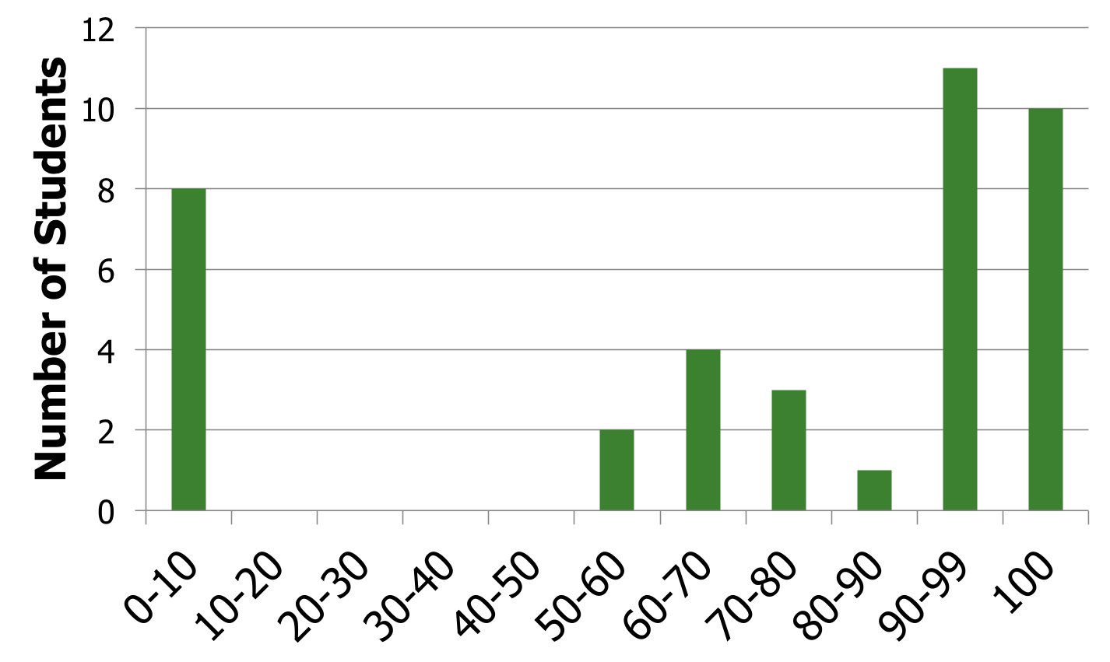
Lab 2 Grade Distribution
Avg 70.5
Med 96.9
Stdev 39.1
Max 100
Min 50.8

Slide 5
Lab 2 Extra Credits
Complete and correct:
  Terence An
  Jared Choi
Almost correct:
  Pete Ehrett
  Xiaofan Li
  Amanda Marano
  Ashish Shrestha
Almost-1 correct:
  Sohil Shah

Slide 6
Readings Specifically for Today
Smith and Sohi, “The Microarchitecture of Superscalar Processors,” Proceedings of the IEEE, 1995
  More advanced pipelining
  Interrupt and exception handling
  Out-of-order and superscalar execution concepts
Kessler, “The Alpha 21264 Microprocessor,” IEEE Micro 1999.

Slide 7
Readings for Next Lecture
SIMD Processing
Basic GPU Architecture
Other execution models: VLIW, DAE, Systolic Arrays
Lindholm et al., "NVIDIA Tesla: A Unified Graphics and Computing Architecture," IEEE Micro 2008.
Fatahalian and Houston, “A Closer Look at GPUs,” CACM 2008.

Slide 8
Recap of Last Lecture
Maintaining Speculative Memory State (Ld/St Ordering)
Out of Order Execution (Dynamic Scheduling)
  Link Dependent Instructions: Renaming
  Buffer Instructions: Reservation Stations
  Track Readiness of Source Values: Tag (and Value) Broadcast
  Schedule/Dispatch: Wakeup and Select
Tomasulo’s Algorithm
OoO Execution Exercise with Code Example: Cycle by Cycle
OoO Execution with Precise Exceptions
Questions on OoO Implementation
  Where data is stored? Single physical register file vs. reservation stations
  Critical path, renaming IDs, …
OoO Execution as Restricted Data Flow
Reverse Engineering the Data Flow Graph

Slide 9
Review: In-order vs. Out-of-order Dispatch
In order dispatch + precise exceptions:
Out-of-order dispatch + precise exceptions:
16 vs. 12 cycles
F
D
E
E
E
E
R
W
IMUL R3 ← R1, R2
ADD R3 ← R3, R1
ADD R1 ← R6, R7
IMUL R5 ← R6, R8
ADD R7 ← R3, R5
F
D
STALL
E
R
W
F
STALL
D
E
R
W
F
D
E
E
E
E
E
R
W
F
D
STALL
E
R
W
F
D
E
E
E
E
R
W
F
D
WAIT
E
R
W
This slide is actually correct
F
D
E
R
W
F
D
E
E
E
E
R
W
F
D
WAIT
E
R
W

Slide 10
Review: Out-of-Order Execution with Precise Exceptions
Hump 1: Reservation stations (scheduling window)
Hump 2: Reordering (reorder buffer, aka instruction window or active window)
TAG and VALUE Broadcast Bus
S
C
H
E
D
U
L
E
R
E
O
R
D
E
R
E
Integer add
Integer mul
F
D
E
E
E
E
W
FP mul
E
E
E
E
E
E
E
E
. . .
E
E
E
E
E
E
E
E
Load/store
in order
out of order
in order

Slide 11
Review: Enabling OoO Execution, Revisited
1. Link the consumer of a value to the producer
  Register renaming: Associate a “tag” with each data value
2. Buffer instructions until they are ready
  Insert instruction into reservation stations after renaming
3. Keep track of readiness of source values of an instruction
  Broadcast the “tag” when the value is produced
  Instructions compare their “source tags” to the broadcast tag → if match, source value becomes ready
4. When all source values of an instruction are ready, dispatch the instruction to functional unit (FU)
  Wakeup and select/schedule the instruction

Slide 12
Review: Summary of OOO Execution Concepts
Register renaming eliminates false dependencies, enables linking of producer to consumers
Buffering enables the pipeline to move for independent ops
Tag broadcast enables communication (of readiness of produced value) between instructions
Wakeup and select enables out-of-order dispatch

Slide 13

Review: Our Example
MUL R3 ← R1, R2
ADD R5 ← R3, R4
ADD R7 ← R2, R6
ADD R10 ← R8, R9
MUL R11 ← R7, R10
ADD R5 ← R5, R11

Slide 14
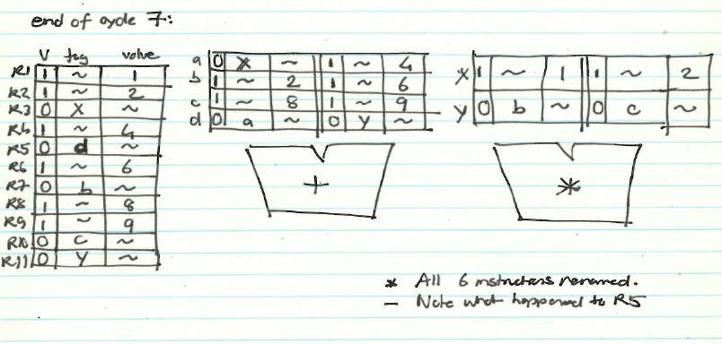
Review: State of RAT and RS in Cycle 7
All our in-class drawings are at:
http://www.ece.cmu.edu/~ece447/s15/lib/exe/fetch.php?media=447_tomasulo.pdf

Slide 15
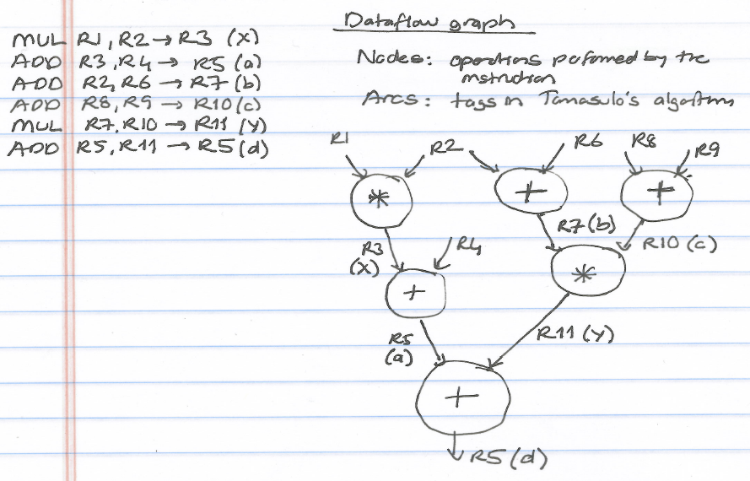
Review: Corresponding Dataflow Graph

Slide 16
Restricted Data Flow
An out-of-order machine is a “restricted data flow” machine
  Dataflow-based execution is restricted to the microarchitecture level
  ISA is still based on von Neumann model (sequential execution)
Remember the data flow model (at the ISA level):
  Dataflow model: An instruction is fetched and executed in data flow order
  i.e., when its operands are ready
  i.e., there is no instruction pointer
  Instruction ordering specified by data flow dependence
    Each instruction specifies “who” should receive the result
    An instruction can “fire” whenever all operands are received

Slide 17
Review: OOO Execution: Restricted Dataflow
An out-of-order engine dynamically builds the dataflow graph of a piece of the program
  which piece?
The dataflow graph is limited to the instruction window
  Instruction window: all decoded but not yet retired instructions
Can we do it for the whole program?
Why would we like to?
In other words, how can we have a large instruction window?
Can we do it efficiently with Tomasulo’s algorithm?

Slide 18
Questions to Ponder
Why is OoO execution beneficial?
  What if all operations take single cycle?
  Latency tolerance: OoO execution tolerates the latency of multi-cycle operations by executing independent operations concurrently
What if an instruction takes 500 cycles?
  How large of an instruction window do we need to continue decoding?
  How many cycles of latency can OoO tolerate?
  What limits the latency tolerance scalability of Tomasulo’s algorithm?
    Active/instruction window size: determined by both scheduling window and reorder buffer size

Slide 19
Registers versus Memory, Revisited
So far, we considered register based value communication between instructions
What about memory?
What are the fundamental differences between registers and memory?
  Register dependences known statically – memory dependences determined dynamically
  Register state is small – memory state is large
  Register state is not visible to other threads/processors – memory state is shared between threads/processors (in a shared memory multiprocessor)

Slide 20
Memory Dependence Handling (I)
Need to obey memory dependences in an out-of-order machine
  and need to do so while providing high performance
Observation and Problem: Memory address is not known until a load/store executes
Corollary 1: Renaming memory addresses is difficult
Corollary 2: Determining dependence or independence of loads/stores need to be handled after their (partial) execution
Corollary 3: When a load/store has its address ready, there may be younger/older loads/stores with undetermined addresses in the machine

Slide 21
Memory Dependence Handling (II)
When do you schedule a load instruction in an OOO engine?
  Problem: A younger load can have its address ready before an older store’s address is known
  Known as the memory disambiguation problem or the unknown address problem
Approaches
  Conservative: Stall the load until all previous stores have computed their addresses (or even retired from the machine)
  Aggressive: Assume load is independent of unknown-address stores and schedule the load right away
  Intelligent: Predict (with a more sophisticated predictor) if the load is dependent on the/any unknown address store

Slide 22
Handling of Store-Load Dependences
A load’s dependence status is not known until all previous store addresses are available.
How does the OOO engine detect dependence of a load instruction on a previous store?
  Option 1: Wait until all previous stores committed (no need to check for address match)
  Option 2: Keep a list of pending stores in a store buffer and check whether load address matches a previous store address
How does the OOO engine treat the scheduling of a load instruction wrt previous stores?
  Option 1: Assume load dependent on all previous stores
  Option 2: Assume load independent of all previous stores
  Option 3: Predict the dependence of a load on an outstanding store

Slide 23
Memory Disambiguation (I)
Option 1: Assume load dependent on all previous stores
+ No need for recovery
-- Too conservative: delays independent loads unnecessarily
Option 2: Assume load independent of all previous stores
+ Simple and can be common case: no delay for independent loads
-- Requires recovery and re-execution of load and dependents on misprediction
Option 3: Predict the dependence of a load on an outstanding store
+ More accurate. Load store dependencies persist over time
-- Still requires recovery/re-execution on misprediction
  Alpha 21264 : Initially assume load independent, delay loads found to be dependent
  Moshovos et al., “Dynamic speculation and synchronization of data dependences,” ISCA 1997.
  Chrysos and Emer, “Memory Dependence Prediction Using Store Sets,” ISCA 1998.

Slide 24
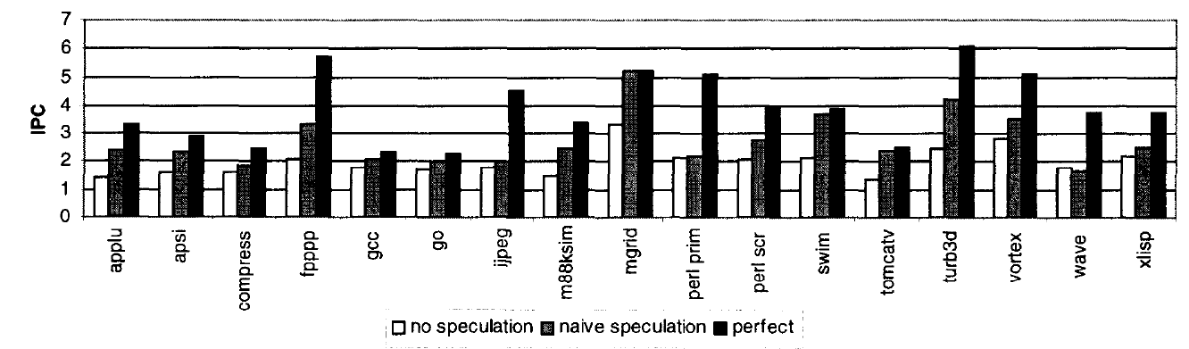
Memory Disambiguation (II)
  Chrysos and Emer, “Memory Dependence Prediction Using Store Sets,” ISCA 1998.
  Predicting store-load dependencies important for performance
  Simple predictors (based on past history) can achieve most of the potential performance

Slide 25
Data Forwarding Between Stores and Loads
We cannot update memory out of program order
→ Need to buffer all store and load instructions in instruction window
Even if we know all addresses of past stores when we generate the address of a load, two questions still remain:
  1. How do we check whether or not it is dependent on a store
  2. How do we forward data to the load if it is dependent on a store
Modern processors use a LQ (load queue) and an SQ for this
  Can be combined or separate between loads and stores
  A load searches the SQ after it computes its address. Why?
  A store searches the LQ after it computes its address. Why?

Slide 26
Food for Thought for You
Many other design choices
Should reservation stations be centralized or distributed across functional units?
  What are the tradeoffs?
Should reservation stations and ROB store data values or should there be a centralized physical register file where all data values are stored?
  What are the tradeoffs?
Exactly when does an instruction broadcast its tag?
…

Slide 27
More Food for Thought for You
How can you implement branch prediction in an out-of-order execution machine?
  Think about branch history register and PHT updates
  Think about recovery from mispredictions
    How to do this fast?
How can you combine superscalar execution with out-of-order execution?
  These are different concepts
  Concurrent renaming of instructions
  Concurrent broadcast of tags
How can you combine superscalar + out-of-order + branch prediction?

Slide 28
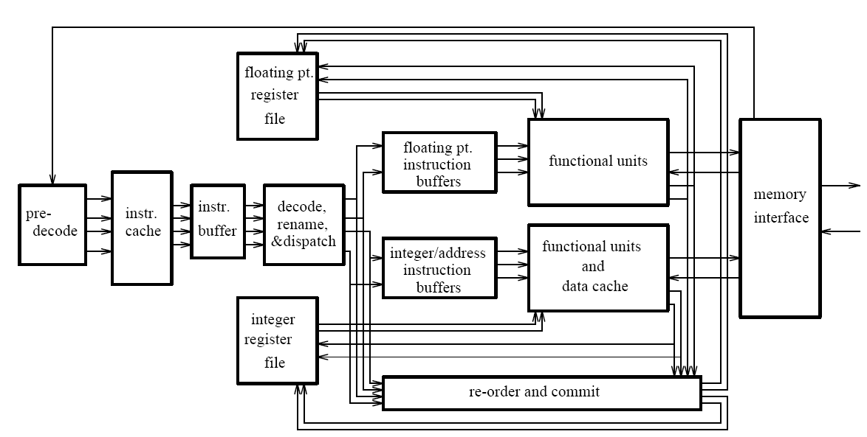
General Organization of an OOO Processor
  Smith and Sohi, “The Microarchitecture of Superscalar Processors,” Proc. IEEE, Dec. 1995.

Slide 29
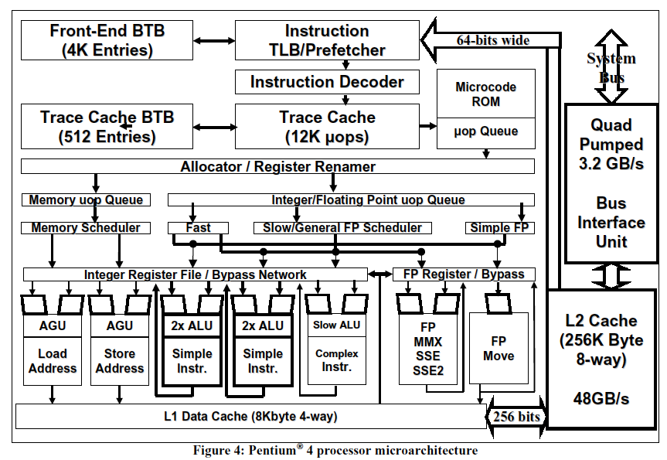
A Modern OoO Design: Intel Pentium 4
Boggs et al., “The Microarchitecture of the Pentium 4 Processor,” Intel Technology Journal, 2001.

Slide 30
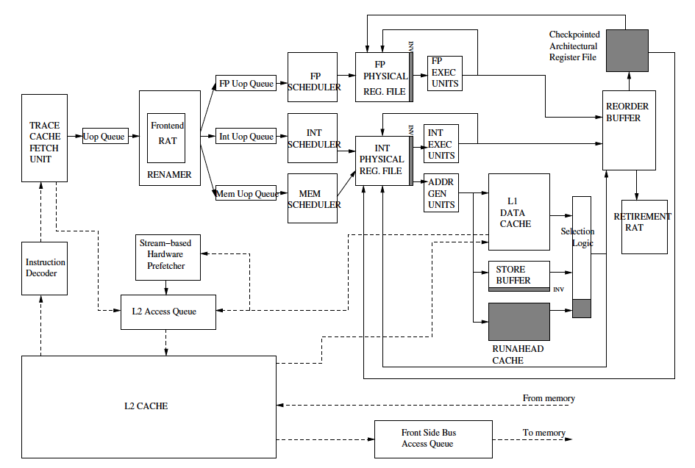
Intel Pentium 4 Simplified
Mutlu+, “Runahead Execution,”
HPCA 2003.

Slide 31
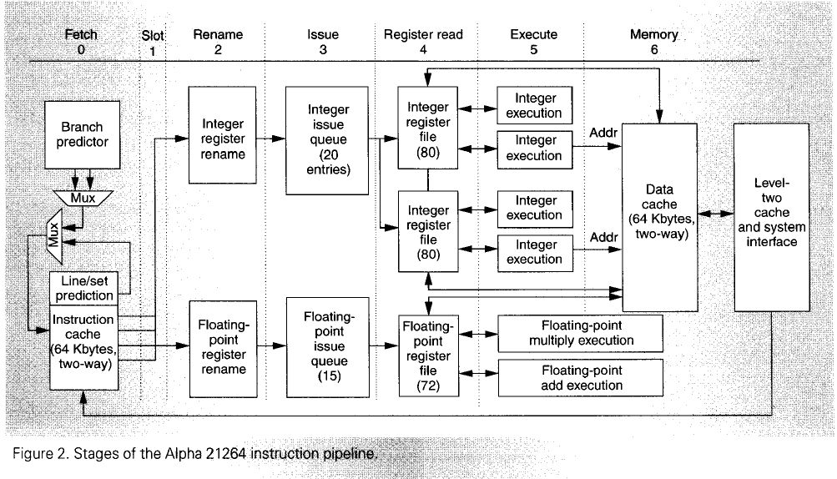
Alpha 21264
Kessler, “The Alpha 21264 Microprocessor,” IEEE Micro, March-April 1999.

Slide 32
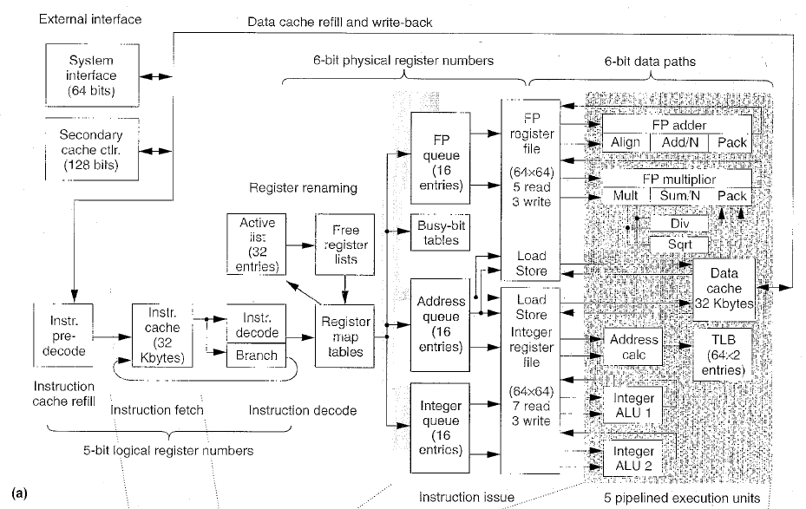
MIPS R10000
Yeager, “The MIPS R10000 Superscalar Microprocessor,” IEEE Micro, April 1996

Slide 33
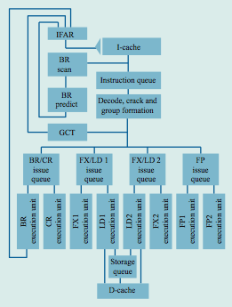
IBM POWER4
Tendler et al., “POWER4 system microarchitecture,” IBM J R&D, 2002.

Slide 34
IBM POWER4
2 cores, out-of-order execution
100-entry instruction window in each core
8-wide instruction fetch, issue, execute
Large, local+global hybrid branch predictor
1.5MB, 8-way L2 cache
Aggressive stream based prefetching

Slide 35
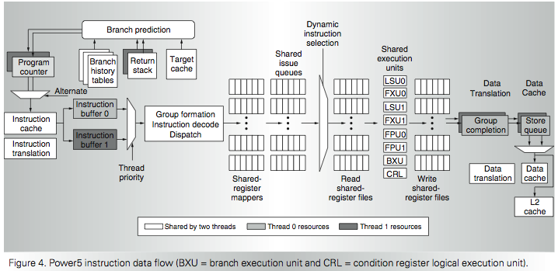
IBM POWER5
  Kalla et al., “IBM Power5 Chip: A Dual-Core Multithreaded Processor,” IEEE Micro 2004.

Slide 36
Recommended Readings
Out-of-order execution processor designs
Kessler, “The Alpha 21264 Microprocessor,” IEEE Micro, March-April 1999.
Boggs et al., “The Microarchitecture of the Pentium 4 Processor,” Intel Technology Journal, 2001.
Yeager, “The MIPS R10000 Superscalar Microprocessor,” IEEE Micro, April 1996
Tendler et al., “POWER4 system microarchitecture,” IBM Journal of Research and Development, January 2002.

Slide 37
And More Readings…
Stark et al., “On Pipelining Dynamic Scheduling Logic,” MICRO 2000.
Brown et al., “Select-free Instruction Scheduling Logic,” MICRO 2001.
Palacharla et al., “Complexity-effective Superscalar Processors,” ISCA 1997.

Slide 38
Other Approaches to Concurrency (or Instruction Level Parallelism)

Slide 39
Approaches to (Instruction-Level) Concurrency
Pipelining
Out-of-order execution
Dataflow (at the ISA level)
SIMD Processing (Vector and array processors, GPUs)
VLIW
Decoupled Access Execute
Systolic Arrays

Slide 40
Data Flow:
Exploiting Irregular Parallelism

Slide 41
Remember: State of RAT and RS in Cycle 7

Slide 42
Remember: Dataflow Graph

Slide 43
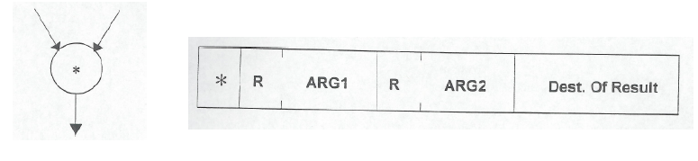
Review: More on Data Flow
In a data flow machine, a program consists of data flow nodes
  A data flow node fires (fetched and executed) when all it inputs are ready
    i.e. when all inputs have tokens
Data flow node and its ISA representation

Slide 44
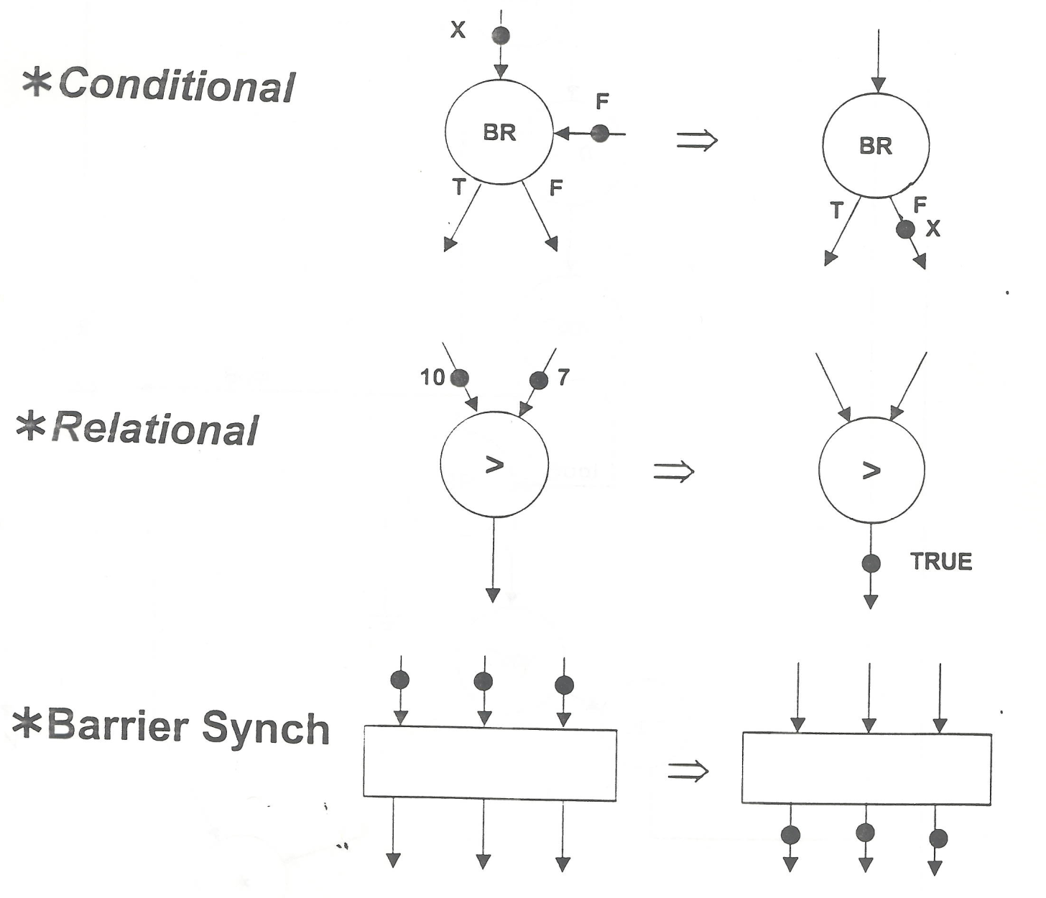
Data Flow Nodes

Slide 45
Dataflow Nodes (II)
A small set of dataflow operators can be used to define a general programming language
Fork
Primitive Ops
Switch
Merge
+
T
T
T
F
T
F
⇒
+
T
T
T
F
T
F

Slide 46
Dataflow Graphs
{x = a + b;
y = b * 7
in
(x-y) * (x+y)}
b
a
1
+
2
*7
Values in dataflow graphs are represented as tokens
An operator executes when all its input tokens are present; copies of the result token are distributed to the destination operators
x
ip = 3
p = L
y
token
< ip , p , v >
3
-
4
+
instruction ptr
port
data
5
*
no separate control flow

Slide 47
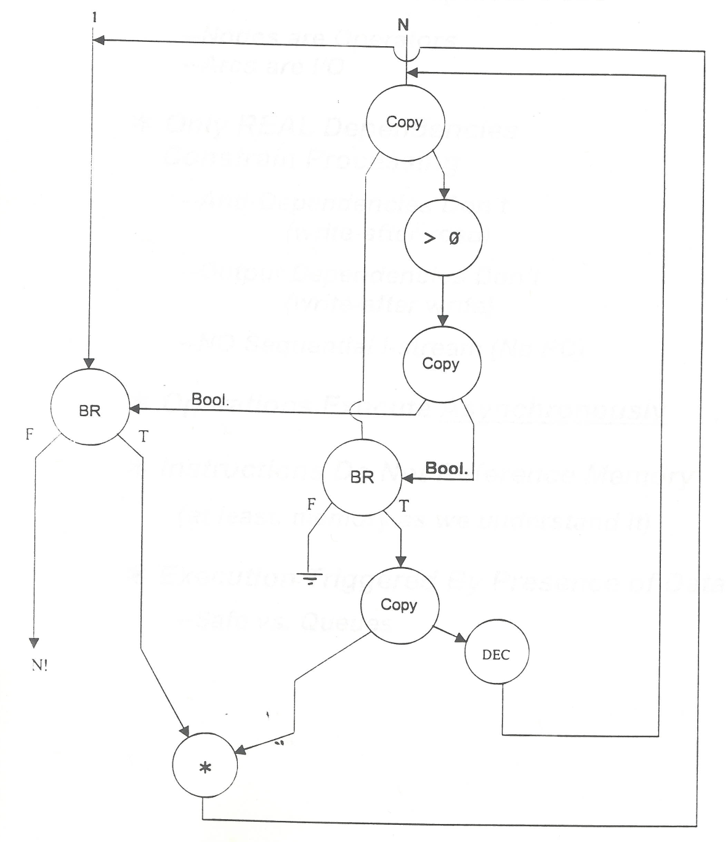
Example Data Flow Program
OUT

Slide 48
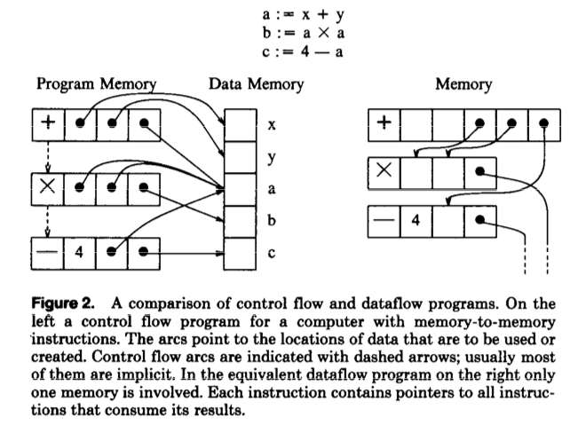
Control Flow vs. Data Flow

Slide 49
Data Flow Characteristics
Data-driven execution of instruction-level graphical code
  Nodes are operators
  Arcs are data (I/O)
  As opposed to control-driven execution
Only real dependencies constrain processing
No sequential instruction stream
  No program counter
Execution triggered by the presence/readiness of data
Operations execute asynchronously

Slide 50
What About Loops and Function Calls?
Problem: Multiple dynamic instances can be active for the same instruction (i.e., due to loop iteration or invocation of function from different location)
IP is not enough to distinguish between these different dynamic instances of the same static instruction
Solution: Distinguish between different instances by creating new tags/frames (at the beginning of new iteration or call)
token
< ip , p , v >
instruction ptr
port
data
a tagged token
<fp, ip, port, data>
frame
pointer
(tag or context ID)
instruction pointer

Slide 51
An Example Frame and Execution
1
+
1
3L, 4L
Program
a
b
2
*
2
3R, 4R
3
-
3
5L
1
+
2
*7
4
+
4
5R
5
x
*
5
out
<fp, ip, p , v>
y
3
-
4
+
1
2
3
L
7
*
5
4
Frame
5
Need to provide storage for only one operand/operator

Slide 52
Monsoon Dataflow Processor [ISCA 1990]
op
r
d1,d2
Instruction
Fetch
ip
Code
fp+r
Operand
Fetch
Token
Queue
Frames
ALU
Form
Token
Network
Network

Slide 53
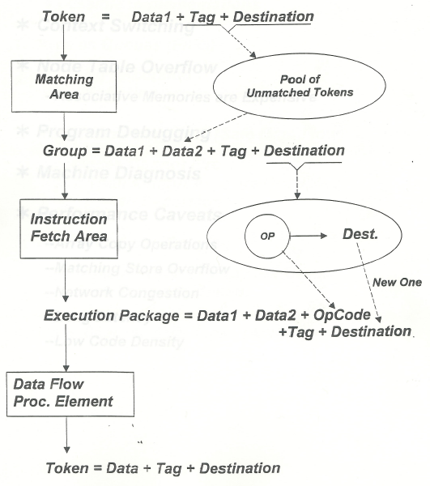
A Dataflow Processor

Slide 54
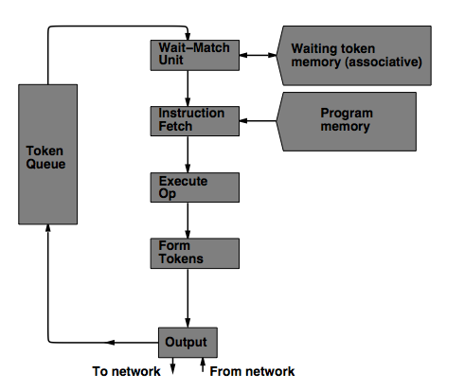
MIT Tagged Token Data Flow Architecture
Wait−Match Unit: try to match incoming token and context id and a waiting token with same instruction address
  Success: Both tokens forwarded, fetch instruction
  Fail: Incoming token stored in Waiting Token Memory, bubble inserted

Slide 55
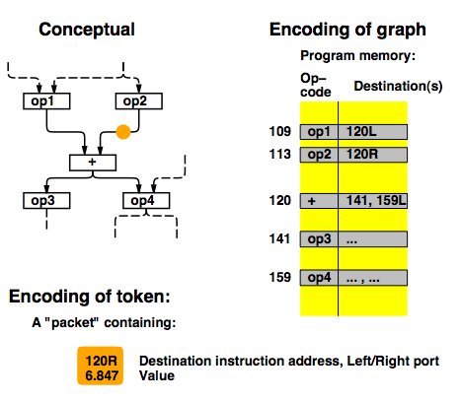
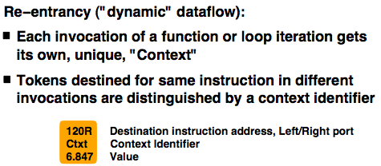
TTDA Data Flow Example

Slide 56
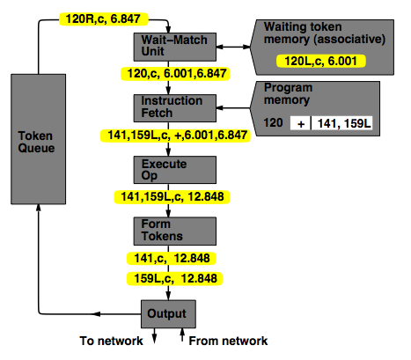
TTDA Data Flow Example

Slide 57
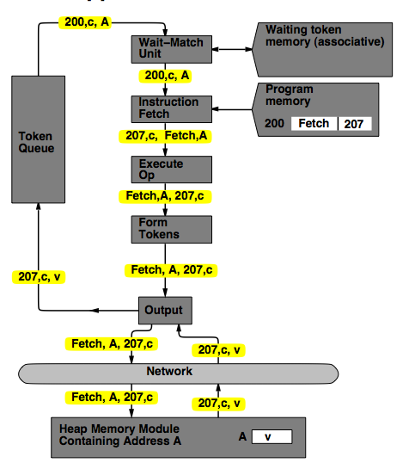
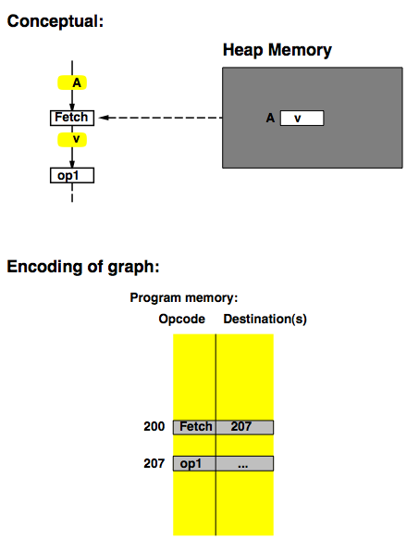
TTDA Data Flow Example

Slide 58
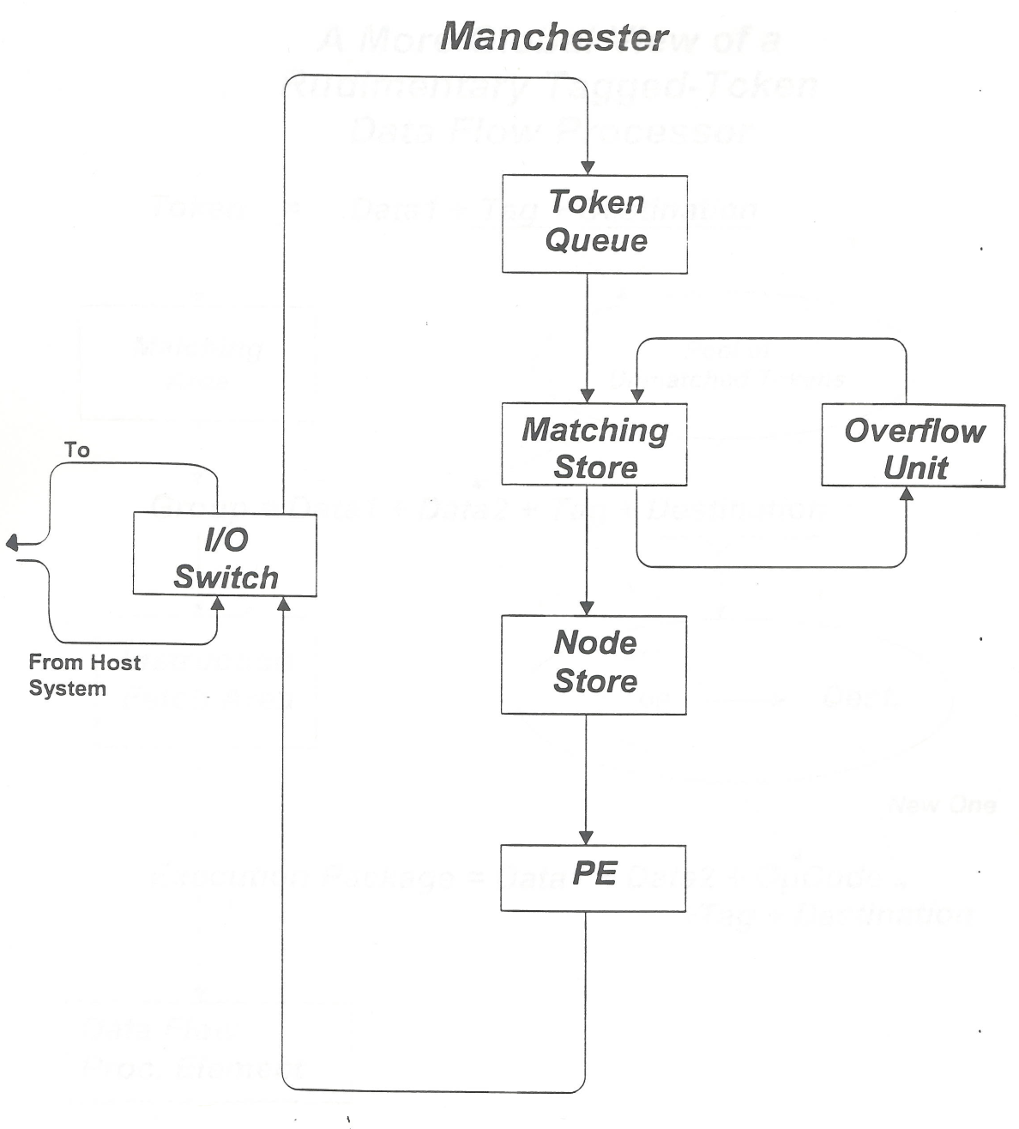
Manchester Data Flow Machine
Matching Store: Pairs together tokens destined for the same instruction
Large data set → overflow in overflow unit
Paired tokens fetch the appropriate instruction from the node store

Slide 59
Data Flow Advantages/Disadvantages
Advantages
  Very good at exploiting irregular parallelism
  Only real dependencies constrain processing
Disadvantages
  Debugging difficult (no precise state)
    Interrupt/exception handling is difficult (what is precise state semantics?)
  Implementing dynamic data structures difficult in pure data flow models
  Too much parallelism? (Parallelism control needed)
  High bookkeeping overhead (tag matching, data storage)
  Instruction cycle is inefficient (delay between dependent instructions), memory locality is not exploited

Slide 60
Combining Data Flow and Control Flow
Can we get the best of both worlds?
Two possibilities
  Model 1: Keep control flow at the ISA level, do dataflow underneath, preserving sequential semantics
  Model 2: Keep dataflow model, but incorporate some control flow at the ISA level to improve efficiency, exploit locality, and ease resource management
    Incorporate threads into dataflow: statically ordered instructions; when the first instruction is fired, the remaining instructions execute without interruption

Slide 61
Data Flow Summary
Availability of data determines order of execution
A data flow node fires when its sources are ready
Programs represented as data flow graphs (of nodes)
Data Flow at the ISA level has not been (as) successful
Data Flow implementations under the hood (while preserving sequential ISA semantics) have been very successful
  Out of order execution
  Hwu and Patt, “HPSm, a high performance restricted data flow architecture having minimal functionality,” ISCA 1986.

Slide 62
Further Reading on Data Flow
  ISA level dataflow
    Gurd et al., “The Manchester prototype dataflow computer,” CACM 1985.
  Microarchitecture-level dataflow:
  Patt, Hwu, Shebanow, “HPS, a new microarchitecture: rationale and introduction,” MICRO 1985.
  Patt et al., “Critical issues regarding HPS, a high performance microarchitecture,” MICRO 1985.
    Hwu and Patt, “HPSm, a high performance restricted data flow architecture having minimal functionality,” ISCA 1986.

