Slide 1
18-447
Computer Architecture
Lecture 14: SIMD Processing
(Vector and Array Processors)
Prof. Onur Mutlu
Carnegie Mellon University
Spring 2015, 2/18/2015

Slide 2
Agenda for Today & Next Few Lectures
Single-cycle Microarchitectures
Multi-cycle and Microprogrammed Microarchitectures
Pipelining
Issues in Pipelining: Control & Data Dependence Handling, State Maintenance and Recovery, …
Out-of-Order Execution
Issues in OoO Execution: Load-Store Handling, …
Alternative Approaches to Instruction Level Parallelism

Slide 3
Approaches to (Instruction-Level) Concurrency
Pipelining
Out-of-order execution
Dataflow (at the ISA level)
SIMD Processing (Vector and array processors, GPUs)
VLIW
Decoupled Access Execute
Systolic Arrays

Slide 4
Reminder: Announcements
Lab 3 due this Friday (Feb 20)
  Pipelined MIPS
  Competition for high performance
    You can optimize both cycle time and CPI
    Document and clearly describe what you do during check-off
Homework 3 due Feb 25
  A lot of questions that enable you to learn the concepts via hands-on exercise
  Remember this is all for your benefit (to learn and prepare for exams)
    HWs have very little contribution to overall grade
    Solutions to almost all questions are online anyway
    But I would still like you to do them (for your benefit)!

Slide 5
Homework 3.1: Feedback Form
Due Monday Feb 23
I would like your feedback on the course
Easy to fill in
Can submit anonymously, if you wish
Worth 0.25% of your grade
Need to get checked off after submitting to get your grade points
  Can email
  If anonymous, show that you are turning in and have a TA check you off

Slide 6
Readings for Today
Lindholm et al., "NVIDIA Tesla: A Unified Graphics and Computing Architecture," IEEE Micro 2008.
Fatahalian and Houston, “A Closer Look at GPUs,” CACM 2008.

Slide 7
Recap of Last Lecture
OoO Execution as Restricted Data Flow
Memory Disambiguation or Unknown Address Problem
Memory Dependence Handling
  Conservative, Aggressive, Intelligent Approaches
Load Store Queues
Design Choices in an OoO Processor
Combining OoO+Superscalar+Branch Prediction
Example OoO Processor Designs
Data Flow (at the ISA level) Approach to Concurrency
  Characteristics
  Supporting dynamic instances of a node: Tagging, Context IDs, Frames
  Example Operation
  Advantages and Disadvantages
  Combining Data Flow and Control Flow: Getting the Best of Both Worlds

Slide 8
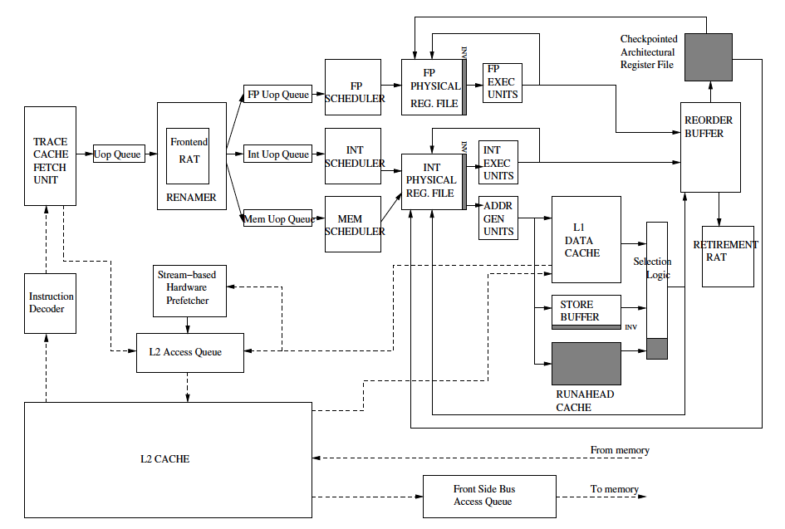
Reminder: Intel Pentium 4 Simplified
Mutlu+, “Runahead Execution,”
HPCA 2003.

Slide 9
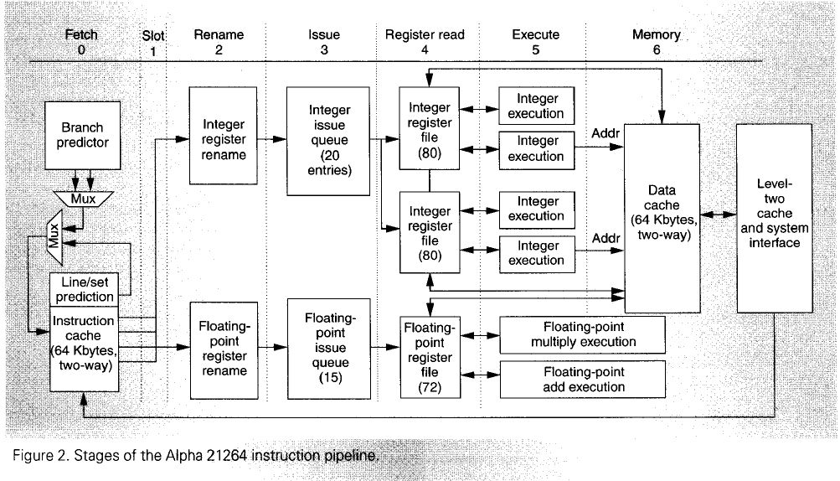
Reminder: Alpha 21264
Kessler, “The Alpha 21264 Microprocessor,” IEEE Micro, March-April 1999.

Slide 10
Review: Data Flow:
Exploiting Irregular Parallelism

Slide 11
Review: Pure Data Flow Pros and Cons
Advantages
  Very good at exploiting irregular parallelism
  Only real dependencies constrain processing
Disadvantages
  Debugging difficult (no precise state)
    Interrupt/exception handling is difficult (what is precise state semantics?)
  Implementing dynamic data structures difficult in pure data flow models
  Too much parallelism? (Parallelism control needed)
  High bookkeeping overhead (tag matching, data storage)
  Instruction cycle is inefficient (delay between dependent instructions), memory locality is not exploited

Slide 12
Review: Combining Data Flow and Control Flow
Can we get the best of both worlds?
Two possibilities
  Model 1: Keep control flow at the ISA level, do dataflow underneath, preserving sequential semantics
  Model 2: Keep dataflow model, but incorporate some control flow at the ISA level to improve efficiency, exploit locality, and ease resource management
    Incorporate threads into dataflow: statically ordered instructions; when the first instruction is fired, the remaining instructions execute without interruption in control flow order (e.g., one can pipeline them)

Slide 13
Review: Data Flow Summary
Data Flow at the ISA level has not been (as) successful
Data Flow implementations under the hood (while preserving sequential ISA semantics) have been very successful
  Out of order execution

Slide 14
Approaches to (Instruction-Level) Concurrency
Pipelining
Out-of-order execution
Dataflow (at the ISA level)
SIMD Processing (Vector and array processors, GPUs)
VLIW
Decoupled Access Execute
Systolic Arrays

Slide 15
SIMD Processing:
Exploiting Regular (Data) Parallelism

Slide 16
Flynn’s Taxonomy of Computers
Mike Flynn, “Very High-Speed Computing Systems,” Proc. of IEEE, 1966
SISD: Single instruction operates on single data element
SIMD: Single instruction operates on multiple data elements
  Array processor
  Vector processor
MISD: Multiple instructions operate on single data element
  Closest form: systolic array processor, streaming processor
MIMD: Multiple instructions operate on multiple data elements (multiple instruction streams)
  Multiprocessor
  Multithreaded processor

Slide 17
Data Parallelism
Concurrency arises from performing the same operations on different pieces of data
  Single instruction multiple data (SIMD)
  E.g., dot product of two vectors
Contrast with data flow
  Concurrency arises from executing different operations in parallel (in a data driven manner)
Contrast with thread (“control”) parallelism
  Concurrency arises from executing different threads of control in parallel
SIMD exploits instruction-level parallelism
  Multiple “instructions” (more appropriately, operations) are concurrent: instructions happen to be the same

Slide 18
SIMD Processing
Single instruction operates on multiple data elements
  In time or in space
Multiple processing elements
Time-space duality
  Array processor: Instruction operates on multiple data elements at the same time using different spaces
  Vector processor: Instruction operates on multiple data elements in consecutive time steps using the same space

Slide 19

Array vs. Vector Processors
ARRAY PROCESSOR
VECTOR PROCESSOR
Instruction Stream
Same op @ same time
LD VR ← A[3:0]
ADD VR ← VR, 1
MUL VR ← VR, 2
ST A[3:0] ← VR
Different ops @ time
LD0
LD1
LD2
LD3
LD0
AD0
AD1
AD2
AD3
LD1
AD0
MU0
MU1
MU2
MU3
LD2
AD1
MU0
ST0
ST1
ST2
ST3
LD3
AD2
MU1
ST0
Different ops @ same space
AD3
MU2
ST1
MU3
ST2
Time
Same op @ space
ST3
Space
Space

Slide 20
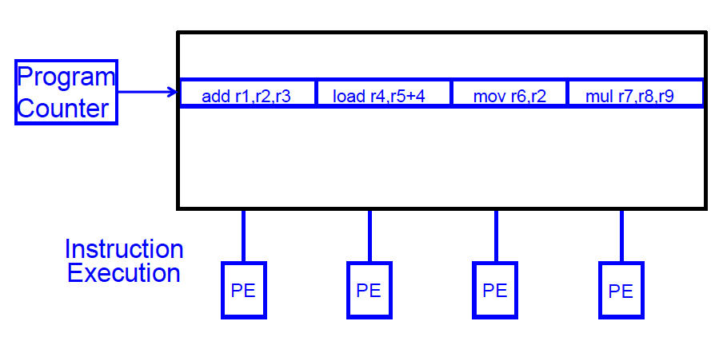
SIMD Array Processing vs. VLIW
VLIW: Multiple independent operations packed together by the compiler

Slide 21
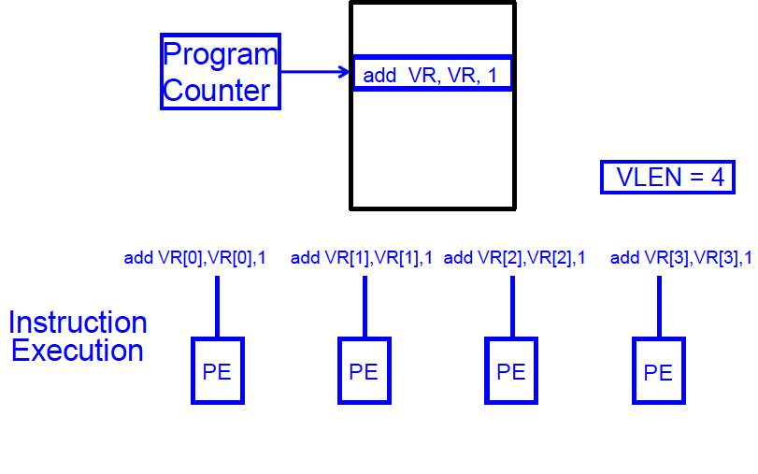
SIMD Array Processing vs. VLIW
Array processor: Single operation on multiple (different) data elements

Slide 22
Vector Processors
A vector is a one-dimensional array of numbers
Many scientific/commercial programs use vectors
    for (i = 0; i<=49; i++)
    C[i] = (A[i] + B[i]) / 2
A vector processor is one whose instructions operate on vectors rather than scalar (single data) values
Basic requirements
  Need to load/store vectors → vector registers (contain vectors)
  Need to operate on vectors of different lengths → vector length register (VLEN)
  Elements of a vector might be stored apart from each other in memory → vector stride register (VSTR)
    Stride: distance between two elements of a vector

Slide 23
Vector Processors (II)
A vector instruction performs an operation on each element in consecutive cycles
  Vector functional units are pipelined
  Each pipeline stage operates on a different data element
Vector instructions allow deeper pipelines
  No intra-vector dependencies → no hardware interlocking within a vector
  No control flow within a vector
  Known stride allows prefetching of vectors into registers/cache/memory

Slide 24
Vector Processor Advantages
+ No dependencies within a vector
  Pipelining, parallelization work well
  Can have very deep pipelines, no dependencies!
+ Each instruction generates a lot of work
  Reduces instruction fetch bandwidth requirements
+ Highly regular memory access pattern
  Can interleave vector data elements across multiple memory banks for higher memory bandwidth (to tolerate memory bank access latency)
  Prefetching a vector is relatively easy
+ No need to explicitly code loops
  Fewer branches in the instruction sequence

Slide 25
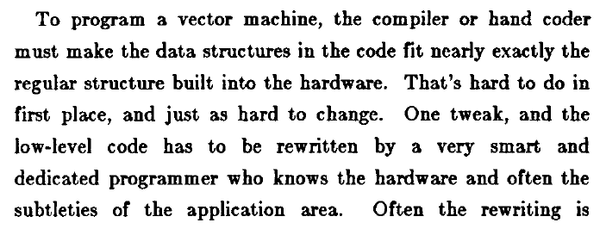
Vector Processor Disadvantages
-- Works (only) if parallelism is regular (data/SIMD parallelism)
++ Vector operations
-- Very inefficient if parallelism is irregular
-- How about searching for a key in a linked list?
Fisher, “Very Long Instruction Word architectures and the ELI-512,” ISCA 1983.

Slide 26
Vector Processor Limitations
-- Memory (bandwidth) can easily become a bottleneck, especially if
1. compute/memory operation balance is not maintained
2. data is not mapped appropriately to memory banks

Slide 27
Vector Processing in More Depth

Slide 28
Vector Registers
Each vector data register holds N M-bit values
Vector control registers: VLEN, VSTR, VMASK
Maximum VLEN can be N
  Maximum number of elements stored in a vector register
Vector Mask Register (VMASK)
  Indicates which elements of vector to operate on
  Set by vector test instructions
    e.g., VMASK[i] = (V_{k}[i] == 0)
M-bit wide
M-bit wide
V0,0
V1,0
V0,1
V1,1
V0,N-1
V1,N-1

Slide 29
Vector Functional Units
Use deep pipeline to execute element operations
  → fast clock cycle
Control of deep pipeline is simple because elements in vector are independent
V1
V2
V3
Six stage multiply pipeline
V1 * V2 → V3
Slide credit: Krste Asanovic

Slide 30
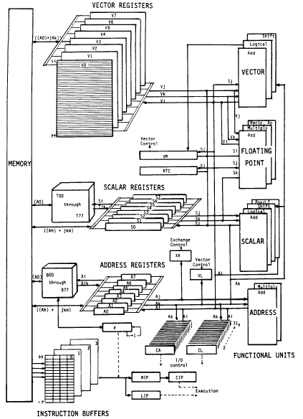
Vector Machine Organization (CRAY-1)
CRAY-1
Russell, “The CRAY-1 computer system,” CACM 1978.
Scalar and vector modes
8 64-element vector registers
64 bits per element
16 memory banks
8 64-bit scalar registers
8 24-bit address registers

Slide 31
Loading/Storing Vectors from/to Memory
Requires loading/storing multiple elements
Elements separated from each other by a constant distance (stride)
  Assume stride = 1 for now
Elements can be loaded in consecutive cycles if we can start the load of one element per cycle
  Can sustain a throughput of one element per cycle
Question: How do we achieve this with a memory that takes more than 1 cycle to access?
Answer: Bank the memory; interleave the elements across banks

Slide 32
Memory Banking
Memory is divided into banks that can be accessed independently; banks share address and data buses (to minimize pin cost)
Can start and complete one bank access per cycle
Can sustain N parallel accesses if all N go to different banks
Bank
0
Bank
1
Bank
2
Bank
15
MDR
MAR
MDR
MAR
MDR
MAR
MDR
MAR
Data bus
Address bus
CPU
Picture credit: Derek Chiou

Slide 33
Vector Memory System
Next address = Previous address + Stride
If stride = 1 & consecutive elements interleaved across banks & number of banks >= bank latency, then can sustain 1 element/cycle throughput
Base
Stride
Vector Registers
Address Generator
+
0
1
2
3
4
5
6
7
8
9
A
B
C
D
E
F
Memory Banks
Picture credit: Krste Asanovic

Slide 34
Scalar Code Example
For I = 0 to 49
  C[i] = (A[i] + B[i]) / 2
Scalar code (instruction and its latency)
  MOVI R0 = 50 1
  MOVA R1 = A 1
  MOVA R2 = B 1
  MOVA R3 = C 1
  X: LD R4 = MEM[R1++] 11 ;autoincrement addressing
  LD R5 = MEM[R2++] 11
  ADD R6 = R4 + R5 4
  SHFR R7 = R6 >> 1 1
  ST MEM[R3++] = R7 11
  DECBNZ --R0, X 2 ;decrement and branch if NZ
304 dynamic instructions

Slide 35
Scalar Code Execution Time (In Order)
Scalar execution time on an in-order processor with 1 bank
  First two loads in the loop cannot be pipelined: 2*11 cycles
  4 + 50*40 = 2004 cycles
Scalar execution time on an in-order processor with 16 banks (word-interleaved: consecutive words are stored in consecutive banks)
  First two loads in the loop can be pipelined
  4 + 50*30 = 1504 cycles
Why 16 banks?
  11 cycle memory access latency
  Having 16 (>11) banks ensures there are enough banks to overlap enough memory operations to cover memory latency

Slide 36
Vectorizable Loops
A loop is vectorizable if each iteration is independent of any other
For I = 0 to 49
  C[i] = (A[i] + B[i]) / 2
Vectorized loop (each instruction and its latency):
  MOVI VLEN = 50 1
  MOVI VSTR = 1 1
  VLD V0 = A 11 + VLN - 1
  VLD V1 = B 11 + VLN – 1
  VADD V2 = V0 + V1 4 + VLN - 1
  VSHFR V3 = V2 >> 1 1 + VLN - 1
  VST C = V3 11 + VLN – 1
7 dynamic instructions

Slide 37
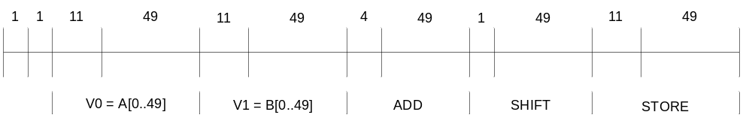
Basic Vector Code Performance
Assume no chaining (no vector data forwarding)
  i.e., output of a vector functional unit cannot be used as the direct input of another
  The entire vector register needs to be ready before any element of it can be used as part of another operation
One memory port (one address generator)
16 memory banks (word-interleaved)
285 cycles

Slide 38
Vector Chaining
Vector chaining: Data forwarding from one vector functional unit to another
V1
V2
V3
V4
V5
LV v1
MULV v3,v1,v2
ADDV v5, v3, v4
Chain
Chain
Load Unit
Mult.
Add
Memory
Slide credit: Krste Asanovic

Slide 39
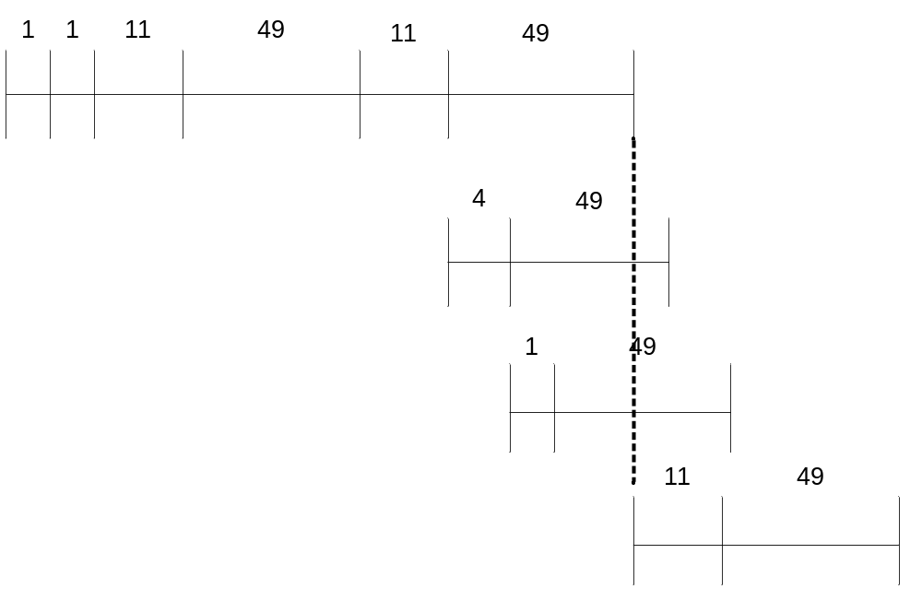
Vector Code Performance - Chaining
Vector chaining: Data forwarding from one vector functional unit to another
182 cycles
Strict assumption:
Each memory bank
has a single port
(memory bandwidth
bottleneck)
These two VLDs cannot be
pipelined. WHY?
VLD and VST cannot be
pipelined. WHY?

Slide 40
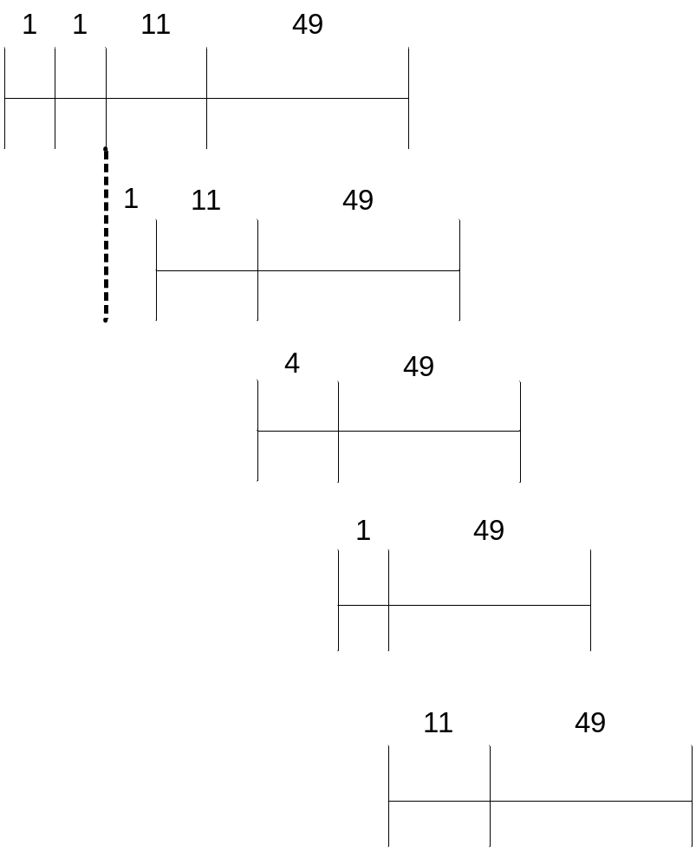
Vector Code Performance – Multiple Memory Ports
Chaining and 2 load ports, 1 store port in each bank
79 cycles
19X perf. improvement!

Slide 41
Questions (I)
What if # data elements > # elements in a vector register?
  Idea: Break loops so that each iteration operates on # elements in a vector register
    E.g., 527 data elements, 64-element VREGs
    8 iterations where VLEN = 64
    1 iteration where VLEN = 15 (need to change value of VLEN)
  Called vector stripmining
What if vector data is not stored in a strided fashion in memory? (irregular memory access to a vector)
  Idea: Use indirection to combine/pack elements into vector registers
  Called scatter/gather operations

Slide 42

Gather/Scatter Operations
Want to vectorize loops with indirect accesses:
  for (i=0; i<N; i++)
  A[i] = B[i] + C[D[i]]
Indexed load instruction (Gather)
  LV vD, rD # Load indices in D vector
  LVI vC, rC, vD # Load indirect from rC base
  LV vB, rB # Load B vector
  ADDV.D vA,vB,vC # Do add
  SV vA, rA # Store result

Slide 43
Gather/Scatter Operations
Gather/scatter operations often implemented in hardware to handle sparse matrices
Vector loads and stores use an index vector which is added to the base register to generate the addresses
Index Vector Data Vector (to Store) Stored Vector (in Memory)
0 3.14 Base+0 3.14
2 6.5 Base+1 X
6 71.2 Base+2 6.5
7 2.71 Base+3 X
Base+4 X
Base+5 X
Base+6 71.2
Base+7 2.71

Slide 44
Conditional Operations in a Loop
What if some operations should not be executed on a vector (based on a dynamically-determined condition)?
  loop: if (a[i] != 0) then b[i]=a[i]*b[i]
  goto loop
Idea: Masked operations
  VMASK register is a bit mask determining which data element should not be acted upon
  VLD V0 = A
  VLD V1 = B
  VMASK = (V0 != 0)
  VMUL V1 = V0 * V1
  VST B = V1
  Does this look familiar? This is essentially predicated execution.

Slide 45
Another Example with Masking
for (i = 0; i < 64; ++i)
if (a[i] >= b[i])
c[i] = a[i]
else
c[i] = b[i]
Steps to execute the loop in SIMD code
1. Compare A, B to get
VMASK
2. Masked store of A into C
3. Complement VMASK
4. Masked store of B into C
A B VMASK
1 2 0
2 2 1
3 2 1
4 10 0
-5 -4 0
0 -3 1
6 5 1
-7 -8 1

Slide 46
Masked Vector Instructions
Simple Implementation
  execute all N operations, turn off result writeback according to mask
Density-Time Implementation
  scan mask vector and only execute elements with non-zero masks
M[7]=1
A[7]
B[7]
M[7]=1
M[6]=0
A[6]
B[6]
M[6]=0
A[7]
B[7]
M[5]=1
A[5]
B[5]
M[5]=1
M[4]=1
A[4]
B[4]
M[4]=1
M[3]=0
A[3]
B[3]
M[3]=0
C[5]
M[2]=0
C[4]
M[1]=1
M[2]=0
C[2]
M[0]=0
M[1]=1
C[1]
C[1]
Write data port
M[0]=0
C[0]
Which one is better?
Write Enable
Write data port
Tradeoffs?
Slide credit: Krste Asanovic

Slide 47
Some Issues
Stride and banking
  As long as they are relatively prime to each other and there are enough banks to cover bank access latency, we can sustain 1 element/cycle throughput
Storage of a matrix
  Row major: Consecutive elements in a row are laid out consecutively in memory
  Column major: Consecutive elements in a column are laid out consecutively in memory
  You need to change the stride when accessing a row versus column

Slide 48
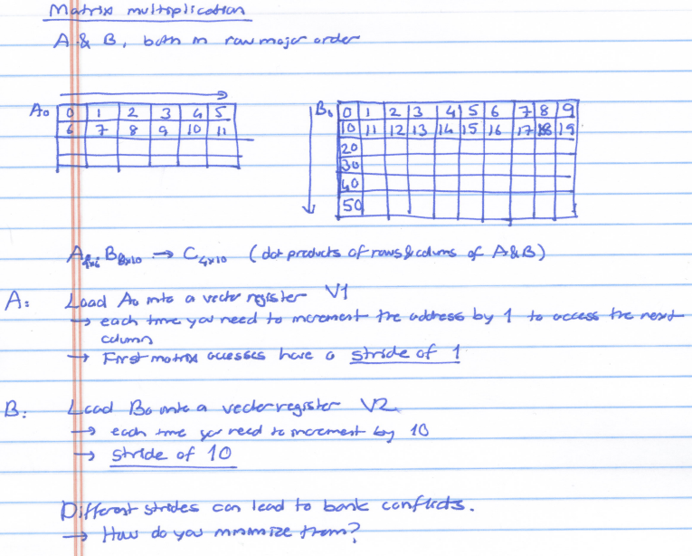

Slide 49
Minimizing Bank Conflicts
More banks
Better data layout to match the access pattern
  Is this always possible?
Better mapping of address to bank
  E.g., randomized mapping
  Rau, “Pseudo-randomly interleaved memory,” ISCA 1991.

Slide 50
Array vs. Vector Processors, Revisited
Array vs. vector processor distinction is a “purist’s” distinction
Most “modern” SIMD processors are a combination of both
  They exploit data parallelism in both time and space
  GPUs are a prime example we will cover in a bit more detail

Slide 51
Remember: Array vs. Vector Processors
ARRAY PROCESSOR
VECTOR PROCESSOR
Instruction Stream
Same op @ same time
LD VR ← A[3:0]
ADD VR ← VR, 1
MUL VR ← VR, 2
ST A[3:0] ← VR
Different ops @ time
LD0
LD1
LD2
LD3
LD0
AD0
AD1
AD2
AD3
LD1
AD0
MU0
MU1
MU2
MU3
LD2
AD1
MU0
ST0
ST1
ST2
ST3
LD3
AD2
MU1
ST0
Different ops @ same space
AD3
MU2
ST1
MU3
ST2
Time
Same op @ space
ST3
Space
Space

Slide 52
Vector Instruction Execution
VADD A,B → C
Execution using one pipelined functional unit
Execution using four pipelined functional units
A[6]
B[6]
A[24]
B[24]
A[25]
B[25]
A[26]
B[26]
A[27]
B[27]
A[5]
B[5]
A[20]
B[20]
A[21]
B[21]
A[22]
B[22]
A[23]
B[23]
A[4]
B[4]
A[16]
B[16]
A[17]
B[17]
A[18]
B[18]
A[19]
B[19]
A[3]
B[3]
A[12]
B[12]
A[13]
B[13]
A[14]
B[14]
A[15]
B[15]
C[2]
C[8]
C[9]
C[10]
C[11]
C[1]
C[4]
C[5]
C[6]
C[7]
C[0]
C[0]
C[1]
C[2]
C[3]
Slide credit: Krste Asanovic

Slide 53
Vector Unit Structure
Functional Unit
Partitioned
Vector
Registers
Elements 0, 4, 8, …
Elements 1, 5, 9, …
Elements 2, 6, 10, …
Elements 3, 7, 11, …
Lane
Memory Subsystem
Slide credit: Krste Asanovic

Slide 54
Vector Instruction Level Parallelism
Can overlap execution of multiple vector instructions
  Example machine has 32 elements per vector register and 8 lanes
  Completes 24 operations/cycle while issuing 1 vector instruction/cycle
Load Unit
Multiply Unit
Add Unit
load
mul
add
time
load
mul
add
Instruction issue
Slide credit: Krste Asanovic

Slide 55
Automatic Code Vectorization
for (i=0; i < N; i++)
C[i] = A[i] + B[i];
Scalar Sequential Code
Vectorized Code
load
load
load
Iter. 1
load
load
load
Time
add
add
add
store
store
store
load
Iter. 1
Iter. 2
Iter. 2
load
Vector Instruction
Vectorization is a compile-time reordering of operation sequencing
⇒ requires extensive loop dependence analysis
add
store
Slide credit: Krste Asanovic

Slide 56
Vector/SIMD Processing Summary
Vector/SIMD machines are good at exploiting regular data-level parallelism
  Same operation performed on many data elements
  Improve performance, simplify design (no intra-vector dependencies)
Performance improvement limited by vectorizability of code
  Scalar operations limit vector machine performance
  Remember Amdahl’s Law
  CRAY-1 was the fastest SCALAR machine at its time!
Many existing ISAs include (vector-like) SIMD operations
  Intel MMX/SSEn/AVX, PowerPC AltiVec, ARM Advanced SIMD

Slide 57
SIMD Operations in Modern ISAs

Slide 58
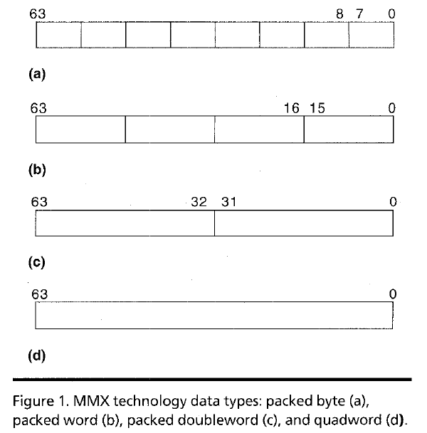
Intel Pentium MMX Operations
Idea: One instruction operates on multiple data elements simultaneously
  Ala array processing (yet much more limited)
  Designed with multimedia (graphics) operations in mind
No VLEN register
Opcode determines data type:
8 8-bit bytes
4 16-bit words
2 32-bit doublewords
1 64-bit quadword
Stride always equal to 1.
Peleg and Weiser, “MMX Technology
Extension to the Intel Architecture,”
IEEE Micro, 1996.

Slide 59
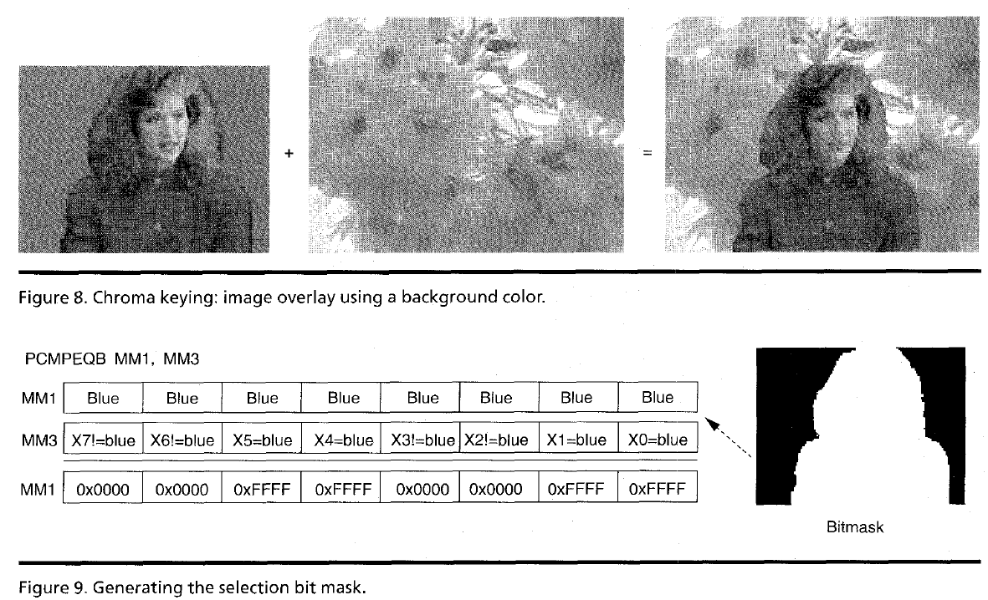
MMX Example: Image Overlaying (I)
Goal: Overlay the human in image 1 on top of the background in image 2

Slide 60
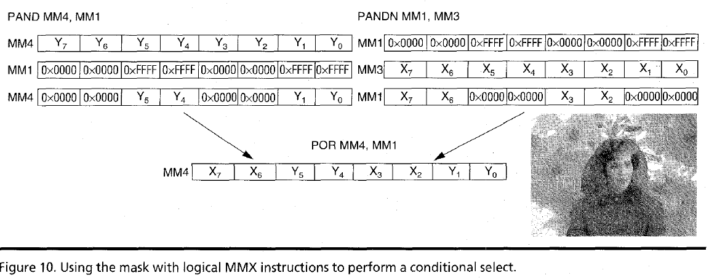
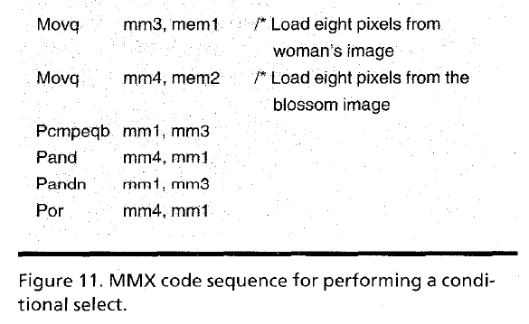
MMX Example: Image Overlaying (II)

