Slide 1
18-447
Computer Architecture
Lecture 15: GPUs, VLIW, DAE
Prof. Onur Mutlu
Carnegie Mellon University
Spring 2015, 2/20/2015

Slide 2
Agenda for Today & Next Few Lectures
Single-cycle Microarchitectures
Multi-cycle and Microprogrammed Microarchitectures
Pipelining
Issues in Pipelining: Control & Data Dependence Handling, State Maintenance and Recovery, …
Out-of-Order Execution
Issues in OoO Execution: Load-Store Handling, …
Alternative Approaches to Instruction Level Parallelism

Slide 3
Approaches to (Instruction-Level) Concurrency
Pipelining
Out-of-order execution
Dataflow (at the ISA level)
SIMD Processing (Vector and array processors, GPUs)
VLIW
Decoupled Access Execute
Systolic Arrays

Slide 4
Homework 3.1: Feedback Form
Due Monday Feb 23
I would like your feedback on the course
Easy to fill in
Can submit anonymously, if you wish
Worth 0.25% of your grade (extra credit)
Need to get checked off after submitting to get your grade points
  Can email
  If anonymous, show that you are turning in and have a TA check you off

Slide 5
A Couple of Things
Midterm I Date
  March 4?
  March 18?
Collaboration on Labs
  All labs individual – no collaboration permitted
Collaboration on homeworks
  You can collaborate
  But need to submit individual writeups on your own

Slide 6
Readings for Today
Lindholm et al., "NVIDIA Tesla: A Unified Graphics and Computing Architecture," IEEE Micro 2008.
Fatahalian and Houston, “A Closer Look at GPUs,” CACM 2008.

Slide 7
Recap of Last Lecture
SIMD Processing
Flynn’s taxonomy: SISD, SIMD, MISD, MIMD
VLIW vs. SIMD
Array vs. Vector Processors
Vector Processors in Depth
  Vector Registers, Stride, Masks, Length
  Memory Banking
  Vectorizable Code
  Scalar vs. Vector Code Execution
  Vector Chaining
  Vector Stripmining
  Gather/Scatter Operations
  Minimizing Bank Conflicts
  Automatic Code Vectorization
SIMD Operations in Modern ISAs: Example from MMX

Slide 8

Review: Code Parallelization/Vectorization
for (i=0; i < N; i++)
C[i] = A[i] + B[i];
Scalar Sequential Code
Vectorized Code
load
load
load
Iter. 1
load
load
load
Time
add
add
add
store
store
store
load
Iter. 1
Iter. 2
Iter. 2
load
Vector Instruction
Vectorization is a compile-time reordering of operation sequencing
⇒ requires extensive loop dependence analysis
add
store
Slide credit: Krste Asanovic

Slide 9
Recap: Vector/SIMD Processing Summary
Vector/SIMD machines are good at exploiting regular data-level parallelism
  Same operation performed on many data elements
  Improve performance, simplify design (no intra-vector dependencies)
Performance improvement limited by vectorizability of code
  Scalar operations limit vector machine performance
  Remember Amdahl’s Law
  CRAY-1 was the fastest SCALAR machine at its time!
Many existing ISAs include SIMD operations
  Intel MMX/SSEn/AVX, PowerPC AltiVec, ARM Advanced SIMD

Slide 10
GPUs are SIMD Engines Underneath
The instruction pipeline operates like a SIMD pipeline (e.g., an array processor)
However, the programming is done using threads, NOT SIMD instructions
To understand this, let’s go back to our parallelizable code example
But, before that, let’s distinguish between
  Programming Model (Software)
  vs.
  Execution Model (Hardware)

Slide 11
Programming Model vs. Hardware Execution Model
Programming Model refers to how the programmer expresses the code
  E.g., Sequential (von Neumann), Data Parallel (SIMD), Dataflow, Multi-threaded (MIMD, SPMD), …
Execution Model refers to how the hardware executes the code underneath
  E.g., Out-of-order execution, Vector processor, Array processor, Dataflow processor, Multiprocessor, Multithreaded processor, …
Execution Model can be very different from the Programming Model
  E.g., von Neumann model implemented by an OoO processor
  E.g., SPMD model implemented by a SIMD processor (a GPU)

Slide 12
How Can You Exploit Parallelism Here?
for (i=0; i < N; i++)
C[i] = A[i] + B[i];
Scalar Sequential Code
Let’s examine three programming options to exploit instruction-level parallelism present in this sequential code:
1. Sequential (SISD)
2. Data-Parallel (SIMD)
3. Multithreaded (MIMD/SPMD)
load
Iter. 1
load
add
store
load
Iter. 2
load
add
store

Slide 13
Prog. Model 1: Sequential (SISD)
for (i=0; i < N; i++)
C[i] = A[i] + B[i];
Can be executed on a:
Pipelined processor
Out-of-order execution processor
  Independent instructions executed when ready
  Different iterations are present in the instruction window and can execute in parallel in multiple functional units
  In other words, the loop is dynamically unrolled by the hardware
Superscalar or VLIW processor
  Can fetch and execute multiple instructions per cycle
Scalar Sequential Code
load
Iter. 1
load
add
store
load
Iter. 2
load
add
store

Slide 14
Prog. Model 2: Data Parallel (SIMD)
for (i=0; i < N; i++)
C[i] = A[i] + B[i];
Scalar Sequential Code
Vector Instruction
Vectorized Code
load
load
VLD A → V1
load
load
Iter. 1
load
load
VLD B → V2
add
add
add
VADD V1 + V2 → V3
store
store
store
VST V3 → C
load
Realization: Each iteration is independent
Idea: Programmer or compiler generates a SIMD instruction to execute the same instruction from all iterations across different data
Best executed by a SIMD processor (vector, array)
Iter. 1
Iter. 2
Iter. 2
load
add
store

Slide 15
Prog. Model 3: Multithreaded
for (i=0; i < N; i++)
C[i] = A[i] + B[i];
Scalar Sequential Code
load
load
load
load
Iter. 1
load
load
add
add
add
store
store
store
load
Iter. 1
Iter. 2
Realization: Each iteration is independent
Idea: Programmer or compiler generates a thread to execute each iteration. Each thread does the same thing (but on different data)
Can be executed on a MIMD machine
Iter. 2
load
add
store

Slide 16
Prog. Model 3: Multithreaded
for (i=0; i < N; i++)
C[i] = A[i] + B[i];
load
load
load
load
add
add
store
store
Iter. 1
Iter. 2
Realization: Each iteration is independent
Idea: Programmer or compiler generates a thread to execute each iteration. Each thread does the same thing (but on different data)
Can be executed on a MIMD machine
This particular model is also called:
SPMD: Single Program Multiple Data
Can be executed on a SIMT machine
Single Instruction Multiple Thread
Can be executed on a SIMD machine

Slide 17
A GPU is a SIMD (SIMT) Machine
Except it is not programmed using SIMD instructions
It is programmed using threads (SPMD programming model)
  Each thread executes the same code but operates a different piece of data
  Each thread has its own context (i.e., can be treated/restarted/executed independently)
A set of threads executing the same instruction are dynamically grouped into a warp (wavefront) by the hardware
  A warp is essentially a SIMD operation formed by hardware!

Slide 18
SPMD on SIMT Machine
for (i=0; i < N; i++)
C[i] = A[i] + B[i];
load
load
Warp 0 at PC X
load
load
Warp 0 at PC X+1
add
add
Warp 0 at PC X+2
store
store
Warp 0 at PC X+3
Iter. 1
Iter. 2
Realization: Each iteration is independent
Idea: Programmer or compiler generates a thread to execute each iteration. Each thread does the same thing (but on different data)
Can be executed on a MIMD machine
Warp: A set of threads that execute
the same instruction (i.e., at the same PC)
This particular model is also called:
SPMD: Single Program Multiple Data
A GPU executes it using the SIMT model:
Single Instruction Multiple Thread
Can be executed on a SIMD machine

Slide 19
Graphics Processing Units
SIMD not Exposed to Programmer (SIMT)

Slide 20
SIMD vs. SIMT Execution Model
SIMD: A single sequential instruction stream of SIMD instructions → each instruction specifies multiple data inputs
  [VLD, VLD, VADD, VST], VLEN
SIMT: Multiple instruction streams of scalar instructions → threads grouped dynamically into warps
  [LD, LD, ADD, ST], NumThreads
Two Major SIMT Advantages:
  Can treat each thread separately → i.e., can execute each thread independently (on any type of scalar pipeline) → MIMD processing
  Can group threads into warps flexibly → i.e., can group threads that are supposed to truly execute the same instruction → dynamically obtain and maximize benefits of SIMD processing

Slide 21
Multithreading of Warps
for (i=0; i < N; i++)
C[i] = A[i] + B[i];
Assume a warp consists of 32 threads
If you have 32K iterations → 1K warps
Warps can be interleaved on the same pipeline → Fine grained multithreading of warps
load
load
Warp 0 at PC X
Warp 1 at PC X
load
load
add
add
Warp 20 at PC X+2
store
store
Iter. 1
Iter. 2
Iter. 33
Iter. 34
Iter.
20*32 + 1
Iter.
20*32 + 2

Slide 22
Warps and Warp-Level FGMT
Warp: A set of threads that execute the same instruction (on different data elements) → SIMT (Nvidia-speak)
All threads run the same code
Warp: The threads that run lengthwise in a woven fabric …
Thread Warp 3
Thread Warp 8
Thread Warp
Common PC
Scalar
Scalar
Scalar
Scalar
Thread Warp 7
Thread
Thread
Thread
Thread
W
X
Y
Z
SIMD Pipeline
Notes:
In SIMD, you need to specify the data array + an instruction (on which to operate the data on) + THE INSTRUCTION WIDTH.
Eg: You might want to add 2 integer arrays of length 16, then a SIMD instruction would look like (the instruction has been cooked-up by me for demo)
add.16 arr1 arr2
However, SIMT doesn't bother about the instruction width. So, essentially, you could write the above example as:
arr1[i] + arr2[i]
and then launch as many threads as the length of the array, as you want.
Note that, if the array size was, let us say, 32, then SIMD EXPECTS you to explicitly call two such 'add.16' instructions!
Whereas, this is not the case with SIMT.

Slide 23
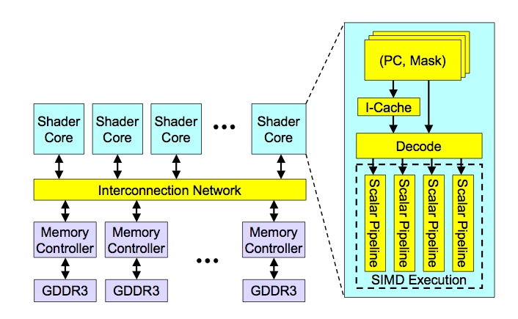
High-Level View of a GPU

Slide 24
Latency Hiding via Warp-Level FGMT
Warp: A set of threads that execute the same instruction (on different data elements)
Fine-grained multithreading
  One instruction per thread in pipeline at a time (No interlocking)
  Interleave warp execution to hide latencies
Register values of all threads stay in register file
FGMT enables long latency tolerance
  Millions of pixels
Thread Warp 3
Warps available
Thread Warp 8
for scheduling
Thread Warp 7
SIMD Pipeline
I-Fetch
Decode
R
R
R
F
F
F
Warps accessing
A
A
A
memory hierarchy
L
L
L
U
U
U
Miss?
D-Cache
Thread Warp 1
All Hit?
Data
Thread Warp 2
Writeback
Thread Warp 6
Slide credit: Tor Aamodt
Notes:
With a large number of shader threads multiplexed on the same execution re- sources, our architecture employs fine-grained multithreading where individual threads are interleaved by the fetch unit to proactively hide the potential latency of stalls before they occur. As illustrated by Figure, warps are issued fairly in a round-robin queue. When a thread is blocked by a memory request, shader core simply removes that thread’s warp from the pool of “ready” warps and thereby allows other threads to proceed while the memory system processes its request.
With a large number of threads (1024 per shader core) interleaved on the same pipeline, FGMT effectively hides the latency of most memory operations since the pipeline is occupied with instructions from other threads while memory operations complete. also hides the pipeline latency so that data bypassing logic can potentially be omitted to save area with minimal impact on performance. simplify the dependency check logic design by restricting each thread to have at most one instruction running in the pipeline at any time.

Slide 25
Warp Execution (Recall the Slide)
32-thread warp executing ADD A[tid],B[tid] → C[tid]
Execution using one pipelined functional unit
Execution using four pipelined functional units
A[6]
B[6]
A[24]
B[24]
A[25]
B[25]
A[26]
B[26]
A[27]
B[27]
A[5]
B[5]
A[20]
B[20]
A[21]
B[21]
A[22]
B[22]
A[23]
B[23]
A[4]
B[4]
A[16]
B[16]
A[17]
B[17]
A[18]
B[18]
A[19]
B[19]
A[3]
B[3]
A[12]
B[12]
A[13]
B[13]
A[14]
B[14]
A[15]
B[15]
C[2]
C[8]
C[9]
C[10]
C[11]
C[1]
C[4]
C[5]
C[6]
C[7]
C[0]
C[0]
C[1]
C[2]
C[3]
Slide credit: Krste Asanovic

Slide 26
SIMD Execution Unit Structure
Functional Unit
Registers
for each
Thread
Registers for thread IDs
0, 4, 8, …
Registers for thread IDs
1, 5, 9, …
Registers for thread IDs
2, 6, 10, …
Registers for thread IDs
3, 7, 11, …
Lane
Memory Subsystem
Slide credit: Krste Asanovic

Slide 27
Warp Instruction Level Parallelism
Can overlap execution of multiple instructions
  Example machine has 32 threads per warp and 8 lanes
  Completes 24 operations/cycle while issuing 1 warp/cycle
Load Unit
Multiply Unit
Add Unit
W0
W1
W2
time
W3
W4
W5
Warp issue
Slide credit: Krste Asanovic

Slide 28
SIMT Memory Access
Same instruction in different threads uses thread id to index and access different data elements
Let’s assume N=16, 4 threads per warp → 4 warps
0
1
2
3
4
5
6
7
8
9
10
11
12
13
14
15
Threads
+
0
1
2
3
4
5
6
7
8
9
10
11
12
13
14
15
Data elements
+
+
+
+
Warp 0
Warp 1
Warp 2
Warp 3
Slide credit: Hyesoon Kim

Slide 29
Sample GPU SIMT Code (Simplified)
CPU code
for (ii = 0; ii < 100000; ++ii) {
C[ii] = A[ii] + B[ii];
}
CUDA code
// there are 100000 threads
__global__ void KernelFunction(…) {
int tid = blockDim.x * blockIdx.x + threadIdx.x;
int varA = aa[tid];
int varB = bb[tid];
C[tid] = varA + varB;
}
Slide credit: Hyesoon Kim

Slide 30
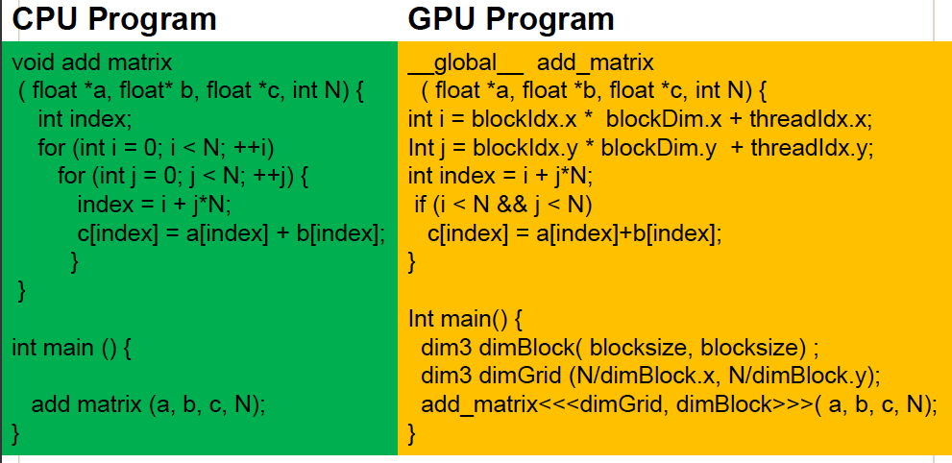
Sample GPU Program (Less Simplified)
Slide credit: Hyesoon Kim

Slide 31
Warp-based SIMD vs. Traditional SIMD
Traditional SIMD contains a single thread
  Lock step: a vector instruction needs to finish before another can start
  Programming model is SIMD (no extra threads) → SW needs to know vector length
  ISA contains vector/SIMD instructions
Warp-based SIMD consists of multiple scalar threads executing in a SIMD manner (i.e., same instruction executed by all threads)
  Does not have to be lock step
  Each thread can be treated individually (i.e., placed in a different warp) → programming model not SIMD
    SW does not need to know vector length
    Enables multithreading and flexible dynamic grouping of threads
  ISA is scalar → vector instructions can be formed dynamically
  Essentially, it is SPMD programming model implemented on SIMD hardware

Slide 32
SPMD
Single procedure/program, multiple data
  This is a programming model rather than computer organization
Each processing element executes the same procedure, except on different data elements
  Procedures can synchronize at certain points in program, e.g. barriers
Essentially, multiple instruction streams execute the same program
  Each program/procedure 1) works on different data, 2) can execute a different control-flow path, at run-time
  Many scientific applications are programmed this way and run on MIMD hardware (multiprocessors)
  Modern GPUs programmed in a similar way on a SIMD hardware

Slide 33
SIMD vs. SIMT Execution Model
SIMD: A single sequential instruction stream of SIMD instructions → each instruction specifies multiple data inputs
  [VLD, VLD, VADD, VST], VLEN
SIMT: Multiple instruction streams of scalar instructions → threads grouped dynamically into warps
  [LD, LD, ADD, ST], NumThreads
Two Major SIMT Advantages:
  Can treat each thread separately → i.e., can execute each thread independently on any type of scalar pipeline → MIMD processing
  Can group threads into warps flexibly → i.e., can group threads that are supposed to truly execute the same instruction → dynamically obtain and maximize benefits of SIMD processing

Slide 34
Threads Can Take Different Paths in Warp-based SIMD
Each thread can have conditional control flow instructions
Threads can execute different control flow paths
A
Thread Warp
Common PC
B
Thread
1
Thread
2
Thread
3
Thread
4
C
D
F
E
G
Slide credit: Tor Aamodt

Slide 35
Control Flow Problem in GPUs/SIMT
A GPU uses a SIMD pipeline to save area on control logic.
  Groups scalar threads into warps
Branch divergence occurs when threads inside warps branch to different execution paths.
Branch
Branch
Path A
Path A
Path B
Path B
This is the same as conditional execution.
Recall the Vector Mask and Masked Vector Operations?
Slide credit: Tor Aamodt

Slide 36
Branch Divergence Handling (I)
Idea: Dynamic predicated (conditional) execution
Stack
A
A/1111
Reconv. PC
Next PC
Active Mask
TOS
TOS
TOS
TOS
-
-
-
-
-
-
-
G
E
A
E
B
E
E
1111
1111
1111
1111
1111
1111
1111
E
E
D
D
0110
TOS
E
D
0110
0110
B
B/1111
TOS
TOS
E
E
C
E
1001
1001
C
D
F
C/1001
D/0110
Thread Warp
Common PC
E
E/1111
Thread
1
Thread
2
Thread
3
Thread
4
G
G/1111
A
B
C
D
E
G
A
Time
Slide credit: Tor Aamodt

Slide 37
Branch Divergence Handling (II)
A;
if (some condition) {
B;
} else {
C;
}
D;
One per warp
Control Flow Stack
Next PC
Recv PC
Active Mask
TOS
A
D
--
--
1111
1111
B
D
1110
A
C
D
D
0001
Execution Sequence
B
C
A
C
B
D
1
1
1
1
0
0
0
1
1
1
1
0
1
1
1
1
D
Time
Slide credit: Tor Aamodt

Slide 38
Remember: Each Thread Is Independent
Two Major SIMT Advantages:
  Can treat each thread separately → i.e., can execute each thread independently on any type of scalar pipeline → MIMD processing
  Can group threads into warps flexibly → i.e., can group threads that are supposed to truly execute the same instruction → dynamically obtain and maximize benefits of SIMD processing
If we have many threads
We can find individual threads that are at the same PC
And, group them together into a single warp dynamically
This reduces “divergence” → improves SIMD utilization
  SIMD utilization: fraction of SIMD lanes executing a useful operation (i.e., executing an active thread)

Slide 39
Dynamic Warp Formation/Merging
Idea: Dynamically merge threads executing the same instruction (after branch divergence)
Form new warps from warps that are waiting
  Enough threads branching to each path enables the creation of full new warps
Warp X
Warp Z
Warp Y

Slide 40
Dynamic Warp Formation/Merging
Idea: Dynamically merge threads executing the same instruction (after branch divergence)
  Fung et al., “Dynamic Warp Formation and Scheduling for Efficient GPU Control Flow,” MICRO 2007.
Branch
Branch
Path A
Path A
Path B

Slide 41
Dynamic Warp Formation Example
A
x/1111
y/1111
Legend
B
A
A
x/1110
y/0011
Execution of Warp x
Execution of Warp y
at Basic Block A
at Basic Block A
C
x/1000
D
x/0110
F
x/0001
y/0010
y/0001
y/1100
D
E
A new warp created from scalar threads of both Warp x and y executing at Basic Block D
x/1110
y/0011
G
x/1111
y/1111
A
A
B
B
C
C
D
D
E
E
F
F
G
G
A
A
Baseline
Time
Dynamic
Warp
Formation
A
A
B
B
C
D
E
E
F
G
G
A
A
Time
Slide credit: Tor Aamodt

Slide 42
Hardware Constraints Limit Flexibility of Warp Grouping
Functional Unit
Registers
for each
Thread
Registers for thread IDs
0, 4, 8, …
Registers for thread IDs
1, 5, 9, …
Registers for thread IDs
2, 6, 10, …
Registers for thread IDs
3, 7, 11, …
Can you move any thread
flexibly to any lane?
Lane
Memory Subsystem
Slide credit: Krste Asanovic

Slide 43
When You Group Threads Dynamically …
What happens to memory accesses?
Simple, strided (predictable) memory access patterns within a warp can become complex, randomized (unpredictable) with dynamic regrouping of threads
  → Can reduce locality in memory
  → Can lead to inefficient bandwidth utilization

Slide 44
What About Memory Divergence?
Modern GPUs have caches
  To minimize accesses to main memory (save bandwidth)
Ideally: Want all threads in the warp to hit (without conflicting with each other)
Problem: Some threads in the warp may hit others may miss
Problem: One thread in a warp can stall the entire warp if it misses in the cache.
Need techniques to
  Tolerate memory divergence
  Integrate solutions to branch and memory divergence

Slide 45
An Example GPU

Slide 46
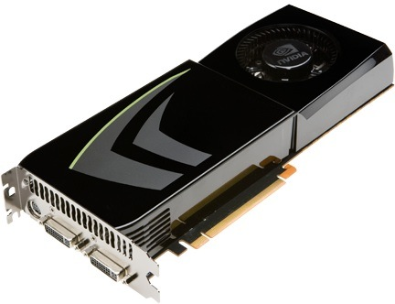
NVIDIA GeForce GTX 285
NVIDIA-speak:
  240 stream processors
  “SIMT execution”
Generic speak:
  30 cores
  8 SIMD functional units per core
Slide credit: Kayvon Fatahalian

Slide 47
NVIDIA GeForce GTX 285 “core”
64 KB of storage
for thread contexts (registers)
…
= SIMD functional unit, control
shared across 8 units
= instruction stream decode
= multiply-add
= execution context storage
= multiply
Slide credit: Kayvon Fatahalian
Notes:
30 * 32 * 32 = 30 * 1024 = 30K fragments
64KB register file = 16 32-bit registers per thread = 64B (1/32 that of LRB)
16KB of shared scratch
80KB / core available to software

Slide 48
NVIDIA GeForce GTX 285 “core”
64 KB of storage
for thread contexts (registers)
…
Groups of 32 threads share instruction stream (each group is a Warp)
Up to 32 warps are simultaneously interleaved
Up to 1024 thread contexts can be stored
Slide credit: Kayvon Fatahalian
Notes:
To get maximal latency hiding:
Run 1/32 of the time
16 words per thread = 64B

Slide 49
NVIDIA GeForce GTX 285
Tex
Tex
…
…
…
…
…
…
Tex
Tex
…
…
…
…
…
…
Tex
Tex
…
…
…
…
…
…
Tex
Tex
…
…
…
…
…
…
Tex
Tex
…
…
…
…
…
…
30 cores on the GTX 285: 30,720 threads
Slide credit: Kayvon Fatahalian
Notes:
If you’re running a CUDA program, and your not launching 30K threads, you are certainly not getting full latency hiding, and you might not be using the GPU well

Slide 50
GPU Readings
Required
  Lindholm et al., "NVIDIA Tesla: A Unified Graphics and Computing Architecture," IEEE Micro 2008.
  Fatahalian and Houston, “A Closer Look at GPUs,” CACM 2008.
Recommended
  Narasiman et al., “Improving GPU Performance via Large Warps and Two-Level Warp Scheduling,” MICRO 2011.
  Fung et al., “Dynamic Warp Formation and Scheduling for Efficient GPU Control Flow,” MICRO 2007.
  Jog et al., “Orchestrated Scheduling and Prefetching for GPGPUs,” ISCA 2013.

Slide 51
VLIW and DAE

Slide 52
Remember: SIMD/MIMD Classification of Computers
Mike Flynn, “Very High Speed Computing Systems,” Proc. of the IEEE, 1966
SISD: Single instruction operates on single data element
SIMD: Single instruction operates on multiple data elements
  Array processor
  Vector processor
MISD? Multiple instructions operate on single data element
  Closest form: systolic array processor?
MIMD: Multiple instructions operate on multiple data elements (multiple instruction streams)
  Multiprocessor
  Multithreaded processor

Slide 53
SISD Parallelism Extraction Techniques
We have already seen
  Superscalar execution
  Out-of-order execution
Are there simpler ways of extracting SISD parallelism?
  VLIW (Very Long Instruction Word)
  Decoupled Access/Execute

Slide 54
VLIW

Slide 55
VLIW (Very Long Instruction Word)
A very long instruction word consists of multiple independent instructions packed together by the compiler
  Packed instructions can be logically unrelated (contrast with SIMD)
Idea: Compiler finds independent instructions and statically schedules (i.e. packs/bundles) them into a single VLIW instruction
Traditional Characteristics
  Multiple functional units
  Each instruction in a bundle executed in lock step
  Instructions in a bundle statically aligned to be directly fed into the functional units

Slide 56
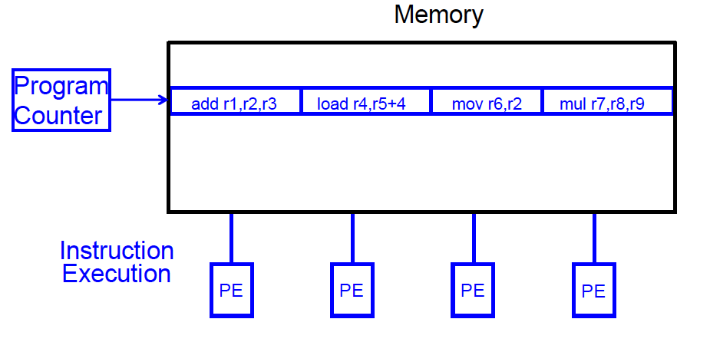
VLIW Concept
Fisher, “Very Long Instruction Word architectures and the ELI-512,” ISCA 1983.
  ELI: Enormously longword instructions (512 bits)

Slide 57
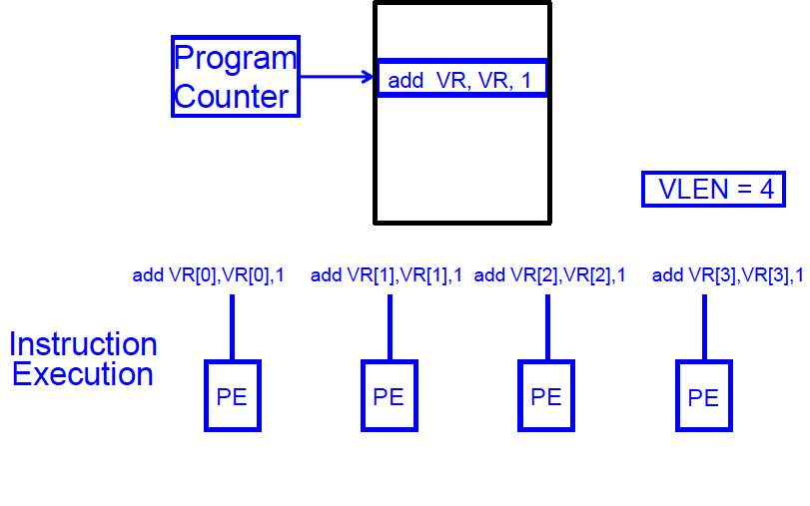
SIMD Array Processing vs. VLIW
Array processor

Slide 58
VLIW Philosophy
Philosophy similar to RISC (simple instructions and hardware)
  Except multiple instructions in parallel
RISC (John Cocke, 1970s, IBM 801 minicomputer)
  Compiler does the hard work to translate high-level language code to simple instructions (John Cocke: control signals)
    And, to reorder simple instructions for high performance
  Hardware does little translation/decoding → very simple
VLIW (Fisher, ISCA 1983)
  Compiler does the hard work to find instruction level parallelism
  Hardware stays as simple and streamlined as possible
    Executes each instruction in a bundle in lock step
    Simple → higher frequency, easier to design

Slide 59
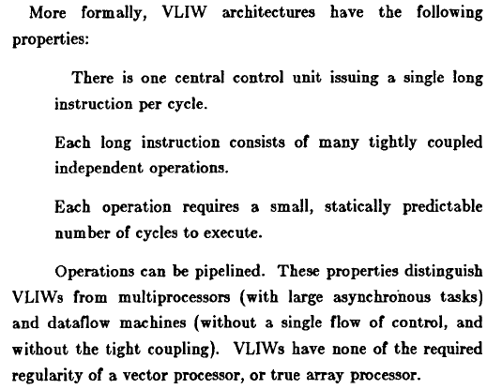
VLIW Philosophy and Properties
Fisher, “Very Long Instruction Word architectures and the ELI-512,” ISCA 1983.

Slide 60
Commercial VLIW Machines
Multiflow TRACE, Josh Fisher (7-wide, 28-wide)
Cydrome Cydra 5, Bob Rau
Transmeta Crusoe: x86 binary-translated into internal VLIW
TI C6000, Trimedia, STMicro (DSP & embedded processors)
  Most successful commercially
Intel IA-64
  Not fully VLIW, but based on VLIW principles
  EPIC (Explicitly Parallel Instruction Computing)
  Instruction bundles can have dependent instructions
  A few bits in the instruction format specify explicitly which instructions in the bundle are dependent on which other ones

Slide 61
VLIW Tradeoffs
Advantages
  + No need for dynamic scheduling hardware → simple hardware
  + No need for dependency checking within a VLIW instruction → simple hardware for multiple instruction issue + no renaming
  + No need for instruction alignment/distribution after fetch to different functional units → simple hardware
Disadvantages
  -- Compiler needs to find N independent operations per cycle
  -- If it cannot, inserts NOPs in a VLIW instruction
  -- Parallelism loss AND code size increase
  -- Recompilation required when execution width (N), instruction latencies, functional units change (Unlike superscalar processing)
  -- Lockstep execution causes independent operations to stall
  -- No instruction can progress until the longest-latency instruction completes

Slide 62
VLIW Summary
VLIW simplifies hardware, but requires complex compiler techniques
Solely-compiler approach of VLIW has several downsides that reduce performance
  -- Too many NOPs (not enough parallelism discovered)
  -- Static schedule intimately tied to microarchitecture
  -- Code optimized for one generation performs poorly for next
  -- No tolerance for variable or long-latency operations (lock step)
++ Most compiler optimizations developed for VLIW employed in optimizing compilers (for superscalar compilation)
  Enable code optimizations
++ VLIW successful when parallelism is easier to find by the compiler (traditionally embedded markets, DSPs)

Slide 63
Decoupled Access/Execute (DAE)

Slide 64
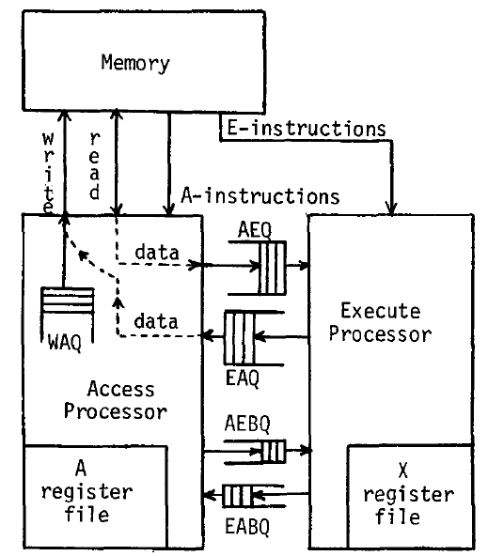
Decoupled Access/Execute (DAE)
Motivation: Tomasulo’s algorithm too complex to implement
  1980s before Pentium Pro
Idea: Decouple operand
access and execution via
two separate instruction
streams that communicate
via ISA-visible queues.
Smith, “Decoupled Access/Execute
Computer Architectures,” ISCA 1982,
ACM TOCS 1984.

Slide 65
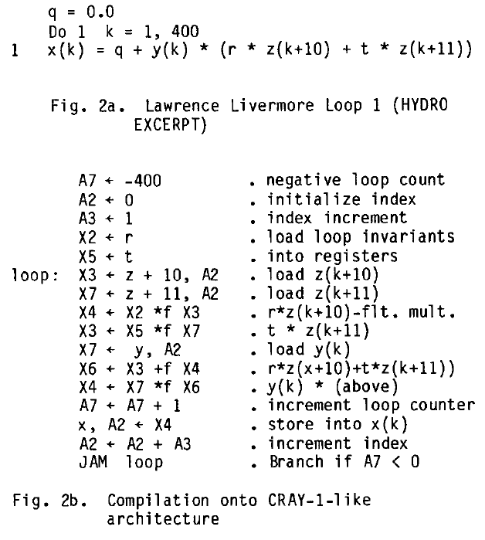
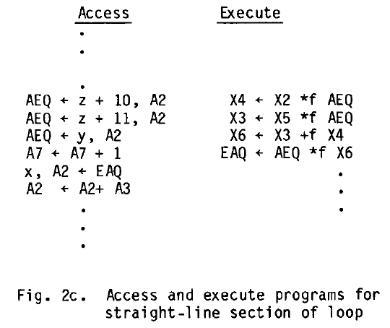
Decoupled Access/Execute (II)
Compiler generates two instruction streams (A and E)
  Synchronizes the two upon control flow instructions (using branch queues)

Slide 66
Decoupled Access/Execute (III)
Advantages:
  + Execute stream can run ahead of the access stream and vice versa
  + If A takes a cache miss, E can perform useful work
  + If A hits in cache, it supplies data to lagging E
  + Queues reduce the number of required registers
  + Limited out-of-order execution without wakeup/select complexity
Disadvantages:
-- Compiler support to partition the program and manage queues
-- Determines the amount of decoupling
-- Branch instructions require synchronization between A and E
-- Multiple instruction streams (can be done with a single one, though)

Slide 67
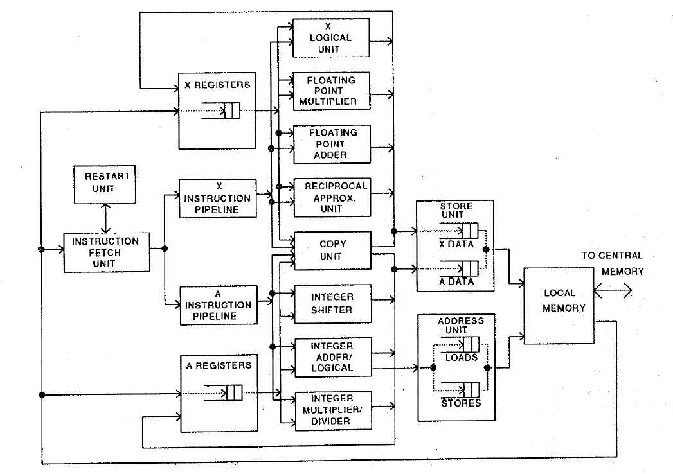
Astronautics ZS-1
Single stream steered into A and X pipelines
Each pipeline in-order
Smith et al., “The ZS-1 central processor,” ASPLOS 1987.
Smith, “Dynamic Instruction Scheduling and the Astronautics ZS-1,” IEEE Computer 1989.

Slide 68
Astronautics ZS-1 Instruction Scheduling
Dynamic scheduling
  A and X streams are issued/executed independently
  Loads can bypass stores in the memory unit (if no conflict)
  Branches executed early in the pipeline
    To reduce synchronization penalty of A/X streams
    Works only if the register a branch sources is available
Static scheduling
  Move compare instructions as early as possible before a branch
    So that branch source register is available when branch is decoded
  Reorder code to expose parallelism in each stream
  Loop unrolling:
    Reduces branch count + exposes code reordering opportunities

Slide 69
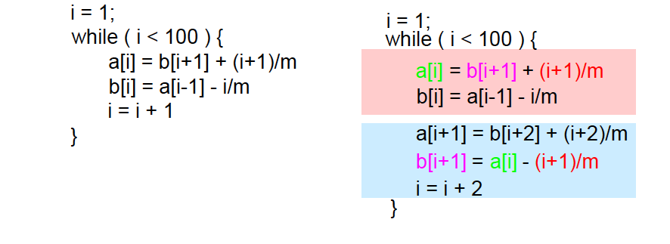
Loop Unrolling
Idea: Replicate loop body multiple times within an iteration
+ Reduces loop maintenance overhead
  Induction variable increment or loop condition test
+ Enlarges basic block (and analysis scope)
  Enables code optimization and scheduling opportunities
-- What if iteration count not a multiple of unroll factor? (need extra code to detect this)
-- Increases code size

