Slide 1
18-447
Computer Architecture
Lecture 17: Memory Hierarchy and Caches
Prof. Onur Mutlu
Carnegie Mellon University
Spring 2015, 2/25/2015

Slide 2
Assignment and Exam Reminders
Lab 4: Due March 6
  Control flow and branch prediction
Lab 5: Due March 22
  Data cache
HW 4: March 18
Exam: March 20
Finish the labs early
You have almost a month for Lab 5

Slide 3
Announcements
Please turn in your feedback form: Very Important
No office hours (for me) today

Slide 4
IA-64: A “Complicated” VLIW ISA
  Recommended reading:
    Huck et al., “Introducing the IA-64 Architecture,” IEEE Micro 2000.

Slide 5
EPIC – Intel IA-64 Architecture
Gets rid of lock-step execution of instructions within a VLIW instruction
Idea: More ISA support for static scheduling and parallelization
  Specify dependencies within and between VLIW instructions (explicitly parallel)
+ No lock-step execution
+ Static reordering of stores and loads + dynamic checking
-- Hardware needs to perform dependency checking (albeit aided by software)
-- Other disadvantages of VLIW still exist
Huck et al., “Introducing the IA-64 Architecture,” IEEE Micro, Sep/Oct 2000.

Slide 6


IA-64 Instructions
IA-64 “Bundle” (~EPIC Instruction)
  Total of 128 bits
  Contains three IA-64 instructions
  Template bits in each bundle specify dependencies within a bundle
    \
IA-64 Instruction
  Fixed-length 41 bits long
  Contains three 7-bit register specifiers
  Contains a 6-bit field for specifying one of the 64 one-bit predicate registers

Slide 7
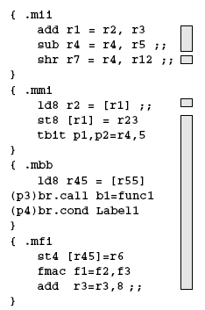
IA-64 Instruction Bundles and Groups
Groups of instructions can be executed safely in parallel
  Marked by “stop bits”
Bundles are for packaging
  Groups can span multiple bundles
    Alleviates recompilation need somewhat

Slide 8
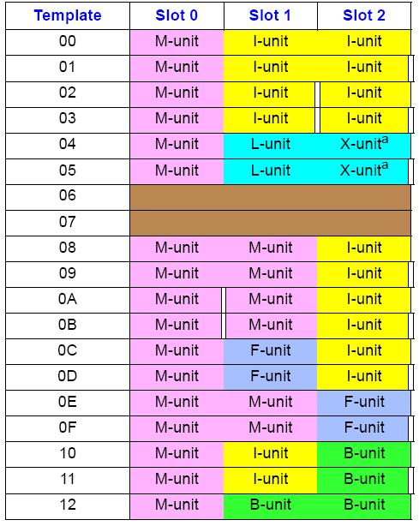
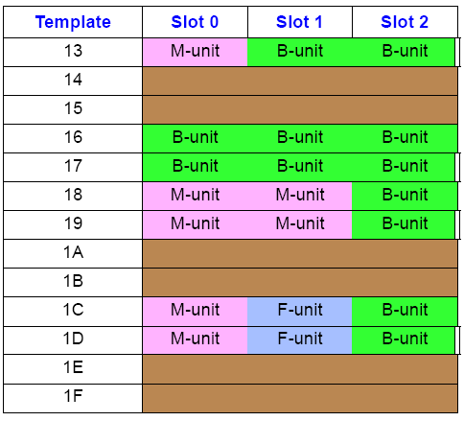
Template Bits
Specify two things
  Stop information: Boundary of independent instructions
  Functional unit information: Where should each instruction be routed

Slide 9
Three Things That Hinder Static Scheduling
Dynamic events (static unknowns)
Branch direction
Load hit miss status
Memory address
Let’s see how IA-64 ISA has support to aid scheduling in the presence of statically-unknown load-store addresses

Slide 10
Non-Faulting Loads and Exception Propagation in IA-64
Idea: Support unsafe code motion
ld.s (speculative load) fetches speculatively from memory
  i.e. any exception due to ld.s is suppressed
If ld.s r1 did not cause an exception then chk.s r1 is a NOP, else a branch is taken (to execute some compensation code)
ld.s r1=[a]
inst 1
inst 2
….
br
inst 1
inst 2
….
unsafe
code
motion
br
….
ld r1=[a]
use=r1
….
chk.s r1
use=r1
ld r1=[a]

Slide 11
Non-Faulting Loads and Exception Propagation in IA-64
Idea: Support unsafe code motion
  Load and its use
Load data can be speculatively consumed (use) prior to check
“speculation” status is propagated with speculated data
Any instruction that uses a speculative result also becomes speculative itself (i.e. suppressed exceptions)
chk.s checks the entire dataflow sequence for exceptions
ld.s r1=[a]
inst 1
inst 2
use=r1
….
br
inst 1
inst 2
….
br
unsafe
code
motion
br
….
ld r1=[a]
use=r1
….
chk.s use
ld r1=[a]
use=r1

Slide 12
Aggressive ST-LD Reordering in IA-64
Idea: Reorder LD/STs in the presence of unknown address
ld.a (advanced load) starts the monitoring of any store to the same address as the advanced load
If no aliasing has occurred since ld.a, ld.c is a NOP
If aliasing has occurred, ld.c re-loads from memory
inst 1
inst 2
….
st [?]
….
ld r1=[x]
use=r1
ld.a r1=[x]
inst 1
inst 2
….
st [?]
….
ld.c r1=[x]
use=r1
potential
aliasing
st[?]

Slide 13
Aggressive ST-LD Reordering in IA-64
Idea: Reorder LD/STs in the presence of unknown address
  Load and its use
inst 1
inst 2
….
st [?]
….
ld r1=[x]
use=r1
ld.a r1=[x]
inst 1
inst 2
use=r1
….
st [?]
….
chk.a X
….
potential
aliasing
st[?]
ld r1=[a]
use=r1

Slide 14
What We Covered So Far in 447
ISA → Single-cycle Microarchitectures
Multi-cycle and Microprogrammed Microarchitectures
Pipelining
Issues in Pipelining: Control & Data Dependence Handling, State Maintenance and Recovery, …
Out-of-Order Execution
Issues in OoO Execution: Load-Store Handling, …
Alternative Approaches to Instruction Level Parallelism

Slide 15
Approaches to (Instruction-Level) Concurrency
Pipelining
Out-of-order execution
Dataflow (at the ISA level)
SIMD Processing (Vector and array processors, GPUs)
VLIW
Decoupled Access Execute
Systolic Arrays
Static Instruction Scheduling

Slide 16
Agenda for the Rest of 447
The memory hierarchy
Caches, caches, more caches (high locality, high bandwidth)
Virtualizing the memory hierarchy
Main memory: DRAM
Main memory control, scheduling
Memory latency tolerance techniques
Non-volatile memory
Multiprocessors
Coherence and consistency
Interconnection networks
Multi-core issues

Slide 17
Readings for Today and Next Lecture
Memory Hierarchy and Caches
Cache chapters from P&H: 5.1-5.3
Memory/cache chapters from Hamacher+: 8.1-8.7
An early cache paper by Maurice Wilkes
  Wilkes, “Slave Memories and Dynamic Storage Allocation,” IEEE Trans. On Electronic Computers, 1965.

Slide 18
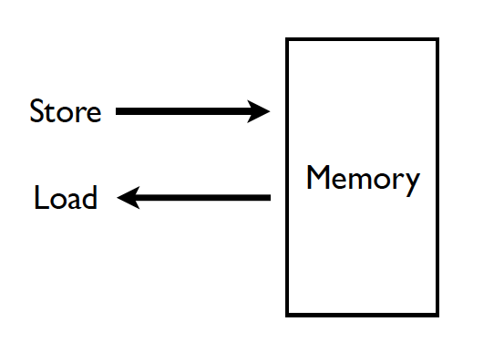
Memory (Programmer’s View)

Slide 19
Abstraction: Virtual vs. Physical Memory
Programmer sees virtual memory
  Can assume the memory is “infinite”
Reality: Physical memory size is much smaller than what the programmer assumes
The system (system software + hardware, cooperatively) maps virtual memory addresses are to physical memory
  The system automatically manages the physical memory space transparently to the programmer
+ Programmer does not need to know the physical size of memory nor manage it → A small physical memory can appear as a huge one to the programmer → Life is easier for the programmer
-- More complex system software and architecture
A classic example of the programmer/(micro)architect tradeoff

Slide 20
(Physical) Memory System
You need a larger level of storage to manage a small amount of physical memory automatically
  → Physical memory has a backing store: disk
We will first start with the physical memory system
For now, ignore the virtual→physical indirection
  As you have been doing in labs
We will get back to it when the needs of virtual memory start complicating the design of physical memory…

Slide 21
Idealism
Pipeline
(Instruction
execution)
Instruction
Supply
Data
Supply
- Zero-cycle latency
- Infinite capacity
- Zero cost
- Perfect control flow
No pipeline stalls
Perfect data flow
(reg/memory dependencies)
Zero-cycle interconnect
(operand communication)
Enough functional units
Zero latency compute
Zero-cycle latency
Infinite capacity
- Infinite bandwidth
Zero cost

Slide 22
The Memory Hierarchy

Slide 23
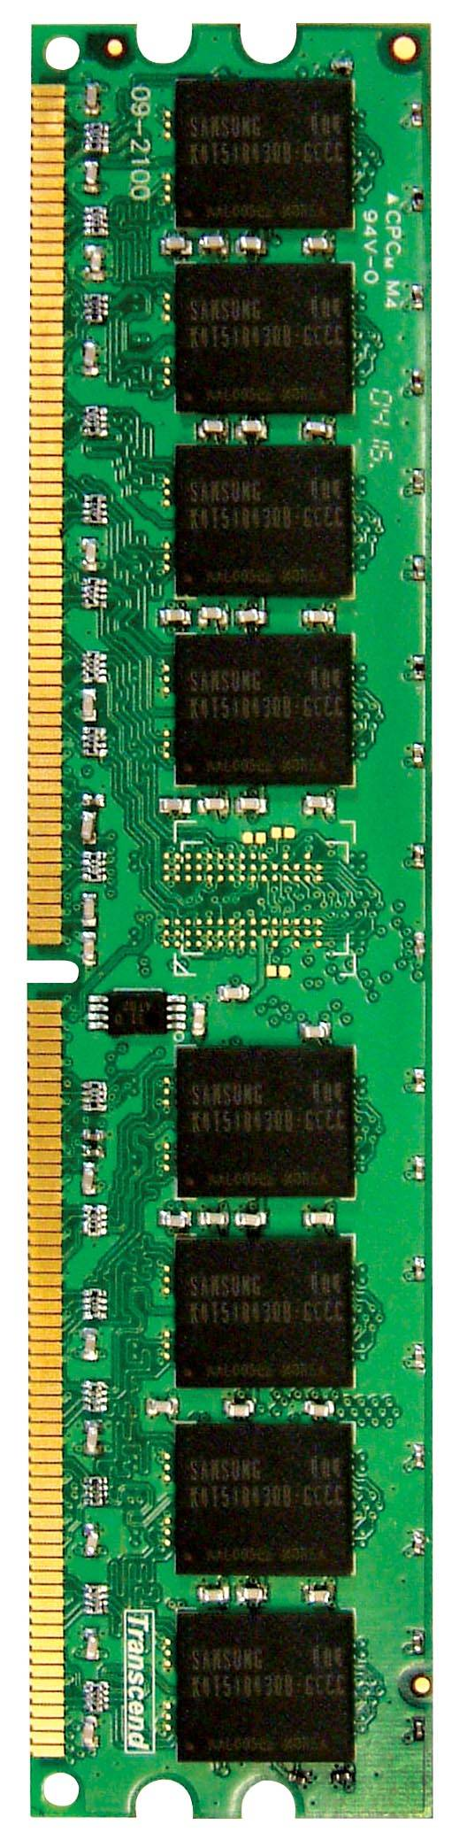

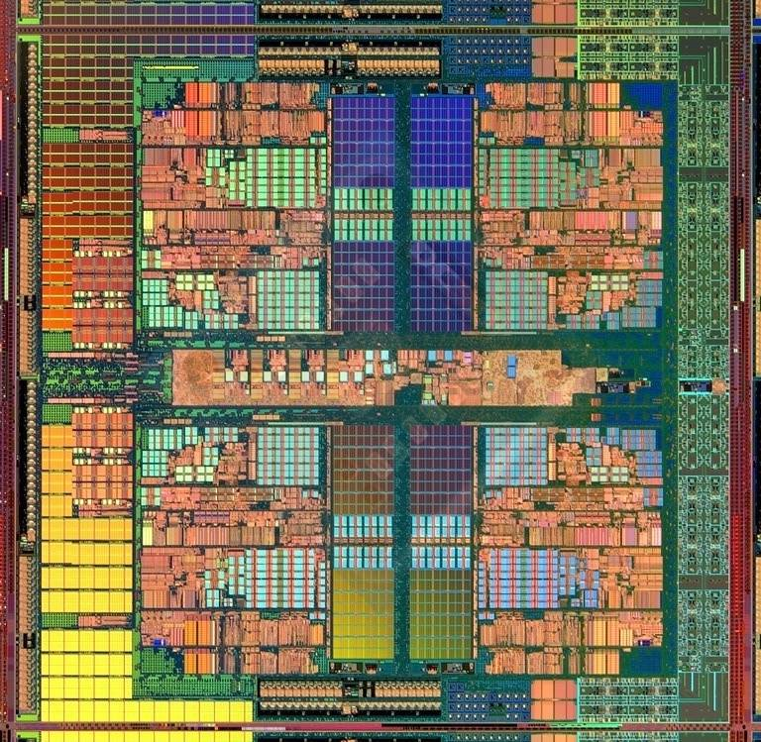
Memory in a Modern System
CORE 0
L2 CACHE 1
CORE 1
L2 CACHE 0
SHARED L3 CACHE
DRAM INTERFACE
DRAM MEMORY CONTROLLER
DRAM BANKS
L2 CACHE 2
CORE 3
CORE 2
L2 CACHE 3

Slide 24
Ideal Memory
Zero access time (latency)
Infinite capacity
Zero cost
Infinite bandwidth (to support multiple accesses in parallel)

Slide 25
The Problem
Ideal memory’s requirements oppose each other
Bigger is slower
  Bigger → Takes longer to determine the location
Faster is more expensive
  Memory technology: SRAM vs. DRAM vs. Disk vs. Tape
Higher bandwidth is more expensive
  Need more banks, more ports, higher frequency, or faster technology

Slide 26
Memory Technology: DRAM
Dynamic random access memory
Capacitor charge state indicates stored value
  Whether the capacitor is charged or discharged indicates storage of 1 or 0
  1 capacitor
  1 access transistor
Capacitor leaks through the RC path
  DRAM cell loses charge over time
  DRAM cell needs to be refreshed
row enable
_bitline

Slide 27
Memory Technology: SRAM
Static random access memory
Two cross coupled inverters store a single bit
  Feedback path enables the stored value to persist in the “cell”
  4 transistors for storage
  2 transistors for access
row select
bitline
_bitline

Slide 28
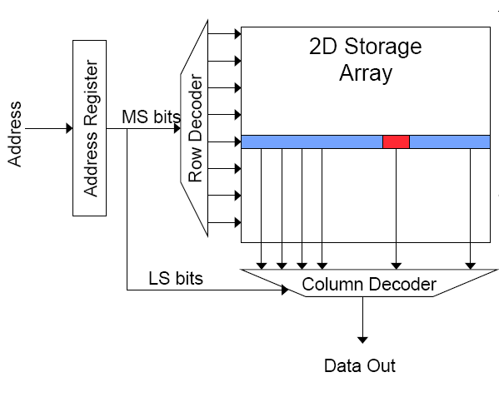
Memory Bank Organization and Operation
Read access sequence:
1. Decode row address & drive word-lines
2. Selected bits drive bit-lines
• Entire row read
3. Amplify row data
4. Decode column address & select subset of row
• Send to output
5. Precharge bit-lines
• For next access

Slide 29
SRAM (Static Random Access Memory)
Read Sequence
  1. address decode
  2. drive row select
  3. selected bit-cells drive bitlines
  (entire row is read together)
  4. differential sensing and column select
  (data is ready)
  5. precharge all bitlines
  (for next read or write)
Access latency dominated by steps 2 and 3
Cycling time dominated by steps 2, 3 and 5
  step 2 proportional to 2^{m}
  step 3 and 5 proportional to 2^{n}
row select
bitline
_bitline
bit-cell array
2^{n} row x 2^{m}-col
(n≈m to minimize
overall latency)
n+m
n
2^{n}
m
2^{m} diff pairs
sense amp and mux
1

Slide 30
DRAM (Dynamic Random Access Memory)
row enable
Bits stored as charges on node capacitance (non-restorative)
  bit cell loses charge when read
  bit cell loses charge over time
Read Sequence
  1~3 same as SRAM
  4. a “flip-flopping” sense amp amplifies and regenerates the bitline, data bit is mux’ed out
  5. precharge all bitlines
Destructive reads
Charge loss over time
Refresh: A DRAM controller must periodically read each row within the allowed refresh time (10s of ms) such that charge is restored
_bitline
RAS
bit-cell array
2^{n} row x 2^{m}-col
(n≈m to minimize
overall latency)
n
2^{n}
m
2^{m}
sense amp and mux
1
A DRAM die comprises
of multiple such arrays
CAS

Slide 31
DRAM vs. SRAM
DRAM
  Slower access (capacitor)
  Higher density (1T 1C cell)
  Lower cost
  Requires refresh (power, performance, circuitry)
  Manufacturing requires putting capacitor and logic together
SRAM
  Faster access (no capacitor)
  Lower density (6T cell)
  Higher cost
  No need for refresh
  Manufacturing compatible with logic process (no capacitor)

Slide 32
The Problem
Bigger is slower
  SRAM, 512 Bytes, sub-nanosec
  SRAM, KByte~MByte, ~nanosec
  DRAM, Gigabyte, ~50 nanosec
  Hard Disk, Terabyte, ~10 millisec
Faster is more expensive (dollars and chip area)
  SRAM, < 10$ per Megabyte
  DRAM, < 1$ per Megabyte
  Hard Disk < 1$ per Gigabyte
  These sample values scale with time
Other technologies have their place as well
  Flash memory, PC-RAM, MRAM, RRAM (not mature yet)

Slide 33
Why Memory Hierarchy?
We want both fast and large
But we cannot achieve both with a single level of memory
Idea: Have multiple levels of storage (progressively bigger and slower as the levels are farther from the processor) and ensure most of the data the processor needs is kept in the fast(er) level(s)

Slide 34
The Memory Hierarchy
move what you use here
fast
small
With good locality of reference, memory appears as fast as
and as large as
cheaper per byte
faster per byte
backup
everything
here
big but slow

Slide 35
Memory Hierarchy
Fundamental tradeoff
  Fast memory: small
  Large memory: slow
Idea: Memory hierarchy
Latency, cost, size,
bandwidth
Hard Disk
Main
Memory
(DRAM)
CPU
Cache
RF

Slide 36
Locality
One’s recent past is a very good predictor of his/her near future.
Temporal Locality: If you just did something, it is very likely that you will do the same thing again soon
  since you are here today, there is a good chance you will be here again and again regularly
Spatial Locality: If you did something, it is very likely you will do something similar/related (in space)
  every time I find you in this room, you are probably sitting close to the same people

Slide 37
Memory Locality
A “typical” program has a lot of locality in memory references
  typical programs are composed of “loops”
Temporal: A program tends to reference the same memory location many times and all within a small window of time
Spatial: A program tends to reference a cluster of memory locations at a time
  most notable examples:
    1. instruction memory references
    2. array/data structure references

Slide 38
Caching Basics: Exploit Temporal Locality
Idea: Store recently accessed data in automatically managed fast memory (called cache)
Anticipation: the data will be accessed again soon
Temporal locality principle
  Recently accessed data will be again accessed in the near future
  This is what Maurice Wilkes had in mind:
    Wilkes, “Slave Memories and Dynamic Storage Allocation,” IEEE Trans. On Electronic Computers, 1965.
    “The use is discussed of a fast core memory of, say 32000 words as a slave to a slower core memory of, say, one million words in such a way that in practical cases the effective access time is nearer that of the fast memory than that of the slow memory.”

Slide 39
Caching Basics: Exploit Spatial Locality
Idea: Store addresses adjacent to the recently accessed one in automatically managed fast memory
  Logically divide memory into equal size blocks
  Fetch to cache the accessed block in its entirety
Anticipation: nearby data will be accessed soon
Spatial locality principle
  Nearby data in memory will be accessed in the near future
    E.g., sequential instruction access, array traversal
  This is what IBM 360/85 implemented
    16 Kbyte cache with 64 byte blocks
    Liptay, “Structural aspects of the System/360 Model 85 II: the cache,” IBM Systems Journal, 1968.

Slide 40
The Bookshelf Analogy
Book in your hand
Desk
Bookshelf
Boxes at home
Boxes in storage
Recently-used books tend to stay on desk
  Comp Arch books, books for classes you are currently taking
  Until the desk gets full
Adjacent books in the shelf needed around the same time
  If I have organized/categorized my books well in the shelf

Slide 41
Caching in a Pipelined Design
The cache needs to be tightly integrated into the pipeline
  Ideally, access in 1-cycle so that dependent operations do not stall
High frequency pipeline → Cannot make the cache large
  But, we want a large cache AND a pipelined design
Idea: Cache hierarchy
Main
Memory
(DRAM)
Level 2
Cache
CPU
Level1
Cache
RF

Slide 42
A Note on Manual vs. Automatic Management
Manual: Programmer manages data movement across levels
  -- too painful for programmers on substantial programs
  “core” vs “drum” memory in the 50’s
  still done in some embedded processors (on-chip scratch pad SRAM in lieu of a cache)
Automatic: Hardware manages data movement across levels, transparently to the programmer
  ++ programmer’s life is easier
  the average programmer doesn’t need to know about it
    You don’t need to know how big the cache is and how it works to write a “correct” program! (What if you want a “fast” program?)

Slide 43
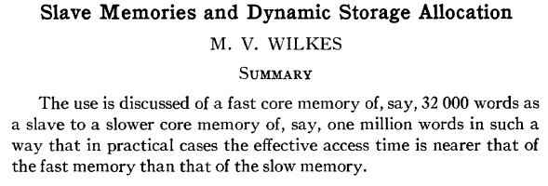
Automatic Management in Memory Hierarchy
Wilkes, “Slave Memories and Dynamic Storage Allocation,” IEEE Trans. On Electronic Computers, 1965.
“By a slave memory I mean one which automatically accumulates to itself words that come from a slower main memory, and keeps them available for subsequent use without it being necessary for the penalty of main memory access to be incurred again.”

Slide 44
A Modern Memory Hierarchy
Register File
32 words, sub-nsec
L1 cache
~32 KB, ~nsec
L2 cache
512 KB ~ 1MB, many nsec
L3 cache,
.....
Main memory (DRAM),
GB, ~100 nsec
Swap Disk
100 GB, ~10 msec
manual/compiler
register spilling
Memory
Abstraction
Automatic
HW cache
management
automatic
demand
paging

Slide 45
Hierarchical Latency Analysis
For a given memory hierarchy level i it has a technology-intrinsic access time of t_{i,} The perceived access time T_{i} is longer than t_{i}
Except for the outer-most hierarchy, when looking for a given address there is
  a chance (hit-rate h_{i}) you “hit” and access time is t_{i}
  a chance (miss-rate m_{i}) you “miss” and access time t_{i} +T_{i+1}
  h_{i} + m_{i} = 1
Thus
T_{i} = h_{i}·t_{i} + m_{i}·(t_{i} + T_{i+1})
T_{i} = t_{i} + m_{i} ·T_{i+1}
h_{i} and m_{i} are defined to be the hit-rate
and miss-rate of just the references that missed at L_{i-1}

Slide 46
Hierarchy Design Considerations
Recursive latency equation
T_{i} = t_{i} + m_{i} ·T_{i+1}
The goal: achieve desired T₁ within allowed cost
T_{i} ≈ t_{i} is desirable
Keep m_{i} low
  increasing capacity C_{i} lowers m_{i}, but beware of increasing t_{i}
  lower m_{i} by smarter management (replacement::anticipate what you don’t need, prefetching::anticipate what you will need)
Keep T_{i+1} low
  faster lower hierarchies, but beware of increasing cost
  introduce intermediate hierarchies as a compromise

Slide 47
Intel Pentium 4 Example
90nm P4, 3.6 GHz
L1 D-cache
  C₁ = 16K
  t₁ = 4 cyc int / 9 cycle fp
L2 D-cache
  C₂ =1024 KB
  t₂ = 18 cyc int / 18 cyc fp
Main memory
  t₃ = ~ 50ns or 180 cyc
Notice
  best case latency is not 1
  worst case access latencies are into 500+ cycles
if m₁=0.1, m₂=0.1
T₁=7.6, T₂=36
if m₁=0.01, m₂=0.01
T₁=4.2, T₂=19.8
if m₁=0.05, m₂=0.01
T₁=5.00, T₂=19.8
if m₁=0.01, m₂=0.50
T₁=5.08, T₂=108

Slide 48
Cache Basics and Operation

Slide 49
Cache
Generically, any structure that “memoizes” frequently used results to avoid repeating the long-latency operations required to reproduce the results from scratch, e.g. a web cache
Most commonly in the on-die context: an automatically-managed memory hierarchy based on SRAM
  memoize in SRAM the most frequently accessed DRAM memory locations to avoid repeatedly paying for the DRAM access latency

Slide 50
Caching Basics
Block (line): Unit of storage in the cache
  Memory is logically divided into cache blocks that map to locations in the cache
When data referenced
  HIT: If in cache, use cached data instead of accessing memory
  MISS: If not in cache, bring block into cache
    Maybe have to kick something else out to do it
Some important cache design decisions
  Placement: where and how to place/find a block in cache?
  Replacement: what data to remove to make room in cache?
  Granularity of management: large, small, uniform blocks?
  Write policy: what do we do about writes?
  Instructions/data: Do we treat them separately?

Slide 51
Cache Abstraction and Metrics
Cache hit rate = (# hits) / (# hits + # misses) = (# hits) / (# accesses)
Average memory access time (AMAT)
= ( hit-rate * hit-latency ) + ( miss-rate * miss-latency )
Aside: Can reducing AMAT reduce performance?
Address
Tag Store
(is the address
in the cache?
+ bookkeeping)
Data Store
Hit/miss?
Data

