Slide 1
18-447
Computer Architecture
Lecture 18: Caches, Caches, Caches
Prof. Onur Mutlu
Carnegie Mellon University
Spring 2015, 2/27/2015

Slide 2
Assignment and Exam Reminders
Lab 4: Due March 6
  Control flow and branch prediction
Lab 5: Due March 22
  Data cache
HW 4: March 18
Exam: March 20
Advice: Finish the labs early
  You have almost a month for Lab 5
Advice: Manage your time well

Slide 3
Agenda for the Rest of 447
The memory hierarchy
Caches, caches, more caches (high locality, high bandwidth)
Virtualizing the memory hierarchy
Main memory: DRAM
Main memory control, scheduling
Memory latency tolerance techniques
Non-volatile memory
Multiprocessors
Coherence and consistency
Interconnection networks
Multi-core issues

Slide 4
Readings for Today and Next Lecture
Memory Hierarchy and Caches
Required
Cache chapters from P&H: 5.1-5.3
Memory/cache chapters from Hamacher+: 8.1-8.7
Required + Review:
  Wilkes, “Slave Memories and Dynamic Storage Allocation,” IEEE Trans. On Electronic Computers, 1965.
Qureshi et al., “A Case for MLP-Aware Cache Replacement,“ ISCA 2006.

Slide 5
Review: Caching Basics
Caches are structures that exploit locality of reference in memory
  Temporal locality
  Spatial locality
They can be constructed in many ways
  Can exploit either temporal or spatial locality or both

Slide 6
Review: Caching Basics
Block (line): Unit of storage in the cache
  Memory is logically divided into cache blocks that map to locations in the cache
When data referenced
  HIT: If in cache, use cached data instead of accessing memory
  MISS: If not in cache, bring block into cache
    Maybe have to kick something else out to do it
Some important cache design decisions
  Placement: where and how to place/find a block in cache?
  Replacement: what data to remove to make room in cache?
  Granularity of management: large, small, uniform blocks?
  Write policy: what do we do about writes?
  Instructions/data: Do we treat them separately?

Slide 7
Cache Abstraction and Metrics
Cache hit rate = (# hits) / (# hits + # misses) = (# hits) / (# accesses)
Average memory access time (AMAT)
= ( hit-rate * hit-latency ) + ( miss-rate * miss-latency )
Aside: Can reducing AMAT reduce performance?
Address
Tag Store
(is the address
in the cache?
+ bookkeeping)
Data Store
(stores
memory
blocks)
Hit/miss?
Data

Slide 8
A Basic Hardware Cache Design
We will start with a basic hardware cache design
Then, we will examine a multitude of ideas to make it better

Slide 9
Blocks and Addressing the Cache
Memory is logically divided into fixed-size blocks
Each block maps to a location in the cache, determined by the index bits in the address
  used to index into the tag and data stores
Cache access:
  1) index into the tag and data stores with index bits in address
  2) check valid bit in tag store
  3) compare tag bits in address with the stored tag in tag store
If a block is in the cache (cache hit), the stored tag should be valid and match the tag of the block
tag
index
byte in block
2b
3 bits
3 bits
8-bit address

Slide 10
Direct-Mapped Cache: Placement and Access
Assume byte-addressable memory: 256 bytes, 8-byte blocks → 32 blocks
Assume cache: 64 bytes, 8 blocks
  Direct-mapped: A block can go to only one location
  Addresses with same index contend for the same location
    Cause conflict misses
tag
index
byte in block
2b
3 bits
3 bits
Tag store
Data store
Address
V
tag
=?
MUX
byte in block
Hit?
Data

Slide 11
Direct-Mapped Caches
Direct-mapped cache: Two blocks in memory that map to the same index in the cache cannot be present in the cache at the same time
  One index → one entry
Can lead to 0% hit rate if more than one block accessed in an interleaved manner map to the same index
  Assume addresses A and B have the same index bits but different tag bits
  A, B, A, B, A, B, A, B, … → conflict in the cache index
  All accesses are conflict misses

Slide 12
Set Associativity
Addresses 0 and 8 always conflict in direct mapped cache
Instead of having one column of 8, have 2 columns of 4 blocks
Tag store
Data store
SET
V
tag
V
tag
=?
=?
MUX
Logic
MUX
byte in block
Address
Hit?
tag
index
byte in block
Key idea: Associative memory within the set
+ Accommodates conflicts better (fewer conflict misses)
-- More complex, slower access, larger tag store
3b
2 bits
3 bits

Slide 13
Higher Associativity
4-way
+ Likelihood of conflict misses even lower
-- More tag comparators and wider data mux; larger tags
Tag store
=?
=?
=?
=?
Logic
Hit?
Data store
MUX
MUX
byte in block

Slide 14
Full Associativity
Fully associative cache
  A block can be placed in any cache location
Tag store
=?
=?
=?
=?
=?
=?
=?
=?
Logic
Hit?
Data store
MUX
MUX
byte in block

Slide 15
Associativity (and Tradeoffs)
Degree of associativity: How many blocks can map to the same index (or set)?
Higher associativity
  ++ Higher hit rate
  -- Slower cache access time (hit latency and data access latency)
  -- More expensive hardware (more comparators)
Diminishing returns from higher
  associativity
hit rate
associativity

Slide 16
Issues in Set-Associative Caches
Think of each block in a set having a “priority”
  Indicating how important it is to keep the block in the cache
Key issue: How do you determine/adjust block priorities?
There are three key decisions in a set:
  Insertion, promotion, eviction (replacement)
Insertion: What happens to priorities on a cache fill?
  Where to insert the incoming block, whether or not to insert the block
Promotion: What happens to priorities on a cache hit?
  Whether and how to change block priority
Eviction/replacement: What happens to priorities on a cache miss?
  Which block to evict and how to adjust priorities

Slide 17
Eviction/Replacement Policy
Which block in the set to replace on a cache miss?
  Any invalid block first
  If all are valid, consult the replacement policy
    Random
    FIFO
    Least recently used (how to implement?)
    Not most recently used
    Least frequently used?
    Least costly to re-fetch?
      Why would memory accesses have different cost?
    Hybrid replacement policies
    Optimal replacement policy?

Slide 18
Implementing LRU
Idea: Evict the least recently accessed block
Problem: Need to keep track of access ordering of blocks
Question: 2-way set associative cache:
  What do you need to implement LRU perfectly?
Question: 4-way set associative cache:
  What do you need to implement LRU perfectly?
  How many different orderings possible for the 4 blocks in the set?
  How many bits needed to encode the LRU order of a block?
  What is the logic needed to determine the LRU victim?

Slide 19
Approximations of LRU
Most modern processors do not implement “true LRU” (also called “perfect LRU”) in highly-associative caches
Why?
  True LRU is complex
  LRU is an approximation to predict locality anyway (i.e., not the best possible cache management policy)
Examples:
  Not MRU (not most recently used)
  Hierarchical LRU: divide the 4-way set into 2-way “groups”, track the MRU group and the MRU way in each group
  Victim-NextVictim Replacement: Only keep track of the victim and the next victim

Slide 20
Hierarchical LRU (not MRU)
Divide a set into multiple groups
Keep track of only the MRU group
Keep track of only the MRU block in each group
On replacement, select victim as:
  A not-MRU block in one of the not-MRU groups (randomly pick one of such blocks/groups)

Slide 21
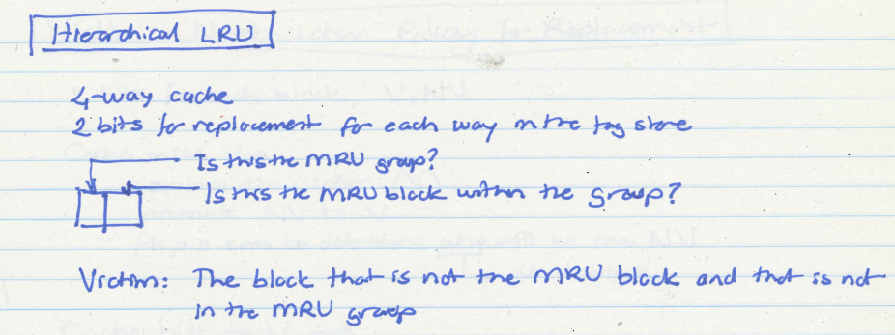
Hierarchical LRU (not MRU) Example

Slide 22
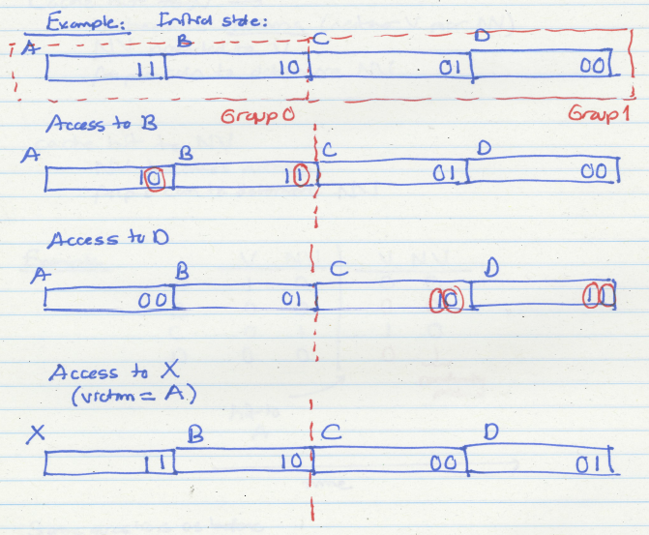
Hierarchical LRU (not MRU) Example

Slide 23
Hierarchical LRU (not MRU): Questions
16-way cache
2 8-way groups
What is an access pattern that performs worse than true LRU?
What is an access pattern that performs better than true LRU?

Slide 24
Victim/Next-Victim Policy
Only 2 blocks’ status tracked in each set:
  victim (V), next victim (NV)
  all other blocks denoted as (O) – Ordinary block
On a cache miss
  Replace V
  Demote NV to V
  Randomly pick an O block as NV
On a cache hit to V
  Demote NV to V
  Randomly pick an O block as NV
  Turn V to O

Slide 25
Victim/Next-Victim Policy (II)
On a cache hit to NV
  Randomly pick an O block as NV
  Turn NV to O
On a cache hit to O
  Do nothing

Slide 26
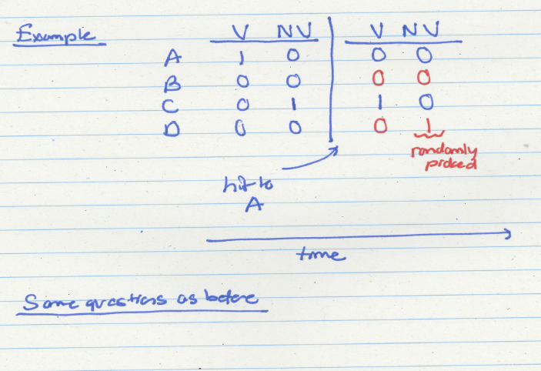
Victim/Next-Victim Example

Slide 27
Cache Replacement Policy: LRU or Random
LRU vs. Random: Which one is better?
  Example: 4-way cache, cyclic references to A, B, C, D, E
    0% hit rate with LRU policy
Set thrashing: When the “program working set” in a set is larger than set associativity
  Random replacement policy is better when thrashing occurs
In practice:
  Depends on workload
  Average hit rate of LRU and Random are similar
Best of both Worlds: Hybrid of LRU and Random
  How to choose between the two? Set sampling
    See Qureshi et al., “A Case for MLP-Aware Cache Replacement,“ ISCA 2006.

Slide 28
What Is the Optimal Replacement Policy?
Belady’s OPT
  Replace the block that is going to be referenced furthest in the future by the program
  Belady, “A study of replacement algorithms for a virtual-storage computer,” IBM Systems Journal, 1966.
  How do we implement this? Simulate?
Is this optimal for minimizing miss rate?
Is this optimal for minimizing execution time?
  No. Cache miss latency/cost varies from block to block!
  Two reasons: Remote vs. local caches and miss overlapping
  Qureshi et al. “A Case for MLP-Aware Cache Replacement,“ ISCA 2006.

Slide 29
Aside: Cache versus Page Replacement
Physical memory (DRAM) is a cache for disk
  Usually managed by system software via the virtual memory subsystem
Page replacement is similar to cache replacement
Page table is the “tag store” for physical memory data store
What is the difference?
  Required speed of access to cache vs. physical memory
  Number of blocks in a cache vs. physical memory
  “Tolerable” amount of time to find a replacement candidate (disk versus memory access latency)
  Role of hardware versus software

Slide 30
What’s In A Tag Store Entry?
Valid bit
Tag
Replacement policy bits
Dirty bit?
  Write back vs. write through caches

Slide 31
Handling Writes (I)
  When do we write the modified data in a cache to the next level?
    Write through: At the time the write happens
    Write back: When the block is evicted
  Write-back
    + Can consolidate multiple writes to the same block before eviction
      Potentially saves bandwidth between cache levels + saves energy
  -- Need a bit in the tag store indicating the block is “dirty/modified”
  Write-through
    + Simpler
    + All levels are up to date. Consistency: Simpler cache coherence because no need to check lower-level caches
    -- More bandwidth intensive; no coalescing of writes

Slide 32
Handling Writes (II)
Do we allocate a cache block on a write miss?
  Allocate on write miss: Yes
  No-allocate on write miss: No
Allocate on write miss
  + Can consolidate writes instead of writing each of them individually to next level
  + Simpler because write misses can be treated the same way as read misses
  -- Requires (?) transfer of the whole cache block
No-allocate
  + Conserves cache space if locality of writes is low (potentially better cache hit rate)

Slide 33
Handling Writes (III)
What if the processor writes to an entire block over a small amount of time?
Is there any need to bring the block into the cache from memory in the first place?
Ditto for a portion of the block, i.e., subblock
  E.g., 4 bytes out of 64 bytes

Slide 34
Sectored Caches
Idea: Divide a block into subblocks (or sectors)
  Have separate valid and dirty bits for each sector
  When is this useful? (Think writes…)
++ No need to transfer the entire cache block into the cache
(A write simply validates and updates a subblock)
++ More freedom in transferring subblocks into the cache (a cache block does not need to be in the cache fully)
  (How many subblocks do you transfer on a read?)
-- More complex design
-- May not exploit spatial locality fully when used for reads
subblock
v
d
subblock
v
d
subblock
v
d
tag

Slide 35
Instruction vs. Data Caches
Separate or Unified?
Unified:
  + Dynamic sharing of cache space: no overprovisioning that might happen with static partitioning (i.e., split I and D caches)
  -- Instructions and data can thrash each other (i.e., no guaranteed space for either)
  -- I and D are accessed in different places in the pipeline. Where do we place the unified cache for fast access?
First level caches are almost always split
  Mainly for the last reason above
Second and higher levels are almost always unified

Slide 36
Multi-level Caching in a Pipelined Design
First-level caches (instruction and data)
  Decisions very much affected by cycle time
  Small, lower associativity
  Tag store and data store accessed in parallel
Second-level caches
  Decisions need to balance hit rate and access latency
  Usually large and highly associative; latency not as important
  Tag store and data store accessed serially
Serial vs. Parallel access of levels
  Serial: Second level cache accessed only if first-level misses
  Second level does not see the same accesses as the first
    First level acts as a filter (filters some temporal and spatial locality)
    Management policies are therefore different

Slide 37
Cache Performance

Slide 38
Cache Parameters vs. Miss/Hit Rate
Cache size
Block size
Associativity
Replacement policy
Insertion/Placement policy

Slide 39
Cache Size
Cache size: total data (not including tag) capacity
  bigger can exploit temporal locality better
  not ALWAYS better
Too large a cache adversely affects hit and miss latency
  smaller is faster => bigger is slower
  access time may degrade critical path
Too small a cache
  doesn’t exploit temporal locality well
  useful data replaced often
Working set: the whole set of data the executing application references
  Within a time interval
hit rate
“working set”
size
cache size

Slide 40
Block Size
Block size is the data that is associated with an address tag
  not necessarily the unit of transfer between hierarchies
    Sub-blocking: A block divided into multiple pieces (each with V bit)
      Can improve “write” performance
Too small blocks
  don’t exploit spatial locality well
  have larger tag overhead
Too large blocks
  too few total # of blocks → less
    temporal locality exploitation
  waste of cache space and bandwidth/energy
  if spatial locality is not high
hit rate
block
size

Slide 41
Large Blocks: Critical-Word and Subblocking
Large cache blocks can take a long time to fill into the cache
  fill cache line critical word first
  restart cache access before complete fill
Large cache blocks can waste bus bandwidth
  divide a block into subblocks
  associate separate valid bits for each subblock
  When is this useful?
subblock
v
d
subblock
v
d
subblock
v
d
tag

Slide 42
Associativity
How many blocks can map to the same index (or set)?
Larger associativity
  lower miss rate, less variation among programs
  diminishing returns, higher hit latency
Smaller associativity
  lower cost
  lower hit latency
    Especially important for L1 caches
Power of 2 associativity required?
hit rate
associativity

Slide 43
Classification of Cache Misses
Compulsory miss
  first reference to an address (block) always results in a miss
  subsequent references should hit unless the cache block is displaced for the reasons below
Capacity miss
  cache is too small to hold everything needed
  defined as the misses that would occur even in a fully-associative cache (with optimal replacement) of the same capacity
Conflict miss
  defined as any miss that is neither a compulsory nor a capacity miss

Slide 44
How to Reduce Each Miss Type
Compulsory
  Caching cannot help
  Prefetching
Conflict
  More associativity
  Other ways to get more associativity without making the cache associative
    Victim cache
    Hashing
    Software hints?
Capacity
  Utilize cache space better: keep blocks that will be referenced
  Software management: divide working set such that each “phase” fits in cache

Slide 45
Improving Cache “Performance”
Remember
  Average memory access time (AMAT)
    = ( hit-rate * hit-latency ) + ( miss-rate * miss-latency )
Reducing miss rate
  Caveat: reducing miss rate can reduce performance if more costly-to-refetch blocks are evicted
Reducing miss latency/cost
Reducing hit latency/cost

Slide 46
Improving Basic Cache Performance
Reducing miss rate
  More associativity
  Alternatives/enhancements to associativity
    Victim caches, hashing, pseudo-associativity, skewed associativity
  Better replacement/insertion policies
  Software approaches
Reducing miss latency/cost
  Multi-level caches
  Critical word first
  Subblocking/sectoring
  Better replacement/insertion policies
  Non-blocking caches (multiple cache misses in parallel)
  Multiple accesses per cycle
  Software approaches

