Slide 1
18-447
Computer Architecture
Lecture 4: ISA Tradeoffs (Continued) and
MIPS ISA
Prof. Onur Mutlu
Kevin Chang
Carnegie Mellon University
Spring 2015, 1/21/2015

Slide 2
Agenda for Today
Finish off ISA tradeoffs
A quick tutorial on MIPS ISA
Upcoming schedule:
  Lab 1.5 & 2 are out today
  Friday (1/23): Lab 1 due
  Friday (1/23): Recitation
  Wednesday (1/28): HW 1 due

Slide 3
Upcoming Readings
Next week (Microarchitecture):
  P&H, Chapter 4, Sections 4.1-4.4
  P&P, revised Appendix C – LC3b datapath and microprogrammed operation

Slide 4
Last Lecture Recap
Instruction processing style
  0, 1, 2, 3 address machines
Elements of an ISA
  Instructions, data types, memory organizations, registers, etc
Addressing modes
Complex (CISC) vs. simple (RISC) instructions
Semantic gap
ISA translation

Slide 5
ISA-level Tradeoffs: Instruction Length
Fixed length: Length of all instructions the same
  + Easier to decode single instruction in hardware
  + Easier to decode multiple instructions concurrently
  -- Wasted bits in instructions (Why is this bad?)
  -- Harder-to-extend ISA (how to add new instructions?)
Variable length: Length of instructions different (determined by opcode and sub-opcode)
    + Compact encoding (Why is this good?)
    Intel 432: Huffman encoding (sort of). 6 to 321 bit instructions. How?
    -- More logic to decode a single instruction
    -- Harder to decode multiple instructions concurrently
Tradeoffs
  Code size (memory space, bandwidth, latency) vs. hardware complexity
  ISA extensibility and expressiveness vs. hardware complexity
  Performance? Energy? Smaller code vs. ease of decode

Slide 6
ISA-level Tradeoffs: Uniform Decode
Uniform decode: Same bits in each instruction correspond to the same meaning
  Opcode is always in the same location
  Ditto operand specifiers, immediate values, …
  Many “RISC” ISAs: Alpha, MIPS, SPARC
  + Easier decode, simpler hardware
  + Enables parallelism: generate target address before knowing the instruction is a branch
  -- Restricts instruction format (fewer instructions?) or wastes space
Non-uniform decode
  E.g., opcode can be the 1st-7th byte in x86
  + More compact and powerful instruction format
  -- More complex decode logic

Slide 7
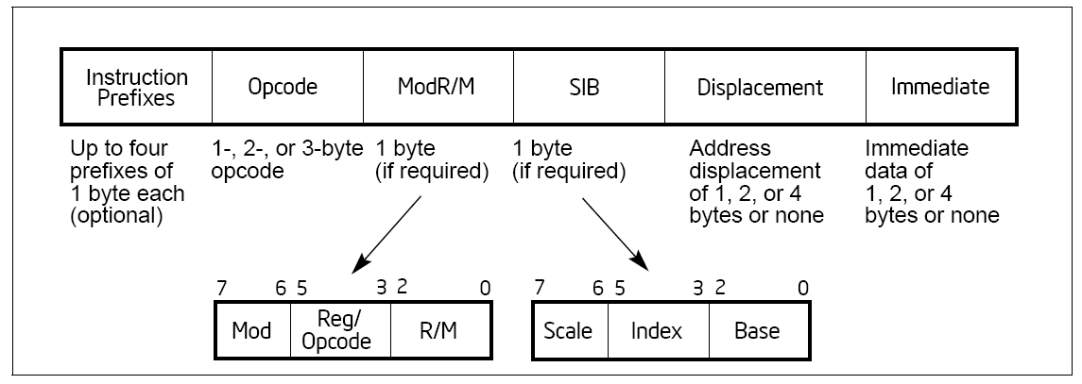
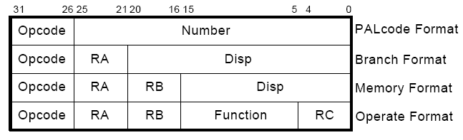
x86 vs. Alpha Instruction Formats
x86:
Alpha:

Slide 8
MIPS Instruction Format
R-type, 3 register operands
I-type, 2 register operands and 16-bit immediate operand
J-type, 26-bit immediate operand
Simple Decoding
  4 bytes per instruction, regardless of format
  must be 4-byte aligned (2 lsb of PC must be 2b’00)
  format and fields easy to extract in hardware
0
6-bit
rs
5-bit
rt
5-bit
rd
5-bit
shamt
5-bit
funct
6-bit
R-type
opcode
6-bit
rs
5-bit
rt
5-bit
immediate
16-bit
I-type
opcode
6-bit
immediate
26-bit
J-type
Notes:
Quickly.

Slide 9
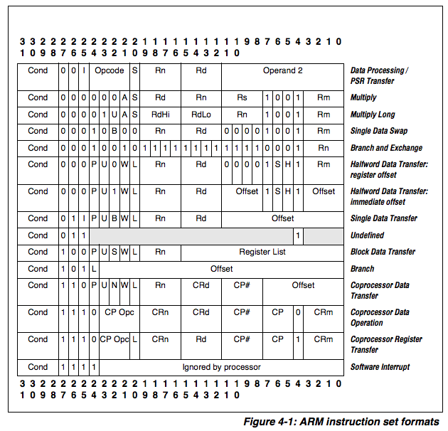
ARM

Slide 10
A Note on Length and Uniformity
Uniform decode usually goes with fixed length
In a variable length ISA, uniform decode can be a property of instructions of the same length
  It is hard to think of it as a property of instructions of different lengths

Slide 11
A Note on RISC vs. CISC
Usually, …
RISC
  Simple instructions
  Fixed length
  Uniform decode
  Few addressing modes
CISC
  Complex instructions
  Variable length
  Non-uniform decode
  Many addressing modes

Slide 12
ISA-level Tradeoffs: Number of Registers
Affects:
  Number of bits used for encoding register address
  Number of values kept in fast storage (register file)
  (uarch) Size, access time, power consumption of register file
Large number of registers:
  + Enables better register allocation (and optimizations) by compiler → fewer saves/restores
  -- Larger instruction size
  -- Larger register file size

Slide 13
ISA-level Tradeoffs: Addressing Modes
Addressing mode specifies how to obtain an operand of an instruction
  Register
  Immediate
  Memory (displacement, register indirect, indexed, absolute, memory indirect, autoincrement, autodecrement, …)
More modes:
  + help better support programming constructs (arrays, pointer-based accesses)
  -- make it harder for the architect to design
  -- too many choices for the compiler?
    Many ways to do the same thing complicates compiler design
    Wulf, “Compilers and Computer Architecture,” IEEE Computer 1981

Slide 14
x86 vs. Alpha Instruction Formats
x86:
Alpha:

Slide 15
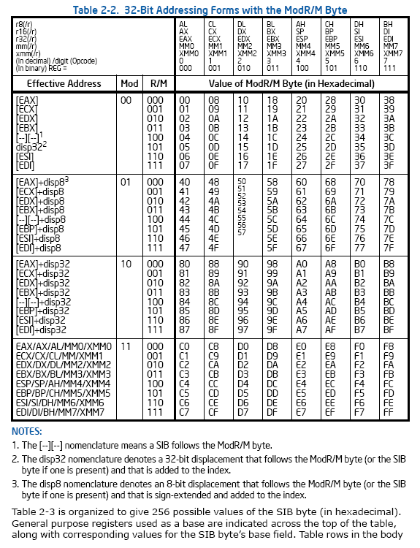

x86
register
indirect
Memory
absolute
SIB +
displacement
register +
displacement
register
Register

Slide 16
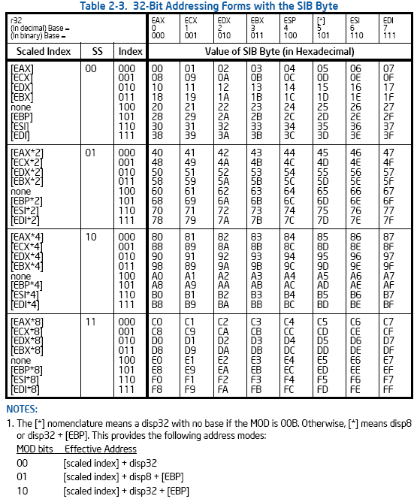
x86
indexed
(base + index)
scaled
(base +
index*4)

Slide 17
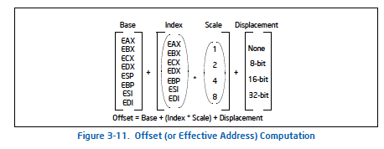
X86 SIB-D Addressing Mode
x86 Manual Vol. 1, page 3-22 -- see course resources on website
Also, see Section 3.7.3 and 3.7.5

Slide 18
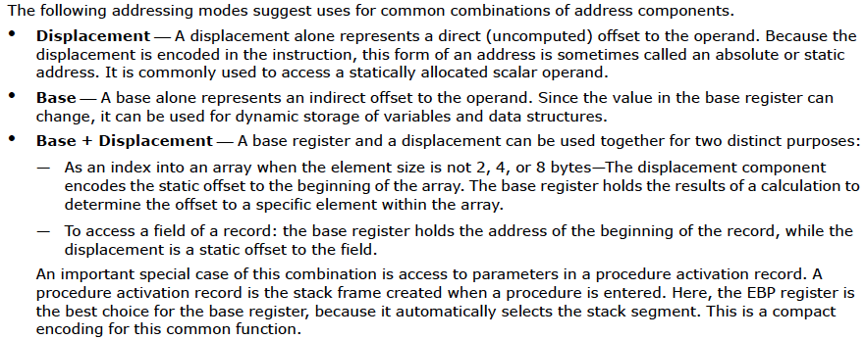
X86 Manual: Suggested Uses of Addressing Modes
Static address
Dynamic storage
Arrays
Records
x86 Manual Vol. 1, page 3-22 -- see course resources on website
Also, see Section 3.7.3 and 3.7.5

Slide 19
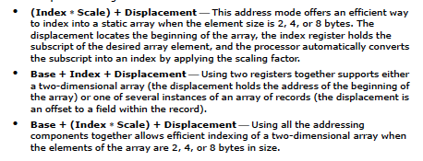
X86 Manual: Suggested Uses of Addressing Modes
Static arrays w/ fixed-size elements
2D arrays
2D arrays
x86 Manual Vol. 1, page 3-22 -- see course resources on website
Also, see Section 3.7.3 and 3.7.5

Slide 20
Other Example ISA-level Tradeoffs
Condition codes vs. not
VLIW vs. single instruction
Precise vs. imprecise exceptions
Virtual memory vs. not
Unaligned access vs. not
Hardware interlocks vs. software-guaranteed interlocking
Software vs. hardware managed page fault handling
Cache coherence (hardware vs. software)
…

Slide 21
Back to Programmer vs. (Micro)architect
Many ISA features designed to aid programmers
But, complicate the hardware designer’s job
Virtual memory
  vs. overlay programming
  Should the programmer be concerned about the size of code blocks fitting physical memory?
Addressing modes
Unaligned memory access
  Compiler/programmer needs to align data

Slide 22
MIPS: Aligned Access
MSB
byte-3
byte-2
byte-1
byte-0
LSB
LW/SW alignment restriction: 4-byte word-alignment
  not designed to fetch memory bytes not within a word boundary
  not designed to rotate unaligned bytes into registers
Provide separate opcodes for the “infrequent” case
  LWL/LWR is slower
  Note LWL and LWR still fetch within word boundary
byte-7
byte-6
byte-5
byte-4
A
B
C
D
LWL rd 6(r0) →
byte-6
byte-5
byte-4
D
LWR rd 3(r0) →
byte-6
byte-5
byte-4
byte-3

Slide 23
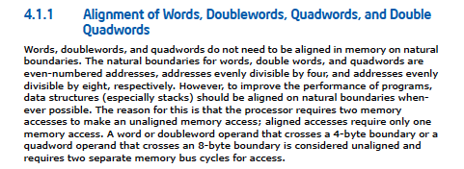
X86: Unaligned Access
LD/ST instructions automatically align data that spans a “word” boundary
Programmer/compiler does not need to worry about where data is stored (whether or not in a word-aligned location)

Slide 24
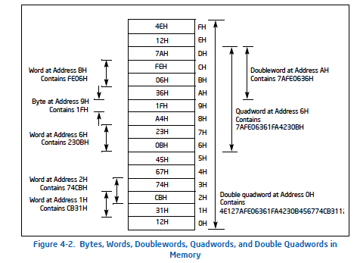
X86: Unaligned Access

Slide 25
What About ARM?
https://www.scss.tcd.ie/~waldroj/3d1/arm_arm.pdf
  Section A2.8

Slide 26
Aligned vs. Unaligned Access
Pros of having no restrictions on alignment
Cons of having no restrictions on alignment
Filling in the above: an exercise for you…

Slide 27
18-447 MIPS ISA
James C. Hoe
Dept of ECE, CMU

Slide 28
MIPS R2000 Program Visible State
Program Counter
32-bit memory address
of the current instruction
**Note** r0=0
General Purpose
Register File
32 32-bit words
named r0...r31
r1
r2
M[0]
M[1]
M[2]
M[3]
M[4]
Memory
2³² by 8-bit locations (4 Giga Bytes)
32-bit address
(there is some magic going on)
M[N-1]

Slide 29
Data Format
Most things are 32 bits
  instruction and data addresses
  signed and unsigned integers
  just bits
Also 16-bit word and 8-bit word (aka byte)
Floating-point numbers
  IEEE standard 754
  float: 8-bit exponent, 23-bit significand
  double: 11-bit exponent, 52-bit significand

Slide 30
Big Endian vs. Little Endian
(Part I, Chapter 4, Gulliver’s Travels)
32-bit signed or unsigned integer comprises 4 bytes
On a byte-addressable machine . . . . . . .
Big Endian Little Endian
What difference does it make?
MSB
(most significant)
LSB
(least significant)
8-bit
8-bit
8-bit
8-bit
MSB
LSB
MSB
LSB
byte 0
byte 1
byte 2
byte 3
byte 3
byte 2
byte 1
byte 0
byte 4
byte 5
byte 6
byte 7
byte 7
byte 6
byte 5
byte 4
byte 8
byte 9
byte 10
byte 11
byte 11
byte 10
byte 9
byte 8
byte 12
byte 13
byte 14
byte 15
byte 15
byte 14
byte 13
byte 12
byte 16
byte 17
byte 18
byte 19
byte 19
byte 18
byte 17
byte 16
pointer points to the big end
pointer points to the little end
check out htonl(), ntohl() in in.h

Slide 31
Instruction Formats
3 simple formats
  R-type, 3 register operands
  I-type, 2 register operands and 16-bit immediate operand
  J-type, 26-bit immediate operand
Simple Decoding
  4 bytes per instruction, regardless of format
  must be 4-byte aligned (2 lsb of PC must be 2b’00)
  format and fields readily extractable
0
6-bit
rs
5-bit
rt
5-bit
rd
5-bit
shamt
5-bit
funct
6-bit
R-type
opcode
6-bit
rs
5-bit
rt
5-bit
immediate
16-bit
I-type
opcode
6-bit
immediate
26-bit
J-type

Slide 32
ALU Instructions
Assembly (e.g., register-register signed addition)
ADD rd_{reg} rs_{reg} rt_{reg}
Machine encoding
Semantics
  GPR[rd] ← GPR[rs] + GPR[rt]
  PC ← PC + 4
Exception on “overflow”
Variations
  Arithmetic: {signed, unsigned} x {ADD, SUB}
  Logical: {AND, OR, XOR, NOR}
  Shift: {Left, Right-Logical, Right-Arithmetic}
0
6-bit
rs
5-bit
rt
5-bit
rd
5-bit
0
5-bit
ADD
6-bit
R-type

Slide 33
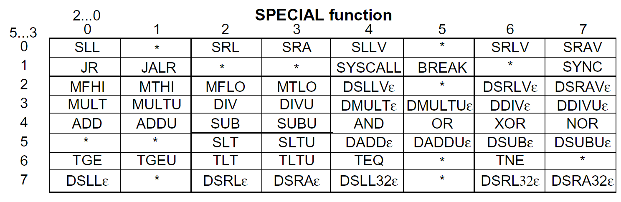
Reg-Reg Instruction Encoding
[MIPS R4000 Microprocessor User’s Manual]
What patterns do you see? Why are they there?

Slide 34
ALU Instructions
Assembly (e.g., regi-immediate signed additions)
ADDI rt_{reg} rs_{reg} immediate₁₆
Machine encoding
Semantics
  GPR[rt] ← GPR[rs] + sign-extend (immediate)
  PC ← PC + 4
Exception on “overflow”
Variations
  Arithmetic: {signed, unsigned} x {ADD, SUB}
  Logical: {AND, OR, XOR, LUI}
ADDI
6-bit
rs
5-bit
rt
5-bit
immediate
16-bit
I-type

Slide 35
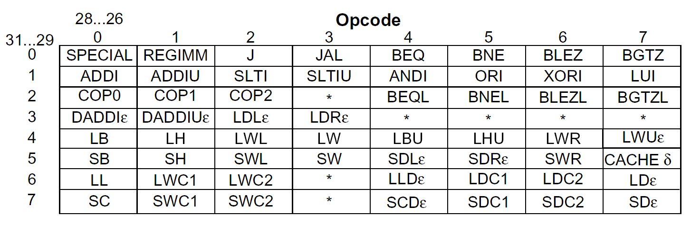
Reg-Immed Instruction Encoding
[MIPS R4000 Microprocessor User’s Manual]

Slide 36
Assembly Programming 101
Break down high-level program constructs into a sequence of elemental operations
E.g. High-level Code
  f = ( g + h ) – ( i + j )
Assembly Code
  suppose f, g, h, i, j are in r_{f}, r_{g}, r_{h}, r_{i}, r_{j}
  suppose r_{temp} is a free register
  add r_{temp} r_{g} r_{h} # r_{temp} = g+h
  add r_{f} r_{i} r_{j} # r_{f} = i+j
  sub r_{f} r_{temp} r_{f} # f = r_{temp} – r_{f}

Slide 37
Load Instructions
Assembly (e.g., load 4-byte word)
LW rt_{reg} offset₁₆ (base_{reg})
Machine encoding
Semantics
  effective_address = sign-extend(offset) + GPR[base]
  GPR[rt] ← MEM[ translate(effective_address) ]
  PC ← PC + 4
Exceptions
  address must be “word-aligned”
  What if you want to load an unaligned word?
  MMU exceptions
I-type
LW
6-bit
base
5-bit
rt
5-bit
offset
16-bit

Slide 38
Store Instructions
Assembly (e.g., store 4-byte word)
SW rt_{reg} offset₁₆ (base_{reg})
Machine encoding
Semantics
  effective_address = sign-extend(offset) + GPR[base]
  MEM[ translate(effective_address) ] ← GPR[rt]
  PC ← PC + 4
Exceptions
  address must be “word-aligned”
  MMU exceptions
SW
6-bit
base
5-bit
rt
5-bit
offset
16-bit
I-type

Slide 39
Assembly Programming 201
E.g. High-level Code
  A[ 8 ] = h + A[ 0 ]
  where A is an array of integers (4–byte each)
Assembly Code
  suppose &A, h are in r_{A}, r_{h}
  suppose r_{temp} is a free register
  LW r_{temp} 0(r_{A}) # r_{temp} = A[0]
  add r_{temp} r_{h} r_{temp} # r_{temp} = h + A[0]
  SW r_{temp} 32(r_{A}) # A[8] = r_{temp}
  # note A[8] is 32 bytes # from A[0]

Slide 40
Load Delay Slots
LW ra ---
addi r- ra r-
addi r- ra r-
R2000 load has an architectural latency of 1 inst*.
  the instruction immediately following a load (in the “delay slot”) still sees the old register value
  the load instruction no longer has an atomic semantics
  Why would you do it this way?
Is this a good idea? (hint: R4000 redefined LW to complete atomically)
*BTW, notice that latency is defined in “instructions” not cyc. or sec.

Slide 41
Control Flow Instructions
Assembly Code
(linearized)
Control Flow Graph
C-Code
  { code A }
  if X==Y then
  { code B }
  else
  { code C }
  { code D }
code A
if X==Y
code A
if X==Y
goto
True
False
code B
code C
goto
code C
code B
code D
code D
these things are called basic blocks

Slide 42
(Conditional) Branch Instructions
Assembly (e.g., branch if equal)
BEQ rs_{reg} rt_{reg} immediate₁₆
Machine encoding
Semantics
  target = PC + sign-extend(immediate) x 4
  if GPR[rs]==GPR[rt] then PC ← target
  else PC ← PC + 4
How far can you jump?
Variations
  BEQ, BNE, BLEZ, BGTZ
BEQ
6-bit
rs
5-bit
rt
5-bit
immediate
16-bit
I-type
  PC + 4 w/
  branch delay slot
Why isn’t there a BLE or BGT instruction?

Slide 43
Jump Instructions
Assembly
J immediate₂₆
Machine encoding
Semantics
  target = PC[31:28]x2²⁸ |_{bitwise-or} zero-extend(immediate)x4
  PC ← target
How far can you jump?
Variations
  Jump and Link
  Jump Registers
J
6-bit
immediate
26-bit
J-type
  PC + 4 w/
  branch delay slot

Slide 44
Assembly Programming 301
fork
E.g. High-level Code
  if (i == j) then
  e = g
  else
  e = h
  f = e
Assembly Code
  suppose e, f, g, h, i, j are in r_{e}, r_{f}, r_{g}, r_{h}, r_{i}, r_{j}
  bne r_{i} r_{j} L1 # L1 and L2 are addr labels
  # assembler computes offset
  add r_{e} r_{g} r0 # e = g
  j L2
  L1: add r_{e} r_{h} r0 # e = h
  L2: add r_{f} r_{e} r0 # f = e
  . . . .
then
else
join

Slide 45
Branch Delay Slots
R2000 branch instructions also have an architectural latency of 1 instructions
  the instruction immediately after a branch is always executed (in fact PC-offset is computed from the delay slot instruction)
  branch target takes effect on the 2nd instruction
bne r_{i} r_{j} L1
nop
add r_{e} r_{g} r0
j L2
nop
L1: add r_{e} r_{h} r0
L2: add r_{f} r_{e} r0
. . . .
  bne r_{i} r_{j} L1
  add r_{e} r_{g} r0
  j L2
L1: add r_{e} r_{h} r0
L2: add r_{f} r_{e} r0
  . . . .
bne r_{i} r_{j} L1
nop
j L2
add r_{e} r_{g} r0
L1: add r_{e} r_{h} r0
L2: add r_{f} r_{e} r0
. . . .

Slide 46
Strangeness in the Semantics
Where do you think you will end up?
      _s: j L1
      j L2
      j L3
      L1: j L4
      L2: j L5
      L3: foo
      L4: bar
      L5: baz

Slide 47
Function Call and Return
Jump and Link: JAL offset₂₆
  return address = PC + 8
  target = PC[31:28]x2²⁸ |_{bitwise-or} zero-extend(immediate)x4
  PC ← target
  GPR[r31] ← return address
  On a function call, the callee needs to know where to go back to afterwards
Jump Indirect: JR rs_{reg}
  target = GPR [rs]
  PC ← target
  PC-offset jumps and branches always jump to the same target every time the same instruction is executed
  Jump Indirect allows the same instruction to jump to any location specified by rs (usually r31)

Slide 48
Assembly Programming 401
Caller
... code A ...
JAL _myfxn
... code C ...
JAL _myfxn
... code D ...
Callee
_myfxn: ... code B ...
JR r31
..... A →_{call} B →_{return} C →_{call} B →_{return} D .....
How do you pass argument between caller and callee?
If A set r10 to 1, what is the value of r10 when B returns to C?
What registers can B use?
What happens to r31 if B calls another function

Slide 49
Caller and Callee Saved Registers
Callee-Saved Registers
  Caller says to callee, “The values of these registers should not change when you return to me.”
  Callee says, “If I need to use these registers, I promise to save the old values to memory first and restore them before I return to you.”
Caller-Saved Registers
  Caller says to callee, “If there is anything I care about in these registers, I already saved it myself.”
  Callee says to caller, “Don’t count on them staying the same values after I am done.

Slide 50
R2000 Register Usage Convention
r0: always 0
r1: reserved for the assembler
r2, r3: function return values
r4~r7: function call arguments
r8~r15: “caller-saved” temporaries
r16~r23 “callee-saved” temporaries
r24~r25 “caller-saved” temporaries
r26, r27: reserved for the operating system
r28: global pointer
r29: stack pointer
r30: callee-saved temporaries
r31: return address

Slide 51
R2000 Memory Usage Convention
high address
free space
stack space
grow down
stack pointer
GPR[r29]
grow up
dynamic data
static data
binary executable
text
reserved
low address

Slide 52
Calling Convention
.......
caller saves caller-saved registers
caller loads arguments into r4~r7
caller jumps to callee using JAL
callee allocates space on the stack (dec. stack pointer)
callee saves callee-saved registers to stack (also r4~r7, old r29, r31)
callee loads results to r2, r3
callee restores saved register values
JR r31
caller continues with return values in r2, r3
........
prologue
....... body of callee (can “nest” additional calls) .......
epilogue

Slide 53
To Summarize: MIPS RISC
Simple operations
  2-input, 1-output arithmetic and logical operations
  few alternatives for accomplishing the same thing
Simple data movements
  ALU ops are register-to-register (need a large register file)
  “Load-store” architecture
Simple branches
  limited varieties of branch conditions and targets
Simple instruction encoding
  all instructions encoded in the same number of bits
  only a few formats
Loosely speaking, an ISA intended for compilers rather than assembly programmers

